Slide 1
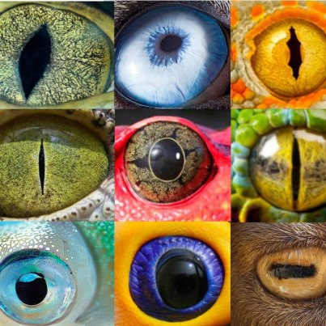
Pupillometry
Cuiting Zhang, Kathy Liu, Benedict Greenwood
Expert: Alexandra Hopkins

Slide 2
Overview
Physiology of the pupil response
Types of pupil response
Locus Coeruleus
Advantages and disadvantages
Methodology and procedure
Case study: where is pupillometry useful?
Data analysis
Useful resources
Notes:
Hello everybody and thank you for coming. Today, Cuiting, Kathy and myself are going to give you an overview of pupillometry. I am going to explain the physiology of the pupil response and the significance of the Locus Coeruleus. Cuiting is then going to walk you through a case study of a pupillometry experiment and will explain how to set up a pupillometry experiment. And lastly, Kathy will finish off by going through the key steps in the analysis of pupillometry data.

Slide 3
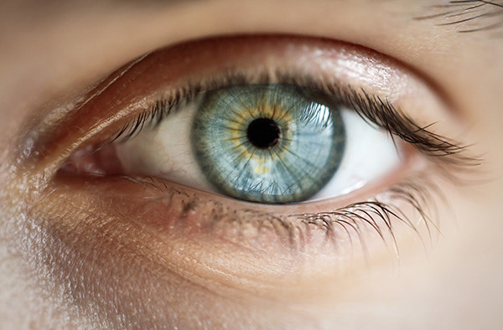
Physiology of pupil responses
Pupil responses are universal – not just humans https://bit.ly/3ey9HmF
Pupil diameter is controlled by two muscle groups in the iris
Sphincter pupillae: constriction
Parasympathetic innervation
Dilator pupillae: dilation
Sympathetic innervation
Pupil
Iris
Sclera
Dilator
Sphincter
Constricted
Dilated
Notes:
Seeing as it’s around lunchtime and people might be a bit hungry or sleepy, we thought we would start with a little video of a pupil response that we found entertaining.
The pupil is the black circle at the centre of the eye and is the point at which light passes through the lens. The pupil is surrounded by the iris, which is the coloured part of the eye. The iris is a set of two smooth muscles, which work together to control the diameter of the pupil, and therefore control how much light enters the eye. The diameter of the human pupil can range from 2 to 8 mm; therefore, the pupil can change the amount of light that enters the eye by a factor of roughly 16.
The first muscle in the iris is the sphincter pupillae, which runs around the inside edge of the iris. It is shown in green on the bottom images. When the iris sphincter muscle contracts, it tightens the inner side of the iris, causing the pupil to constrict. The iris sphincter is innervated by the parasympathetic nervous system, the part of the autonomic nervous system that is involved in homeostasis (i.e. keeping the body in stable condition). Parasympathetic signalling dominates during rest, which is why when we are resting, our pupils are comparatively small.
The second muscle is the dilator pupillae, which radiates out from the pupil and connect the interior edge of the iris with the exterior edge. In the top image, you can clearly see the strands of this muscle radiating outwards and in the bottom image, the strands are shown in yellow. When the iris dilator muscle contracts, it pulls the inner side of the iris outward, causing the pupil to dilate. The iris dilator muscle is controlled by the sympathetic nervous system, the part of the autonomic nervous system that is involved in arousal, wakefulness, and the fight-or-flight response.
What the cat video does show us is that pupil responses are not just seen in humans, but are conserved across different species. And that tells us the mechanisms involved in them are likely to be evolutionarily important.

Slide 4
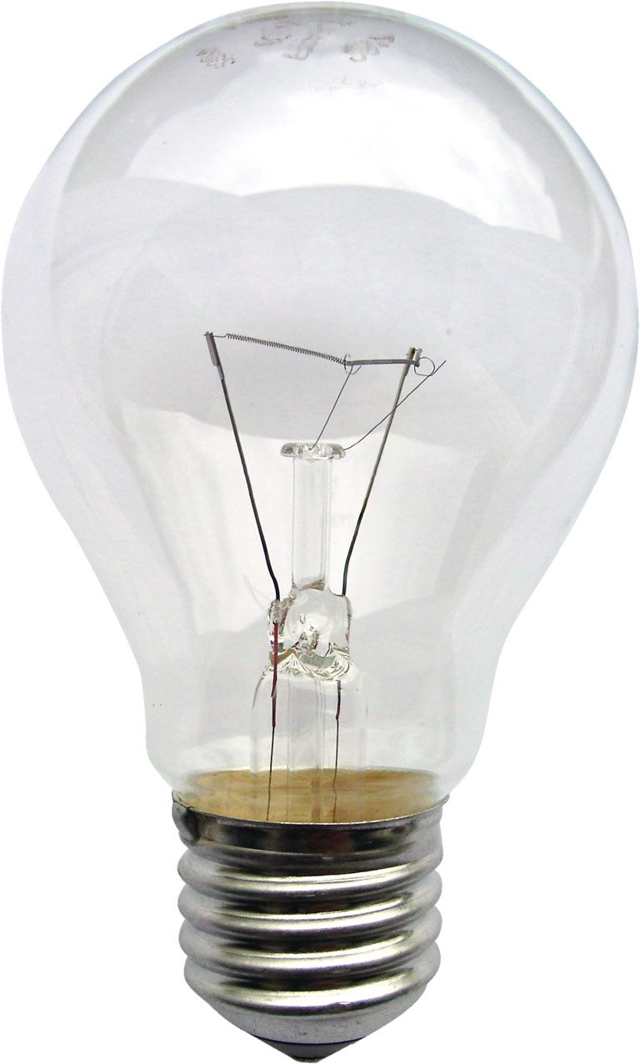
The three pupil responses
1. Pupil light response
Upto 5 mm
2. Pupil near response
3. Psychosensory pupil response
(effort, arousal, emotion and more) Upto 0.5mm
• Task-evoked pupillary response (TEPR)
Pupil responses…
…are seen reliably across individuals
…can be reflexive or modulated by high-level cognition
…have variable magnitudes
Notes:
The pupil changes its size in response to three distinct kinds of stimuli: firstly, it constricts in response to brightness, called the pupil light response. You can observe this response yourself next time you look in the mirror. If you close your eyes then open them you will see your pupils shrinking. The pupil also constricts when viewing objects very close to your eyes (called the pupil near response). The third response is called the psychosensory pupil response, in which the pupil dilates in response to a stimulus – either a sensory stimulus or a psychological stimulus. In psychology studies, this is sometimes referred to as the task-evoked pupillary response.
This response has received attention from many different fields of psychology and is elicited by many processes. For example, pupils dilate in response to exerting effort, sexual arousal, emotion and working memory. Given that the Psychosensory pupil response is seen in such a broad range of situations, it probably does not reflect a single cognitive process. Generally speaking, the literature can be summarised by saying that anything that increases mental demands can cause the psychosensory pupil response.
These three responses are very consistent and are seen reliably across individuals.
Pupil responses are partly reflexive. For example, pupils always constrict, and never dilate, in response to light. But pupil responses are also partly modulated by high-level cognition. For example, when you choose to attend to a light in your peripheral visual field, your pupils constrict more than when you choose to ignore this light. In research studies, some researchers may be interested in separating out involuntary responses and slower arousal or mental-effort related processes linked to high-level cognition.
It is also worth noting that different pupil responses have different magnitudes too. The changes in pupil size in response to light are very big and the pupil diameter can shrink by upto 5 mm. In contrast, the changes in pupil diameter seen in the psychosensory pupil response are much smaller, and range from 0.1 – 0.5 mm.

Slide 5
Characteristics of task-evoked pupillary responses
3.5
Stimulus onset
TEPR: pupillary response linked to stimulus presentation or task demand
Involuntary
Tonic vs phasic pupil dilation
Tonic = baseline
Phasic = event-related
Time locked to critical information
Pupil size increases linearly
Phasic
Pupil diameter (mm)
Tonic
3
0
5
10
Time (s)
Notes:
In psychology studies, there are a few characteristics of the psychosensory pupil response that we need to be aware of.
Firstly, it is involuntary – it is a reflex.
Secondly, we distinguish between tonic and phasic pupil dilation. Tonic pupil dilation refers to how dilated someone’s pupils are at baseline. Everyone differs in how much their pupils are dilated at rest, some people have very small pupils and others have wider pupils. Phasic pupil dilation refers to sudden pupil dilation in response to an event. Phasic pupil dilation is time-locked to the event and pupil size increases linearly. That means that the increase in pupil diameter does not depend on baseline pupil size.

Slide 6
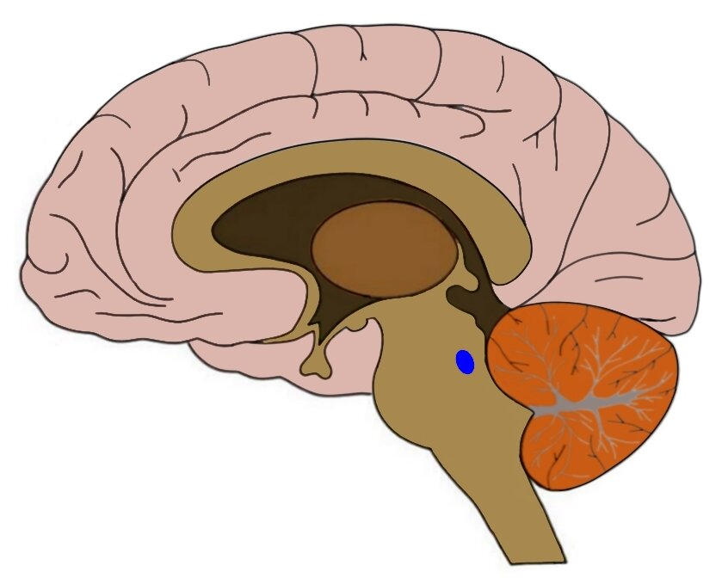
Neural pathways governing the pupil response
Constriction pathway (parasympathetic)
Dilation pathway (sympathetic)
Hypothalamus
Locus coeruleus
Notes:
Constriction and dilation are controlled by two neural pathways. There are a lot of brain areas in this figure so I am going to focus in on the most important ones.
The pupillary light response and pupil near response are driven by the constriction pathway. When light falls on the retina, nerve impulses travel along the optic nerve, crosses the optic chiasm and projects to the pretectal nucleus on the opposite side of the brain. Information is then sent to the Edinger-Westphal nucleus, which combines information from the left and right visual fields. Signals are then sent via a series of nerves to the iris sphincter muscle, which contracts.
In contrast, the dilation pathway is a subcortical pathway. It starts at the locus coeruleus and the hypothalamus and ends at the iris dilator muscle. In the image in the bottom-right I have highlighted the positions of the hypothalamus and locus coeruleus in the brain. The locus coeruleus is a nucleus in the pons of the brainstem and is especially active when the organism is aroused, awake and alert. In the context of pupil dilation, the role of the hypothalamus is similar to the locus coeruleus, in that its activity reflects arousal and wakefulness. These two regions project via a series of nerves to the iris dilator muscle and cause pupils to dilate.
I would like to emphasise that the right hand side of the diagram is simplified. There are many other regions involved in the dilation pathway too. For example, as well as having bidirectional connections with each other, the locus coeruleus and hypothalamus are regulated by other subcortical and cortical regions, such as the Orbito-Frontal Cortex and the Anterior Cingulate Cortex.
The constriction pathway and the dilation pathway are largely independent but they do interact. For example, the locus coeruleus and hypothalamus inhibit the Edinger-Westphal nucleus (SHOW THIS WITH POINTER). Therefore, their activity causes pupil dilation not only by activating the sympathetic dilation pathway, but also by inhibiting the parasympathetic constriction pathway.
It is always bearing this in mind when reading papers about pupillometry because papers often talk about pupil dilation as a measure of sympathetic nervous system dominance. Pupil dilation does not purely reflect sympathetic nervous system activity, it always reflects the balance between sympathetic and parasympathetic signalling.

Slide 7
Relationship between Locus Coeruleus and arousal
Locus coeruleus-norepinephrine (LC-NE) system is involved in arousal and influences attention, memory and cognitive control
Adaptive Gain Theory (Aston-Jones & Cohen, 2005)
LC-NE system could regulate exploitation vs exploration
Exploitation
Exploration
LC firing rate
LC firing rate
Notes:
In the next couple of slides I am going to provide some more detailed information on the relevance of the locus coeruleus to pupillometry, and then Cuiting will go through a case study to illustrate how pupillometry can be used to study the locus coeruleus.
Locus coeruleus neurons provide most of the brain’s norepinephrine (known as noradrenaline in British English) and most locus coeruleus neurons are noradrenergic. Activity in the locus coeruleus is associated with arousal, attention, memory and cognitive control.
Aston-Jones and Cohen’s Adaptive Gain Theory is a highly influential theory in the field of pupillometry research. The theory proposes that arousal, attention other associated processes are not specific functions of the locus coeruleus, but instead reflect the locus coeruleus’s involvement in optimising behaviour on a larger scale.
According to Aston-Jones & Cohen, animals exhibit two types of behaviour – exploitation of their environment and exploration of their environment.
In exploitation, you are engaged in a single task and are ‘exploiting’ the rewards that a task has to offer. For example, you are reading a book and you are getting pleasure from reading. During exploitation, the locus coeruleus has phasic activity. This means there are task-related spikes in activity.
In exploration you are easily distracted and tend to switch from one task to another; in this mode, you are ‘exploring’ different tasks, to find the one that offers the highest reward. Exploration is associated with high tonic locus coeruleus activity. This means that baseline locus coeruleus activity is elevated.
According to Adaptive Gain Theory, animals alternate between exploitation and exploration to optimize reward. For example, you read your book and initially it is highly rewarding. But then after a while, you get bored so you switch to exploration. You put down the book and look for an activity that offers higher reward than reading, like eating.

Slide 8
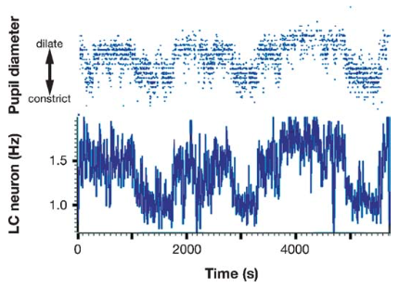
Locus coeruleus and pupil dilation (Aston-Jones & Cohen, 2005)
Key finding:
LC activity is associated with pupil diameter
Implication:
Pupil diameter is an indicator of organism state
Supporting evidence from the Four Armed Bandit Task
(Jepma & Nieuwenhuis, 2011)
Notes:
In one of their key experiments, Aston-Jones and Cohen measured firing rate of locus coeruleus neurons in monkeys. The monkeys performed a signal detection task and were required to respond immediately following a specific visual target stimulus but to withhold responding to distractor stimuli. Locus coeruleus activity was phasic immediately after target stimuli and was tonic during distractor stimuli.
The authors also measured pupil diameter at the same time and found that pupil diameter mirrored locus coeruleus firing rate, such that increases in locus coeruleus activity were associated with increases in pupil diameter.
This suggests that measuring pupil diameter provides an index of locus coeruleus activity, and therefore the state of the organism, whether they are currently in exploitation mode (with comparatively constricted pupils) or exploration mode (with comparatively dilated pupils).
Support for The Adaptive Gain Theory also comes from human behavioural studies. For example, Jepma & Nieuwenhuis got participants to perform the Four Armed Bandit task. In this task, participants have to draw cards from one of four possible decks, each associated with a particular pay-off. The payoffs change over time, which leads to exploitation-exploration cycles in behaviour. If a deck has a high pay-off, participants will keep selecting cards from this deck. However, because pay-offs fluctuate gradually, there comes a point at which the deck is no longer profitable, and participants consequently start exploring other decks. The crucial finding by Jepma & Nieuwenhuis (New-ven-hoos) was that participants’ pupils were larger when trying out new decks than while sticking with the same deck.

Slide 9
However…
Changes in pupil dilations not just specific to the LC (Joshi, Li, Kalwani & Gold, 2015)
Although causal link between LC-NE activation and the psychosensory pupil response, similar relationships also evident in
inferior and superior colliculi
anterior and posterior cingulate cortex
DA neuron innervation can also produce pupil dilation
Switches in behaviour are correlated with other factors
Notes:
An important caveat is that pupil dilation is not a pure index of locus-coeruleus activity, even though it is the best and most reproducible measure. Pupil size can also reflect the activity of other regions too, such as the inferior and superior colliculi and the anterior and posterior cingulate cortex. Pupil dilation is also not solely controlled by noradrenergic signalling, since studies have found that stimulation of dopamine neurons can cause pupils to dilate. Therefore, if you observe that someone’s pupils have dilated, you cannot be 100% certain it is driven by locus coeruleus norepinephrine signalling.
The other problem with studies like Jepma & Nieuwenhuis’ (New-ven-hoos’) study is that they rely on correlations: they do not manipulate whether the person is in exploitation or exploration mode, but instead this is inferred from behaviour. Any switches in behavioural mode are usually correlated with other factors, such as changes in arousal and reward, and it is often not possible to control these factors.

Slide 10
Overview
Physiology of the pupil response
Types of pupil response
Locus Coeruleus
Advantages and disadvantages
Methodology and procedure
Case study: where is pupillometry useful?
Data analysis
Useful resources
Notes:
Hello everybody and thank you for coming. Today, Cuiting, Kathy and myself are going to give you an overview of pupillometry. I am going to explain the physiology of the pupil response and the significance of the Locus Coeruleus. Cuiting is then going to walk you through a case study of a pupillometry experiment in the field of autism research to really illustrate how pupillometry can answer a research question. Cuiting will also explain how to set up a pupillometry experiment and Kathy will go through the key steps in the analysis of pupillometry data.

Slide 11
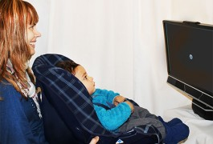
Advantages of Pupillometry
Does not require volitional response
Not controlled by conscious effort
More sensitive and more reliable than other physiological measures (e.g., HR, SCR)
Non-invasive
Can be used in tandem with other neuroimaging methodologies (e.g., EEG, MEG, fMRI)

Slide 12
Disadvantages of Pupillometry
Sensitive to variation in lighting conditions
A summative measure → combined effects
Low face validity → difficulties in choosing a reliable baseline
Task evoked pupillary response (TEPR)
Careful research design
Rigorous research methods
Accurate programming for pupillometry
Balancing advantages and disadvantages

Slide 13
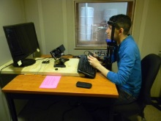
Pupillometry Procedure
Find an intermediate light condition for conducting the experiment
Ensure participant is sitting comfortably with head placed on the head-stabilizer
Ensure eye is focused on the screen
Calibrate eye-tracker
Validate information acquired during calibration

Slide 14
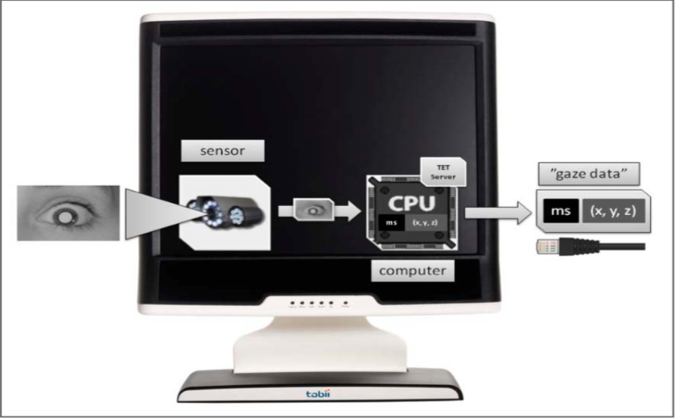
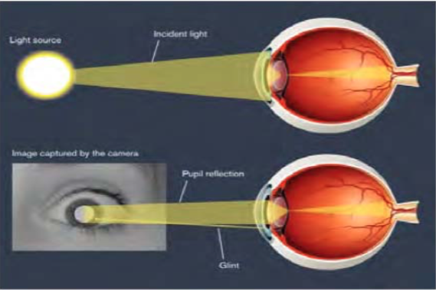
Eye Tracking Technology
Near infrared (IR) illuminator
Image sensor
Image/mathematical processing algorithms

Slide 15
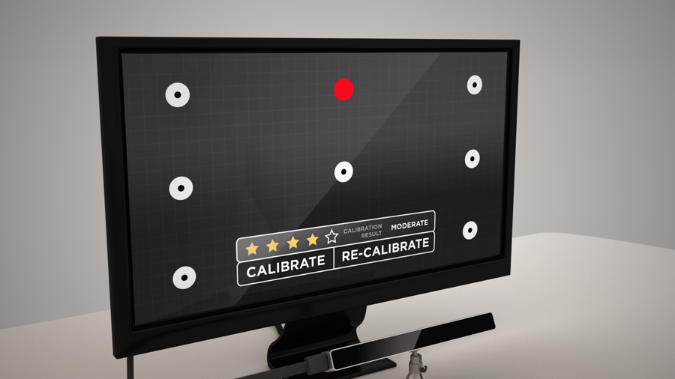
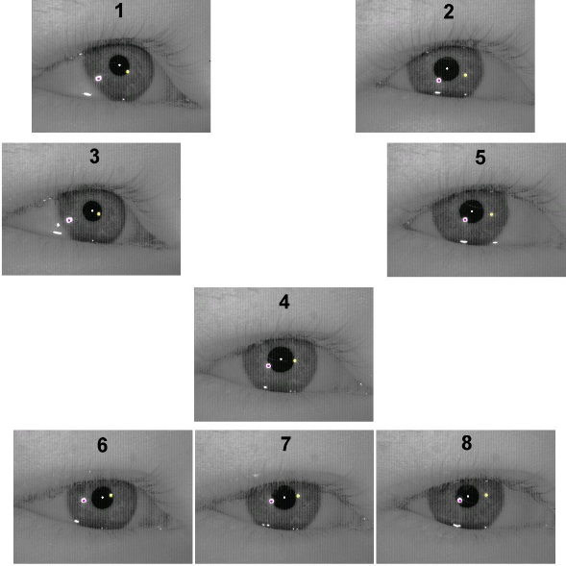
Calibration and Validation
Calibration: we need to “teach” the computer what the eye looks like when the participant is fixated on a known location on the screen
Validation: we make sure calibration was accurate
Calibration is successful if errors found are minimal

Slide 16
Calibration Assumptions
Vergence: the eye-tracker assumes that the participant is always looking at the screen
Lighting: the eye-tracker assumes that eye is constantly lit
Practical Hints
No mascara or heavy make-up (because dark bits are tracked as pupil)
No glasses (soft contact lenses are fine, but make sure eyes are not too dry or overly wet)
No medication or coffee before
Allow breaks (because pupil size is sensitive to stress and fatigue)

Slide 17
What can pupillometry indicate?
Locus coeruleus function
Gilzenrat et al. (2010), Aston-Jones and Cohen (2005)
Emotionally relevant stimuli
Seminal paper of Hess and Polt (1960)
Mental effort
Load on attention (Kahneman, 1973)
Load on memory (Beatty and Kahneman, 1966)
Interference of stimuli (Laeng et al., 2011)
Unconscious processing of stimuli
Hakerem & Sutton, 1966

Slide 18
Where is pupillometry useful?
As a proxy for brain functioning
Pupillometry as an index of LC functioning
Useful, as the LC is difficult to see with neuroimaging methods
E.g., Relating LC-NE system-mediated attentional focus, to ASD Advantage (Blaser et al., 2014)
Developmental studies
Easier, screen looking and eye tracker vs. EEG
Studies of infants have found greater pupillometric reactions to impossible events (Jackson & Sirois, 2009)
Clinical application
Indexing linguistic processing effort in aphasic patients (Chapman et al., 2015)
Different responses to looming sounds in Alzheimer’s disease (Fletcher et al., 2015)

Slide 19
Where is pupillometry useful? - Example
Pupillometry Reveals a Mechanism for the Autism Spectrum Disorder (ASD) Advantage in Visual Tasks
(Blaser et al., 2014)
Aim: Applying pupillometry to reveals a more basic factor of ASD advantage – attention focus
Hypothesis: Greater phasic activity in the LC-NE system of the ASD group engenders greater attentional focus, contributing to the ASD advantage
Method:
Pupillometry - task-evoked, phasic pupil responses – measure of LC-NE system-mediated attentional focus
ASD participants vs. typically developing (TD) controls
Visual tasks

Slide 20
Easy Task
Medium Task
Difficult Task

Slide 21
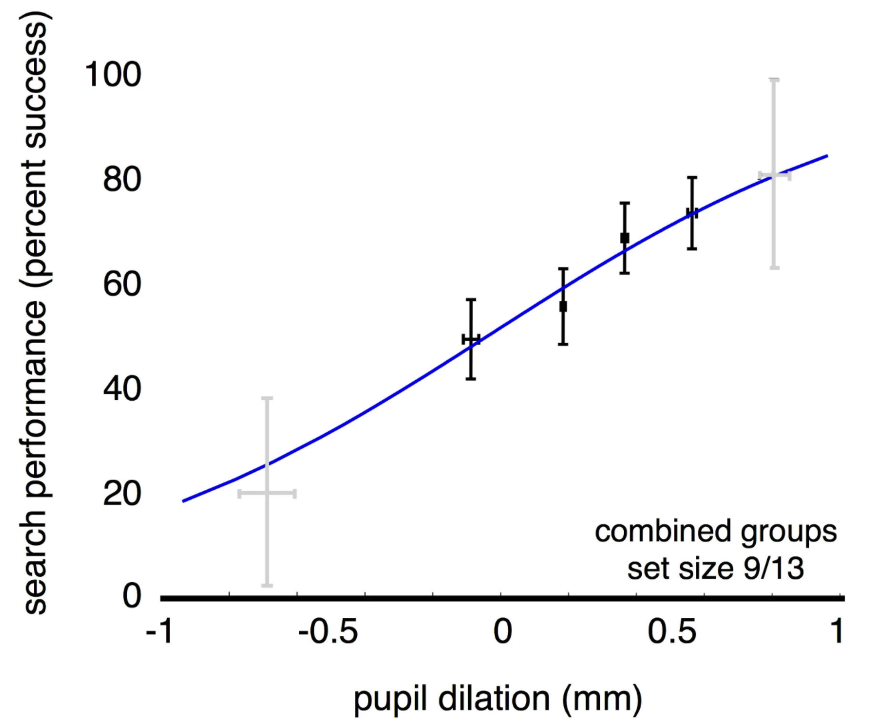
Difficult Task
Relationship between phasic pupil dilation and visual search performance

Slide 22
Overview
Physiology of the pupil response
Types of pupil response
Locus Coeruleus
Advantages and disadvantages
Methodology and procedure
Case study: where is pupillometry useful?
Data analysis
Useful resources
Notes:
Hello everybody and thank you for coming. Today, Cuiting, Kathy and myself are going to give you an overview of pupillometry. I am going to explain the physiology of the pupil response and the significance of the Locus Coeruleus. Cuiting is then going to walk you through a case study of a pupillometry experiment in the field of autism research to really illustrate how pupillometry can answer a research question. Cuiting will also explain how to set up a pupillometry experiment and Kathy will go through the key steps in the analysis of pupillometry data.

Slide 23
Analysis - Preprocessing
Raw pupil data must be preprocessed in several steps before analysis and visualization
De-blinking
Low-pass filtering
Baseline correction
Normalization
Data Alignment
Identifying and dropping contaminated trials

Slide 24
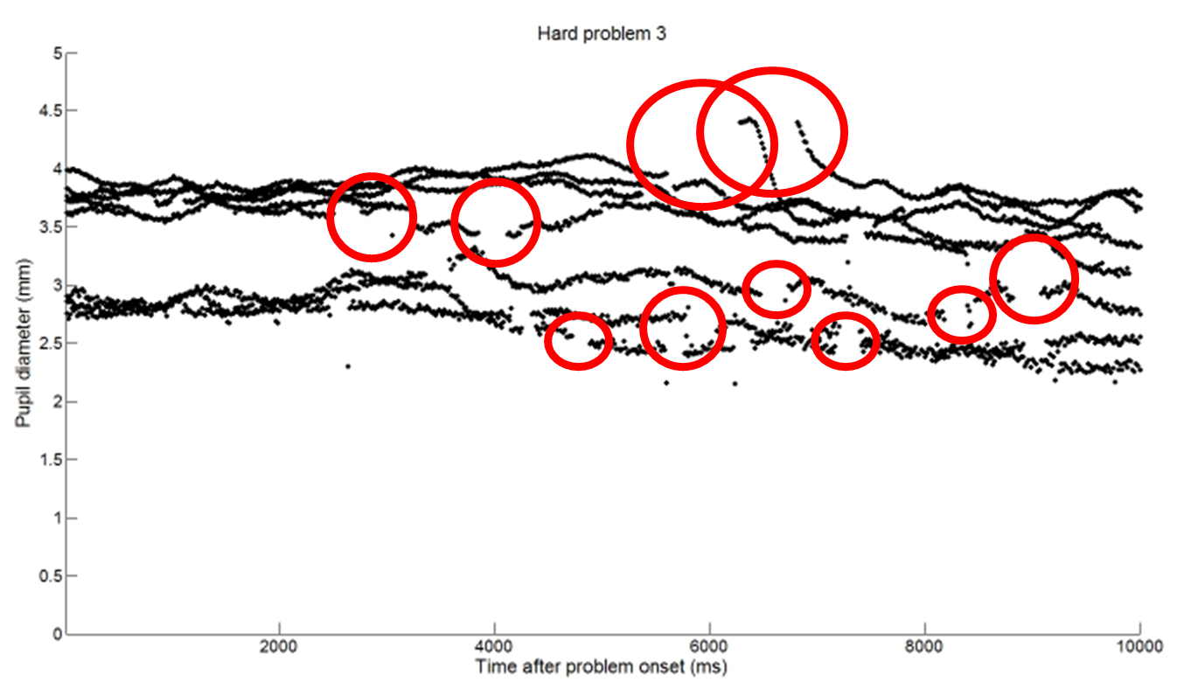
Analysis - Preprocessing

Slide 25
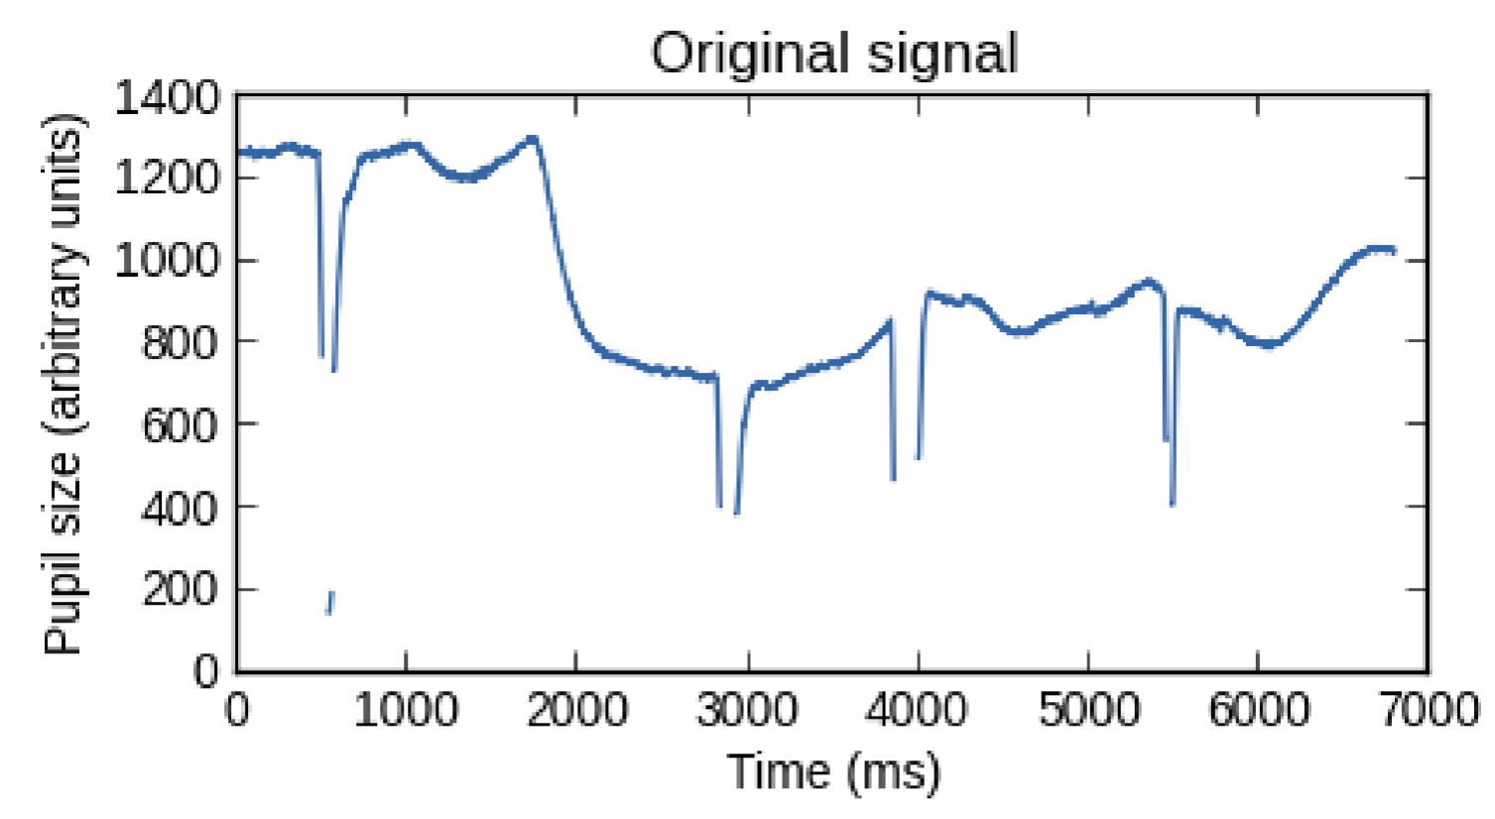
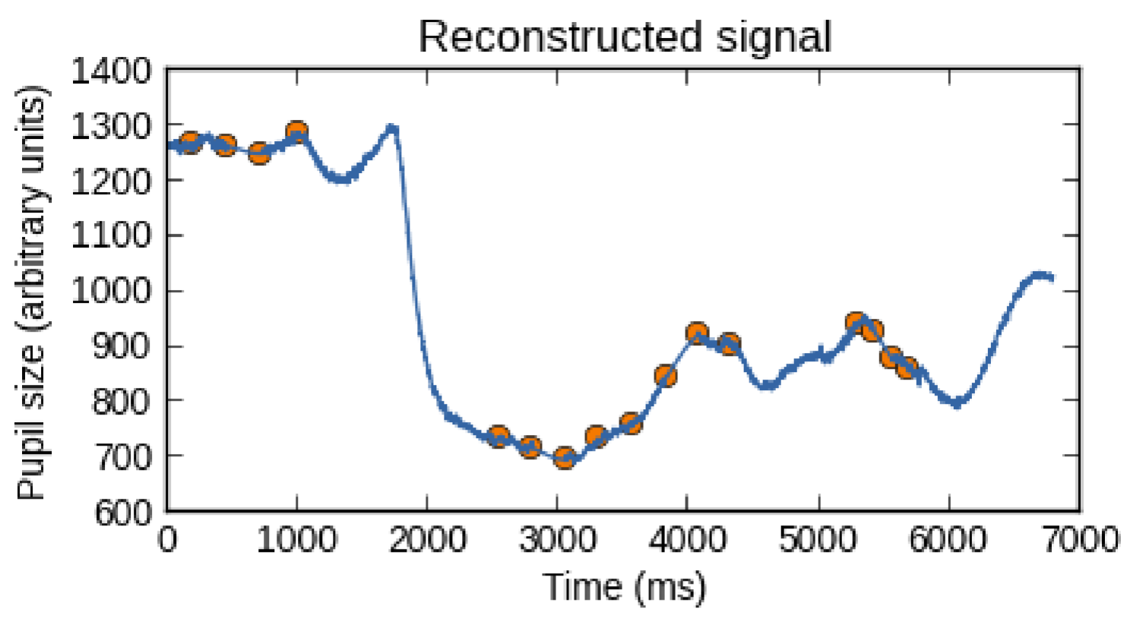
De-blinking
Blinks are generally not a problem if they are fast (<125ms) and/or uncorrelated with stimulus timing landmarks.
Linear interpolation
25

Slide 26
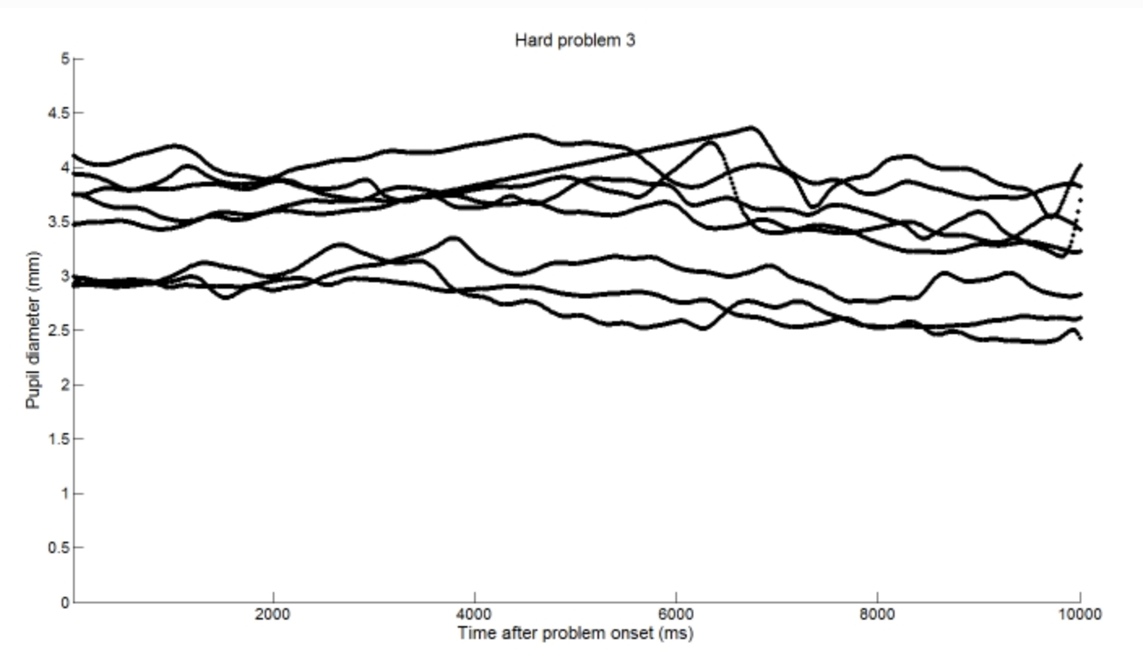
Low-Pass Filtering
Changes faster than 10 Hz are uncorrelated between the eyes, and thus low-pass filtering at 10 Hz level is justified to remove some of the noise from the data.

Slide 27
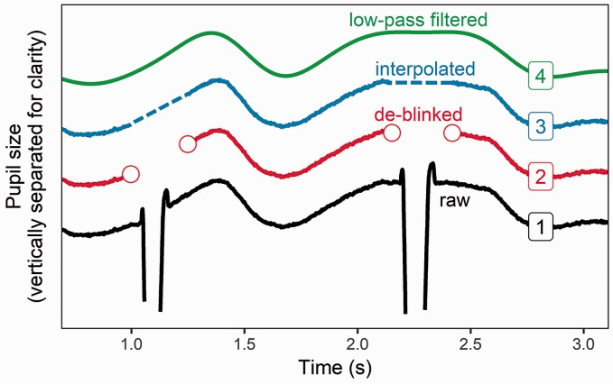
27

Slide 28
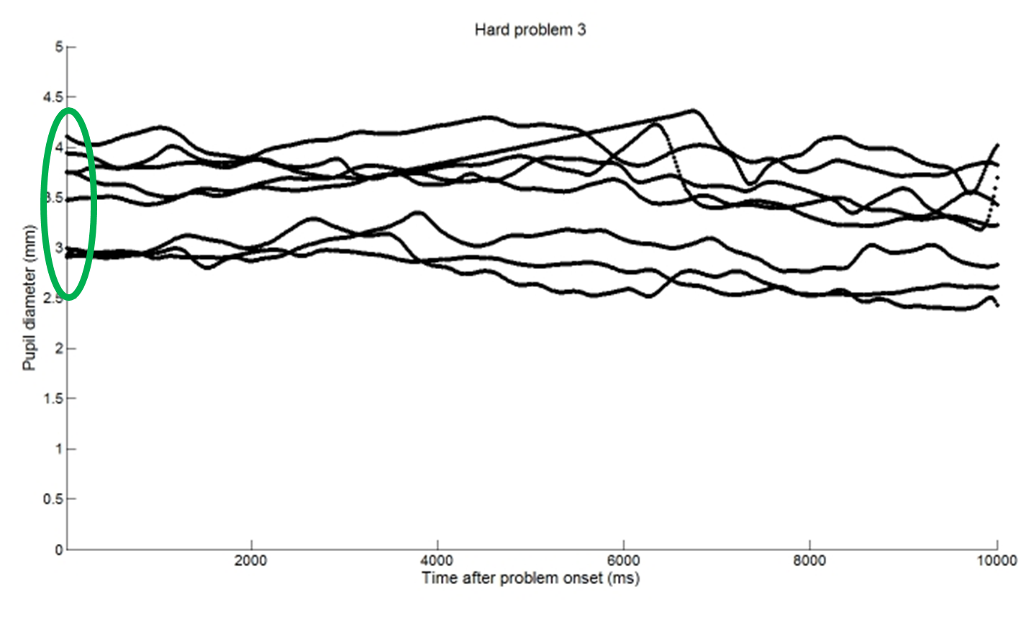
Baseline Correction and Normalization
Correction = absolute subtraction of the baseline level
Normalization = no gold standard method

Slide 29
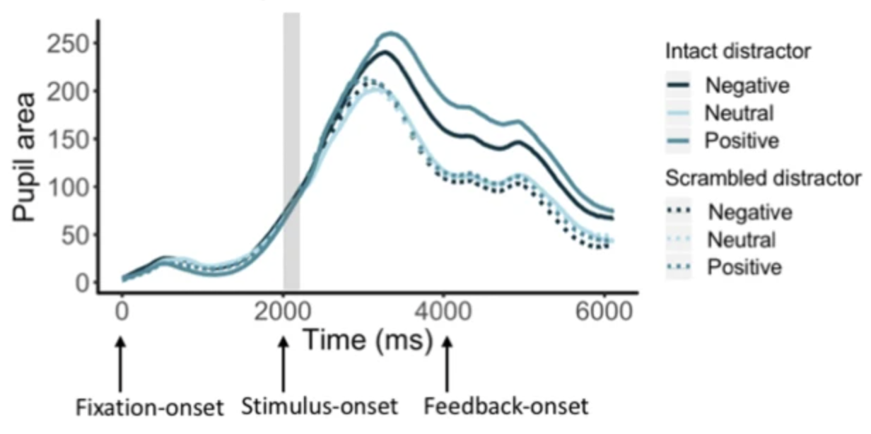
Data Alignment
Time alignment between trials is required before averaging/comparing across multiple trials
Walsh, A.T., Carmel, D. & Grimshaw, G.M. Reward elicits cognitive control over emotional distraction: Evidence from pupillometry. Cogn Affect Behav Neurosci 19, 537–554 (2019). https://doi.org/10.3758/s13415-018-00669-w

Slide 30
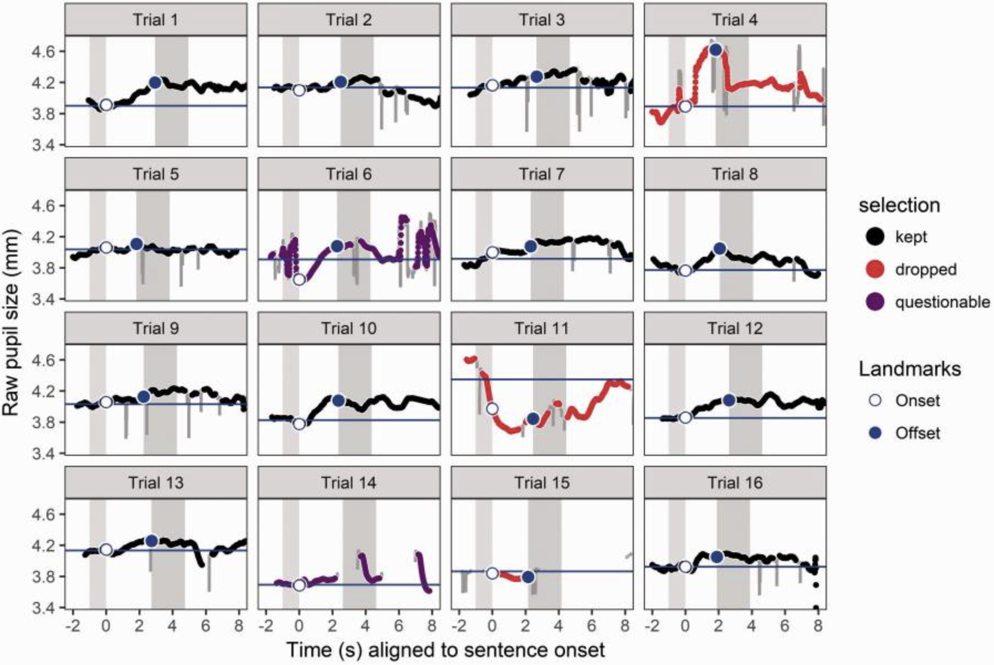
Identifying and Dropping Contaminated Trials
Strategy should be consistently applied and blinded to test condition
30

Slide 31
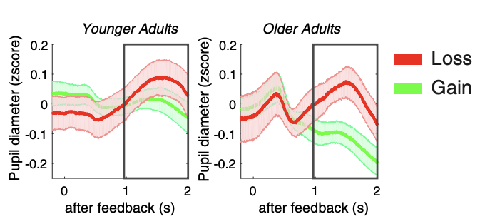
Analysis
Outcome measures include peak pupil diameter, peak pupil latency, mean pupil dilation in a fixed time window, etc.
General linear model
Koelewijn, Thomas et al. “The pupil response is sensitive to divided attention during speech processing.” Hearing research vol. 312 (2014): 114-20. doi:10.1016/j.heares.2014.03.010
Hämmerer, Dorothea, et al. “Locus Coeruleus Integrity in Old Age Is Selectively Related to Memories Linked with Salient Negative Events.” Proceedings of the National Academy of Sciences of the United States of America, vol. 115, no. 9, Feb. 2018, pp. 2228–33.

Slide 32
Useful resources
Laeng, B., et al. (2012). Pupillometry: A Window to the Preconscious? Perspectives on Psychological Science, 7, 18-27
Mathôt, S. (2018) Pupillometry: Psychology, Physiology, and Function. Journal of Cognition, 1(1): 16, 1-23
Aston-Jones, G., & Cohen, J. D. (2005). An integrative theory of locus coeruleus-norepinephrine function: adaptive gain and optimal performance. Annual Reviews Neuroscience, 28, 403-450
http://www.uqtr.ca/~siroiss/pupillometry/ - A useful walkthrough of practical aspects in pupillometry (with further useful references!)
https://www.ncbi.nlm.nih.gov/pmc/articles/PMC6166306/ - This article describes the basic considerations needed to plan, set up, and interpret a pupillometry experiment

Slide 33
Thanks for listening

