Slide 1
T-tests, ANOVAs and Regression
Dr Roopal Desai
Roa’a Alsulaiman

Slide 2
Overview
Parametric vs nonparametric
T tests
Student Test
Paired Test
ANOVA
One way
Two way
Linear Regression
Multiple Regression

Slide 3
Parametric VS non parametric testing
No assumed distribution.
In general, the measure of central tendency in the non-parametric test is median
Does not require previous knowledge about the population
Assume underlying statistical distributions in the data.
In general, the measure of central tendency in the parametric test is mean
Requires previous knowledge about the population

Slide 4
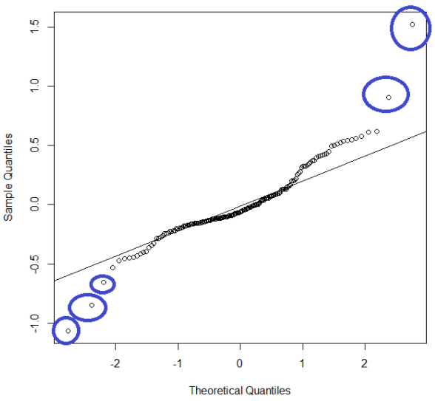
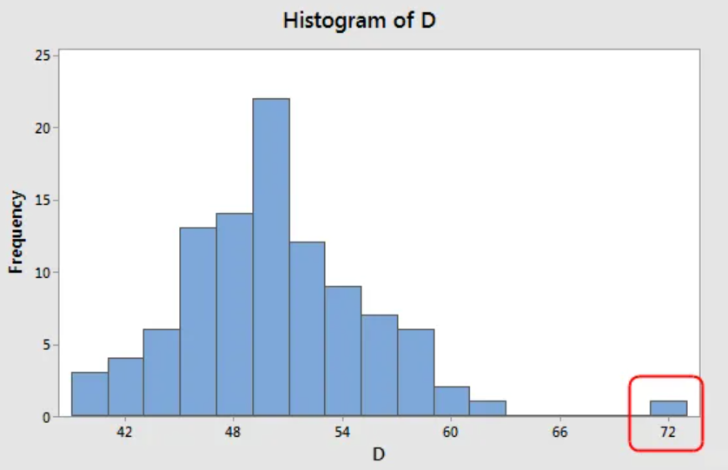
Testing the assumptions
1) Normality of distribution
Histogram & Q-Q plot

Slide 5
Testing the assumptions
2) Similar variance across groups
(Homogeneity)
3) Independence (in some cases)
Levene’s test
Data collection and design

Slide 6
T-tests
The t test is one type of inferential, parametric statistic
Determine whether there is a significant difference between the means of two groups / conditions
There are three main types

Slide 7
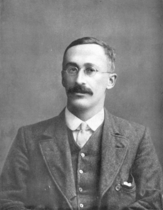
Student's T-test
used to determine if there is a significant difference between the means of two group
William Sealy Gosset​
1908

Slide 8
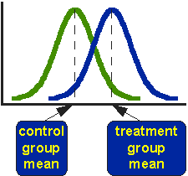
Student's T-test
It is also known as independent samples t-test, two sample t-tests, between samples t-test and unpaired samples t-test.
Notes:
https://www.graphpad.com/quickcalcs/ttest1.cfm

Slide 9
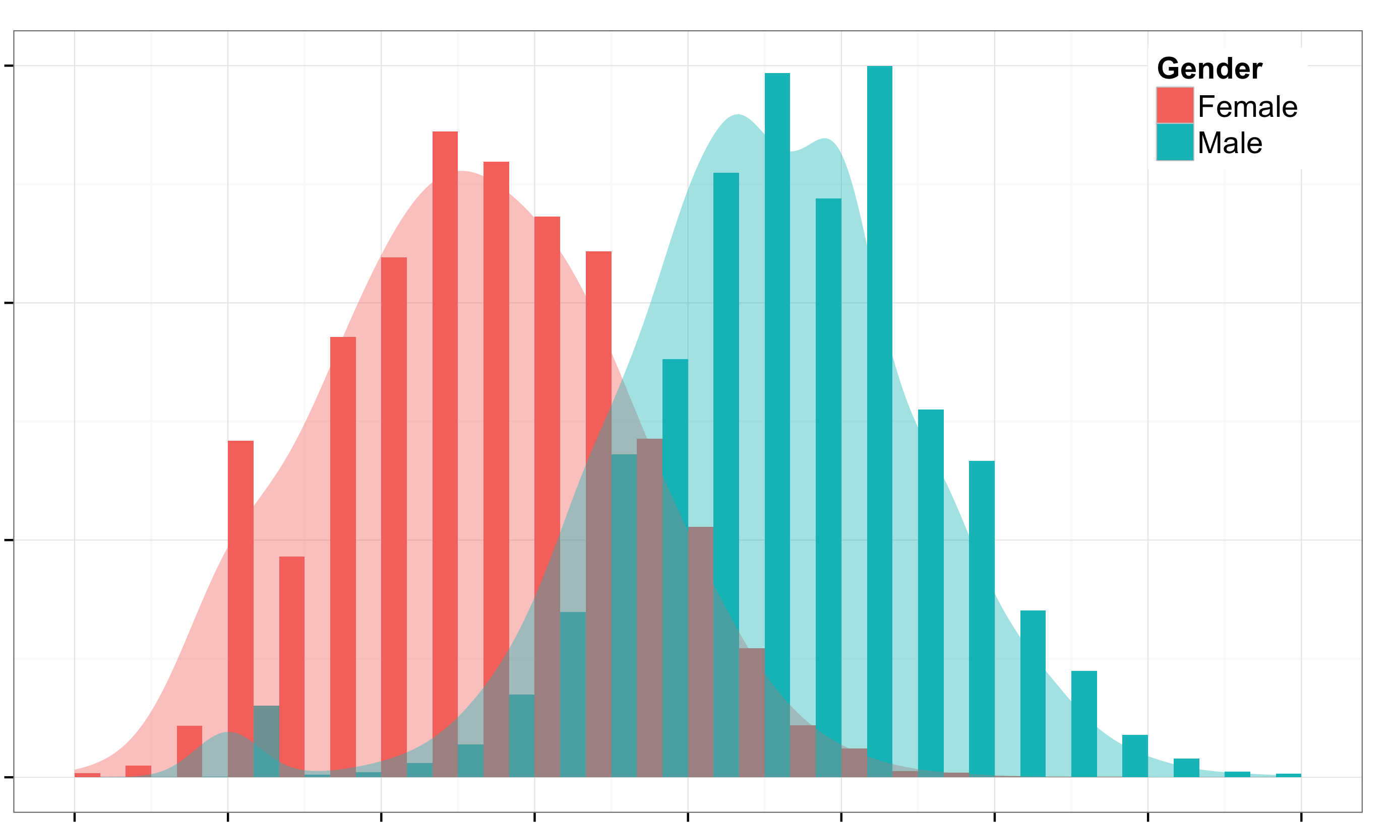
Student's T-test
Independent groups
Independent measurements
One independent, categorical variable that has two levels/groups
One continuous dependent variable

Slide 10
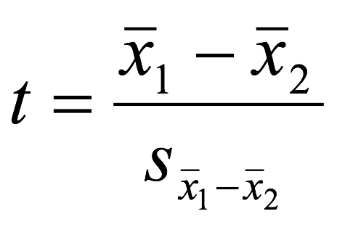
FORMULA
The difference betweent the meand divided by the pooled standard error of the mean.

Slide 11
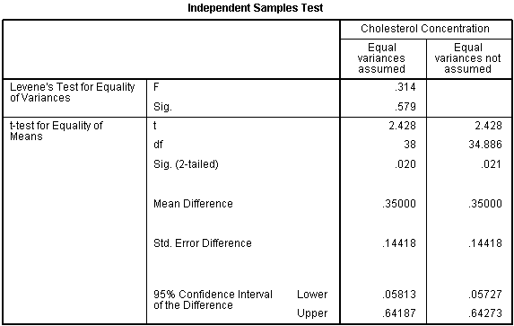
Which intervention is more effective in lowering cholesterol levels in overweight males: Exercise or weight loss?
This study found that overweight, physically inactive male participants had statistically significantly lower cholesterol concentrations (5.80 ± 0.38 mmol/L) at the end of an exercise-training programme compared to after a calorie-controlled diet (6.15 ± 0.52 mmol/L), t(38) = 2.428, p = 0.020.

Slide 12
Paired T-test
Estimate whether the means of two related measurements are significantly different from one another
Used when two continuous variables are related
Same participant at different times
Different sites on the same person
Cases and their matched controls.
Also known as within-subjects, repeated-measures and dependent-samples.

Slide 13
Paired T-test
The outcome variable has a continuous scale
The differences between the pairs of measurements are normally distributed
The interest is on the difference in the outcome measurements between each pair

Slide 14
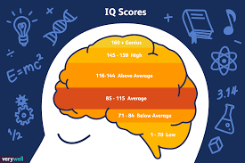
One sample T-test
There is only one group which is to be compared to a set value or a known population mean.

Slide 15
T-tests
Means come from the same group?
Yes
No
Comparing means of 2 groups?
Comparing mean of a group against a known mean?
Paired t-test
Student's T-test
One-sample T-test

Slide 16
ANOVA
One-way ANOVA
Two-way ANOVA

Slide 17
Analysis of Variance - ANOVA
2 Groups
➔ t-test
3+ groups
➔ ?
ANOVA

Slide 18
One-way ANOVA
Comparing means between 3+ groups
Does height differ significantly according to ethnic origin ?
Height
X₁
X₂
X₃

Slide 19
Calculating F
=
=
The Null Hypothesis μ₁ = μ₂ = μ₃
Variance 1: variation within the groups
Variance 2: variance between the groups
F = Between Groups Variance
Within Groups Variance

Slide 20
The model
Software output looks like this:
Height
The results of the ANOVA shows
F(2, 27) = 4.467, p = 0.021

Slide 21
Contrasts
If the test proves significant, we can expect an effect, but which one ?
Planned contrasts
Used when have a priori hypothesis
Post hoc tests
Used when there is no a priori hypothesis
-Correct for multiple comparisons (e.g. Bonferronni)

Slide 22
Two-way ANOVA
Two levels
-Country of origin
-Sex

Slide 23
REGRESSION

Slide 24
Regression
Creating a more complex model
Is there a relationship between height and weight ?
Is weight a predictor for height ?
Two continuous variables

Slide 25
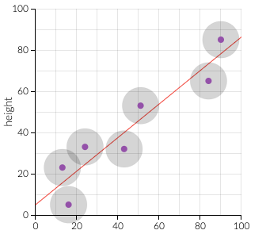
Linear regression: predicting a value
For example, suppose we start out knowing the height and hand size of a bunch of individuals in a "sample population," and that we want to figure out a way to predict hand size from height for individuals not in the sample. By applying OLS, we'll get an equation that takes hand size---the 'independent' variable---as an input, and gives height---the 'dependent' variable---as an output.
Below, OLS is done behind-the-scenes to produce the regression equation. The constants in the regression---called 'betas'---are what OLS spits out. Here, beta_1 is an intercept; it tells what height would be even for a hand size of zero. And beta_2 is the coefficient on hand size; it tells how much taller we should expect someone to be for a given increment in their hand size.
weight
height

Slide 26
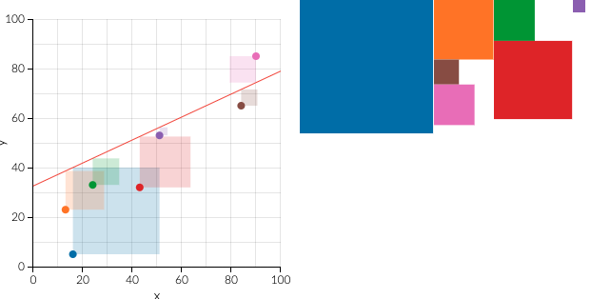
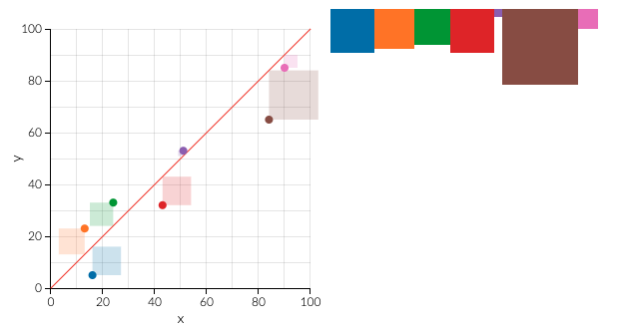
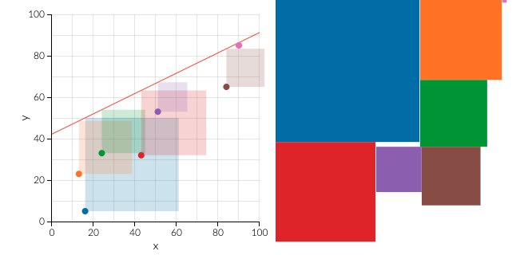
Linear regression: OLS fitting the line
For example, suppose we start out knowing the height and hand size of a bunch of individuals in a "sample population," and that we want to figure out a way to predict hand size from height for individuals not in the sample. By applying OLS, we'll get an equation that takes hand size---the 'independent' variable---as an input, and gives height---the 'dependent' variable---as an output.
Below, OLS is done behind-the-scenes to produce the regression equation. The constants in the regression---called 'betas'---are what OLS spits out. Here, beta_1 is an intercept; it tells what height would be even for a hand size of zero. And beta_2 is the coefficient on hand size; it tells how much taller we should expect someone to be for a given increment in their hand size.

Slide 27
Linear regression
y = a + bx+ ε

Slide 28
Multiple regression
y = a + b₁x₁+b₂x₂ + ε…

Slide 29
Credits:
Maria Fernanda Morales Calva
Timothee Maniquet

Slide 30
Questions?

Slide 31
References
Bozeman Science. (2016). Student's t test. [Video]. Available at: https://www.youtube.com/watch?v=pTmLQvMM-1M. (Accessed: 25 October 2018)
Peat, J., & Barton, B.(2005). Medical Statistics. A Guide to Data Analysis and Critical Appraisal. Sydney: Blackwell Publishing.
University of Wisconsin. (2017) T test. Available at: https://researchbasics.education.uconn.edu/t-test/. (Accessed: 22 October 2018)
https://statistics.laerd.com/

