Slide 1
Methods for Dummies
2nd level analysis for fMRI
Presenters: Man Sze (Jackie), Taylor Lyons
Expert: Dr. Guillaume Flandin

Slide 2
Overview
Recap on 1st level analysis
2nd level analysis
Fixed, Random (Mixed) Effects
Hierarchical model, Summary statistics
Demo
QnA

Slide 3
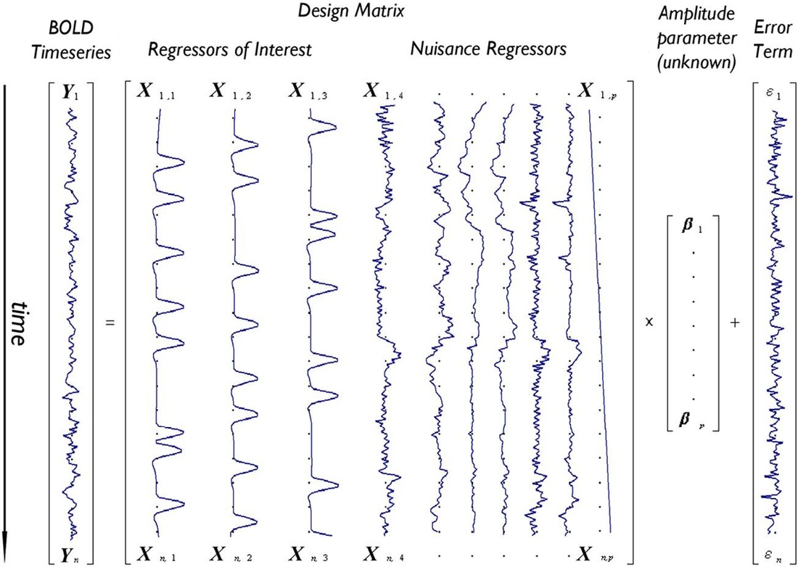
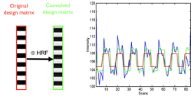
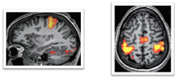
1st level analysis: individual analysis

Slide 4
Last lecture on 1st level analysis
Basis Functions
Model the fMRI signal
2. Parametric Modulation
Attributes of the tasks
3. Correlated Regressors
Multicollinearity

Slide 5
2nd level analysis: group analysis
Find presence of significant effect in the group level, not individual level
finding average beta value
how much the effect varies
what are the sources of these effects
How?
Fixed effects
Random effects

Slide 6
Fixed Effect Analysis
Combine all data points from all subjects into a single analysis
Assume effect is constant
One t-test for all data points

Slide 7
Fixed Effect Analysis
Example
N: 12 subjects each with 50 scans = 600 scans
c = [4, 3, 2, 1, 1, 2, 3, 3, 3, 2, 4, 4]
Within subject variability:
σ_{w}² = [0.9, 1.2, 1.5, 0.5, 0.4, 0.7, 0.8, 2.1, 1.8, 0.8, 0.7, 1.1]
Mean group effect (M) = 2.67
Mean σ_{w}² = 1.04
Standard Error Mean (SEM) = σ_{w}² / sqrt(N) = 0.04
t = M/SEM = 62.7, p = 10⁻⁵¹

Slide 8
Fixed Effect Analysis
Advantages
Simple Model
High degrees of freedom
Disadvantages
Assumption of common variance
Sensitive to extreme results from individual subjects
Can’t generalize findings to population

Slide 9
Random Effects Analysis (a.k.a Mixed Effects Analysis)
Different effects the experimental manipulation on different individuals
response magnitude
Based on how participants are drawn randomly from the population
Make inference

Slide 10
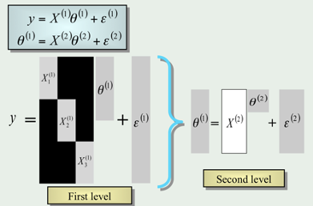
Hierarchical models
Estimate subject and group stats at the same time via iterative looping
Highly accurate
Computationally intensive

Slide 11
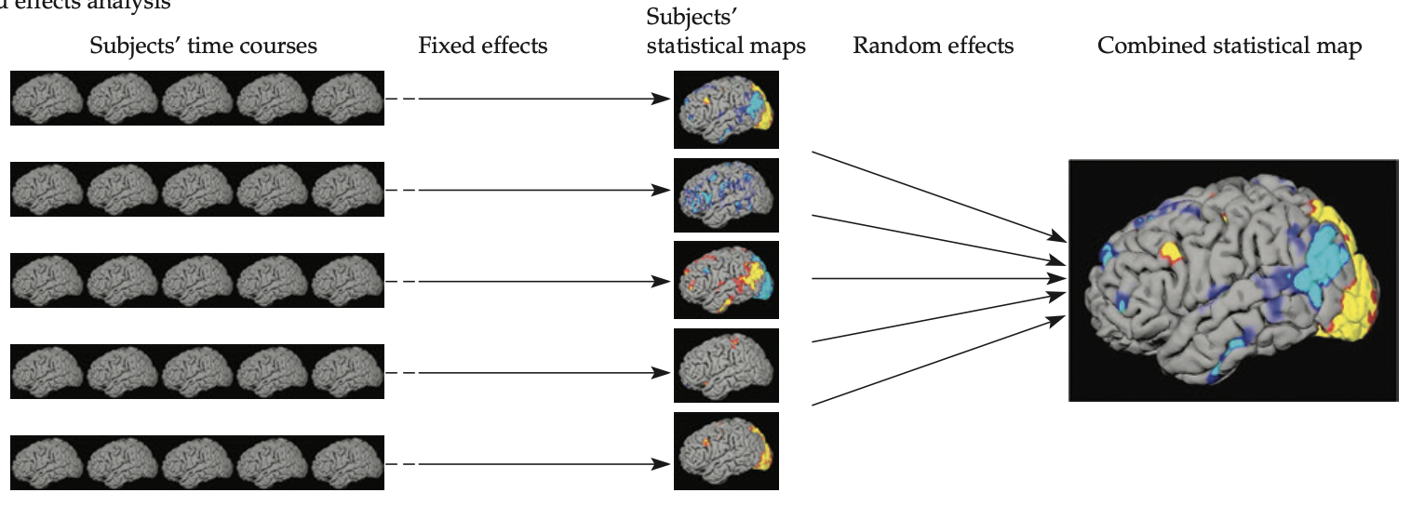
Summary Statistics
Step-by-step model
1st level: fixed
2nd level: random

Slide 12
Summary Statistics
Example
N = 12 subjects
c = [4,3,2,1,1,2,3,3,3,2,4,4]
Mean group effect (M) = 2.67
Between subject variability (SD) σ_{b}² = 1.07
Standard Error Mean (SEM) = σ_{b}² /(sqrt(N))=0.31
t = M/SEM = 8.61, p = 10⁻⁶

Slide 13
Fixed Effect Analysis
Example
N: 12 subjects each with 50 scans = 600 scans
c = [4, 3, 2, 1, 1, 2, 3, 3, 3, 2, 4, 4]
Within subject variability:
σ_{w}² = [0.9, 1.2, 1.5, 0.5, 0.4, 0.7, 0.8, 2.1, 1.8, 0.8, 0.7, 1.1]
Mean group effect (M) = 2.67
Mean σ_{w}² = 1.04
Standard Error Mean (SEM) = σ_{w}² / sqrt(N) = 0.04
t = M/SEM = 62.7, p = 10⁻⁵¹

Slide 14
Summary
2nd level analysis
Fixed vs Random (Mixed) Effects
Hierarchical models
Summary Statistics

Slide 15
Demo

Slide 16
QnA

Slide 17
Thanks!
Helpful resources:
Principles of fMRI channel on Youtube: https://www.youtube.com/channel/UC_BIby85hZmcItMrkAlc8eA
SPM videos: https://www.fil.ion.ucl.ac.uk/spm/course/video/#Group
Advanced readings on mixed models: Mixed-effects and fMRI studies by Friston et al., 2004

