Slide 1

Random Field Theory
Sarah Alobaidi, Letitia Schneider & Pia Brinkmann
Methods for Dummies (mfD)

Slide 2
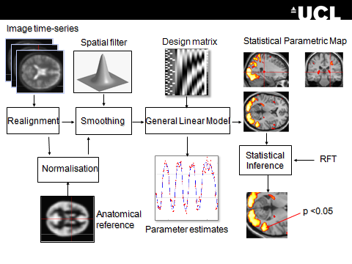
Where we are:

Slide 3
Hypothesis Testing
Null hypothesis : H0 : no relationship between BOLD signal and task design matrix
To test a hypothesis, we construct a ‘test statistic’ and ask how likely is it of obtaining our sample outcome if the the null hypothesis were true.
t statistic = sample mean – population mean
sample std / sqrt(n)
Null Distribution of T
Inferences at a single voxel

Slide 4
Hypothesis Testing
u_{α}
Significance level α:
α = P (Type I Error)
Decision rule threshold u_{α →} determines false positive rate α
Choose u to give acceptable α
α
p-value:
A p-value summarises evidence against H₀.
This is the chance of observing value more extreme than
under the null hypothesis.
α = P(T > u_{α} H₀)

Slide 5
Types of Error
 | Non -Active | Active
Declared active | 50 | 950
Failed to be declared active | 80 | 20

Slide 6
Hypothesis Testing
u_{α}
Significance level α:
α = P (Type I Error)
Decision rule threshold u_{α →} determines false positive rate α
Choose u to give acceptable α
Inferences at a single voxel
α
Conclusion about the hypothesis:
We reject the null hypothesis in favour of the alternative
hypothesis if t > u_{α}
t
p-value:
A p-value summarises evidence against H₀.
This is the chance of observing value more extreme than
under the null hypothesis.
p-value

Slide 7
Multiple Comparison Problem
Mass univariate approach
  thousands of voxel = thousands of t-tests
E.g. 100,000 voxels = 100,000 t-tests a = .05 (5%)
Independent tests * a = 5000 false positive
Using the same threshold will result in inflated
probability of obtaining false positives

Slide 8
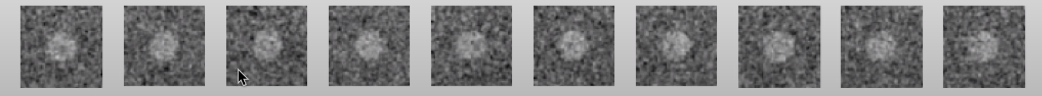
Measures of Error

Slide 9
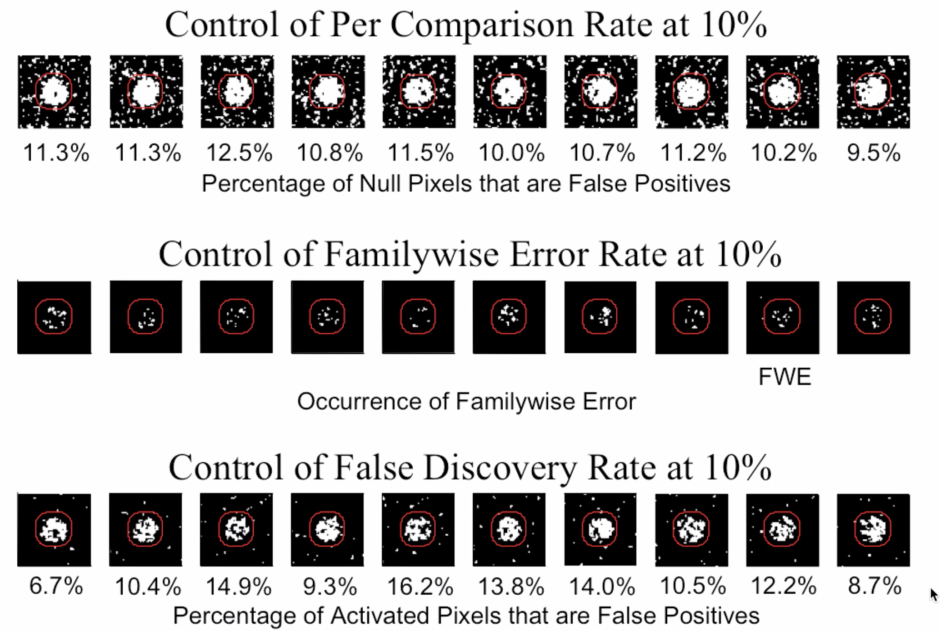
Measures of Error: Per comparison
Controls probability of each observation being a false positive

Slide 10
Measures of Error : Family-wise Error-Rate (P_{FWE})
Controls probability of any false positives in a family

Slide 11
Multiple Comparisons Problem
Bennett et al. 2009
Task > Rest contrast in a mentalisation paradigm
Using parameters: t(131) > 3.15, p(uncorrected) < 0.001, two active clusters observed
FWER and FDR indicated no active voxels

Slide 12
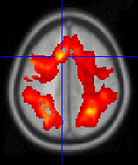
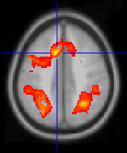
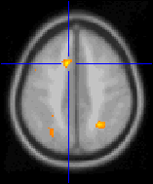
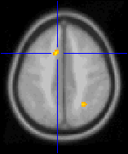
Bonferroni Correction
α = P_{FWE} / n
α = New single-voxel threshold
n = Number of tests (i.e. voxels)
FWE = Family-wise error (typically 0.05)
Height Thresholding
u_{α}

Slide 13
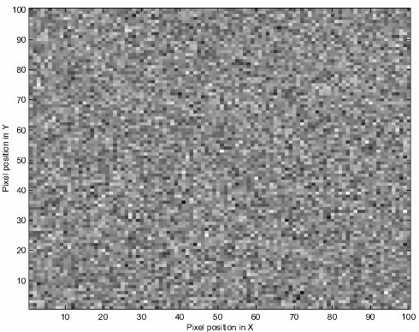
Bonferroni Correction: Example
α = P_{FWE} / n
Example:
P_{FWE} = .05
10,000 voxels, 100,00 t-tests all with 40 d.f
α = 0.05/10,000
α = 0.0000005
corresponding t=5.77

Slide 14
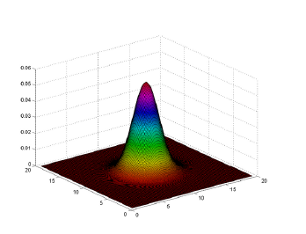
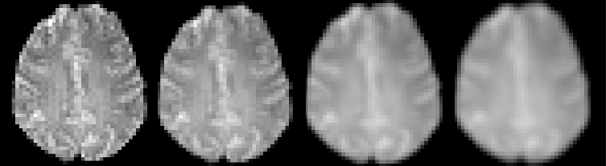
Spatial Correlation
Spatial Correlation is universally present within all imaging data.

Slide 15
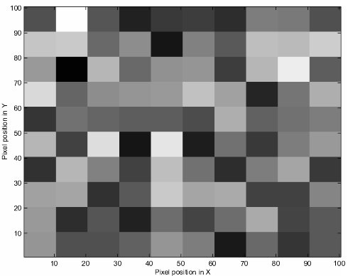
The impact of Spatial Correlation on Bonferroni Correction
Spatial Correlation =
No. of independent values < number of voxels
Bonferroni correction is far too conservation.
Independent observation assumption violated
α = P_{FWE} / n

Slide 16
Spatial Correlation
Appropriate Bonferroni:
0.05/100 = 0.0005
?
Bonferroni when independence is assumed:
0.05/10,000 = 0.000005

Slide 17
Topological inference
More sensitivity
Set level inferences
  Number of clusters above u
Cluster level inference
  Spatial extent above u
Voxel level inferences
  Height of local maxima
intensity
More specificity
t_{α}
t_{clus}
space

Slide 18
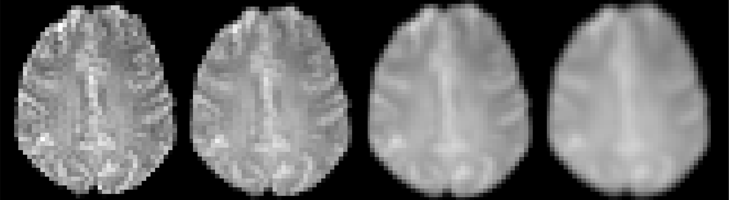
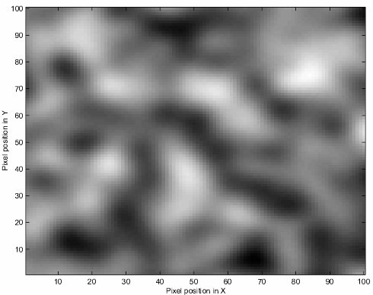
Too Smooth for Bonferroni

Slide 19
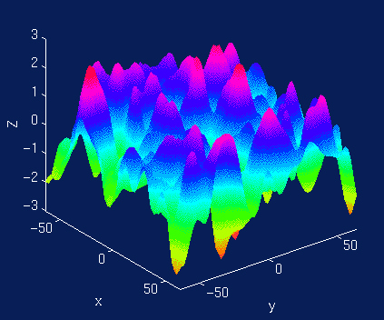
Random Field Theory
Alternative multiple corrections method (FWER)
Accommodating to spatial correlations
Goal: To determine the height threshold that will give the desired FWER
  Approximate upper tail of maximum distribution
  Use this to find appropriate threshold

Slide 20
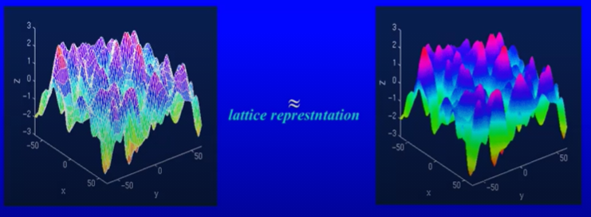
Random Field Theory: assumptions
Error fields are reasonable lattice approximation to underlying random field with multivariate Gaussian distribution (i.e. smooth statistical maps)
The fields are continuous, with a twice-differentiable autocorrelation function

Slide 21
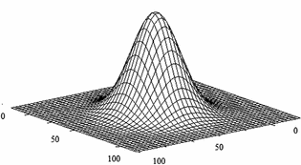
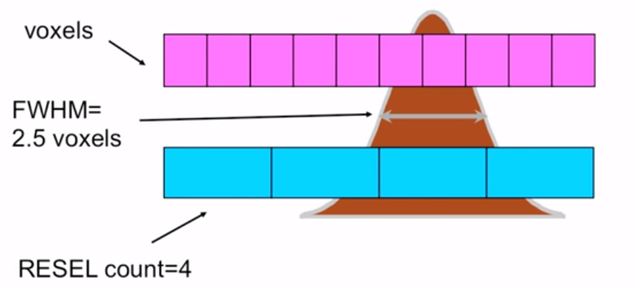
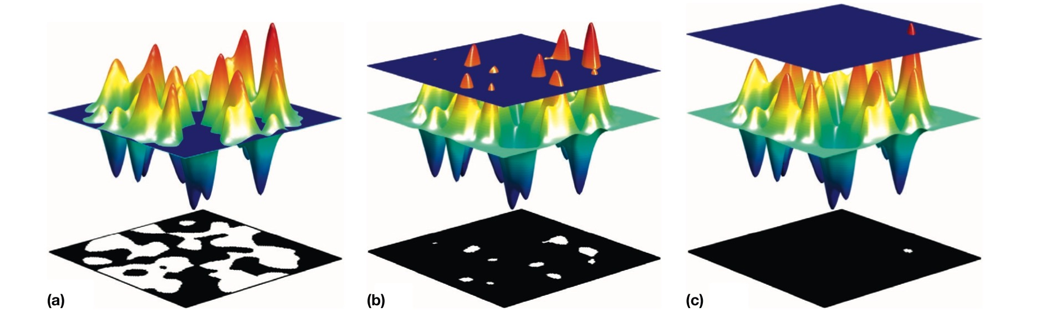
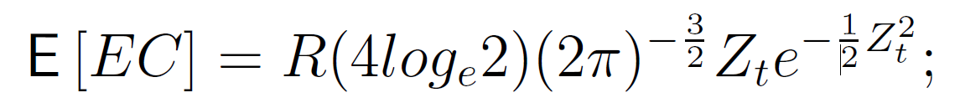
Random Field Theory: finding threshold
  Estimate smoothness
  Get RESELs
  Euler Characteristic
  Find height threshold for desired FWE

Slide 22
The Euler Characteristic
E[EC] = N(blobs) – N(holes)
E[EC] → Expected Euler Characteristic
≤ threshold
Threshold
> threshold
6 – 2 = 4
10
1
Increasing threshold

Slide 23
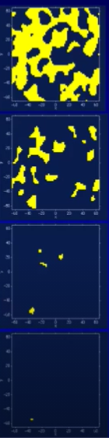
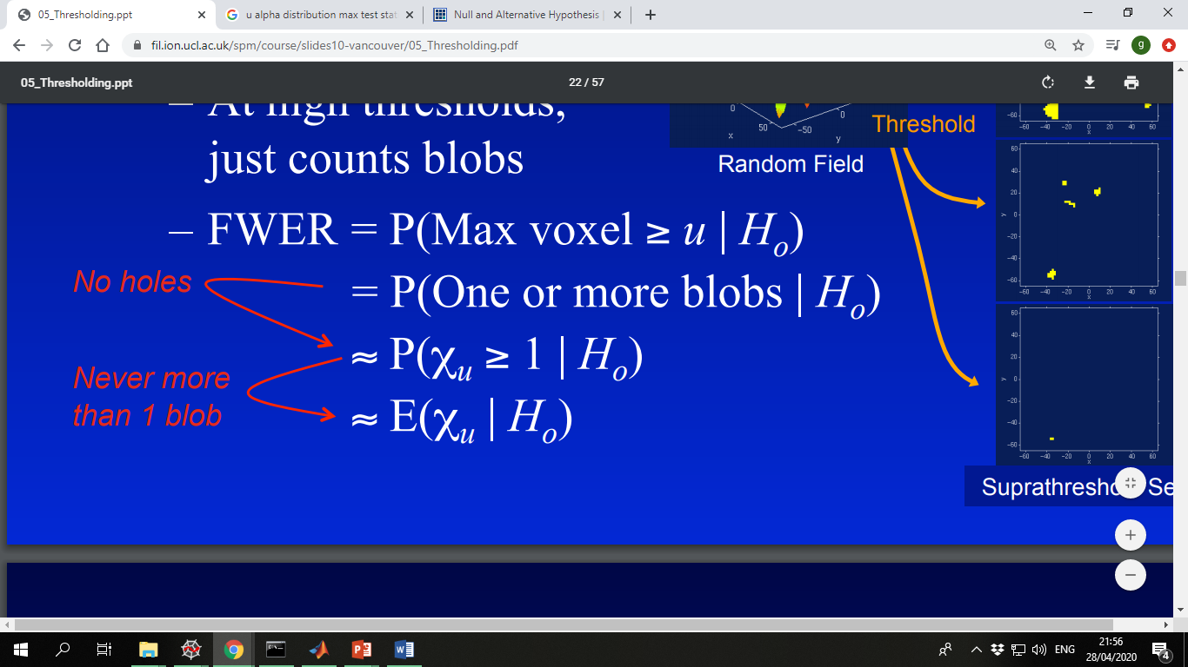
FWER & Euler Characteristic
No holes exist
Never more than one blob

Slide 24
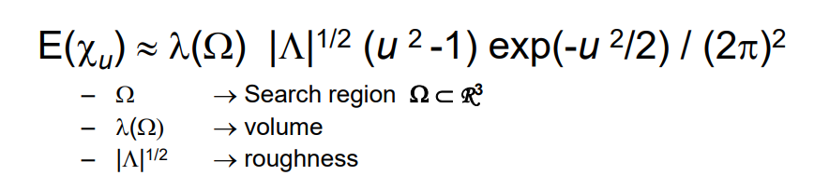
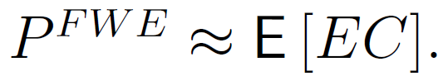
3) E[EC] at different thresholds
# of resels
Z (or T) -score threshold
(or the inverse the level of smoothness)
Expected Euler Characteristic

Slide 25
Random Field Theory: finding threshold
  Estimate smoothness
  Get RESELs
  Euler Characteristic
  Find height threshold for desired FWE

Slide 26
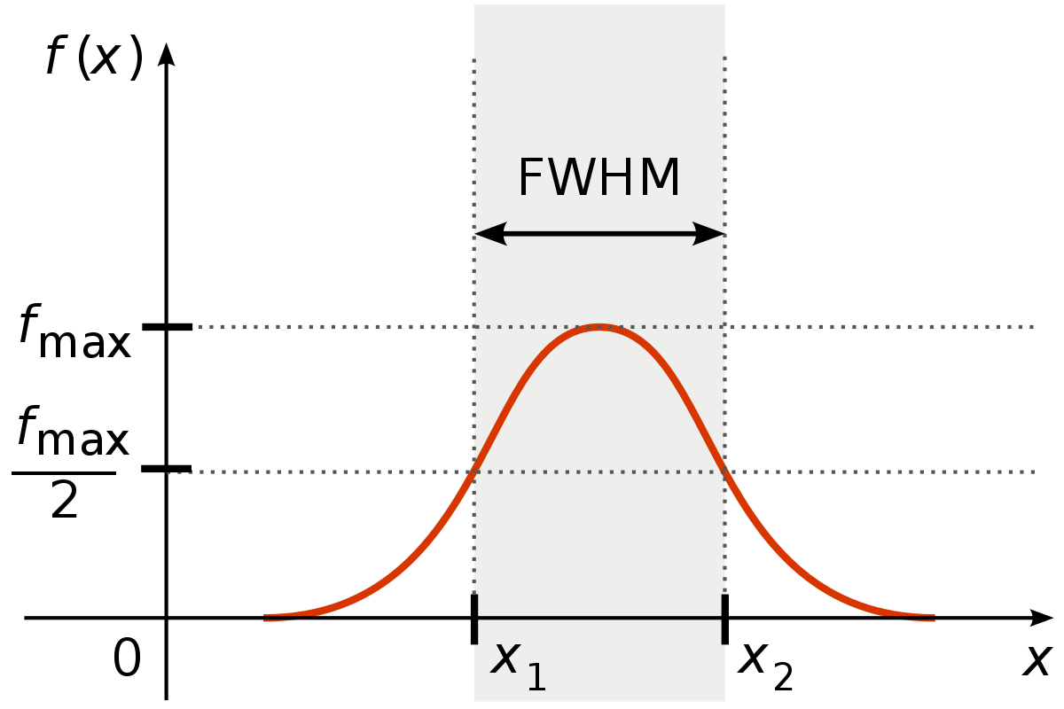
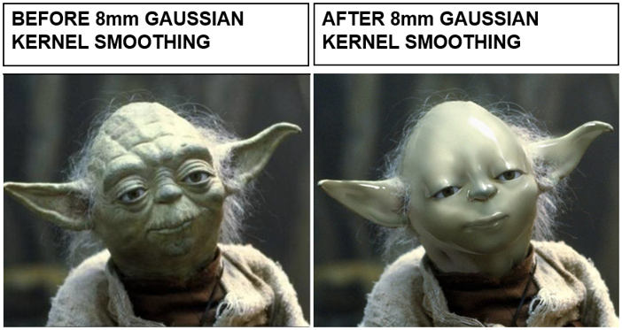
1)Estimate Smoothness

Slide 27

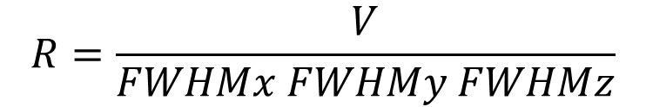


2) RESolution ELement (RESEL)
$$R=\frac{V}{FWHMx FWHMy FWHMz}$$
RESEL = FWHM (x,y,z)
RESEL count = volume search area in units of smoothness
$$R=\frac{V}{FWHM}$$
$$R=\frac{10}{2.5}$$
$$4=\frac{10}{2.5}$$
Notes:
Higher smoothing value, big FWHM – less RESELs

Slide 28
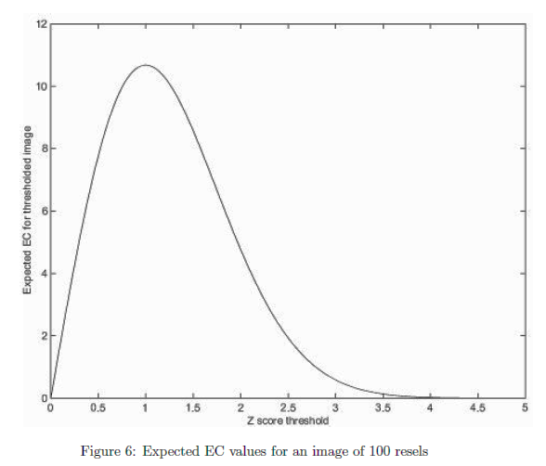
3)The Euler Characteristic
10
Apply RFT to smoothed image:
Result of E[EC] → E[EC] of 0.049 for
Z set to 3.8
The probability of getting one or more regions (blobs) where Z is greater than 3.8, in a 2D image with 100 resels is 0.049
6
1

Slide 29
Adaptability of RFT
Statistic value (t/z/f) increases?
Search volume increases?
Smoothing increases?
FWER
FWER
FWER

Slide 30
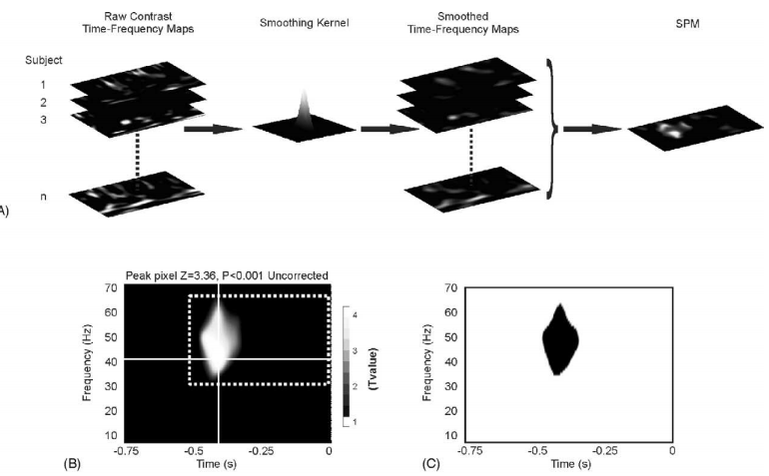
EEG and RFT
Apply RFT to EEG data

Slide 31
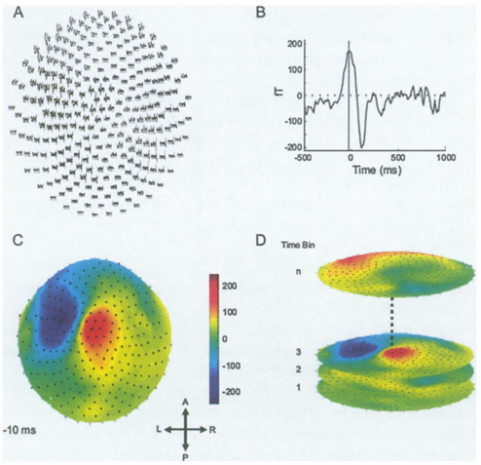
MEG and RFT
Apply RFT to MEG data

Slide 32
Measures of Error

Slide 33
Measures of Error: False Discovery Rate
Controls ratio of true positives : false positives

Slide 34
References
Nichols, T. (2012). Multiple testing corrections, nonparametric methods, and random field theory. NeuroImage. 62 (2), 811-815.
Kilner, J., Kiebel, S. & Friston, K. (2005). Applications of random field theory to electrophysiology. Neuroscience Letters. 374 (3), 174-178.
Brett, M., Penny, W. & Kiebel, S. (2004). An introduction to Random Field Theory. Human Brain Function. London. 867-879.
Kilner, J. M., & Friston, K. J. (2010). Topological inference for EEG and MEG. The Annals of Applied Statistics, 1272-1290.
Flandin G, Friston KJ. (2019). Analysis of family-wise error rates in statistical parametric mapping using random field theory. Hum Brain Mapp, 40(7):2052-2054.
Eklund, A., Nichols, T. E., & Knutsson, H. (2016). Cluster failure: Why fMRI inferences for spatial extent have inflated false-positive rates. Proceedings of the National Academy of Sciences of the United States of America, 113(28), 7900–7905.
https://mediacentral.ucl.ac.uk/Play/39922 ← Previous SPM 2020 course seminar on RFT.
https://www.youtube.com/watch?v=nv0HePjQAD8&t=678s ← Mumford Brain Stats

