Slide 1
Study design & Efficiency
By Jessica Rapley & Nisa Kahn
MfD 10/2/21

Slide 2
Contents of the Lecture:
Study Design
Types of Study Design:
Subtraction
Conjunction
Factorial
Parametric
Stimulus presentation strategies:
Blocked design
Event-related design
Mixed design
Efficiency
General advice
Terminology
Challenges with BOLD IR
Stimulus timing: One condition
Fourier Transformation
High-pass filtering
Stimulus timing: Two/more conditions
Different efficiencies for different contrasts
Correlation between regressors

Slide 3
Why is it so important to correctly design your experiment?
Main design goal: To test specific hypotheses
We want to manipulate the subject’s experience and behavior in some way that is likely to produce a functionally specific neurovascular response.
What can we manipulate?
Stimulus type and properties
Stimulus timing
Subject instructions

Slide 4
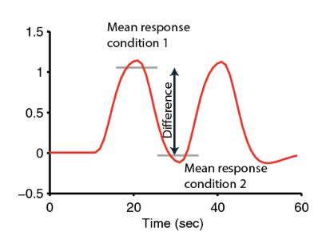
Goal of design:
Isolate functional processes of interest
BOLD signal is relative – choose stimulus conditions and timings that maximise BOLD signal contrast
Avoid confounding physiological and psychological artifacts
Collect as much data as possible
Measure behaviour
Based on Huettel (Chapter 9)

Slide 5
Different types of Study Design:
Categorical designs
Subtraction - Pure insertion, evoked / differential responses
Conjunction - Testing multiple hypotheses
Parametric designs
Linear - Adaptation, cognitive dimensions
Nonlinear - Polynomial expansions, neurometric functions
- Model-based regressors
Factorial designs
Categorical - Interactions and pure insertion
Parametric - Linear and nonlinear interactions
- Psychophysiological Interactions (PPI)
Task A – Task B
a A A A A

Slide 6
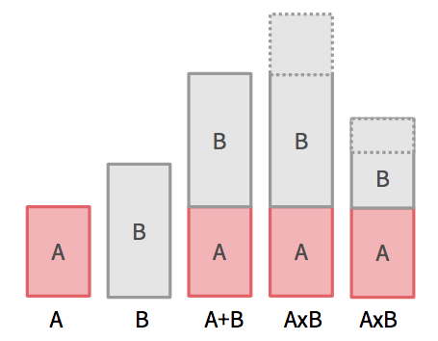
Subtraction:
Two task conditions differing in the process of interest
Task condition 1: evokes process of interest
Task condition 2: evokes all but the process of interest
If the experiment, is looking at the neuronal structures underlying a single process called ‘N’ …
Subtraction: [Task A] – [Task B]
Subtraction: [task with N] – [matched task without N] = N
Assumption of ‘pure insertion’
Two (or more) conditions can be cognitively added with no interactions among the cognitive components of a task (Amaro & Barker, 2006)

Slide 7
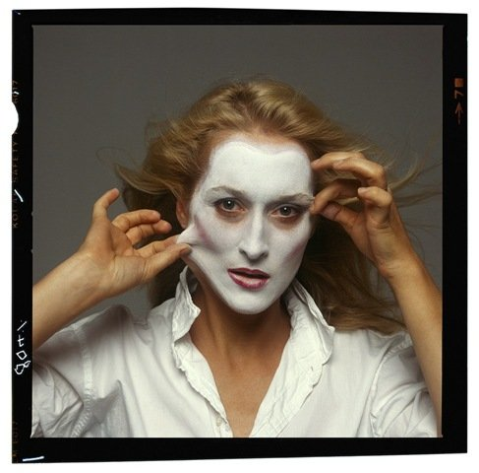
Cognitive subtraction: Interpretations
Question:
Which neural structures support face recognition?
Related stimuli
vs.
→ P implicit in control task?
Meryl Streep Mum?!
Same stimulus, different tasks
vs.
→ Interaction of process and task?
Name the person! Name gender!
Distant stimuli
vs.
→ Several components differ!

Slide 8
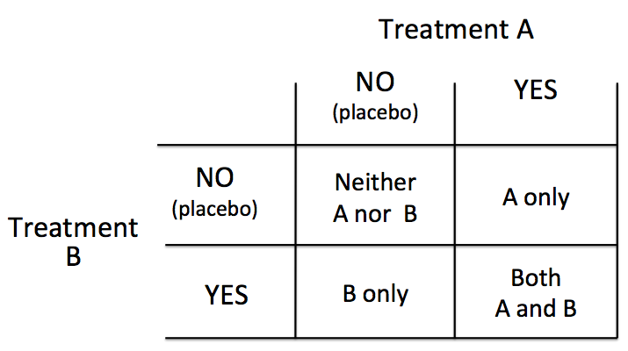
Factorial:
Two or more variables (or factors) and the different levels of each variable are matched
Test for interactions explicitly
‘…perform a task where the cognitive components are intermingled in one moment, and separated in another instance of the paradigm’ (Amaro & Barker, 2006)
2 factors x 2 levels = 4 conditions

Slide 9
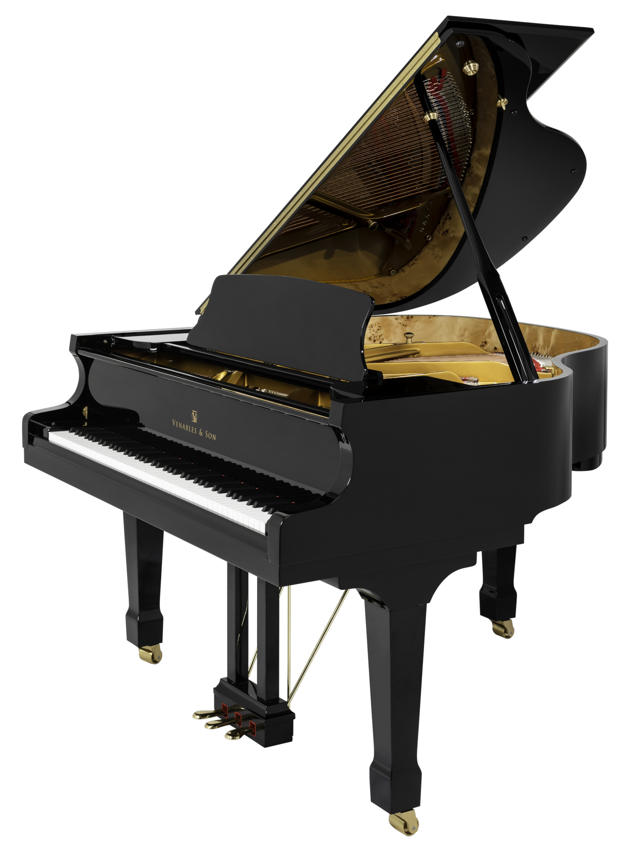
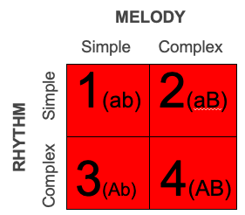
EXAMPLE: INTEGRATED RHYTHM CENTER?
Question: When performing a complex rhythm and melody, is there a shared rhythm centre?
→Or are there separate processes that control melody and rhythm ?
In this example, the 2 factors are rhythm and melody:
a - simple rhythm
A - complex rhythm
b- simple melody
B - complex melody
The 4 outcomes are:
1 : simple rhythm, simple melody (ab)
2: simple rhythm, complex melody (aB)
3: complex rhythm, simple melody (Ab)
4: complex rhythm, complex melody
(AB)

Slide 10
Ways to interpret factorial design results:
Main Effects: Melody and Rhythm separately
→(1+2) - (3+4) = Main effect of Rhythm
→(1+3) - (2-4) = Main effect of Melody
Simple Effects: Each outcome in the condition of another.
Eg.
2-1 = complex melody, in the context of simple rhythm
4 -2 = simple rhythm in the context of complex melody
MELODY
Simple Complex
1(ab) 2(aB)
3(Ab) 4(AB)
RHYTHM
Complex Simple

Slide 11
Parametric:
A A A A A
Based on the idea that cognitive demand of task vary systematically with BOLD signal
Incrementally increase difficulty of task; relate to BOLD signal
Step-wise increase
Allow dissociation between areas functionally associated with task & other ‘maintenance’ areas
However, other circuits may be recruited at higher cognitive demand
Example: increasing the blurriness in audio, and telling subject to write down what they hear.
Increasing difficulty in face recognition test → more complicated faces

Slide 12
Conjunction:
Isolate process of interest by finding commonalities between task conditions
Task pair 1: subtraction isolating A & B
Task pair 2: subtraction isolating A & C
Main purpose is to see the similarities between areas.
Example Question: Is there one rhythm center for Hand movements, foot movement and speech?
A = process of interest

Slide 13
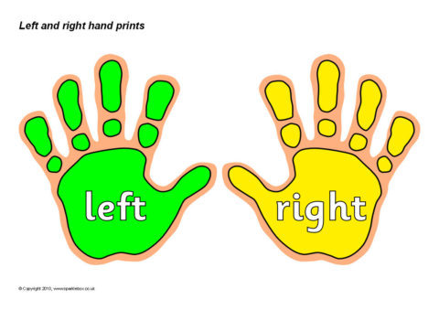
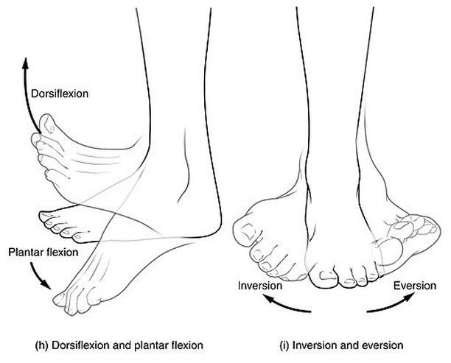
Question: Is there one rhythm center for hand movements, foot movement and speech?
Do these regions have a shared rhythm center or are there different modalities for each region?
Superimpose the fMRI scans over each other and measure commonality.
Results:
Commonality in activated regions and voxel = shared rhythm center
No commonality = separate rhythm centers

Slide 14
Ways of testing for conjunction:
Conjunction Null Hypothesis:
Global Null Hypothesis:
More strict analysis
P = 0.05
Therefore, only activation over the p value threshold, can reject the null hypothesis and prove overlapping activation
More lenient analysis
More lenient numerical value
Allows researchers to indicate trends in activation
Shows a more directional effect
Reasons for use:
Conjunction NH: Drug trials – need a strict design, with a conservative null hypothesis. → Has a large effect on people
Global NH: Activation of Speech and arm movement

Slide 15
Summary:
Amaro & Barker (2006)

Slide 16
Study Design Overview:
Subtraction
Conjunction
Factorial
Parametric
Stimulus presentation strategies
Blocked
Event-related
Mixed

Slide 17
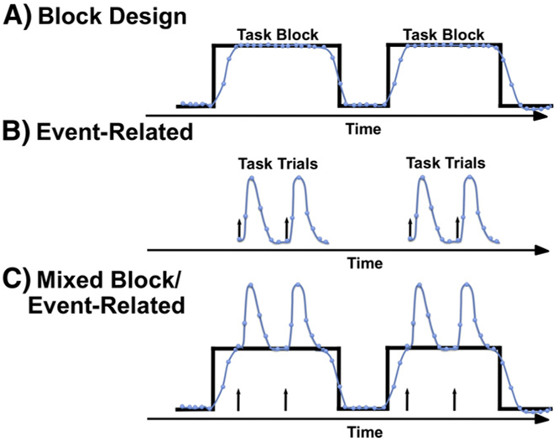
Presenting stimulus:
How to present your stimulus?
Detection: knowing which voxel is active (spatial resolution)
Estimation: time course of active voxel (temporal resolution)
Petersen & Dubis (2012)

Slide 18
Block design:
Alternating between task conditions
Strong detection/statistical power
Maximise data variability due to experimental manipulation (between-conditions variability)
Minimise other sources of data variability (within-conditions variability)
However…
Insensitive to shape and timing of hemodynamic response
Expectancy effect.
Based on Huettel (Chapter 9)

Slide 19
Example block design:
Task A vs. Task B
Example: Squeezing Right Hand vs. Left Hand
Allows you to distinguish differential activation between conditions
Does not allow identification of activity common to both tasks
Can control for uninteresting activity
Task A vs. No-task
Example: Squeezing Right Hand vs. Rest
Shows you activity associated with task
May introduce unwanted results

Slide 20
Pros and Cons of Blocked Design:
Pros:
Avoid rapid task-switching (e.g. patients)
Fast and easy to run;
Good signal to noise ratio
Cons:
Expectation
Habituation
Signal drift
Poor choice of baseline may preclude meaningful conclusions
Can’t have Many tasks, that cannot be conducted repeatedly

Slide 21
Event-related design:
Evoke process of interest transiently by brief presentation of individual stimuli
Task order randomised
Better estimation of HRF shape and timing
Allow trial-by-trial sorting based on subject response
However…
Evoke smaller changes in BOLD signal
Larger switching cost between tasks?
Based on Huettel (Chapter 9)

Slide 22
Pros and Cons of Event Related Design:
Pros:
Real world testing
Eliminate predictability of block designs (e.g. expectation);
Can look at novelty and priming;
Can look at temporal dynamics of response.
Cons:
Lower statistical power (small signal change)
More complex design and analysis (esp. timing and baseline issues).

Slide 23
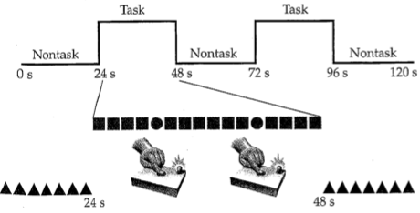
Mixed designs:
Combination of blocked and event-related designs
Stimulus present in regular blocks; >1 types of events per block
Analysis of IVs on different time scale
Block -> state-related processes (e.g. attention)
Event -> item-related processes (e.g. button press)
Example of a mixed design:
Within task block, subject is presented with a video of different numbers. The event is a letter of the alphabet coming up in that sequence.
The subject is told to press the button when a letter is presented.
Block stimuli: video of numbers
Event Stimuli: letter presented

Slide 24
Summary:
4 different types of Study design:
Subtraction
Factorial
Parametric
Conjunction
3 Different Stimulus presenting Designs:
Block Design
Event related Design
Mixed Design
Take home note: Which ever study design you choose in both design or stimulus presenting strategies, it all depends on your question!

Slide 25
Efficiency and optimisation of fMRI designs

Slide 26
A good fMRI design needs two things…
An appropriate study design: Induce subject to do or experience the psychological state that you want to study (psychological)
Efficiency: Effectively detect brain signals related to those psychological states (statistical)
You can have a great psychological experiment with huge neuronal response, but be completely unable to identify this in fMRI-signal because you can’t disassociate the BOLD signal

Slide 27
Outline
General advice
Terminology
Challenges with BOLD IR
Stimulus timing: One condition
Fourier Transformation
High-pass filtering
Stimulus timing: Two/more conditions
Different efficiencies for different contrasts
Correlation between regressors

Slide 28
General advice
Scan for as long as possible
Avoid fatigue, habituation and discomfort
Statistical power (40-60 mins)
Group analysis: number of subjects
keep subject as busy as possible
Minimise the time subjects are not engaged in a task
Breaks in scanning
disrupts the spin equilibrium
reduce efficiency of any temporal filtering
"session" effects
400
100
This Photo by Unknown Author is licensed under CC BY-SA

Slide 29
Terminology
Trials: replication of a condition
Components of a trial: bursts of neural activity, or periods of sustained neural activity
For example, a working memory trial can consist of a stimulus (event), a retention interval (epoch) and a response (event).
Stimulus Onset Asynchrony (SOA): time between onset of two different stimuli
Inter-Trial Interval (ITI): time between the onset of successive trials
Inter-Stimulus Interval (ISI): time between the offset of one component and the onset of the next

Slide 30
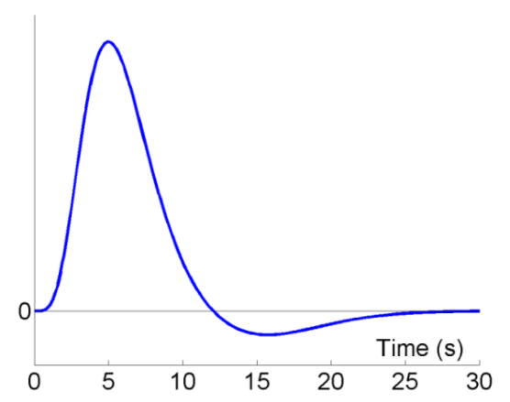
Challenges with BOLD Impulse response
BOLD impulse response (IR)
Haemodynamic Response Function (HRF): relation between burst of neuronal activity and BOLD signal
Typical response: peak at 4-6, undershoot at 10-30s, returns to baseline at 25-32s
Problems:
Delayed and dispersed BOLD response
Low frequency noise

Slide 31
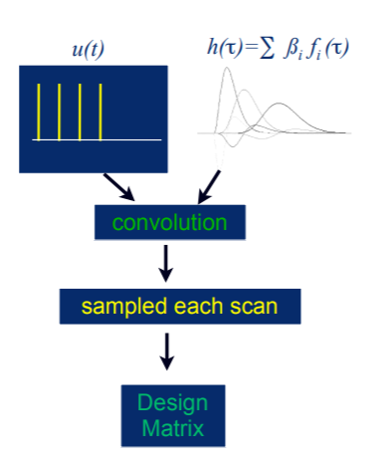
Optimising efficiency: stimulus timing
Temporal convolution model
Stimulus x IR = Predicted fMRI data
The following examples will use this model
Stimulus timing
You want trials to be temporally close to limit ITI
In order to be sensitive to differences between trials close together in time (i.e., <20 s), you can either
Fix SOA but vary the order of trials
Fix the order but vary the SOA
GLM: Y(data) = X(design matrix) . β(parameters) + ϵ(error)

Slide 32
Stimulus timing: Single condition vs baseline

Slide 33
Fixed SOA
SOA = 16s
SOA = 4s
Not efficient - Low variability of the signal
Even less efficient – “raised baseline”

Slide 34
Varied SOA
Stochastic design: minimal SOA of 4’s, but only a 50% probability of an event every 4s
Only half stimulus used compared to 4s SOA, but more efficient.
Reason:
Larger variability in signal
Has a good ability to estimate the shape of the BOLD IR

Slide 35
Varied SOA
Blocked design: vary the SOA in a systematic fashion (block of 5 stimuli every 4s with 20s rest)
More efficient than a stochastic design
Why? – explained using the Fourier transform of each function

Slide 36
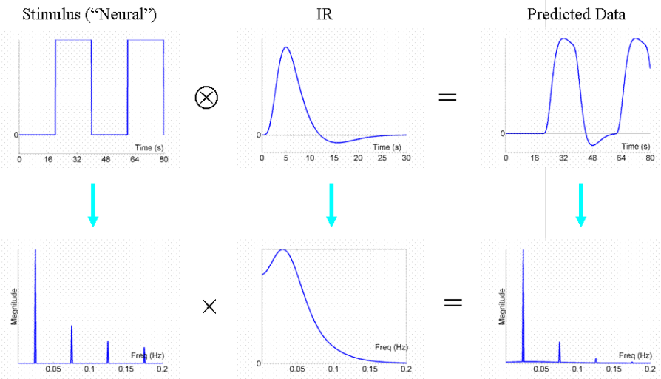
Fourier transform
FT plots magnitude as a function of frequency
The BOLD IR acts as a low pass filter and attenuate higher frequencies.
Block design more efficient because the majority of signal is “passed” by the IR filter

Slide 37
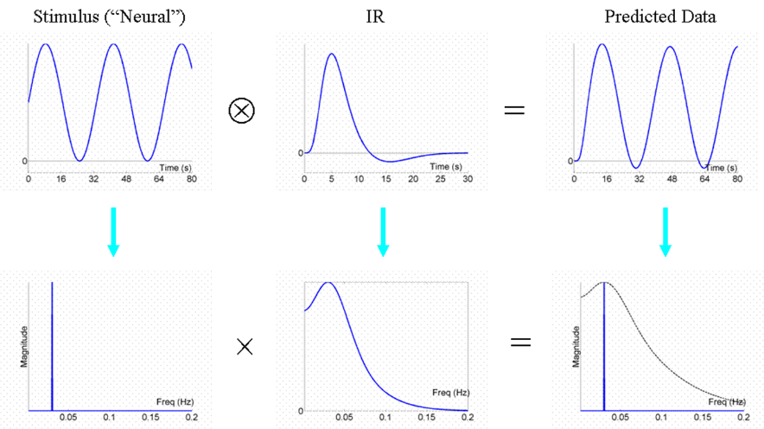
Most efficient design
Majority of signal passed by the IR, not filtered out.
Stimulus frequency should be best aligned with the dominant frequency of the IR (.03 Hz) or 1 waveform in 32 seconds
Issue: Practically, it would not be possible for most designs which have discrete events rather than modulated changes.

Slide 38
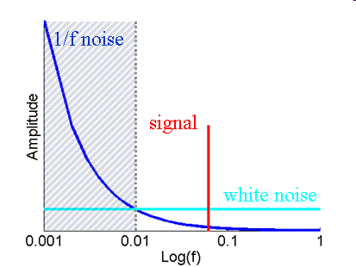
Problem: low frequency noise
Two main components of fMRI noise:
low-frequency "1/f" noise
background "white noise“
Causes: scanner drift, gradual changes in physical parameters
Solution: High-pass filter
Goal: maximise the loss of noise and minimise the loss of signal

Slide 39
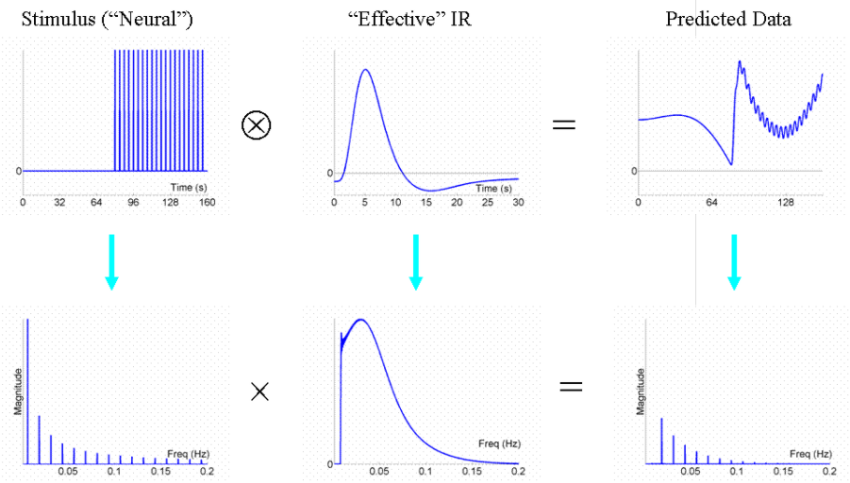
Consequences of high pass-filtering
The high-pass filter would cause issues with design blocks that are too long
Block designs are only efficient when the block length is short
Issue with block design: subject may become aware of blocking and alter strategy/attention
compromise between efficiency and predictability

Slide 40
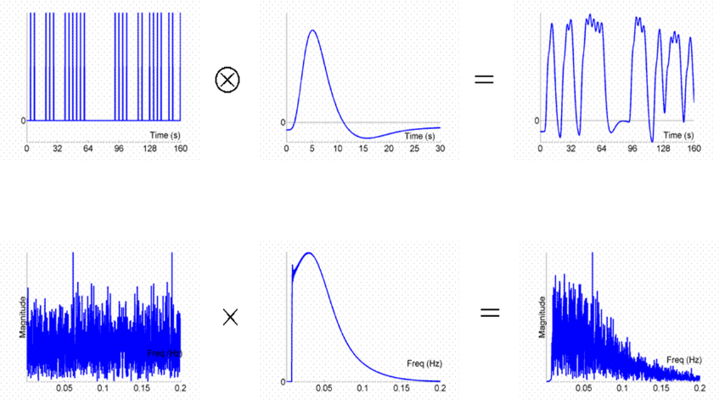
Revisiting the stochastic design
The high-pass and low-pass filter discussed create a single band-pass filter or ‘efficient HRF”
Minimal SOA of 4’s, but only a 50% probability of an event every 4s
randomised SOA "spreads" the signal energy across a range of frequencies
Majority of signal is passed → reasonably efficient design
Best practice for event related designs

Slide 41
Stimulus timing: 2 or more conditions

Slide 42
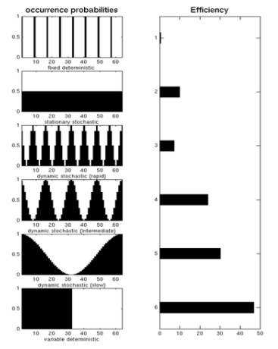
GENERAL LINEAR MODEL
GLM: Y(data) = X(design matrix) . β(parameters) + ϵ(error)
Efficiency(e) is the ability to estimate β (parameters), given the design matrix (X) for a particular contrast (c) and the given noise variance (σ²)
e(σ², c, X) = {σ²c^{T} (X^{T}X)⁻¹ c}⁻¹
The efficiency for each contrast is different
High covariance (correlation) between regressors can reduce efficiency.

Slide 43
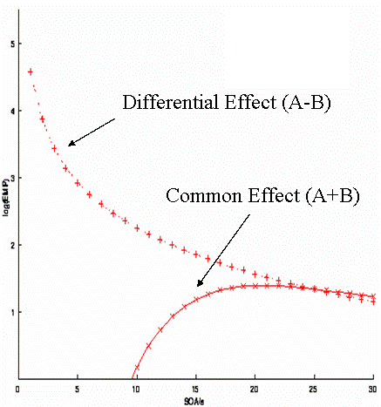
Different efficiency for different contrasts
A fully randomised design with two event-types (A and B, let’s say happy and sad faces).
Long SOAs (16-20s) are optimal for common effect (A+B)
Short SOA’s are optimal for the differential effect (A-B)
Trade off: The optimal SOA depends on the speciﬁc contrast of interest.
What about when you want to be sensitive to both contrasts?

Slide 44
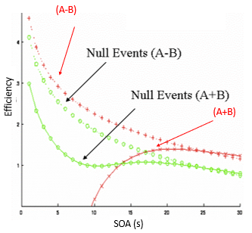
Reducing the trade off: null events
Null events: “fixation trials” allow for selective averaging
Purpose: buy us efficiency for detecting the common effect (A+B) even at short SOAs with a small reduction of efficiency for detecting the differential effect (A-B)
This is equivalent to the stochastic design – randomises SOA between the events of interest

Slide 45
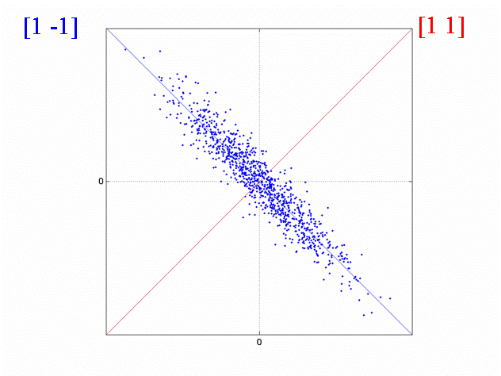
Correlation between regressors
Efficiency can be considered in terms of the correlation between regressors.
Differential effect (A-B) has a high negative correlation
Common effect (A + B) has low variance
Corresponds to different efficiency for different contrast
e(σ², c, X) = {σ²c^{T} (X^{T}X)⁻¹ c}⁻¹

Slide 46
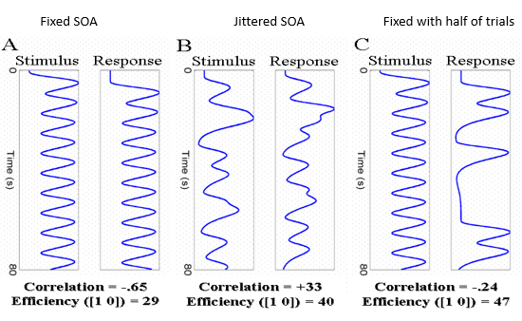
Reducing correlation between regressors
Issue: High correlation between two regressors means that the parameter estimate for each one will be estimated inefficiently
Solution:
C -- Keep stimulus-response interval fixed at 4s, but only cue a response on a random half of trials.
It will reduce correlation between the regressors and increases efficiency

Slide 47
Conclusions:
STUDY DESIGN:
Factorial: Subtraction : Task A – Task B
→can look at multiple factors in an experiment
Parametric: Task increases in difficulty
Conjunction: Looking for similarities in brain activation for multiple different regions.
STIMULUS PRESENTING DESIGN:
Blocked design – sustained stimuli
Event related – event related stimuli
Mixed design – combination of the two.
Consider efficiency before experiment - prioritise study design being appropriate for the research question
Block design (short block length ~20sec) are most efficient
Stochastic designs are also useful in specific contexts - For specific inferences linked to particular events at particular times
Different contrasts have different efficiencies – bridge the gap with null events
Correlation between regressors should be considered and minimised to improve efficiency

Slide 48
References
Rik Henson’s SPM guide: http://imaging.mrc-cbu.cam.ac.uk/imaging/DesignEfficiency
Amaro Jr., E., & Barker, G. J. (2006). Study design in fMRI: Basic principles. Brain and Cognition, 60, 220-232. doi: 10.1016/j.bandc.2005.11.009
Calamante F. et al. (1999) Measuring cerebral blood flow using magnetic resonance techniques. J Cereb Blood Flow Metab 19, 701-35.
Dougherty D., Rauch S., Rosenbaum JF. (2004). Essentials of Neuroimaging for Clinical Practice
Huettel S., Song A., McCarthy G. (2009). Functional Magnetic Resonance Imaging McRobbie D. et al. (2008). MRI From Picture to Proton
Previous MfD slides

Slide 49
References
SPM course slides (2016)
Scott A. Huettel. (2004). Functional Magnetic Resonance Imaging. Chapter 9.
Friston, K. J., Price, C. J., Fletcher, P., Moore, C., Frackowiak, R. S., & Dolan, R. J. (1996). The trouble with cognitive subtraction. NeuroImage, 4(2), 97–104.
Price, C. J., & Friston, K. J. (1997). Cognitive conjunction: a new approach to brain activation experiments. NeuroImage, 5(4 Pt 1), 261–70.
Amaro, E., & Barker, G. J. (2006). Study design in fMRI: Basic principles. In Brain and Cognition (Vol. 60, pp. 220–232).
Seidman, L. J., Breiter, H. C., Goodman, J. M., Goldstein, J. M., Woodruff, P. W., O’Craven, K., et al. (1998). A functional magnetic resonance imaging study of auditory vigilance with low and high information processing demands. Neuropsychology, 12, 505–518.
Petersen, S. E., & Dubis, J. W. (2012). The mixed block/event-related design. NeuroImage.
Donaldson, D. I., Petersen, S. E., Ollinger, J. M., & Buckner, R. L. (2001). Dissociating state and item components of recognition memory using fMRI. NeuroImage, 13(1), 129–142.
https://mediacentral.ucl.ac.uk/Player/2897
https://www.coursera.org/learn/functional-mri-2/lecture/zVWBb/module-7a-advanced-experimental-design-i-fundamentals-of-design-efficiency
http://imaging.mrc-cbu.cam.ac.uk/imaging/DesignEfficiency
Thank you: Dr Sara Bengtsson

