Slide 1
DCM for ERP/ERF: Theory and Practice
UCL/WCHN Methods for Dummies 2020/2021 – Session 16
Presented by: Ulrich Stoof
Expert: Vladimir Litvak

Slide 2
Aims of the Presentation
1. Provide an overview on the theory behind DCM for ERP / ERF
- Conceptually, including foundations on mesoscopic modelling
- Formally, including model definitions and details
… to help building a fundament for further review and research.
2. Give an introduction to the modelling practice with DCM for ERP / ERF
- General considerations, relating to DCM specification and application
- Use of SPM, relating to the implementation of DCM using the open-source tool
… to help developing and applying models in own projects.
And to be a small reference to helpful resources for further exploration.

Slide 3
Overview
Introduction: Modelling Aim, DCM Approach and DCM Versions
Foundations: Modelling Scales and Neural Mass Models (NMM)
Dynamic Causal Modelling (DCM) for Event-Related Potentials (ERP) and Fields (ERF)
Modelling Practice and an Example: Mismatch Negativity (MMN)

Slide 4
Introduction

Slide 5
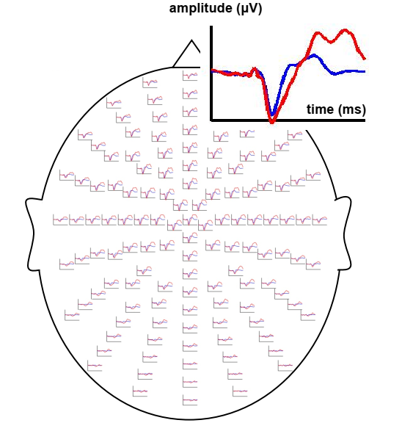
Modelling Aim and Approach
Modelling Aim
Explain all data with few parameters
How to …
Assume data are caused by few interacting brain sources
*M/EEG are complex data
Analyses / modelling: in time, frequency, time-frequency and space domains
Adapted from Kiebel (n.a.), Dynamic Causal Modelling for EEG and MEG, Presentation at TU Dresden

Slide 6
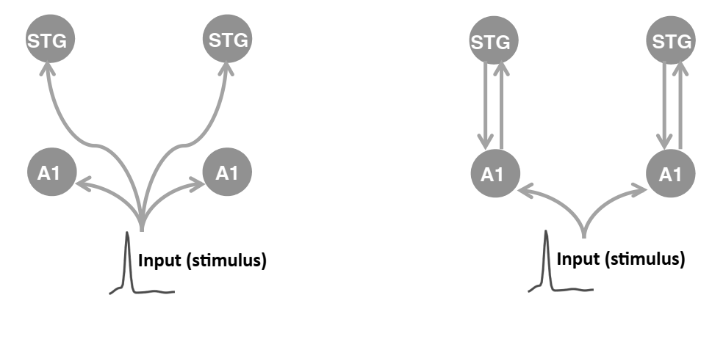
“Conventional” vs. DCM of ERPs (time domain)
Note: Popular DCM models in research concerning steady state responses (frequency domain) are not covered
“Conventional” Analysis
DCM Analysis
Which regions are involved in a task?
How do regions communicate? What role do intrinsic connections have?
Sensor space / functional connectivity
Source space / effective connectivity
Adapted from Kiebel (n.a.), Dynamic Causal Modelling for EEG and MEG, Presentation at TU Dresden
A1 - left and right primary auditory cortex
STG - left and right superior temporal gyrus

Slide 7
Foundations

Slide 8
DCM versions for EEG and MEG Data / Analyses
DCM for M/EEG are more biologically detailed (e.g. realistic parameters for neural masses) than DCM for fMRI
Variety of models (for evoked and induced responses, and steady states), can be grouped into physiological (convolution and conductance) and phenomenological models
The original (convolution-based) DCM for ERP/F (David et al., 2006) is based on Jansen and Rit’s (1995) neural mass model (NMM)
Physiological Models
Phenomenological Models
Convolution-based
Conductance-based
Based on Jansen and Rit (1995) model
Based on Morris and Lecar (1981) model
DCM for induced responses (Chen et al., 2008) is a linear model fitted directly to power time course
Different cortical column models, and approximations of population dynamics (i.e. neural mass and field models) in SPM
Different cortical column models, and approximations of population dynamics (i.e. neural mass and field models) in SPM
DCM for phase coupling (Penny et al., 2009) is based on prior research related to weakly coupled oscillators
Examples for neural models in SPM: ERP, CMC
Examples for neural models in SPM: MFM, NFM, CMM

Slide 9
Foundations
Modelling scales, and the purpose of mesoscopic modelling
Biophysical context of neural mass models / DCM
Neural mass models used in ERP and CMC DCMs
Research leading to the original DCM for ERP / ERF
The Jansen and Rit Model as the basis for convolution-based DCMs
Additional references
Concept
Detailed

Slide 10
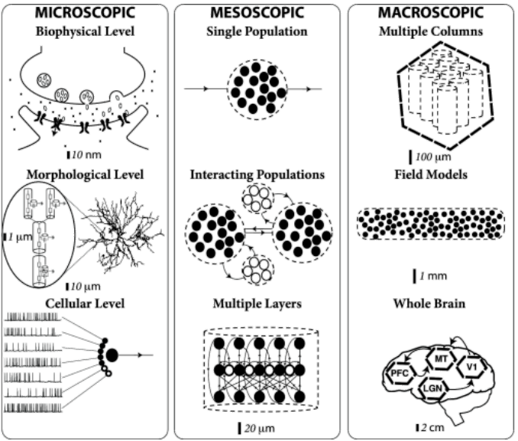
Modelling Scales and Mesoscopic Modelling
Mesoscopic modelling¹
Conceptualise the meso-scope(s) as intervening levels
Influenced by underlying microscopic processes
Show also new, emergent mesoscopic dynamics
Contribute to measurable signals (e.g. EEG, MEG)
Two approaches to bridge micro- to macroscopic levels: neuron-to-brain, or neuronal ensembles with state variables
DCM for EEG / MEEG as mesoscopic models
Aim to derive best fitting parameter estimates (e.g. coupling) to explain the measured (observed) data (e.g. ERPs in EEG)
Are based on neural mass models (NMM) or neural field models (NFM) which incorporate biologically plausible / experimentally derived lumped parameters
Copied from Gerstner et al. (2014), Neuronal Dynamics,
available online: https://neuronaldynamics.epfl.ch/
¹ See also: Freeman (2000), Mesoscopic Brain Dynamics, and Spiegler (2012), Dynamics of biologically informed neural mass models of the brain

Slide 11
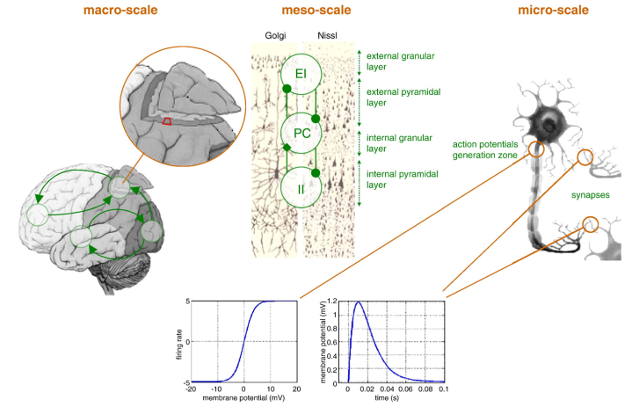
Biophysical Context of Neural Mass Models / DCM
3
Neuronal features at the microscale (right) affect dynamics at the mesoscale (cortical column) (centre), transformation functions:
Linear transformation of pre-synaptic input to post-synaptic potential (PSP)
Non-linear (sigmoidal) transformation of PSP into firing rates / action potentials
Processes at the mesoscale affect dynamics at the macroscale (left), e.g.
Connections (strengths and directions) between cell populations within region
Connections (strengths and directions) between different (cortical) regions
Mesoscopic Neural Mass Models (NMM) aim to capture / generate a broad range of dynamics (e.g. measurable MEG / EEG signals) using averages of relevant biophysical parameters (lumped)
4
2
1
Adapted from Daunizeau et al. (2011), Dynamic causal modelling: A critical review of the biophysical and statistical foundations

Slide 12
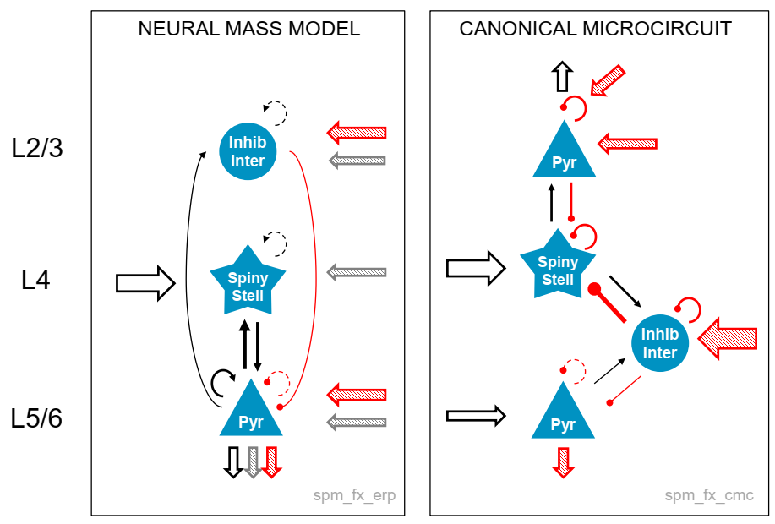
Cortical Column / NMM used in ERP and CMC DCMs
Cortical Column (ERP)
Cortical Column (CMC)
NMM in the ERP DCM
Populations:
stellate cells (SC) (granular layer 4)
pyramidal cells (PC) (extra-gran. layer 2, 3)
inhibitory interneurons (II) (extra-gran. 5, 6)
Connections:
extrinsic forward
extrinsic lateral
extrinsic backward
intrinsic (self) inhibitory
intrinsic (self) excitatory
NMM in the Canonical Microcircuit (CMC) DCM
Populations: includes above populations, pyramidal cells split into two
Motivation: elaborate forward (predominantly from superficial layers (gamma) and backward from deep layers (alpha and beta frequencies) connections, this allows to model observed neuronal frequencies more precisely
Neuronal populations and connections in NMM used in ERP and CMC DCMs
Adapted from Auksztulewicz (2019), DCM for evoked responses, Presentation, SPM for MEEG Course

Slide 13
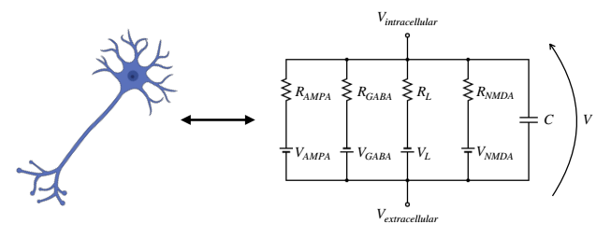
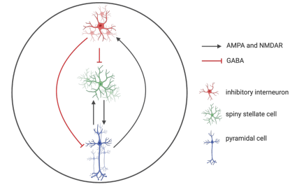
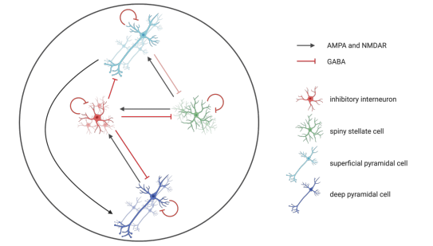
A Short Intro to Conductance-Based Models in DCM
Basics of conductance-based models
Inspired by the Hodgkin and Huxley (1952) single neuron model, which models the states of cells based on the ion-flow in / out of a cell
This approach allows to model receptors (e.g. excitatory AMPA, NMDA, inhibitory GABA) expressed in neurons / populations
Different conductance-based DCMs allow to model with various receptor types (in steady-state or perturbation experiments)
From neurons to populations to sources
As in convolution based models, neurons are grouped into populations, and further into cortical columns
Different cortical column models are defined, e.g. with three / four different populations
Dynamics (statistics) of cortical columns can are captured with neural mass (NMM), mean field (MFM), and neural field models (NFM)
Model of a single cell, and population models used e.g. in DCM MFM and DCM CMM
Copied from Pereira et al. (2021), Conductance-based DCM: A mathematical review of its application to cross-power spectral densities, Preprint: arXiv:2104.02957

Slide 14
Some research leading to DCM for ERP / ERF
1970s First convolution-based population (neural mass) models (NMM), e.g. Lopes da Silva et al. (1974, 1976)
(Lopes da Silva et al. (1976), Model of neuronal populations: The basic mechanism of rhythmicity)
1990s Extensions of convolution-based models to replicate event-related activity, e.g. Jansen et al. (1993, 1995)
(Jansen and Rit (1995), Electroencephalogram and visual evoked potential generation in a mathematical model of coupled cortical columns)
1991 Layout of cortical areas / connections in macaque monkeys (e.g. Felleman and van Essen, 1991)
(Felleman and van Essen (1991), Distributed hierarchical processing in the primate cerebral cortex)
2003 Convolution-based models to replicate the whole M/EEG spectrum (David and Friston, 2003)
(David and Friston (2003), A neural mass model for MEG/EEG: Coupling and neuronal dynamics)
2005 Mechanisms leading to evoked responses (M/EEG) using coupling changes in NMM (David et al., 2005)
(David et al. (2005), Modelling event-related responses in the brain)
2006 DCM for evoked responses (ER) in EEG and MEG (David et al., 2006)
(David et al. (2006), Dynamic causal modelling of evoked responses in EEG and MEG)
Extension of the DCM for ER with lead field parametrisation by Kiebel et al. (2006)
(Kiebel et al. (2006), Dynamic causal modelling of evoked responses in EEG/MEG with lead field parametrisation)
2000s Several extension of DCM for ERP, see references for examples and reviews (e.g. Kiebel et al. (2007, 2008, 2009), Daunizeau et al. (2011), Moran et al. (2013), and Pinotsis et al. (2013))
Foundations
FIL / WCHN Research

Slide 15
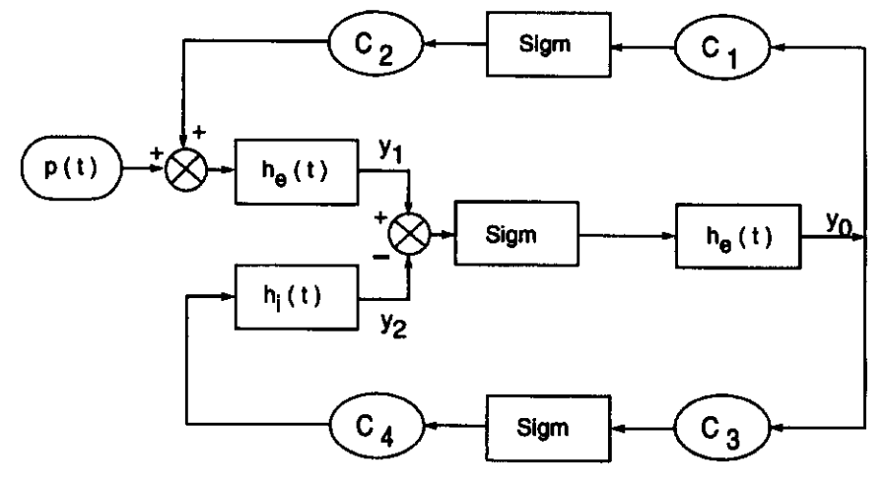
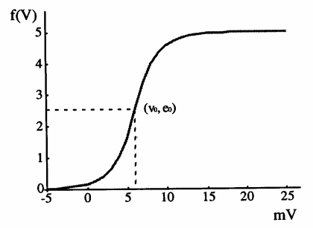
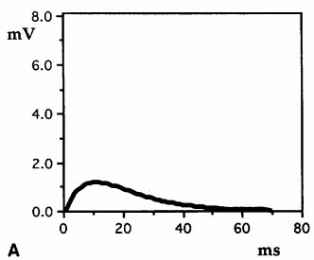
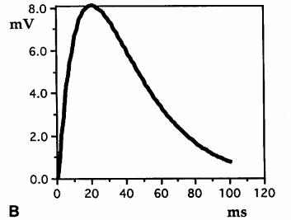
Features of the Jansen and Rit Model (1995)
Aim of their models: to replicated evoked potentials in the visual cortex
Single-column model (1):
Populations: abstract cortical column with three populations (pyramidal cells, excitatory and inhibitory local interneurons)
Connections: pyramidal cells receive local input as well as excitatory input from distant / other cortical columns (p(t))
Transformations: i) linear (h_{e}(t), h_{i}(t)) converting input into PSP, ii) a non-linear (sigmoidal) (Sigm) converting PSP into firing rates
Parameters: e.g. experimentally derived connectivity constants (C1-C4) (number of synapses, lumped into C), maximal amplitudes for IPSP and EPSP (A, B), e₀ maximum firing rate of the population, v₀ the PSP for which 50% firing rate is achieved
Model exploration and behaviour: particularly explored four-dimensional parameter space (A,B,C,v₀), showed that alpha and beta activity can be replicated with different parameter choices
Double-column model (not shown here):
Extension: combined two cortical columns of structure (1)
Additional parameters: K (connectivity constants), a_{d} (delay)
Model exploration and behaviour: i) with identical columns: produced in-phase oscillations; ii) with different columns: produced alpha and beta oscillations
(1) Simplified model of cortical alpha generation
Copied from Jansen and Rit (1995), Figure 1
(2) EPSP (A) and IPSP (B) generating functions, and sigmoid function which converts PSP (voltage) to pulse (right)
Copied from Jansen et al.(1993), Figures 2, 3

Slide 16
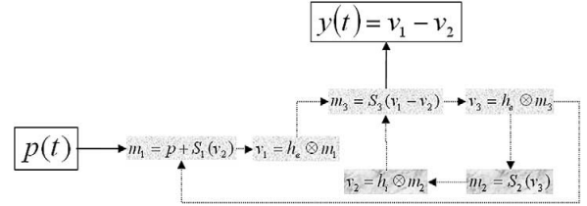
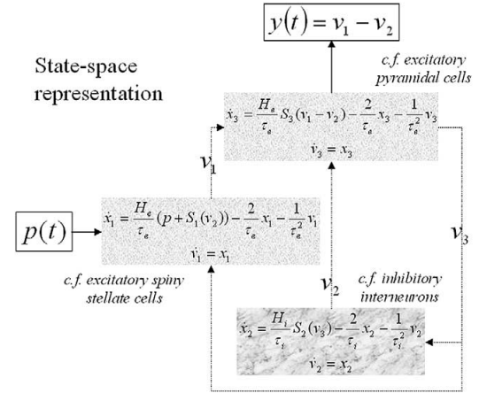
More formal Introduction to the J&R (1995) NMM
Incl. equivalent Kernel and State-space Representations, Model Parameters
“Formalisation” of the Jansen and Rit (1995) neural mass model (NMM):
Transformations (operators):
First, linear operator, converts pre-synaptic input m(t) (includes p(t)) into post-synaptic potential (v(t)) (PSP), modelled as a linear transformation $v=h⊗m$ ($⊗$ convolution operator in time domain, and h(t) is the impulse response or first order kernel) $h\left(t\right)=\left\{\begin{aligned}H\frac{t}{τ}exp\left(−\frac{t}{τ}\right) t≥0 \\ 0 t<0\end{aligned}\right.$ (with excitatory (h_{e}(t)) and inhibitory (h_{i}(t)) kernels)
Second, nonlinear (sigmoidal) operator converts average PSP into average firing rates / action potentials $S_{k}\left(v\right)=\frac{c_{k}^{1}e_{0}}{1+exp⁡(r\left(v_{0}−c_{k}^{2}v\right))}$ (k-th subpopulation, population parameters (see below))
Model parameters: Physiological interpretation and standard values (above)
Equivalent representations of the Jansen and Rit (1995) model (right)
Copied from David and Friston (2003), Table 1 and Figure 1

Slide 17
(Additional) References
Additional key references for neuronal population modelling, specifically related to ERP (and DCM)
David and Friston (2003), A neural mass model for MEG/EEG: Coupling and neuronal dynamics
David et al. (2005), Modelling event-related responses in the brain
Book chapters (in “Statistical Parametric Mapping: The Analysis of Functional Brain Images”, 2007):
Ch. 31, Harrison et al. (2007), Neuronal models of ensemble dynamics,
Ch. 33, David et al. (2007), Neuronal models of EEG and MEG
Additional key references on DCM of ERP / ERF, and the CMC
David et al. (2006), Dynamic causal modelling of evoked responses in EEG and MEG
Kiebel et al. (2006), DCM of evoked responses in EEG/MEG with lead field parametrization
Kiebel et al. (2007), DCM of evoked responses: The role of intrinsic connections
Book chapters (in “Statistical Parametric Mapping: The Analysis of Functional Brain Images”, 2007):
Ch. 42, Friston et al. (2007), Dynamic causal models for EEG (includes an interesting FAQ)
Bastos et al. (2012), Canonical microcircuit for predictive coding
Pinotsis et al. (2013), Dynamic causal modelling of lateral interactions in the visual cortex
Additional references on DCM for EEG / MEG
Review of DCM for evoked responses in M/EEG: Kiebel et al. (2008), DCM for EEG and MEG, in Cognitive Neurodynamics
DCM examples for evoked, induced and steady state responses: Kiebel et al. (2009), DCM for EEG and MEG, in Human Brain Mapping
Biophysical and statistical foundations: Daunizeau et al. (2011), DCM: A critical review of the biophysical and statistical foundations
Comparison of convolution- and conductance-based DCMs: Moran et al. (2013), Neural masses and fields in DCM
Conductance-based DCMs: Pereira et al. (2021), Conductance-based DCM: A mathematical review of its application to CPSD

Slide 18
Dynamic Causal Modelling for ERP / ERF

Slide 19
DCM for ERP / ERF
Aim of DCM for ERP / ERF
The DCM framework
Model components
Neuronal state equations
Bayesian approaches
Additional resources
Concept
Detailed

Slide 20
DCM for ERP / ERF …
are generative models, i.e. they can generate synthetic data by integrating the system (equations) using parameters estimated from real data
allow to explore biophysical and neuronal parameters, and their relationship to the measured M/EEG signals (observations) (i.e., are mesoscopic)
include temporal and spatial aspects (i.e., are spatiotemporal models)
Particularly, they can be used to …
elucidate effective connectivity between brain regions, and
test how perturbations change the (extrinsic, intrinsic) coupling

Slide 21
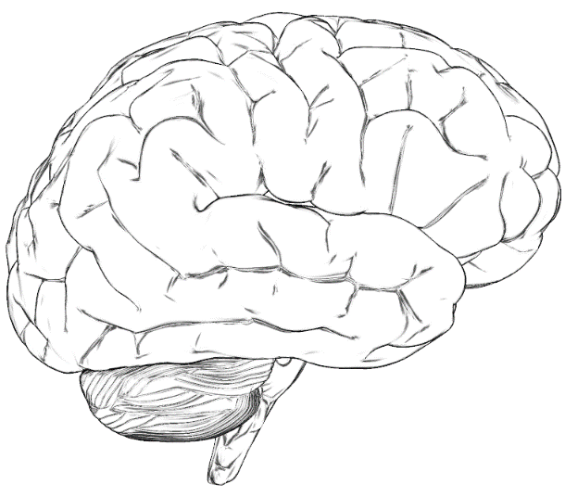
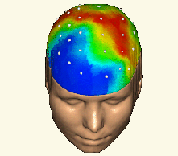
DCM Framework
Forward Problem
Model Specification, Inversion and Comparison / Averaging
Hypotheses are formulated as generative (forward) models, which differ in respect to the connections (i.e., priors over parameters)
Each model is estimated (inverted) using Bayesian model inversion (Variational Bayes), this delivers model evidence and parameter posteriors
Competing models can be compared using Bayes Factor, or their results can be averaged, these procedures are named Bayesian Model Selection (BMS) and Averaging (BMA)
$$p(y|θ,m)$$
Likelihood
Model $m$
Data $y$
$$θ$$
Bayes’ rule
Parameters
$$p\left(θ|y,m\right)=\frac{p\left(y|θ,m\right)p\left(θ,m\right)}{p\left(y|m\right)}$$
Posterior
Evidence
$$p(θ|y,m)$$
$$p(y|m)$$
With priors
$$p(θ|m)$$
Inverse Problem
Adapted from Zeidman (2019), Bayesian Model Selection and Averaging, Presentation, SPM for MEEG Course

Slide 22
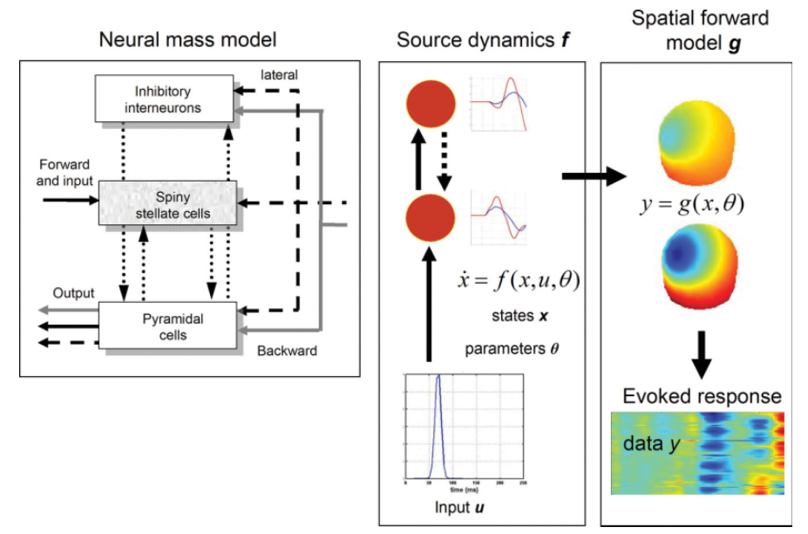
The Generative (Forward) Model in DCM for ERPs
Copied from Kiebel (2009), Dynamic Causal Modelling for EEG and MEG

Slide 23
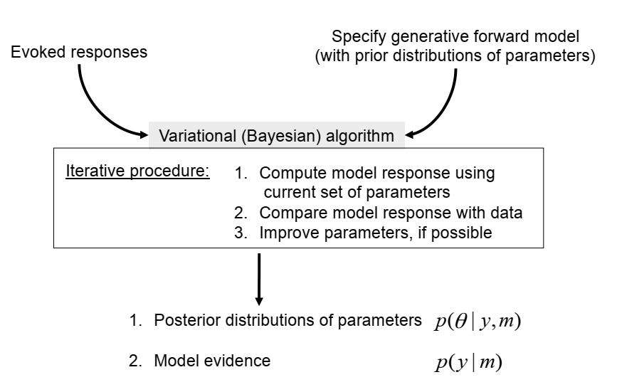
Bayesian Model Inference
Free energy
$F≅\log{p\left(y | m\right)=\text{accuracy}−\text{complexity}}$
Adapted from Kiebel (n.a.), Dynamic Causal Modelling for EEG and MEG, Presentation at TU Dresden

Slide 24
Model Components and Procedures
Component or Steps | Description or Purpose | Elements, Formulae, and Procedures
Hierarchical NMM for M/EEG (e.g. David et al. (2003, 2005)) | Biophysical basis of the model (x – neuronal states, u – exogenous inputs, h or y – response) | State equation ($\dot{x}=f(x,u,θ)$), Observer equation ($h=g(x,θ)$), Operators (p(t) and S(x)), Parameters (e.g. coupling and internal)
Event-related input and response (see also Kiebel et al. (2007)) | Experimental (stimulus)-specific effects are modelled by coupling gains, and intrinsic modulation | $A_{ijk}^{F}=A_{ij}^{F}B_{ijk}^{}$, $A_{ijk}^{B}=A_{ij}^{B}B_{ijk}^{}$, $A_{ijk}^{L}=A_{ij}^{L}B_{ijk}^{}$ (A_{ij} encodes connection strength to ith from jth source (forward, backward, lateral); B_{ijk} encodes its gain for the kth ERP) $H_{ek}^{(i)}=H_{e}^{(i)}B_{ijk}^{}$ (intrinsic change through gain of amplitude H_{e})
Spatial forward model (e.g. Kiebel et al. (2006, 2008)) | Relationship between observed scalp data (h) and ith source data (x₀ ^{(i)}) (assumed to be linear and instantaneous) | $h=g\left(x,θ\right)=L(θ^{L})x_{0}$ (L is lead-field matrix (i.e., spatial forward model) and accounts for the passive conduction of the electromagnetic field)
Dimension reduction | Computational efficiency, retaining max. information | $y ←Ey$, $L ←EL$, $e ←Ee$ (projection of data on subspace def. by principal Eigenvectors E)
Observation and likelihood model (see also Kiebel et al. (2008)) | Generate predicted measurement (i.e. generalized convolution of inputs), delivers an observation model and associated likelihood; model is fitted by tuning free parameters $\left(θ\right)$ to minimize discrepancy between predicted and observed model under complexity constraints (minimize Variational Free Energy) | $y=vec\left(h(θ\right)+Xθ^{X})+ε$, $p(y|θ,λ)=N\left(vec\left(h(θ\right)+Xθ^{X}),diag(λ)⊗V\right)$ (error noise ($ε$) assumed to be zero-mean Gaussian and independent over channels (thus, $\left(Cov(vec\left(e\right)=diag(λ)⊗V\right)$), $λ$ is a unknown vector of channel-specific variances, low frequency noise of drift components X) For model fitting: parameters are constrained by priors (prior density $\left(p(θ\right))$, which is used together with the likelihood $\left(p(y|θ\right))$ to estimate the posterior density $\left(p(θ|y\right))$
Prior expectations (see also David et al. (2006)) | Connectivity is constant over peri-stimulus, have a substantial impact on the fitting results / functions | Priors (prior distributions) are assumed to be Gaussian and are therefore defined by their mean and variance (see coming Table)
Inference and model comparison (see also Friston et al. (2003)) | Parameter estimation corresponds to approximating the moments of the posterior distribution (Bayes’ rule) | $p\left(θ|y,m\right)=\frac{p\left(y|θ,m\right)p\left(θ,m\right)}{p\left(y|m\right)}$, see also following pages on the procedure / algorithm and model comparison with evidence

Slide 25
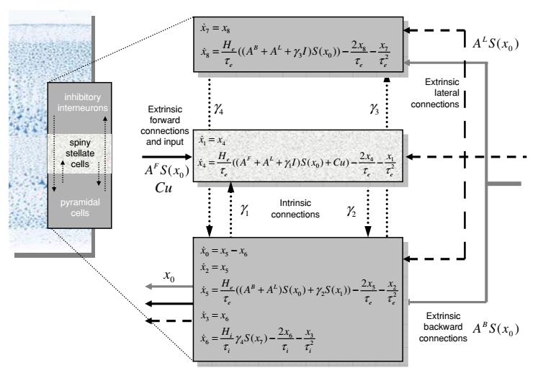
Neuronal State Equations
Notes on NMM components (recap):
Neural mass model (e.g. David et al., 2003, 2005)
Three interacting populations in a cortical column
Transformation functions (H, S)
External connections and strength (A)
Internal connections and strength (γ)
Other parameters (e.g. time constants (τ))
Multiple regions (models) can be combined
Neuronal state equations (an example)
Copied from Kiebel et al. (2008), Figure 1

Slide 26
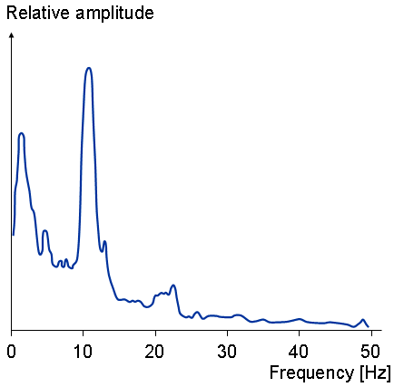
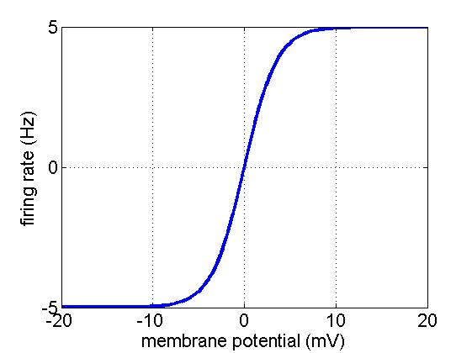
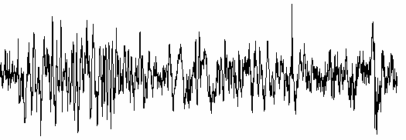
State Equations – Time to Spectral Domain
Analytic Transfer Function in the Frequency domain
Time Differential Equations
Linearise
$$Y=g(θg,v6)$$
$$Y=g(θg,v6)$$
$$H(s)=g\left(sI−A\right)B$$
$$\dot{v}=f(θf,u)$$
$$\dot{v}=A\left(θf\right)+Bu$$
Adapted from Moran (2018), DCM for Steady State Responses / Cross Spectral Densities, Presentation, SPM for MEEG Course

Slide 27
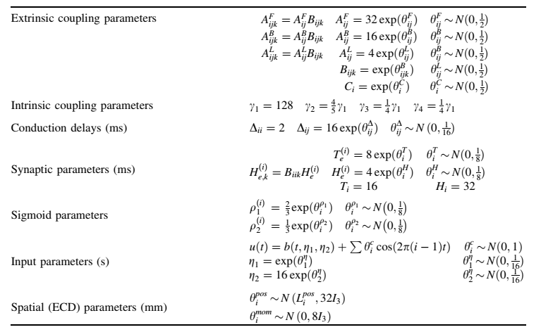
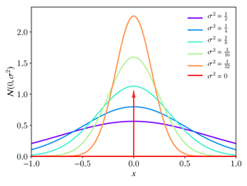
Prior Densities for Parameters
Notes on parameter priors:
Are assumed to have normal distributions with different levels of certainty (precise prior knowledge) (i.e., small variance means high certainty)
Reflect “expectations” / aims, and are (mostly) biophysically grounded, e.g. forward connections (A^{F}) exert stronger effects than backward and lateral
Constrain model inversion / fitting, have substantial impact on parameters / objective function
See also Kiebel et al. (2006, 2008), as well as Jansen and Rit (1995) for reasoning / background
Prior densities of parameters (an example)
Copied from Kiebel et al. (2008), Table 1

Slide 28
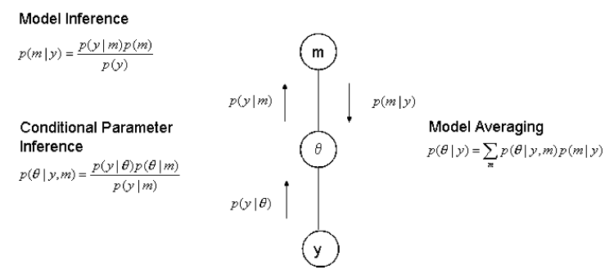
Bayesian Model Inversion, Selection and Averaging
Various Bayesian procedures are implemented for DCMs, these included algorithms for model inference (BMI, Variational Bayes), model selection (BMS) and averaging (BMA) (e.g. Penny et al. (2004, 2007)), Bayesian model reduction (BMR) and Parametric empirical Bayes (e.g. Friston et al. (2016))
Only BMI, BMS and BMA are presented here in more detail
Bayesian Procedure | Aim, Formulae, and Steps
Bayesian model inversion (BMI) (e.g. Friston et al. (2003, 2007)) | Aim: model fitting, i.e. estimating the parameter values which min. the variational free energy (F) by max. the marginal log likelihood ($ln p\left(y|λ,m\right)$) while min. the discrepancy between true (p) and approximate (q) conditional densities ($D_{KL}(q||p(θ|y,λ,m))$; parameter estimation corresponds to approximating the moments of the posterior under Bayes’ rule ($p\left(θ|y,m\right)=\frac{p\left(y|θ,m\right)p\left(θ,m\right)}{p\left(y|m\right)}$) Steps: iterative Variational Bayes (VB) under the Laplace assumption to approximate conditional density ($q(θ)$); comparable to an Expectation Maximisation algorithm (E-step: min F according to approx. conditional densities (q), M-step: min F according to error var. (λ) $F\left(q,λ,m\right)=$ $D_{KL}(q||p\left(θ | y,λ,m\right)−ln p\left(y|λ,m\right)$
Bayesian model selection (BMS) (e.g. Penny et al. (2004, 2007)) | Aim: selection of the model with highest model evidence, using Bayes’ Factors, approximation of model evidence with free energy (F) $B_{ij}=\frac{p(y|m=j)}{p(y|m=i)}$, $ln B_{ij}≈F_{j}−F_{i}$ (which should be > 3, i.e. about 20 times stronger evidence)
Bayesian model averaging (BMA) | Aim: avg. connection strengths over models to investigate parameters, posterior prob. weight. $p\left(θ|y\right)=\sum_{m}{p\left(θ|y,m\right)p\left(m|y\right)}$
Selected Bayesian approaches in DCM (a special case of belief propagation in BMS and BMA) Copied from Penny et al. (2007), Figure 35.2

Slide 29
Essential Resources
SPM Software, homepage, documentation and handbook: https://www.fil.ion.ucl.ac.uk/spm/doc/
SPM Book (available online): https://www.sciencedirect.com/book/9780123725608/statistical-parametric-mapping
Prof. Friston’s website / presentations (e.g. https://www.fil.ion.ucl.ac.uk/~karl/Dynamic%20Causal%20Modelling%20(Nepal).pptx)
SPM for MEG/EEG (online) Workshop (10-13 May 2021)
Overview: https://www.fil.ion.ucl.ac.uk/spm/course/london/ (registration also via Inkpath for UCL PhDs)
Programme: https://www.fil.ion.ucl.ac.uk/spm/course/london/SPM_MEG-EEG_2021.pdf

Slide 30
(Additional) References related to Bayesian Methods
Foundations related to Bayesian approaches used in SPM and DCM
Bayesian model inversion:
Friston et al. (2002), Classical and Bayesian inference in neuroimaging
Friston (2002), Bayesian estimation of dynamical systems: An application to fMRI
Friston et al. (2003), Dynamic causal modelling
Friston et al. (2006), Variational free energy and the Laplace approximation
Bayesian model comparison:
Penny et al. (2004), Comparing dynamic causal models
Penny (2012), Comparing dynamic causal models using AIC, BIC and Free Energy
Book chapters (in “Statistical Parametric Mapping: The Analysis of Functional Brain Images”, 2007):
Ch. 24, Penny et al. (2007), Variational Bayes
Ch. 34, Friston and Penny (2007), Bayesian inversion of dynamic models
Ch. 35, Penny et al. (2007), Bayesian model selection and averaging
Ch. 42, Friston et al. (2007), Dynamic causal modelling for EEG
Ch. 43, Stephan and Penny (2007), Dynamic causal models and Bayesian selection
Bishop (2006), Pattern Recognition and Machine Learning
Additional references related to group studies / model comparison
Bayesian Model Selection (BMS): Rigoux et al. (2014), Bayesian model selection for group studies
Parametric Empirical Bayes (PEB): Friston et al. (2016), Bayesian model reduction and empirical Bayes for group (DCM) studies

Slide 31
Modelling Practice and an Example

Slide 32
Modelling Practice and an Example
Considerations in the context of modelling with DCM
Example – Mismatch Negativity (MMN) with DCM
Background and aims of the MMN studies
Hypotheses and model specifications
How to set up the DCM in the SPM GUI
Model inversion and comparison
Additional resources

Slide 33
General Modelling Considerations
DCM for ERP / ERF allows hypotheses testing in respect to …
… the involvement of brain areas in neural processing (which network?)
… the connections between brain regions (which connectivity and direction?)
... differentiation between extrinsic vs. intrinsic drivers
… the role of contextual factors (modulatory effects)
… exploration of connection / parameter changes
Model specifications / hypotheses should take into account prior research …
… to allow interpretation, and ensure model relevance
… to limit the model space, and ensure high model evidence
Steps: data collection, model definitions, fitting, selection, interpretation

Slide 34
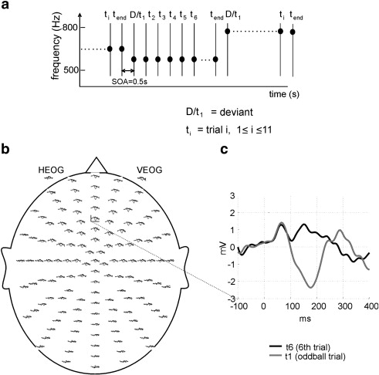
Modelling Mismatch Negativity with DCM
1. Background and Aims of the Studies (e.g. Garrido et al. (2007, 2008))
Background on the MMN and roving paradigms
The MMN paradigm is a deviant neuronal response (ERP) following an unexpected change of an auditory stimulus
The roving paradigm is a more stringent experimental setup which standardises the auditory stimulus, i.e. standard and deviant tone have same characteristics
Aim of the MMN studies
Garrido et al. (2007, 2008) investigated in subsequent studies i) the involvement of different brain regions, ii) the connections of these regions, iii) the role of intrinsic connections, iv) the role of learning vs. stimulus change
Results
Showed, that the processing is a) hierarchical, b) due to extrinsic and intrinsic coupling changes, c) due to learning and not due to stimulus changes
This can be explained by predictive coding, which “embeds” both intrinsic and extrinsic plasticity (i.e., adaptation and model adjustment hypotheses)
Design and responses elicited in a roving paradigm
Adapted from Garrido et al. (2008), Figure 1

Slide 35
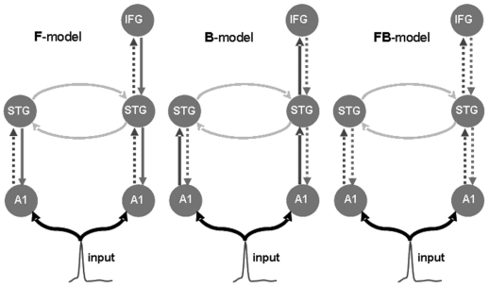
Modelling Mismatch Negativity with DCM
2. Hypotheses and Model Specifications (e.g. Garrido et al. (2007, 2008))
Hypotheses / specifications
Several sets of models were specified to i) simulate the ERP (forward model) ii) test modulatory effects (F,B,FB models)
A subsequent study (2008) tested additional models to investigate involved regions and connections involved further, and which changes best explain the deviant EEG signal
Results
The negative log free energy is smallest for the FB-model which is a hierarchical model in which both forward and backward connections change
Further testing (2008) showed, that a model in which both extrinsic and intrinsic connections can change best explains the observed data
A1 - left and right primary auditory cortex
STG - left and right superior temporal gyrus
IFG - right inferior frontal gyrus
Model specification in a MMN paradigm
Copied from Garrido et al. (2007), Figure 1

Slide 36
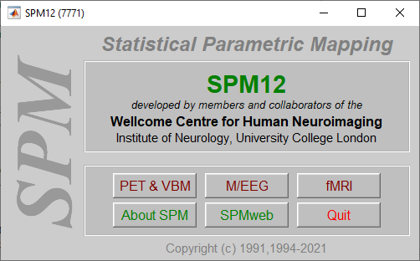
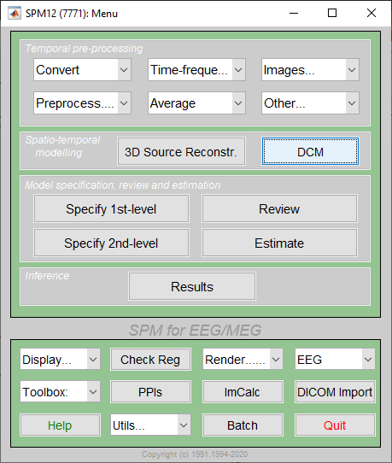
Modelling Mismatch Negativity with DCM
3.a How to setup the DCM in the SPM GUI – SPM12 for M/EEG, DCM

Slide 37
Modelling Mismatch Negativity with DCM
3.b How to setup the DCM in the SPM GUI – SPM for EEG
Type of data / observation model:
ERP (for evoked responses)
Type of neuronal model:
Convolution based: e.g. ERP (David et al., 2006), CMC (Pinotsis et al., 2013)
Conductance based: e.g. NMM (Marreiros et al., 2009)
Specification of the Data and Design

Slide 38
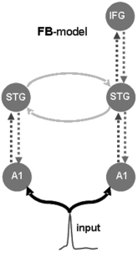
Modelling Mismatch Negativity with DCM
3.c How to setup the DCM in the SPM GUI – Electromagnetic and Neuronal Model
Specification of the electromagnetic model
Name and MNI coordinates of the sources
Specification of the neuronal model
Connections, input, and modulation
 | lA1 | rA1 | lSTG | rSTG | rIFG
lA1
rA1
lSTG
rSTG
rIFG
Connections
Modulations (dotted lines)

Slide 39
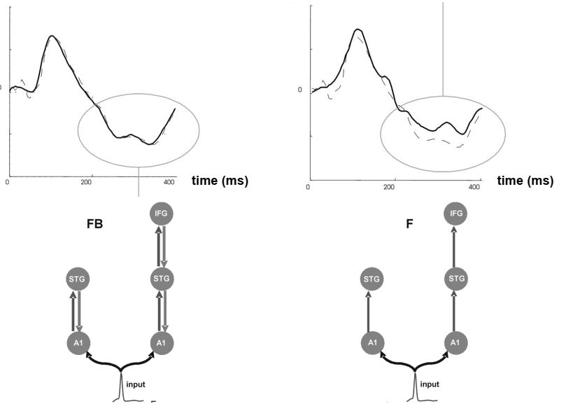
Modelling Mismatch Negativity with DCM
4.a Results and Interpretation – Model Simulations / Fitting in Time-Domain
Simulation results / fit for FB and F models
Copied from Garrido et al. (2007)
Notes:
Comparison of predicted and observed responses
Significant agreement between predicted and observed responses for the FB model

Slide 40
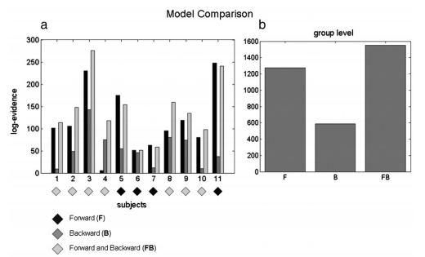
Modelling Mismatch Negativity with DCM
4.b Results and Interpretation – Model Evidence at Individual and Group Level
Bayesian model selection (BMS)
Copied from Garrido et al. (2007), Figure 3
Notes:
Model evidence
Models are compared based on their log model evidence
All models better than null model
FB model performed better in seven out of eleven subjects
Group Level
Log evidence for each of the three models is summed over all subjects
FB model has the
Interpretation
Generation of MMN can be explained by coupling changes (FB) between brain regions
F- and FB-Models have higher model evidences across subjects, suggesting the importance of forward connections, but also indicating multiple solutions
More broadly, under predictive coding, forward connections might encode prediction errors (between predicted and observed input) and backward connections might provide conceptual guidance

Slide 41
Appendix (Preparational Steps, not DCM specific)
Preparational Steps for the MMN Tutorial (Ch. 40, SPM 12 Manual)
Task | Steps in the SPM GUI
Pre-processing | 1) simple conversion and reviewing (CONVERT > CONVERT) - “just read”, prepare SPM file (spmeeg_subject1.mat) 2) preparing batch inputs (CONVERT > PREPARE) a) batch inputs > channel selection (channelselection.mat) b) channel types > EOG, batch inputs > montage > re-reference (conversion to avg. reference) (avref.mat) batch inputs > montage > custom montage (replace EXG1 > HEOG, EXG2 > VEOG, delect EXG3) (avref_eog.mat) c) batch inputs > trial definition (trialdef.mat) | 3) preprocessing step by step a) Convert: CONVERT > define settings “yes” (channelselection.mat) > b) Montage: PREPROCESSING > MONTAGE > (avref_eog.mat) > c) Prepare: CONVERT > PREPARE (BATCH) > (sensors.pol) > d) High-pass filter: PREPROCESSING > FILTER > highpass, cutoff 0.1 > e) Downsample: PREPROCESSING > DOWNSAMPLE > 200Hz > f) Low-pass filter: PREPROCESSING > FILTER > lowpass, cutoff 30 > g) Epoch: PREPROCESSING > EPOCH > (trialdef.mat) > h) Artefacts: DISPLAY > M/EEG > EEG > scalp (select “bad” electrode) PREPROCESSING > DETECT ARTEFACTS > Detection (threshold) > i) Averaging: AVERAGE > AVERAGE > robust averaging (weights: yes) >
Sensor Space Analysis | 1) Convert to images - IMAGES > CONVERT TO IMAGES | 2) Statistical inference - SPECIFY 2nd-LEVEL > two sample t-test, e.g. “standard” “Inf” … > - ESTIMATE > (SPM.mat) - RESULTS > (SPM.mat) and define F-Contrast >
Source Reconstruction | 3D SOURCE RECONSTRUCTION > a) Mesh (maefdfMspmeeg_subject1.mat) - comment/label, template (normal) > b) Coregister - use template > | c) Forward model - “EEG BEM“ > (single_subj_T1_EEG_BEM.mat) d) Invert - Reconstruction: Imaging > All conditions: Yes > Model: Standard

Slide 42
Neuronal and Observation Models for M/EEG
Neuronal Model | Description
ERP (evoked-response potential) | 3-population convolution-based NMM.
SEP (sensory evoked potential) | Variant of the ERP model, with different fixed parameter values (see spm_fx_sep.m). As with the ERP model, this is a 3-population convolution-based NMM.
LFP (local field potential) | 3-population convolution-based NMM. This model is conceptually the same as the ERP model, except for the inhibitory within-source connections: the inhibitory population has recurrent self-connections. These were included to allow for modelling of high-frequency oscillations in the beta band (Moran et al. (2007)).
CMC (canonical microcircuit) | 4-population convolution-based NMM.
NMM (neural mass model) | 3-population conductance-based NMM.
MFM (mean field model) | 3-population conductance-based MFM.
CMM (canonical microcircuit model) | 4-population conductance-based NMM.
NMDA | 3-population conductance-based NMM (defining an MFM model is also possible, but not via the GUI). This model includes the NMDA receptor
CMM_NMDA | 4-population conductance-based NMM. This model includes the NMDA receptor.
NFM (neural field model) | 3-population convolution-based NFM. Although possible via the GUI, combining this option along with an ERP or CSD observation model does not make sense and will consequently return an error (see spm_dcm_x_neural.m).
Observation Model | Description
ERP (evoked-response potential) | Observation model for ERPs. Returns predictions in the time domain. Can be used with all of the above neuronal models, except the NFM.
CSD (cross-spectral density) | Observation model for resting-state data. Returns predictions in the frequency domain. Can be used with all of the above neuronal models, except the NFM.
TFM (time-frequency model) | DCM of induced cross-spectra. SPM will automatically choose a CMC neuronal model for you (see spm_dcm_tfm.m and spm_fx_cmc_tfm.m)) .
IND (induced responses) | DCM of induced responses. SPM will automatically choose the associated neuronal model for you (see pm_dcm_ind.m and spm_fx_ind.m). This model is not covered in the publication (Pereira et al. (2021)). For details, refer to Chen et al. (2008)
PHA (phase coupling) | DCM for phase coupling. SPM will automatically choose the associated neuronal model for you (see spm_dcm_phase.m and spm_fx_phase.m). This model is not covered in the publication (Pereira et al. (2021)). For details, refer to Penny et al. (2009)
NFM (neural field model) | Can only be used with the NFM neuronal model.
Adapted from Pereira et al. (2021), Conductance-based DCM: A mathematical review of its application to cross-power spectral densities, Preprint: arXiv:2104.02957

Slide 43
Resources and References
MMN paper, dataset and tutorial:
Garrido et al. (2007), Dynamic causal modelling of evoked responses: A reproducibility study
Garrido et al. (2008), The functional anatomy of the MMN: A DCM study of the roving paradigm
Garrido et al. (2009), The mismatch negativity: A review of underlying mechanisms
Dataset, available via: http://www.fil.ion.ucl.ac.uk/spm/data/eeg_mmn/
SPM Software, homepage, documentation and handbook: https://www.fil.ion.ucl.ac.uk/spm/doc/
Tutorial on the MMN case study in SPM Manual Ch. 40, EEG Mismatch negativity data
Further theoretical and practical training / guidance:
SPM for MEG/EEG (online) Workshop (10-13 May 2021)
Overview: https://www.fil.ion.ucl.ac.uk/spm/course/london/ (registration also via Inkpath for UCL PhDs)
Programme: https://www.fil.ion.ucl.ac.uk/spm/course/london/SPM_MEG-EEG_2021.pdf

Slide 44
Summary and Outlook

Slide 45
Summary
DCM for ERP / ERF are a set of biophysically grounded mesoscopic models intended to elucidate causal mechanisms underlying evoked responses
In DCM competing hypotheses (models) are defined in terms of a) different connections, and / or b) modulations, and / or c) selection of brain regions
They allow to infer the most parsimonious model of effective connectivity between brain regions (sources) and of modulatory effects on these connections
Several Bayesian techniques are used to estimate models (parameter values) as well as to compare models in single- or multiple-subject studies

Slide 46
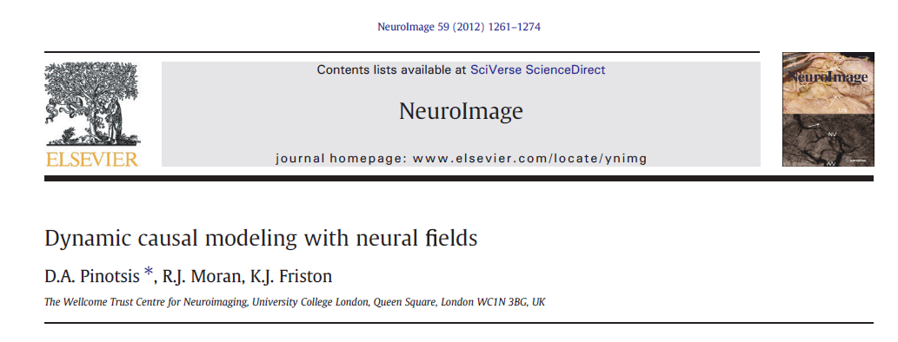
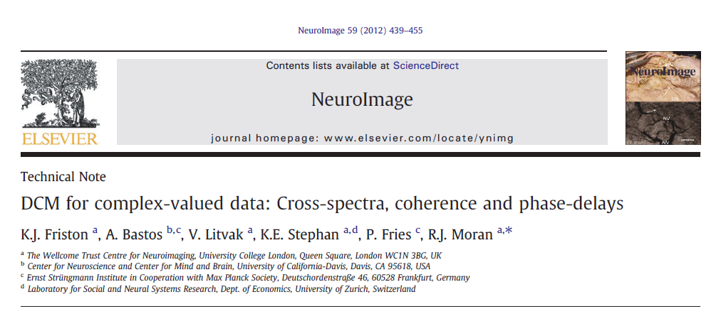
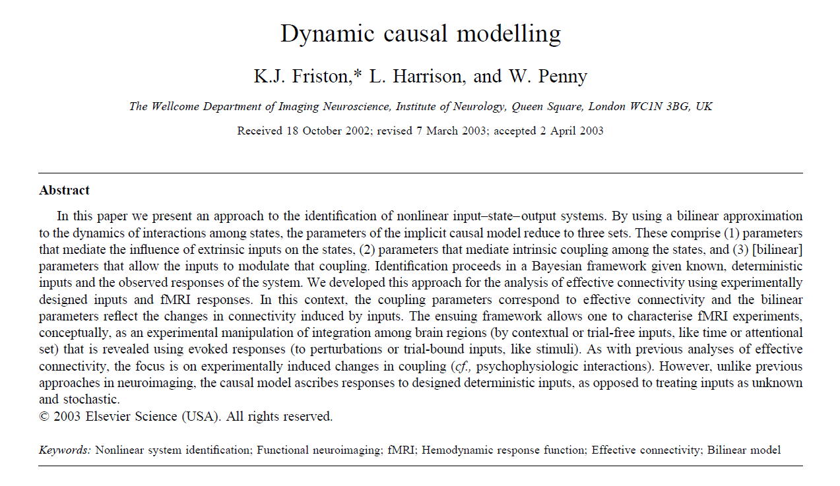
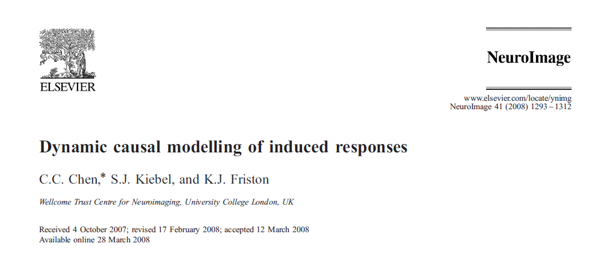
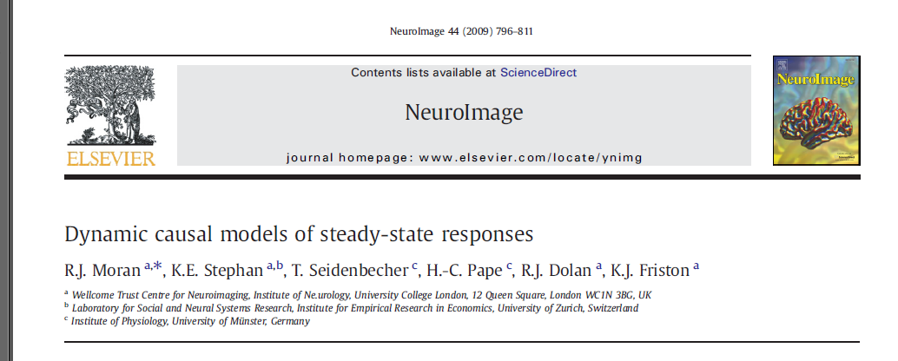
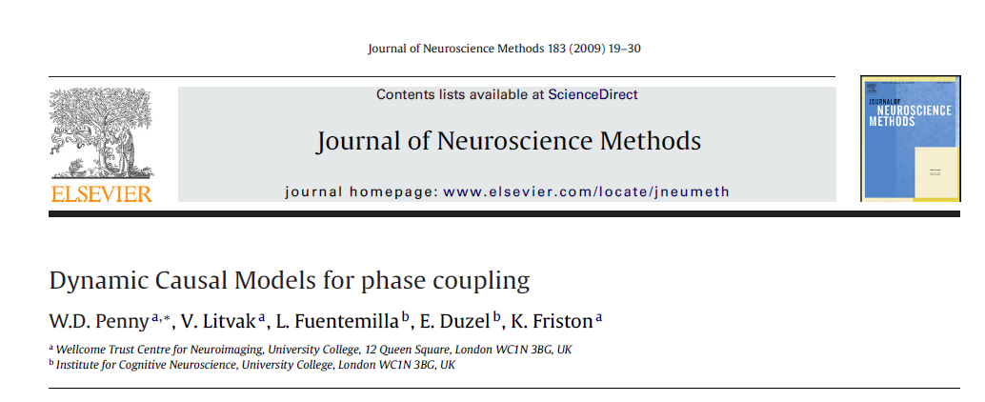
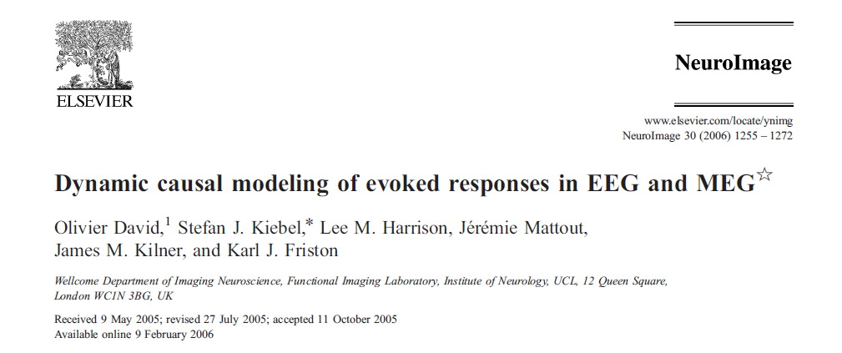
DCM Extensions and Applications (beyond ERP / ERF)
Dynamic causal modelling of synaptopathy
Karl Friston
DCM for M/EEG Extensions
… e.g. induced responses, steady states
DCM Applications
… e.g. to model and predict a wide range of behavioural, neuronal and physiological processes under various conditions, including Neurogenerative Disorders, Schizophrenia, ASD, Epilepsy, Channelopathies, Autoimmune (see many examples + references in the cited presentation)
… use of DCM for M/EEG also as a “mathematical microscope”, e.g. to elucidate mechanisms or neuronal communication at synaptic and neurotransmitter level (e.g. Rosch et al., 2018)
Adapted from Friston (2019), Dynamic Causal Modelling, Presentation, BrainModes 2019, Pokhara

Slide 47
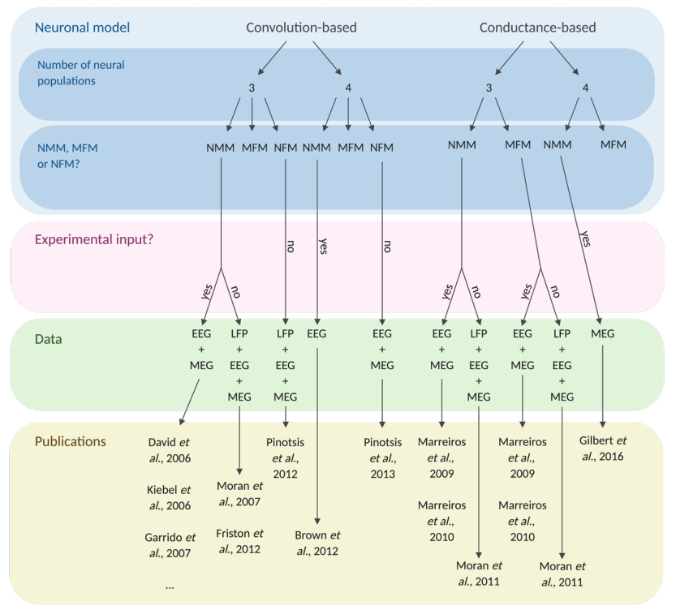
Review on Conductance-Based DCM (April 2021)
Copied from Pereira et al. (2021), Conductance-based DCM: A mathematical review of its application to cross-power spectral densities, Preprint: arXiv:2104.02957

Slide 48
Q & A

