Slide 1
Introduction to Connectivity:
Resting-state and PPI
Alessandra Yu; Joana Oliveira; Marcus Glennon
Expert: Dr Sarah Gregory
Slides adapted from MfD 2019

Slide 2
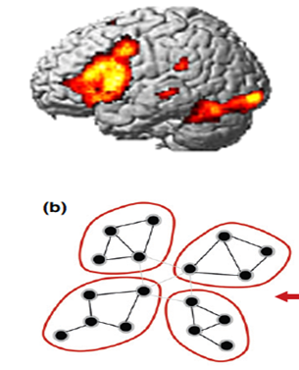
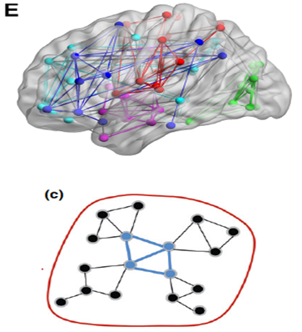

Slide 3
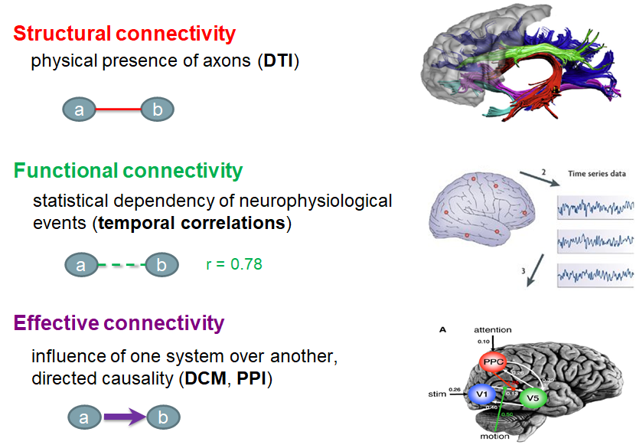
Roerbroek, et al 2011
Notes:
Anatomical connectivity refers to the physical presence of an axonal projection from one brain area to another. → Identification of large axon bundles connecting remote regions in the brain has recently become possible non-invasively in vivo by diffusion weighted Magnetic resonance imaging and fiber tractography.
Functional connectivity refers to the correlation structure (or more generally: any order of statistical dependency) ineffective connectivity modelling moves beyond statistical dependency to measures of directed influence and causality within the networks constrained by further assumptions the data such that brain areas can be grouped into interacting networks.

Slide 4
Functional Connectivity

Slide 5
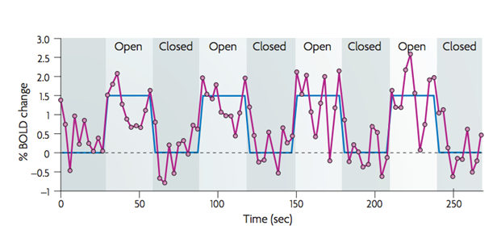
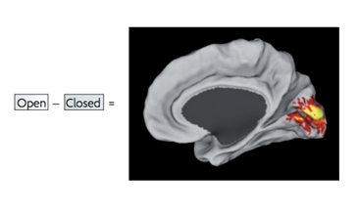
Task-evoked fMRI paradigms
Fox et al, 2005/2007
Notes:
Traditional fMRI analysis involves the analysis of BOLD variations during task-related paradigms. A typical example of this is opening and closing the eyes. The average of stimulation times, across multiple blocks; with posterior subtraction of the “silence” periods, minimizes the “noise” in the BOLD signal and highlight the regions modulated by the paradigm.
Attention-demanding tasks trigger two opposite types of response: increase in activity (frontal and parietal cortical regions) - correlations. Decrease on the activity (posterior cingulate, medial and lateral parietal and medial pre-frontal cortex (anticorrelations).
If the attention demand increases, the response also increases.

Slide 6
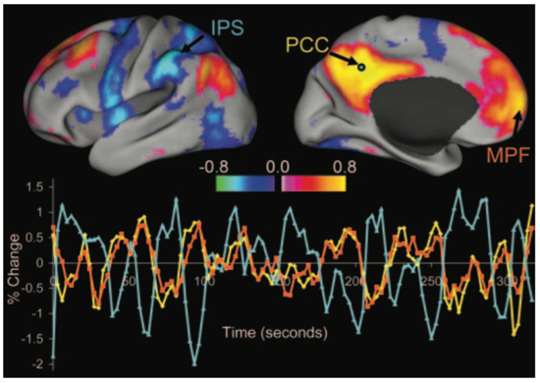
Resting state fMRI
Subject is at rest: fixation on a crosshair; eyes closed; instructed to lie still and refrain from falling asleep.
Fox et al, 2005/2007
Notes:
PCC - posterior cingulate/precuneous → Correlation → MPF - medial pre-frontal cortex
PCC→ anticorrelation → IPS - intra-parietal sulcus
The BOLD changes are less intense during resting state fMRI.

Slide 7
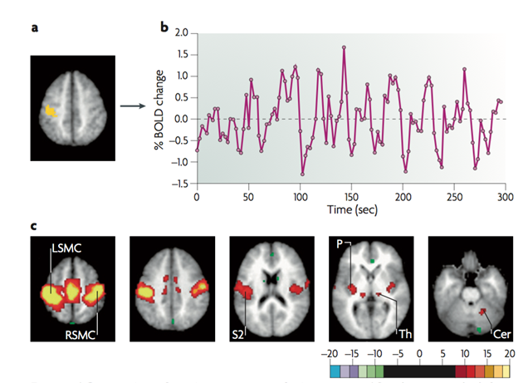
Seed-based analysis
Somatomotor Cortex
Biswal et al. 1995; Fox et al, 2005/2007
Notes:
SEED based analysis, first there is a hypothesis. For example to study further the somatomor cortex, select the are of interest. On a second instance to verify the same type of activation on the remaining brain. Spontaneous BOLD fluctuations measured in the left somatomor cortex are specifically correlated with spontaneous fluctuations in the right somatomor cortex and with medial motor areas in the absence of motor behaviour. (secondary association cortex as posterior nuclei of the thalamus, putamen, cerebellum).

Slide 8
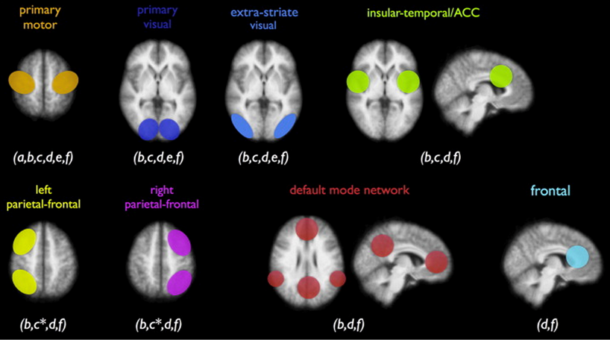
Functional Networks
Smith et al. 2009; Heuvel et al. 2010
Notes:
The default mode network (DMN) is a network of brain regions that are active when an individual is awake and at rest. It is one of the most studied networks present during resting state and is one of the most easily visualized networks.
The key networks, also referred as components, which are more frequently reported include: the DMN, the sensory/motor component, the executive control component, up to three different visual components, two lateralized frontal/parietal components, the auditory component and the temporal/parietal component.As already reported, these resting-state networks consist of anatomically separated, but functionally connected regions displaying a high level of correlated BOLD signal activity. These networks are found to be quite consistent across studies, despite differences in the data acquisition and analysis techniques

Slide 9
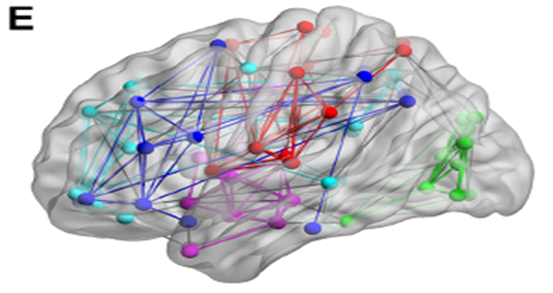
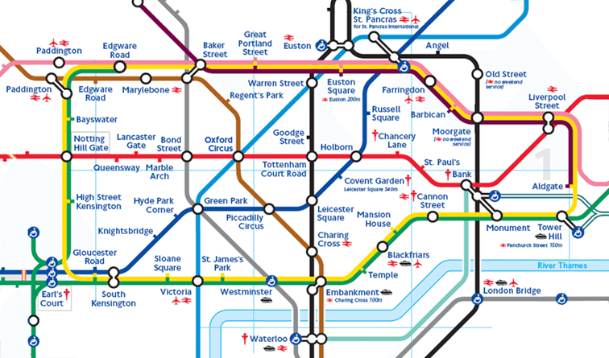
Independent component analysis
Fox et al. 2007; Finn et al. 2015
Notes:
They showed that the functional connectomes are subject specific similar to fingerprints. In other words, considering that you have a database of the connectomes of all subjects, if you acquire a new resting-state fMRI from a subject you can identify that subject from the database with about 90% accuracy.
Spatial topography and coherence. The observation that the somatomotor system is coherent in its spontaneous activity has been replicated many times10–15,21 (FIG. 2). By placing seed regions in additional brain areas, many other neuro-anatomical systems have been shown to be coherent in their spontaneous activity, including visual10,11, auditory10, task-negative/default mode29–32, hippocampus or episodic memory24,33, language10,34, dorsal attention32,35 and ventral attention systems35. Many of these systems have also been identified using hierarchical clustering37,38 and ICA2

Slide 10
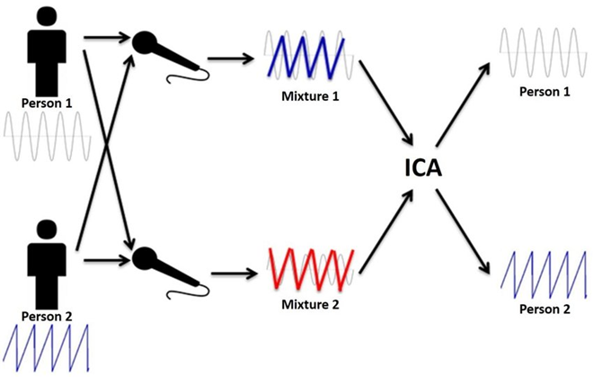
Independent component analysis
Fox et al. 2007
Notes:
This approach does not require a priori definition of seed regions. Instead, sophisticated algorithms analyse the entire BOLD data set and decompose it into components that are maximally independent in a statistical sense. Each component is associated with a spatial map. Some maps reflect noise components whereas others reflect neuro-anatomical systems. Because this technique is data driven and automatically isolates sources of noise, it holds tremendous promise and its use is increasing.

Slide 11
Accounting for noise
removing physiological fluctuations (cardiac or respiratory activity) through linear regression
isolating sources of noise through:
○ eliminating global signal
○ eliminating signals emerging in areas likely to produce physiological artefacts (e.g. ventricles)
○ independent component analysis (ICA)
Fox et al. 2007; Murphy et al. 2013; Kassinopoulos et al. 2019

Slide 12
pros
easy to acquire
ideal for patients who cannot perform certain tasks
one data set allows to study different functional networks in the brain
good for exploratory analyses
(potentially) helpful as a clinical diagnostic tool (e.g. epilepsy, Alzheimer’s disease)
cons
establishes correlations, not causal relationships

Slide 13
Functional connectivity
Effective Connectivity
Temporal correlations between spatially remote areas
Whole brain connectivity
Data Driven (exploratory)
Correlation analysis
MODEL-FREE
No Causation
The influence of one neuronal system over another
Reduced set of regions
Hypothesis Driven (Confirmatory)
Regression analysis
MODEL-DEPENDENT
Causal (based on a model)
Friston et al. 1997/1998/2011

Slide 14
Functional connectivity
Effective Connectivity
Correlation
Regression
Are two datasets related?
•Continuous data
•Assumes constant relationship between two variables
•Observational data
No directionality
Can we predict activity in region A from activity in region B?
•Continuous data
•Tests influence of explanatory variable on dependent variable
•Data from an experimental manipulation
Directional
Friston et al. 1997/1998/2011

Slide 15
Psychophysiological Interaction (PPI)

Slide 16
PPI: Definition and Function
PPI determines the relationship in activity between two distant brain areas in different psychological contexts
Measures effective connectivity: how psychological variables or external manipulations change the coupling between regions
Psychological Regressor
Area A
Area B

Slide 17
PPI: Practical Example
How can brain activity in V5 (motion detection area) be explained by the interaction between attention to visual motion & V1/V2 (primary visual cortex) activity?
ATTENTION
V5
V1/V2
Friston et al., Neuroimage 1997

Slide 18
PPI: Practical Example
Two possible questions:
A. How contribution of one region to another is influenced by the experimental context
B. How an area’s response to an experimental context is modulated by input from another region
Mathematically indistinguishable… BUT one may be more neurobiologically plausible

Slide 19
PPI: Practical Example
● Connectivity between V1 and V5 while subject observes visual movement
● Experimental manipulation: attention vs. no attention
Stimuli:
SM = Radially moving dots
SS = Stationary dots
Task:
TA = Attention
TN = No attention (i.e. passive viewing)

Slide 20
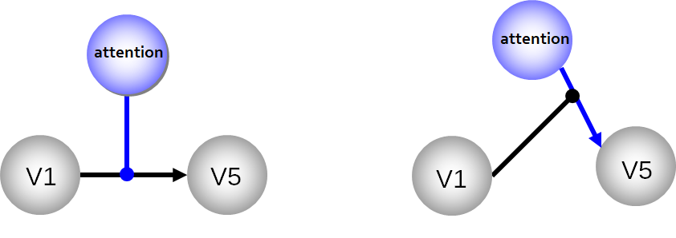
PPI: Practical Example (Experimental Design)
Before analysis can begin, we need:
● Factorial Design: two different types of stimuli (motion/stationary), two different task conditions (attention/no attention)
● Plausible anatomically driven hypothesis: V5 might show an attention-dependent coupling with V1…

Slide 21
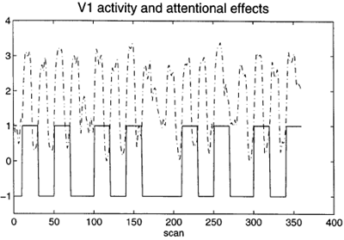
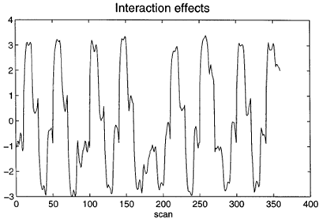
PPI: Practical Example
Remember the GLM Equation?

Slide 22
PPI: Practical Example
The PPI equation is simply an extension of this...

Slide 23
PPI: Practical Example

Slide 24
PPI: Practical Example
Contrast Vector:

Slide 25
PPI: Analysis
on SPM
Standard GLM analysis (preprocessing, first level, and second level analyses)
Extracting BOLD signal from a source region identified in the GLM and for which we want to investigate connectivity
Forming the interaction term
Performing a second GLM including the interaction term, the source region’s extracted term and the experimental vector in the design (PPI-GLM)
Determine significance!

Slide 26
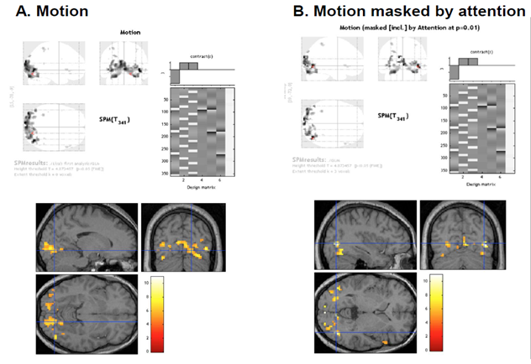
PPI: Analysis on SPM
1. Perform standard GLM Analysis to determine regions of interest and interactions
Notes:
1. Perform standard GLM Analysis to determine regions of interest and interactions
Same preprocessing, first-level, and second-level analyses
Scans for motion; and scans for motion masked by attention, generating your interaction scans for your physiology and psychology conditions.

Slide 27
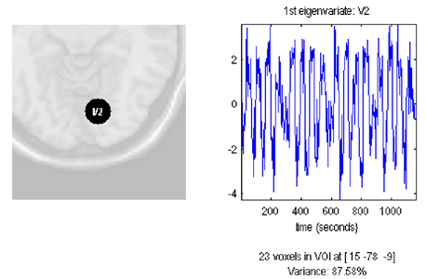
PPI: Analysis on SPM
2. Define source region and extract BOLD SIGNAL time series (e.g. V1)
Use Eigenvariates (there is a button in SPM) to create a summary value of the activation across the region over time.
⁠—> saves the extracted VOI data in the file VOI V1 1.mat in the working directory & displays figure

Slide 28
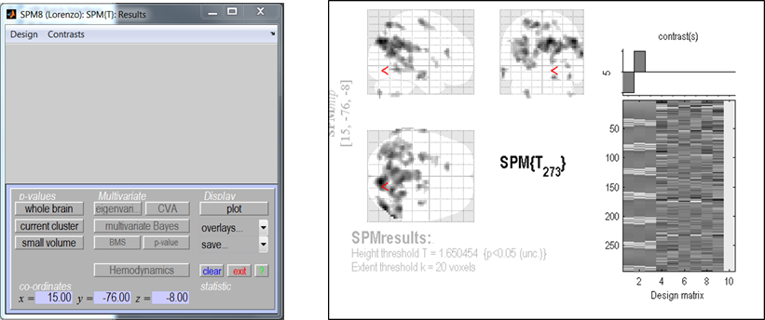
PPI: Analysis on SPM
2. Define source region and extract BOLD SIGNAL time series (e.g. V1)
Use Eigenvariates (there is a button in SPM) to create a summary value of the activation across the region over time.

Slide 29
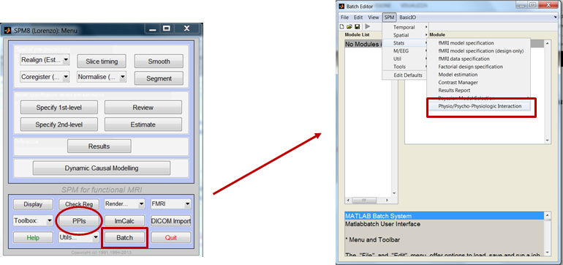
PPI: Analysis on SPM
3. Form the interaction term (to prepare for running second GLM)

Slide 30
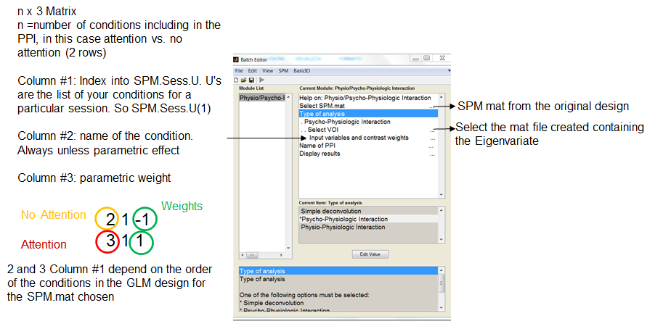
PPI: Analysis on SPM
3. Form the interaction term (source signal x experimental manipulation)
Physiological condition: Activity in V1
Psychological condition: Attention vs. No Attention
Notes:
• Select the parameters of interest from the original GLM
This creates an n x 3 matrix, where n is the number of conditions including the psychophysiological interaction,

Slide 31
PPI: Analysis on SPM
4. Perform the second GLM using the interaction term, the source region’s extracted term and the experimental vector in the design:
Physiological condition: Activity in V1
Psychological condition: Attention vs. No Attention
Deconvolve & Calculate & Convolve
Notes:
• Select the parameters of interest from the original GLM
This creates an n x 3 matrix, where n is the number of conditions including the psychophysiological interaction,

Slide 32
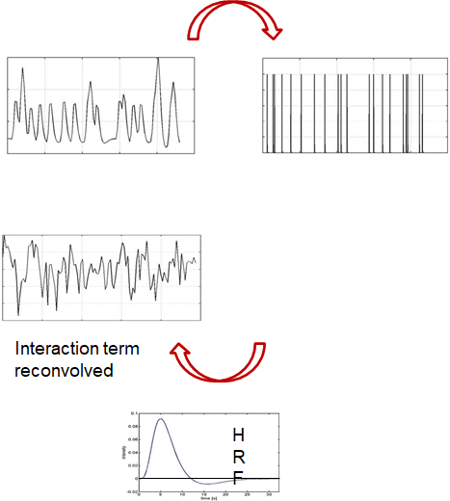
PPI: Analysis on SPM
4.
(a) Deconvolve physiological regressor (V1) à transform BOLD signal
into neuronal activity
(b) Calculate the interaction term V1 (Att-NoAtt)
(c) Convolve the interaction term V1 (Att-NoAtt) with the HRF
Notes:
Deconvolve: Time lag with bold signal: transforming it into a neural signal rather than the BOLD signal--HRF is what you use
Necessary so that you can then do the interaction
Calculate (multiply with psychological variable)
To make it understandable to SPM, you have to reconvolve it.

Slide 33
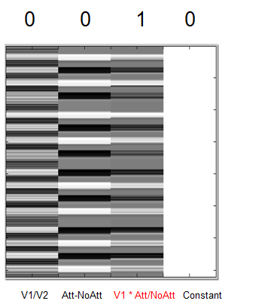
PPI: Analysis on SPM
At this point a file ppiname.mat is created
It contains the:
PPI.Y (original VOI eigenvariate)
PPI.P (Attention vs. no attention vector)
variable PPI.ppi (interaction term)

Slide 34
PPI: Analysis on SPM
5. Create PPI-GLM using the Interaction term – seen before!
Y = V1 β₁ + (Att-NoAtt) β₂ + (Att-NoAtt) * V1 β₃ + β_{i}Xi + e
H₀: β₃ = 0
6. Determine significance!
Based on a change in the regression
slopes between source region and another region during condition 1 (Att) as compared to condition 2 (NoAtt)
Notes:
Column 1: signal in the region
Column 2: attention/no attention contrast
Column 3: the contrast: positive interaction (to put the negative)
Column 4: Constant
Pseudoeffective connectivity: look at 2018 and previous slides: how you interpret your findings: you have to bring your own knowledge about biology into it.

Slide 35
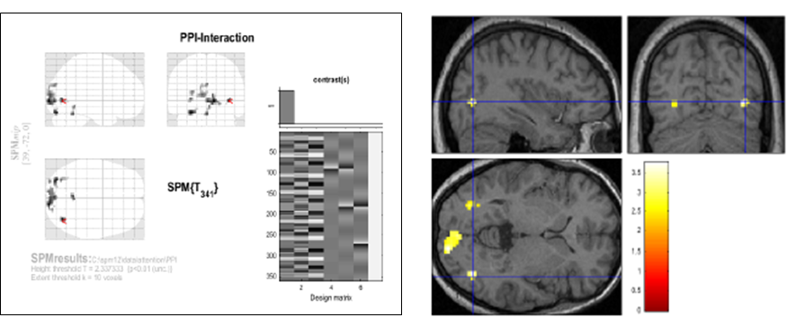
PPI: Analysis on SPM
Mismatch from previous 2 slides. Here this model interaction term is in the 1st column (not 3rd, so specify positive weight for the interaction term to see significant connectivity between original VOI as function of the experimental context
Notes:
Positive weight means where you put the 1 in the contrast vector.

Slide 36
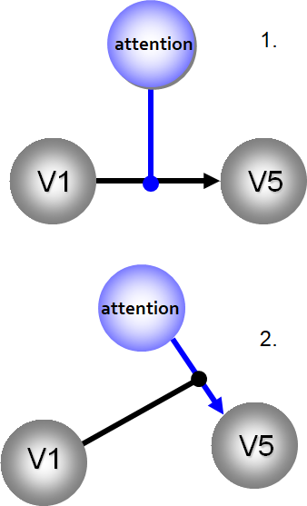
PPI: How should we interpret our results?
Two possible interpretations:
1. The contribution of the source area to the target area response depends on experimental context
e.g. V1 input to V5 is modulated by attention
2. Target area response (e.g. V5) to experimental variable (attention) depends on activity of source area (e.g. V1)
e.g. The effect of attention on V5 is modulated by V1 input
Mathematically, both are equivalent!
But… one may be more neurobiologically plausible.
Notes:
You can really only make conditional causal claims:
You can’t say what’s contributing as a cause.
They both would demonstrate relationships.
You have to import your own knowledge to make an interpretation.

Slide 37
PPI: Pros & Cons
Pros:
Given a single source region, PPIs can test for regions exhibiting context-dependent connectivity across the entire brain
“Simple” to perform
Based on regressions and assume a dependent and independent variables (i.e., they assume causality in the statistical sense: but careful!).
Cons:
Very simplistic model: only allows modelling contributions from a single area
Ignores time-series properties of data (can do PPIs on PET and fMRI data)
Interactions are instantaneous for a given context
Any causal interpretation should be made cautiously & based on an informed hypothesis
Need DCM to elaborate a mechanistic model!
Notes:
Allows for context dependent (especially psychological context)
Easy/simple to perform
Using the GLM, you’re assuming some form of causality or prediction. Not fair
Only looks at region of interest
They don’t have any time parameters
PSEUDO effective connectivity: very dependent on informed hypothesis.

Slide 38
Thank you!
Many thanks to Sarah Gregory!
to previous MfD presenters for slides
&
to all of you for your attention!

Slide 39
References:
Biswal, B., Yetkin, F.Z., Haughton, V.M., & Hyde, J.S. (1995). Functional connectivity in the motor cortex of resting human brain using echo-planar MRI. Magnetic Resonance Medicine, 34(4), 537-41
Fox, M. D., & Raichle, M. E. (2007). Spontaneous fluctuations in brain activity observed with functional magnetic resonance imaging. Nature reviews. Neuroscience, 8(9), 700–11. doi:10.1038/nrn2201
Fox, M. D., Snyder, A. Z., Vincent, J. L., Corbetta, M., Van Essen, D. C., & Raichle, M. E. (2005). The human brain is intrinsically organized into dynamic, anticorrelated functional networks. Proceedings of the National Academy of Sciences of the United States of America, 102(27), 9673–8. doi:10.1073/pnas.0504136102
Finn, E.S., Shen, X., Scheinost, D., Rosenberg, M.D., Huang, J., Chun, M.M., Papademetris, X., Constable, R.T., 2015. Functional connectome fingerprinting: identifying individuals using patterns of brain connectivity. Nat. Neurosci. 18, 1664–1671. https://doi.org/10.1038/nn.4135
Kassinopoulos, M., Mitsis, G.D., 2019. Identification of physiological response functions to correct for fluctuations in resting-state fMRI related to heart rate and respiration. Neuroimage 202, 116150. https://doi.org/10.1016/j.neuroimage.2019.116150
Murphy, K., Birn, R.M., Bandettini, P.A., 2013. Resting-state fMRI confounds and cleanup. Neuroimage 80, 349–359. https://doi.org/10.1016/j.neuroimage.2013.04.001
Smith, S.M., Fox, P.T., Miller, K.L., Glahn, D.C., Fox, P.M., Mackay, C.E., Filippini, N., Watkins, K.E., Toro, R., Laird, A.R., Beckmann, C.F., 2009. Correspondence of the brain’s functional architecture during activation and rest. Proc. Natl. Acad. Sci. U. S. A. 106, 13040–5. https://doi.org/10.1073/pnas.0905267106
Smith, S.M., Nichols, T.E., Vidaurre, D., Winkler, A.M., Behrens, T.E.J., Glasser, M.F., Ugurbil, K., Barch, D.M., Van Essen, D.C., Miller, K.L., 2015. A positive-negative mode of population covariation links brain connectivity, demographics and behavior. Nat. Neurosci. 18, 1565–1567. https://doi.org/10.1038/nn.4125
Roerbroek, A., Seth, A., & Valdes-Sosa, P. (2011). Causal Time Series Analysis of functional Magnetic Resonance Imaging Data. JMLR: Workshop and Conference Proceedings 12 (2011) 65–94 .
Friston KJ, Buechel C, Fink GR et al. Psychophysiological and Modulatory Interactions in Neuroimaging. Neuroimage (1997) 6, 218-229.
Dolan RJ, Fink GR, Rolls E, et al., How the brain learns to see objects and faces in an impoverished context, Nature (1997) 389, 596-9.
Several slides were adapted from last year’s presentation

