Slide 1
Meta-analysis of imaging studies
Jasmine Siew and Rohan Bhome
Expert: Thomas Nichols

Slide 2
Overview
Why?
Important steps
Meta-analysis techniques
Limitations/pitfalls

Slide 3
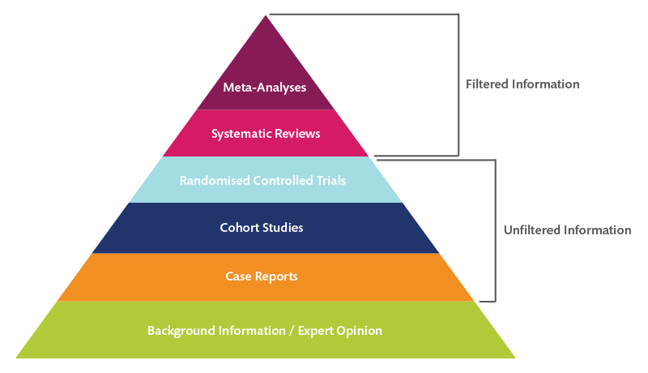
Hierarchy of evidence
Notes:
Thus, because of the rigorous scientific approach, meta-analyses are considered the “highest level of evidence”.

Slide 4
Background
Single imaging studies underpowered
analyses and thresholding procedures that increase false positives
Influenced by experimental procedures
So meta-analyses needed but:
No clear consensus on neuroimaging meta-analysis
Need for guidelines- informed and traceable decisions for researchers
Replication

Slide 5
1. Research Question
What is the research question?
What approach to investigating it?
Eg fMRI studies- do you include several tasks purporting to measure particular brain function or only one task to increase uniformity
Decisions need to be made a priori
Pre-register

Slide 6
Research question informs inclusion/exclusion criteria
Inclusion
Modalities of studies/ paradigms
Subject groups- eg healthy controls only, studies with control groups, specific age range etc
Analysis techniques- main effects vs interactions; papers reporting results on a particular threshold

Slide 7
Group Effects
Between group effects:
Experimental vs meta-analytical level
Compare groups across all studies (eg Alzheimer’s disease vs controls)
or
Separate meta-analyses for one group (Alzheimer’s disease) vs other group (controls)

Slide 8
2. Power of the meta-analysis
Presumption that enough studies have asked the research question for it to be worth doing a meta-analysis
Small number of studies- one or two studies’ results may skew overall findings- limited generalisabilty
Where large effect size expected- more acceptable to have fewer studies
Trade off between number of studies and introducing heterogeneity
Simulation study suggested atleast 17-20 experiments for smaller effect sizes

Slide 9
3. Data collection and extraction
Literature search
Combination of search terms: “Disease”; “Imaging modality”; “experiments” (if fMRI for eg)
Reference lists of relevant articles
Grey literature
Search engines, search terms, date boundaries
Data extraction – sample size, x,y,z co-ordinates in standard space (i.e. MNI or TAL), whole-brain analysis, both increases and decreases in activation are reported (for SDM)
Two investigators

Slide 10
4a. Included studies cover same search coverage
CBMA
Prerequisite. Usually whole brain.
Generally avoid experiments with ROI or SVC analyses
But this is a limitation as many studies with relevant findings may be ineligible. Could acknowledge in intro/discussion
ROI Meta-analysis
meta-analysis focusses on ROI in which case null-space has to be adapted to the ROI, i.e. testing against random spatial association across the ROI only
All included experiments need to have used the same mask for ROI

Slide 11
4a. Included studies cover same search coverage (continued)
Sometimes unclear if whole brain covered
However, use scanner parameters to decide if whole brain covered or not
Sometimes whole brain minus a few slices
These experiments might be considered for inclusion, but should be reported as experiments with “almost complete brain coverage”

Slide 12
4b. Identify and adjust for differences in reference space
Imaging data is normalized into a standard space in order to be able to investigate effects across subjects
Talairach and Tournoux (TAL) and Montreal Neuroscience Institute(MNI)
Different co-ordinates
Identify from methods section of studies (sometimes unclear)
Transform into same space

Slide 13
5. Adjust for multiple contrasts
Multiple experiments for one set of subjects in a study
Two ways:
Adjust for within group differences- pool co-ordinates from all relevant contrasts and average contrast maps of sample and adjusting variance
Combining contrast maps of sample using weighted mean depending on contribution of each contrast to each voxel
Notes:
One approach would be to adjust for within-group effects by, e.g. pooling the coordinates from all relevant contrasts (in this case No-Go > Go and NoGo > Rest) into one experiment (Turkeltaub et al., 2012), averaging the contrast maps of a sample and adjusting the variance (Rubia et al., 2014; Alegria et al., 2016), or combining the contrast maps of a sample using a weighted mean depending on the amount of information of each contrast in each voxel (Alustiza et al., 2016).

Slide 14
6. Find a balance between sensitivity and susceptibility to false positives
controlling for the family-wise error (FWE) or the false discovery rate(FDR)
on the voxel- or cluster-level
ALE- cluster level FWE correction
See later under meta-analysis techniques
Notes:
a meta-analysis that aims to maximize sensitivity might show unthresholded whole brain maps if the fact that false positives are not controlled for is clearly indicated and the explorative nature of the results highlighted. However, a lack of control for multiple comparisons also comes with the concurrent downside of a potential contamination of the meta-analytic results (which in turn may strongly influence the future literature) by chance discoveries.

Slide 15
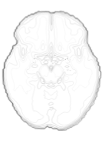
Neuroimaging Meta-Analysis Approaches (1)
Thomas Nichols, Neuroimaging Meta-Analysis OHBM Educational Course, 2018
Region of Interest
Traditional Meta-Analysis, on mean %BOLD & stderr
Almost impossible to do
ROI-based results rare (exception: PET)
Different ROIs used by different authors
Heterogenous boundaries
Peak %BOLD useless, due to voodoo bias
Peak is overly-optimistic estimate of %BOLD in ROI
True %BOLD
Estimated %BOLD
MNI x-axis

Slide 16
Intensity Based meta-analysis (IBMA)
Access to statistical maps of whole brain data
Subthreshold but consistent signal

Slide 17
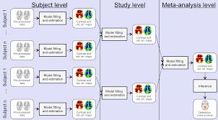
Camille Maumet, Neuroimaging Meta-Analysis, OHBM Educational Course, 2017

Slide 18
IBMA (3)- statistical approaches
With subjects’ statistics maps P/T/Z Images only
Fisher’s
Stouffer’s
Stouffer’s random effects- variability between studies
Weighted Stouffer’s- numbers in studies known; larger studies carry greater weight

Slide 19
IBMA (3)
With Contrast of Parameter Estimate (COPE) only (Effect size images)
Only allows random-effects model without weights
With COPE’s & VARCOPES (variance)
Gold standard 3rd level mixed effects model
FSL’s FEAT/FLAME 2nd-level FLAME: Combining subjects
3rd-level FLAME: Combining studies
Allows meta-regression
Units of Contrast maps need to be the same- different packages scale contrast data differently and this needs to be accounted for.
Imaging data rarely shared and this is limiting.

Slide 20
Neuroimaging Meta-Analysis Approaches (3)
Thomas Nichols, Neuroimaging Meta-Analysis OHBM Educational Course, 2018
Coordinate-Based Meta-Analysis (CBMA)
x,y,z locations only
Activation Likelihood Estimation (ALE)
Multilevel Kernel Density Analysis (MKDA)
x,y,z and Z-value
Signed Differential Mapping (SDM)
Turkeltaub et al. (2002). Meta-analysis of the functional neuroanatomy of single-word reading: method and validation. NeuroImage, 16(3), 765–780.
Eickhoff et al. (2009). Coordinate-based activation likelihood estimation meta-analysis of neuroimaging data: a random-effects approach based on empirical estimates of spatial uncertainty. Human Brain Mapping, 30(9), 2907-26.
Eickhoff et al. (2012). Activation likelihood estimation meta-analysis revisited. NeuroImage, 59(3), 2349–61
Wager et al. (2004). Neuroimaging studies of shifting attention: a meta-analysis. NeuroImage 22 (4), 1679–1693.
Kober et al. (2008). Functional grouping and cortical-subcortical interactions in emotion: a meta-analysis of neuroimaging studies. NeuroImage, 42(2), 998–1031.
Radua & Mataix-Cols (2009). Voxel-wise meta-analysis of grey matter changes in obsessive-compulsive disorder. British Journal of Psychiatry, 195:391-400.
Costafreda et al. (2009). A parametric approach to voxel- based meta-analysis. NeuroImage, 46(1):115-122.
Notes:
creating focus maps: that is, full brain images obtained through smoothing of reported activations with a spatial kernel. Obviously, there are as many focus maps as the total number of foci. Secondly, the focus maps corresponding to a particular study are combined to create the study-specific maps. These per-study images are subsequently combined into a single image that represents the evidence for consistent activation (clustering). Significance of these images is assessed with a Monte Carlo test under the null hypothesis of complete spatial randomness.
Sparse representation of overall results. Based on published maxima co-ordinates

Slide 21
ALE
Thomas Nichols, Neuroimaging Meta-Analysis OHBM Educational Course, 2018
ALE – Activation Likelihood Estimation (Turkeltaub et al., 2002)
ALE per-study map
Study 1
Study 1
Study 2
Study 2
Study 3
Study 3
kernel FHWM f
ALE map
ALE interpretation for single focus
Probability of observing a focus at that location
ALE combining
Probability of union of events…
ALE(p₁,p₂) = p₁ + p₂ − p₁×p₂
ALE(p₁,p₂,p₃) = p₁ + p₂ + p₃ − p₁×p₂ − p₁×p₃ − p₂×p₃ + p₁×p₂×p₃

Slide 22
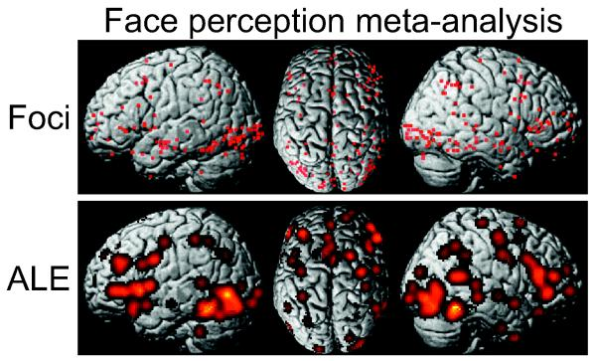
Eickoff et al., 2011
Compare observed ALE with null hypothesis
ALE interpretation:
Probability of observing one or more foci at a given location based on a model of Gaussian spread with FWHM (based on sample size) f

Slide 23
Multilevel Kernel Density Analysis
Binary indicator maps for each contrast are created by convolving peak foci using a flat disc kernel
Radius of kernel usually 10-15mm (Wagner et al., 2004) centred on focus
Activation within distance r from location given a value of 1.
MKDA statistic image is weighted based on number of participants in a study
Robustness to possible bias from studies that systematically report more foci per cluster

Slide 24
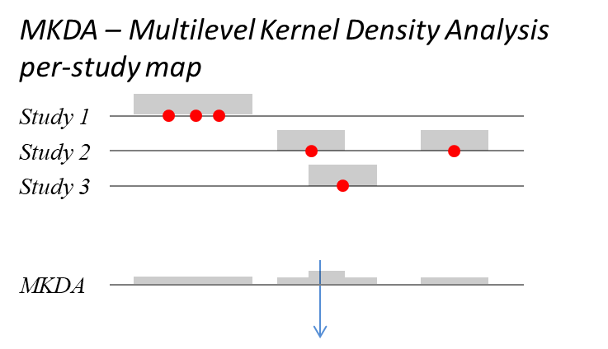
MKDA (unweighted) interpretation:
For any given location, what is proportion of studies having one or more foci within distance r
Thomas Nichols, Neuroimaging Meta-Analysis OHBM Educational Course, 2018

Slide 25
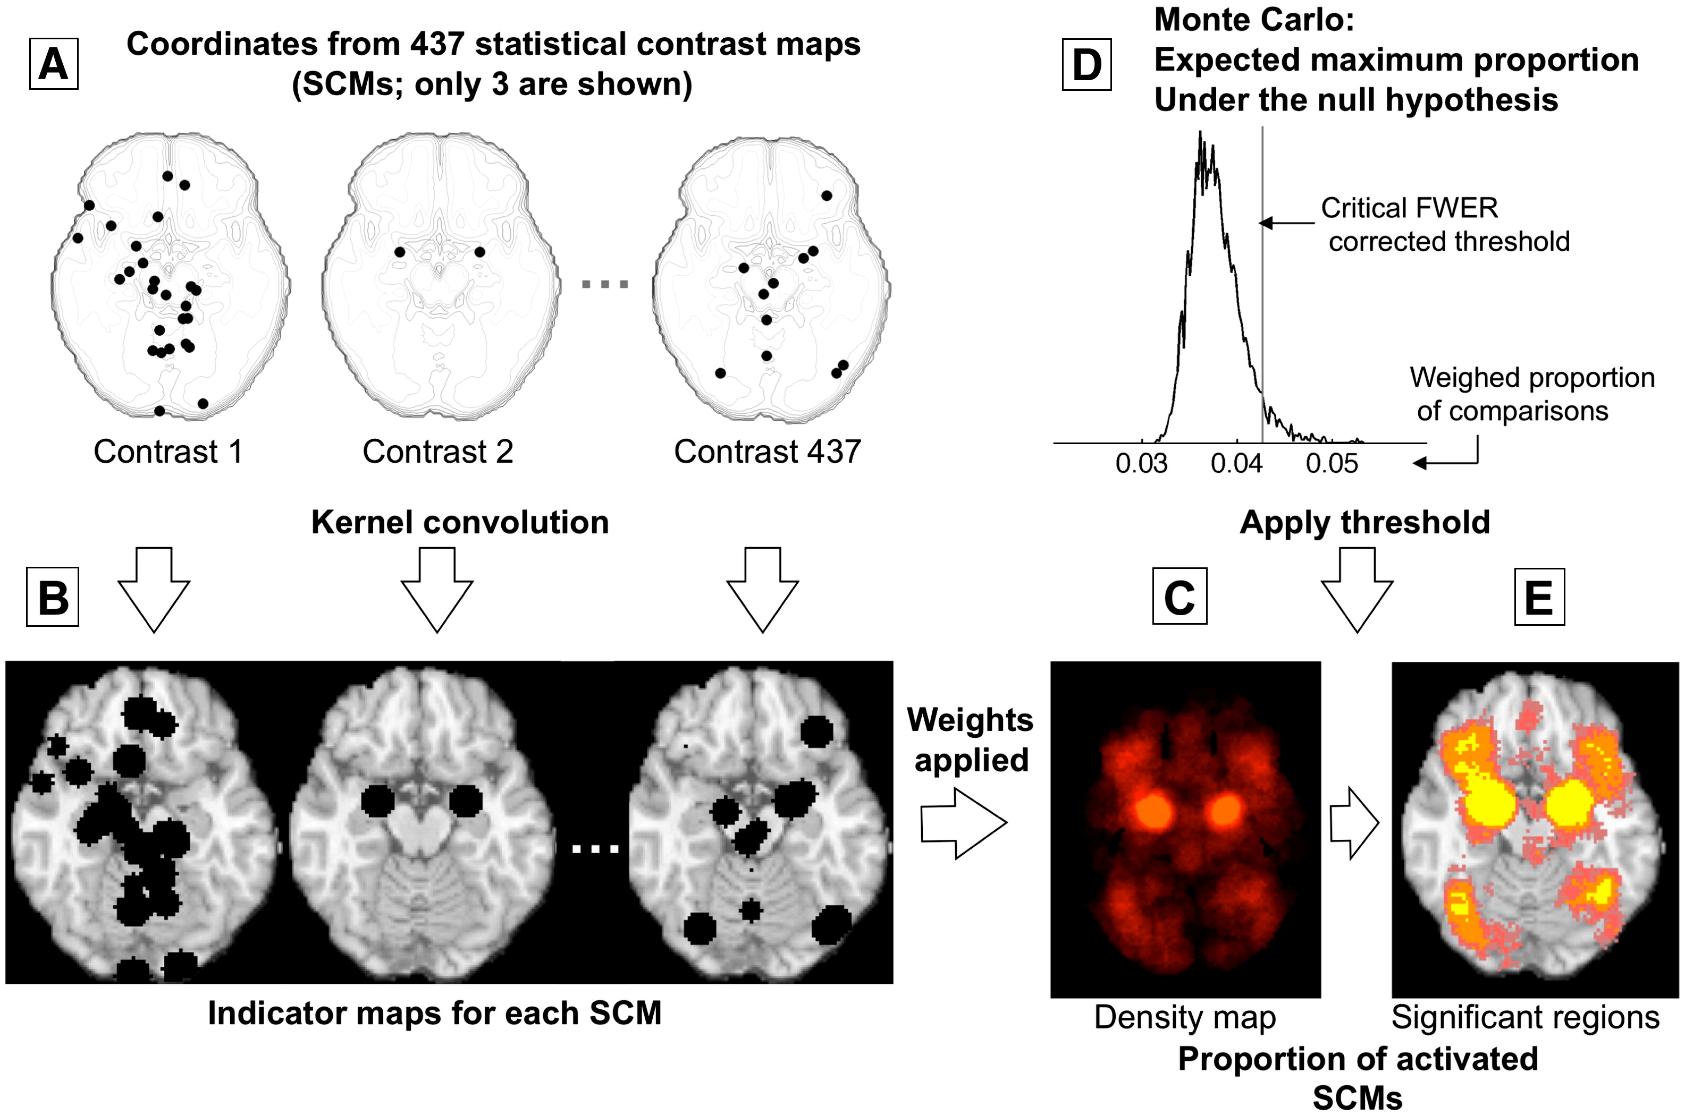
Wager et al., 2009
Notes:
Fig. 2. Example procedures for multilevel kernel density analysis (MKDA). (Adapted from Wager et al. (2007), Fig. 3). (A) Peak coordinates of three of the 437 comparison maps included in a meta-analysis of emotion. Peak coordinates of each map are separately convolved with the kernel, generating (B) indicator maps for each study contrast map (SCM). (C) The weighted average of the indicator maps is compared with (D) the maximum proportion of activated comparison maps expected under the null hypothesis in a Monte Carlo simulation and (E) thresholded to produce a map of significant results. Color key is as in Fig. 1.

Slide 26
Signed differential mapping (SDM)
SDM is a stricter selection of the reported peak coordinates (only regions that appear statistically significant at the whole-brain level)
Peak results that are corrected
Co-ordinates converted from MNI to Talairach
un-normalised Gaussian kernel around peak co-ordinates
FWHM is set at 25mm
Positive and negative activations/volumes recreated on same map -> therefore at meta-analytic level voxel will be insignificant
Notes:
This strict criterion is intended to avoid biases towards liberally thresholded brain regions because it is not uncommon in neuroimaging studies that the statistical threshold for some regions of interest is rather more liberal than for the rest of the brain.
his kernel is adapted from that of ALE and preferred to that of MKDA because it assigns a higher value to the voxels closer to the reported coordinates. Full-width at half maximum is set at 25 mm because in previous simulations we found it to have an excellent control of false positives – consistent with our simulation work, a recent study has reported that the optimal FWHM for the previous methods is about 15–30 mm. ¹⁷

Slide 27
SDM (continued)
null distribution created to test which voxels have more studies reporting differences around them than expected by chance.
Whole brain level
Monte Carlo randomisations
Further iterations:
anisotropic kernels (Radua et al., 2014)
Permutation of subject images (PSI) (Radua et al., 2019).
Notes:
of the meta-analytic values is
, which assign different values to the different neighboring voxels based on the spatial correlation between them

Slide 28
Large scale meta-analysis tools
Yarkoni, Poldrack, Nichols, Essen, & Wager (2011). Large-scale automated synthesis of human functional neuroimaging data. Nature Methods, 8(8), 665-670.
Notes:
(a) Outline of the NeuroSynth approach. The full text of a large corpus of articles is retrieved and terms of scientific interest are stored in a database. Articles are retrieved from the database on the basis of a user-entered search string (for example, 'pain') and peak coordinates from the associated articles are extracted from tables. A meta-analysis of the peak coordinates is automatically performed, producing a whole-brain map of the posterior probability of the term given activation at each voxel (P(pain|activation)). (b) Outlines of forward and reverse inference in brain imaging. Given a known psychological manipulation, one can quantify the corresponding changes in brain activity and generate a forward inference, but given an observed pattern of activity, drawing a reverse inference about associated cognitive states is more difficult because multiple cognitive states could have similar neural signatures. (c) Given meta-analytic posterior probability maps for multiple terms (for example, working memory, emotion and pain), one can classify a new activation map by identifying the class with the highest probability, P, given the new data (in this example, pain).

Slide 29
Use of large scale meta-analytic databases
Use meta-analytic databases
Where do foci occur for particular cognitive processes
Then do the study
Notes:
Can also help generate hypotheses

Slide 30
Reporting of meta-analysis
Research question
• Detailed inclusion and exclusion criteria and the motivation why they were applied
• All steps of the meta-analytic study ideally in a flow-chart
• Number of experiments included in each analysis
• Handling of multiple experiments from the same subject group
• Detailed information on each included experiment (number of subjects, specific characteristics of the subjects, task description, stimuli used, coordinate space

Slide 31
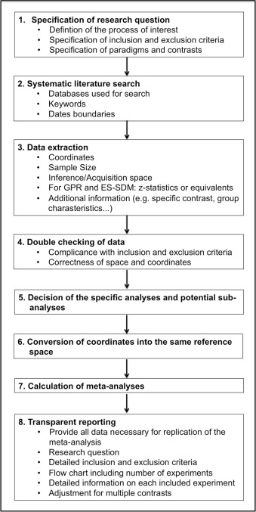
Summary
Muller et al., 2018

Slide 33
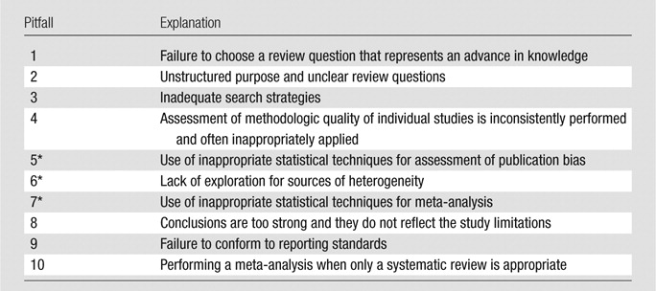
Pitfalls
McInnes and Bussoyt, 2015

Slide 34
Questions?

