Slide 1
Model Selection
Christina Maher, Blanca Piera Pi-Sunyer, Juliana Sporrer
Expert: Dr Michael Moutoussis

Slide 2
Outline
Introduction to Models
Recap: what is a statistical model and why is it useful?
Recap: Common statistical models in Neuroscience
Example
Model Fitting
Frequentist parameter estimation
Bayesian parameter estimation
Model Comparison
Things to consider
Measures of fit
Group-level selection

Slide 3
PART I: INTRODUCTION TO MODELS
Blanca Piera Pi-Sunyer

Slide 4
Recap: What is a statistical model?
A model is a representation of an idea, an object, a process or a system that is used to describe and explain phenomena that cannot be experienced directly.
Stands for something
Describes patterns in data in reduced dimensions
Friedenthal, et al. (2012). OMG Press.
Notes:
A model can be understood as a representation of the real world
It is a representation because it stand for something in reality that cannot be exprineced directly in its entirety
and describes patterns that are present in the real world;
The representation has reduced dimensions of all the influences that come to play in the real world to that it is halfway between being too abstract and too realistic.

Slide 5
Recep: Why is it useful?
A Model is a Representation for a Purpose
Identifies and disentangles influences
Allows to create hypotheses
Allows to classify events
“All models are wrong, but some are useful”
Notes:
Importantly, a model is representation for a purpose; such that it allows you to identify and disentangle relevant influences for the question about the real world that you want to ask, and allows you to create hypotheses about how the system being modelled actually works, and finally classify existing observations into conclusions or evaluations
So in a sense, all models are are approximations of reality - like abstractions. If they were perfect, then they would be the system we are modelling. If we explain all aspects of something – it isn’t very useful as it can’t be generalized to other situations.
As a model of a complex system becomes more complete, it becomes less understandable. Alternatively, as a model grows more realistic, it also becomes just as difficult to understand as the real-world processes it represents
So actually, useful models are those that find the balance between how complex and how generalisable they are.

Slide 6
Recap: Common statistical models in Neuroscience
Descriptive Models
What do nervous systems do?
Summarise data
Mechanistic Models
How do nervous systems function?
Bridge descriptive data together
Interpretive Models
Why do nervous systems operate in particular ways?
Computational and information-theoretic principles
Behavioural - cognitive - neural relationships
Dayan & Abbott (2001). The MIT Press.
Notes:
There are many kinds of models that we can do to describe different questions we may have. In Neuroscience, there are three common models we use:
Descriptive models, which serve to answer ‘what’ questions, such as what do nervous systems do? These models summarize large amounts of experimental descriptive models data compactly yet accurately, thereby characterizing what neurons and neural circuits do. These models may be based loosely on biophysical, anatomical, and physiological findings, but their primary purpose is to describe phenomena, not to explain them.
There are also Mechanistic models, which answer ‘how’ questions, such as how do nervous systems function, on the basis of known anatomy, physiology, and circuitry. Such models often form a bridge between descriptive models couched at different levels.
Finally, interpretive models answer ‘why’ questions. These use computational and information-theoretic principles interpretive models to explore the behavioral and cognitive significance of various aspects of nervous system function, addressing the question of why nervous systems operate as they do.

Slide 7
Example: Does height predict liking dogs?
Dataset
age, gender, height, weight, dog liking ratings
Models
Liking dogs ~ intercept + β1* height + β2 * age + βn * n
Liking dogs ~ intercept + β1 * height
Liking dogs ~ intercept + β1* height + β2 * age
Notes:
In today’s presentation we will discuss methods which we can use to fit data into different models, and then compare these models to determine which model describes the data best.
For example, imagine we have a dataset with demographics of different people and the extent to which they like dogs, and we want to build a model on how height predicts liking dogs.
We have a lot of information, and our goal is to decide which dimensions we want to fit to the data to best represent how complex it is, but also how it could generally apply to other datasets and the real world.
So if we had a simple model with just height as a predictor, we could try to estimate how much variance in liking dogs height as an only predictor this accounts for.
If we include height and age as predictors, and therefore more dimensions, we are estimating how much variance these in liking dogs these variables account for.
And we could do this for all the parameters we have available in our dataset, and try to tune these parameters until they fit the data.
However, here is where selecting the best model comes to play, and deciding between models which are less accurate only containing height as a fitted predictor, and models that include all the possible parameters and overfit the data, which are no longer generalisable.
In the rest of the presentation we will explore how to fit the parameters included in each model to the data; and then how to compare each model fit to decide which model fits the data best.

Slide 10
Notes:
I'm not familiar with simplex, but I think that both simplex and simulated annealing are not about which objective function one uses (which is the difference in the table otherwise, between the Frequentist and Bayesian) but which numerical algorithm one uses. Something similar could be said about sampling methods - there is no reason not to use sampling methods to estimate frequentist models, but we don't have to go into that :)

Slide 12
Notes:
No known statistical properties of least squares?? It's simply the sum-log-likelihood of a gaussian (i.e. a homoskedastic hypothesis).

Slide 17
Analytically intractable posterior distribution

Slide 19
Part III: Model Comparison
Christina Maher

Slide 20
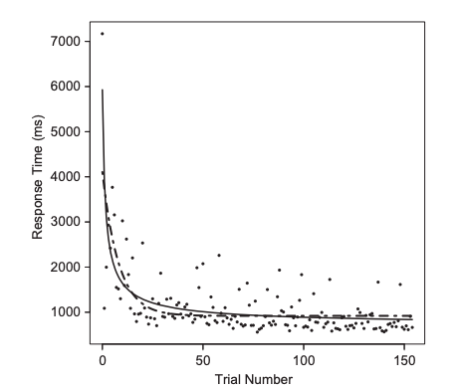
What is model comparison?
Determining which model best describes behavioral data
Helps uncover the mechanisms that underlie behavior
Useful when different models make similar qualitative predictions BUT differ quantitatively
Example: Learning (Heathcote et al., 2000).
Wilson & Collins, 2019; Farrell & Lewandowsky, 2018
“Power law” =
VS
Exponential function =

Slide 21
Model Selection Consideration
Overfitting:
-model is too complex fitting both the noise and signal
-overfitted models will not generalize to other datasets and do not help explain underlying behavioral mechanisms
MODELLING GOAL = find the best and simplest model

Slide 22
Considerations for Model Characteristics
-data never speaks for itself, requiring a model for explanation
-we must select amongst the several existing models that explain our data
-model selection = intellectual judgement + quantitative evaluation
- model should be “as simple as possible but no simpler”
-model should be interpretable
-model should capture all hypotheses that you plan to test
Wilson & Collins, 2019; Farrell & Lewandowsky, 2018

Slide 23
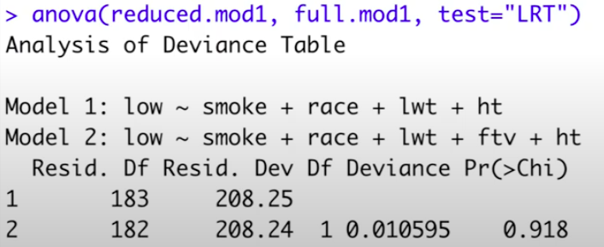
Measures of Fit: The Likelihood Ratio Test
-Examining whether increased likelihood for a more complex model is merited by its extra parameters
- Comparing a more complex model to a simpler model to see if it fits a particular dataset significantly better.
-Limitations: only appropriate for nested models and depends on the null hypothesis testing approach
Code Source:
https://www.youtube.com/watch?v=xoM1ynjQYtc
Notes:
deviance is approximately χ2 distributed in the case of nested models, under the null hypothesis of no difference
Null = no difference between full and reduced model
Alternative = Full model is statistically better than the reduced model
Example above meaning = fail to reject null, no evidence that full model is better than reduced therefore parameter can be dropped from the model without making it worse

Slide 24
Measures of Fit: Akaike’s Information Criterion (AIC)
Estimates prediction error and model quality
Based on information theory, AIC computes the relative amount of information lost by a given model. Less information lost = higher model quality.
Accounts for the trade-off between goodness-of-fit and model complexity
Goal: minimize information lost. Model with the smallest AIC is the “winning” model.
Farrell & Lewandowsky, 2018
Example R output:

Slide 25
Bayes Factor
Ratio of the likelihood of one particular hypothesis (or model) to the likelihood of another.
Interpreted as a measure of model evidence or the strength of evidence in favor of one model among competing models.
Function from R library “BayesFactor” (computes the Bayes factors for specific linear models against the intercept-only null)
Source: http://pcl.missouri.edu/bayesfactor

Slide 26
Measures of Fit: Bayesian Information Criterion (BIC)
Alternative to AIC
Unit Information Prior = amount of information gained from a single data point
BIC addresses problems of overfitting by introducing penalties for the number of parameters. Lower BIC value indicates lower penalty terms hence a better model.
Farrell & Lewandowsky, 2018

Slide 27
Measures of Fit: AIC & BIC
This weighted punishment of complexity means that the BIC has a greater preference for simplicity than AIC
Particularly relevant for nested models
BIC
-default assumption of priors
-procedure will be more conservative (prefer simpler models) than the AIC
AIC
-will select more complex models than the BIC
Farrell & Lewandowsky, 2018
Practical implication : Use both!!

Slide 28
Cross Validation
Resampling procedure used to evaluate a model on a limited data sample, facilitating efficient model generalization.
Testing how well your model is able to be trained by some data and then predict data it has not seen. If you trained with all data, you’d be left with none for testing.
Calibration sample is used for model fitting, and the best fitting model is compared to a validation sample.

Slide 29
Cross Validation - Techniques
Techniques:
The Holdout Method - data separated into two sets, called the Training set and Test set by a classifier.
Random Subsampling -randomly splitting the data into subsets, whereby the size of the subsets is defined by the user
K-Fold Cross Validation - data are split randomly into K sets, and each set j successively serves as the validation set
Leave-one-out Cross Validation - each data point is successively left out of the training set and serves as the sole member of the validation set

Slide 30
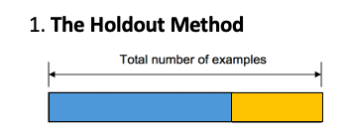
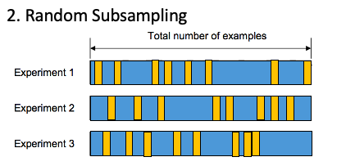
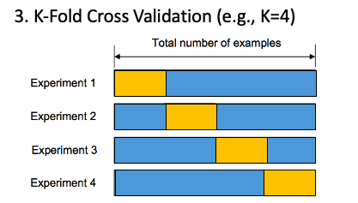
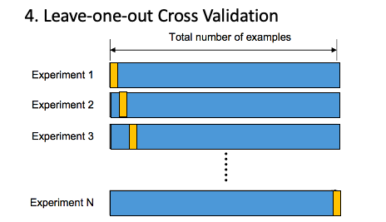
Based on MfD lecture 2018 (Benrimoh & Bedder)

Slide 31
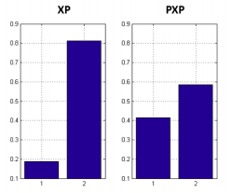
Between-Group Model Comparison
Model with highest frequency (fits the most participants) in the population is best model
Protected Exceedance Probabilities (PEPs) measure how likely it is that any given model is more frequent than all other models in the comparison set.
Example: SPM (SPM short course for fMRI, London 2014)
Bayes Omnibus Risk (BOR)
Posterior probability that frequencies are different
Protected Exceedance Probabilities (PEP)

Slide 32
Additional Resources
Computational Modelling of Cognition and Behavior by Farrell & Lewandowsky
Computational Psychiatry: A Primer by Peggy Series
Wilson, R. C., & Collins, A. G. (2019). Ten simple rules for the computational modeling of behavioral data. eLife, 8, e49547. https://doi.org/10.7554/eLife.49547
Decision-making ability, psychopathology, and brain connectivity (Moutoussis et al., 2021) https://www.sciencedirect.com/science/article/pii/S0896627321002853

