Slide 1
Practice of Preprocessing and Analysis
Methods for Dummies/Voxel-Based Morphometry
Ryo Segawa
UCL Queen Square Institute of Neurology
MSc Advanced Neuroimaging
e-mail: zczlseg@ucl.ac.uk

Slide 2
Reference
VBM Tutorial (Ashburner, 2015)
・https://www.fil.ion.ucl.ac.uk/~john/misc/VBMclass15.pdf

Slide 3
Prerequisites
MATLAB
-SPM12
IXI Dataset
http://brain-development.org/ixi-dataset/

Slide 4
Preprocessing

Slide 5
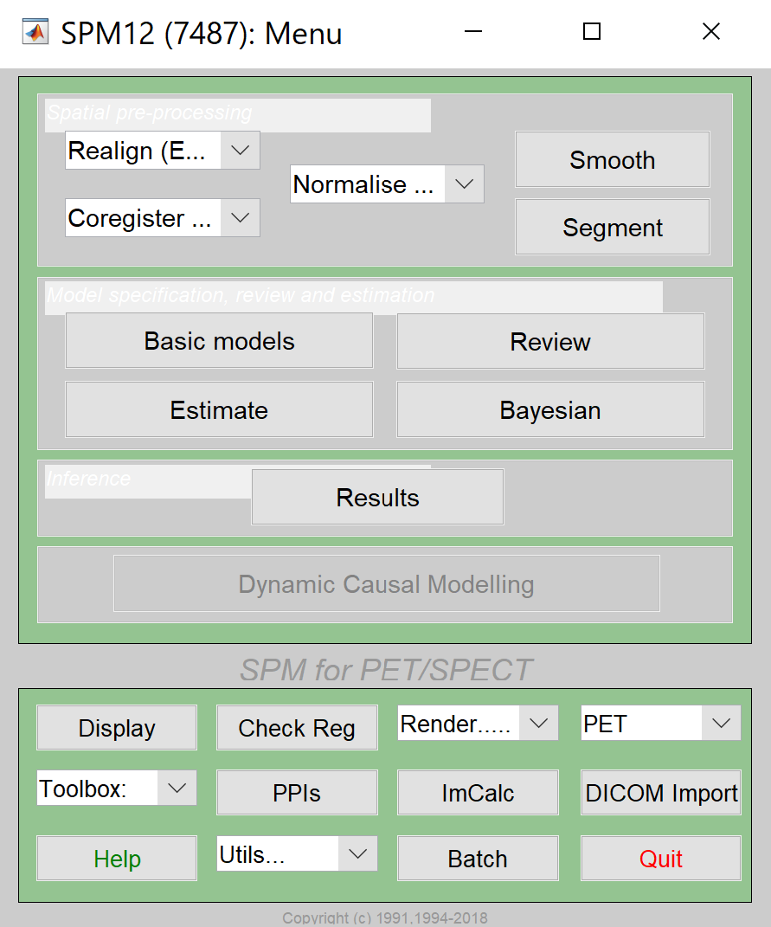
Checking the alignment

Slide 6
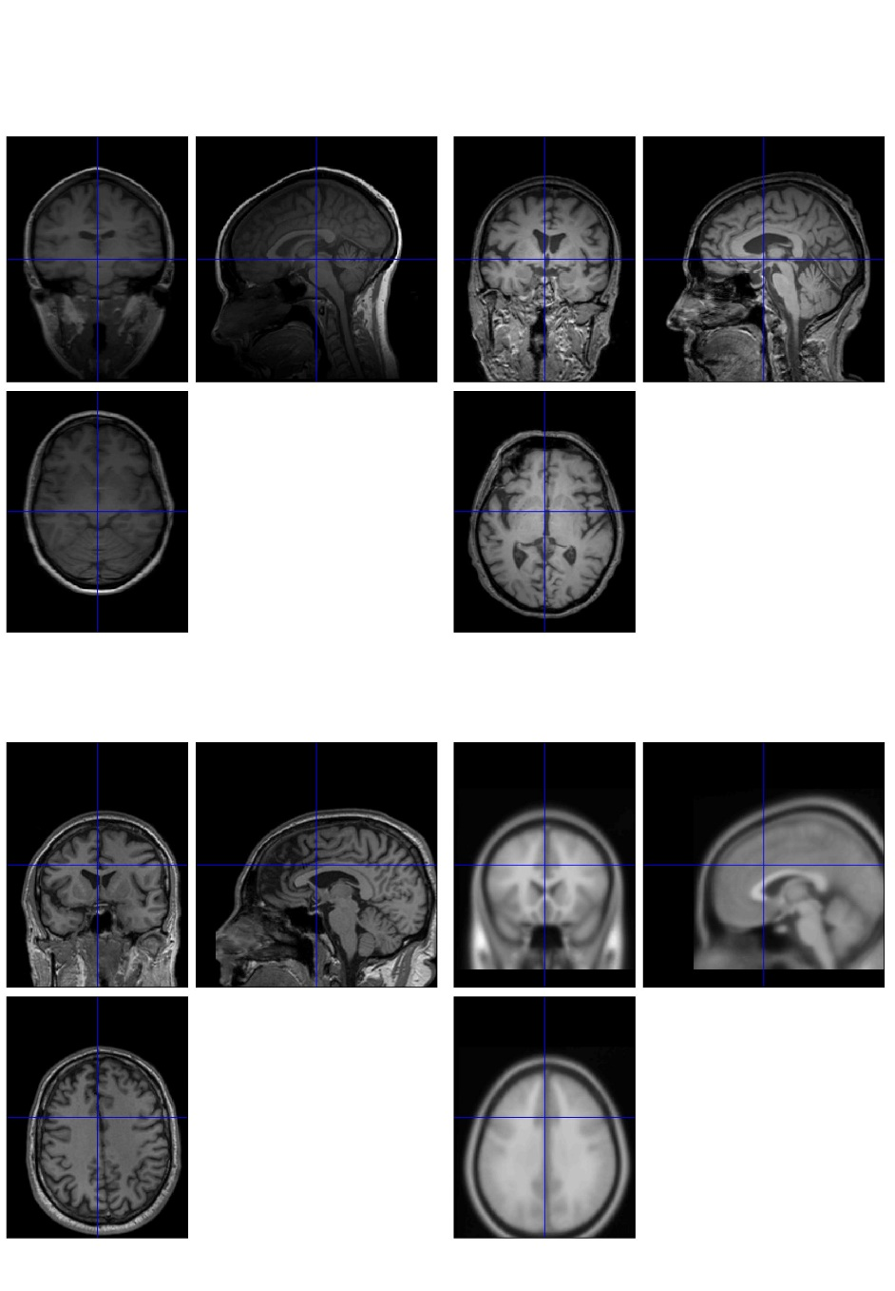
Checking the alignment

Slide 7
Setting the origin

Slide 8
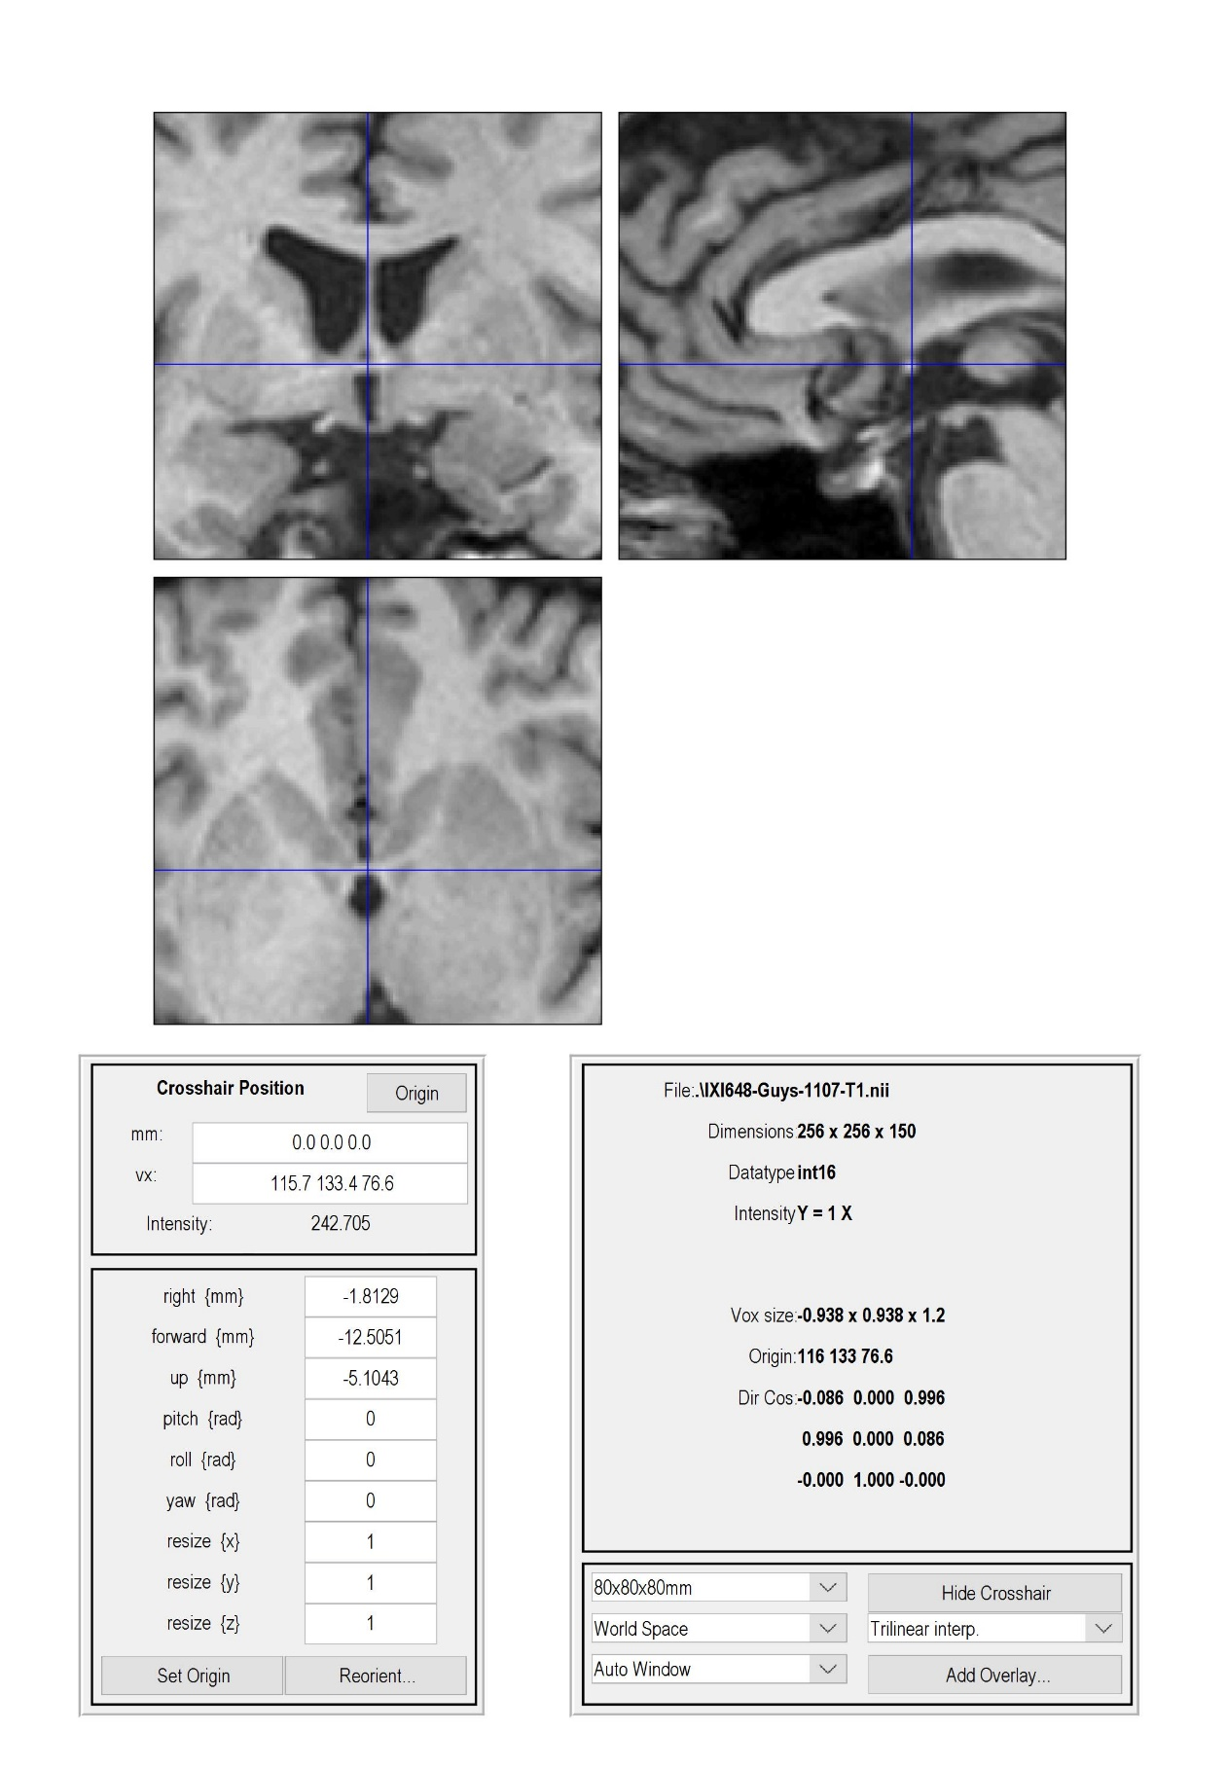
Setting the origin

Slide 9
Segmentation

Slide 10
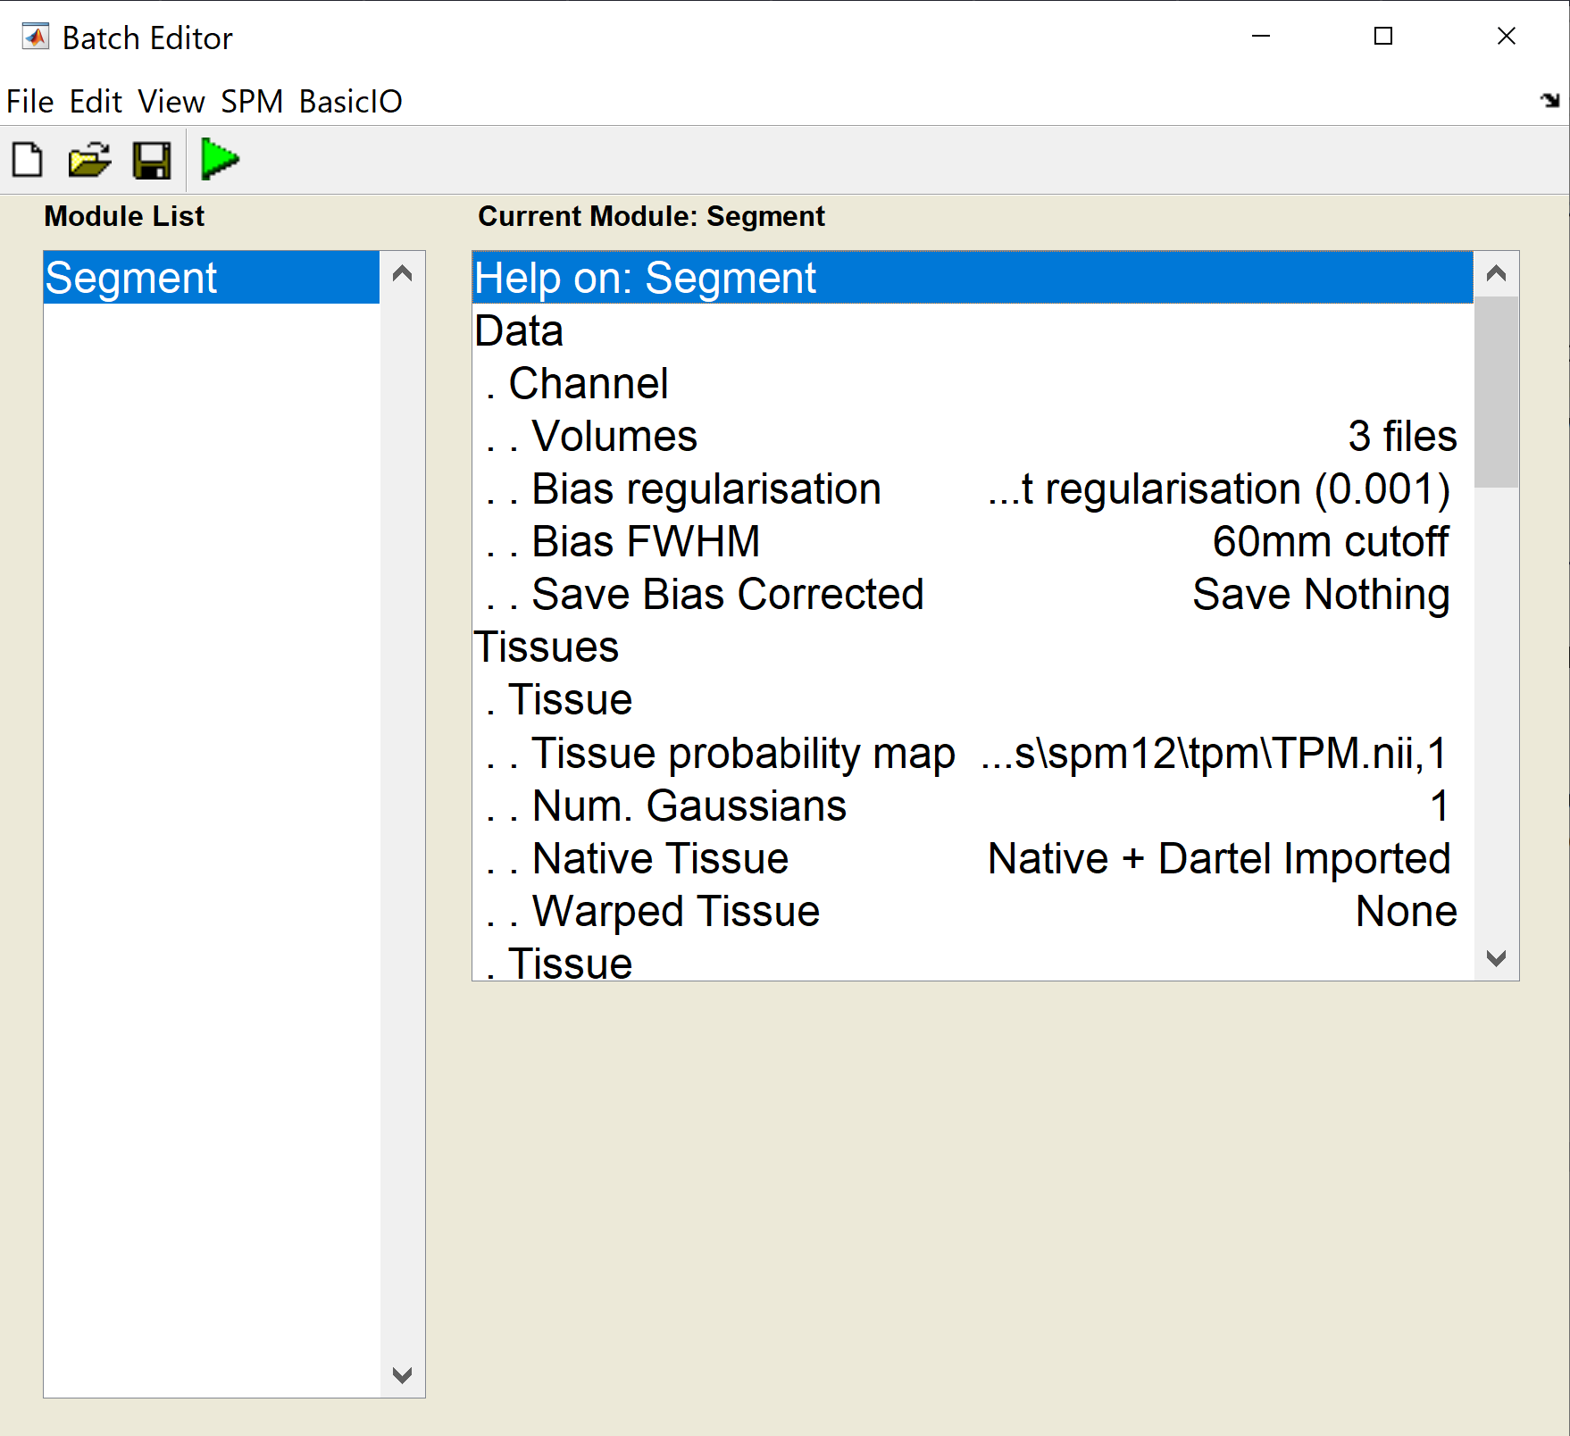
Segmentation

Slide 11
Segmentation
Data
Channel
Volumes: all scans to be segmented
Bias regularisation: (default)
Bias FWHM: (default)
Save Bias Corrected: (default)

Slide 12
Segmentation
Tissues
Tissue: corresponds to grey matter
Tissue probability map: (default)
Num. Gaussians: (default)
Native Tissue: Native + Dartel imported
Warped Tissue: None

Slide 13
Segmentation
Tissues
Tissue: corresponds to white matter
Tissue probability map: (default)
Num. Gaussians: (default)
Native Tissue: Native + Dartel imported
Warped Tissue: None

Slide 14
Segmentation
Tissues
Tissue: corresponds to CSF
Tissue probability map: (default)
Num. Gaussians: (default)
Native Tissue: Native Space
Warped Tissue: None

Slide 15
Segmentation
Tissues
Tissue: corresponds to skull
Tissue probability map: (default)
Num. Gaussians: (default)
Native Tissue: None
Warped Tissue: None

Slide 16
Segmentation
Tissues
Tissue: corresponds to soft tissue outside the brain
Tissue probability map: (default)
Num. Gaussians: (default)
Native Tissue: None
Warped Tissue: None

Slide 17
Segmentation
Tissues
Tissue: corresponds to other stuff outside the head
Tissue probability map: (default)
Num. Gaussians: (default)
Native Tissue: None
Warped Tissue: None

Slide 18
Segmentation
Warping & MRF
MRF Parameter: 1
Clean Up: (default)
Warping regularisation: (default)
Affine regularisation: (default)
Sampling distance: (default)
Deformation fields: None

Slide 19
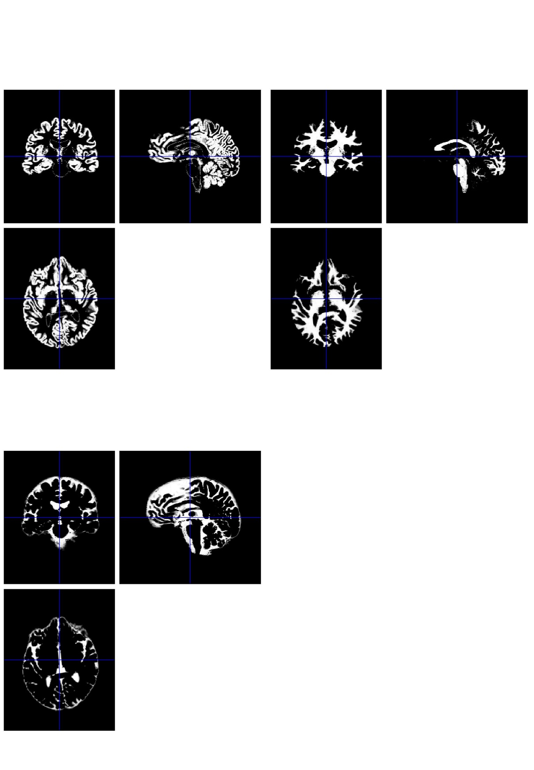
Segmentation

Slide 20
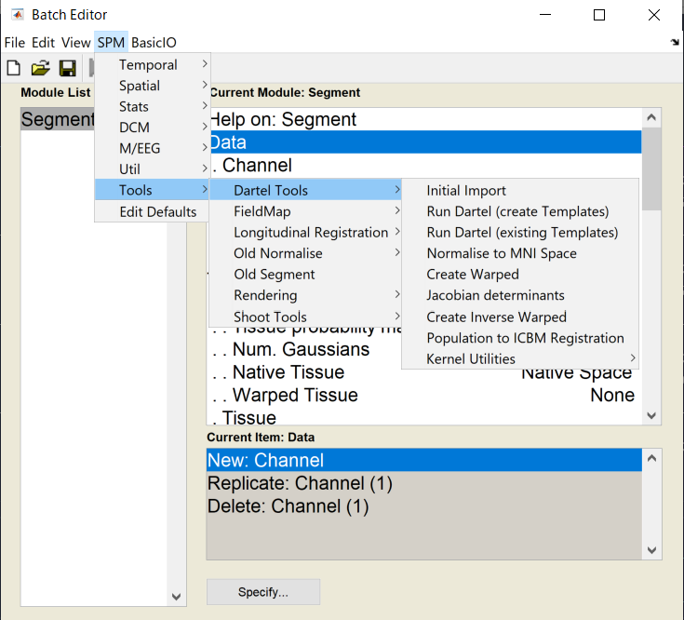
Run Dartel (create Templates)

Slide 21
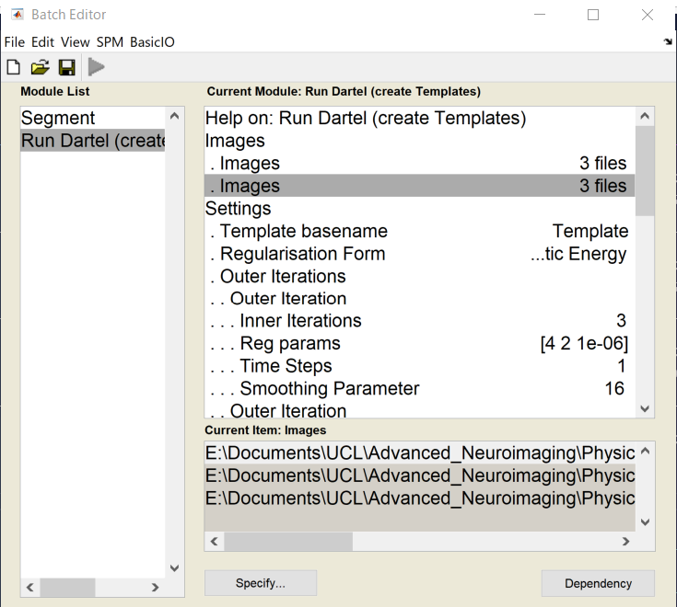
Run Dartel (create Templates)

Slide 22
Normalise to MNI space

Slide 23
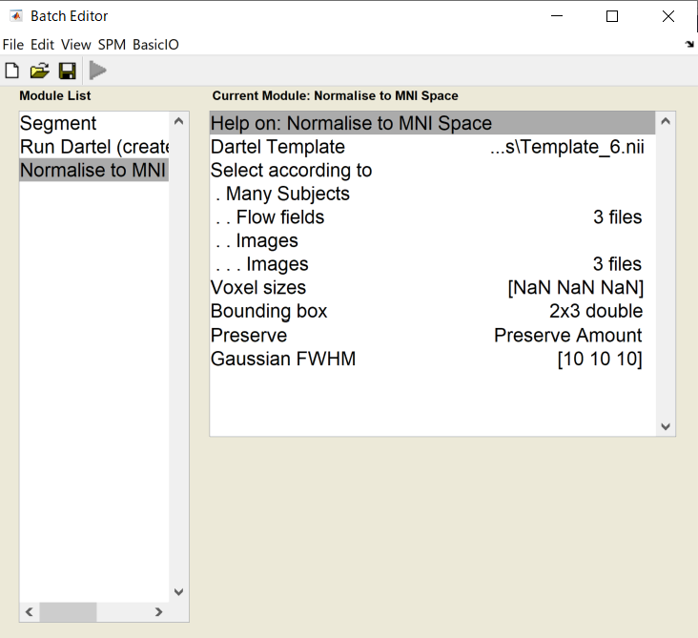
Normalise to MNI space

Slide 24
Normalise to MNI space

Slide 25
Statistical Analysis
1. Basic Models – to specify a design matrix that explains how the processed data are caused
2. Estimate – to actually fit the GLM to the data, and estimate the smoothness of the residuals for the subsequent random field theory corrections
3. Results – to characterise differences

Slide 26
Statistical Analysis
・To create design matrix, load the grey matter, white matter and CSF volumes of 55 healthy subjects of different sexes and ages
– e.g. on SPM command window,
load info.txt

Slide 27
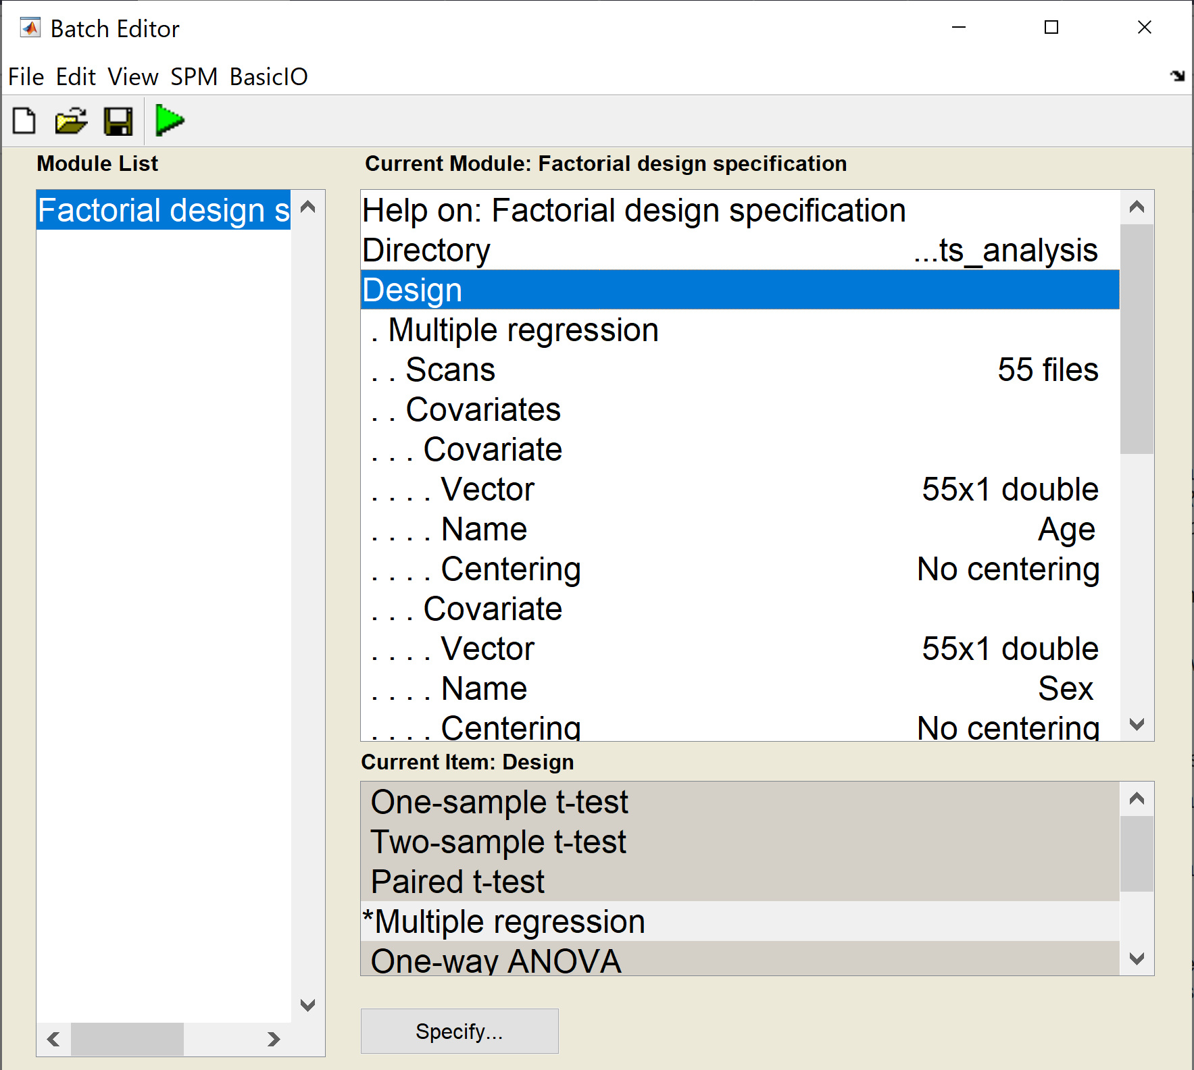
Statistical Analysis – Basic Models

Slide 28
Statistical Analysis – Basic Models
Directory
specify an arbitrary directory in which to run the analysis

Slide 29
Statistical Analysis – Basic Models
Design
Multiple Regression
Scans: 55 previously computed files
Covariates
Covariate
Vector: info(:,1)
Name: Age
Centering: No centering
Covariate
Vector: info(:,2)
Name: Sex
Centering: No centering

Slide 30
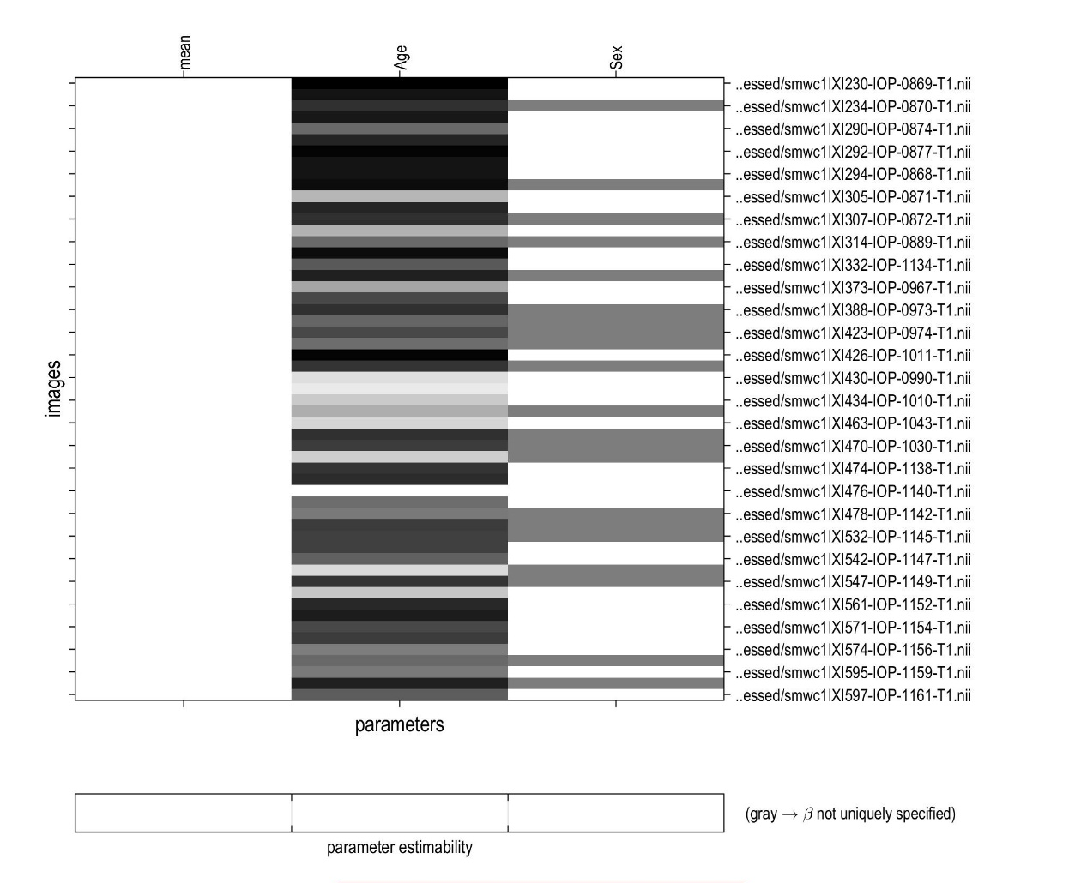
Statistical Analysis – Basic Models

Slide 31
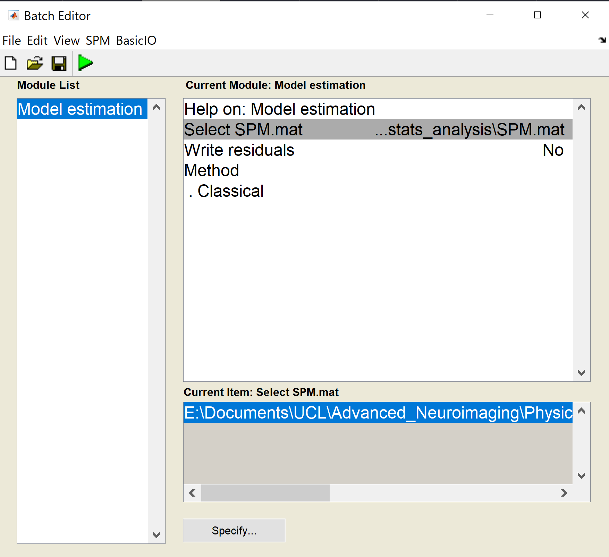
Statistical Analysis – Estimate

Slide 32
Statistical Analysis – Results

Slide 33
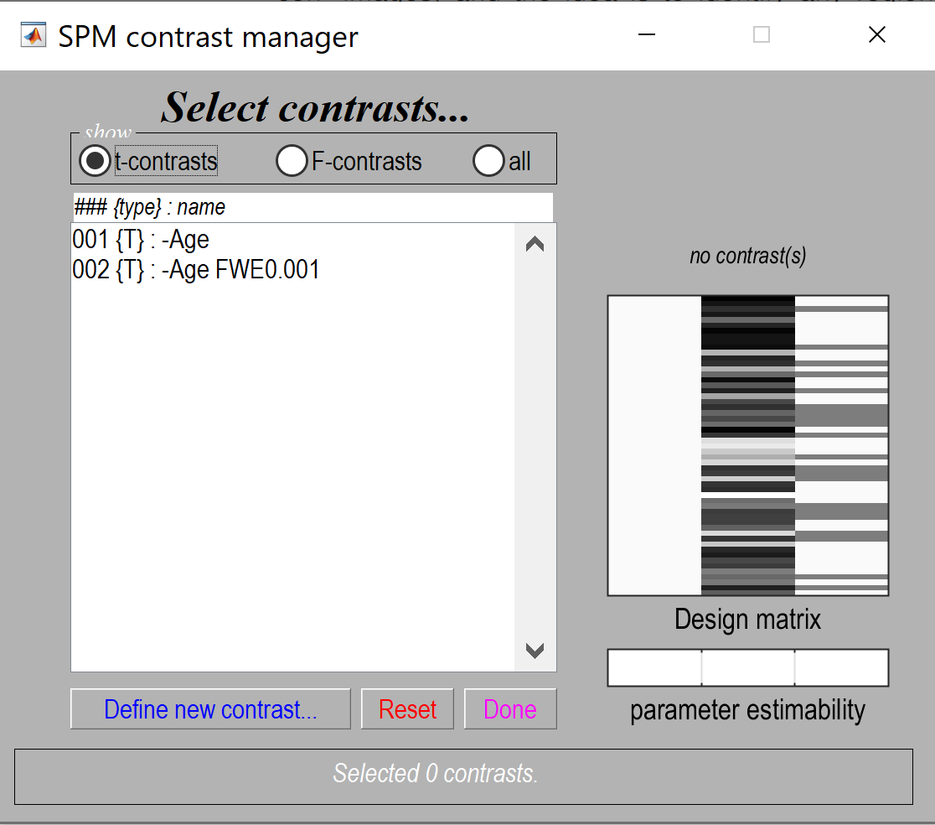
Statistical Analysis – Results

Slide 34
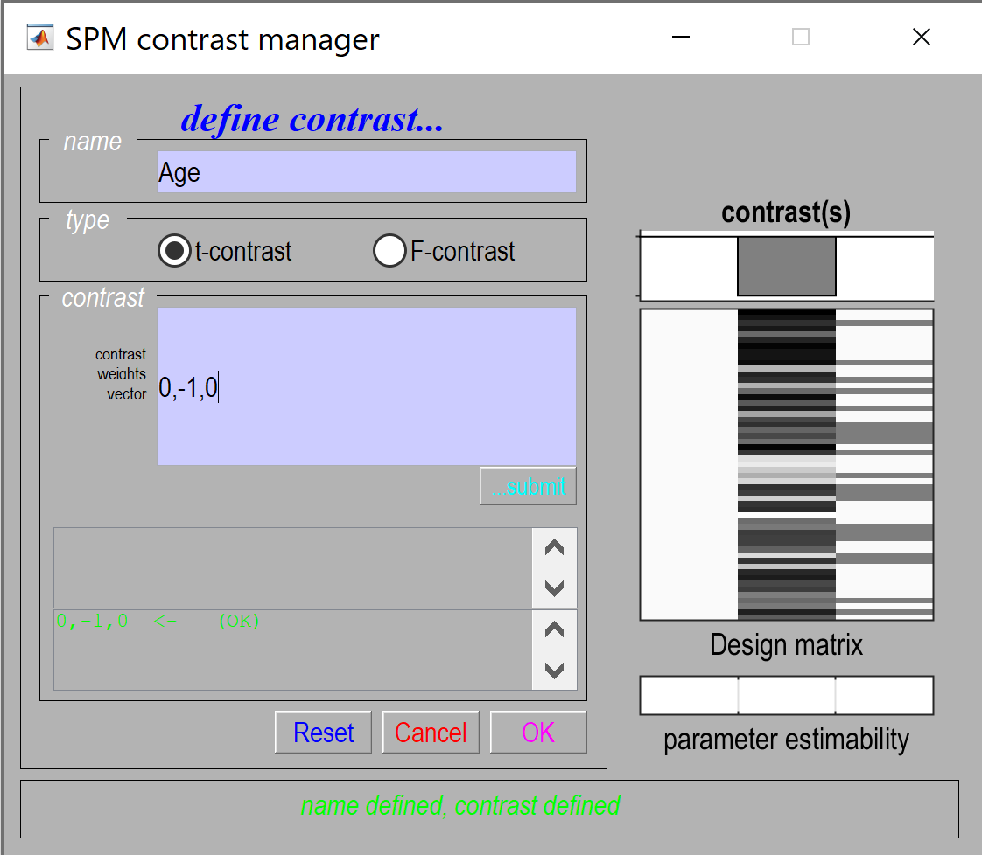
Statistical Analysis – Results

Slide 35
Statistical Analysis – Results
mask with other contrast(s): no
title for comparison: leave this as it is
p value adjustment to control: FWE(family-wise error correction)
threshold {T or p value}: 0.05
& extent threshold {voxels}: 0

Slide 36
Statistical Analysis – Results

Slide 37
Statistical Analysis – Results

Slide 38
Statistical Analysis
Statistical Analysis of VBM is primarily done using:
A General Linear Model (GLM)
A Mass Univariate Approach
Independent statistical test conducted for each voxel

Slide 39
General Linear Model
Y = Xβ + ε
Y : Voxel Intensity (DV) (“data”)
Xβ: predictor variables (“regressor”) + scaling parameters
ε : error term (“residuals”)
Voxel Intensity: function modelling different things that lead to differences between scans
Predictor Variables: Any factors that may account for differences in GMC
Residuals: Difference between data and scaled regressor
Notes:
GLM is used to identify regions of gray matter concentrations that are significantly related to the particular effects being studied. It’s a flexible framework that allows many different tests to be applied, ranging from group comparisons and identifying regions of gray matter concentration that are related to specified covariates, such as disease severity or age, to complex interactions between different effects of interest (Ashburner & Friston, 2000).

Slide 40
The General Linear Model
GLM models an observed signal in terms of an explanatory variable (aka regressor)
In Neuroimaging/VBM:
Timeseries arising from single experiment
BOLD Timeseries in a given voxel
Series of measurements associated with individuals in a group
Cortical thickness in different patients at specific location
Notes:
The General Linear Model, is used to model an observed signal in terms of an explanatory variable (also known as a regressor).
This signal could be a number of things depending on the experiment.
Some Neuroimaging/VBM examples would be:
experiment that looks at the timeseries from a single experiment, in which case our signal may be the BOLD timeseries in a given voxel
An experiment that looks at a number of individuals in a group, in which case our signal may be the cortical thickness in different patients at a specific location

Slide 41
The General Linear Model
GLM is a linear model - it can scale regressors and sum them to explain the data
How can one signal fit the other?
= How does the regressor fit the data?
Notes:
So, as the GLM is a linear model it can scale regressors and sum the up to explain the data.
The GLM therefore tries to see how one signal can fit the data. Or in other words, how does the regressor fit the data.

Slide 42
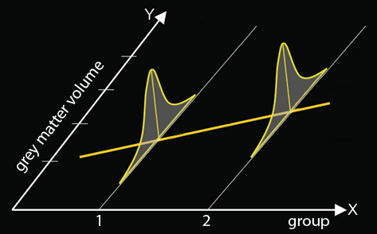
The General Linear Model
Y = Xβ + ε
Voxel Intensity: a function modelling different things that lead to differences between scans
Example:
Two-Group Comparison
V = β₁(G1) + β₂(G2) + β₃(covariates) + β₄(global volume) + μ + ε
V = β₁(AD) + β₂(HC) + β3(life stress) + β4(global volume) + μ + ε
Notes:
In this example by the MfD group 2009, we are looking at differences in Grey matter concentrations between a group of healthy controls and Alzheimer’s Disease patients.
We add predictor variables for each to the GLM to assess whether there is a significant difference based on group.
The GLM controls for covariates that may affect GMC, so we are also investigating whether the differences in grey matter are still present when controlling for a covariate that may affect both groups (in this case life stress). As you can see Global Volume is included at the end as its own covariate. It is essential to account for this as differing volumes of brain regions will vary depending on the global brain volume.
Two way of incorporating information regarding global volume during our model building is to either use the “global normalisaton” tab in SPM to specify this covariate, or to perform “proportional scaling,” which scales all voxels of the brain based on the total incranial volume.

Slide 43
Mass Multivariate Approach
We start off with the assumption that there are no signals/effects in our data.
That is our Null Hypothesis (H0)
Tested using parametric tests such as T-test and F-Test
Standard parametric tests are used to test the null hypothesis (must be normally distributed)
T-test: Used to check if two samples have the same mean
F-test: Used to check if two samples have the same variance
Smoothing of Segmented images is required for normal distribution of residuals
Residuals: The difference between data and the scaled regressor
Notes:
The standard parametric statistical procedures (t-tests and F-tests) are used to test the hypotheses, so they are valid providing that the residuals, once fitted to the model, are independent and normally distributed. While the residuals should be independent, there are reasons to them not being normally distributed. Given that original segmented images contain values between 0 and 1, some numbers can be close to either extremes. Thus, only by smoothing the segmented images does the behavior of residuals become more normally distributed (Ashburner & Friston, 2000).

Slide 44
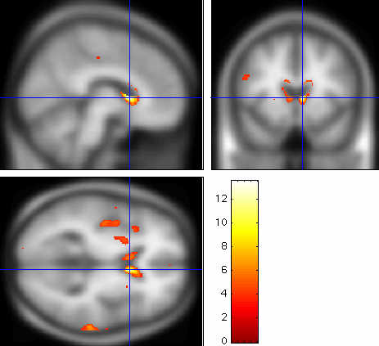
Statistical Parametric Maps (SPM)
Mass univariate independent statistical tests conducted for every voxel (with around 100,000 voxels, VBM runs 100,000 tests)
The results of these tests are displayed as SPMs
SPM can display clusters of significant differences in grey matter concentrations (GMC) between the two groups/variables of interest
Notes:
In VBM we run an independent statistical test for every voxel. Thus, if we have 100,000 voxels, we run 100,000 tests.
The results of all these tests are clustered together and displayed as Statistical Parametric Maps, or in short, SPMs.
SPMs are image processes with voxel values that are, under the null hypothesis, distributed according to a known probability density function, usually the specific T or F distributions.
So basically, SPMs can display clusters of significance of grey matter concentrations, for example between two groups or between two variables of interest.

Slide 45
Multiple Comparisons
More tests = More false positives generated
a t-test performed at p < .05 has a 5% chance of at least 1 false positive
100,000 tests = 5,000 false positives
Thus, multiple comparisons require good statistical corrections in order to be valid
Notes:
However, since SPMs incorporate hundreds of thousands of tests, many false positives are generated.
For example, a T-test with a p-value of < 0.05 has a 5% chance of at least one false positive. With 100,000 tests, that would lead to 5,000 false positives.
To fix this inherent issue with multiple comparisons, we need to employ statistical corrections to ensure the validity of our tests.

Slide 46
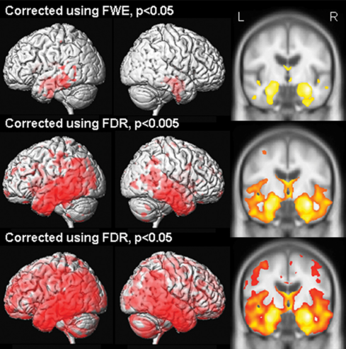
Statistical Corrections
There are three main corrections we can use
Bonferroni correction
False Discovery Rate
Random Field Theory/Family-wise Error
Notes:
So, there are three main corrections that we can use for multiple comparisons.
Bonferroni,
False discovery Rate,
And Random Field Theory/Family-Wise Error

Slide 47
Statistical Corrections
Bonferroni
Treats each voxel separately
P value threshold is set to equal number of tests run
Assumption: all tests are independent
Problems with SPM: many voxels are highly correlated with adjacent voxels (this effect increases with smoothing)
False Discovery Rate
Treats each voxel separately
Calculates expected false positives rate within uncorrected, already detected positives
More sensitive, but less specific
Random-Field-Theory/Family-Wise Error
Looks at pixel’s width of smoothing kernels (“resels”) instead of voxels.
Good choice for highly correlated voxels of a VBM SPM
Data is treated as continuous measurement instead of independent
Gaussian random field theory is more appropriate choice than Bonferroni or False discovery Rate for VBM
Notes:
For Voxel Based Morphometry, Random Field theory is the best choice to use.

Slide 48
Multiple Comparisons
Must base corrections on peak heights (voxel-wise) vs. cluster extent as smoothness of residuals is not uniformly distributed in VBM (Mechelli, Price, Friston & Ashburner, 2005)
Why not uniformly distributed?
Underlying neuroanatomy is non-stationary
Smoother regions will have larger clusters, and less-smooth regions will have smaller clusters
Therefore, bigger blobs expected in smoother regions, purely by chance
Notes:
Important to consider that we must look at peak wise corrections rather than cluster wise corrections. This is mainly due to smoothing of residuals not being uniformly distributed in VBM.

Slide 49
Global Effects
Global effects need to be modelled in the statistical analysis
Regional volumes differ as a function of whole brain volume
Regional studies must correct for global brain volume by counting either:
Total Grey matter volume
Total intra-cranial volume
Notes:
As mentioned in a previous slide with the GLM equation example, global brain volume is a constant covariate that needs to be accounted for in our statistical analysis. Brain volume in a specific region would be smaller or larger in one brain or the other depending on the whole brain volume. Regional studies must therefore correct for this by accounting for either Total Grey Matter volume or Total Intra-cranial volume, but this largely depends on your research question.

Slide 50
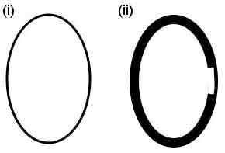
Global Effects
(i) is globally thinner, but locally thicker than (ii); which effect do we care about?
For regional studies we tend to look at differences in local thickness!
Fig. (2). Global and localized inferences may identify different brain regions. In the example, images (i) and (ii) differ at both global and local levels. Without modelling some kind of “global'' value as a confounding effect, the comparison would identify greater volume for image (ii) relative to image (i) in all voxels apart from the thinner area on the right side of image (ii). When global differences are discounted, however, the same comparison will detect greater volume for image (i) relative to image (ii) in the thinner area on the right side of image (ii) only.
(Mechelli, Price, Friston, and Ashburner, 2005)
Notes:
Here is a brief example of Global Effects:
So we can see “Brain (i)” is overall thinner than “Brain (ii)”. However, if we are conducting regional studies, and our are of interest is this right area of these brains, then we see that “Brain (i)” is THICKER than Brain (ii) in that specific area, RELATIVE to it’s whole brain volume.

Slide 51
Maintaining Statistical Validity
Important to maintain statistical validity as:
VBM assumption
that voxel intensity errors are normally distributed
ensured via Gaussian RFT smoothing
BUT
Smoothed image residuals NOT always normally distributed
Effect is increased when comparing single subject vs. group studies -> false positives are inflated
Can be counterbalanced by having groups of equal size
Notes:
So to recap, the maintaining of statistical validity is very important in VBM, as it works on the assumption that intensity errors are normally distributed (which should be ensured via Gaussian Smoothing).
However, as I talked about in previous slides, the smoothed images are not always normally distributed, and this effect is even more pronounced when we compare single subject to group studies, which tends to inflate false-positive rates. But the inflated false positives can be counterbalanced by using groups that are equal in size.

Slide 52
Longitudinal Analysis
Boundary shift integral (BSI)
Allows us to get accurate estimates of whole brain volume changes -> (BUT misses out on regional changes)
Fluid Registration
Allows us to do very detailed alignment of longitudinal scans, allowing for regional volumes to be computed -> computed by Jacobian determinants of Warps -> Jacobian determinant encode relative volume before and after warping
Voxels at later time point are warped to voxels from the start
Notes:
BSI allows us to get rather accurate estimates of whole brain volume changes.
Fluid Registration on the other hand allows us to do a detailed alignment of longitudinal scans allowing for regional volumes to be computed. These are computed by the Jacobian determinants.

