Slide 1
Co-registration and Spatial Normalization
Methods for Dummies, 2021-2022
8th Dec 2021
Hee Kyung Park, India Walford

Slide 2
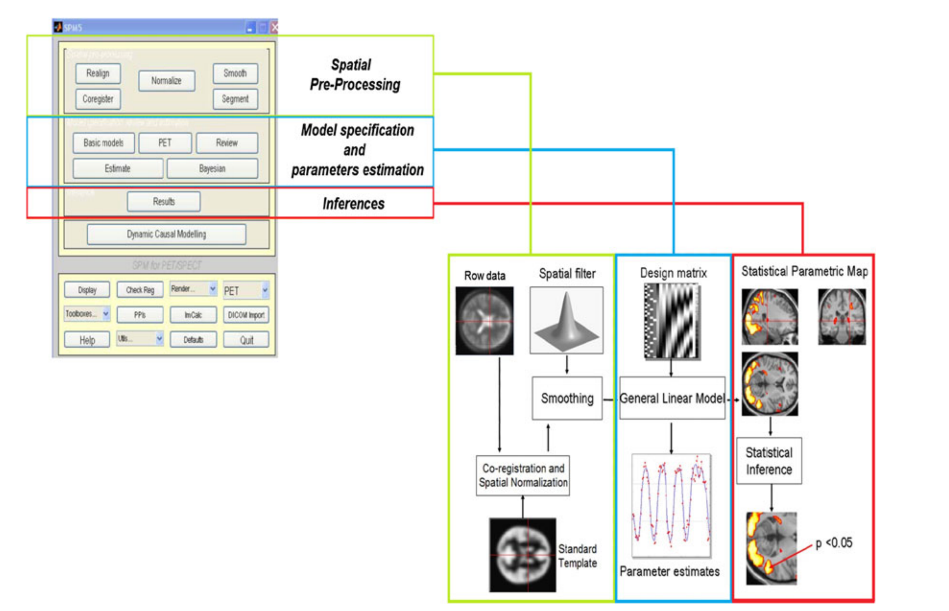
General overview of SPM analysis
Vizza, P., Tradigo, G., Messina, D. et al. Methodologies for the analysis and classification of PET neuroimages. Netw Model Anal Health Inform Bioinforma 2, 191–208 (2013).

Slide 3
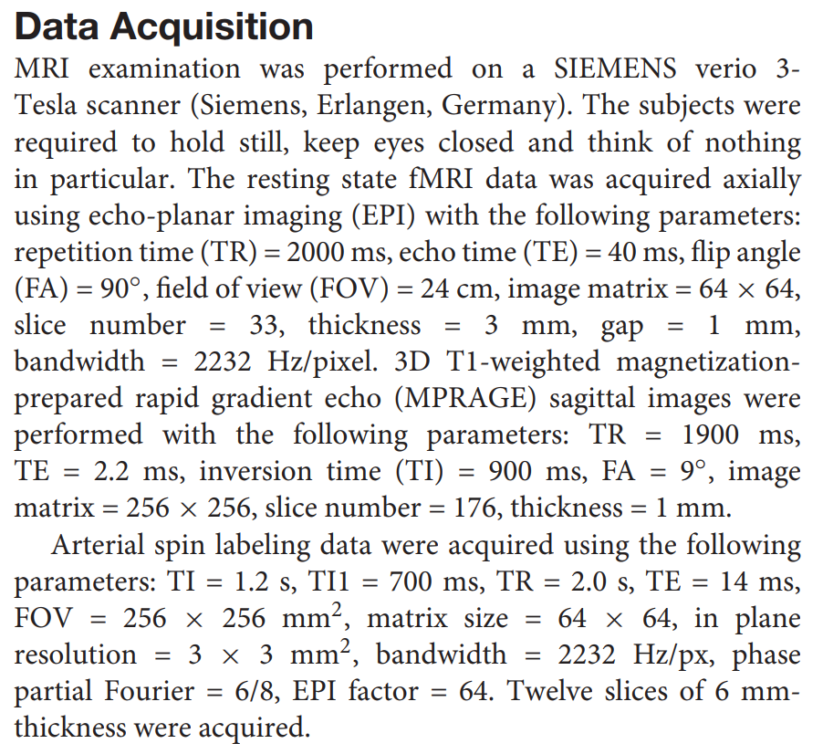
Examples: Methods
Frontiers in Neuroscience. 2019;13:738

Slide 4
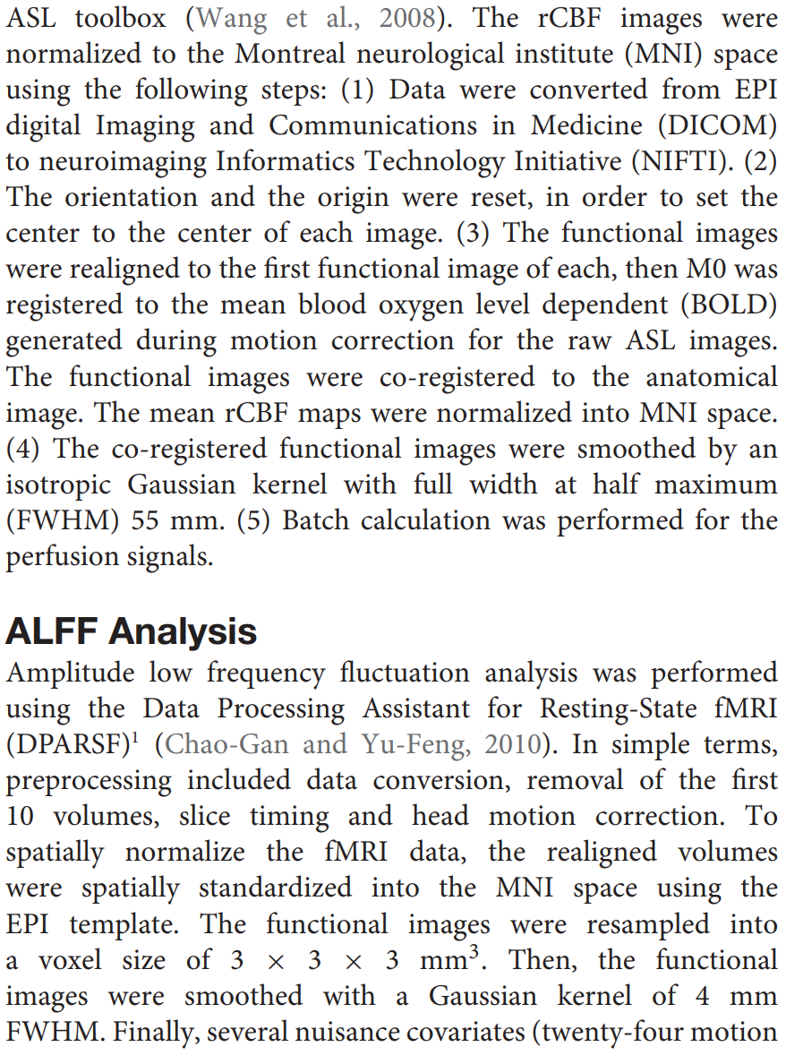
Examples: Methods
The functional images were co-registered to the anatomical image.
Frontiers in Neuroscience. 2019;13:738

Slide 5
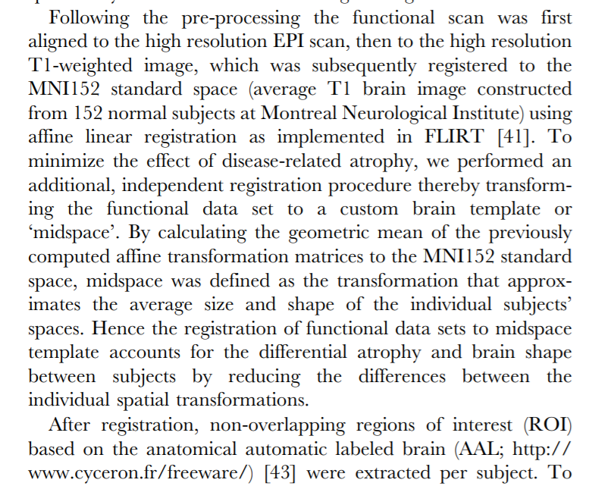
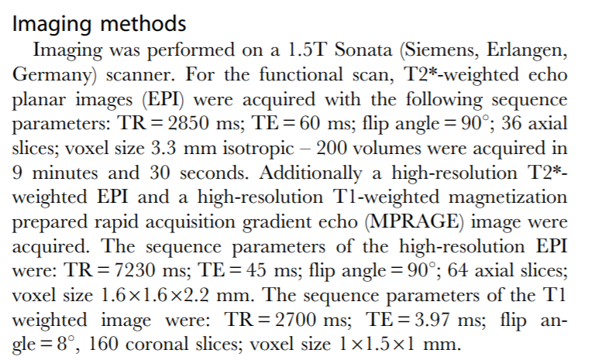
The functional scan was aligned to the high resolution T1-weighted image.
PLoS One. 2010 Nov 1;5(11):e13788.

Slide 6
Co-registration
Image co-registration: the process of geometrically aligning two or more images so that corresponding pixels representing the same objects may be integrated or fused.
Inter-subject co-registration:
To standardize images and measurements to brain atlases
J Digit Imaging. 2014;27:369-379
https://en.wikibooks.org/wiki/Neuroimaging_Data_Processing/Processing/Steps/Coregistration_and_Normalization

Slide 7
Intra-subject Co-registration
For motion correction
Correction for differences in sequence measurements
The images with various sequences are acquired sequentially.
T1-weighted gradient echo (anatomic data)/T2*-weighted echo-planar (functional data)
Sequence localization disagreements when selecting regions of interest
To mix functional and anatomical information of PET and MRI, respectively
Functional-to-structural misalignment may occur, which lead to misinterpretation of the functional significance in studies using fMRI.
AJNR Am J Neuroradiol. 2018 Dec;39(12):2332-2339
J Digit Imaging. 2014;27:369-379
https://en.wikibooks.org/wiki/Neuroimaging_Data_Processing/Processing/Steps/Coregistration_and_Normalization

Slide 8
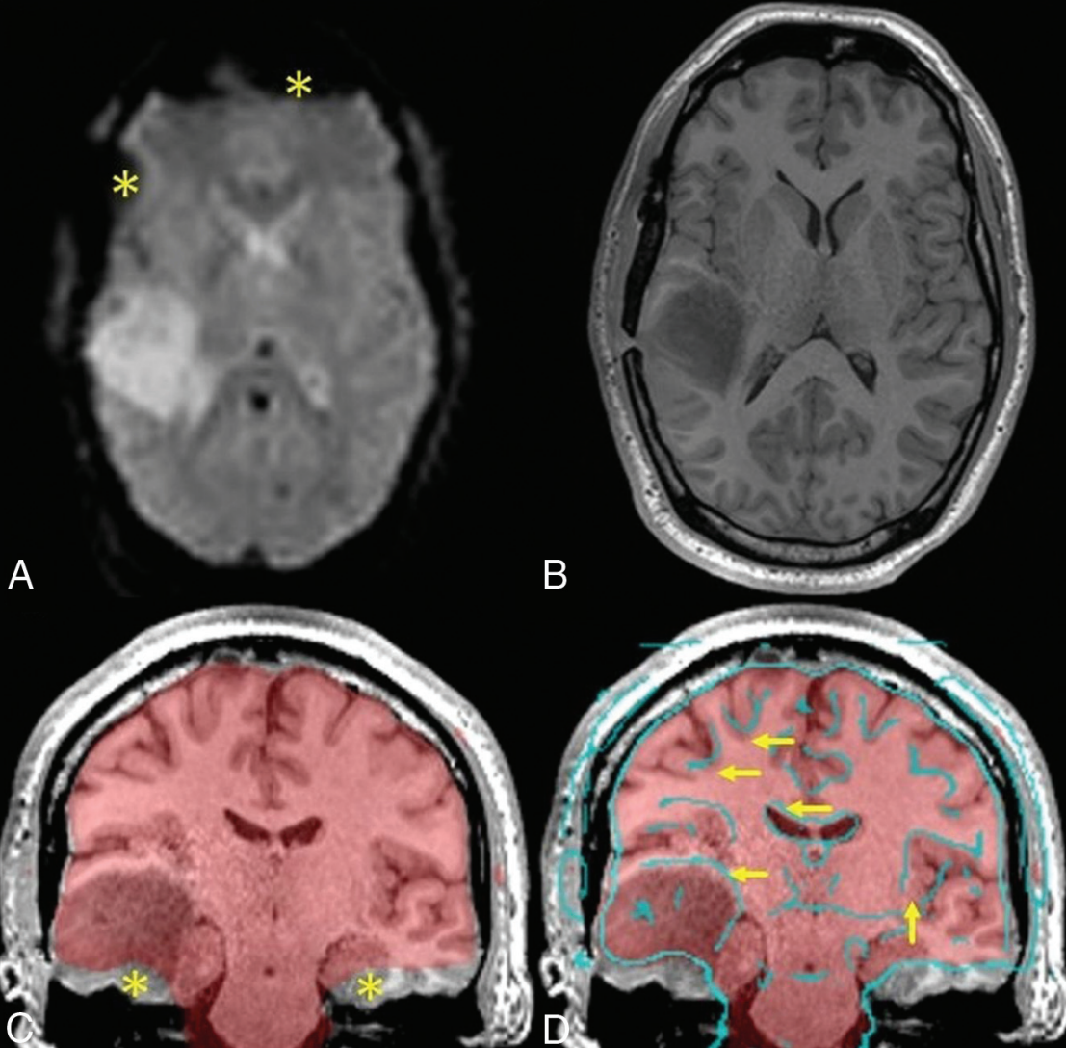
T2*EPI
Inherently poor resolution of EPI
Signal drop-out from susceptibility artifacts near the sinuses and craniotomy (*)
A
B
B. T1-MPRAGE
Anatomic data
MPRAGE: magnetization prepared rapid gradient echo
EPI: echo-planar imaging
C. The fusion image of the average EPI mask over the MPRAGE image
Signal drop-out at the skull base(*)
C
D
D. The fusion image of edge-enhanced EPI
Slight misalignment (arrows) due to patient motion between MPRAGE and EPI
AJNR Am J Neuroradiol. 2018 Dec;39(12):2332-2339

Slide 9
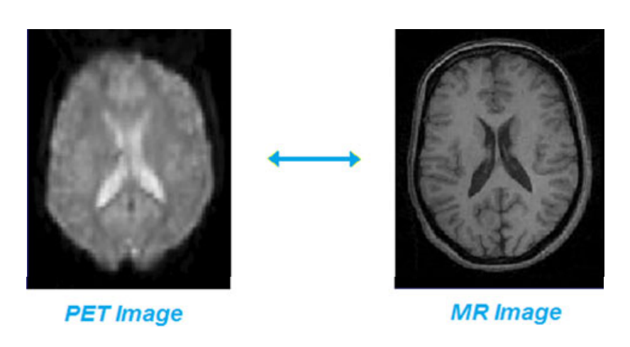
PET and MR images for co-registration step
Vizza, P., Tradigo, G., Messina, D. et al. Methodologies for the analysis and classification of PET neuroimages. Netw Model Anal Health Inform Bioinforma 2, 191–208 (2013).

Slide 10
Affine transformation is used in co-registration
Translation
Rotation
Shear
Zoom
Previous slides, MfD, 2019-2020, Baihan Wang

Slide 12
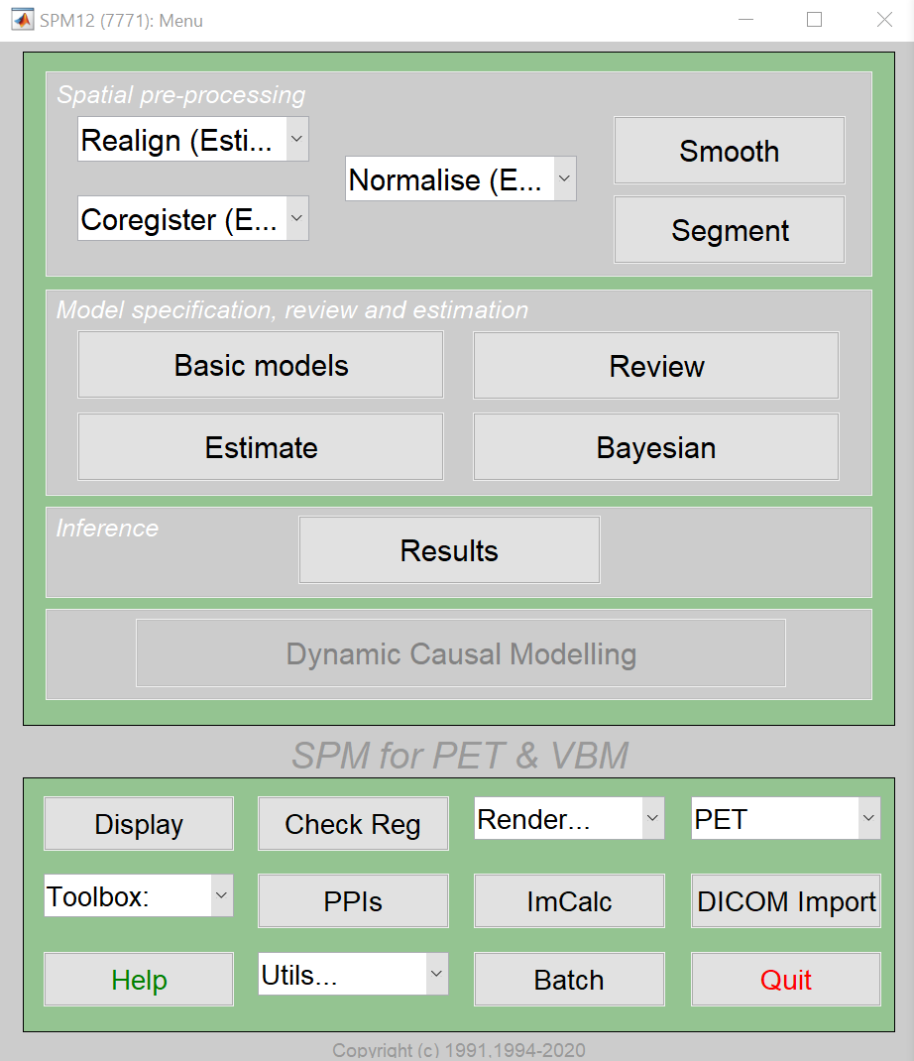
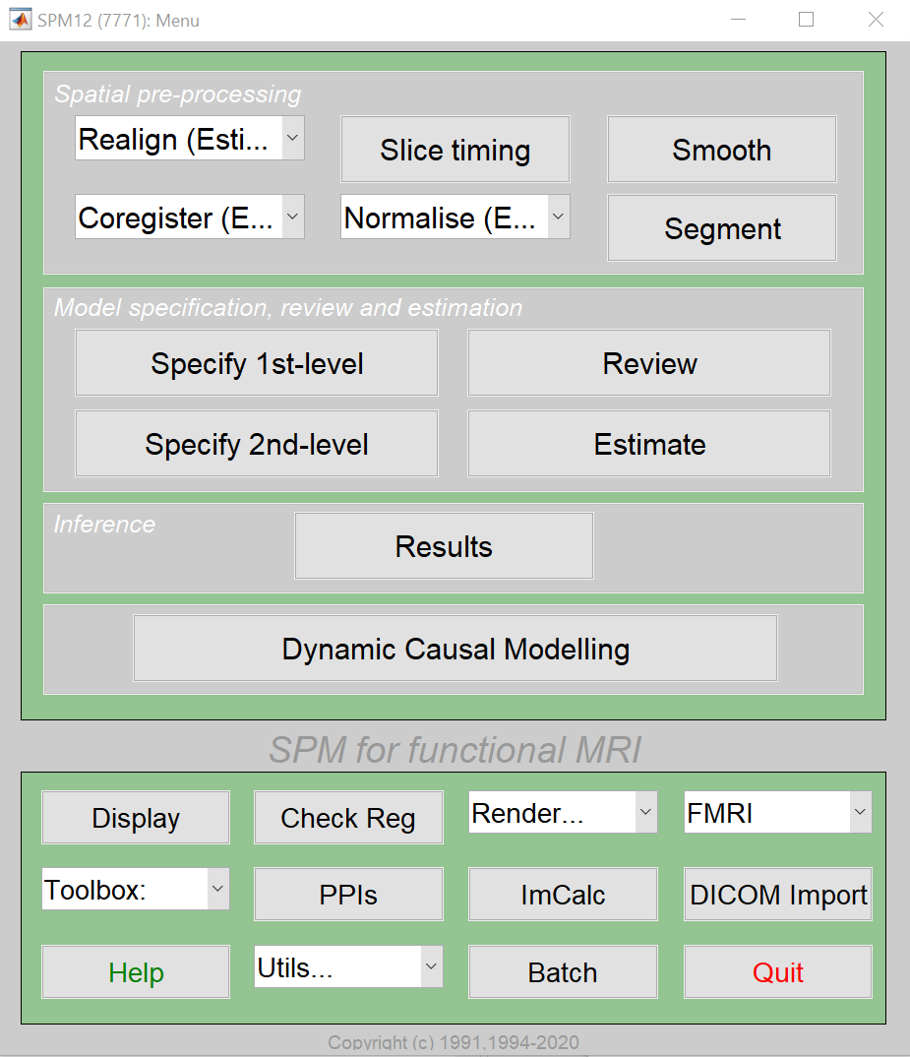
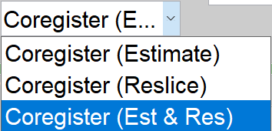

Slide 13
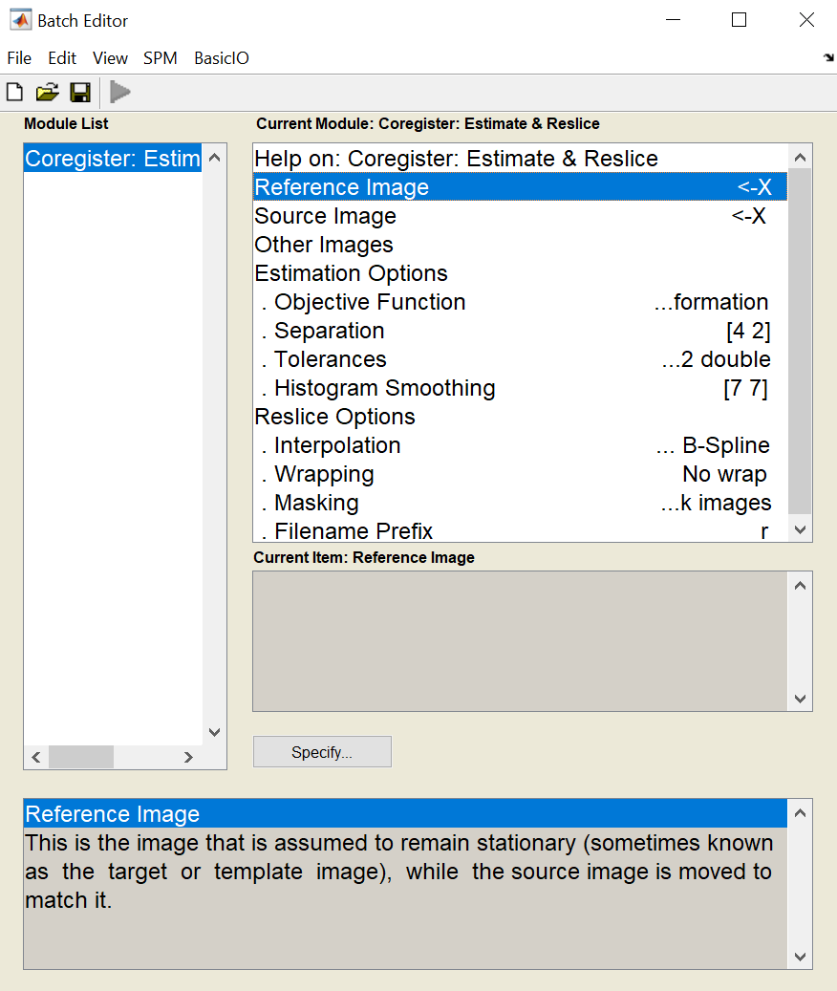
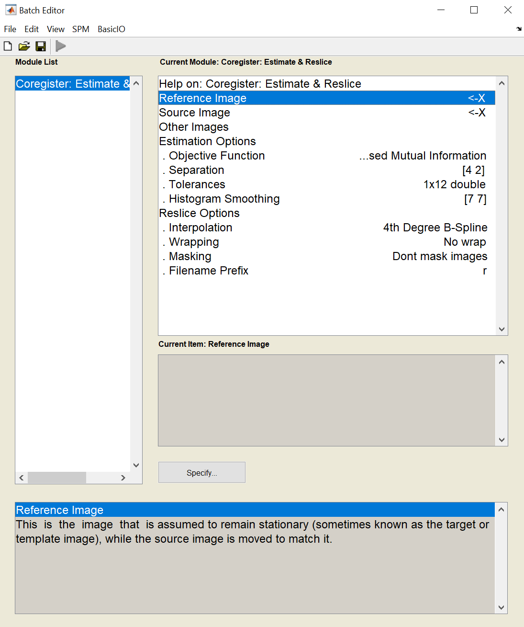
Within the SPM Batch GUI
A Reference Image: image which other images will be warped to match

Slide 14
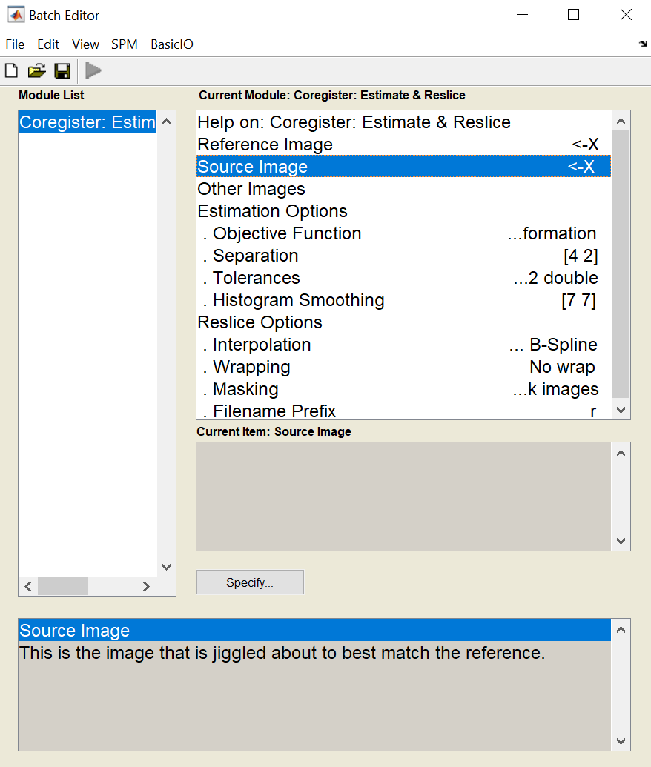
Within the SPM Batch GUI
Source Image (s): image(s) which to be warped to match the Reference Image

Slide 15
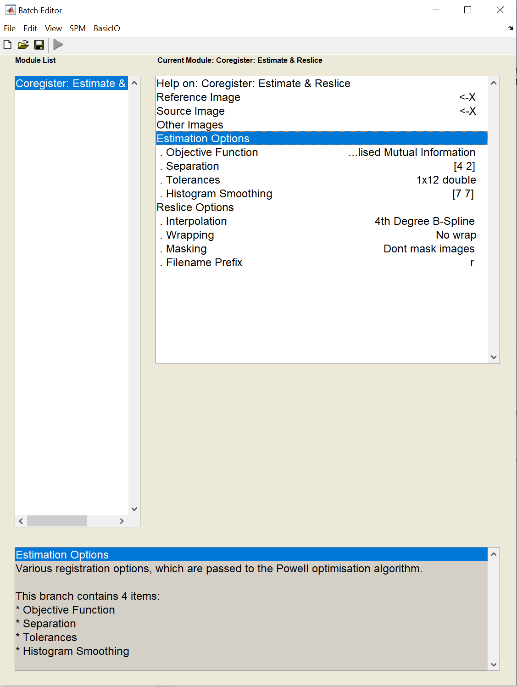
Within the SPM Batch GUI
Estimate and Reslice corrects for patient movement by aligning intra-series images
Important for modalities that have extended acquisition times and rely on temporal resolution, such as dynamic contrast-enhance MRI
Vizza, P., Tradigo, G., Messina, D. et al. Methodologies for the analysis and classification of PET neuroimages. Netw Model Anal Health Inform Bioinforma 2, 191–208 (2013).

Slide 16
Within the SPM Batch GUI
Estimation
Within-subject registration using a rigid-body model
Fixed Image: is assumed to remain stationary
Moved Image: is jiggled about the best match the fixed image
Other Image: any images that need to remain in alignment with the moved image
https://www.fil.ion.ucl.ac.uk/spm/

Slide 17
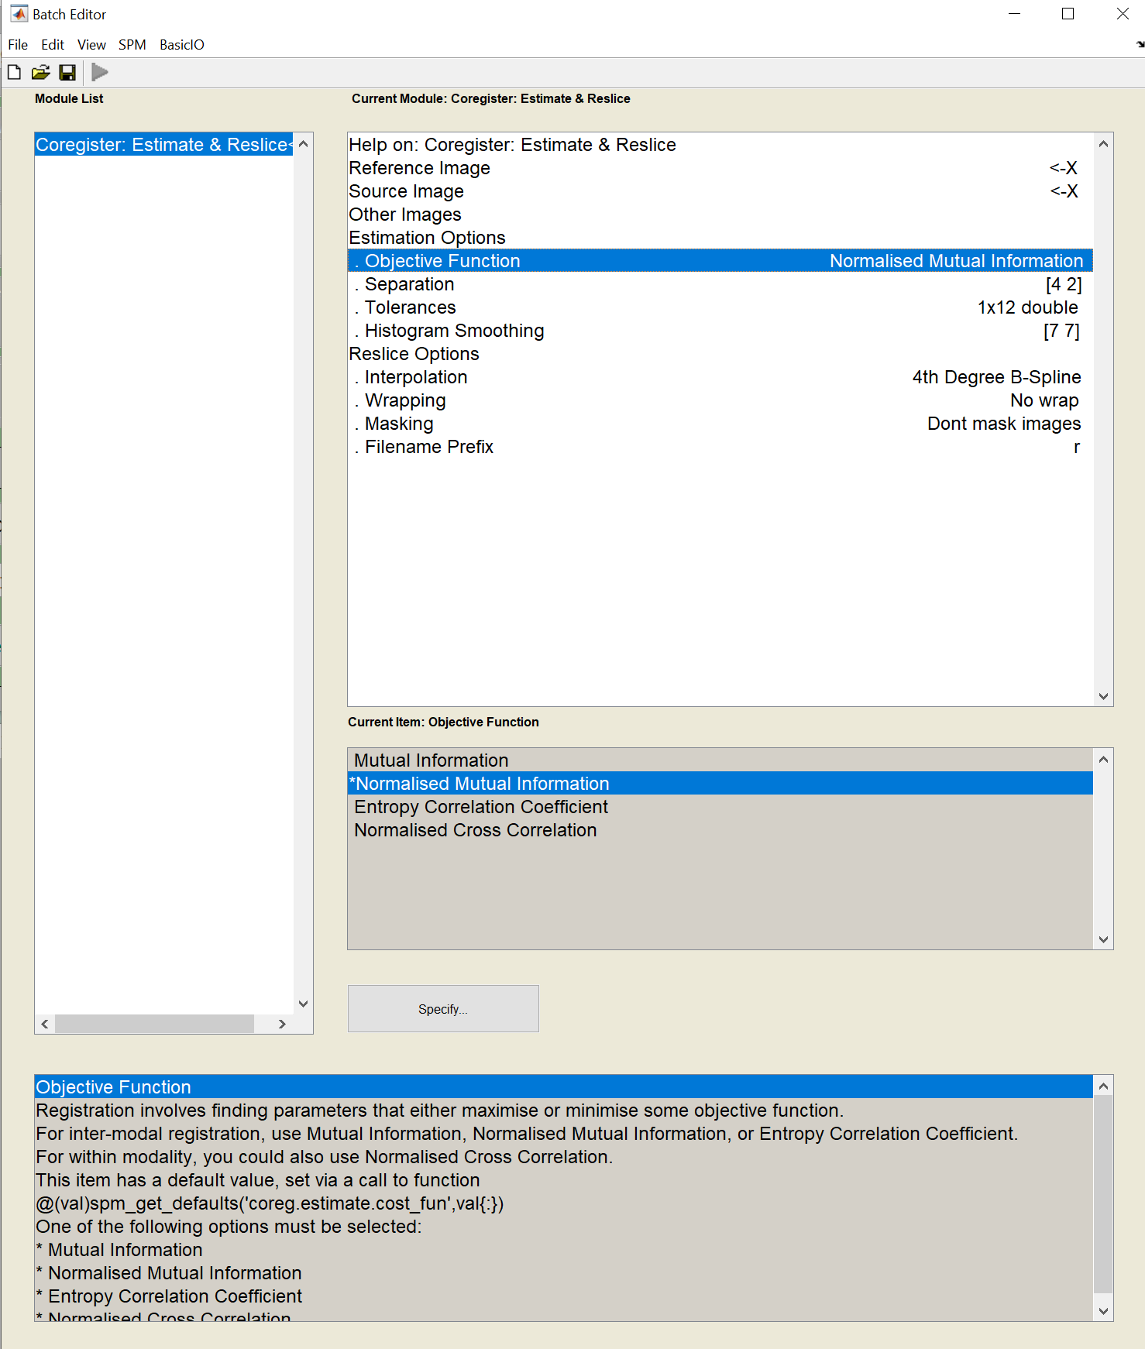
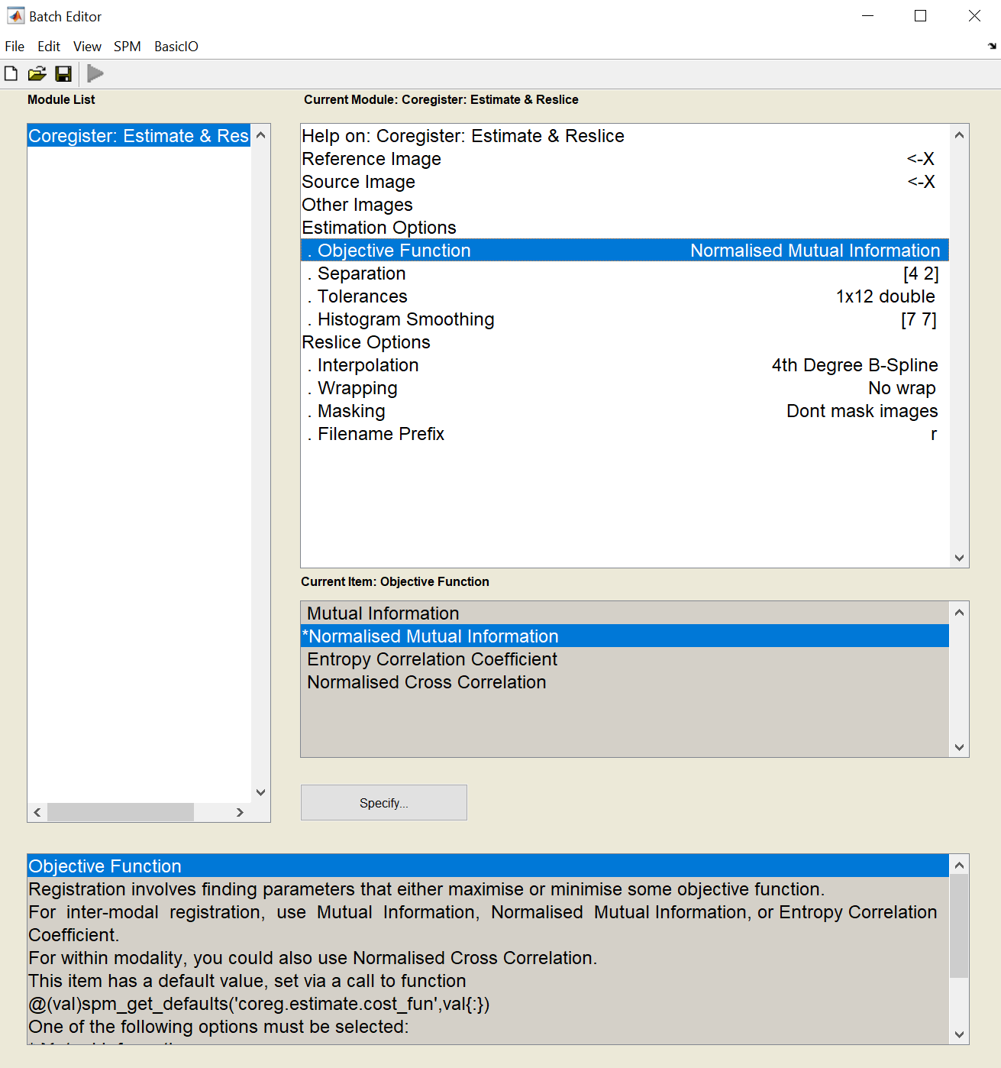
Within the SPM Batch GUI
Estimation
The objective (cost) function : the parameter that is either minimized or maximized during estimation.
Normalized mutual information (NMI)
Cross-correlation
Mutual information (MI)
Correlation ratio (CR)
https://www.fil.ion.ucl.ac.uk/spm/

Slide 18
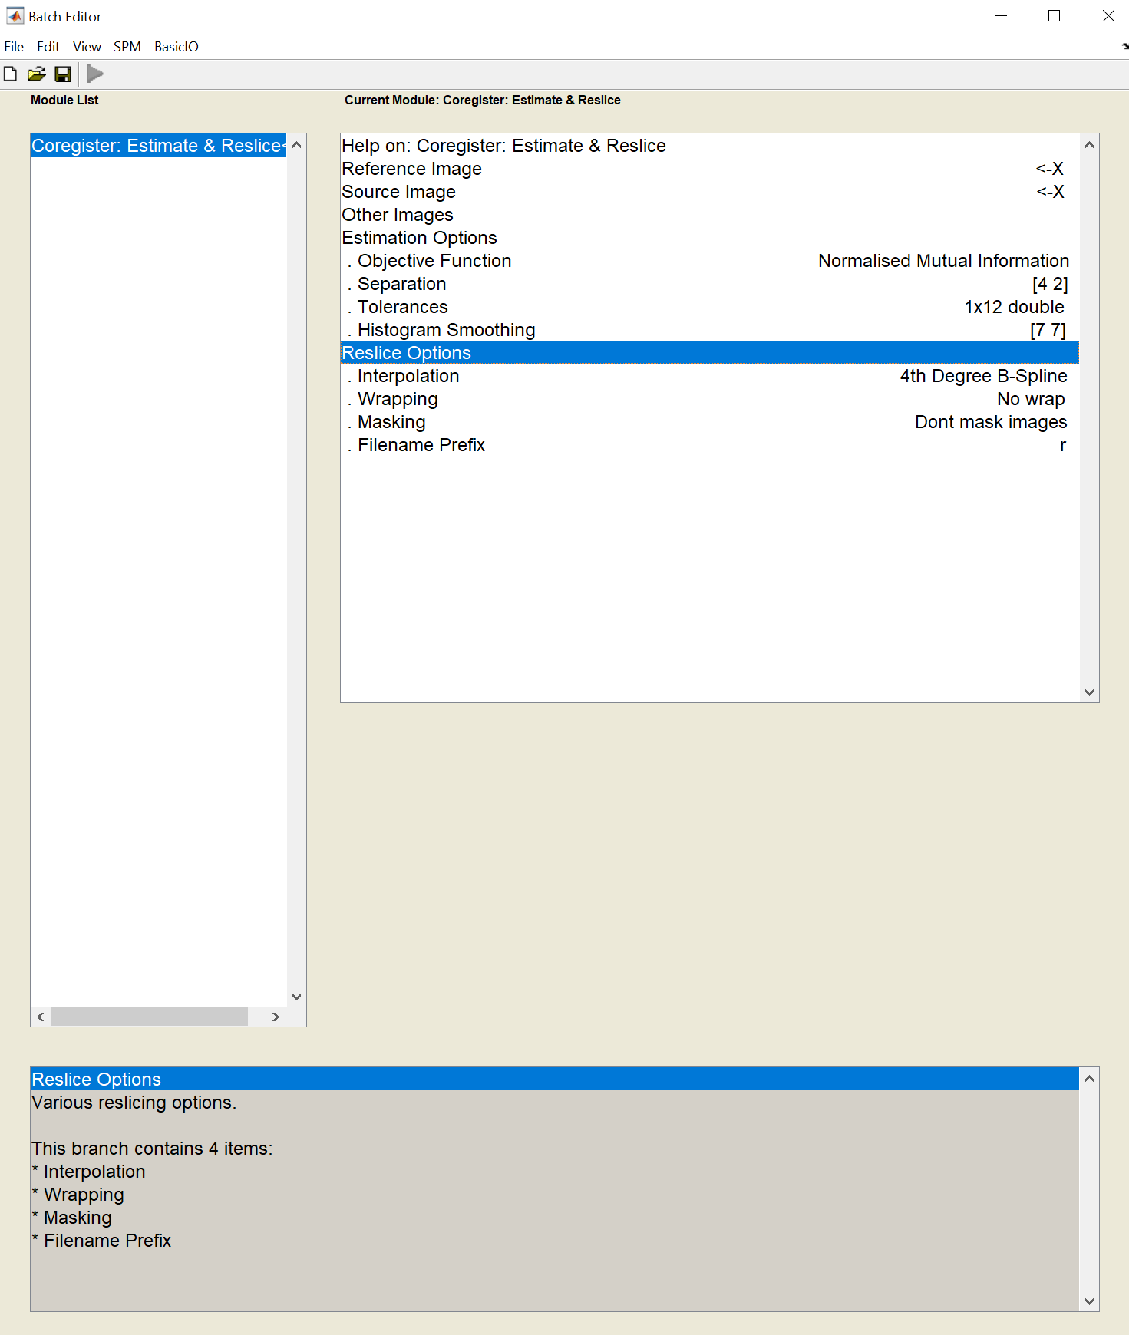
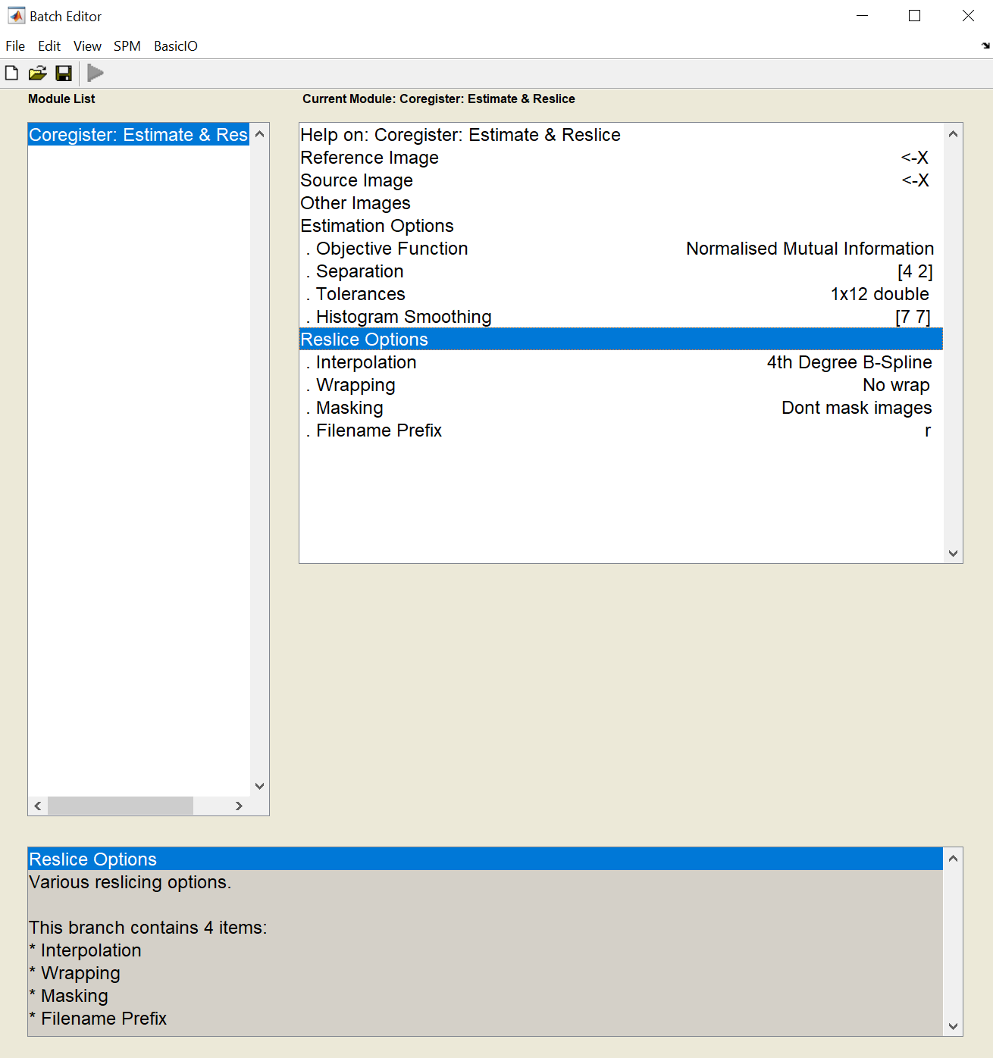
Within the SPM Batch GUI
Reslice
Reslice images to match voxel-for-voxel with an image defining some space
Default prefix of the filenames: ‘r’’
https://www.fil.ion.ucl.ac.uk/spm/

Slide 19
The voxel-to-voxel affine transformation matrix
The histograms for the images in the original orientation
The histograms for the images in the final orientation
The registered images are displayed at the bottom.
https://www.fil.ion.ucl.ac.uk/spm/
Vizza, P., Tradigo, G., Messina, D. et al. Methodologies for the analysis and classification of PET neuroimages. Netw Model Anal Health Inform Bioinforma 2, 191–208 (2013).

Slide 20
In summary
Co-registration: the process of geometrically aligning two or more images, in particular functional and structural images (T2*EPI and T1 MPRAGE)
Affine transformation (translation/rotation/shear/zoom)
To maximize mutual information between images

Slide 21
Spatial Normalisation

Slide 22
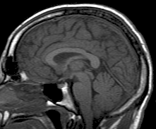
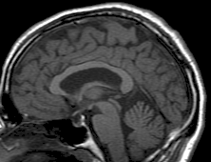
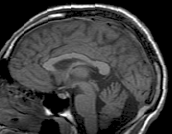
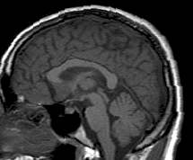
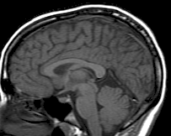
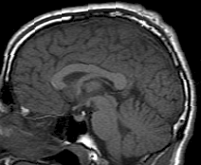
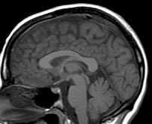
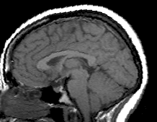
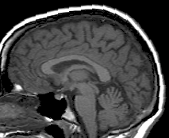
Why Normalise?
Movement of co-registered images into standardised space.
Inter-individual variability in brain shapes and size.
Difficult to attribute activation to specific anatomical structures.
Volume varies from ~1100 – 1500cc. Differences of ~35% are possible.
Permits voxel-wise comparison between subjects

Slide 23
Tailrach Atlas
Based on single post-mortem dissection
Uses Broodman areas as labels for brain regions
Anchors; Anterior Commissure – Posterior Commissure (AC-PC)
Talaraich & Tournoux, 1988
Notes:
The Talaraich Atlas is the oldest (1988), based on photographs of thick sagittal anatomic sections taken from autopsy of a single woman's brain. Hand-drawn tracings of these photographs were then created and placed on rectangular coordinate system whose reference was the anterior commissure-posterior commissure (AC-PC) line. However, using one single brain is not enough; would be better to take an average of many brains to get a typical shape. The two spaces can be converted into one another, albeit with some difficulty, as the Talaraich brain has larger temporal lobes than the MNI.

Slide 24
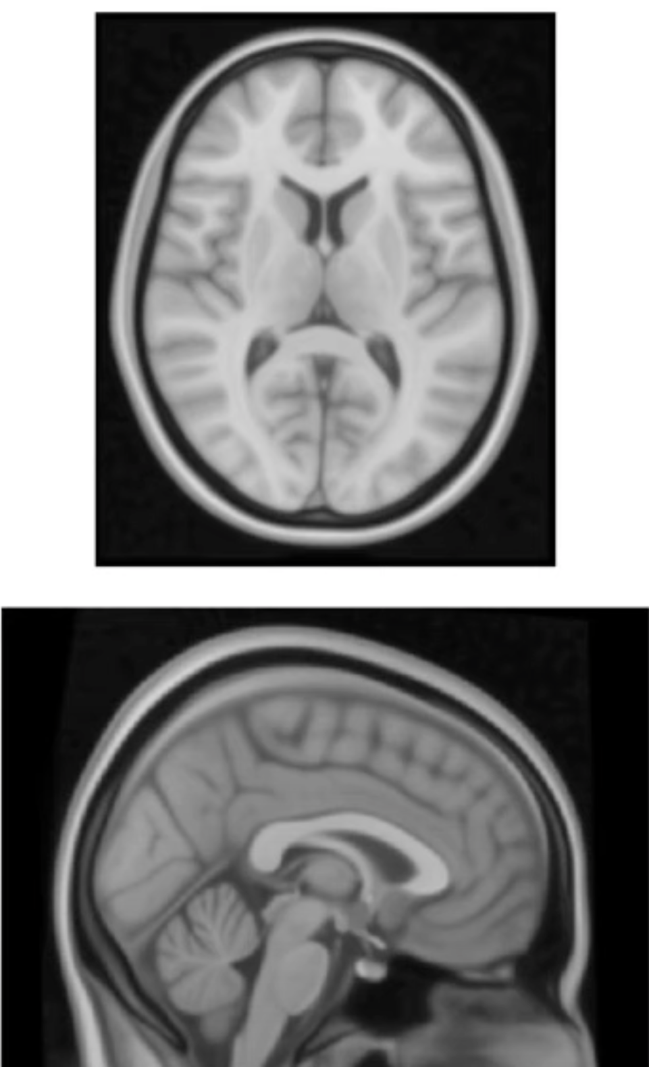
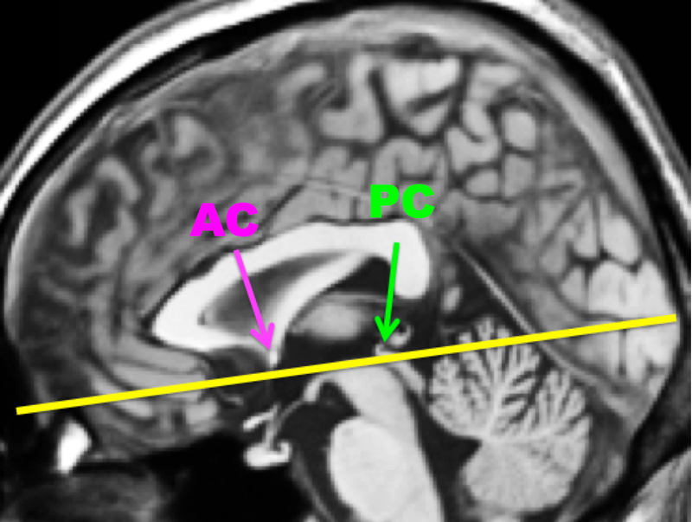
Montreal Neurological Institute Template MNI152
Replaced Tailrach
Different templates (e.g., Colin27, MNI305)
Average structural scan of 152 brains
Standard template in SPM
Represents what’s ‘common’;
E.g., Insular & ventricles are sharp.
Parietal lobe less defined
Can refer to locations with reference to anchor point; AC-PC line.
Notes:
If using a different population, say children or elderly, consider using a different template.

Slide 25
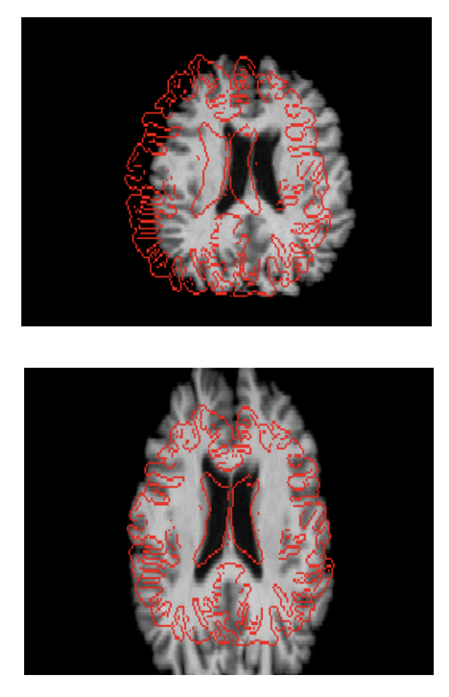
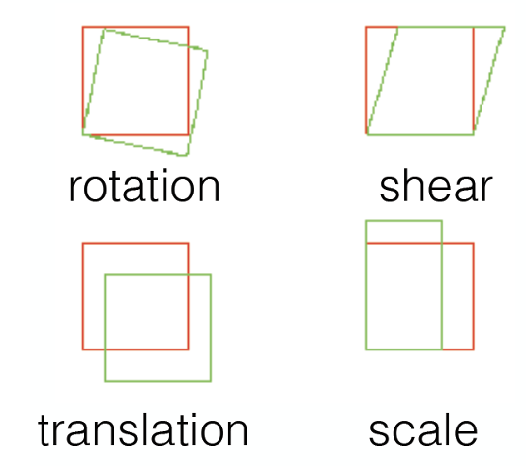
Linear Transformations
Firstly, linear (affine transformations) are used.
Linear refers to equal transformations in opposite directions
12 Degrees of Freedom (DOG). 3 axes.
zoom
Notes:
Whereas translations and rotations are easy to do, zooms and shears are a little different. Zooms either shrink or enlarge an image, whereas shears take the diagonally opposite corners and stretch them away from each other.
As with rigid body translations – rotations and translations, zooms and shears have 3 DOF, in the x, y and z co-ordinates. This gives 12 DOF total.
Called linear transformations because a transformation in one direction is accompanied by a transformation of equal magnitude in the opposite direction. E.g., transformation of 1mm to the left implies that a the image has been moved by 1mm *from* the right.

Slide 26
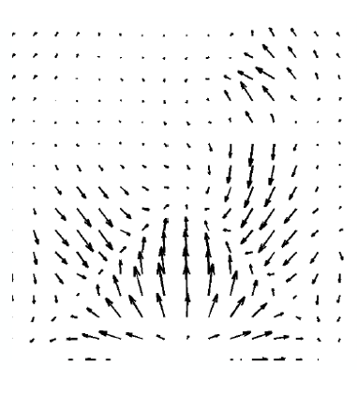
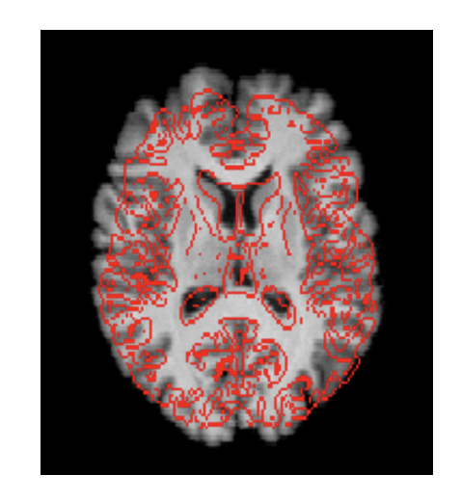
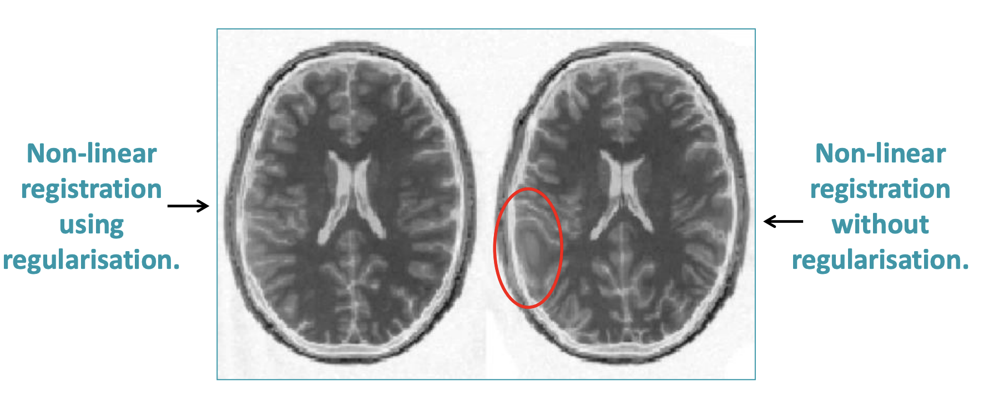
Non-Linear Transformations
Secondly, non-linear transformations (warping) are subsequently used.
1000s DOFs.
Small scale changes.
Moves voxels to template locations.
Regularisation prevents overfitting
Notes:
So, what if we don’t want to have an equal transformation on both sides? Then we can apply non-linear transformations.
A non-linear transformation can enlarge the image in one direction whilst shrinking it in another, such as when you squeeze a sponge, except you squeeze a brain.

Slide 27
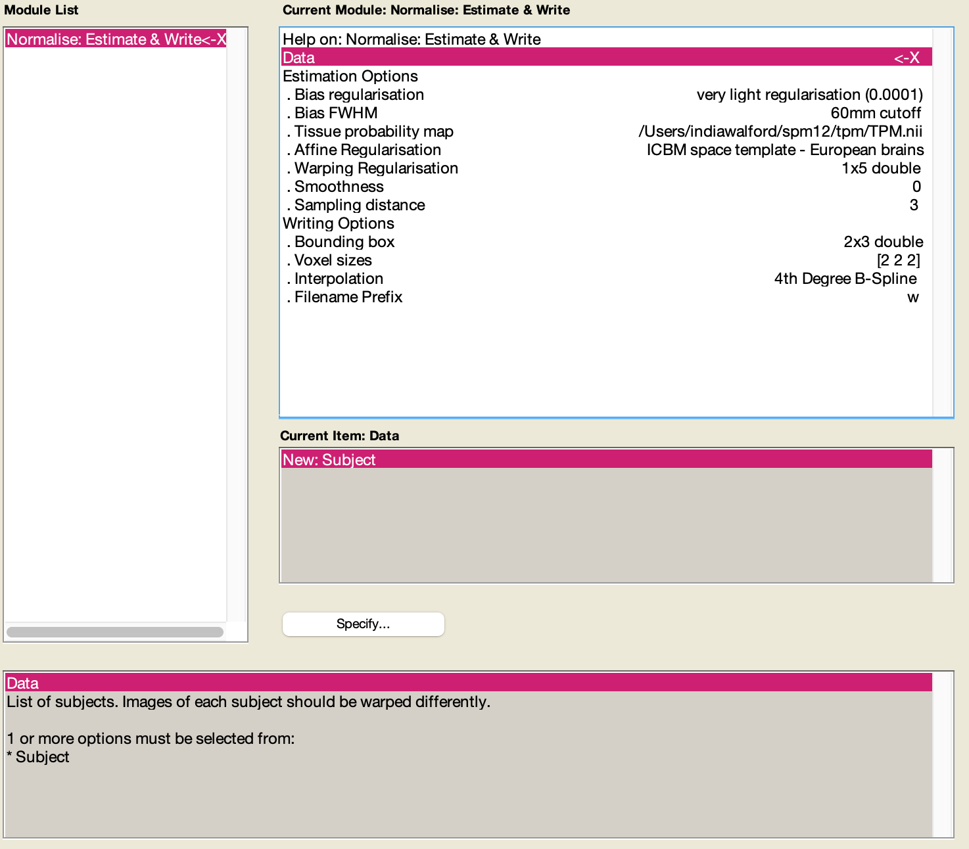
SPM Demo: How to Normalise
Use Normalise, Estimate & Write tool.
In the ‘Data’ section, click on New: Subject.

Slide 28
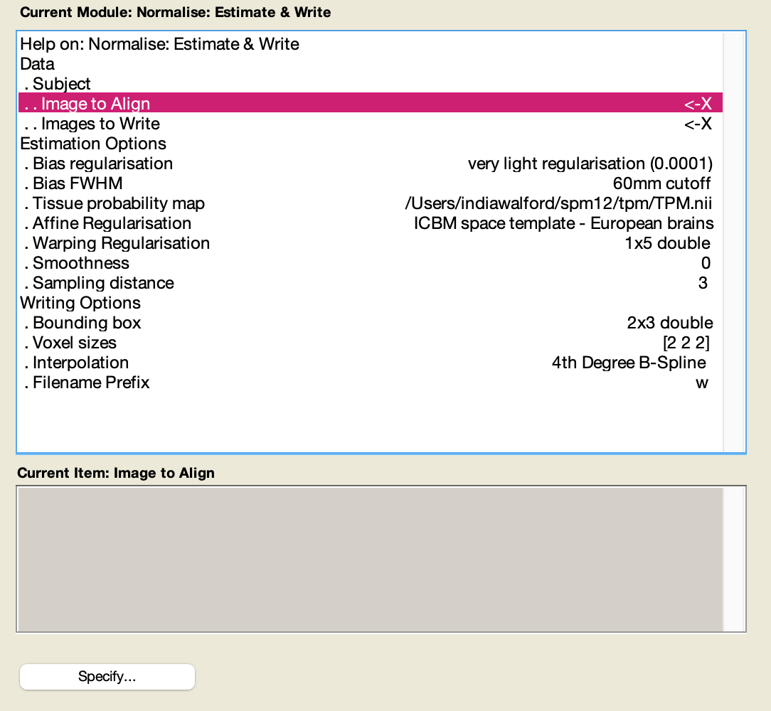
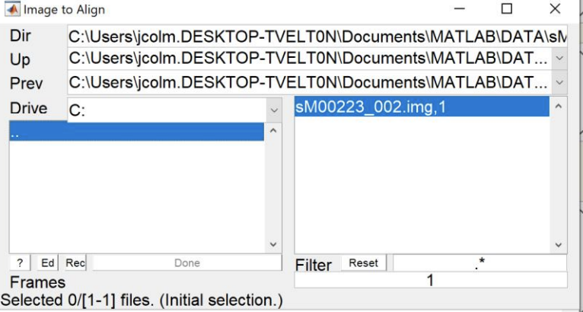
SPM Demo: How to Normalise
Select the structural image to align.
Images to Align:
The image that the template (atlas) data is warped into alignment with.

Slide 29
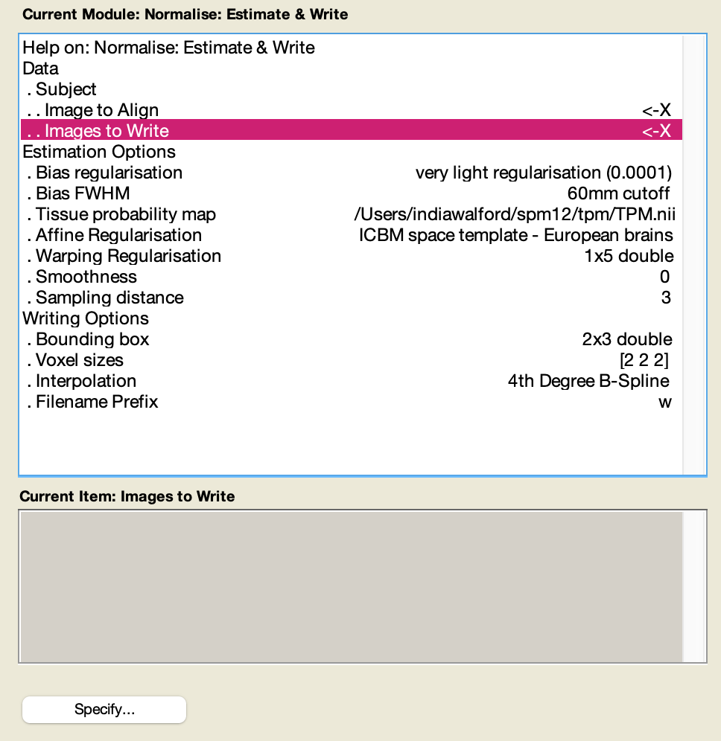
SPM Demo: How to Normalise
Select the functional images to write.
Images to Write:
These are the images for warping according to the estimated parameters.

Slide 30
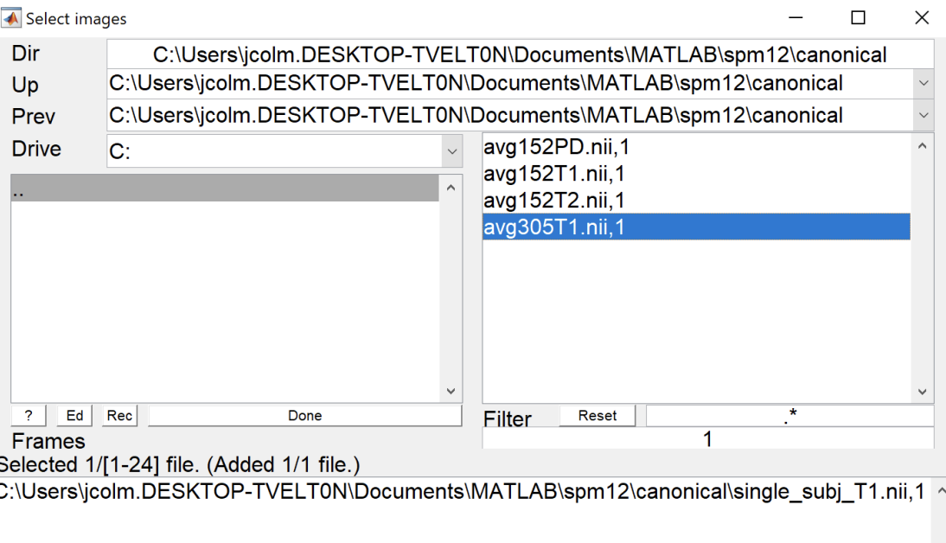
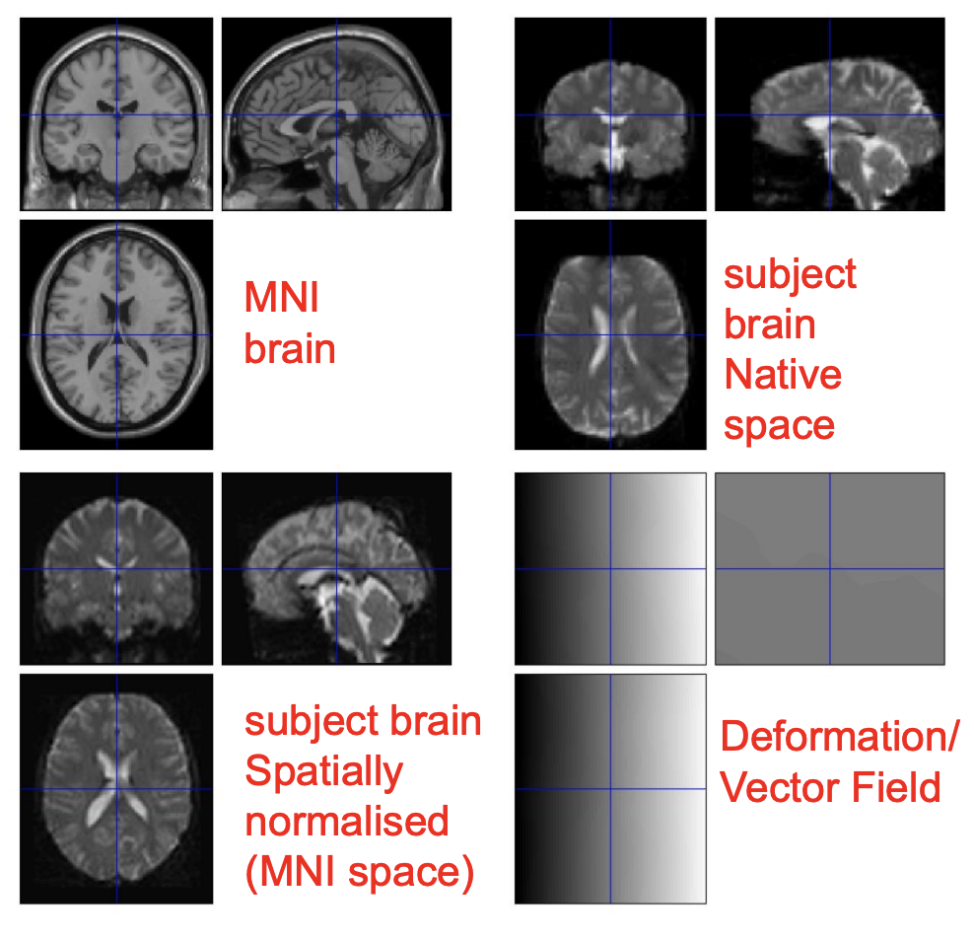
SPM Demo: How to Normalise
Press run! Can take a minute or two.
Unless changed, files will have the default prefix w (for ‘warped’).
Can check results using the ‘CheckReg’ function in SPM.
Go to spm canonical folder, and compare with MNI template.

Slide 31
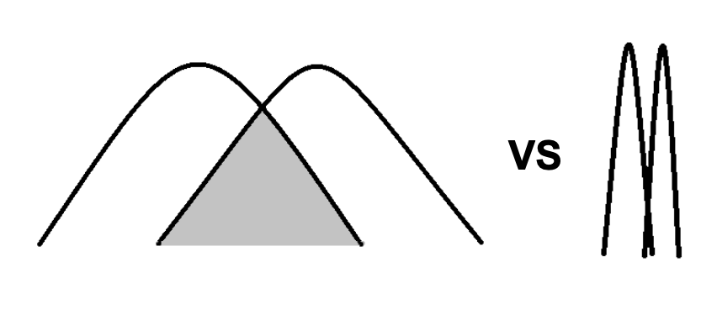
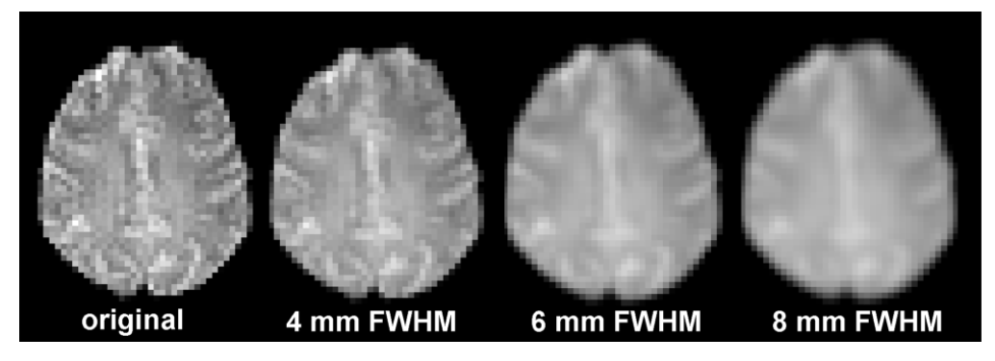
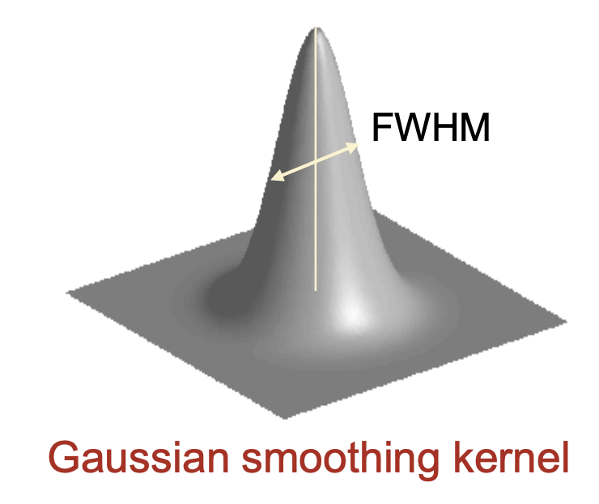
Smoothing
Replace each voxel with a weighted average of that voxel’s neighbour.
Decreases spatial resolution
Why make the images more blurry?
fMRI data is noisy
Smoothing enhances signal to noise ratio (S:N).
Data becomes more normally distributed
Compensation for imperfect registration
Compensation for intersubject variability in neural organisation
Apply Gaussian Kernel. Full-Width at Half-Maximum.
Notes:
Say we have one voxel that is at an extreme to its neighbours, an outlier, smoothing will act to reduce this affect.
Compensation for imperfect registration; Imagine that every subject in an fMRI experiment showed activity in a particular portion of the left inferior frontal gyrus. However, because spatial normalization across subjects is imperfect, these activations will not line up perfectly in a group analysis. Smoothing the data makes it more likely that the activations will overlap, and thus be detected, despite errors in normalization.
Compensation for intersubject variability: Even if spatial normalization was perfect, there still would likely be imperfect alignment of activity patterns (or structural characteristics) across participants. However, although there is general agreement in functional localization across subjects, it is not perfect. Imperfect correspondence in microanatomical landmarks and cytoarchitecture. As in the case of imperfect registration, smoothing the data (often) makes it more likely that common patterns will be detected when looking at a group of subjects.

Slide 32
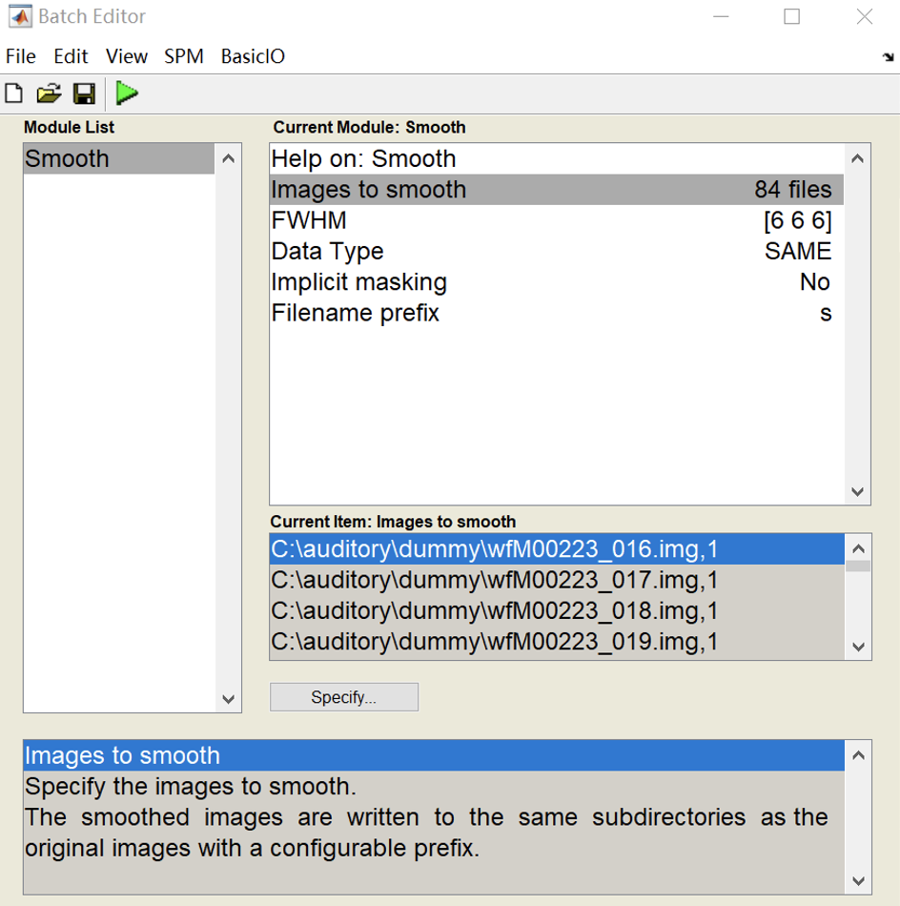
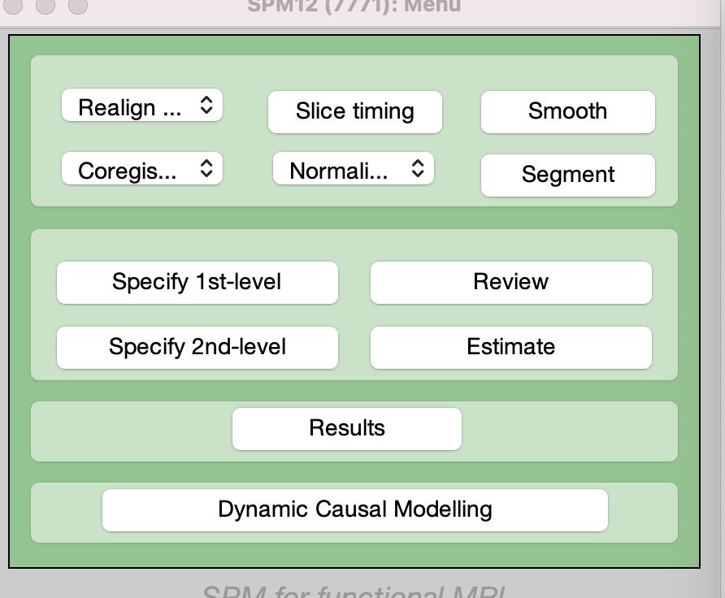
SPM Demo: Smoothing
Select ‘smooth’.
Add images which were spatially normalised, i.e., functional images (prefixed with w).
Adjust FWHM.
Images will be prefixed with s.

Slide 33
Thank you for your kind attention
Q&A

