Slide 1
1st Level Analysis: Design Matrix, Contrasts, General Linear Modelling
Presented by Rita Bertani and Mansoureh Fahimi
Expert: Guillaume Flandin

Slide 2
Part 1:
Convolution
Design matrix
General Linear Model
Presented by Rita Bertani

Slide 3
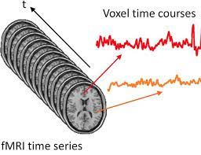
First level (single subject) analysis
Model of relationship between time-varying BOLD MRI signal and expected response induced by task stimuli
→ First level: in each voxel for single subjects
From http://www.mlnl.cs.ucl.ac.uk/pronto/course_slides_2018/ExtractingFeatures_fMRI_2018.pdf
Notes:
Participants in the scan, they do a task, we get number of volumes, and for any given voxel in the brain we estimate the timeseries (how the signal in this voxel varies over time)

Slide 4
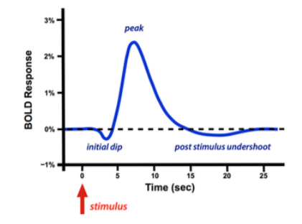
How would a voxel respond if involved in cognitive process X?
To model response in each voxel we need:
Task (input functions) – at what time during the task did a particular condition come up?
Haemodynamic response function (HRF)
From
https://www.vut.cz/www_base/zav_prace_soubor_verejne.php?file_id=193076
Notes:
We are interested in cognitive process X
How would a voxel respond if involved in process X?
To model the response in each voxel we need:
Task (input functions) – at what time during the task did a particular condition come up?
Haemodynamic response function

Slide 5
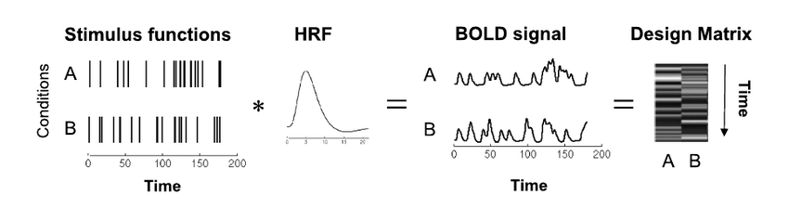
From
https://www.researchgate.net/publication/313497784_Bayesian_Joint_Detection-Estimation_in_Functional_MRI_with_Automatic_Parcellation_and_Functional_Constraints/figures
Convolution: timing of stimuli * haemodynamic response function (HRF)
→ Design matrix
Notes:
Convolution
Model (expectation) of how the signal in a voxel changes over time, if that voxel is processing stimulus A
Then another model is made for stimulus B
The design matrix is a greyscale transposition of this model

Slide 6
From
https://www.researchgate.net/publication/313497784_Bayesian_Joint_Detection-Estimation_in_Functional_MRI_with_Automatic_Parcellation_and_Functional_Constraints/figures
Convolution → assumptions:
Linear relationship between stimulus onset and BOLD response
Notes:
For convolution, we need to assume:
Linear relationship between stimulus onset and BOLD response
Stimulus presented every 2 seconds → change in BOLD signal every 2 seconds
When is it not linear? When a second stimulus is presented too close to the first one → observed BOLD response to second stimulus still reflecting BOLD response to first stimulus
Another thing to keep in mind: we only convolve signal related to neural activity, not signal related to movement for example

Slide 7
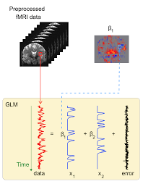
General Linear Model (GLM)
GLM – multiple linear regression
Mass univariate approach
Y: recorded fMRI data
X1 and X2: predicted response
β1 and β2: beta parameters
Error = residuals = noise
From https://www.fmrib.ox.ac.uk/primers/appendices/glm.pdf
Notes:
General Linear Model – multiple linear regression
Mass univariate approach – focusing on one voxel at the time
Other approaches are possible – e.g., considering response to stimulus 1 at time t in all voxels
But here we focus on GLM
We have our data: BOLD fMRI timeseries that we recorded
We have our task, with two different stimuli, and the timings in which these two stimuli occurred
We have a model of the haemodynamic response function
Convolution: task (timing of stimuli) x haemodynamic response function
X1 and X2 – predicted response (how activity in this specific voxel should change if voxel is involved in processing stimulus 1 and 2 respectively)
Beta parameters (one for each voxel in the brain): indicate how strong response was at each voxel
Error (or residuals): variability in the observed data that cannot be explained with our model

Slide 8
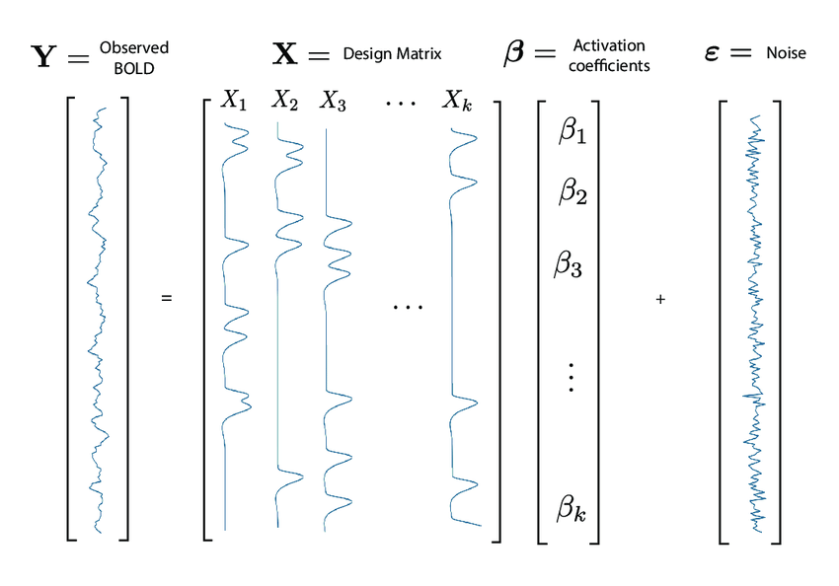
General Linear Model (GLM)
β = regression coefficients
From https://www.researchgate.net/publication/278826818_Feature_extraction_and_supervised_learning_on_fMRI_from_practice_to_theory
Notes:
Another representation
We get one image per beta parameter, and the final image for the residuals
I just wanted to point out that here β parameters are called activation coefficients, but it’s better to call them regression coefficients, or simply regressors
Regressors are not just for the tasks, but for anything that could explain the observed data – could also be confounds, such as movement – how much does movement explain the observed response? The aim is to reduce the error, by fitting as much information as possible in our model – even information that we are not interested in

Slide 9
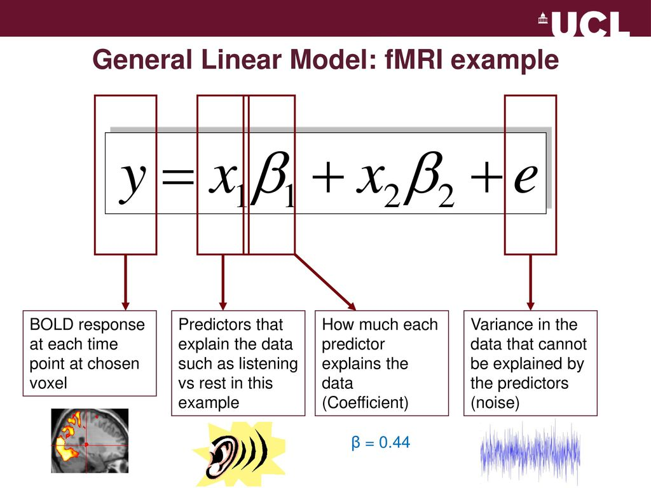
General Linear Model (GLM)
Holly Rossiter & Louise Croft
Methods for Dummies 2010

Slide 10
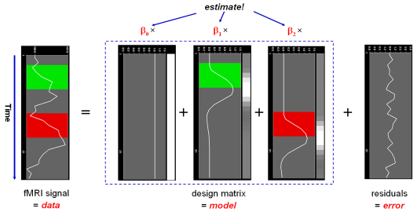
General Linear Model (GLM)
From
https://www.brainvoyager.com/bv/doc/UsersGuide/StatisticalAnalysis/TheGeneralLinearModel.html

Slide 11
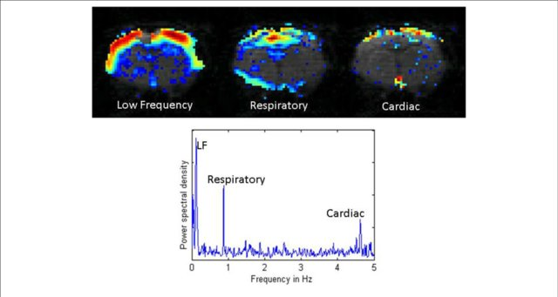
Noise
Signal changes related to:
Scanner itself
Subject’s physiology
Subject’s movements
Pre-processing to eliminate most of the noise
How to deal with remaining noise?
From https://www.researchgate.net/publication/281486050_Considerations_for_Resting_State_Functional_MRI_and_Functional_Connectivity_Studies_in_Rodents
Notes:
Measured signal is noisy → we measure task-related activation, but also changes in signal related to the scanner itself (scanner warms up over time, intensity of signal decreases), or to the subject’s physiology (for example, heartbeat and breathing), or to the subject’s movements
Pre-processing to eliminate most of this noise
But some of this noise remains → how can we get to the true signal? True signal = task-related changes in the haemodynamic response function (HRF) → these changes can be very small – how do we detect them?

Slide 12
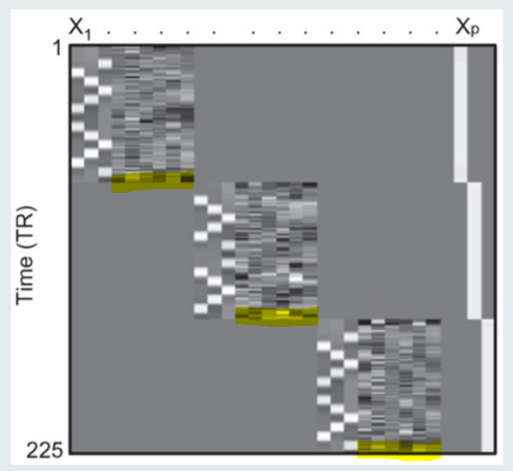
Noise – Solution 1
Noise regressors (in yellow in the figure)
Notes:
Solution 1 is using noise regressors, as mentioned before in the presentation
In our design matrix, we include noise regressors to explain some of the variance and therefore reduce error
Here we have our design matrix, we can see three runs, in each run we have three conditions, and for each of these conditions we have a regressor of interest that can be intentionally manipulated, as we’ll explain later
We also have six noise regressors (here in yellow) → these are regressors of no interest, they are not manipulated, but they can tell us how much of the variance in our data is explained, for example, by head movement

Slide 13
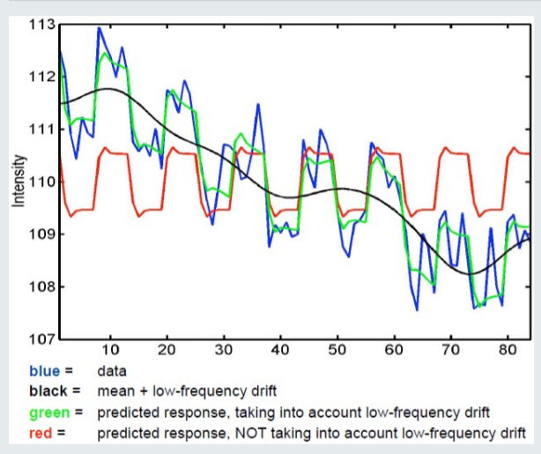
Noise – Solution 2
High-pass filter
By default, SPM filter leaves out signals lasting longer than 128 seconds
Emily Thomas & Joao Santos
Methods for Dummies 2019/20
Notes:
Solution 2 - applying high-pass filter to increase signal to noise ratio
Scanner heats up over time → decrease in signal intensity – but this decrease has nothing to do with our task of interest!
This decrease in signal intensity affects mainly low frequencies
Assumption: most low frequencies in our signal are due to scanner heating up (noise)
Solution: in SPM, we select high-pass filter → low-frequencies are filtered out
Default high-pass filter in SPM filters out signals which last longer than 128 seconds
When using this filter, we need to accept that some task-relevant info may be filtered out as well

Slide 14
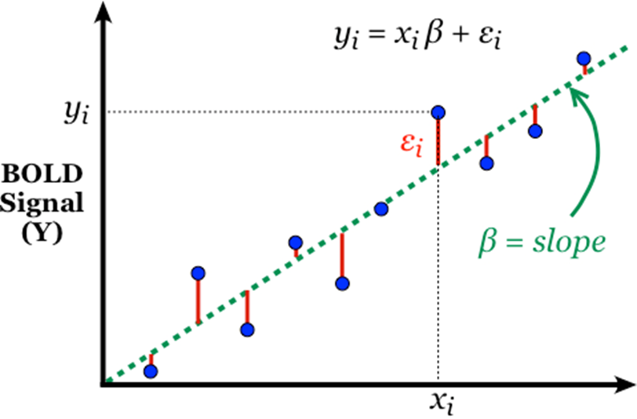
Beta parameter estimation
Method of ordinary least squares (OLS)
Emily Thomas & Joao Santos
Methods for Dummies 2019/20
Notes:
To estimate our beta parameters for each voxel
Method of ordinary least squares
We estimate beta parameter values that minimise the sum of squared errors
Sum of squared errors: sum of squared differences between actual value (recorded fMRI signal, Y) and predicted value (our model, X)

Slide 15
Beta parameter estimation
Ordinary least squares → assumptions:
1) Independent observations
2) Homogeneous variance
3) Normal distribution of residuals
If these assumptions are not satisfied:
→ Weighted least squares (WLS)
Emily Thomas & Joao Santos
Methods for Dummies 2019/20
Notes:
Ordinary least squares – assumptions?
1) Independent observations
2) Homogeneous variance
3) Normal distribution of residuals
In reality, these assumptions are not satisfied – so we don’t use ordinary least squares, but rather weighted least squares (WLS) → knowledge of the variance of observations incorporated into the regression

Slide 16
Contrasts
Parts of the brain that respond to stimulus 1 more than to stimulus 2?
→ Combine beta parameters to find the answer
Brain scan from https://www.researchgate.net/publication/244942244_A_Case_of_Severe_Hyponatremia_Induced_by_Radiographic_Contrast_Agent/figures?lo=1&utm_source=google&utm_medium=organic
Notes:
Which parts of the brain respond to stimulus 1 more than they do to stimulus 2?
We combine beta parameters to find the answer

Slide 17

Contrasts
Parts of the brain that respond to stimulus 1 more than to stimulus 2?
Voxels in which β1 > β2
β1 – β2 > 0
H0: β1 – β2 = 0
H1: β1 – β2 > 0
T-test
Notes:
I am interested in voxels than respond to stimulus 1 more than to stimulus 2 → look for voxels in which beta 1 > beta 2, which becomes beta 1 – beta 2 > zero
Null hypothesis: beta 1 – beta 2 = 0
Alternative hypothesis: beta 1 – beta 2 > 0
T-test: to test assumption that – in specific voxel – activation in response to stimulus 1 is significantly greater than activation in response to stimulus 2
Test against the null hypothesis

Slide 18
END of PART 1
Thanks for your attention!

Slide 19
1st Level Analysis:
Design Matrix, GLM, Contrasts & Inference
Part 2
Mansoureh Fahimi

Slide 20
Classical Inference
Contrasts and inference (t-tests and F-tests)
Correlated regressors and orthogonalisation

Slide 21

Statistical inference: Contrasts
WHAT:
We want to know if there is a significant activation in a particular voxel due to our experiment conditions
  Evaluating whether the experimental manipulation caused a significant change in the parameter weights
HOW:
We use contrasts
  Specify effects of interest
  Perform statistical evaluation of hypothesis
Contrasts and their interpretation depend on the model specification and design of the experiment
Notes:
Once we have the model we want to see if there is any significant activation in a particular brain region/voxel due to our experimental conditions. Asking this question means asking if any of parameter weights of interest we calculated with our model justify the signal changes.
In order to do that we use contrasts. So in general contrast specify effect of interest by weighting our parameters and selecting regressors of interest. Our inference will be performed on a linear combination of regression coefficeints (beta) c^{T}β. Where c represents the contrast vector we are using to determine which conditions we want to compare/test.

Slide 22
With the right contrast design you can model any linear test with the GLM
T-test
F-test
Multiple regression
Analysis of variance (ANOVA)
Analysis of covariance (ANCOVA)
These are all mass-univariate approaches! With the t or f test you will create a statistical image over all voxels (or points in time or space)

Slide 23

Contrast definition
Design matrix in all voxels :
Y = X₁β₁ + X₂β₂ + β₃ constant + errors
With :
Y : the measured signal
X₁ : experimental variable
X₂ : nuisance variables
Constant : mean signal
β : contribution of each variable to Y
Time
Noise regressors (X₂)
Constant
Defined regressor (X₁)

Slide 24
Contrast definition
A contrast specifies the effect of interest through the following formula :
Time
With :
C: contrast vector, entered manually when using SPM
c^{T}β: the linear combinaison of the estimated parameters
n: the number of parameters
Noise regressors (X₂)
Constant
Defined regressor (X₁)

Slide 25
Statistical evaluation of the hypothesis
Case 1 → T test
Objective : assess the effect of
(1) one parameter : (c^{T} = [1 0 0 0 …])
(2) A combination of parameters : (c^{T} = [-1 1 0 0 …])
T-test is a signal-to-noise ratio measure
  Estimate the standard deviation of the estimate in each “on” vs each “off” conditions in the time-series
Unidimensional → C^{T} is a vector, not a matrix with several dimensions
Unidirectional → H₀: C^{T} β=0 vs H₁: C^{T} β>0 or C^{T} β<0

Slide 26
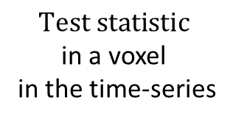
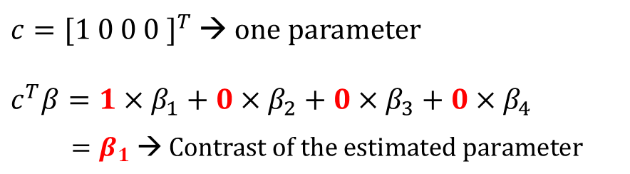
2) Statistical evaluation of the hypothesis
Case 1 → T test
1
On
$c={[1 0 0 0 ]}^{T}$ → one parameter
$$c^{T}β=1×β_{1}+0×β_{2}+0×β_{3}+0×β_{4}$$
$=β_{1} \text{→ }\text{Contrast} \text{of} \text{the} \text{estimated} \text{parameter}$
0
Off
Time
Mean contrast of the
estimated
parameter
$$\text{Test} \text{statistic}$$
in a voxel
in the time-series
T =
Contrast variance
of the estimated
parameter
Noise regressors (X₂)
Constant
Defined regressor (X₁)
[1 0 0 0 ]

Slide 27
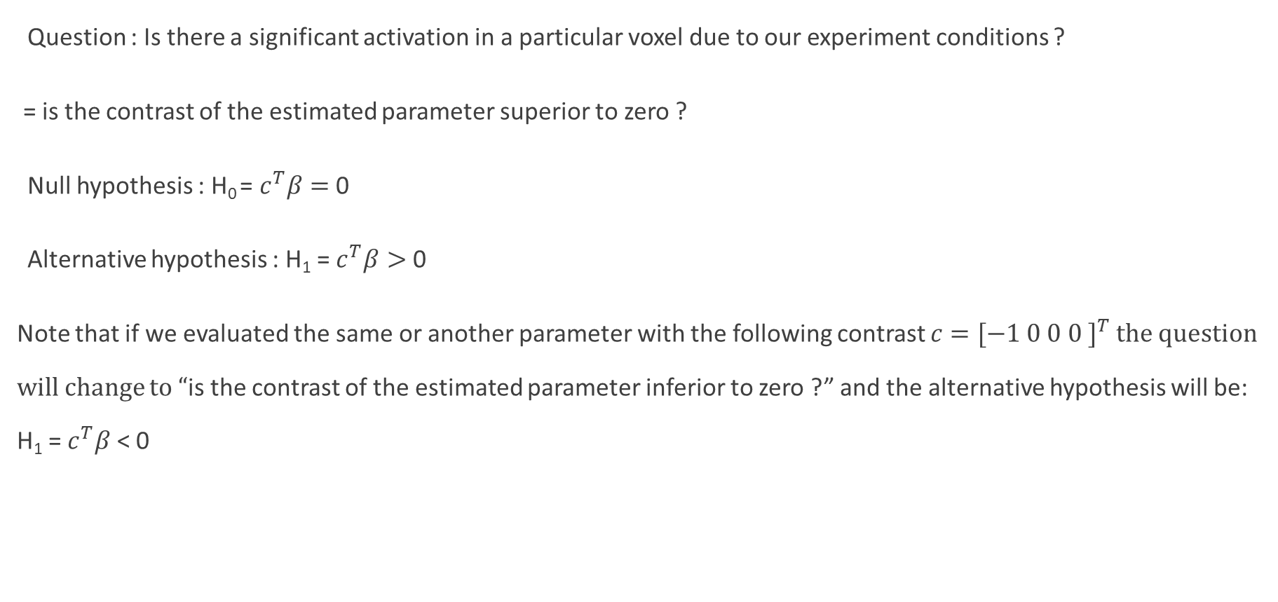
Statistical evaluation of the hypothesis
Case 1 → T test
Question : Is there a significant activation in a particular voxel due to our experiment conditions ?
= is the contrast of the estimated parameter superior to zero ?
Null hypothesis : H₀ = $c^{T}β=$ 0
Alternative hypothesis : H₁ = $c^{T}β>$ 0
Note that if we evaluated the same or another parameter with the following contrast $c={[−1 0 0 0 ]}^{T}$ the question will change to “is the contrast of the estimated parameter inferior to zero ?” and the alternative hypothesis will be: H₁ = $c^{T}β$ < 0

Slide 28
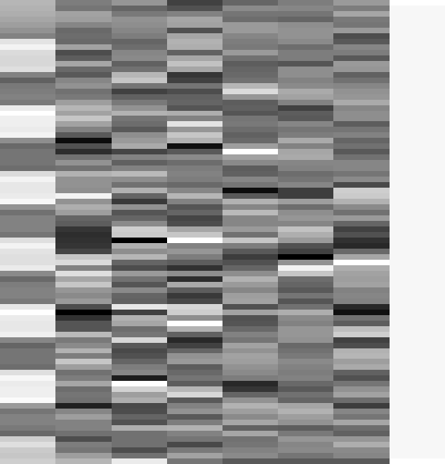
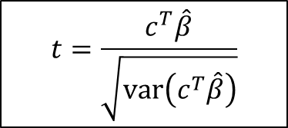
Statistical evaluation of the hypothesis
Case 1 → T test
Passive word listening versus rest
c^{T} = [ 1 0 0 0 0 0 0 0]
Q: activation during listening ?
1
SPMresults:
Null hypothesis:
Height threshold T = 3.2057 {p<0.001}
voxel-level
mm mm mm
T
(
Z
≡
)
p
uncorrected
13.94
Inf
0.000
-63 -27 15
12.04
Inf
0.000
-48 -33 12
$$t=\frac{c^{T}\hat{β}}{\sqrt{\text{var}\left(c^{T}\hat{β}\right)}}$$
11.82
Inf
0.000
-66 -21 6
13.72
Inf
0.000
57 -21 12
12.29
Inf
0.000
63 -12 -3
9.89
7.83
0.000
57 -39 6
7.39
6.36
0.000
36 -30 -15
6.84
5.99
0.000
51 0 48
6.36
5.65
0.000
-63 -54 -3
6.19
5.53
0.000
-30 -33 -18

Slide 29
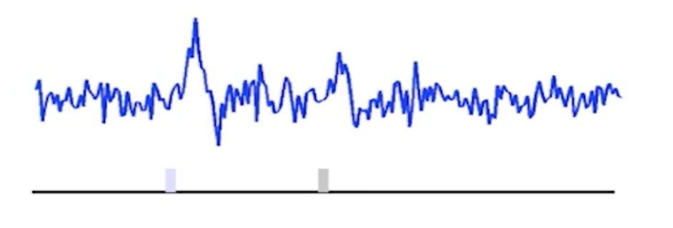
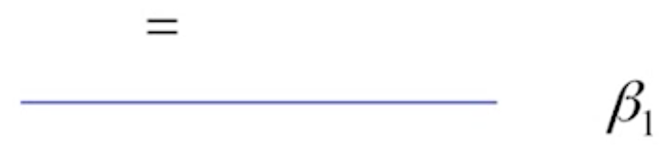
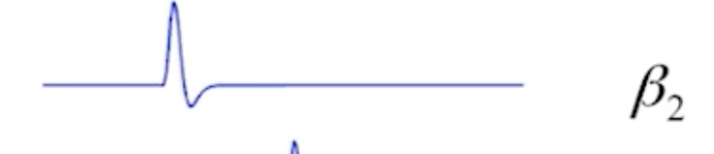
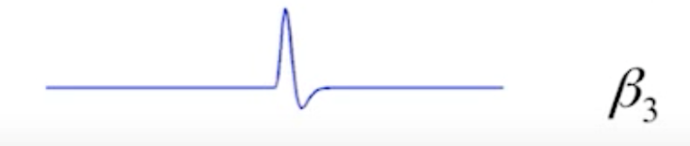
Example
Event-related experiment with two types of stimuli.
‘In what areas of the brain is there a difference between condition A(β₂) and B(β₃)?’
Statistical equivalent:
H₀: β₂ = β₃ = 0
H₀: C^{T} (β) = 0
C^{T} = [0, 1, -1]
β₂(1) > β₃(-1)
Notes:
Here is an event related example where two stimuli are presented a separate points in time. We have 3 parameters, the first is the constant (mean of the signal) and the 2nd and 3rd are our regressors for each stimulus presented, plus noise.
Our vector is written [0 1 -1] if we want to compare one parameter against another
Or [ 0 1 0 ] for the contribution of B2
Or [ 0 0 1 ] for the contribution of B3

Slide 30
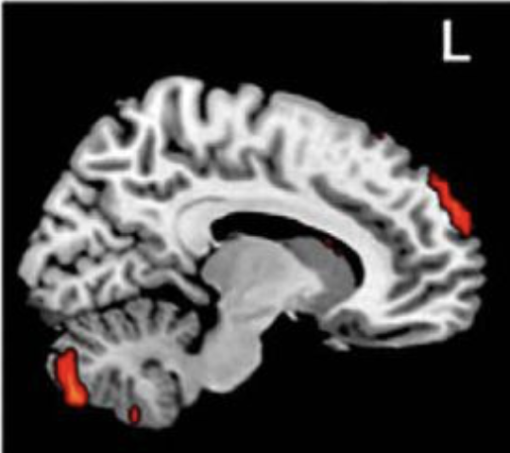
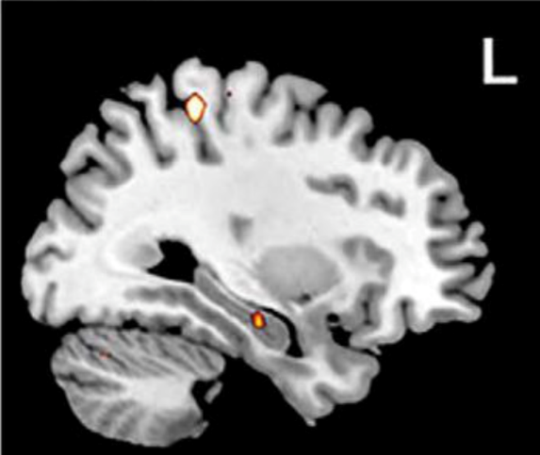

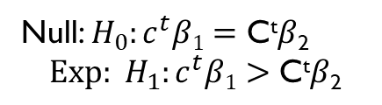
T-test
You can test the assumption that the activation in event 1($β1$) significantly greater than in event 2($β$₂). This means that your Null/Experimental
hypothesis would look like this
contrast of
estimated
parameters
Null: $H_{0}:c^{t}β1=\text{C}\text{t}β\text{2}$
$${Exp: H}_{1}:c^{t}β1>\text{C}\text{t}β\text{2}$$
T =
variance
estimate
C^{t} = [1, -1, 0, 0, 0,] - Comparing two conditions. In other words, you are asking SPM to show you the voxels in the brain where mean signal of C^{t}$β$₁ are greater than the mean signal of those in C^{t}$β$₂
Notes:
For example expected to find a difference in the mean activation of the cerebellum between the two conditions. For example one condition included a higher level cognitive task and the other was a simple cognitive task. You want to assess the question, is the cerebellum involved in higher cognitive thinking?
The experimental hypothesis would produce a ‘colourful blob’ on the cerebellum, meaning, there’s a significant difference in the activation of the voxels of the brain in this regions, between these two tasks
The null hypothesis on the other hand would show no such activation pattern, suggesting that there is no significant difference (therefore no difference in the contribution of the cerebellum between the two tasks).

Slide 31
T-test summary
T-test is a simple signal-to-noise ratio measure
H₀: C^{T} β=0 vs H₁: C^{T} β>0
“One” linear hypothesis testing
We can’t test both β₁=0 and β₂=0 at a same time
What if we have many interrelated experimental conditions, e.g. factorial design?
How can we test multiple linear hypothesis?
Y = X1 * β1 + X2 * β2 + β3 + ε

Slide 32
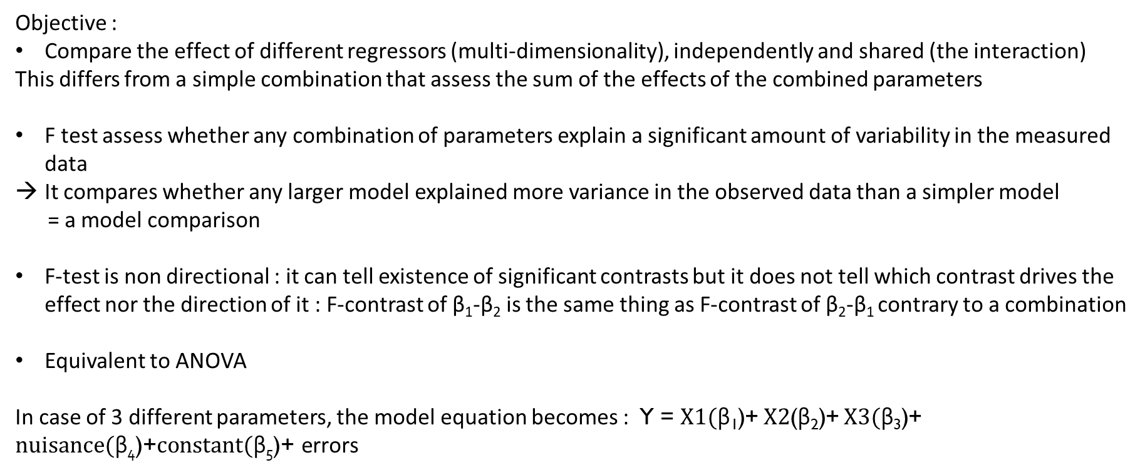
Statistical evaluation of the hypothesis
Case 2 → F test
Objective :
Compare the effect of different regressors (multi-dimensionality), independently and shared (the interaction)
This differs from a simple combination that assess the sum of the effects of the combined parameters
F test assess whether any combination of parameters explain a significant amount of variability in the measured data
It compares whether any larger model explained more variance in the observed data than a simpler model
= a model comparison
F-test is non directional : it can tell existence of significant contrasts but it does not tell which contrast drives the effect nor the direction of it : F-contrast of β₁-β₂ is the same thing as F-contrast of β₂-β₁ contrary to a combination
Equivalent to ANOVA
In case of 3 different parameters, the model equation becomes : Y = $X1(\text{β}\text{1}\text{)}$+ $X2$($\text{β}\text{2}\text{)}$+ $X3(\text{β}\text{3}\text{)}$+ $nuisance(\text{β}\text{4}\text{)}\text{+}constant(\text{β}\text{5}\text{)}\text{+ }\text{errors}$

Slide 33
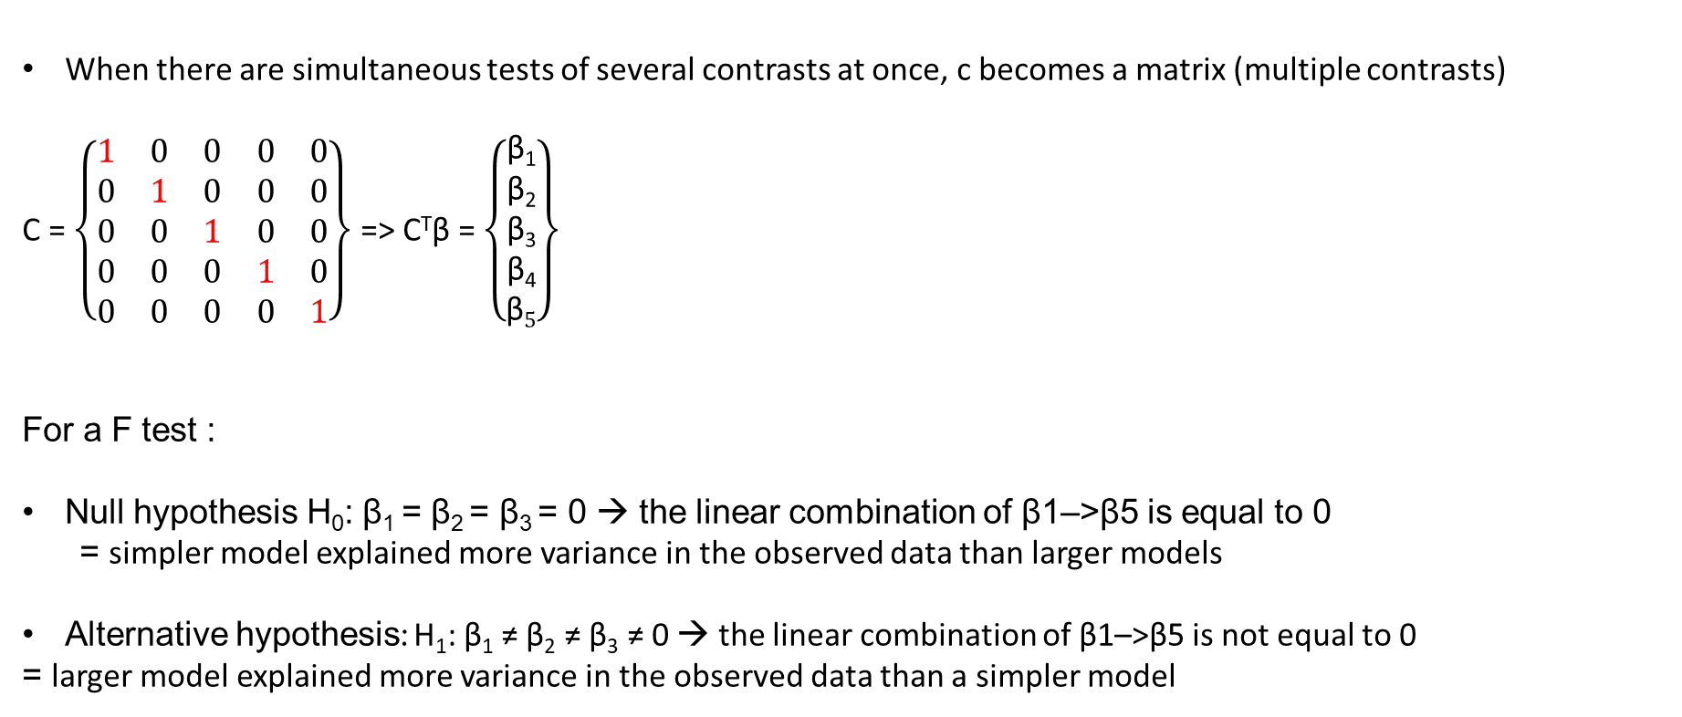
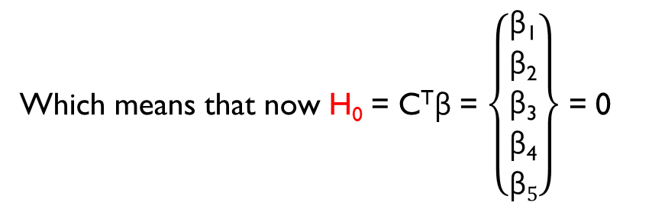
Statistical evaluation of the hypothesis
Case 2 → F test
When there are simultaneous tests of several contrasts at once, c becomes a matrix (multiple contrasts)
C = $\left\{\begin{matrix}1 & 0 & 0 & 0 & 0 \\ 0 & 1 & 0 & 0 & 0 \\ 0 & 0 & 1 & 0 & 0 \\ 0 & 0 & 0 & 1 & 0 \\ 0 & 0 & 0 & 0 & 1\end{matrix}\right\}$ => C^{T}β = $\left\{\begin{matrix}\text{β}\text{1} \\ \text{β}\text{2} \\ \text{β}\text{3} \\ \text{β}\text{4} \\ \text{β}5\end{matrix}\right\}$
For a F test :
Null hypothesis H₀: β₁ = β₂ = β₃ = 0 → the linear combination of β1–>β5 is equal to 0
= simpler model explained more variance in the observed data than larger models
Alternative hypothesis: H₁: β₁ ≠ β₂ ≠ β₃ ≠ 0 → the linear combination of β1–>β5 is not equal to 0
= larger model explained more variance in the observed data than a simpler model
Which means that now H₀ = C^{T}β = $\left\{\begin{matrix}\text{β}\text{1} \\ \text{β}\text{2} \\ \text{β}\text{3} \\ \text{β}\text{4} \\ \text{β}5\end{matrix}\right\}$ = 0

Slide 34
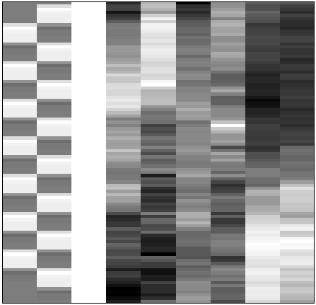
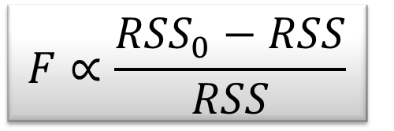
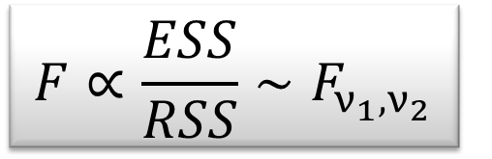
F-test - the extra-sum-of-squares principle
Model comparison:
Null Hypothesis H₀: True model is X₀ (reduced model)
X₀
X₁
X₀
Test statistic: ratio of explained variability and unexplained variability (error)
RSS
RSS₀
ν₁ = rank(X) – rank(X₀)
ν₂ = N – rank(X)
Full model ?
or Reduced model?
Notes:
Testing for multiple linear hypothesis means testing between two models. Consider this design matrix have a model with X0 and X1 as a full model. We want to know if the added variance can better justify the variability in the error term. So in this case we use an F test as a comparison of reduced sum of square divided by the unexplained variance.
WE compute the two residuals, full model will have a less error, as a lot of the noise has already been predicted in the model. In F statistics variance of the noise is approximated by full model. The numerator represents the variance added by X1
What is RSS in F-test?
The residual sum of squares (RSS) measures the level of variance in the error term, or residuals, of a regression model. The smaller the residual sum of squares, the better your model fits your data; the greater the residual sum of squares, the poorer your model fits your data.
explained sum of squares (ESS)

Slide 35
F-contrast
Multi-dimensional and non-directional
  Tests whether at least one β is different from 0, against the null hypothesis
  H₀: β₁=β₂=β₃=0
  Equivalent to an ANOVA
Function:
  Test multiple linear hypotheses, main effects, and interaction
  But does NOT tell you which parameter is driving the effect nor the direction of the difference (F-contrast of β₁-β₂ is the same thing as F-contrast of β₂-β₁) – like in ANOVA main effect.
Notes:
So how do you test a directional effect? Do you have to do a separate t afterwards?

Slide 36
F-test summary
The F-test evaluates whether any combination of contrasts explain a significant amount of variability in the measured data
H₀: C β=0 vs H₁: C β≠0
More flexible than T-test
F-test can tell the existence of significant contrasts. It does not tell which contrast drives the significant effect or what is the direction of the effect.

Slide 42
Notes:
You would rarely do this because you don’t know which parameter to give the shared variance to. So you can’t do orthogonilaztion yourself
SPM will apply it when you have parametric regressors
It’s rarely rational to do this in practice
If there is still a lot of correlation and you really cannot do anything about removing shared variance. What you can do is to do an F-test across all of them

