Slide 1
Bayes’ Theorem
4th February 2022
Dr Hans Odd
Expert: Michael Moutoussis

Slide 2
It is a rigorous method for interpreting evidence in the context of previous experience or knowledge.
It provides researchers the tools to update their beliefs in the light of new data.
Can be sued to compare the relative strengths of multiple hypotheses, using the Bayes Factor.

Slide 3
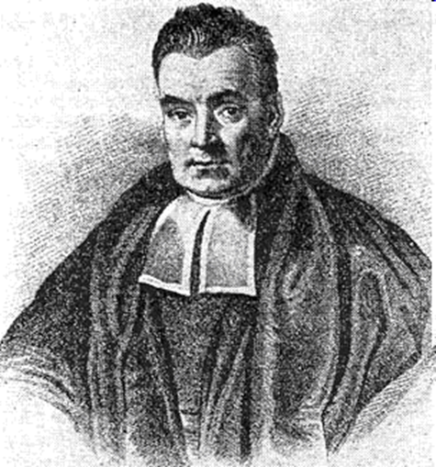
The Reverend Thomas Bayes (1702-1761)
‘Essay towards solving a problem in the doctrine of chances’,
Philosophical Transactions of the Royal Society of London in 1764.
Never published during his life and his work was edited by Richard Price
Poorly remarked on and the ideas were independently conceived of by the French
Mathematician Laplace
Ideas relegated to obscurity, supplanted by Frequentist thought until the 1950’s

Slide 4
P(A|B) = P(B|A) * P(A)
P(B)

Slide 5
P(A|B) = P(B|A) * P(A)
P(B)
“Posterior” of A given B

Slide 6
P(A|B) = P(B|A) * P(A)
P(B)
“Posterior” of A given B
“Prior” probabilities of A, B

Slide 7
P(A|B) = P(B|A) * P(A)
P(B)
“Likelihood” for B given A
“Posterior” of A given B
“Prior” probabilities of A, B

Slide 8
P(A|B) = P(B|A) * P(A)
P(B)

Slide 9
P(Hypothesis|Data) = P(Data|Hypothess) * P(Hypothesis)
P(Data)

Slide 10
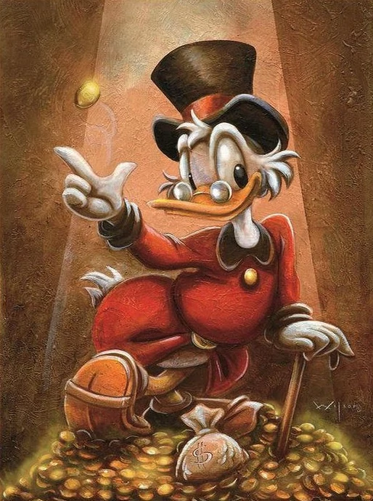
Examples of Bayes’ Theorem

Slide 11
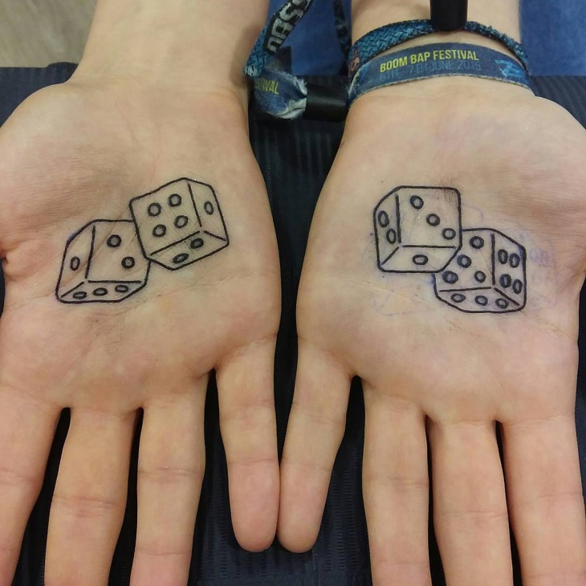
Examples of Bayes’ Theorem

Slide 12
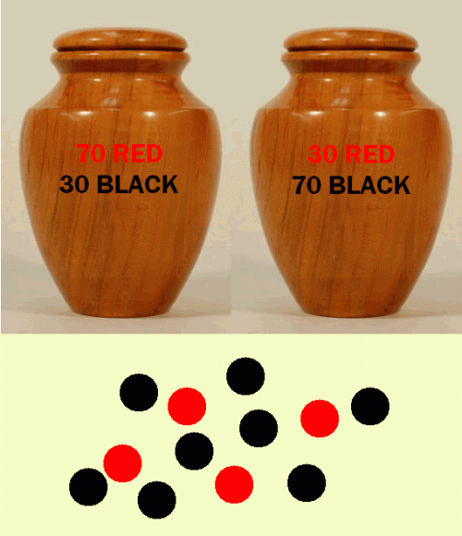
Examples of Bayes’ Theorem

Slide 13
Want to get those difficult colleagues
off your back and restore your
sanity?
NYU psychology
Professor Tessa West shows you how

Slide 14
“What a Jerk!”
How Do I measure “Jerkiness”?

Slide 15
“What a Jerk!”
How Do I measure “Jerkiness”?
I measured two parameters in 100 workmates:

Slide 16
“What a Jerk!”
How Do I measure “Jerkiness”?
I measured two parameters in 100 workmates:
Kindness

Slide 17
“What a Jerk!”
How Do I measure “Jerkiness”?
I measured two parameters in 100 workmates:
Kindness
Fairness

Slide 18
Foundation of Bayesian Approach
Unlike a Frequentist model where I’d simply reject the null hypothesis if it was
More likely that the hypothesis was true, in a Bayesian approach I have to choose
A model, or in other words a Prior.

Slide 19
Foundation of Bayesian Approach
Unlike a Frequentist model where I’d simply reject the null hypothesis if it was
More likely that the hypothesis was true, in a Bayesian approach I have to choose
A model, or in other words a Prior.
This Prior is a model that we think might explain the data, and the Bayesian analysis
Tells us how probable it is that the data is explained by that model.

Slide 20
Foundation of Bayesian Approach
Unlike a Frequentist model where I’d simply reject the null hypothesis if it was
More likely that the hypothesis was true, in a Bayesian approach I have to choose
A model, or in other words a Prior.
This Prior is a model that we think might explain the data, and the Bayesian analysis
Tells us how probable it is that the data is explained by that model.
We could for example propose that all people are equally Jerks – a uniform model
Or, because life has told us anecdotally that some people are Jerks all of the time, most
People are only Jerks some of the time, we could employ a natural distribution of
Jerkiness – a gaussian distribution.

Slide 21
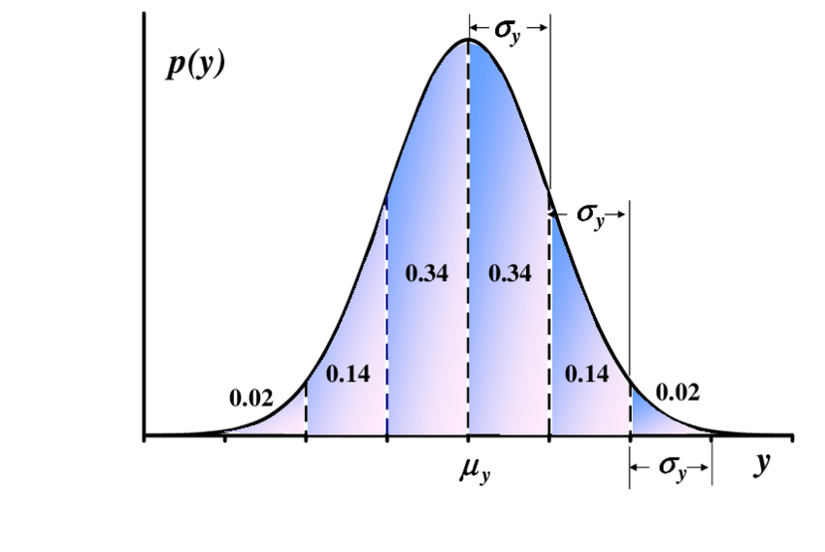
Jerk Natural Distribution

Slide 22
Jerk Natural Distribution
Total Jerk

Slide 23
Jerk Natural Distribution
Total Jerk
Average Joe

Slide 24
Jerk Natural Distribution
Total Jerk
Average Joe
Angel

Slide 25
Data
treated me
fairly unfairly

Slide 26
People's
character
Kind
Selfish

Slide 27
People's
character
Kind
Selfish
10%
40%
40%
10%
treat me
fairly unfairly

Slide 28
Inference
People's
character
Kind
Selfish
Now I just met Maria, and I was treated fairly.
10%
40
40%
10
treated me
fairly unfairly

Slide 29
People's
character
Kind
Selfish
Now I just met Maria, and I was treated fairly.
How likely is that the person was kind,
given my experience of being
treated fairly ?
10%
40
40%
10
treated me
fairly unfairly

Slide 30
People's
character
Kind
Selfish
Now I just met Maria, and I was treated fairly.
How likely is that the person was kind,
given my experience of being
treated fairly ?
Conditional probability, or
p(K|f)
= n_Kind / n_total
= 40/50
= 80 out of 100
10%
40
40%
10
treated me
fairly unfairly

Slide 31
U Updated beliefs
Maria's
character
Kind
Selfish
80 x 20% =
64
16
80 x 80% =
20 x 80% =
4
16
20 x 80% =
Maria will treat me
fairly unfairly

Slide 32
You have now experienced the famous 'Bayes Theorem' :
I started off believing 50:50 that Maria might be kind,
but now I believe 80% that Maria may be kind !

Slide 33
An a Alternative scenario ...
Maria's
character
Kind
Selfish
What I meet her again, and she now treated me unfairly ?
64
16
4
16
Maria treated me
unfairly

Slide 34
An Alternative scenario ...
Maria's
character
Kind
Selfish
What I meet her again, and she now treated me unfairly ?
I would just be back to
'square 1', and have no idea about Maria!
p(K|f,u) =
= 16/(16+16)
= 50%
64
16
4
16
Maria treated me
unfairly

Slide 35
I In summary ...
Maria's
character
Kind
Selfish
if
treated
fairly
94%
80%
treated
fairly
50%
P(K| no data)

Slide 36
In summary ...
Maria's
character
Kind
Selfish
if
treated
fairly
94%
80%
treated
fairly
if
treated
unfairly
50%
P(K| no data)

Slide 37
Take Home Message
First of all, be kind AND fair when you meet people gathering data for a Bayes Theory
Presentation!
Bayes inference gives more data than Frequentist analysis about hypotheses – gives
Probablistic answers to what data is correct ( Probability Density Function)
Allows to modify our models by incorporating new data

