Slide 1

Methods for dummy
Behavioural modelling
Harry Costello & Tommaso Currò, 9th February 2022

Slide 2
Outline
Why do we need models in data analysis?
Why computational modelling?
What is a computational model?
How is computational modelling different from «standard» analysis?
Examples of computational models

Slide 3
Why do we need models in data analysis?
Model
Describe, predict and explain behavior.
DATA
Experimental design
Notes:
We perform analyses to make meaning out of data, to interpret them and to recognise patterns. Data alone are meaningless!
We have two tools to use to make meaning out of data: Experimental design and models
A model is an abstract explanatory device, a tool used to make sense of observations and evidence.
Modeling attempts to capture how information is manipulated in the brain to produce the behavior;
Ultimate goal: we want to describe, predict and explain people’s behavior.
Data never speak for themselves but require a model to be understood and to be explained. satisfy your goal of identifying a cognitive process in behavior . Data can be interpreted only in the context of the design of the experiment
While experimental design means planning a set of procedures to investigate a relationship between variables to make the results objective and valid, CM that “exists” primarily in the minds of the people who use it to describe, predict, and explain the data.”
you designed the experiment to test specific hypotheses, and constructed models to reflect them.
Models are never correct, but some are useful.

Slide 4
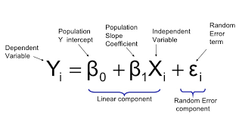
Let’s start simple!
Notes:
Simple linear regression is a model that we use to describe the data.
The problem with the use of it are the assumptions about the distributions of data that we analyse and we have fixed parameters to explain the data. the fact that it may not reflect the specific process that produced the data given that it has a standard form.
Models also protect from cognitive limitations by providing an «objective» and quantitative tool. Allows to avoid misinterpreting the implications of the workings behind the data.

Slide 5
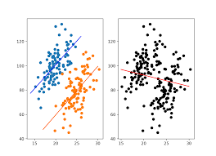
Why computational modelling?
Overcome problem of averaging techniques (Simpson’s paradox)
Allows description of how data were generated
Identify hidden assumptions
Make quantitative predictions
(Guest & Martin, 2020; Broadland, 2015)
Notes:
What are the benefits of CM? To overcome the problems of the previous/current techniques. (this is always the reason to try something else!)
(when doing analyses think in distributions, not in tests). Standard analyses use averaging tools (mean) but averaging may misrepresent the existing effect
By deconstructing mechanisms of behavior and quantifying parameters of interest, computational modeling helps researchers to study brain-behavior mechanisms.
Force to make consistent assumptions
the choice of mathematics is not at all arbitrary but derived from some deeper theoretical principle.
We know that the basic aim of modeling is to connect the model’s predictions with our data;
And not only differences between groups/distributions. The goal of computational modelling is to replicate the behaviour of the system it parallels and to do so based on actual, known properties of the system components (Brodland, 2015).
CM seeks to retain information about the underlying structure of each participant’s responses (distributions).
Averaging means discarding information on cognitive structures.
Simpson’s paradox happens when an average result obtained by collapsing data over individuals shows the opposite pattern of results that those shown by the individuals separately.
A way to put “word models” into mathematical language and to analyze the result
Identify hidden assumptions
Explain observations
Make quantitative predictions (and therefore better communication)
Read this on Mendeley Computational Modeling in Cognition and Cognitive Neuroscience
Create behavioural observation: generative. So anticipated predictions. Provide link of how processes are created and allows quantitative comparison.

Slide 6
What is a computational model?
Mathematical description: a verbal description is formalised to remove ambiguity.
Models contain parameters, “tuning knobs” that fine-tune the predictions of the model modulating its architecture
Help answering 3 types of questions(Dayan & Abbott, 2001):
  Descriptive = What
  Mechanistic = How
  Interpretive = Why
(Blohm et al., 2020)
Notes:
Iterative process to find the best models given different assumptions and modeling choices.
Parameters adapt the structure of the model to a particular situation. The structure can change to describe better the data at hand. Cm can define parameters that reflect the generative processes (cneural correlates of the data.
What: Compact summary of large amounts of data
Mechanistic = How? Show how neural circuits perform complex function
Interpretive = Why? Computations in the brain are usually performed in an optimal or nearly optimal way. Understanding optimal algorithms and their implementation to explain why the brain is designed the way it is
Levels of Marr: Brain hierarchy of complexities. Cm allows bridging levels of description (computational, algorithmic, implementational)
What is the role of parameters?
free parameters: a class of parameters in cognitive models that are adjusted until the predictions are in line with the data to the extent possible.
Free parameters are usually estimated from the data that the model seeks to explain, by finding those values that maximally align the model’s predictions with the data
Fixed parameters, that are not estimated from the data and hence are invariant across.
The role of fixed parameters is primarily to “get the model off the ground” by providing somemeaningful values for its components where necessary.
Types of modelling include:
Machine learning
Bayesian modelling: integrating
Neural networks
Dynamic Causal Modelling
Connection models
Modeling choices like the prior, parameters setting, what cognitive claims they mapped onto.
Builds mathematical models describing computations in the brain that give rise to mental abilities

Slide 7
What are the benefits of using computational modelling?
Improve reasoning about the experiment
Foster transparent communication
Better-specified theories
Parameters are psychologically meaningful
Notes:
How is a computational modelling different to standard analysis?
In my own research, I investigate reaction times: the analyses improved a lot when I abandoned the Gaussian distribution, but still they models are not as good as computational models as the Diffusion model which have specific parameters that are psychologically meaningful. parameters in computational models have meaning, that is why it is interesting. (example rate of information accumulation before making a decision
Expliciting models help constrain scientists’ own thinking.
Formal modelling allows open and transparent communication between different groups
Specifying a model naturally results in better-specified theories, and therefore in better science.
Of course, there is a tradeoff: require much thinking, knowledge, time and effort compared to more used techniques like ANOVA.
models have many roles, including driving hypotheses, making assumptions explicit, synthesizing knowledge, making experimental predictions, and facilitating applications to medicine (blohm)
Report features important to understand what the model shows and why. This includes things like discussing what assumptions are important for achieving the key effects of the model and which assumptions are ancillary ones necessary for implementation, what theoretical claims the assumptions of the model map onto, and what space of possible patterns of performance the model could capture.
Verbal theorizing is becoming insufficient (big data available, many researchers working on the same topic need and effective way to communicate).
A principal advantage of computational models is that we are forced to specify all parts of our theory.
Hypotheses propose a specific relationship that could explain a given phenomenon.
Generative because it can produce behavioural predictions

Slide 8
Bayesian approach
Uses posterior distribution to make inferences
Acknowledge uncertainty
Modeling flexibility
Notes:
Focuses on evidence and allows to respond to the specific and important questions.
Uncertainty is maintened in bayesian approach through the use of prior distributions and probability distributions.
Flexibility because is based on probability theory. Allows to translate research questions into specific statistical inferences. Allows different structure of models
Tradeoff is that it takes longer for computations (the model I run this morning is still going!) possibly a present after the presentation.
The best we can hope for it to compare the relative probabilities of opposing hypothesis. (bayes factor)
Bayesian inference is the mathematical formulation of Occam’s razor, therefore it forces to accept the easiest option because that is the most likely to have generated the data.
the model should stay as high-level/abstract as possible, but be as detailed as necessary (Occam’s razor)
Parameter estimation (the goal of parameter estimation is to find those parameter values that maximize the agreement between the model’s predictions and the data)
Model comparison (Need to evaluate different models to find the one that fits the data better)
After building the model, we test the predictions. We use the model to generate some data and compare them to the data that we used to create the models to see if it can retrieve the parameters.
interpretation of those parameter values can often shed a light on the underlying processes.
minimizing the discrepancy between predictions and data
The goal of fitting a model to data is to find those best-fitting parameter values.
Model fitting: The goal of fitting a model to data is to find those best-fitting parameter values.
Parameter estimation: Parameter estimation involves finding the set of parameter values that best account for real behavioral data for a given model. These parameters can be used as a succinct summary of a given data set
https://journals.plos.org/ploscompbiol/article?id=10.1371/journal.pcbi.1007043
Read this on Mendeley Bayesian Methods in Cognitive Modeling

Slide 9
Modelling Process: a step-by-step guide
Framing the question
Implementing the Model
Model Testing
STEP 1. DEFINE THE GOAL
STEP 2. LITERATURE REVIEW
STEP 3. IDENTIFY INGREDIENTS
STEP 4. QUANTIFY HYPOTHESES
NEW HYPOTHESES
STEP 5. MODELLING ESTIMATIO
UNEXPLAINED
DATA
STEP 6. DRAFT THE MODEL
STEP 7. IMPLEMENT THE MODEL
EXPERIMENTS
STEP 8. MODEL COMPLETION
STEP 9. MODEL EVALUATION
EXPERIMENTAL PREDICTION
Blohm, Kording & Schrater (2020)

Slide 10
Modelling Process: a step-by-step guide
1. Define the goal
2. Review current evidence
3. Identify ingredients
4. Model specification
5. Model estimation
6. Model comparison
7. Model checking

Slide 11
Step 1 – Define the goal
Step 1
PURPOSE: Find a phenomenon and ask a question
Example – Motivation is central in depression:
Anhedonia a core symptom - loss of interest in engaging with previously rewarding activities.
Question: What are the behavioural mechanisms underlying anhedonia?
Goal: Develop a computational model of anhedonia

Slide 12
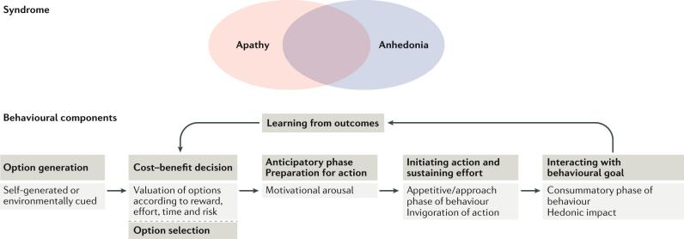
Step 2 – Literature review
Step 2
PURPOSE: To gain important theoretical and experimental insight
Background of phenomenon, questions, hypotheses, models used.
Value based decision making is impaired in depression.
Effort-based decision making for reward: the willingness to expend effort in order to attain a reward.

Slide 13
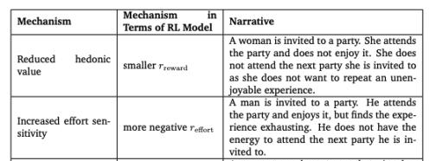
Step 3 – Identify ingredients
Step 3
PURPOSE: To set up elements required and specific conditions to be satisfied
Variables and parameters
What are the ingredients (reward, effort sensitivity)?
Different latent variables can result in the same observable symptom
Huys et al. 2021
Notes:
https://pubmed.ncbi.nlm.nih.gov/34935117/

Slide 14
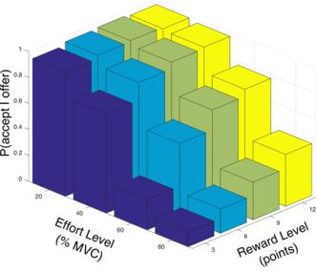
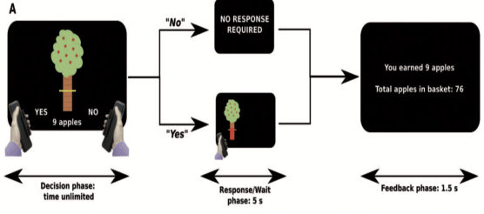
Experimental design
Example
The apple gathering task: an effort task in which participants decide to accept or reject offers within which different levels of reward are available for different levels of physical effort (grip force)
The likelihood of accepting offers increases with reward on offer and decreases with increasing effort required.

Slide 15
Standard
Computational
Group comparison
ANOVA - Compare propensity to exert effort (proportion of offers accepted) of task between groups.
Correlation with anhedonia measure
Regress outcomes against anhedonia or apathy measures.
What does the system do?
What cognitive processes influence accept/reject responses during the task.
How does the system do what it does?
Mathematically define hidden parameters (reward sensitivity, effort sensitivity etc).
Utilise generative modelling.
How is the system physically realized?
Neural correlates of parameters

Slide 16
4. Model specification: formulation of processes generating observed data
5. Model estimation: Adjustment of model parameters to best fit the data
6. Model comparison: Identify most parsimonious model.
7. Model checking: how well model recapitulates patterns in the data
  “Everything should be made as simple as possible – but no simpler!”
  -Einstein
Notes:
Start with model specification where your model of the process is hypothesis driven and mathematically defined. But really this is an iterative process which takes time where developments and different mathematical models go through the same process to identify the optimal

Slide 17
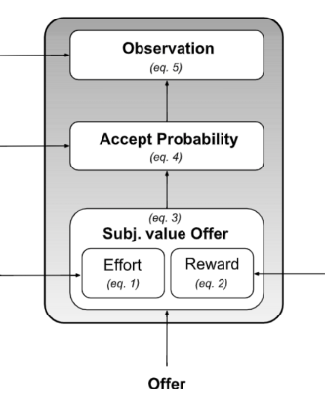
Step 4 – Model specification
Step 4
PURPOSE: Mathematical quantification of verbal hypothesis
Map out intuitions and proposals about mechanisms and variables into precise mathematical language
Decision noise
Accept bias
Effort sensitivity
Reward sensitivity
Notes:
Bernoulli distribution is the simplest discrete distribution

Slide 18
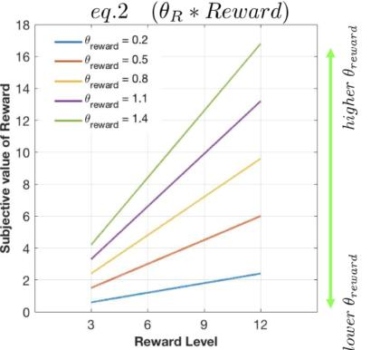
Decision noise
Accept bias
Effort sensitivity
Reward sensitivity
Notes:
As reward level increases how does subjective value of reward change. Just a linear scaling.

Slide 19
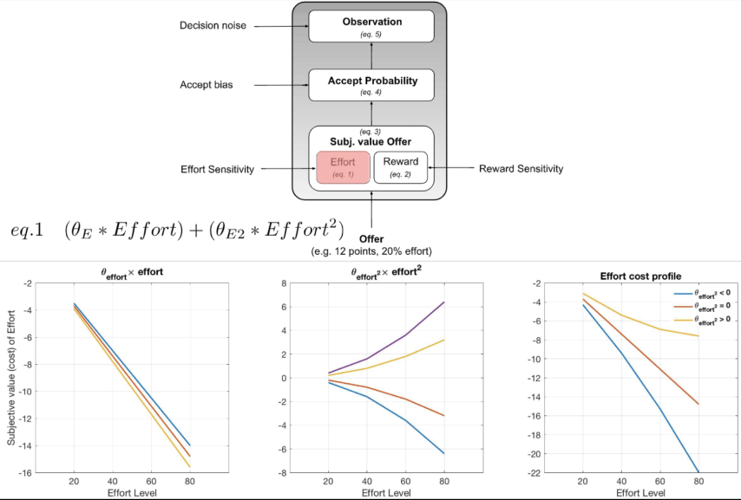
Notes:
Two effort terms in this model – effort is negative, linear effect but also quadratic effort (as effort gets higher there is this catastrophic response, whereas others maybe become a bit more macho and feel the higher effort is a challenge).

Slide 20
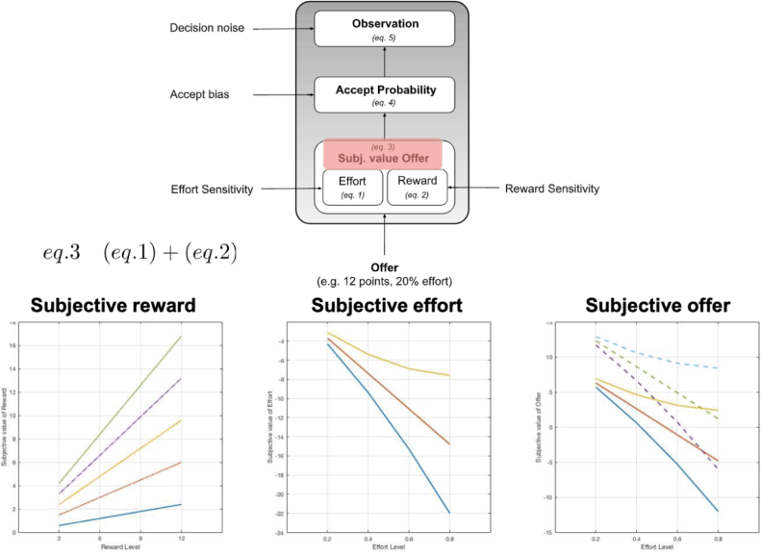
Notes:
Combined

Slide 21
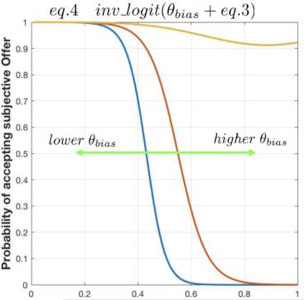
Decision noise
Accept bias
Effort sensitivity
Reward sensitivity
Notes:
To what extent are people just willing to accept – shifts model to the left and the right.

Slide 22

Decision noise
Accept bias
Effort sensitivity
Reward sensitivity
Notes:
Decision noise – shaky brain, inattentive, not paying attention, behaving in a more random fashion.
In this model represented by equations which capture a softmax function to model decision probabilities.
But are there different methods -

Slide 23
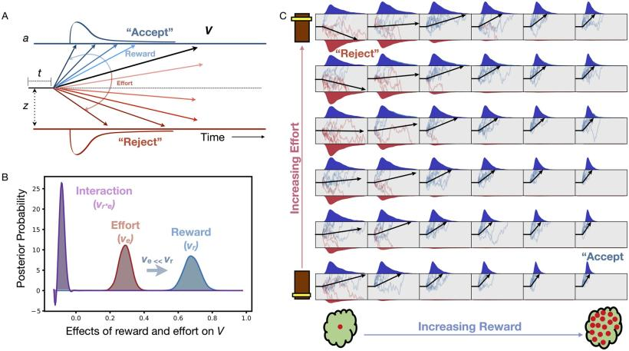
Step 4 – Model specification
Step 4
Are there alternative methods? Drift Diffusion Modelling
Notes:
DDM: model of sequential sampling with diffusion signals, where the decision maker accumulates evidence until the process hits either an upper or lower stopping boundary.
(A) Model assumes decisions to accept offers arise from a noisy process of evidence accumulation up to a decision boundary, a, at a drift rate, V and starting point of evidence accumulation termed the bias, z. The final term accounts for non-decision time components, t. (B) Both reward and effort significantly alter drift rate but reward has a significantly greater impact than effort.

Slide 24
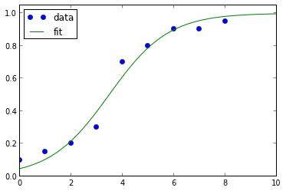
Step 5 – Model estimation
Step 5
PURPOSE: Adjustment of model parameters to best fit the data
Different approaches available.
Maximum likelihood estimation – parameters are chosen to maximize the likelihood that the assumed model results in the observed data
The likelihood function expresses the likelihood of parameter values occurring given the observed data. It assumes that the parameters are unknown.
Uses the log likelihood function as it is easier to optimise.
Notes:
Otherways include expectation maximisation. Hierarachical – Bayesian inference, non-hierarchical – maximum likelihood estimate.
Bayesian statistics is a departure from classical inferential statistics that prohibits probability statements about parameters and is based on asymptotically sampling infinite samples from a theoretical population and finding parameter values that maximize the likelihood function.
Monte Carlo simulations are just a way of estimating a fixed parameter by repeatedly generating random numbers.
Markov chain – memoryless sequences of events that are probabilistically related to one another.
MCMC methods are used to approximate the posterior distribution of a parameter of interest by random sampling in a probabilistic space

Slide 25
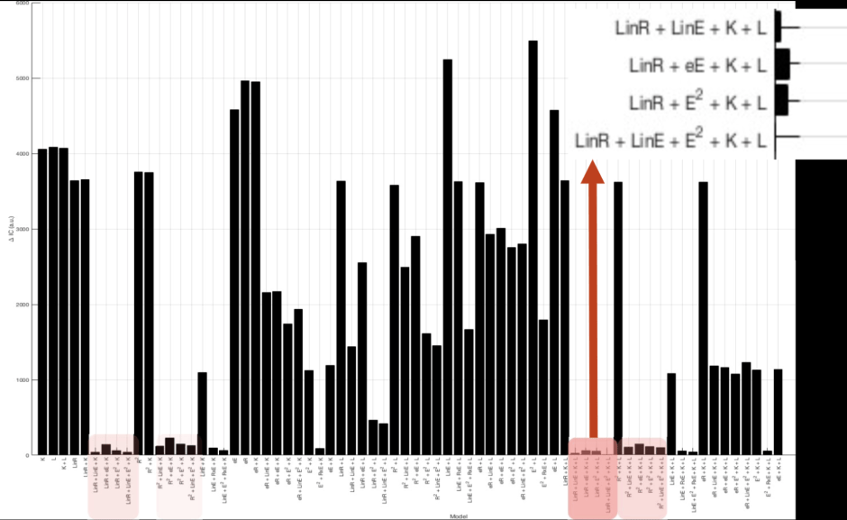
Notes:
Family of models that appears to capture the data best incorporates a linear reward & effort function, a quadratic effort function, a bias and lapse (noise).

Slide 26
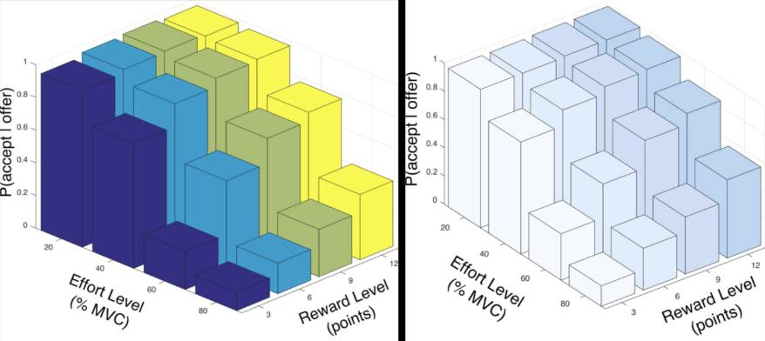
Step 6 – Model checking
Step 6
PURPOSE: How well the model captures the data
DATA (all groups)
MODEL
Notes:
Otherways include expectation maximisation. Hierarachical – Bayesian inference, non-hierarchical – maximum likelihood estimate.
Bayesian statistics is a departure from classical inferential statistics that prohibits probability statements about parameters and is based on asymptotically sampling infinite samples from a theoretical population and finding parameter values that maximize the likelihood function.
Monte Carlo simulations are just a way of estimating a fixed parameter by repeatedly generating random numbers.
Markov chain – memoryless sequences of events that are probabilistically related to one another.
MCMC methods are used to approximate the posterior distribution of a parameter of interest by random sampling in a probabilistic space

Slide 27
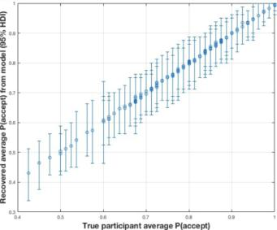
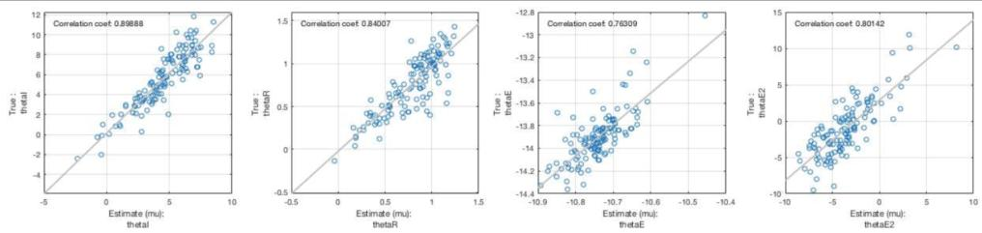
Step 6 – Model checking: parameter recovery
Notes:
how well model recapitulates patterns in the data (surrogate)

Slide 28
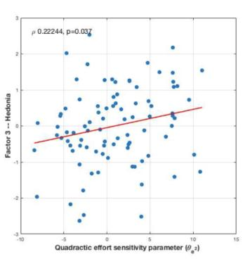
Implementation of Model – Correlation with symptoms
PURPOSE: What does the model tell us about anhedonia & other depressive symptoms
Effort sensitivity correlates with anhedonia. Why is this important?
Role for behavioural activation?
Graded activities
Pharmacological & psychological therapies focusing on effort costs
Dopamine thought to be key in motivated behaviour. Role for dopaminergic antidepressants.
Low anhedonia High anhedonia
Effort insensitive Effort sensitive
Notes:
Otherways include expectation maximisation. Hierarachical – Bayesian inference, non-hierarchical – maximum likelihood estimate.
Bayesian statistics is a departure from classical inferential statistics that prohibits probability statements about parameters and is based on asymptotically sampling infinite samples from a theoretical population and finding parameter values that maximize the likelihood function.
Monte Carlo simulations are just a way of estimating a fixed parameter by repeatedly generating random numbers.
Markov chain – memoryless sequences of events that are probabilistically related to one another.
MCMC methods are used to approximate the posterior distribution of a parameter of interest by random sampling in a probabilistic space

Slide 29
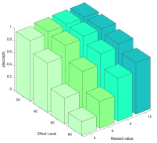
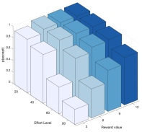
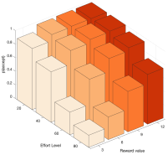
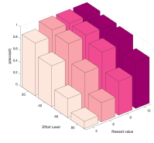
Implementation of Model – Case control study
Step 4
PURPOSE: What about at the group level?
CTR n = 59
REL n = 37
MDD n = 48
REM n = 50

Slide 30
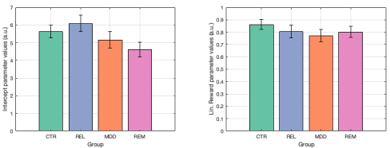
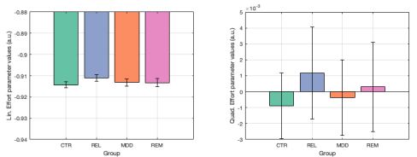
Bias*
CTR+REL>DEP+REM
Reward
Effort
Effort^2

Slide 31
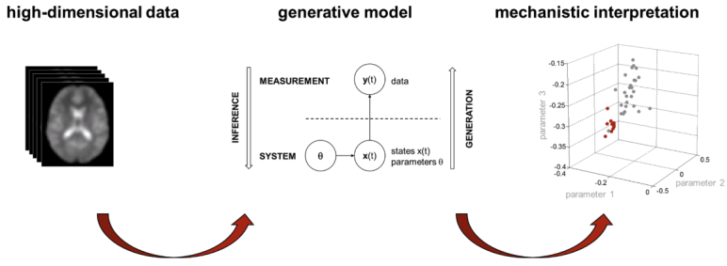
Application to neuroimaging
Much the same
What does the system do?
How does the system do what it does?
How is the system physically realized?

Slide 32
Coding example
Coding example from Matlab: choice reaction task (Participants must make simple decisions under time constraints)
Notes:
The first group: assign values to two variables (nreps and nsamples) that determine the behavior of the simulation. , the number of random walks (i.e., decisions) to be conducted and the number of times that evidence is being sampled for each decision.
The second group of statements (lines 5 to 7) assigns values to variables that have a psychological content. We specify a drift rate, which determines the amount of evidence that is available during sampling: The larger the drift rate, the more the random walk is nudged toward a boundary. We also specify the noise in the evidence, via the standard deviation (sdrw) of the distribution from which we will sample the evidence. Finally, we set the response criterion, which determines the distance of the two boundaries (dashed lines in Figure 2.1) from the origin
The next few lines (9 to 11) create variables that are needed to keep track of the simulation results. The evidence is a two-dimensional matrix that has as many rows as there are to-be-simulated decisions
The heart of the simulation takes place within the loop defined by the statement. Line 13 is arguably the most important part of the program. This statement performs
the random walk by calling three different R built-in function. what we are doing here is drawing nsamples observations from a normal (Gaussian) distribution with mean drift and standard deviation sdrw. l c (0, ...) , where the ellipsis represents the call to rnorm just discussed. The function c concatenates the arguments provided in parentheses; all that happens here is that we add a leading zero to the random samples, which represents the state of evidence at the very outset of the decision process. we call cumsum and hand it the zero-prepended vector of samples, line 13 is a random walk toward one or the other evidence boundary
, we now have a random walk that we can turn into a decision with a specified response latency
Each path corresponds to a single choice trial in which the participant repeatedly samples evidence from the stimulus until the sum of the available evidence is sufficient to make a response.
Now imagine how the model will behave when the evidence favors one decision over
the other, as expected when an informative stimulus is present. This introduces some- thing called “drift” toward the favored threshold by “nudging”. a drift rate, which determines the amount of evidencethat is available during sampling: The larger the drift rate, the more the random walk is nudged toward a boundary.
Through writing code, we debug our scientific thinking.
Because data is theory-laden, it can never be free from, or understood outside, the assumptions implicit in its collec-tion

Slide 33
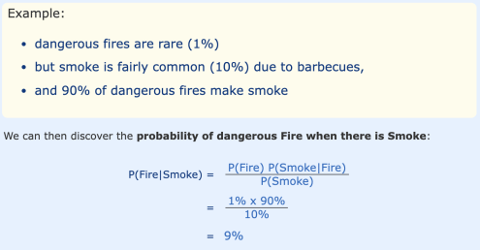
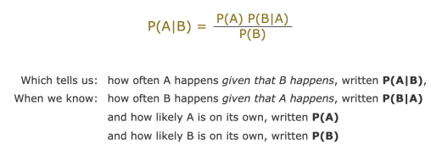
Step 5 – Model estimation
Step 5
PURPOSE: Adjustment of model parameters to best fit the data
Different approaches available. In this case Stan (MCMC) approach used – Bayesian statistical inference with Markov chain Monte Carlo (MCMC) sampling:
Monte Carlo simulations: a way of estimating a fixed parameter by repeatedly generating random numbers.
Markov chain – ‘memoryless’ sequences of events that are probabilistically related to one another.
MCMC methods are used to approximate the posterior distribution of a parameter of interest by random sampling in a probabilistic space
Notes:
Otherways include expectation maximisation. Hierarachical – Bayesian inference, non-hierarchical – maximum likelihood estimate.
Bayesian statistics is a departure from classical inferential statistics that prohibits probability statements about parameters and is based on asymptotically sampling infinite samples from a theoretical population and finding parameter values that maximize the likelihood function.
Monte Carlo simulations are just a way of estimating a fixed parameter by repeatedly generating random numbers.
Markov chain – memoryless sequences of events that are probabilistically related to one another.
MCMC methods are used to approximate the posterior distribution of a parameter of interest by random sampling in a probabilistic space

Slide 34

Reinforcement learning: action selected determined by estimating the value, V(s), of the states - the long-term
sum of future rewards experienced if the state is visited.
Estimated value (V_{t})
Learning rate
Flaws:
No influence of individuals internal state on reward magnitude.
Learns immediate reward and a state, but ignores the values of all subsequent states.
Reward prediction error:
Difference between the experienced reward (r_{t}) &
the estimated value (V_{t})
Notes:
Straightforward account of reward learning that links experienced rewards to estimated values

