Slide 1
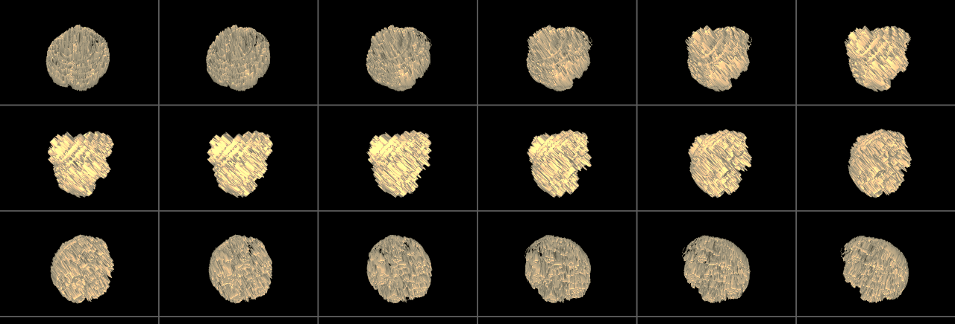
Issues with analysis and Interpretation in fMRI

Slide 2
Statistical power
A frequentist issue?

Slide 3
Recap – Type I/Type II Error
The probability that a hypothesis test will correctly reject a false null hypothesis is the power of the test.
 |  | Actual condition
 |  | H₀ true | H₀ false
Test result | Reject H₀ | False positive (Type I error) | True positive
 | Failure to reject H₀ | True negative | False negative (Type II error)
 |  | Specificity: proportion of actual negatives which are correctly identified | Sensitivity (power): proportion of actual positives which are correctly identified
Notes:
There are two types of errors that we can make:
- Type I error: H₀ is true, but we mistakenly reject it (False positive); Controlled by significance level α.
- Type II error: H₀ is false, but we fail to reject it (False negative)
I like to remember these by thinking about the law example. If someone innocent is wrongly convicted, that’s always worse than if someone guilty is let go.

Slide 4
Power and n
A study is considered to lack power if the sample size is “too small” to demonstrate the effect we look for.
We usually expect small sample sizes to result in increased type II error – i.e. failure to reject the null hypothesis when the null hypothesis false.
However, in fMRI research, too small a sample size may actually result in a very strong (but spurious) finding (Yarkoni, 2009).

Slide 5
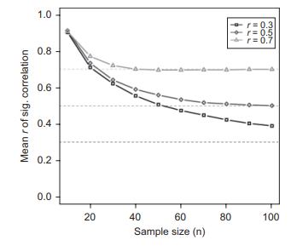
Small samples, big correlations
“An underpowered fMRI analysis will consistently produce spatially circumscribed and numerically inflated effects.”
Lets say we suspect 10 regions of interest may be correlated with a emotional response. (α becomes 0.005)
We conduct fMRI on 20 participants.
Now let’s say the “real-world” correlation, r, = 0.4.
A power analysis will show us that a) only 13% of the ROIs is likely to show significance, and b) the r indicated in our 1 significant ROI will be around 0.7
Yarkoni 2009
Notes:
10 ROIs takes the average activation across all the voxels in that region, simplifies the stats and interpretation.

Slide 6
How many participants do I need?
Depends…
But a power analyses can be ran if you have:
an estimated an effect size, r or d
a (suitably corrected) significance threshold
a suitable study design (correlation or t-test? Within or between subjects?)
software packages such as R Studio or power calculation websites
Notes:
Pearson’s r - the correlation coefficient a measure of linear correlation between two sets of data
Cohen’s d – effect size used to indicate the standardised difference between two means
I believe a t-test has more power than a correlation, but loses information. A within-subjects design has more power than a between subjects design.

Slide 7
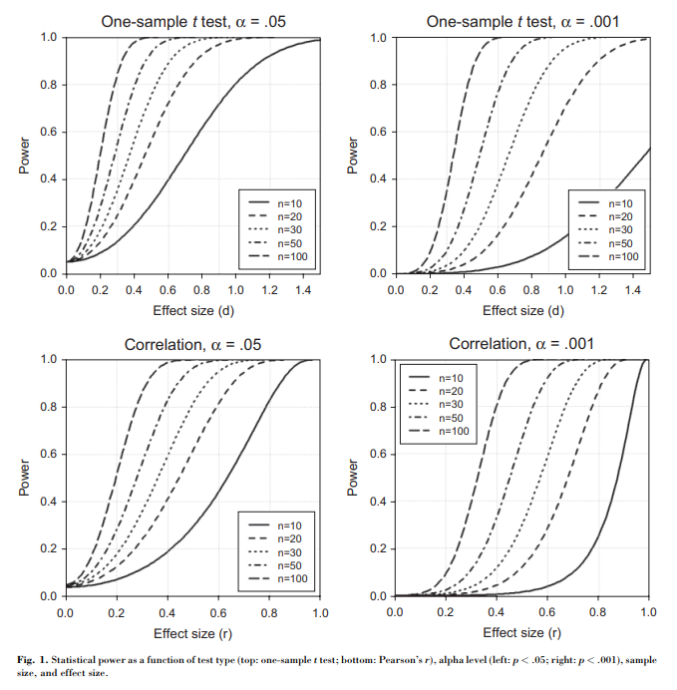
Yarkoni, 2009

Slide 8
What kind of inference do you want to make?
Making an inference about what is typical is less strict than what is an average.
Clinical neuroscience may require more patients to find reliable effects specific to a clinical population compared to finding typical activation in the general population.
However, special cases may be inciteful – for example Seghier et al. (2012) looked at reading aloud in a patient who had damage to a crucial reading area.
Friston, Holmes & Worsley, 1999
Notes:
Seghier et al. then looked at the area the patient relied upon and used it as a hypothesis in a healthy sample of 29 patients.

Slide 9
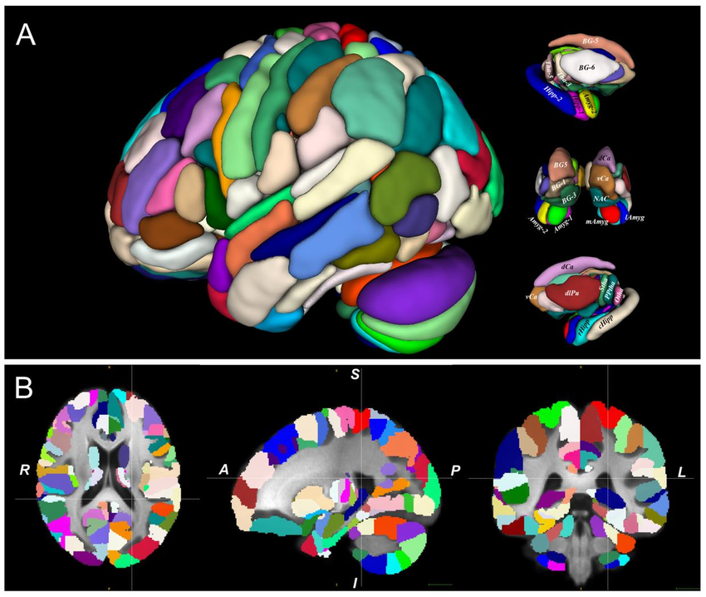
Be careful with defining ROIs
Looking at the average activation across many voxels in a defined region of interest is a way to simplify your analysis, and reduce the influence of statistical thresholds.
But how you define an ROI may skew your results.
Defining an ROI based on activation observed in your data is cyclical, and will inflate your correlations. Vul et al. 2009.
Notes:
Defining an ROI should be a priori and decided before running a study so it can’t influence be influenced by your data.
Using ROIs from probabilistic anatomical maps such as Brainnetome,, or functional boundaries from other independent research is recommended.

Slide 10
Thresholding

Slide 11
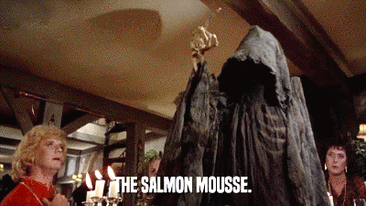
No more salmon…
Bennett et al., (2010) showed how significance thresholds that were not strict enough resulted in false positives at the level of activation in the voxel.
Now we all use appropriate thresholds, so problem solved…

Slide 12
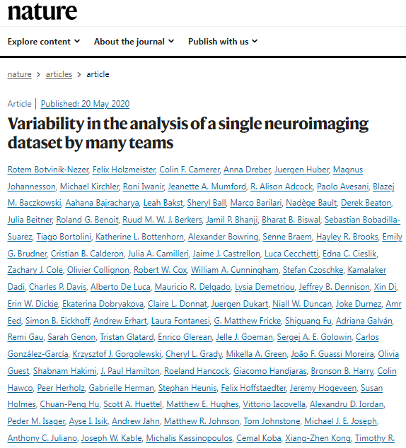
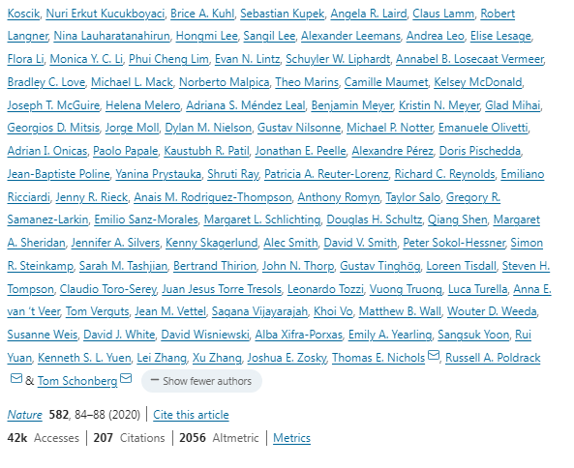
Although….

Slide 13
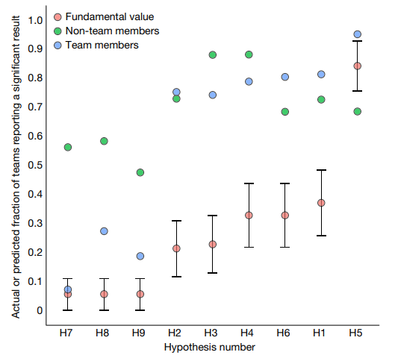
108 individuals performing one of two versions of a decision-making under risk
Seventy teams (69 of whom had previous fMRI publications)
test nine forecasted hypotheses (yes or no)
Notes:
“The dataset included fMRI data from 108 individuals, each performing one of two versions of a task” which were “previously used to study decision-making under risk”
“Seventy teams (69 of whom had previous fMRI publications) were provided with the raw data, and an optional preprocessed version of the dataset” and asked to test nine forecasted hypotheses.
Support for these 9 hypothesis was either yes or no.
You can see from this figure that hypotheses 7, 8 and 9 were consistently refutes, and hypothesis 5 was consistently supported, but the other 5 had much more variability depending on the team analysing the data.
Team members (n=83) and a selection of non-team members (n=65) also took place in a market exchange where they effectively bet on the overall outcome of the results. The dots show that all except one hypothesis for team members fell outside of the 95% confidence intervals for actual results. In other words, team members and non-team members were not accurate predictors and tended to overestimate evidence.

Slide 14
What influenced the results?
Spatial smoothing – increased spatial smoothing of the unthresholded statistical maps was more likely to result in a “significant” outcome.
Software package used – FSL was more likely than SPM to result in a “significant” outcome.
Large variability was present in both thresholded and unthresholded statistical maps.
Notes:
higher estimated smoothness of the unthresholded statistical maps (estimated using the FMRIB Software Library (FSL) smoothest function) was associated with a greater likelihood of significant outcomes. NOTE this was not the size of the smoothing kernel used in pre-processing, but rather the smoothing used in the overall process.
Software package difference were not as strong as the smoothness (did not pass nonparametric bootstrapping analysis)
Large variability in the voxels that were activated in the unthresholded maps and the thresholding processes led to variable and sometimes contradictory conclusions due to things like multiple regressors being correlated with the gain parameter.
The authors concluded that data sharing and “the development of automated statistical analysis tools … that can run a broad range of pipelines and assess their convergence”. But it goes to show how analysis both before and after thresholding still presents big problems for fMRI data.

Slide 15
(Informal) Reverse Inference
“Activation in the angular gyrus indicates the participants were using arithmetic strategies to successfully complete the task”.

Slide 16
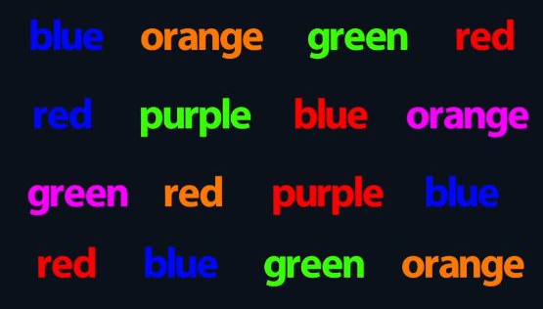
(Informal) Reverse Inference
Therefore:

Slide 17
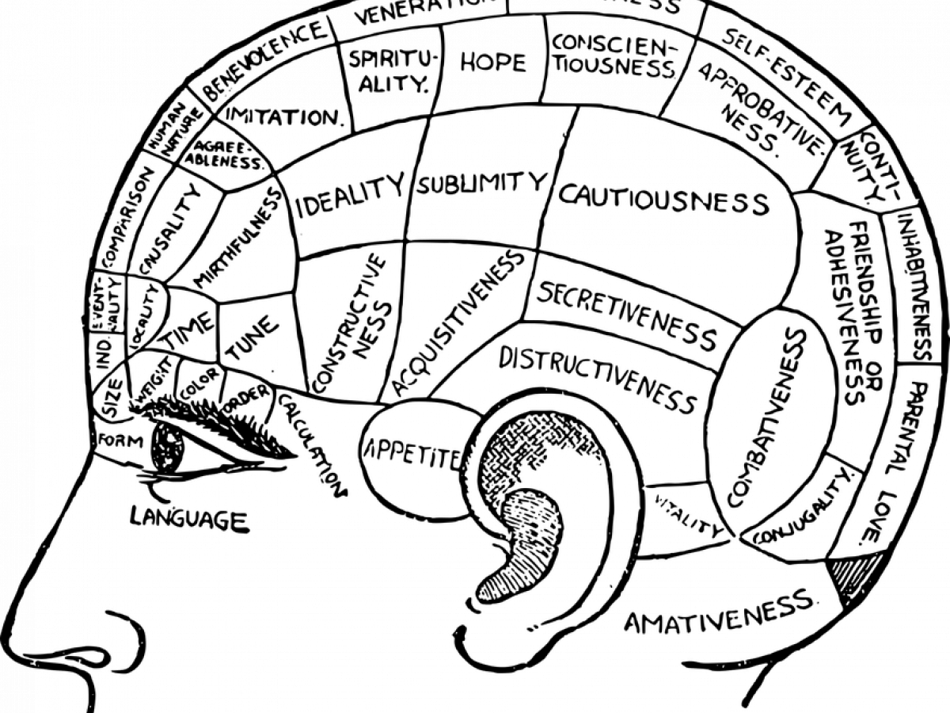
(Informal) Reverse Inference
Relies on a fundamental misunderstanding of the brain
Regions may have specialised functions, but specialised tasks is very unlikely
Context is important
Most areas are implicated in many tasks, not for researchers to pick and choose

Slide 18
Formal inference using Bayes:
$$P\left(cognition | activation\right)=\frac{P\left(activation | cognition\right) P\left(cognition\right)}{P(activation)}$$
Notes:
We can use bayes theorem to conduct a formal inference
It’s very difficult to find all the times a brain area is activated in response to a task

Slide 19
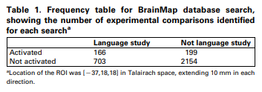
Formal inference using Bayes:
$$P\left(language | Broca′s\right)=\frac{P\left(Broca^{′}s | language\right) P\left(language\right)}{P(Broca^{′}s)}$$
= 0.46
Poldrack, 2006
Notes:
We can use bayes theorem to conduct a formal inference
Remember how our “real-world” correlation earlier was 0.4?
This is a meta-analysis approach, when we cover DCM and PEB we will be looking at a formal inference technique at the individual and group level.

Slide 20
Conclusions
Both sample sizes and ROI selection can inflate effect sizes, as well as reduce them.
Thresholding is crucial, but so is the pre-processing steps. fMRI research is still variable.
Informal inference is a poor interpretation of fMRI results. Formal inference is helpful but difficult to implement.

