Slide 1
Basis of M/EEG signals (Part 1)
Yue Kong
Muhammad Akil Yerilwan Putra
March 23, 2022

Slide 2
Overview
Introduction to EEG
Basis of EEG signals
Basic principles of EEG recording
Extra:
EEG signatures (ERP and oscillations)
Frequency spectrum (waves)
Clinical applications

Slide 3
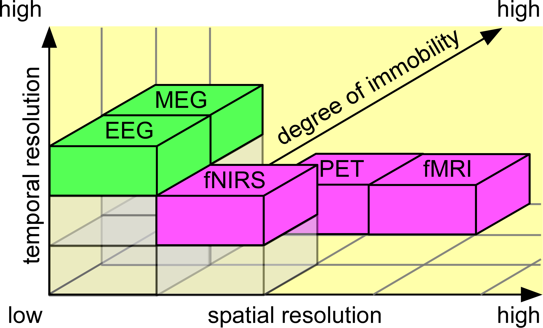
Introduction to EEG
EEG (Electroencephalogram): a way to measure electrical activity in the brain (cortex)
Characteristics:
Direct and non-invasive
Excellent temporal resolution
Can be mobile
Combined with other imaging techniques
Commonly used to detect seizure and epileptic activity
Adapted from
Mehta & Parasuraman, 2013

Slide 4
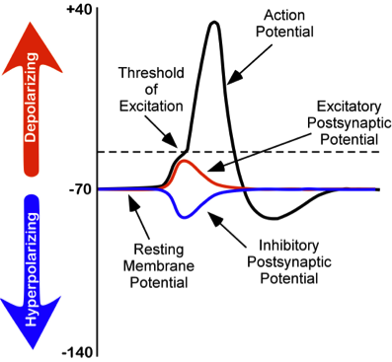
Basis of EEG signals
Types of Voltage:
Action potential: discrete voltage spikes that travel from the beginning of the axon at the cell body to the axon terminals, where neurotransmitter are released.
Postsynaptic potentials (PSP): voltages that arise when the neurotransmitters bind to receptors on the membrane of the postsynaptic cell.
EEG reflects summed post synaptic activity of large cell ensembles.
(EPSP)
(IPSP)
https://mathsgee.com/learn/mod/page/view.php?id=10385

Slide 5
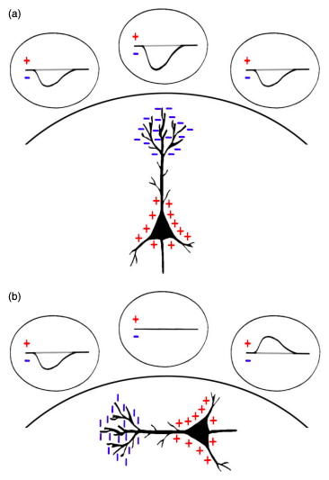
Basis of EEG signals
Dipole: a region of positive charge separated from a region of negative charge by some distance.
The region of positive charge is referred to as a source, while the region of negative charge is referred to as a sink.
Electrodes detect the sum of positive and negative charges in their proximity.
Radial dipole
Tangential dipole
Jackson & Bolger, 2014

Slide 6
Basis of EEG signals
To produce a measurable (nonzero) signal, neurons must be both arranged in a parallel fashion, and synchronously active.
This is most likely to occur in cortical pyramidal cells, which are aligned perpendicular to the surface of the cortex.
Jackson & Bolger, 2014

Slide 7
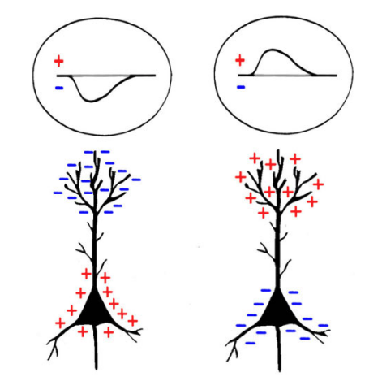
Basis of EEG signals
Measured EEG cannot determine if activity is excitatory or inhibitory.
Either an IPSP (which produces an extracellular positivity) near the soma, or an EPSP (which produces an extracellular negativity) at the apical dendrites.
Either an EPSP near the soma or an IPSP at the apical dendrites.
Jackson & Bolger, 2014

Slide 8
Spatial resolution
The low spatial resolution is attributable to:
Limited number of sensors
Volume conduction

Slide 9
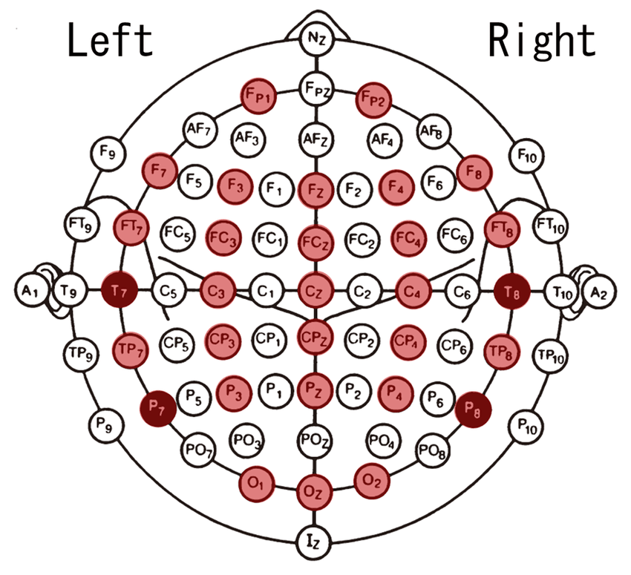
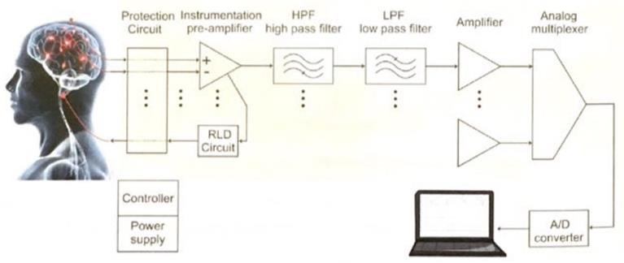
Measuring an EEG-signal
The 10 – 20 system : standardised placement
EEG system: electrodes, differential amplifier, recording PC and stimulus PC.
The way the electrodes are connected to the amplifiers are referred to as a montage
Nasion
Auricullar points
Auricullar points
Inion
Ueda, Sakai and Yanagisawa, (2019)
Modir (2017)

Slide 10
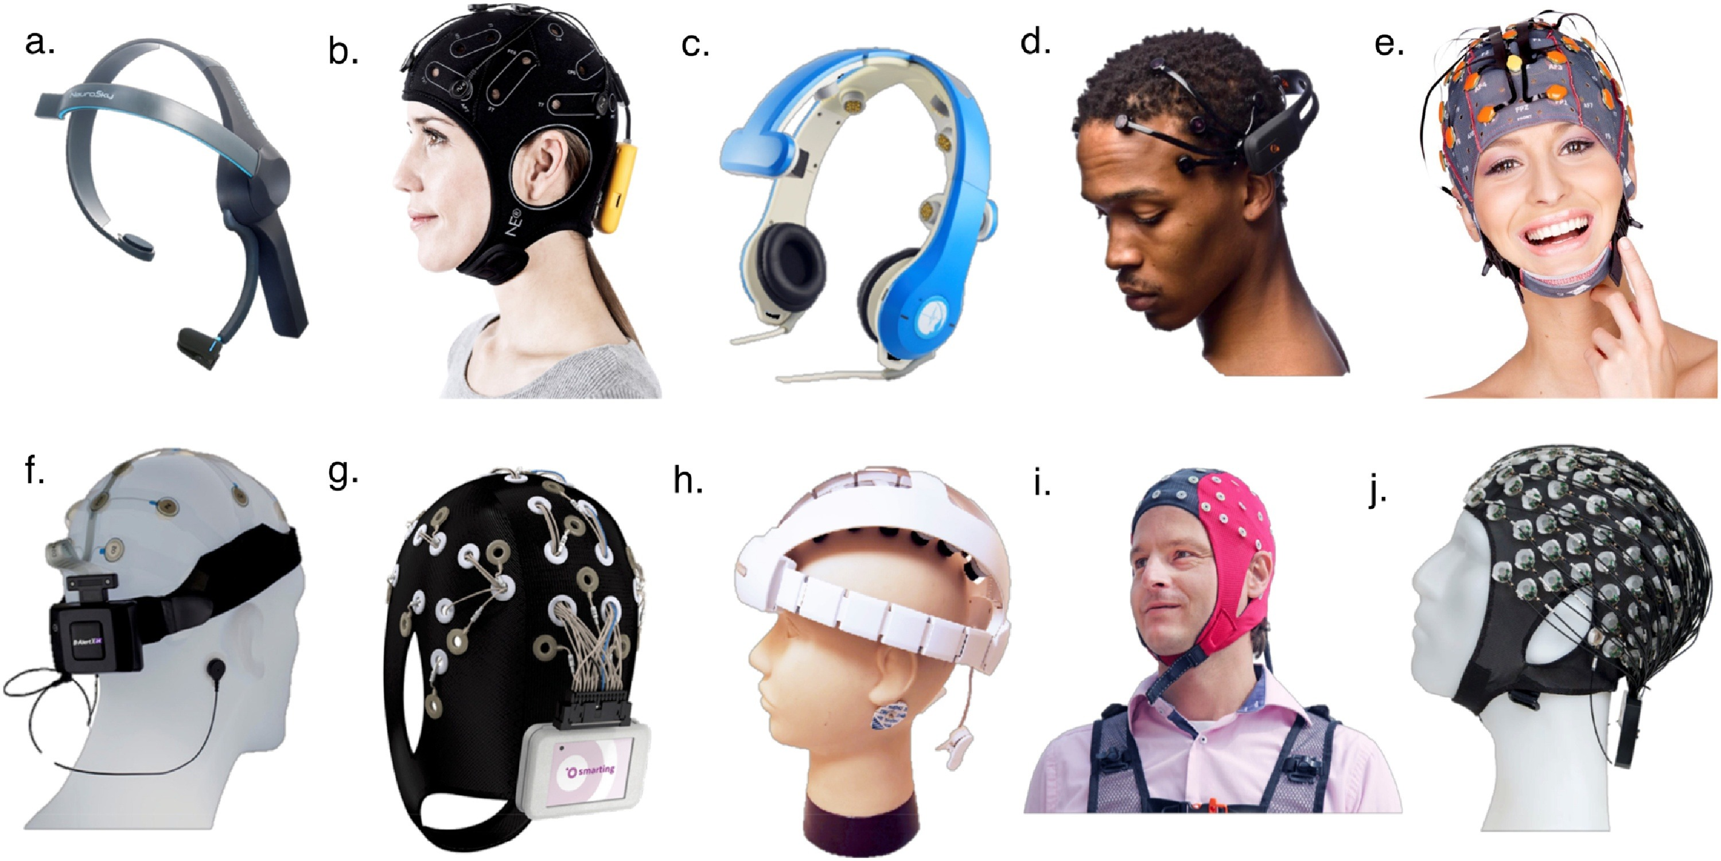
Mobile EEG
Lau-Zhu et al., 2019

Slide 11
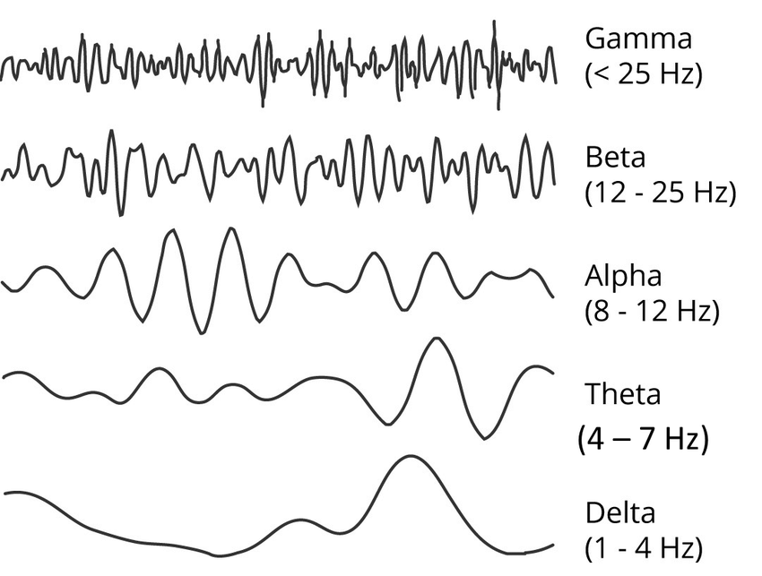
Frequency Spectrum (waves)
>
(Sakhavi 2017)
Notes:
For comparison.
There are a lot more waves and specific wave components which appear depending on circumstances.

Slide 12
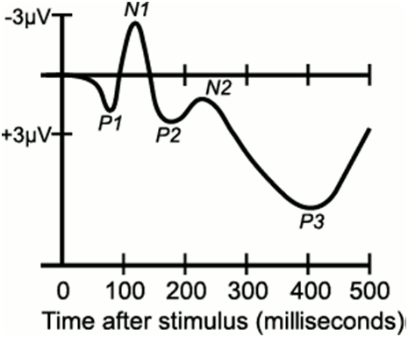
Common signatures
Event-related potential (ERP): transient activity, time-locked to an event, most often an external stimulus.
Neural oscillations: frequency specific patterns of neural activity
Spontaneous oscillations (e.g. sensorimotor rhythm, alpha rhythm)
Induced oscillations (e.g. steady-state visual evoked potentials (SSVEP), evoked by an synchronous to a periodic external stimulus)
Wikipedia
Berlin BCI

Slide 13
Clinical/Experimental Application
Epilepsy
Parkinson’s disease
Memory problems (“Alzheimer’s”)
Seizures
Post traumatic stress disorder
Language impairments (“Dyslexia”)
Sleep disorders and insomnia
EEG monitoring is actively in daily clinical practice.
Monitoring and treatment patients
Detection of burst suppression on anaesthesia
Detection of cerebral ischemia
Prognostication outcomes
In cases with significant/permanent damage
Cognitive function
Coma
(Soufineyestani et al 2020)
(Sun et al 2020)
Notes:
EEG used in practice for its key sensitivity to detect neurophysiological changes in the brain.

Slide 14
Advantages and Disadvantages
Advantages
Ongoing / real time activity
Non-invasive
Low-cost
Quiet
High temporal resolution
Minimal safety concerns
Disadvantages
Poor spatial resolution
High noise
Subjective
Requires a trained physiologist to run and read the recording

Slide 15
Jackson, A. F., & Bolger, D. J. (2014). The neurophysiological bases of EEG and EEG measurement: A review for the rest of us. Psychophysiology, 51(11), 1061-1071. Lau- Zhu, A., Lau, M, P,H. & McLoughlin,G. (2019). Mobile EEG in research on neurodevelopmental disorders: Opportunities and challenges. Developmental Cognitive Neuroscience. 36, https://doi.org/10.1016/j.dcn.2019.100635 Mehta, R. K., & Parasuraman, R. (2013). Neuroergonomics: a review of applications to physical and cognitive work. Frontiers in human neuroscience, 7, 889. Modir, A. (2017). NIRS signal evaluation in order to epileptic seizure detection. 10.13140/RG.2.2.23784.32007. Ueda, K., Sakai, Y., & Yanagisawa, H. (2019). Quantitative evaluation of sense of discrepancy to operation response using event-related potential. https://arxiv.org/pdf/1907.01827.pdf Soufineyestani, S., Dowling, D., Khan, A., 2020. Electroencephalography (EEG) Technology Applications and Available Devices. Applied Sciences, University of Minnesota Duluth. https://webcache.googleusercontent.com/search?q=cache:6_gW1h8XfiwJ:https://www.mdpi.com/2076-3417/10/21/7453/pdf+&cd=13&hl=en&ct=clnk&gl=uk&client=safari Sun, Y., Wei, C., Cui, V., Xiu, M., & Wu, A., 2020. Electroencephalography: Clinical Applications During the Perioperative Period. Frontiers in medicine, 7, 251. https://doi.org/10.3389/fmed.2020.00251 https://www.brightbraincentre.co.uk/electroencephalogram-eeg-brainwaves/ https://mathsgee.com/learn/mod/page/view.php?id=10385
References

Slide 16
Basis of M/EEG signals (Part 2)
Yue Kong
Muhammad Akil Yerilwan Putra
March 23, 2022

Slide 17
Outline
MEG: magnetoencephalography, measure changes in magnetic flux density outside of the head
Where do MEG signals come from
How do we record them
What do they mean
EEG versus MEG

Slide 18
Outline
Where do MEG signals come from
How do we record them
What do they mean
EEG versus MEG

Slide 19
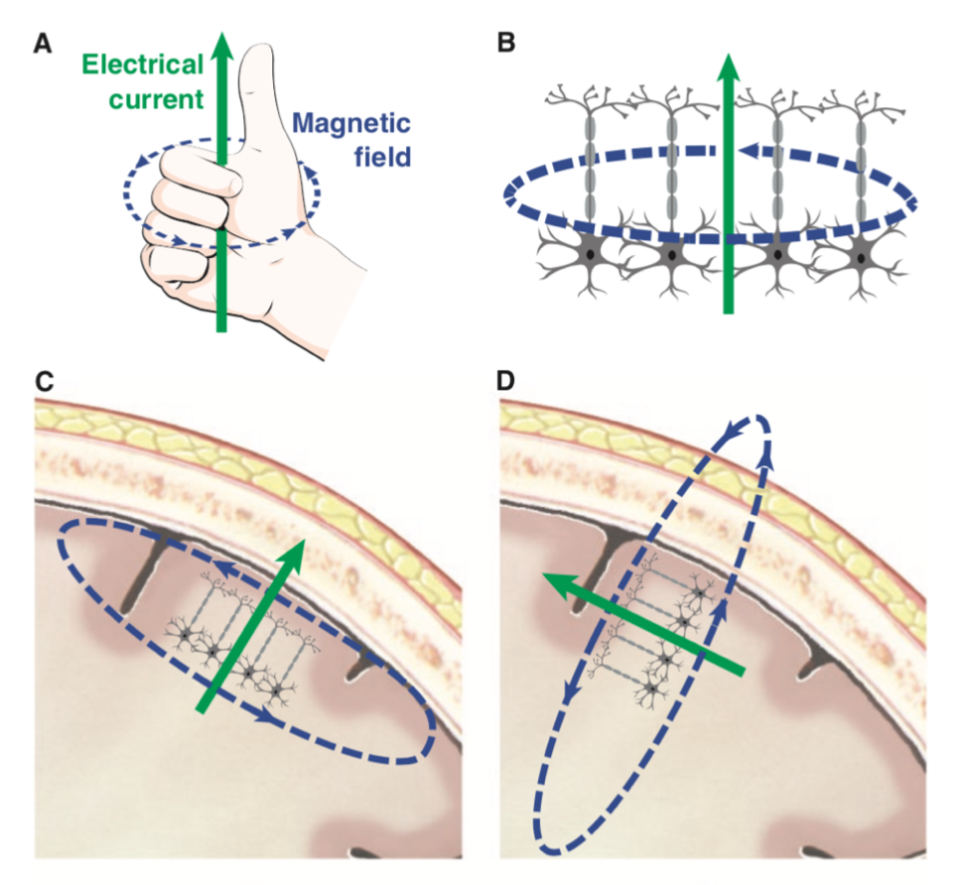
Where do MEG signals come from
Pyramidal cells / stellate cells
in layer II/III and V
perpendicular to the surface
synchronous
EPSP / action potentials
Intracellular / extracellular currents
Sulci / gyri *
* Generally speaking
gyrus
sulcus

Slide 20
Outline
Where do MEG signals come from
How do we record them
What do they mean
EEG versus MEG

Slide 21
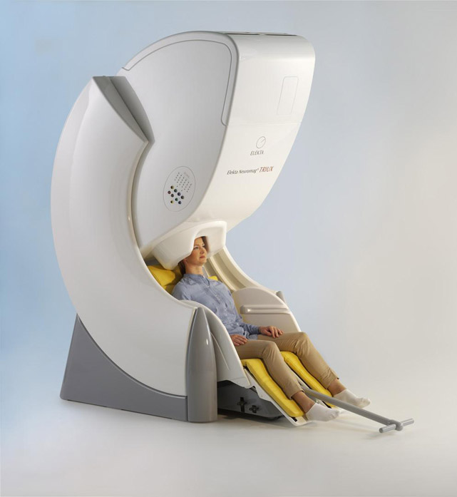
How do we record them
Magnetically Shielded Room
earth: 25~65 x 10⁻⁶ T; brain: 10⁻¹⁵ T
SQUIDs: Superconducting QUantum Interference Device
superconducting: 0 resistance → infinite conductivity
below 4 K (-269.15 °C), using liquid helium
Don’t move!
3D-printed headcast

Slide 22
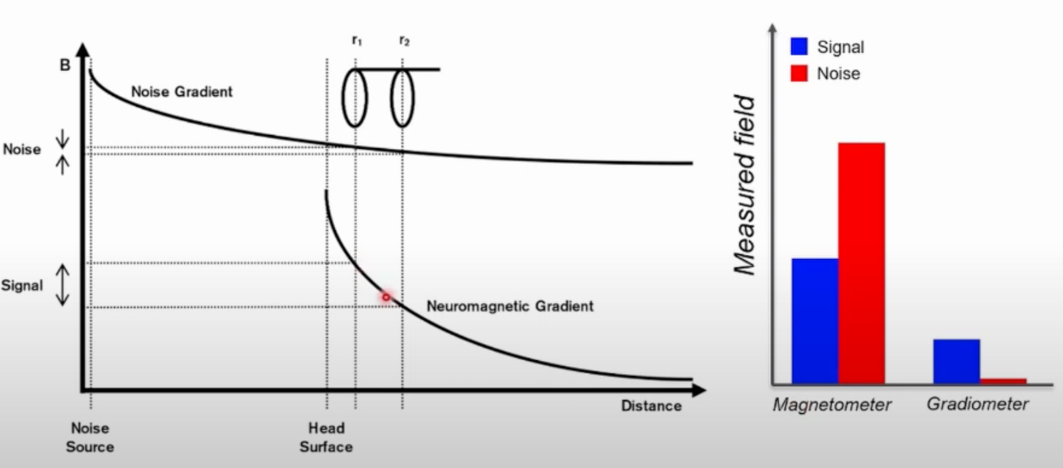
How do we record them

Slide 23
How do we record them

Slide 24
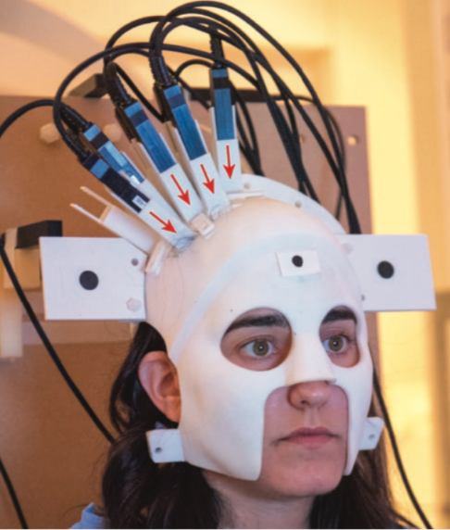
How do we record them
OPM (Optically pumped magnetometers)
Portable
Shorter distance → higher SNR
OPM (2018)
WCHN (2021)

Slide 25
Outline
Where do MEG signals come from
How do we record them
What do they mean
EEG versus MEG

Slide 26
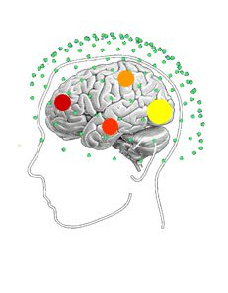
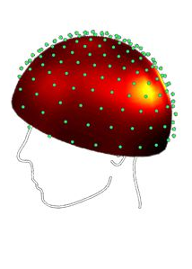
What do they mean
Temporal * spatial * spectral
Careful! Domain reduction can deceive (Zich, 2020, TiCS)
Epoch
Trial average (ERF)
Time-frequency analysis
Source localization
Orientation
Extent
Depth
Forward & Inverse problem
Forward modelling:
easy!
Neuronal activity/
Current density
EEG/MEG Sensor data

Slide 27
Outline
Where do MEG signals come from
How do we record them
What do they mean
EEG versus MEG

Slide 28
EEG versus MEG
 | EEG | MEG
Temporal resolusion | ms | ms
Spatial resolusion | poor | good
Source of signals | Deep and shallow dipoles | mainly shallow dipoles
 | Gyri and sulci | Mainly sulci
Quality of signals | Affected by skull, meninges | Unaffected by skull, meninges
SNR* | low | high
feasibility | Cheap, widely available | Expensive, limited availability
* EEG needs 3 times of data to get the same results with MEG (Florian Destoky et al., 2018, Neuroimage)

