Slide 1
Functional Connectivity and Psychophysiological Interaction (PPI)
Lucy Core, Ozzie Ozturk, Alexiane Touze
Methods for Dummies
April 20, 2022

Slide 2
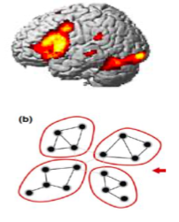
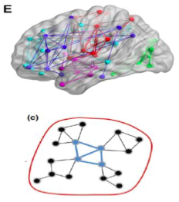
How is brain activity localized?
How do brain areas interact?
“Connectivity analysis”

Slide 3
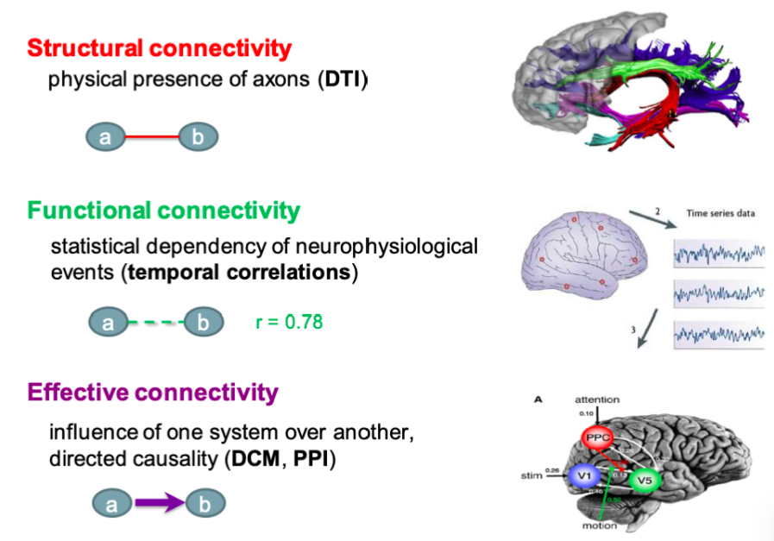
3 types of brain connectivity
Roerbroek et al., 2011

Slide 4
Functional Connectivity
Notes:
Alexiane

Slide 5
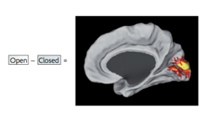
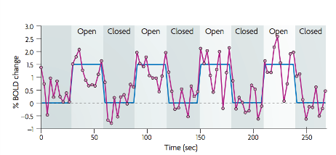
Task-evoked fMRI paradigms
Fox & Raichle, 2007

Slide 6
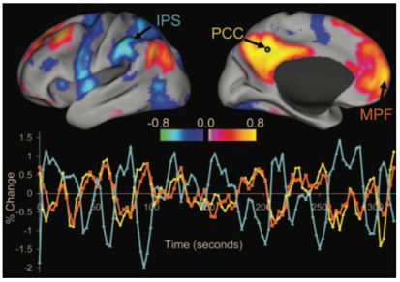
Resting-state fMRI
Subject is at rest:
fixation on a crosshair or eyes closed
instructed to lie still and refrain from falling asleep
Fox & Raichle, 2007

Slide 7
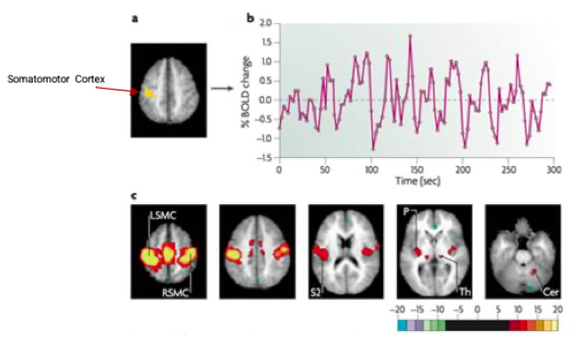
Seed-based analysis
Fox & Raichle, 2007

Slide 8
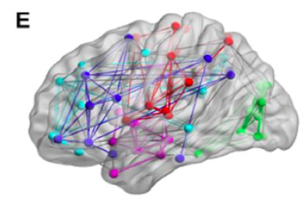
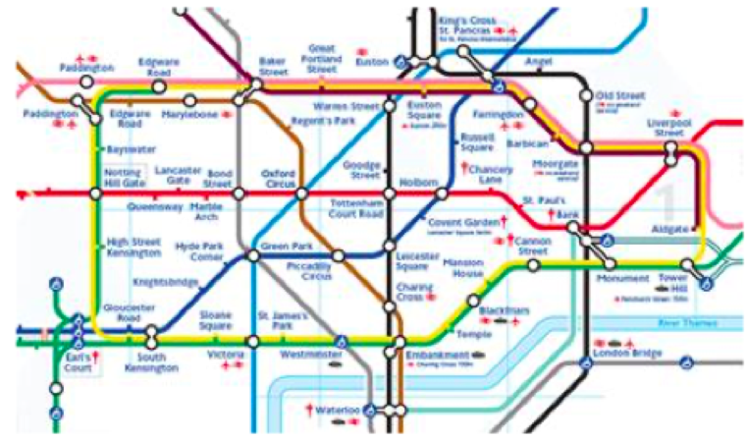
Independent component analysis (ICA)
Fox & Raichle, 2007

Slide 9
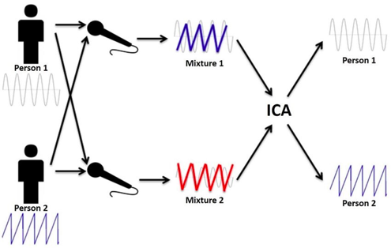
Independent component analysis (ICA)
Fox & Raichle, 2007

Slide 10
Accounting for noise
Removing physiological fluctuations (cardiac or respiratory activity) through linear regression
Isolating sources of noise through:
Eliminating global signal
Eliminating signals emerging in areas likely to produce physiological artefacts (e.g ventricles or white matter)
Independent component analysis (ICA)
Fox & Raichle, 2007

Slide 11
PROS
Easy to acquire
Ideal for patients who can’t perform certain tasks
One data set allows to study different functional networks in the brain
Good for exploratory analyses
(potentially) helpful as a clinical diagnostic tool (e.g. epilepsy, AD)
CONS
Establishes correlations, not causal relationships

Slide 12
Functional connectivity
Are two datasets related?
Temporal correlations between spatially remote areas
Whole brain connectivity
Data driven (exploratory)
Correlation analysis
MODEL-FREE
No Causation
Effective connectivity
Can we predict activity in region A from activity in region B?
The influence of one neuronal system over another
Reduced set of regions
Hypothesis driven (confirmatory)
Regression analysis
MODEL-DEPENDENT
Causal (based on a model)

Slide 13
Psychophysiological Interaction (PPI)
Notes:
Lucy

Slide 14
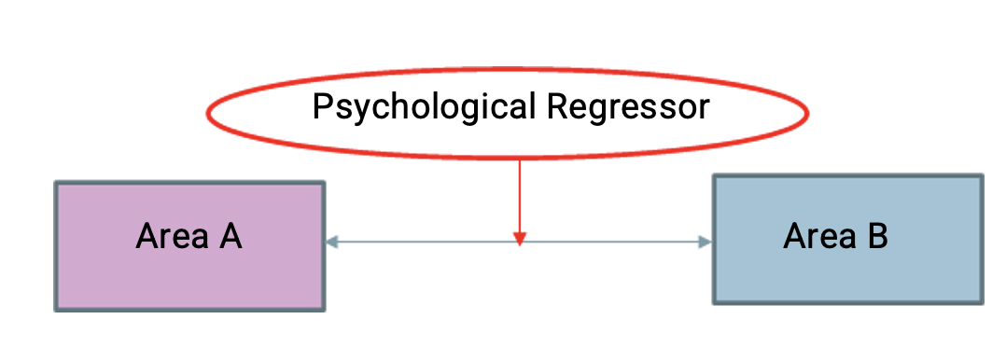
What is PPI?
Brain connectivity analysis method proposed by Friston et al (1997)
Estimates changes in the coupling between two regions that depend on an interaction between the psychological content (the task) and physiological activity (time course of brain activity) of a particular region
Notes:
Psychophysiological interaction or PPI is a connectivity analysis method that Friston and colleagues introduced in 1997
It estimates the changes between the coupling, or the effective connectivity, between two brain regions
And this coupling is context dependent. It relies on the interaction between the task at hand (so the psychological content) and the time course of the brain activity in another region, which is the physiological component.
That’s where the name psychophysiological interaction comes from
As you can see in the diagram here, the two boxes represent two different brain regions that are connected to one another. And then there’s a psychological variable that is exerting influence on the connection
The goal of this analysis is to explain the activity of one region by measuring the interactions between another region and a psychological variable

Slide 15
Practical Example: Research Question
How can activity in V5 (motion detection area) be explained by the interaction between attention to visual motion and activity in V1/V2 (primary visual cortex)?
Target region: V5
Psychological variable: attention
Physiological variable: V1/V2 activity
Notes:
So now we’re going to talk through a practical example of PPI and hopefully it will become a bit more clear.
Out question is - How can activity in V5, which is a motion detection area, be explained by the interaction between attention to visual motion and activity in V1/V2, primary visual cortex?
This question has three main parts which make up the pieces of the diagram below.
So the target region or the area of interest is V5. That’s the area whose activity we want to explain
The psychological variable is attention to visual motion
And the physiological variable is the activity in the primary visual areas (V1/V2).

Slide 16
Practical Example: Study Design & Hypothesis
2 x 2 Factorial Design
Stimuli: participants view moving or stationary dots
Task: participants actively attend or passively view the dots
Hypothesis
Area V5 shows an attention-dependent coupling with area V1/V2
Notes:
In this example, there is a 2x2 factorial design
There are two types of stimuli. Participants view a display of dots that are either moving or stationary
And they have to actively attend or passively view the stimuli
The hypothesis is that area V5, a motion detection area, will show attention-dependent coupling with primary visual areas, V1/V2.

Slide 17
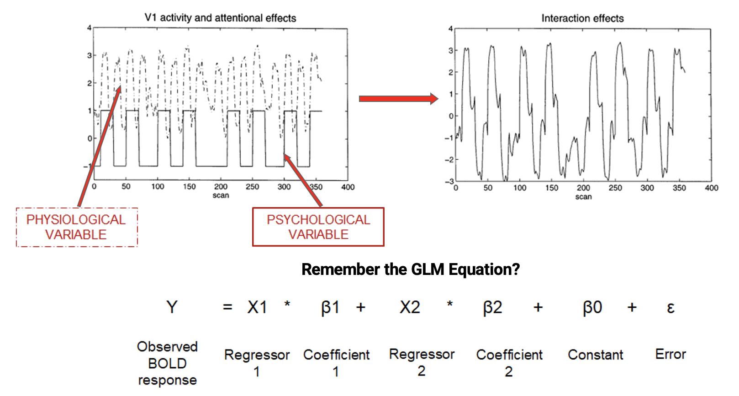
Practical Example: How it Works Part 1
Notes:
So this slide is just a quick reminder of how fMRI data are collected and what the general linear model is
In this top left image, time, or the scan number, is on the x axis. The solid line represents the psychological variable, or when the task occurred. We can see that a blocked design was used. So when it’s at 1 that’s presumably the attend condition and when it’s at -1 that’s the no attention, or the passive viewing condition.
Then the dotted line is showing the physiological variable so this is the BOLD signal from area V1.
If we multiply the psychological and physiological variables together, we get the graph shown on the right which is the interaction between the two.
So this slide is essentially just showing how we define a psychophysiological interaction
Then the bottom part is a reminder of the GLM equation, which everyone should hopefully already know.

Slide 18
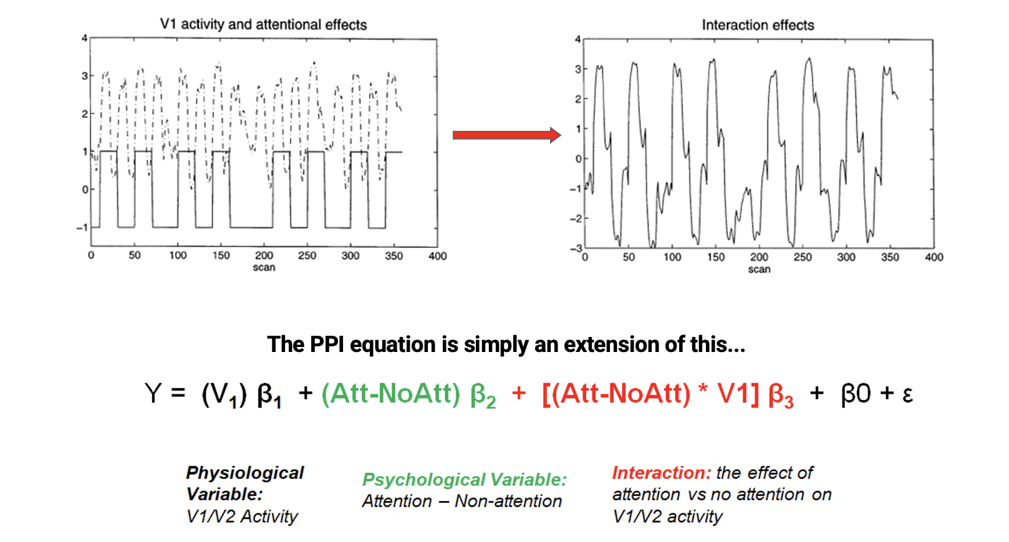
Practical Example: How it Works Part 2
Notes:
Now we’re going to dive into some of the details of PPI and take a look at the math behind it.
So in our example, we’re interested in V5 activity, remember V5 is our target region. There are 3 things that could be explaining the variability in activity in this area.
The first thing is the activity in V1, the V1 timeseries. This is our physiological variable and is shown in black here. This is the main effect of V1. This is also called functional connectivity, it’s just the correlation between V1 and V5.
A second thing that may cause V5 activity is the task, the psychological variable. So anytime the stimulus is presented the V5 signal may go up and otherwise it goes down, and vice versa. This is shown in green and it’s the main effect of the task.
The third thing that could explain the V5 activity is the interaction between those two things. And this is the part that we are interested in. We want to know when the V5 signal goes up and down due to the task but only when there’s activity in V1. This is shown in red and notice that it’s just the multiplication of the physiological and the psychological variables.
Another way of framing this conceptually is - are the target region (in our case V5) and seed region (in our case V1) more correlated with one another during the task compared to when the task is not happening?

Slide 19
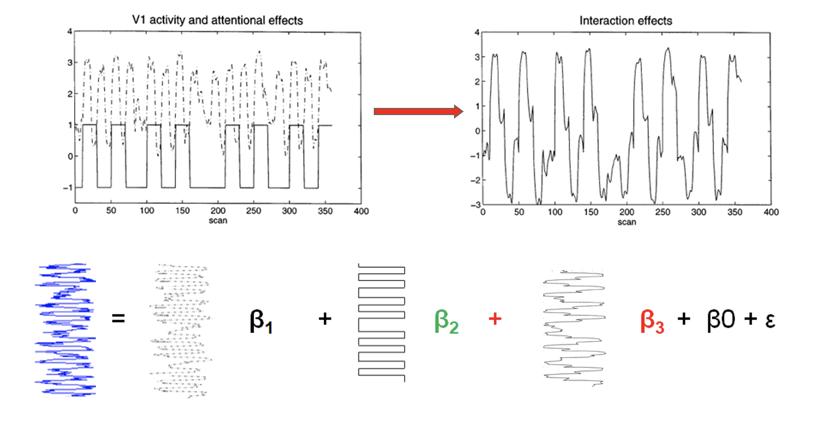
Practical Example: How it Works Part 3
Notes:
This slide is showing a graphical representation of the equation we just went over. Here, time is shown going vertically. And so the terms that just discussed are all vectors.

Slide 20
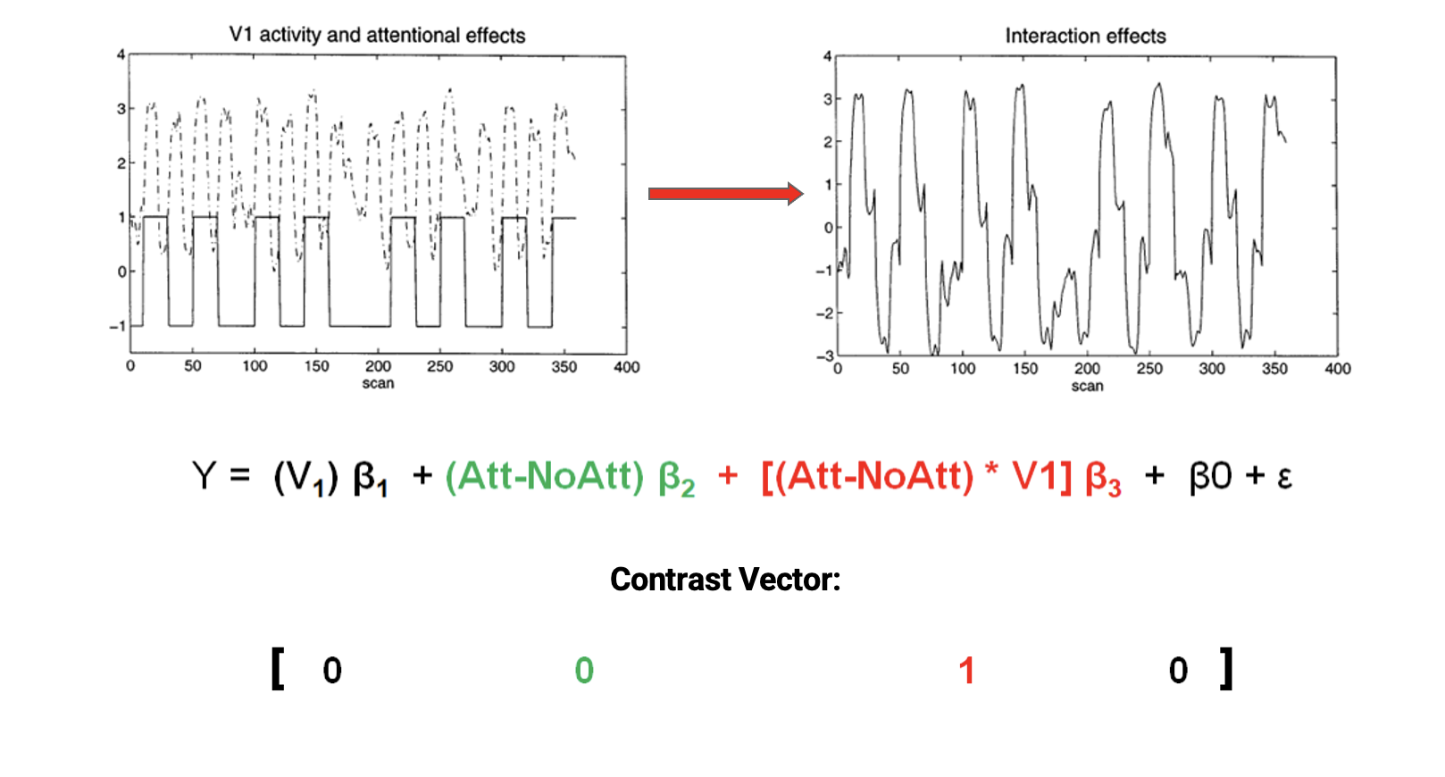
Practical Example: How it Works Part 4
Notes:
This slide shows the contrast vector we’d want to use. Because we’re interested in the interaction term, we assign it a 1 and everything else is assigned a 0.

Slide 21
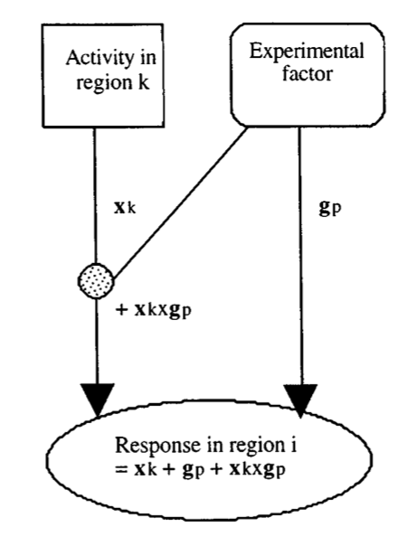
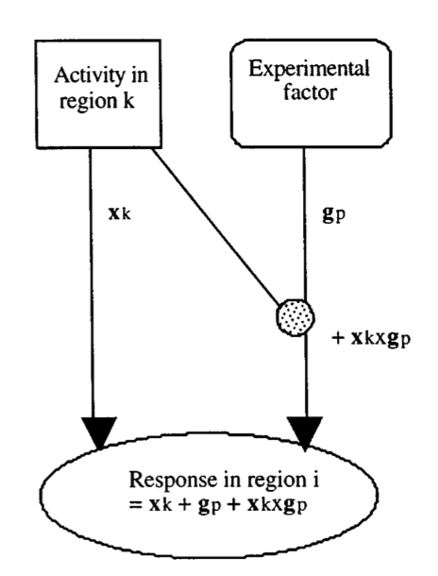
2 Possible Interpretations
1) The psychological factor modulates the activity of a region
2) The activity of a region modulates responsiveness of the target area to the psychological factor
Notes:
Now that we have an understanding of how PPI works, I want to point out that there are two possible scenarios for how the interaction could occur. And this is important because it influences our interpretation of what PPI means.
The first possibility is that the psychological or experimental factor modulates the activity of a region which in turn affects the target region. In our example, this would mean that the contribution of area V1 on V5 is altered by the attention task.
The second scenario is that the activity of a region modulates the responsiveness of the target area to the psychological factor. In our example, this means that V5’s activity to the attention task is due to V1’s contribution.
So the difference between the two scenarios is just what factor is doing the modulating.
Both situations are mathematically equivalent although one could be more neurobiologically plausible
Now Ozzie is going to take us through this example using SPM.

Slide 22
PPI in SPM
Notes:
Ozzie

Slide 23
PPI: Analysis on SPM
y = (A2 −A1)β1 + (B2 −B1)β2 + (A2 −A1)(B2 −B1)β3 + Gβ4 +ε
y= V1 β1 + (Att-NoAtt) β2 + (Att-NoAtt) * V1 β3 + Gβ4 + ε
Perform standard GLM Analysis
Extracting BOLD signal from a source region identified in the GLM and for which we want to investigate connectivity
Forming the interaction term
Performing a second GLM including the interaction term, the source region’s extracted term and the experimental vector in the design
Notes:
First equation is a standard 2x2 factorial design GLM equation: 2 main effects, interaction, constant or confounds such as movement parameters, session effects
We can replace them with the variable from our example, main effect for activity in the area, main effect for psychological variable, their interaction variable.
In order to get these variables first we need to perform a standard GLM analyses.
We will use this for extracting….

Slide 24
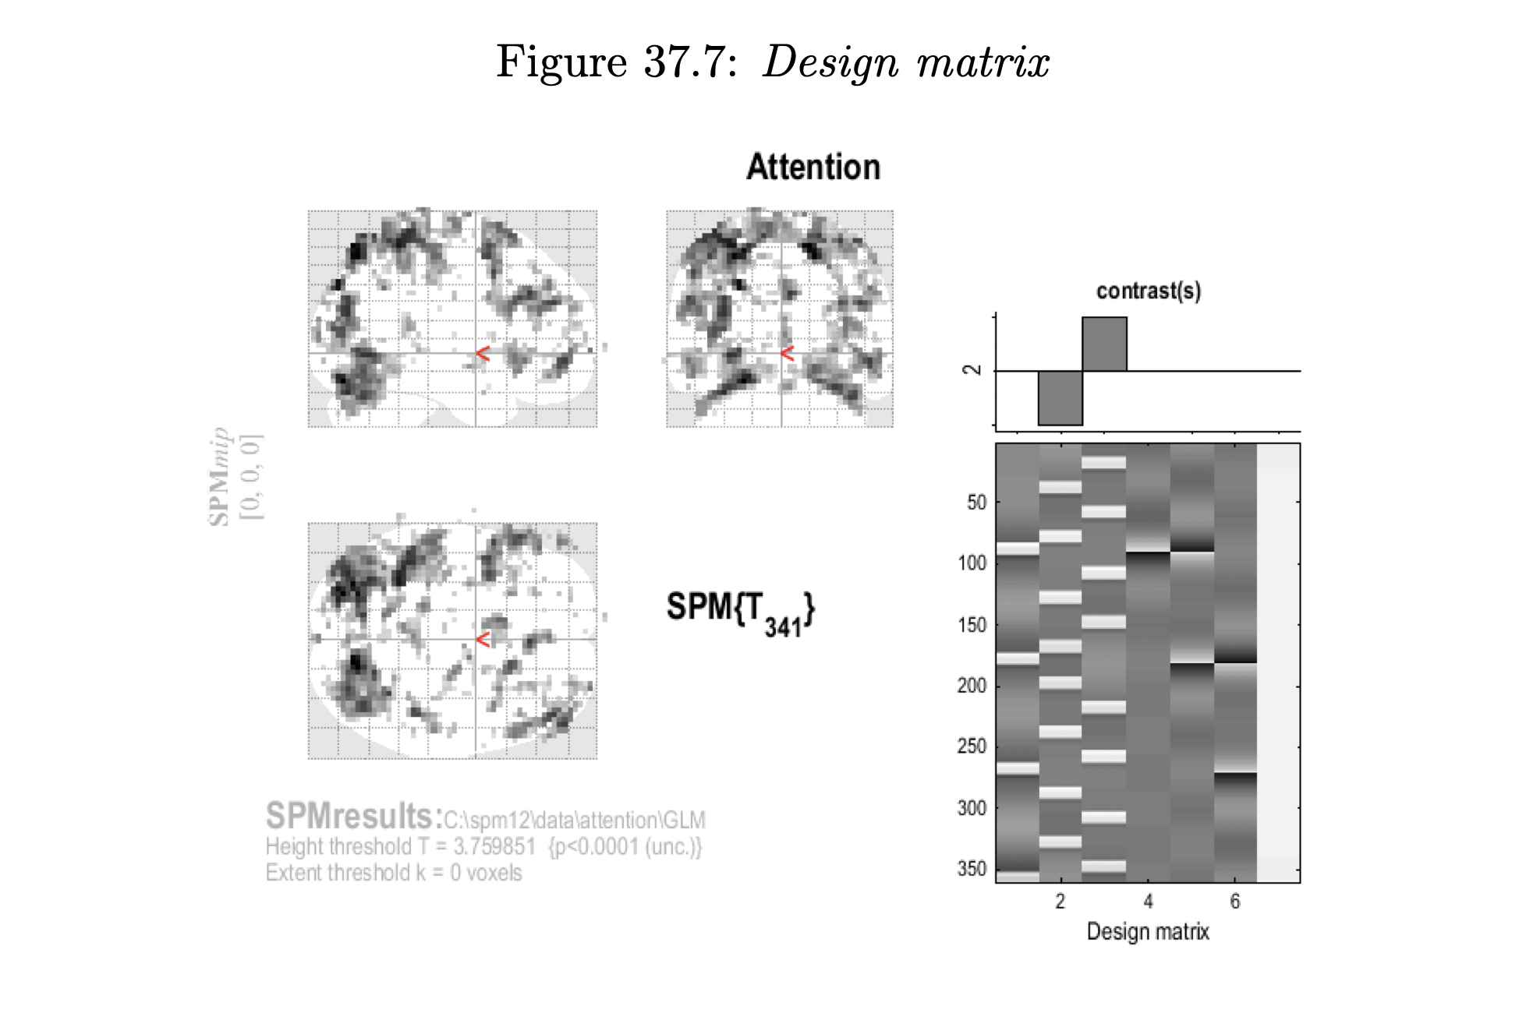
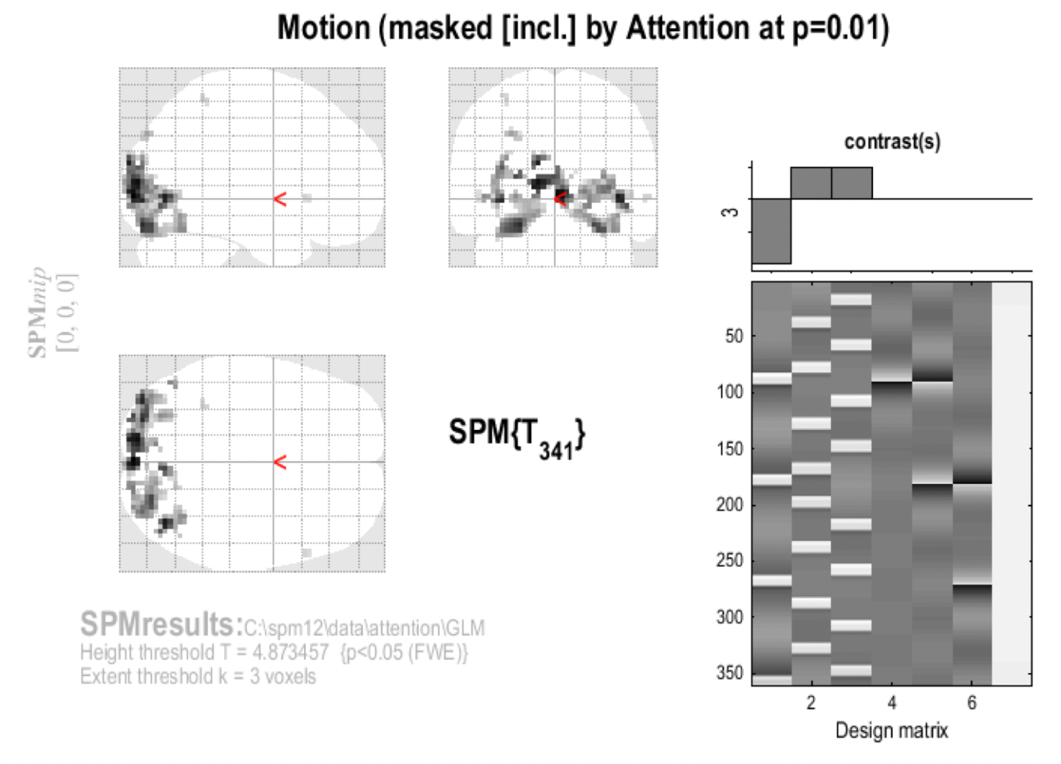
Perform standard GLM Analysis to determine regions of interest and interactions
Notes:
Standard GLM preprocessing, first-level, and second-level analyses
Which will give us a statistical parametric map for the attention contrast alone and
Right side has a mask which shows us the location where Attention is greater than No Attention

Slide 25
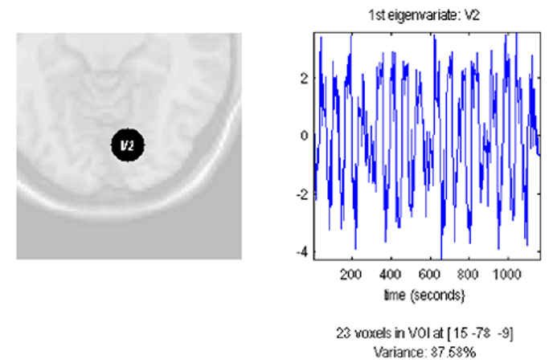
Extracting BOLD signal from a source region identified in the GLM
Select the Motion contrast (not masking)
Use a p-value adjustment of FWE with height threshold of 0.05 and a cluster threshold of 3
Press eigenvariate
Name of region - e.g. V1
Adjust data for effects of interest
Define Volume of Interest and its radius
Notes:
The left side shows the location on a standard brain. The right side shows the first eigenvariate of the extracted BOLD signal.

Slide 26
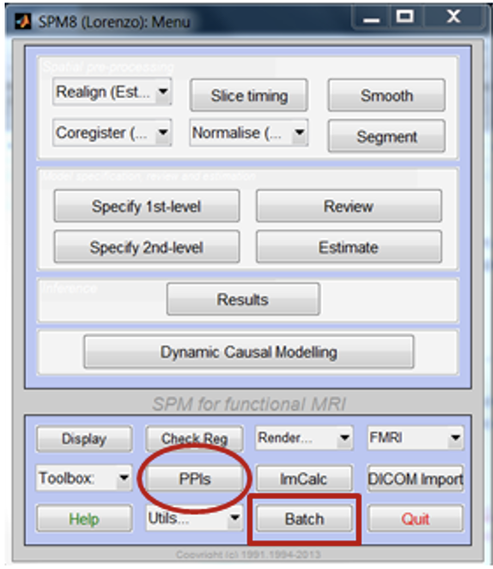
Forming the interaction term
Notes:
Can press either
Choose the SPM.mat file in the GLM directory from earlier

Slide 27
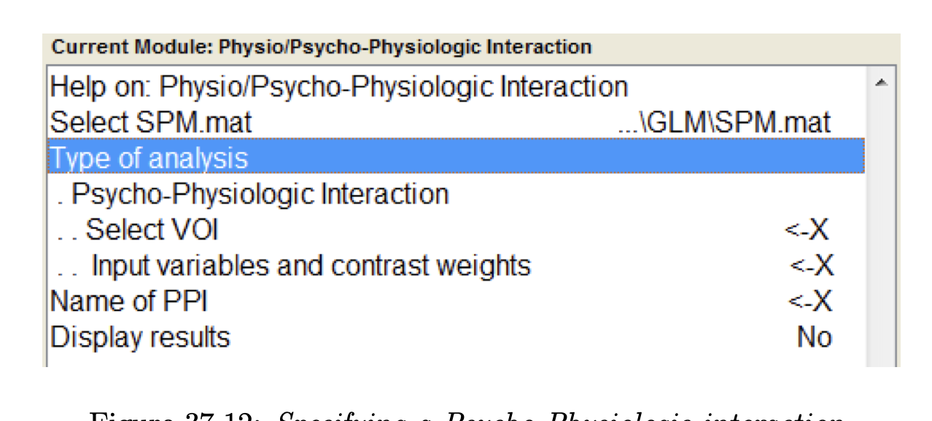
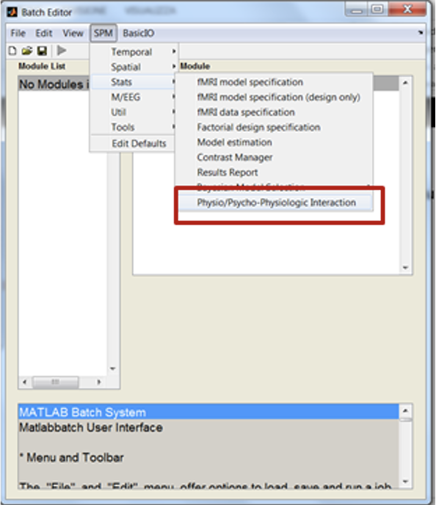
Forming the interaction term
Choose Psycho-Physiologic interaction
Select the extracted BOLD signal
Create a matrix n x 3
n = number of conditions
First column = Condition order in the mat. file
Second column = “1” unless parametric effects
Third column = Contrast weights
[2 1 -1, 3 1 1]
Notes:
Because we are trying to see where attention is greater than No Attention, we multiply the no attention condition regressor with -1

Slide 28
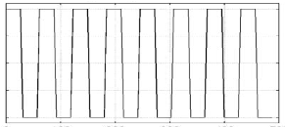
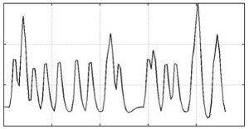
Forming the interaction term - Deconvolve & Calculate & Convolve
(Att-NoAtt)
V1
*
Psychological Variable
BOLD Signal
Notes:
When we are forming the interaction variable,
We cannot multiple the BOLD signal, our physiological variable, with time onset, our psychological variable, because BOLD responses are delayed by several seconds. Our two variables are shifted in time.

Slide 29
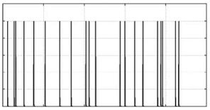
Forming the interaction term - Devonvolve
(Att-NoAtt)
V1
*
Deconvolved
Neuronal Activity
Psychological Variable
Notes:
So first we need transform the BOLD signals to neuronal activity.

Slide 30
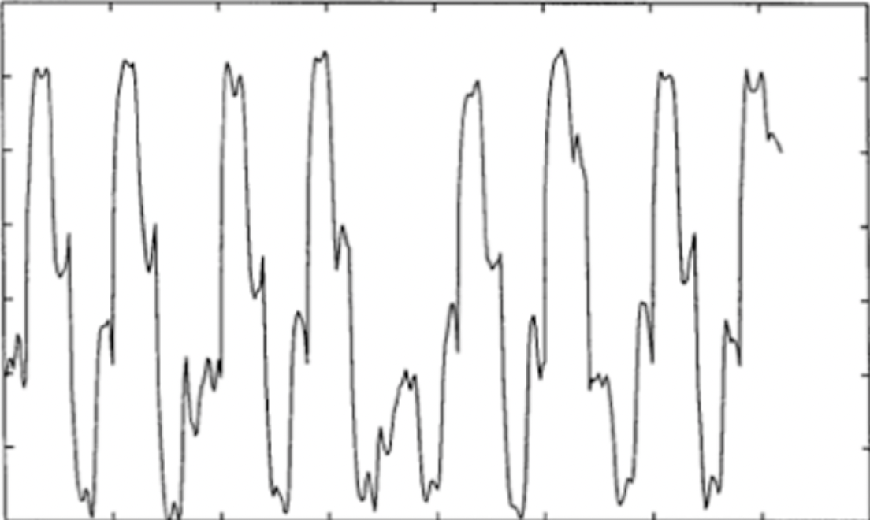
Forming the interaction term - Calculate
(Att-NoAtt)
V1
Interaction Effect
*
=
Deconvolved
Neuronal Activity
Psychological Variable
Notes:
Then we calculate the interaction variable.
However, we are still in neural space and interaction variable we will need to use in the GLM has to be in BOLD

Slide 31
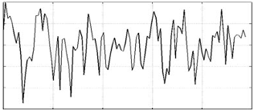
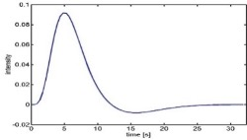
Forming the interaction term - Convolve
(Att-NoAtt)
V1
Interaction
*
=
Psychological Variable
Neuronal Activity
Convolved interaction term with the HRF
HRF
Notes:
However, we are still in neural space and, the interaction variable we will need to use in the GLM has to be a BOLD Signal.
So we calculate the interaction variable within the hemodynamic response function.

Slide 32
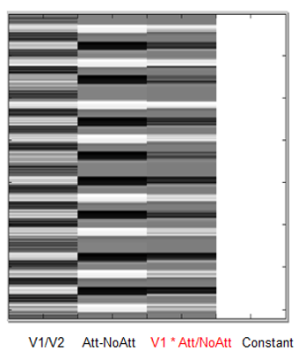
Create PPI-GLM
y = V1 β1 + (Att-NoAtt) β2 + (Att-NoAtt) * V1 β3 + Gβ4 + ε
ppi‘name’.mat is created
It contains the:
●PPI.Y (original VOI eigenvariate) V1 β1
●PPI.P (Attention vs. no attention vector) (Att-NoAtt) β2
●variable PPI.ppi (interaction term) (Att-NoAtt) * V1 β3
Determine Significant?
Based on a change in the regression
slopes between source region and another region during Attention as compared to No-Attention
Notes:
Finally we are ready to run the second GLM.
PPI calculation will create a mat file.

Slide 33
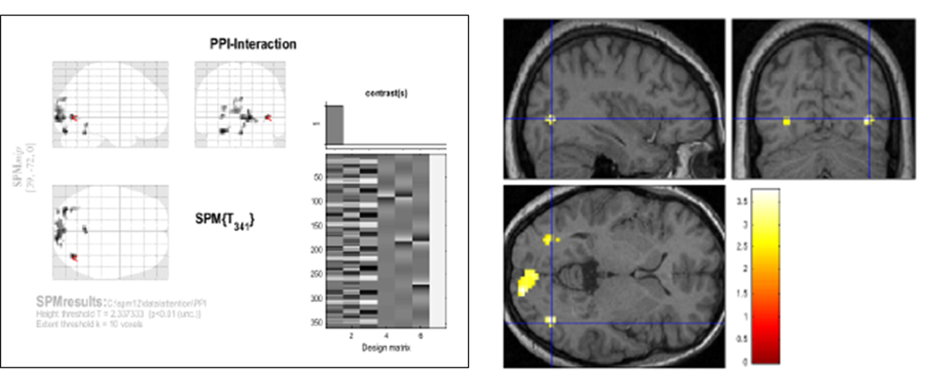
PPI: Analysis on SPM
Notes:
One thing to note here is that GLM model on the left is not the same from before and the first column is the interaction variable.
Now we can specify positive weight for the interaction term to see significant connectivity between original VOI as function of the experimental context.

Slide 34
Thank you for your attention!
Any questions?

