Slide 1
DCM for fNIRS: Theory and Practice
Methods for Dummies 2021/22
Peter Crowe
Thanks: Magda Dubois & Jolanda Malamud
Slides adapted in part from MfD 2004

Slide 2
Overview
Effective Connectivity
DCM overview
Bilinear model
Hemodynamic model
Model comparison
DCM for fNIRS
Motor Imagery example

Slide 3
Effective Connectivity
Recalling PPI, EC models changes in coupling between regions
In DCM inputs are deterministic as opposed to stochastic
Plausible nonlinear, dynamic generative model of brain responses
DCM differs from previous approaches to modelling brain responses,
using a dynamical, nonlinear approach and deterministic inputs

Slide 4
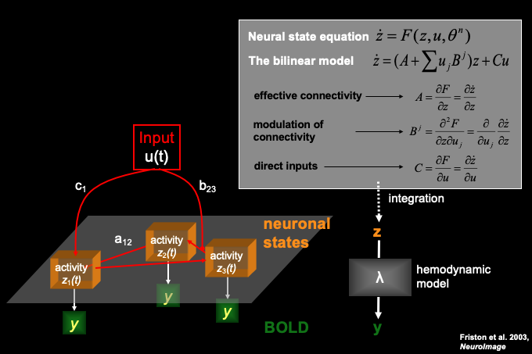
DCM overview
Neuronal states are modelled separately for each region of interest,
their connectivity matrix is acted upon directly and indirectly

Slide 5
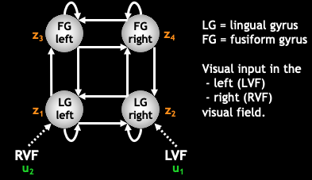
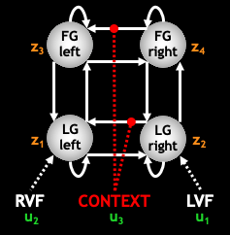
Bilinear model
Inclusion of inputs effecting modulation between regions transforms
a linear dynamical system into a bilinear model

Slide 6
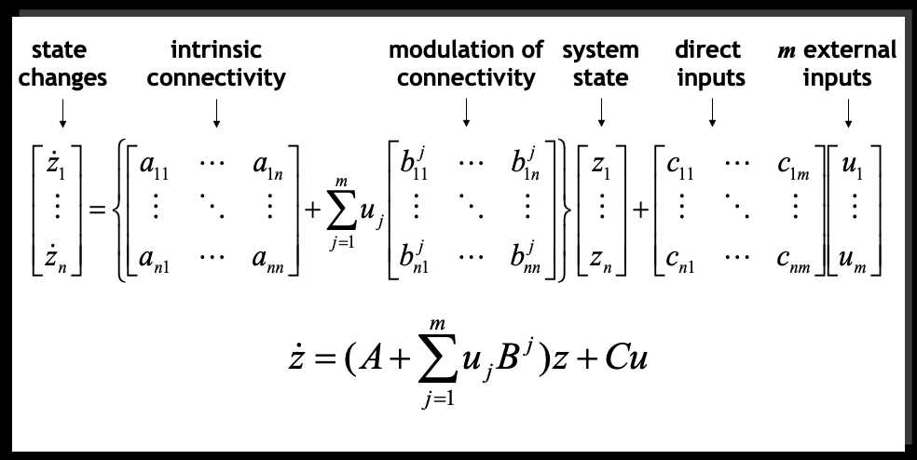
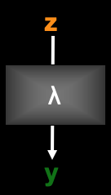
Bilinear model
DCM estimates parameters at the neuronal level such that the modelled BOLD signals are maximally similar to the experimentally measured BOLD signals

Slide 7
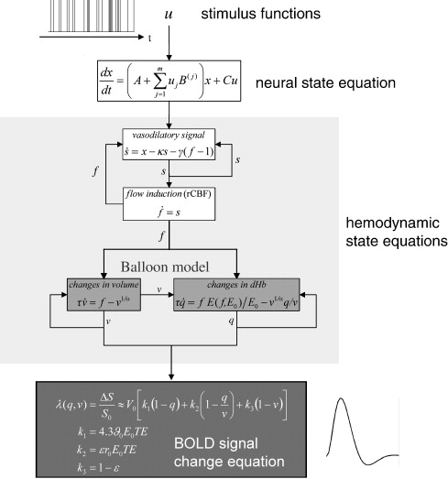
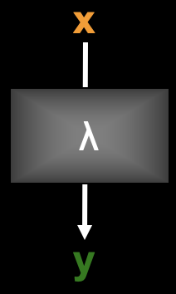
Hemodynamic model (BOLD)
Stephan et al. 2007,
Neuroimage

Slide 8
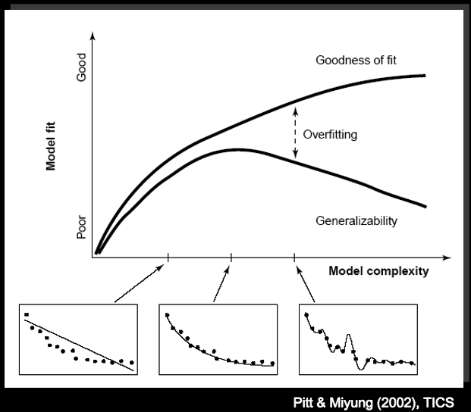
Model comparison

Slide 9
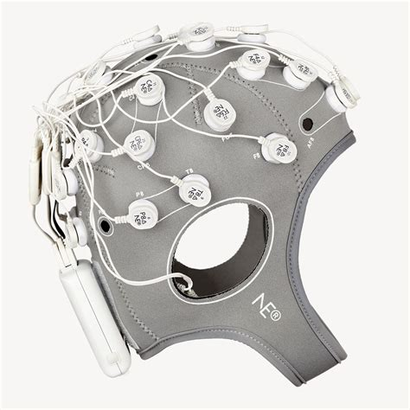
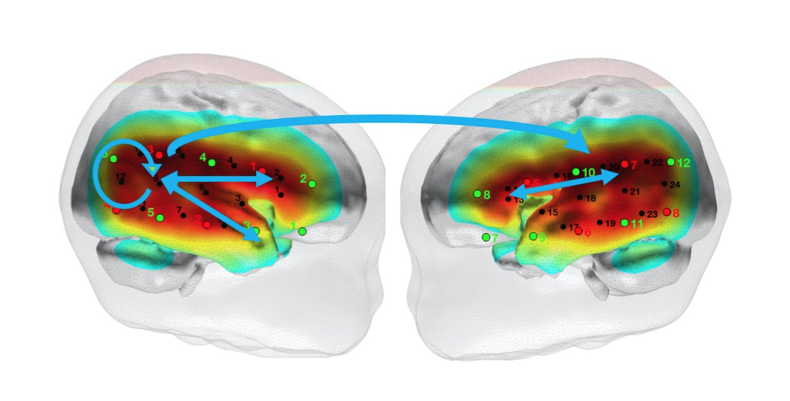
DCM for fNIRS
Neuroelectrics
BrainHack Donostia

Slide 10
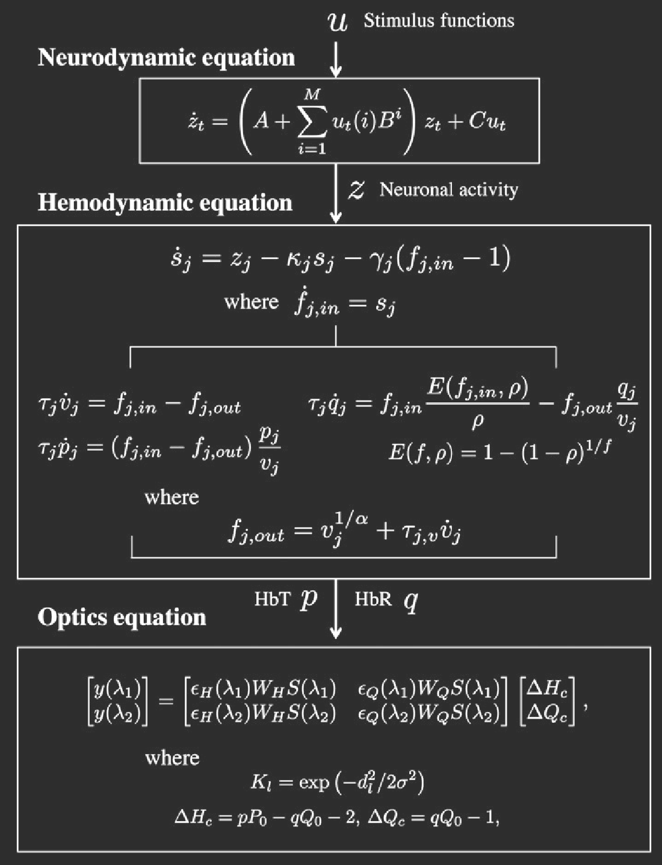
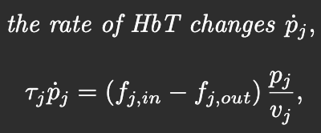
DCM for fNIRS
1. hemodynamics model:
2. optics model:
3. optics model:
spatially extended hemodynamic sources
The neurodynamic and hemodynamic models used for
DCM-fMRI analysis are extended for DCM-fNIRS
Tak et al. 2015, Neuroimage

Slide 11
Motor Imagery example
Experimental Setup:
Session 1: squeeze and release a ball with right hand during task blocks
Session 2: kinaesthetic imagery of the same movement, without moving
In both: 5s blocks of tasks, 25s rest blocks
Previous findings:
activation in SMA and premotor cortex during ME & MI
reduced activation in M1 during motor imagery
DCM for fMRI: SMA-M1 coupling may serve to attenuate M1 activation during MI
Objectives:
how the MI condition affects the directed connections between SMA & M1
how these interactions are associated with the activity in M1 and SMA during ME & MI
during motor imagery SMA and premotor cortex are active while M1 is not, the example explores effects of SMA-M1 coupling

Slide 12
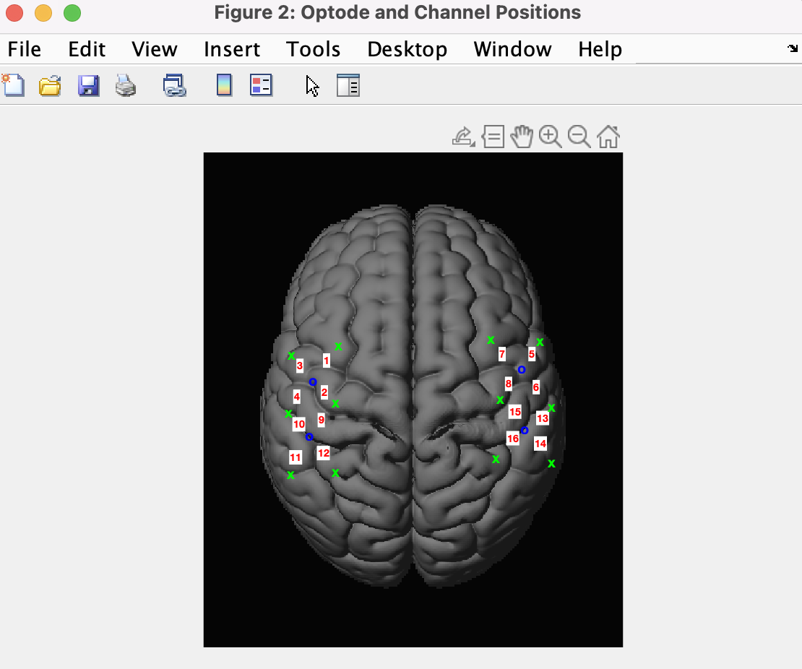
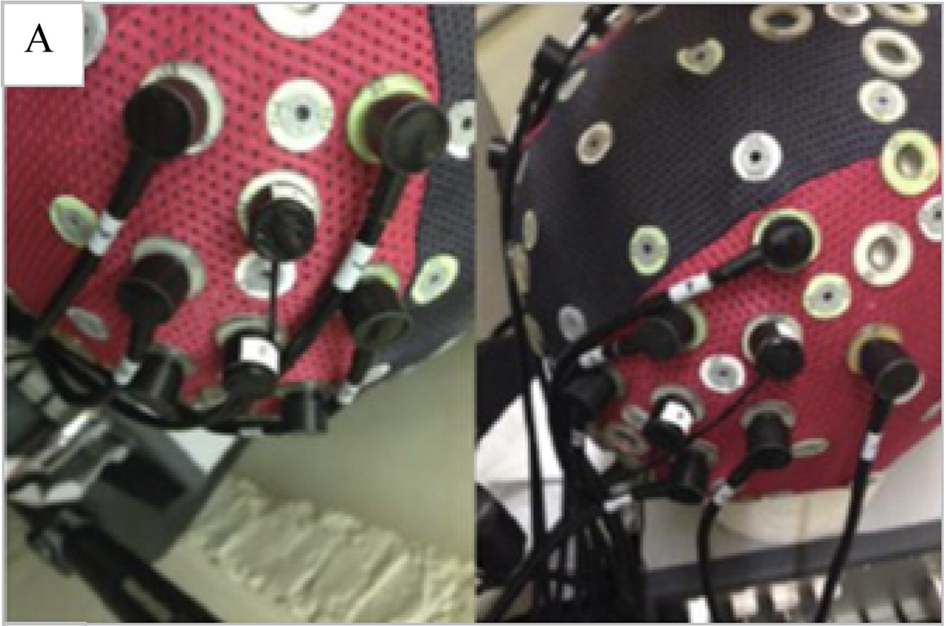
Motor Imagery example
Kempny et al. 2016, Neuroimage
SPM12

Slide 13
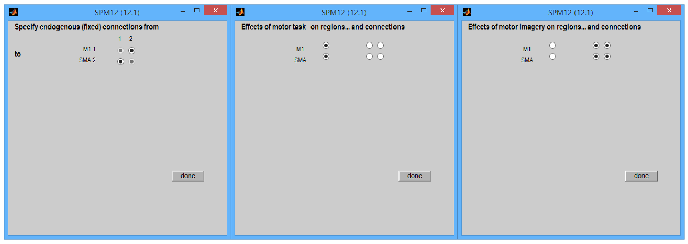
Motor Imagery example
SPM12 Manual

Slide 14
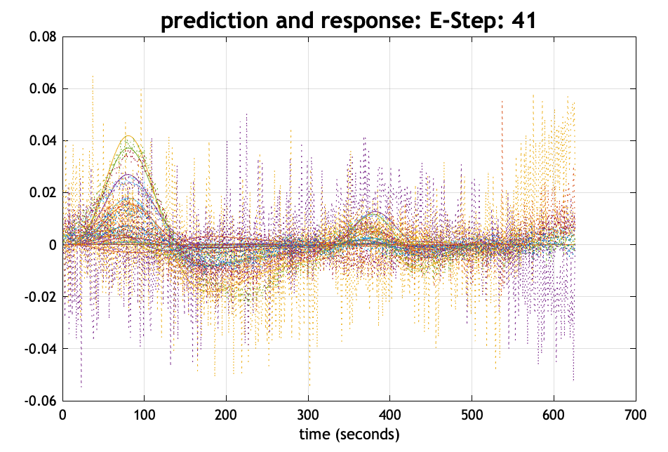
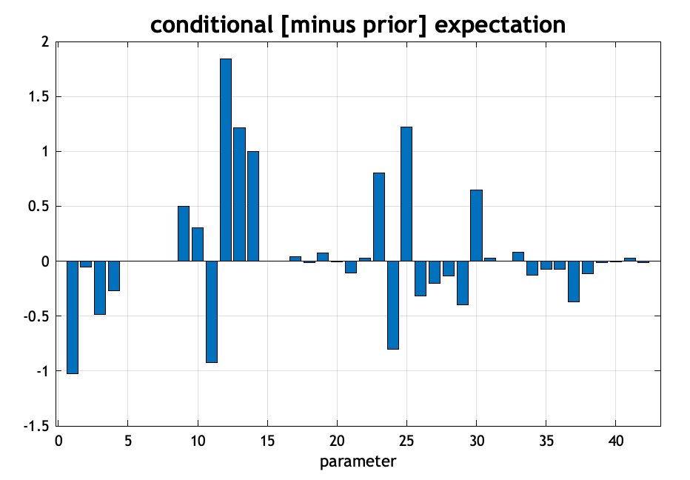
Motor Imagery example
SPM12

Slide 15
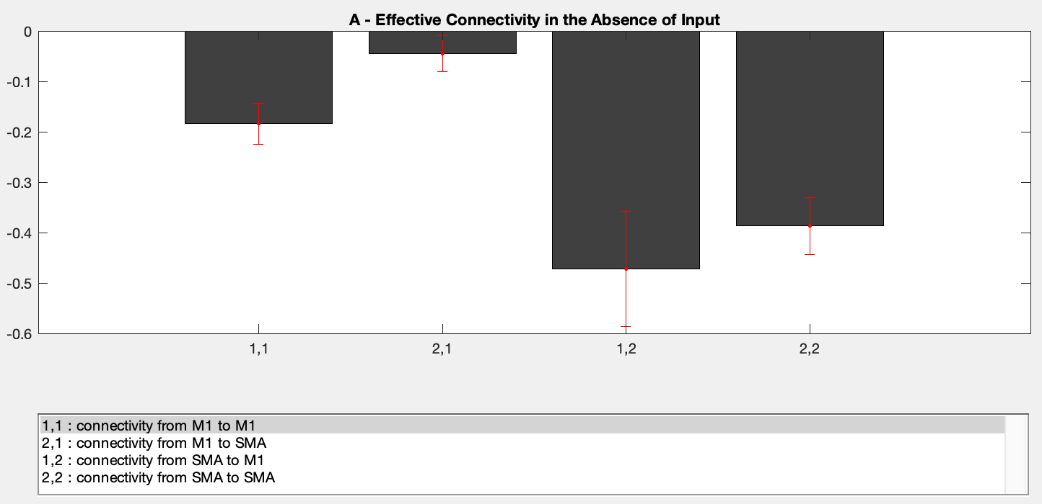
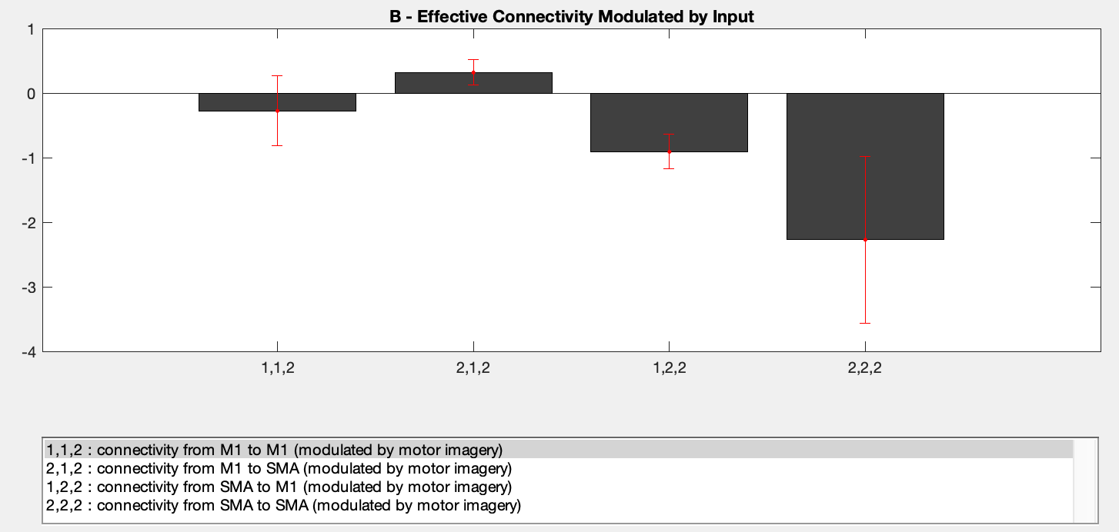
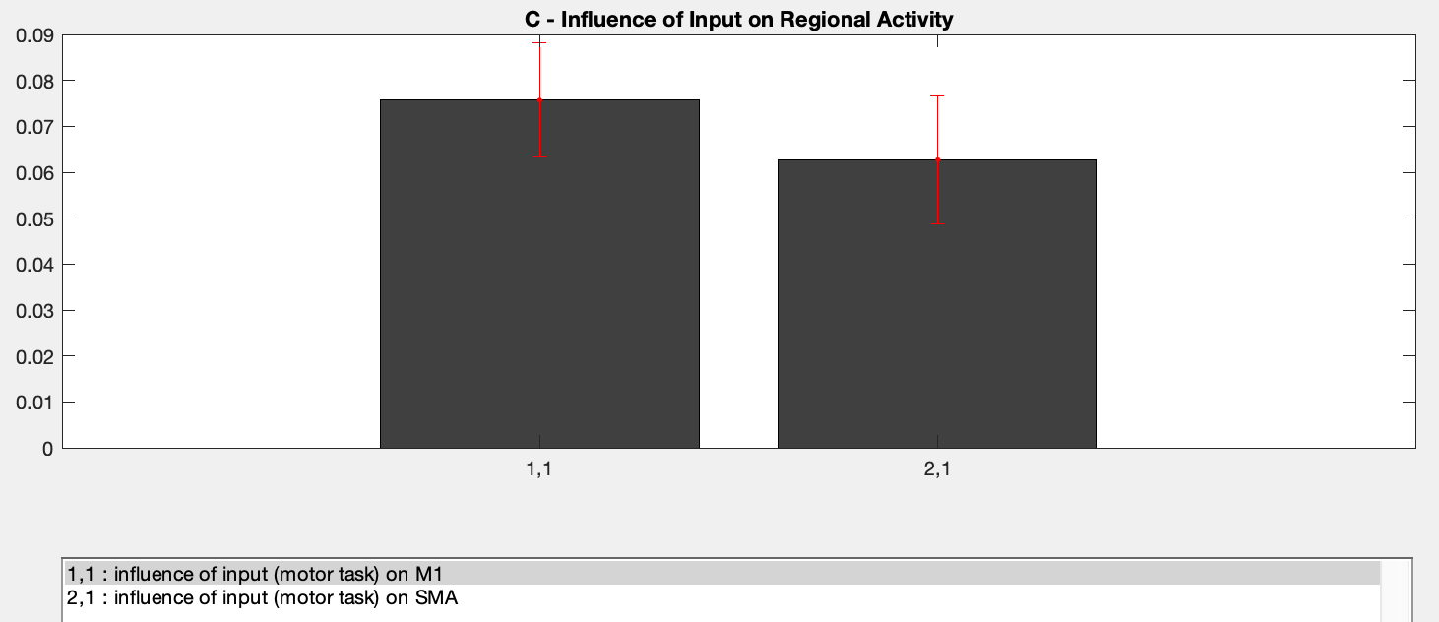
Motor Imagery example
SPM12

Slide 16
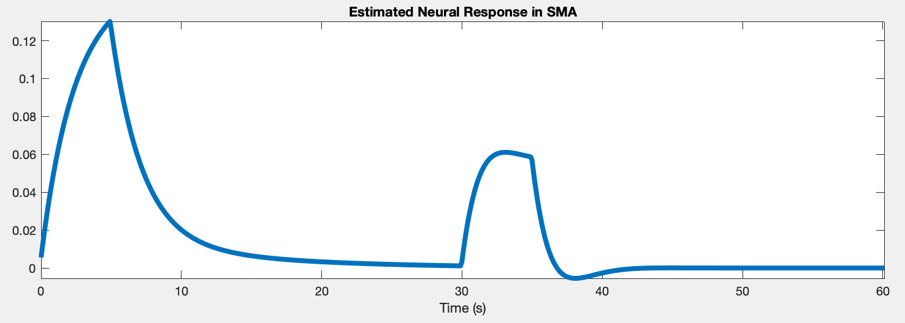
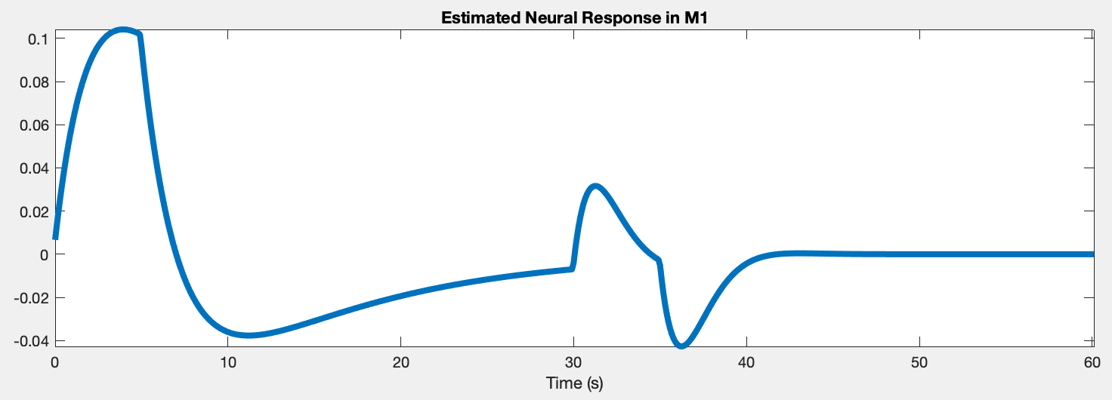
Motor Imagery example
SPM12

Slide 17
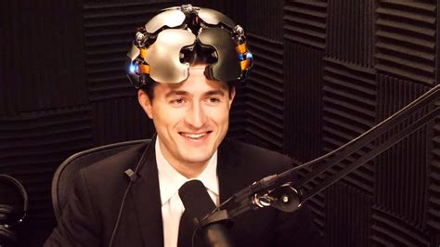
Questions
Thank you for your attention!
Questions?

Slide 18
References
Ashburner, J., Barnes, G., Chen, C. C., Daunizeau, J., Flandin, G., Friston, K., ... & Penny, W. (2014). SPM12 manual. Wellcome Trust Centre for Neuroimaging, London, UK, 2464, 4.
Bulgarelli, C., Blasi, A., Arridge, S., Powell, S., de Klerk, C. C., Southgate, V., ... & Hamilton, A. (2018). Dynamic causal modelling on infant fNIRS data: A validation study on a simultaneously recorded fNIRS-fMRI dataset. NeuroImage, 175, 413-424.
Friston, K. J., Harrison, L., & Penny, W. (2003). Dynamic causal modelling. Neuroimage, 19(4), 1273-1302.
Kempny, A. M., James, L., Yelden, K., Duport, S., Farmer, S., Playford, E. D., & Leff, A. P. (2016). Functional near infrared spectroscopy as a probe of brain function in people with prolonged disorders of consciousness. NeuroImage: Clinical, 12, 312-319.
Myung, I. J., & Pitt, M. A. (2002). Mathematical modeling. Stevens’ handbook of experimental psychology, 4, 429-460.
Stephan, K. E., Weiskopf, N., Drysdale, P. M., Robinson, P. A., & Friston, K. J. (2007). Comparing hemodynamic models with DCM. Neuroimage, 38(3), 387-401.
Tak, S., Kempny, A., Friston, K. J., Leff, A. P., & Penny, W. D. (2015). Dynamic causal modelling for functional near-infrared spectroscopy. Neuroimage, 111, 338-349.
Methods for Dummies previous cohorts, esp. den Ouden, H., & Hassabis, D. (2004). DCM for fMRI: Theory.
Images also from: https://www.neuroelectrics.com, Lex Fridman podcast, & DALL·E 2 (Open AI).
Resources:
https://github.com/KevinAquino/DCM-course
https://github.com/borjablanco/BHDonostia_2020_fNIRS

