Slide 1

fMRI
Preprocessing
Guillaume Flandin
Wellcome Trust Centre for Neuroimaging
University College London
SPM Course
Chicago, 22-23 Oct 2015

Slide 2



Image time-series
Spatial filter
Design matrix
Statistical Parametric Map
Realignment
Smoothing
General Linear Model
Statistical
Inference
RFT
Normalisation
Anatomical
reference
p <0.05
Parameter estimates

Slide 3
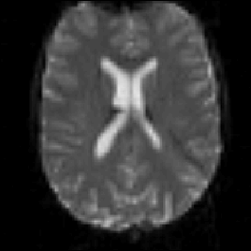
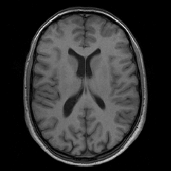
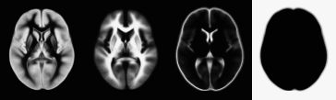
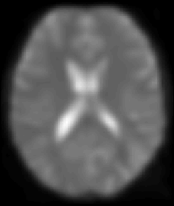
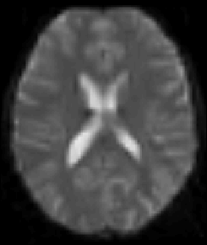
fMRI time series
Structural MRI
Template
Smoothed fMRI
Normalise/Segment
❸
Realign
Coregister
Smooth
Deformation
❶
❷
❺
Write Normalised
❹

Slide 4
Contents
Registration basics
Motion and realignment
Inter-modal coregistration
Spatial normalisation
Gaussian smoothing

Slide 5
Contents
Registration basics
  Voxel-to-world mapping
  Transformation
  Similarity measure
  Optimisation
  Interpolation
Motion and realignment
Inter-modal coregistration
Spatial normalisation
Gaussian smoothing

Slide 6
Representation of imaging data
Three dimensional images are made up of voxels.
Voxel intensities are stored on disk as lists of numbers.
Meta-information about the data:
  The image dimensions
    Allowing conversion from list to 3D array
  The “voxel-to-world mapping”
    Spatial transformation that maps from data coordinates (voxel column i, row j, slice k) into a real-world position (x,y,z mm) in a coordinate system e.g.:
      Scanner coordinates
      T&T/MNI coordinates

Slide 7
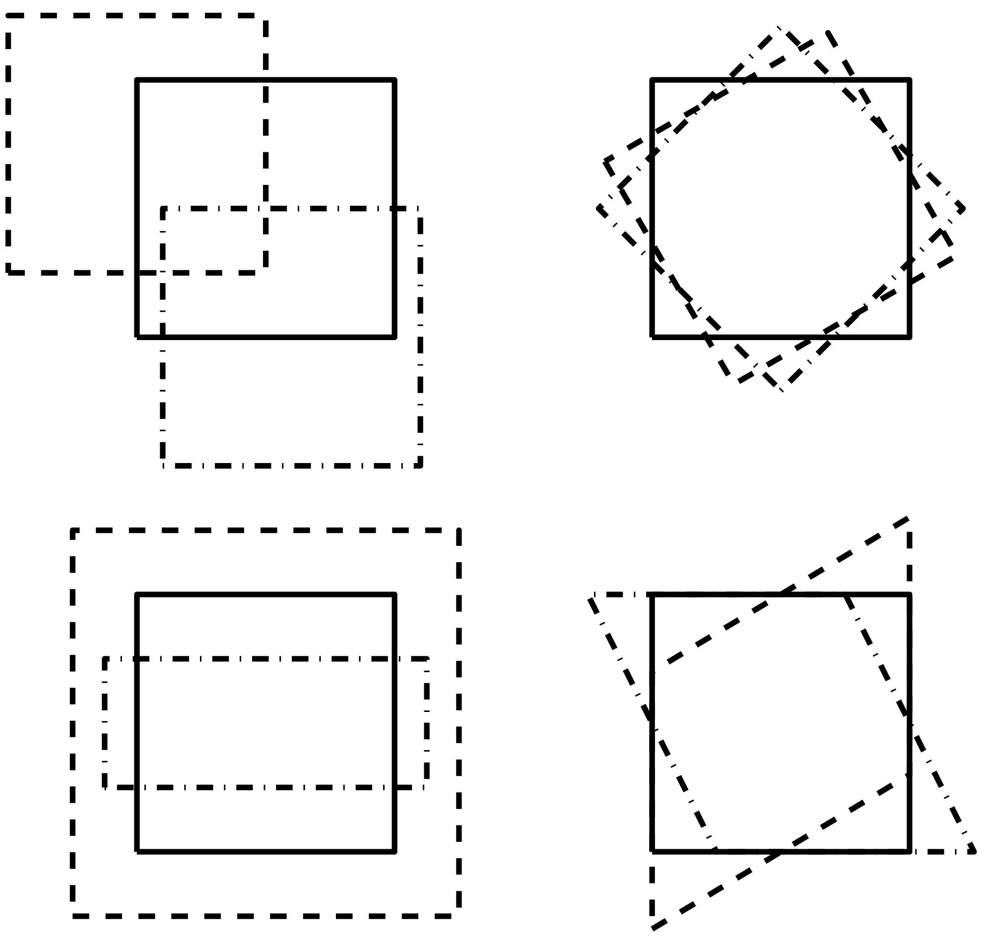
Image registration
Process of transforming different set of images into one coordinate system.
Two key ingredients:
  Transformation type:
    Rigid
    Affine
    Non-linear
  Similarity measure:
    Mean-squared difference
    Correlation coefficient
    Mutual information
Within-subject
Between-subject
Within-modality
Between-modality

Slide 8
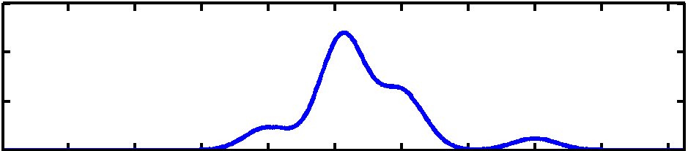
Optimisation
Automatic image registration is done by using an optimisation algorithm.
Optimisation involves finding some “best” parameters according to an “objective function”, which is either minimised or maximised.
Most probable solution (global optimum)
Objective function
Local optimum
Local optimum
Value of parameter

Slide 9
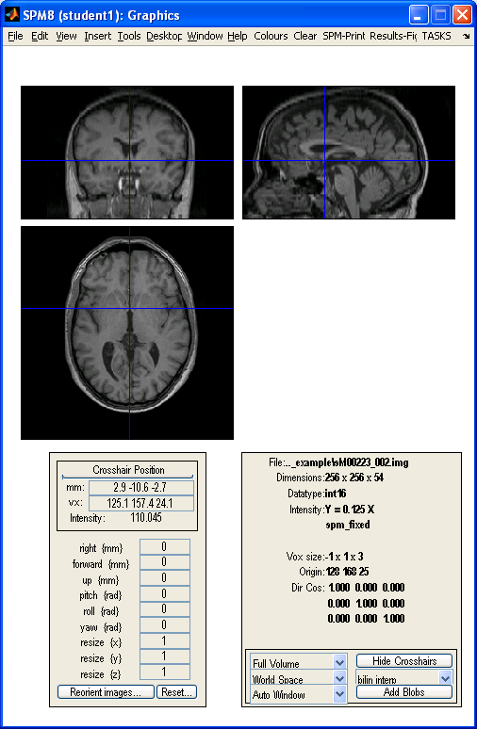
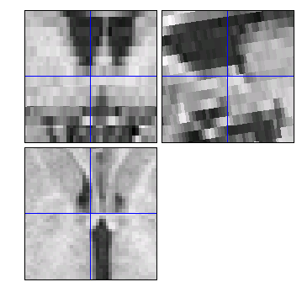
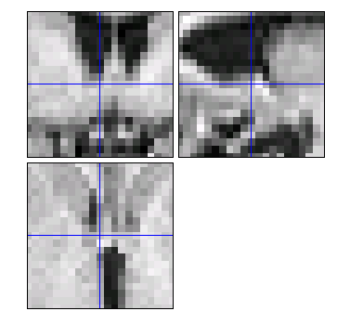
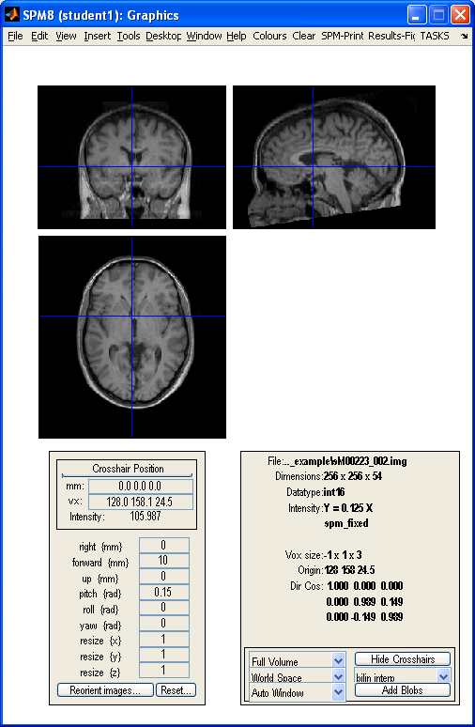
Reslicing / Interpolation
Reoriented
(1x1x3 mm
voxel size)
Resliced
(to 2 mm
cubic)
Applying the transformation parameters, and re-sampling the data onto the same grid of voxels as the target image
  reslicing, interpolation, regridding, transformation, and writing

Slide 10
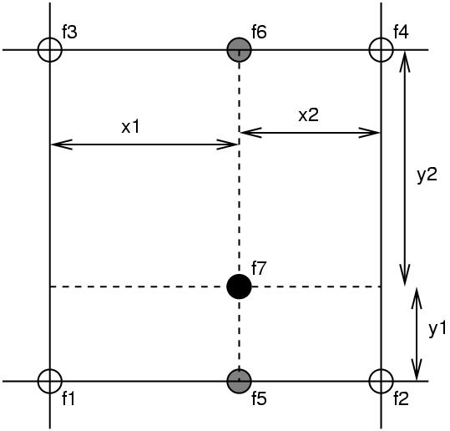
Simple Interpolation
Nearest neighbour
  Take the value of the closest voxel
Tri-linear
  Just a weighted average of the neighbouring voxels
  f₅ = f₁ x₂ + f₂ x₁
  f₆ = f₃ x₂ + f₄ x₁
  f₇ = f₅ y₂ + f₆ y₁

Slide 11
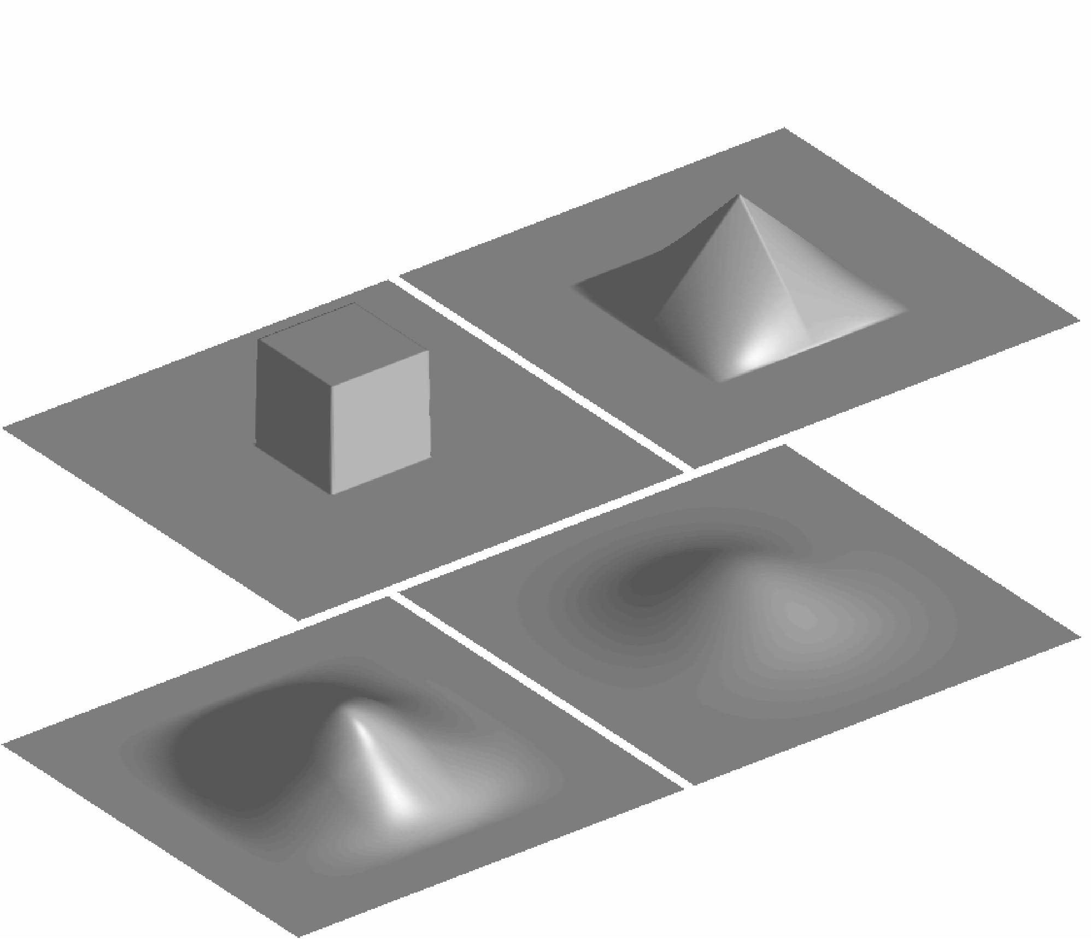
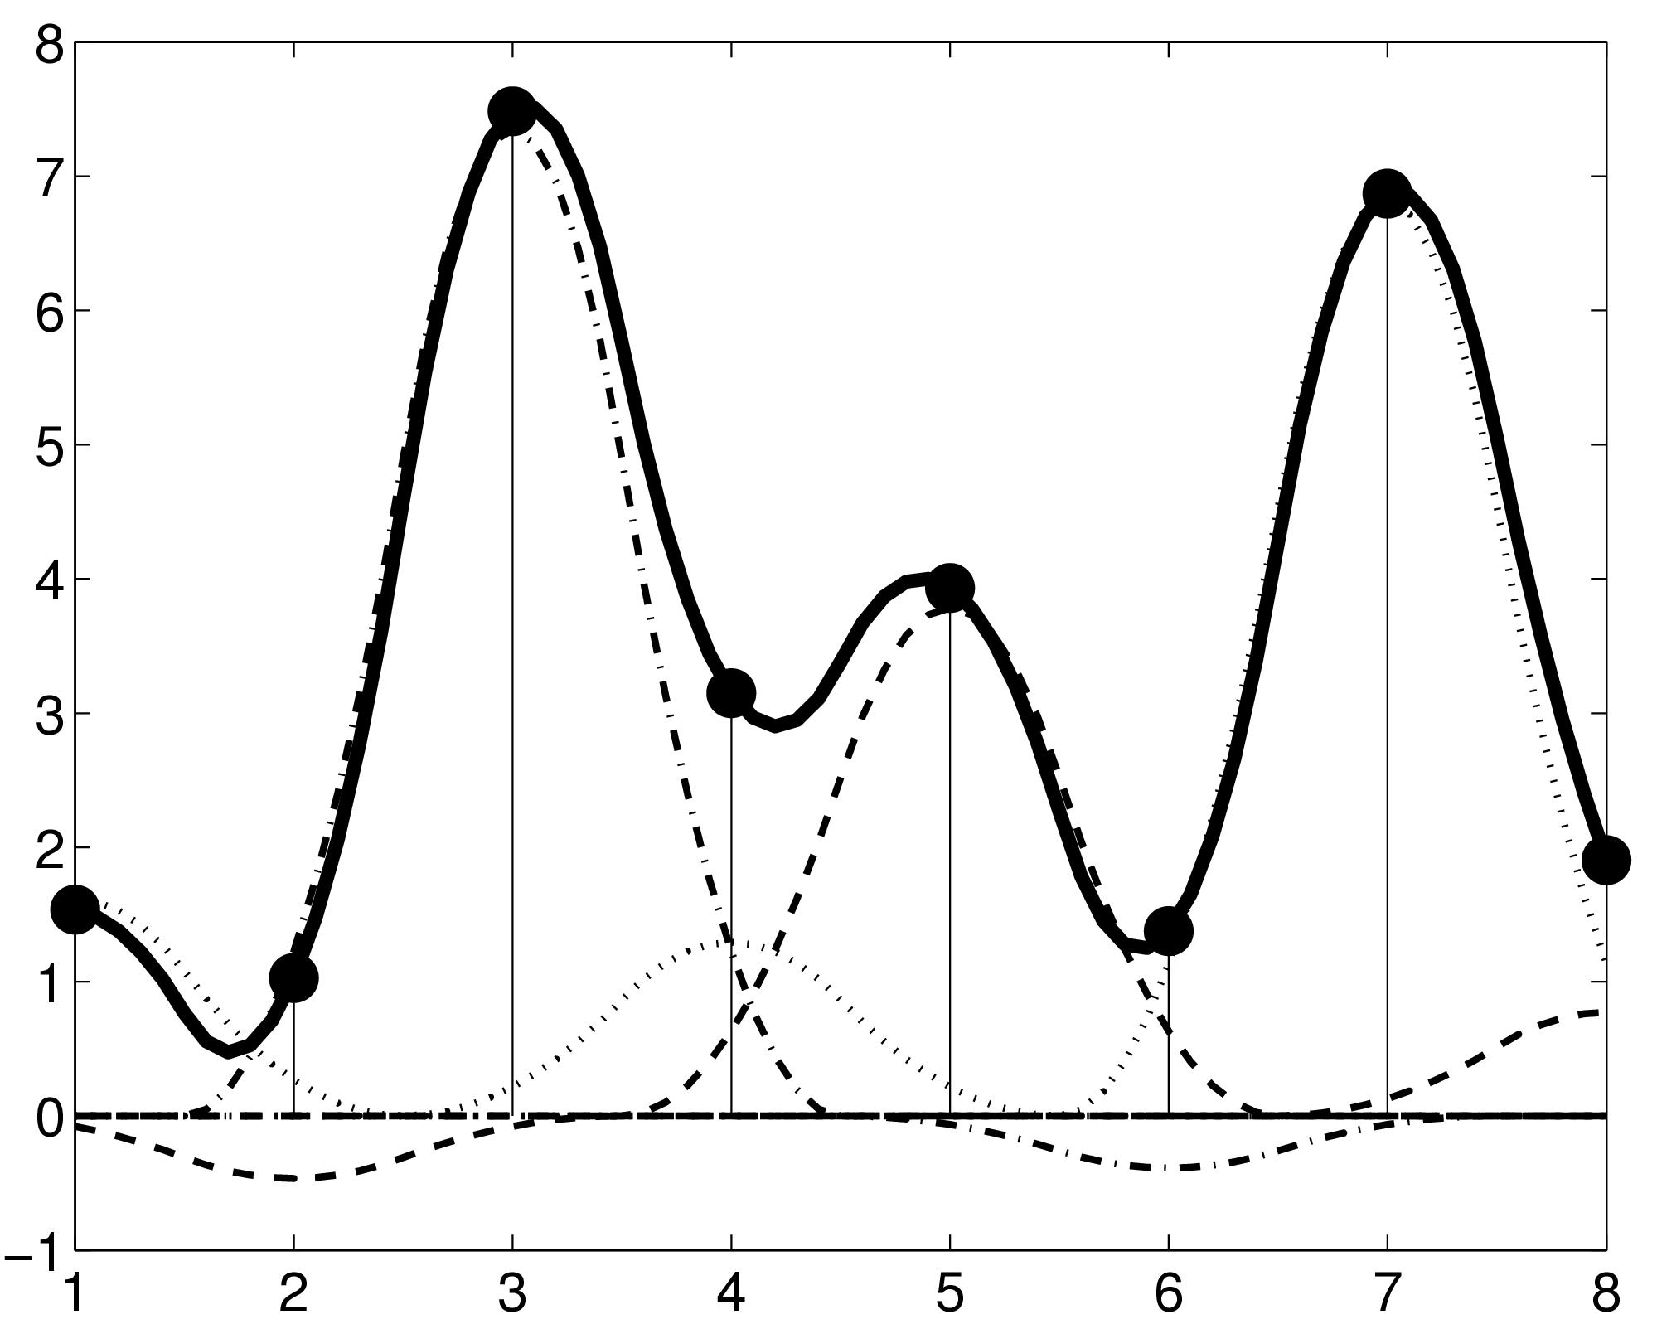
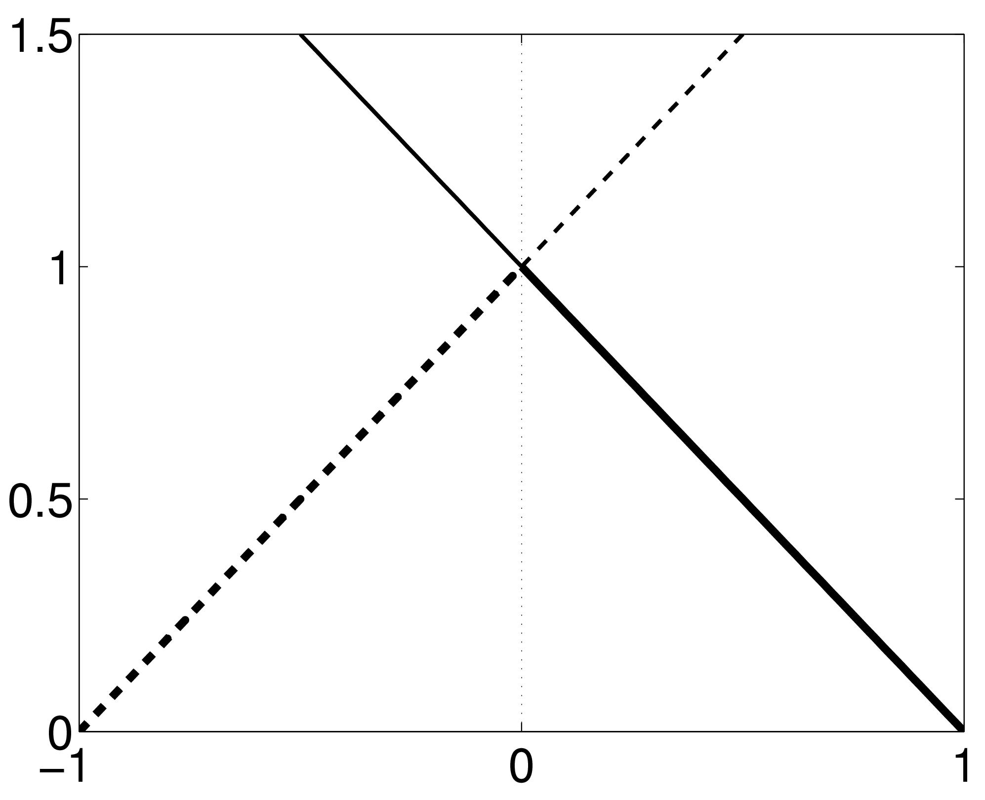
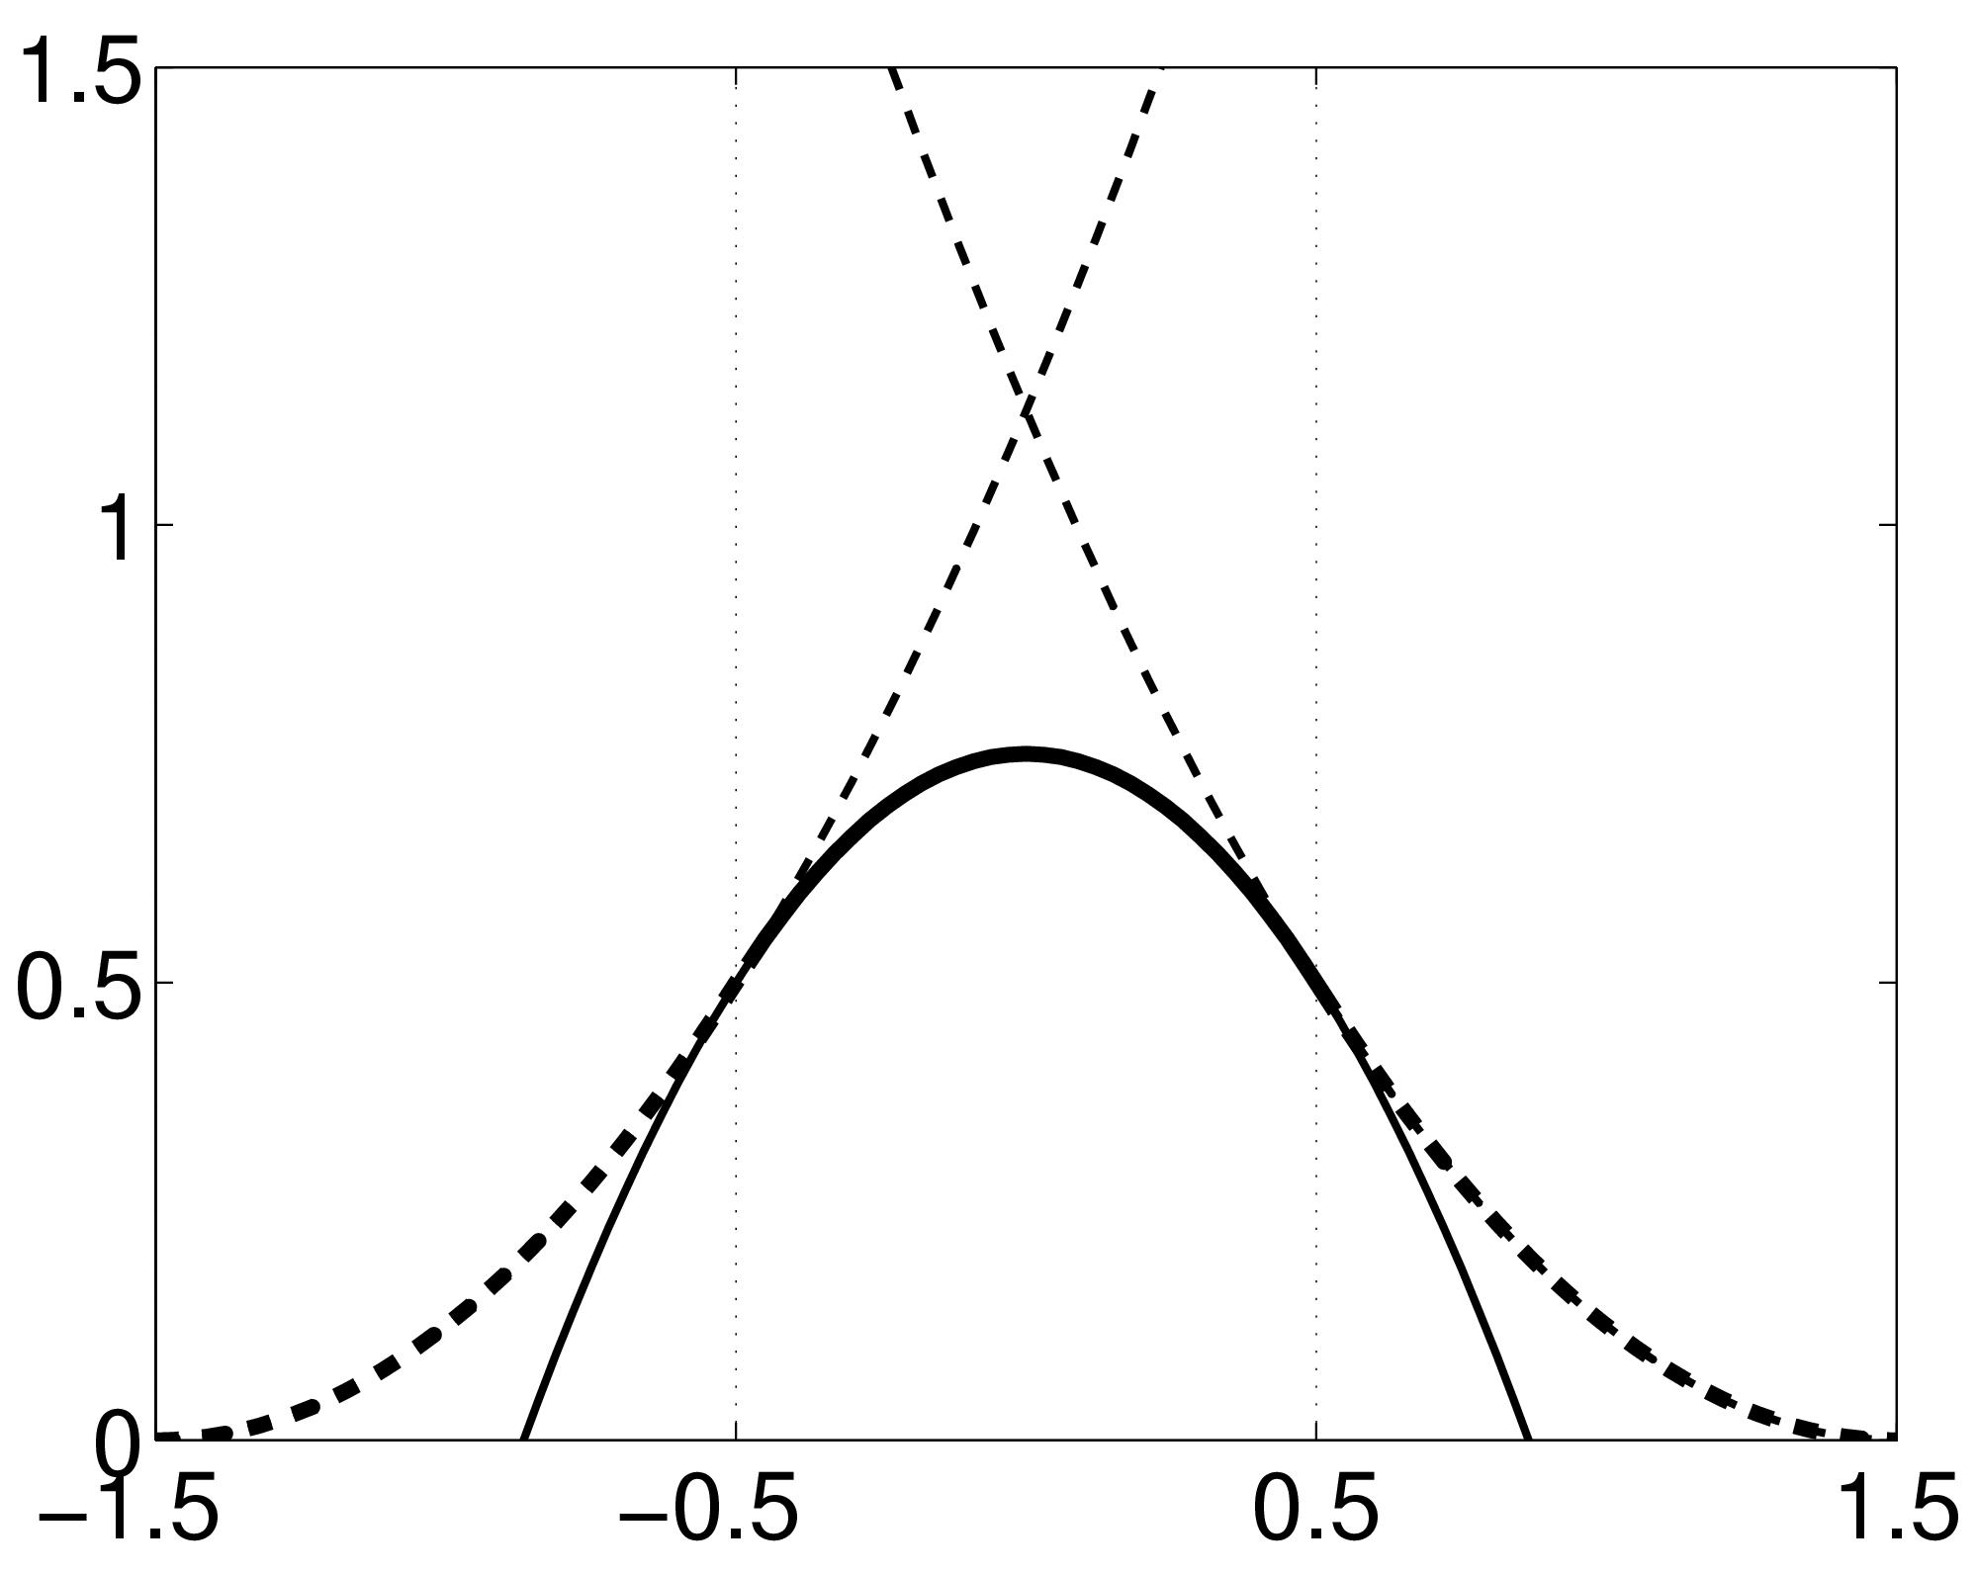
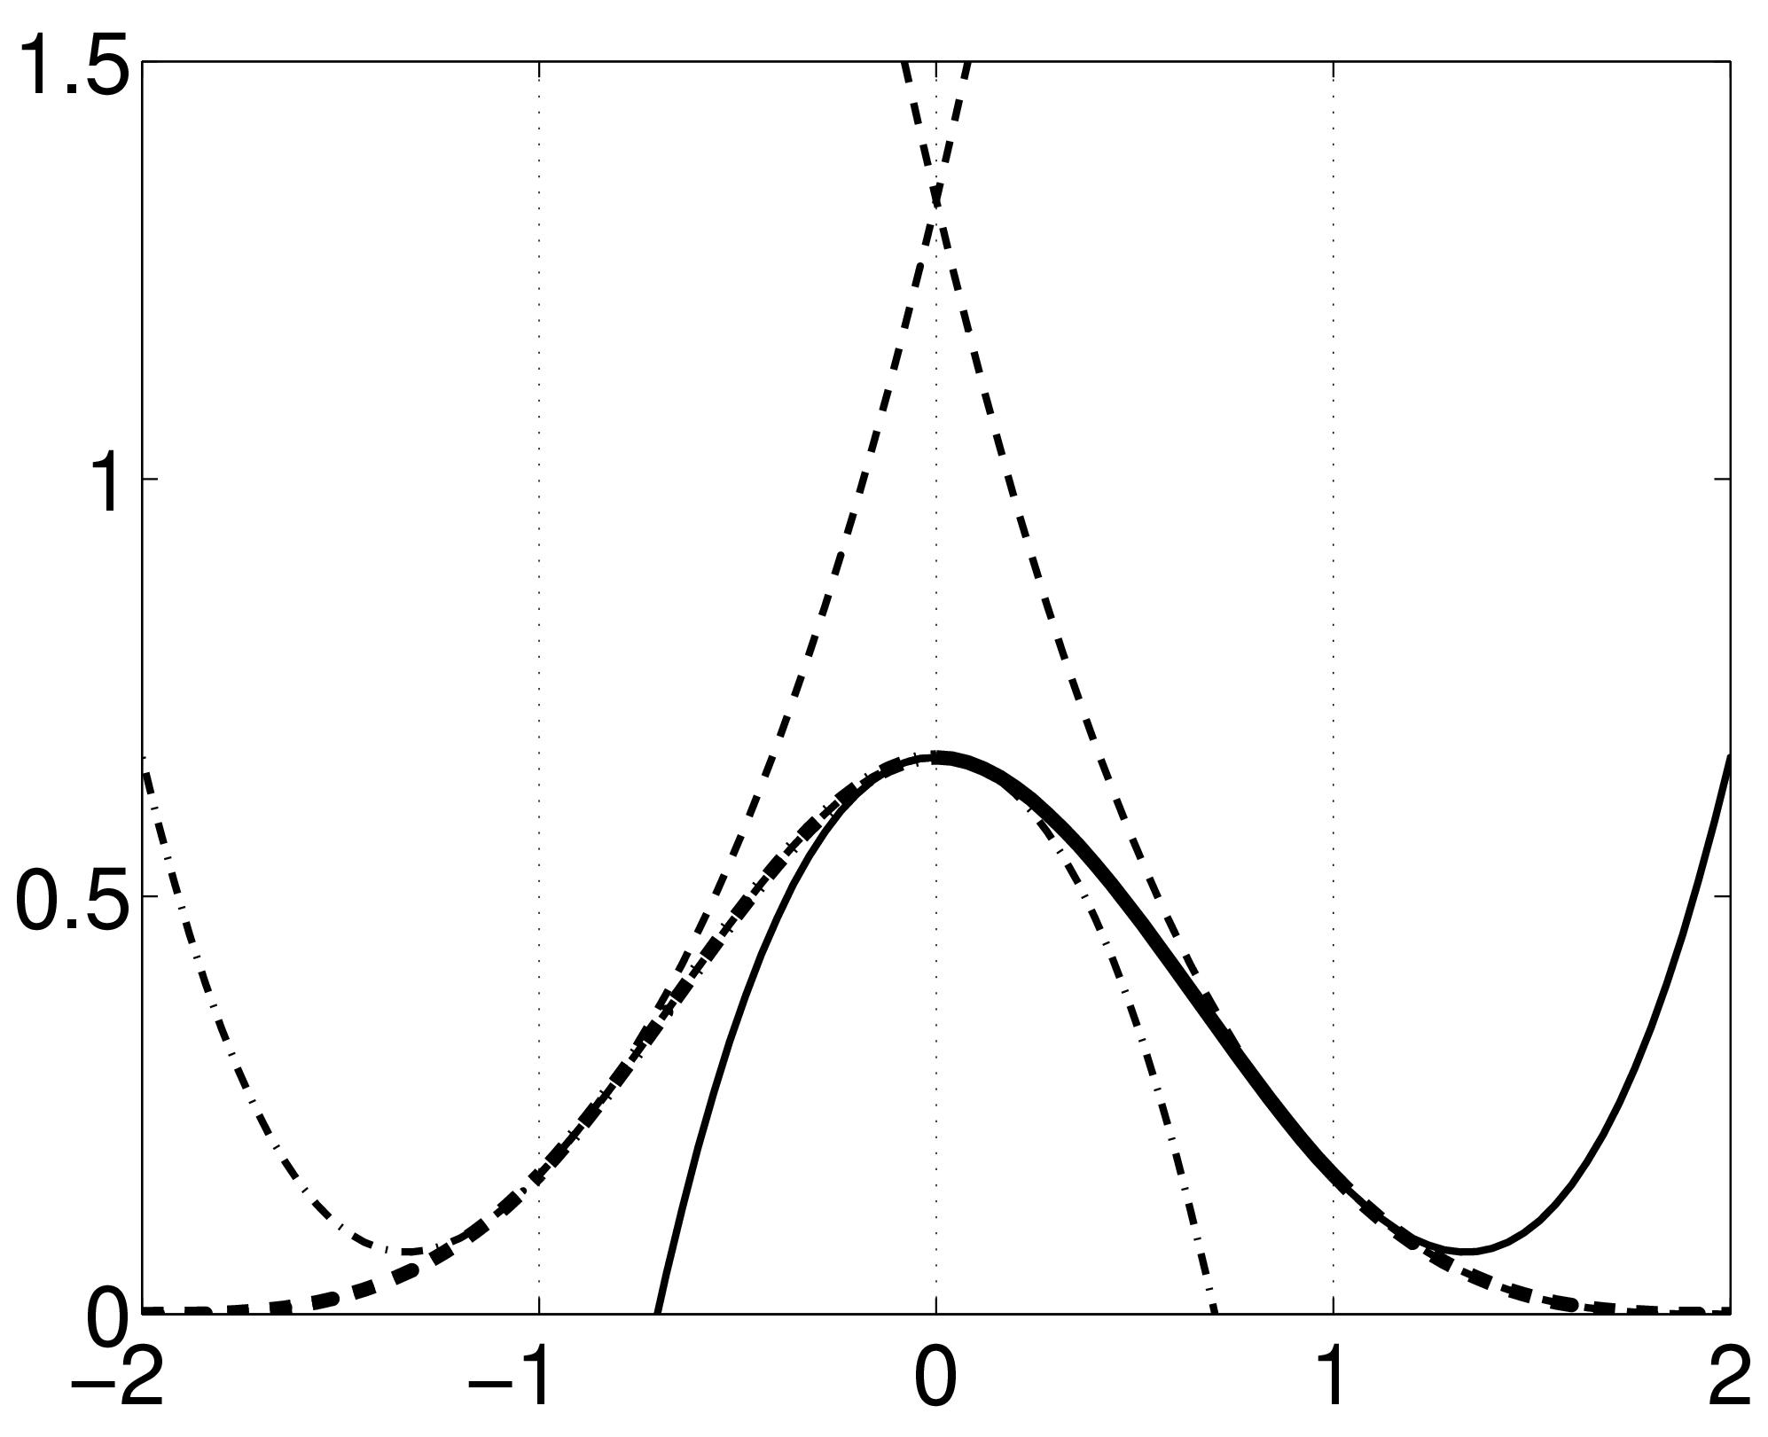
B-spline Interpolation
2D B-spline basis functions of degrees 0, 1, 2 and 3
A continuous function is represented by a linear combination of basis functions
B-splines are piecewise polynomials
Nearest neighbour and trilinear interpolation are the same as B-spline interpolation with degrees 0 and 1.

Slide 12
Contents
Registration basics
Motion and realignment
Inter-modal coregistration
Spatial normalisation
Gaussian smoothing

Slide 13
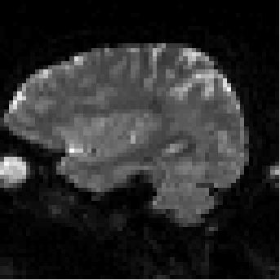
Motion correction
Head movement is a very large source
of variance in fMRI data.
Motion correction: realign a time-series
of images acquired from the same
subject.
  Within-subject transformation: rigid-body (6 parameters)
  Within-modality: least squares objective function
translation
0.4
0.2
mm
0
-0.2
-0.4
0
10
20
30
40
50
60
70
80
90
image
x translation
rotation
y translation
0.6
z translation
0.4
pitch
roll
degrees
yaw
0.2
0
-0.2
0
10
20
30
40
50
60
70
80
90
image

Slide 14
Residual Errors from aligned fMRI
Slices are not acquired simultaneously
  rapid movements not accounted for by rigid body model
Resampling can introduce interpolation errors
  especially tri-linear interpolation
Image artefacts may not move according to a rigid body model
  image distortion
  image dropout
Functions of the estimated motion parameters can be modelled as confounds in subsequent analyses

Slide 15
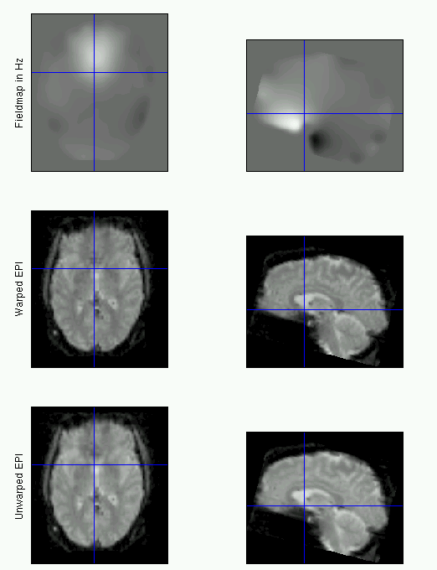
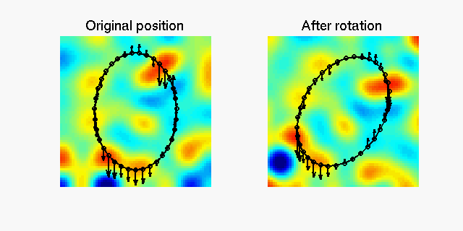
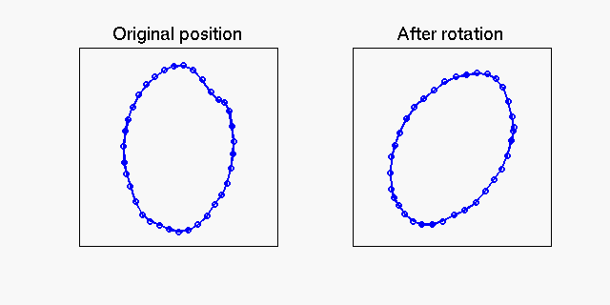
Movement by Distortion Interaction of fMRI
Subject disrupts B₀ field, rendering it inhomogeneous
  Distortions in phase-encode direction
Subject moves during EPI time series
  Distortions vary with subject orientation
  Shape varies (non-rigidly)
“Realign & Unwarp”: generative model that combines a model of geometric distortions and a model of subject motion to correct images.

Slide 16
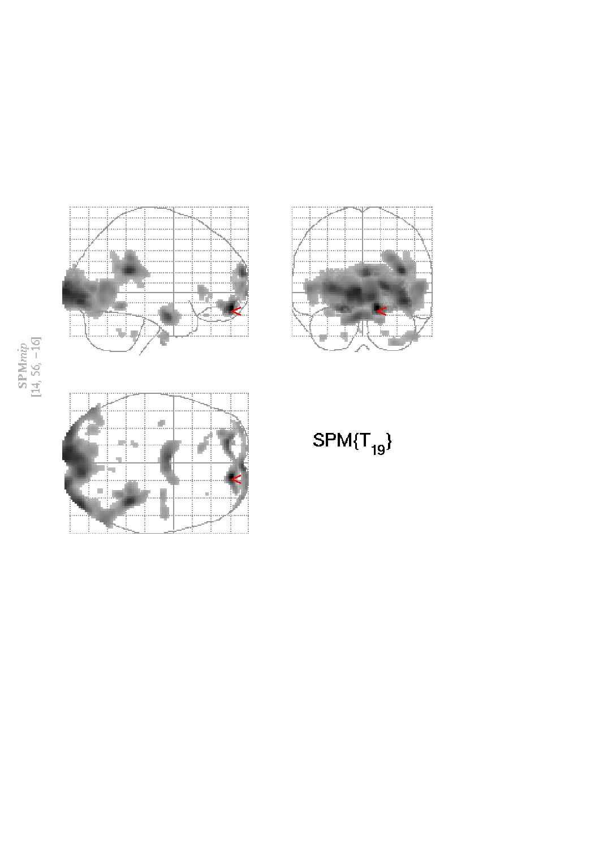
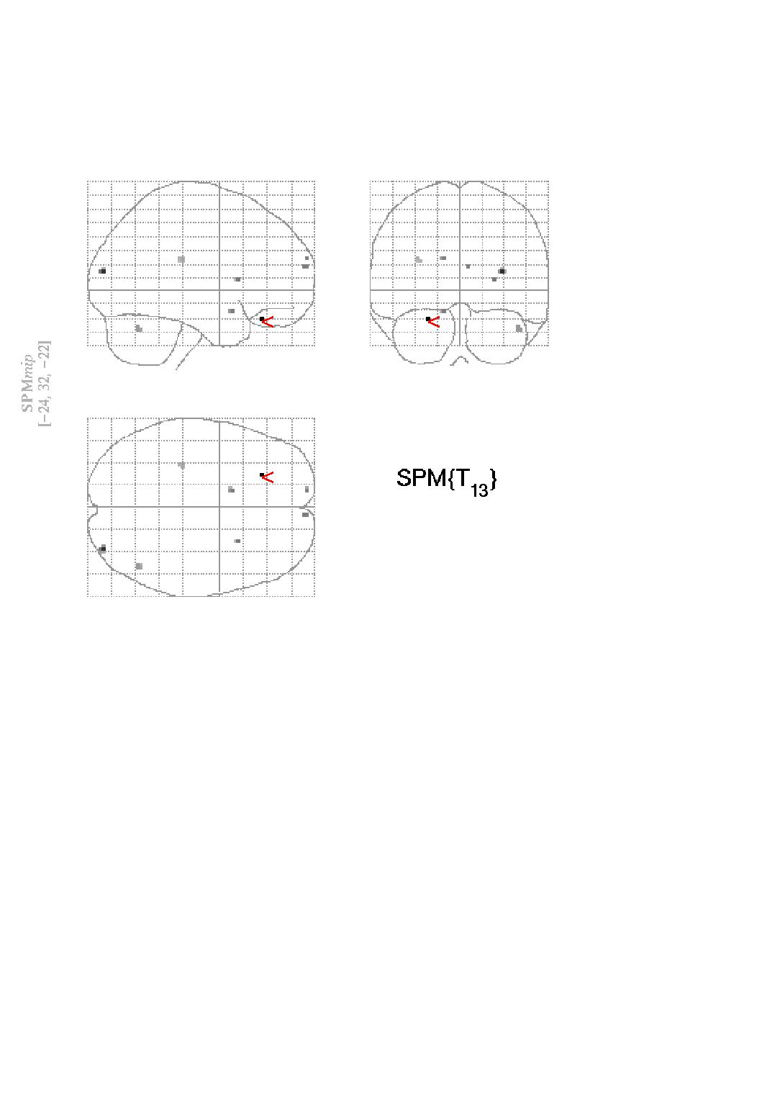
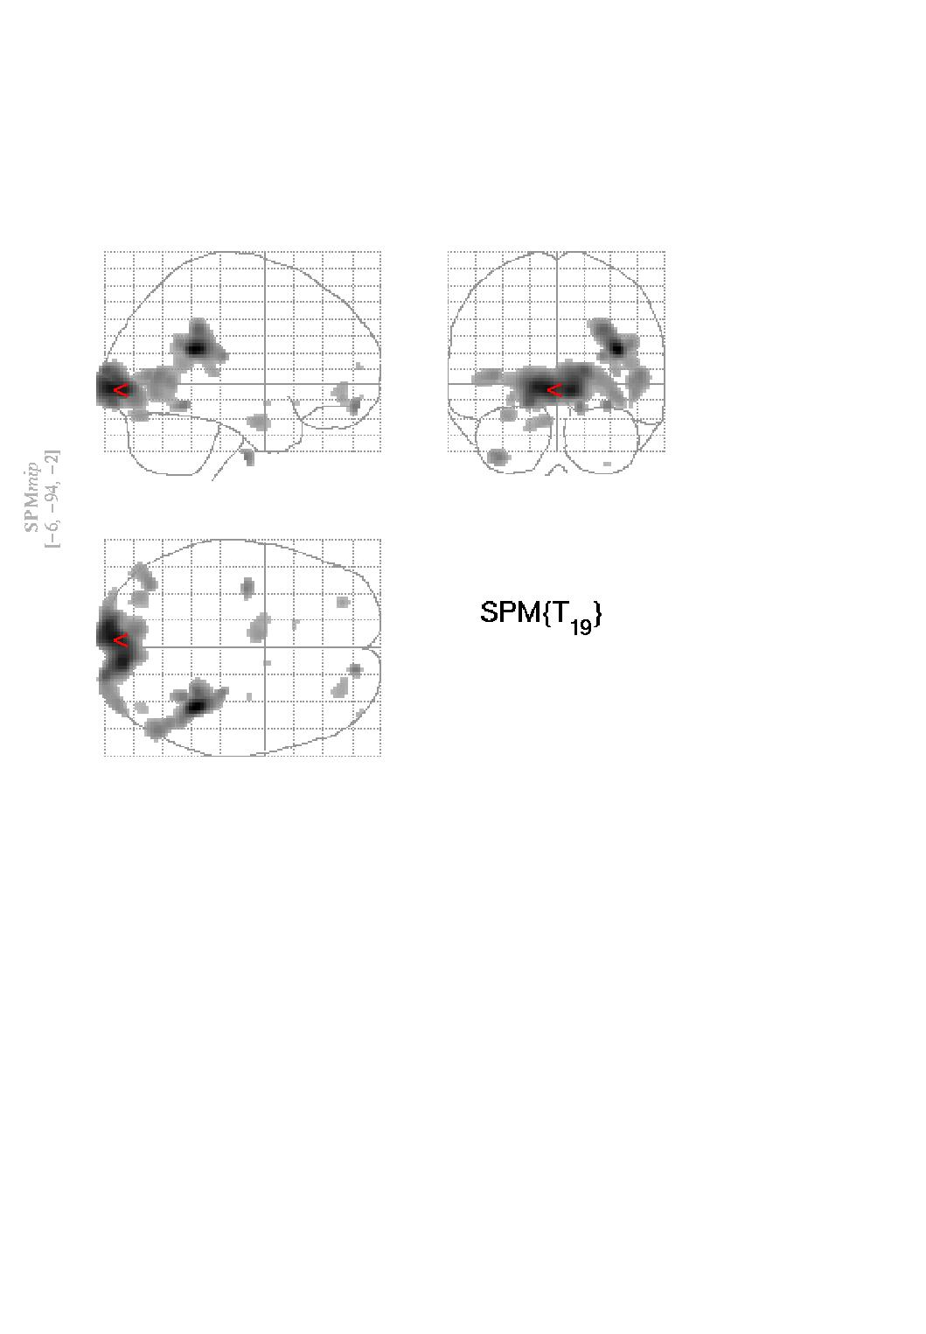
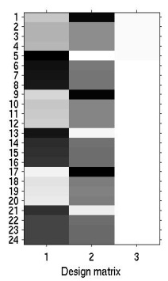
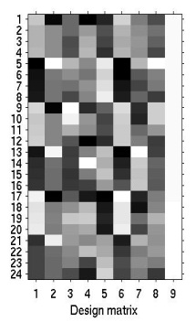

Movement correction strategies
No correction
Correction by covariation
Correction by Unwarp
No correction

Slide 17
Contents
Registration basics
Motion and realignment
Inter-modal coregistration
Spatial normalisation
Gaussian smoothing

Slide 18
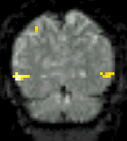
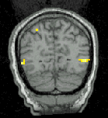
Coregistration
(intra-subject, inter-modal)
Inter-modal registration.
Match images from same subject but different modalities:
anatomical localisation of single subject activations
achieve more precise spatial normalisation of functional image using anatomical image.

Slide 19
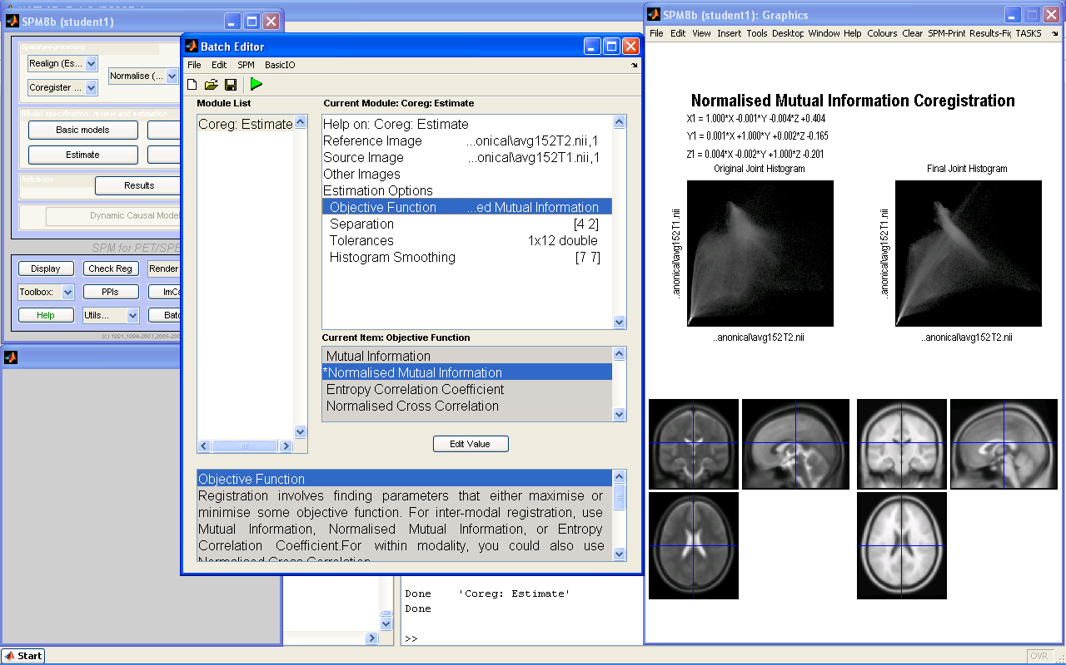
Coregistration maximises Mutual Information
Between-modality registration:
Seek to measure shared information in some sense.
Joint histogram sharpness correlates with image alignment.
Mutual information and related measures attempt to quantify how well one image predicts the other.

Slide 20
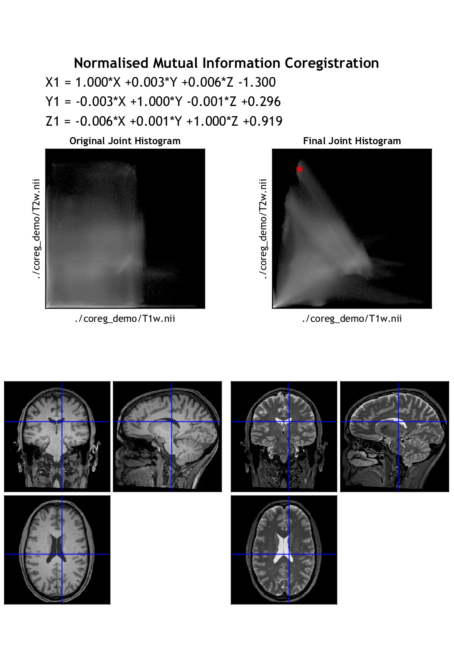
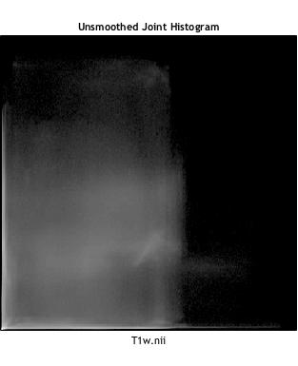
Coregistration

Slide 21
Contents
Registration basics
Motion and realignment
Inter-modal coregistration
Spatial normalisation
  Unified segmentation
Gaussian smoothing

Slide 22
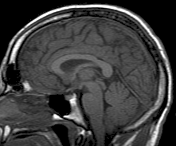
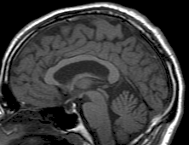
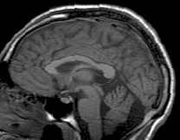
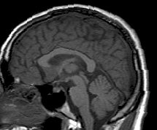
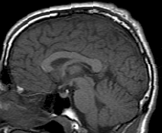
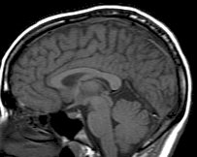
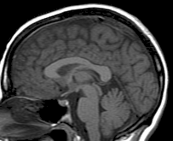
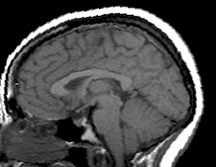
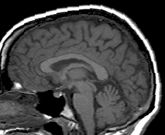
Spatial Normalisation

Slide 23
Spatial Normalisation - Reasons
Inter-subject averaging
  Increase sensitivity with more subjects
    Fixed-effects analysis
  Extrapolate findings to the population as a whole
    Random-effects analysis
Make results from different studies comparable by aligning them to standard space.

Slide 24
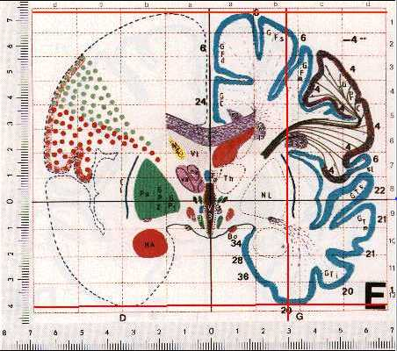
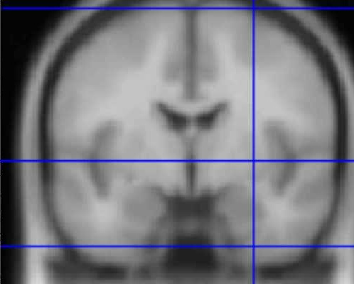
Standard spaces
Talairach Atlas
MNI/ICBM AVG152 Template
The MNI template follows the convention of T&T, but doesn’t match the particular brain (http://imaging.mrc-cbu.cam.ac.uk/imaging/MniTalairach)

Slide 25
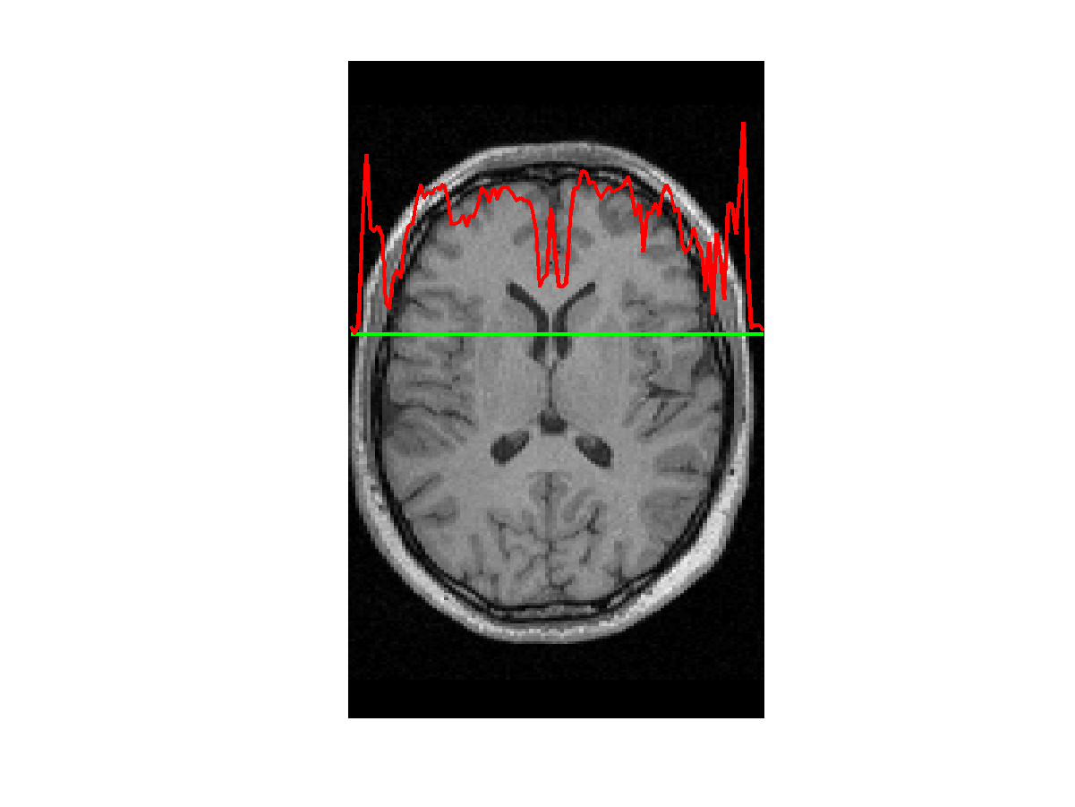
Unified Segmentation
Normalising segmented tissue maps should be more robust and precise than using the original images.
Tissue segmentation benefits from spatially-aligned prior tissue probability maps.
Combining normalisation and segmentation in a unified model:
  Gaussian mixture model segmentation
  Intensity inhomogeneity (bias field) correction
  Warping (non-linear registration)

Slide 26
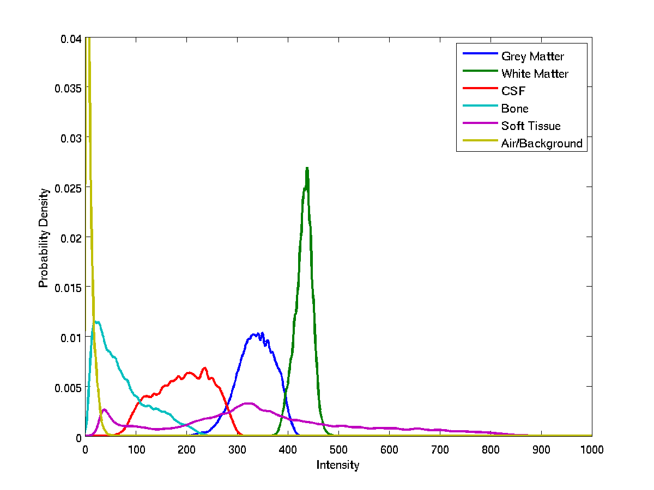
Tissue intensity distributions (T1-weighted MRI)

Slide 27
Mixture of Gaussians
Classification is based on a Mixture of Gaussians model, which represents the intensity probability density by a number of Gaussian distributions.
Frequency
Image Intensity

Slide 28
Non-Gaussian Intensity Distributions
Multiple Gaussians per tissue class allow non-Gaussian intensity distributions to be modelled.
  E.g. accounting for partial volume effects

Slide 29
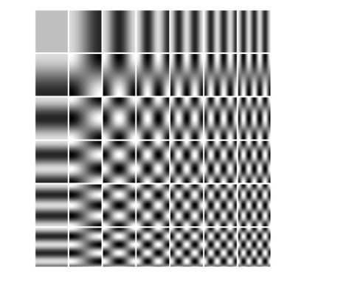
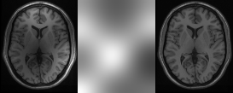
Modelling inhomogeneity
A multiplicative bias field is modelled as a spatially smooth image (a linear combination of basis functions).
Corrupted image
Bias Field
Corrected image

Slide 30
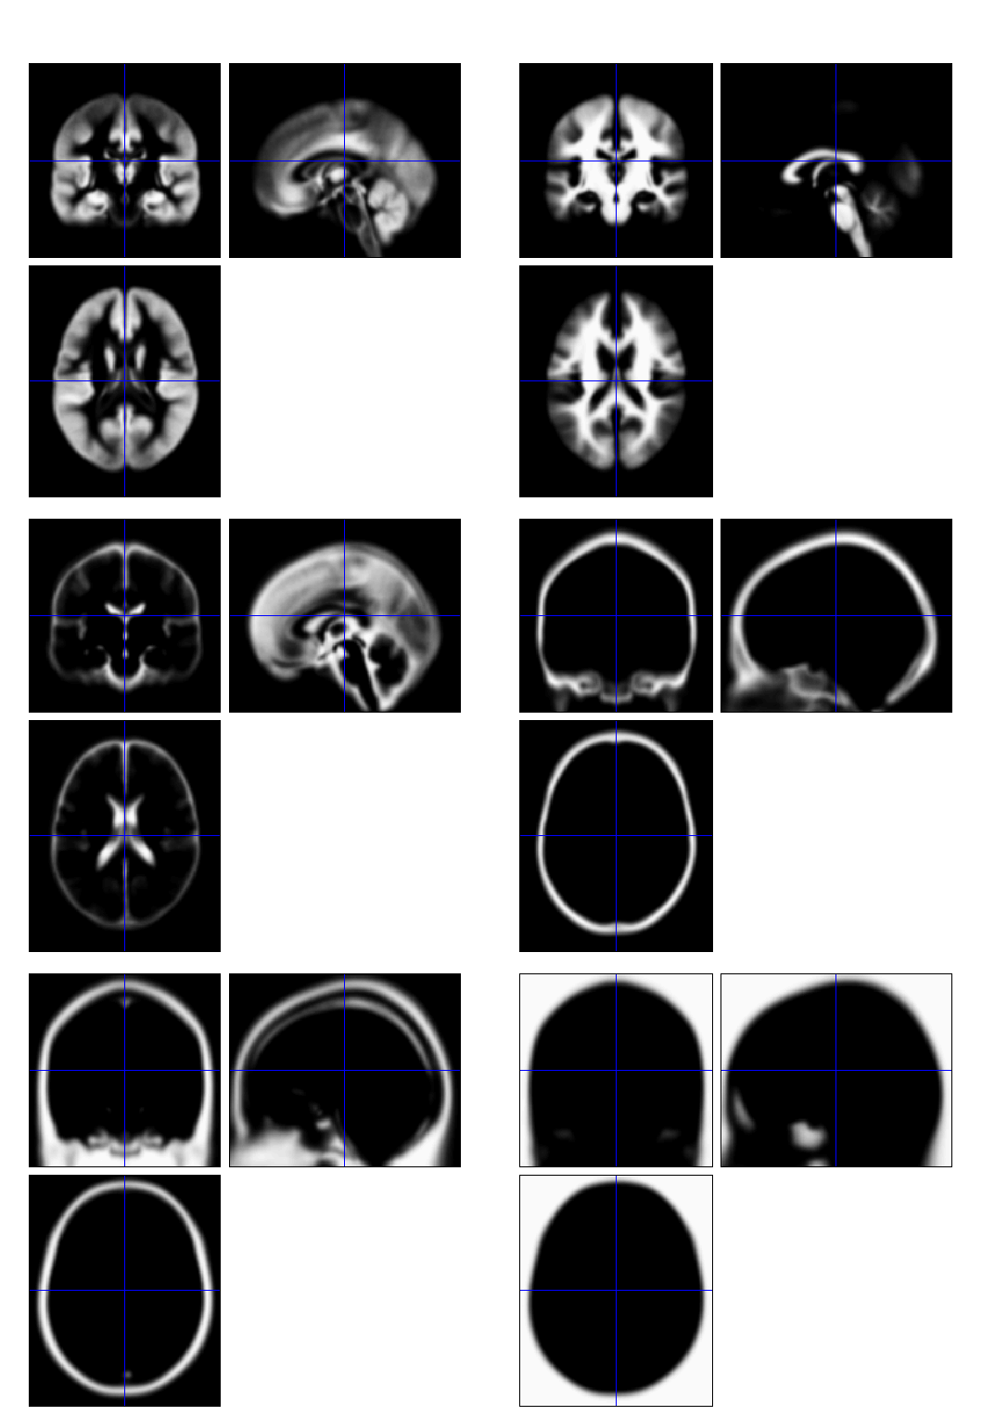
Tissue Probability Maps
Each TPM indicates the prior probability for a particular tissue at each point in MNI space.
SPM12’s TPMs are derived from the IXI dataset initialised with the ICBM 452 atlas and other data.

Slide 31
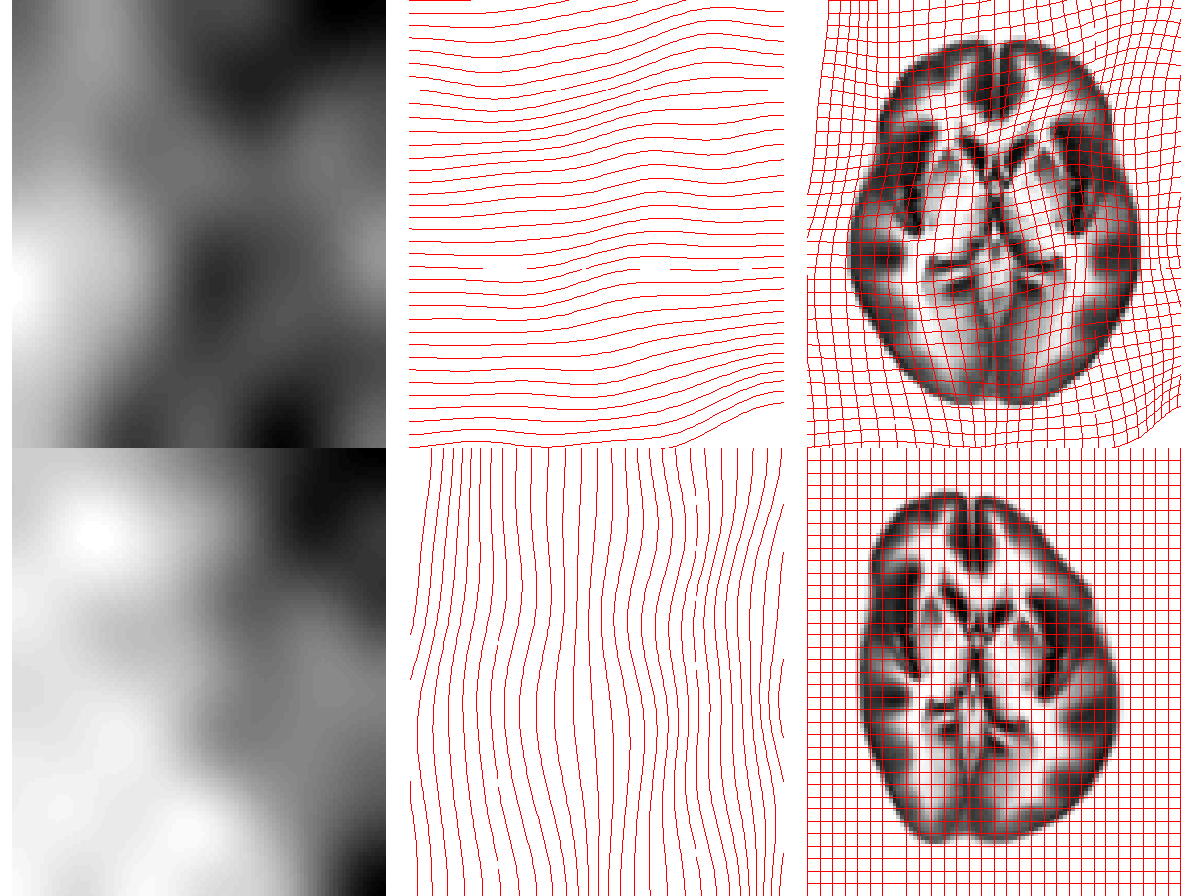
Deforming the Tissue Probability Maps
Tissue probability images are warped to match the subject.
The inverse transform warps to the TPMs.
Warps are constrained to be reasonable by penalising various distortions (regularisation).

Slide 32
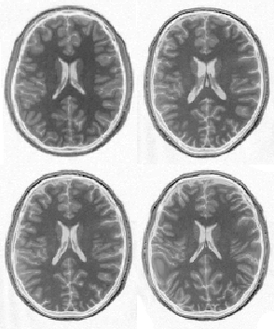
Spatial Normalisation – Overfitting
Without regularisation, the non-linear normalisation can introduce unnecessary deformation
Affine registration.
(SSE = 472.1)
Template
image
Non-linear
registration
without
regularisation.
(SSE = 287.3)
Non-linear
registration
using
regularisation.
(SSE = 302.7)

Slide 33
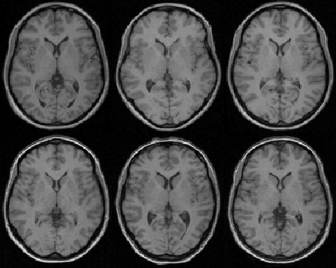

Spatial Normalisation – Results
Affine registration
Non-linear registration

Slide 34
Spatial Normalisation – Limitations
Seek to match functionally homologous regions, but...
  No exact match between structure and function
  Different cortices can have different folding patterns
  Challenging high-dimensional optimisation, many local optima
Compromise
  Correct relatively large-scale variability (sizes of structures)
  Smooth over finer-scale residual differences

Slide 35
Contents
Registration basics
Motion and realignment
Inter-modal coregistration
Spatial normalisation
Gaussian smoothing

Slide 36
Smoothing
Why would we deliberately blur the data?
  Improves spatial overlap by blurring over minor anatomical differences and registration errors
  Averaging neighbouring voxels suppresses noise
  Increases sensitivity to effects of similar scale to kernel (matched filter theorem)
  Makes data more normally distributed (central limit theorem)
  Reduces the effective number of multiple comparisons
How is it implemented?
  Convolution with a 3D Gaussian kernel, of specified full-width at half-maximum (FWHM) in mm
Notes:
Spatial normalisation is never exact, so homologous regions can never be precisely registered. Furthermore, due to the noisy nature of the BOLD signal, activations from different scans can be slightly offset, thereby cancelling each other out. Smoothing spreads out the different areas and reduces the discrepancy.

Slide 37









Effect of smoothing
3D Gaussian smoothing with FWHM: 0, 2, 4, 6, 8, 10, 12, 14, 16 mm isotropic

Slide 38
fMRI time series
Structural MRI
Template
Smoothed fMRI
Normalise/Segment
❸
Realign
Coregister
Smooth
Deformation
❶
❷
❺
Write Normalised
❹

Slide 39
fMRI time series
Structural MRI
Template
Smoothed fMRI
Normalise/Segment
❷
Realign
Coregister
Smooth
Deformation
❶
❸
❺
Write Normalised
❹

Slide 40
fMRI time series
Template
Smoothed fMRI
Normalise/Segment
❷
Realign
Smooth
Deformation
❶
❹
Write Normalised
❸

Slide 41
References
Friston et al. Spatial registration and normalisation of images.
Human Brain Mapping 3:165-189 (1995).
Collignon et al. Automated multi-modality image registration based on information theory. IPMI’95 pp 263-274 (1995).
Thévenaz et al. Interpolation revisited. IEEE Trans. Med. Imaging 19:739-758 (2000).
Andersson et al. Modeling geometric deformations in EPI time series. Neuroimage 13:903-919 (2001).
Ashburner & Friston. Unified Segmentation. NeuroImage 26:839-851 (2005).
Klein et al. Evaluation of 14 nonlinear deformation algorithms applied to human brain MRI registration. NeuroImage 46(3):786-802 (2009).

Slide 42
Spatial normalisation with DARTEL
Limitation of current approach:
  Limited flexibility (low DoF) registration has been criticised
  Inverse transformations are useful, but not always well-defined
  More flexible registration requires careful modelling and regularisation (prior belief about reasonable warping)
  MNI/ICBM templates/priors are not universally representative
The DARTEL toolbox combines several methodological advances to address these limitations.

Slide 43



fMRI time series
Structural MRI
Template
…
DARTEL
Create template
Segment
❹
❸
Realign
Coregister
Deformation
❶
❷
Smoothed fMRI
❺
DARTEL
Norm to MNI
and Smooth

Slide 44


Evaluations of nonlinear registration algorithms

