Slide 1

fMRI Modelling &
Statistical Inference
Guillaume Flandin
Wellcome Trust Centre for Neuroimaging
University College London
SPM Course
Chicago, 22-23 Oct 2015

Slide 2



Image time-series
Spatial filter
Design matrix
Statistical Parametric Map
Realignment
Smoothing
General Linear Model
Statistical
Inference
RFT
Normalisation
Anatomical
reference
p <0.05
Parameter estimates

Slide 3

Example: Auditory block-design experiment
Passive word listening
versus rest
BOLD response at [62,-28,10]
7 cycles of
rest and listening
Blocks of 6 scans
with 7 sec TR
time (seconds)
Stimulus function

Slide 4
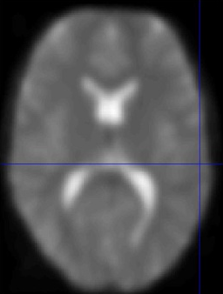
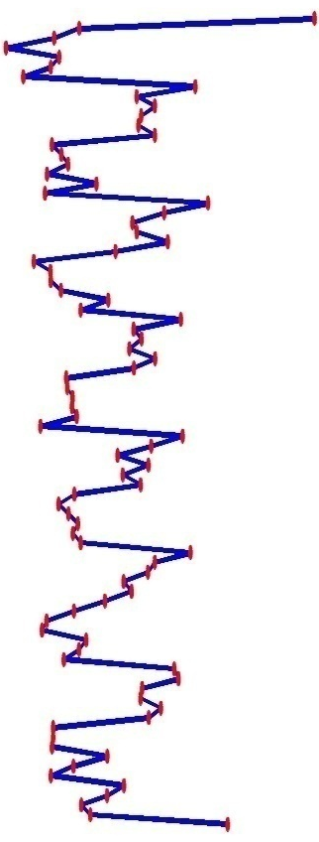
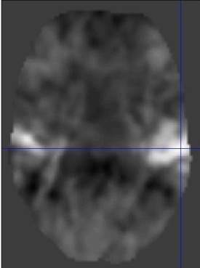
Voxel-wise time series analysis
Model
specification
Parameter
estimation
Time
Hypothesis
Statistic
Time
BOLD signal
single voxel
time series
SPM

Slide 5

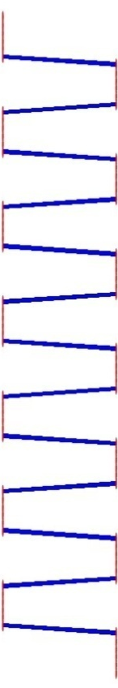

Single voxel regression model
error
=
β₁
+
β₂
+
Time
x₁
x₂
e
BOLD signal

Slide 6
Mass-univariate analysis: voxel-wise GLM
X
y
+
=
Model is specified by
Design matrix X
Assumptions about e
N: number of scans
p: number of regressors
The design matrix embodies all available knowledge about experimentally controlled factors and potential confounds.

Slide 7
GLM: a flexible framework for parametric analyses
    one sample t-test
    two sample t-test
    paired t-test
    Analysis of Variance (ANOVA)
    Analysis of Covariance (ANCoVA)
    correlation
    linear regression
    multiple regression

Slide 8



Parameter estimation
Objective:
estimate parameters to minimize
=
+
y
X
Ordinary least squares estimation (OLS) (assuming i.i.d. error):

Slide 9
Problems of this model with fMRI time series
The BOLD response has a delayed and dispersed shape.

Slide 10
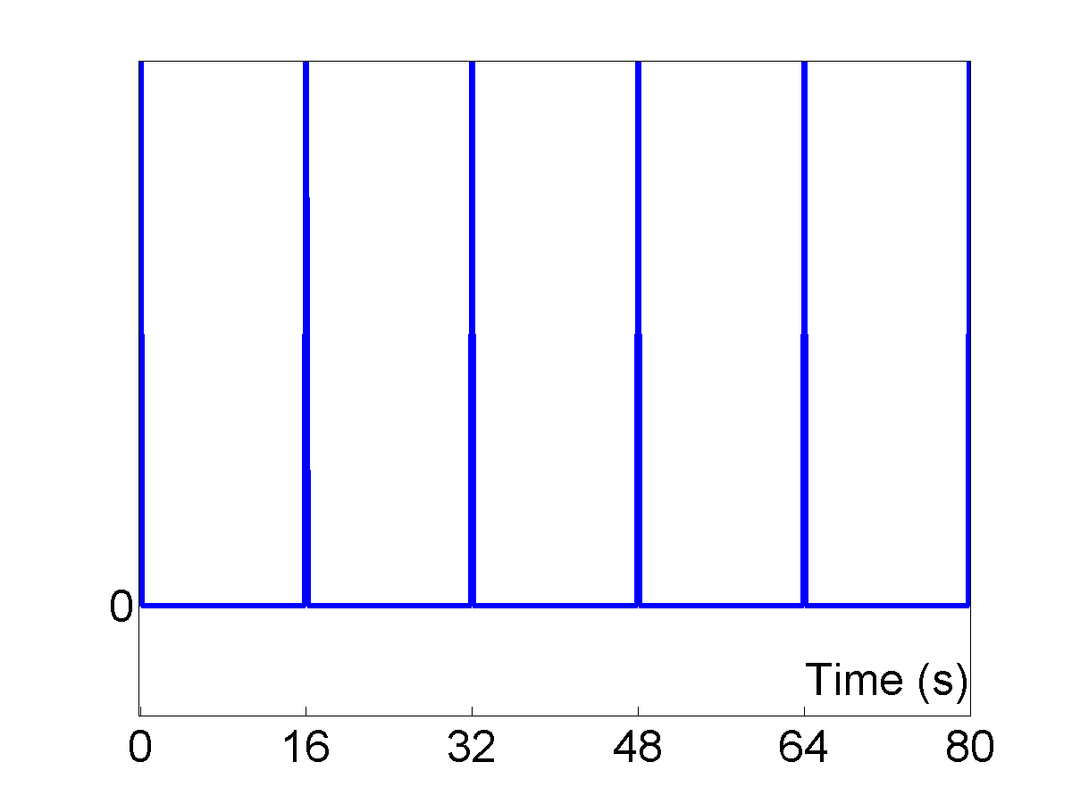
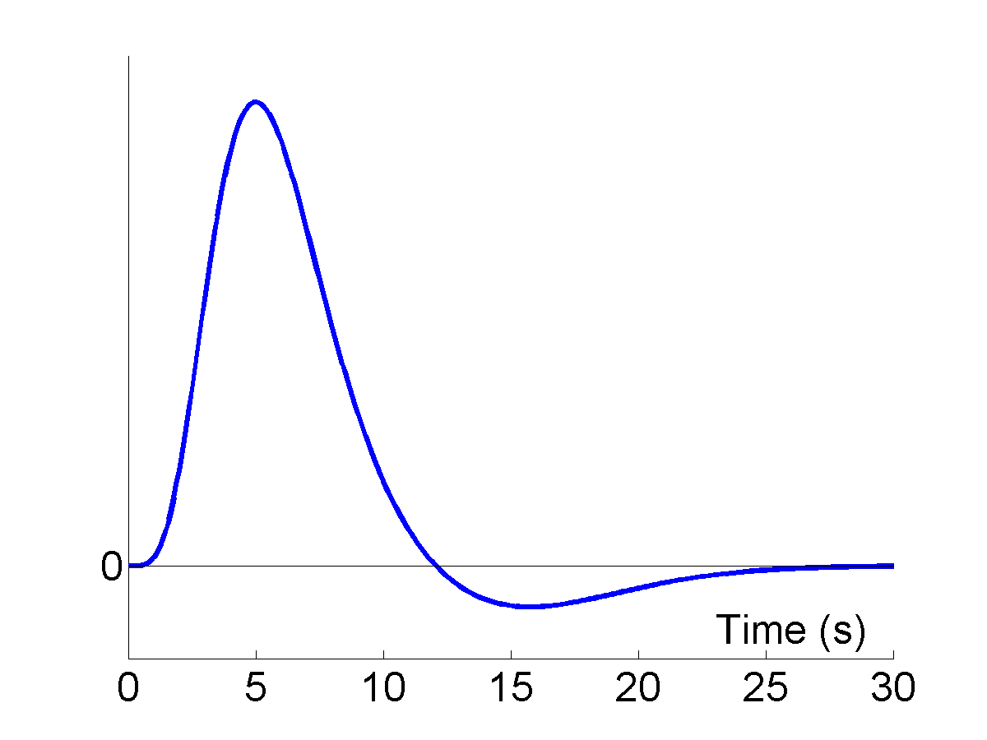
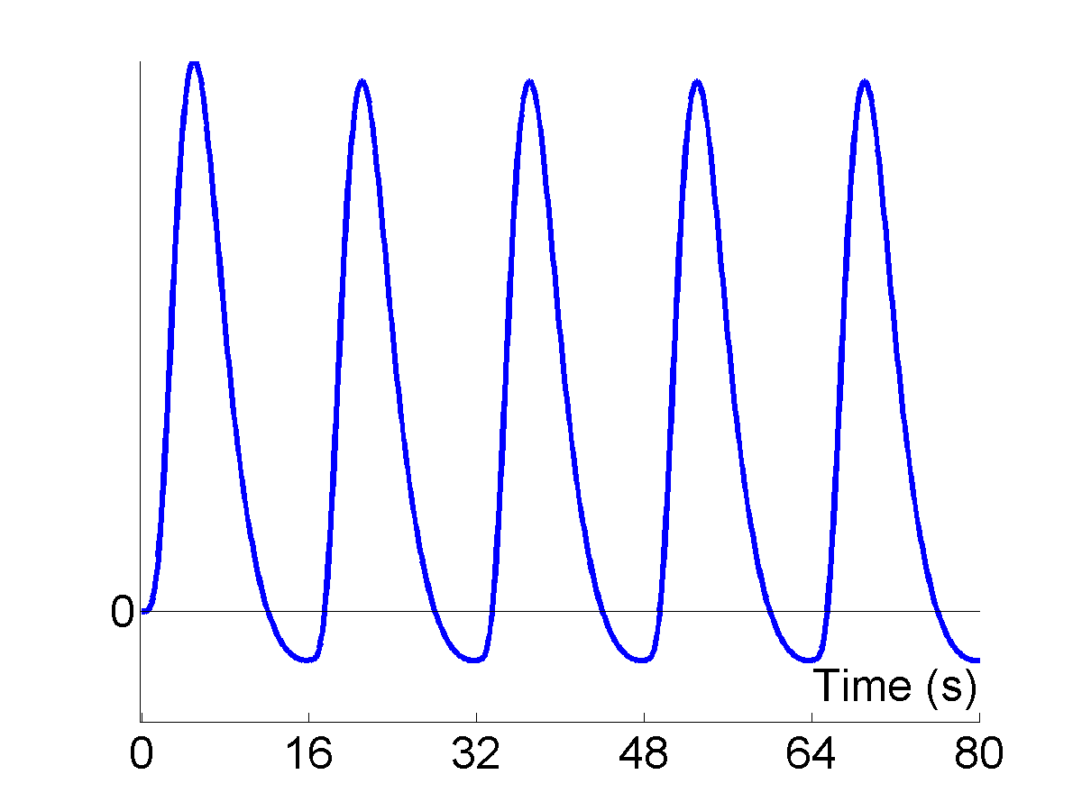
BOLD response: Convolution model
Hemodynamic response function (HRF)
Expected BOLD
Impulses
⊗
=
Linear time-invariant system:
expected BOLD response
= input function ⊗ impulse response function (HRF)

Slide 11
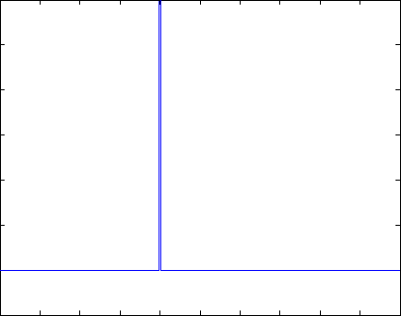
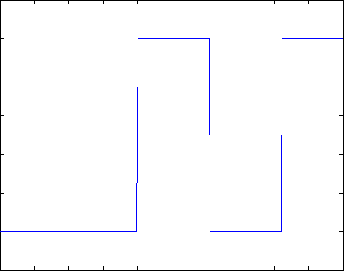
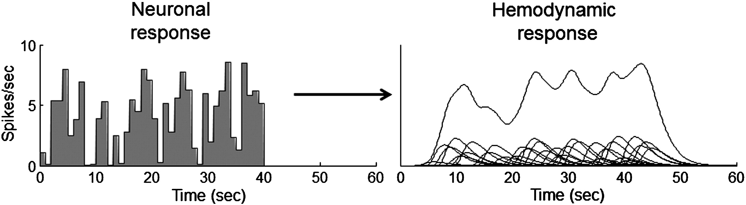
Problem 1: BOLD response
Solution: Convolution model

Slide 12
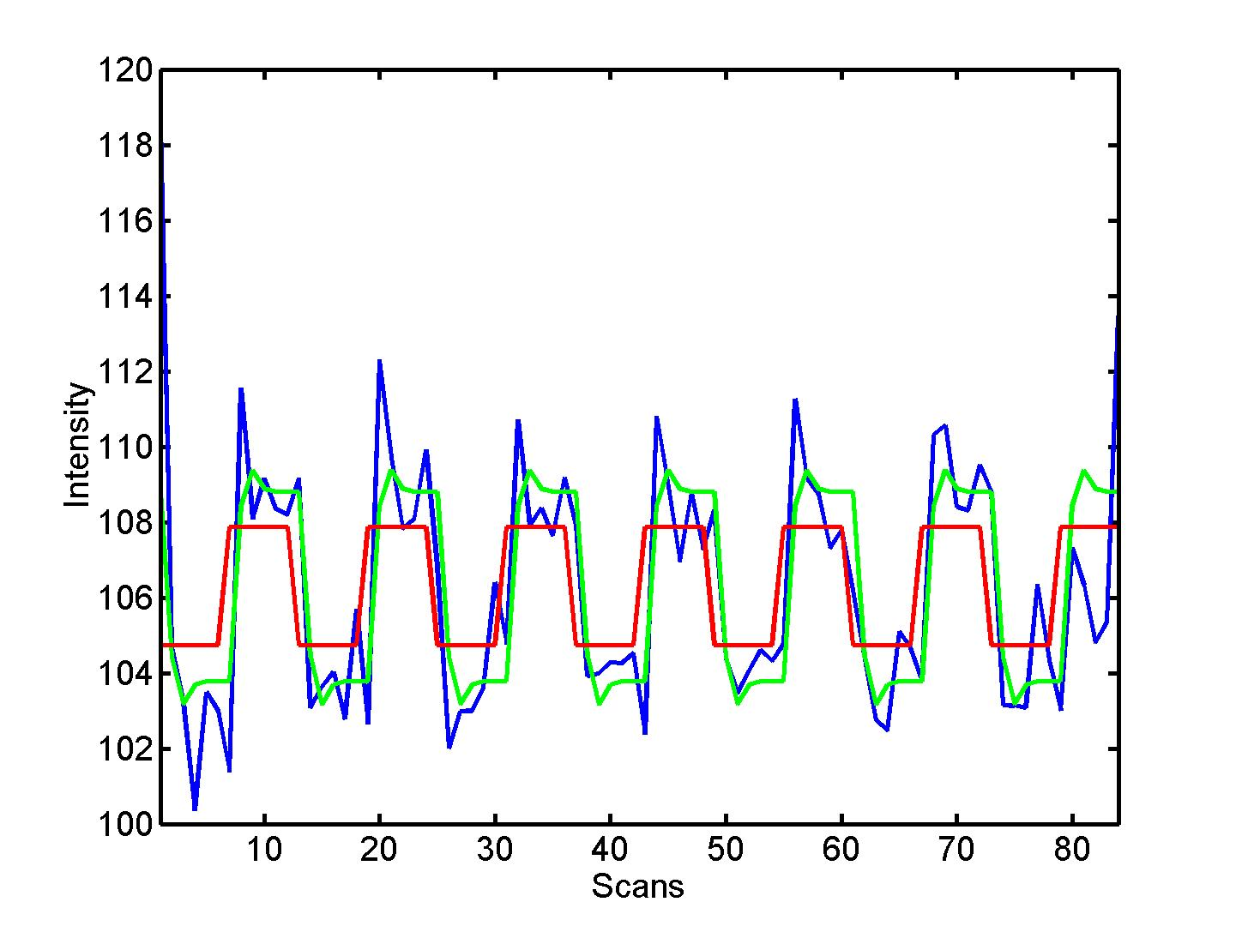


Convolution model of the BOLD response
Convolve stimulus function with a canonical hemodynamic response function (HRF):
⊗ HRF

Slide 13
Hemodynamic Response ⇨ Temporal Basis Set
Canonical HRF
Informed Basis Set
Canonical HRF
Temporal derivative
Dispersion derivative
Brief
Stimulus

Slide 14
Problems of this model with fMRI time series
The BOLD response has a delayed and dispersed shape.
The BOLD signal includes substantial amounts of low-frequency noise (eg due to scanner drift).

Slide 15
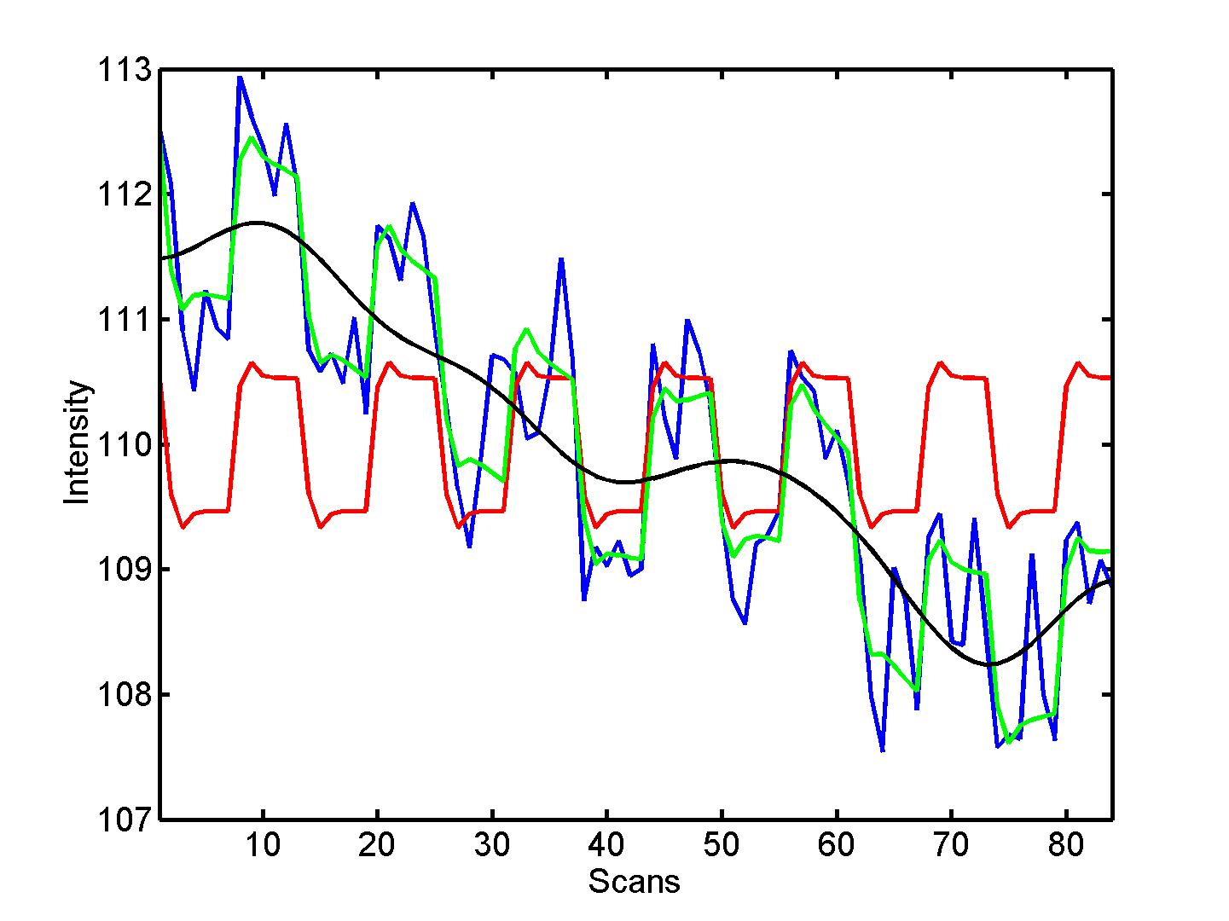

Problem 2: Low-frequency noise
Solution: High pass filtering
blue = data
black = mean + low-frequency drift
green = predicted response, taking into account low-frequency drift
red = predicted response, NOT taking into account low-frequency drift
discrete cosine transform (DCT) set

Slide 16
Problems of this model with fMRI time series
The BOLD response has a delayed and dispersed shape.
The BOLD signal includes substantial amounts of low-frequency noise (eg due to scanner drift).
Due to breathing, heartbeat & unmodeled neuronal activity, the errors are serially correlated. This violates the assumptions of the noise model in the GLM.

Slide 17
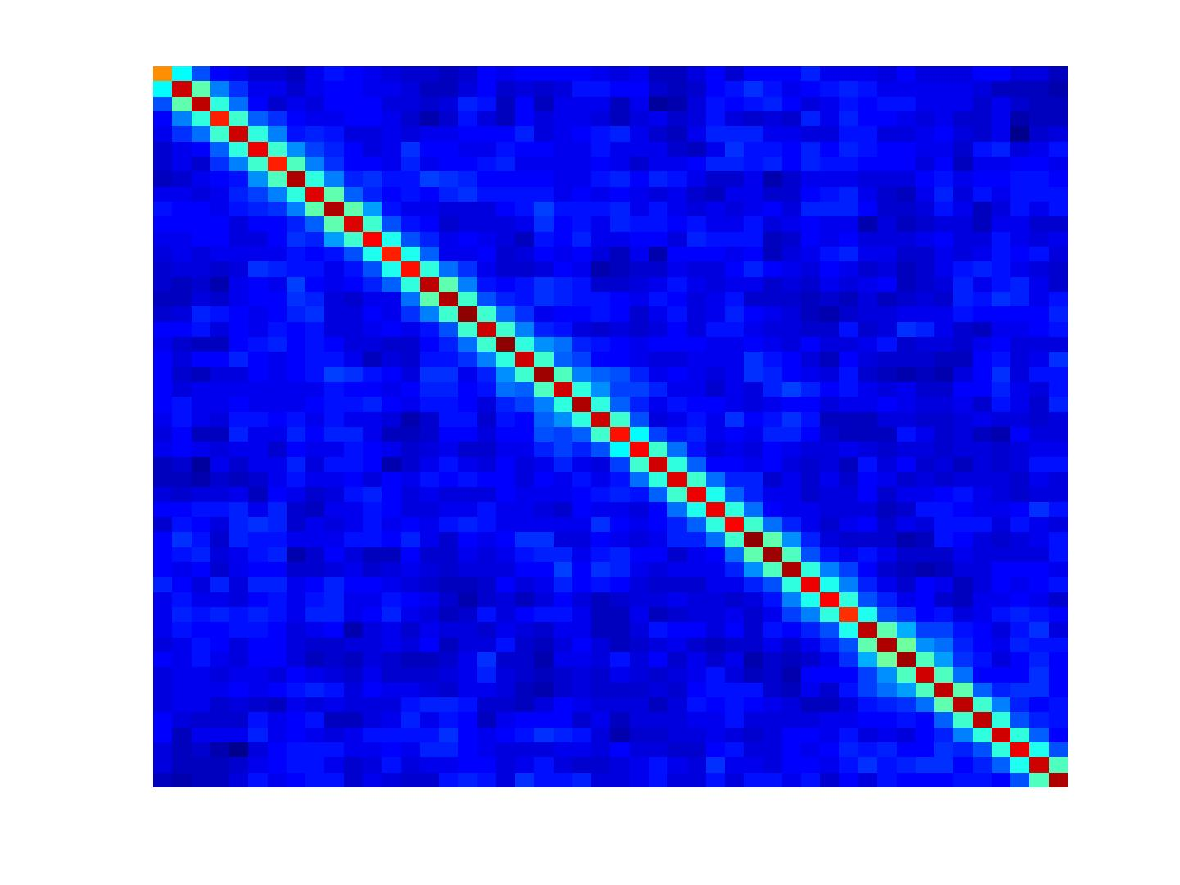
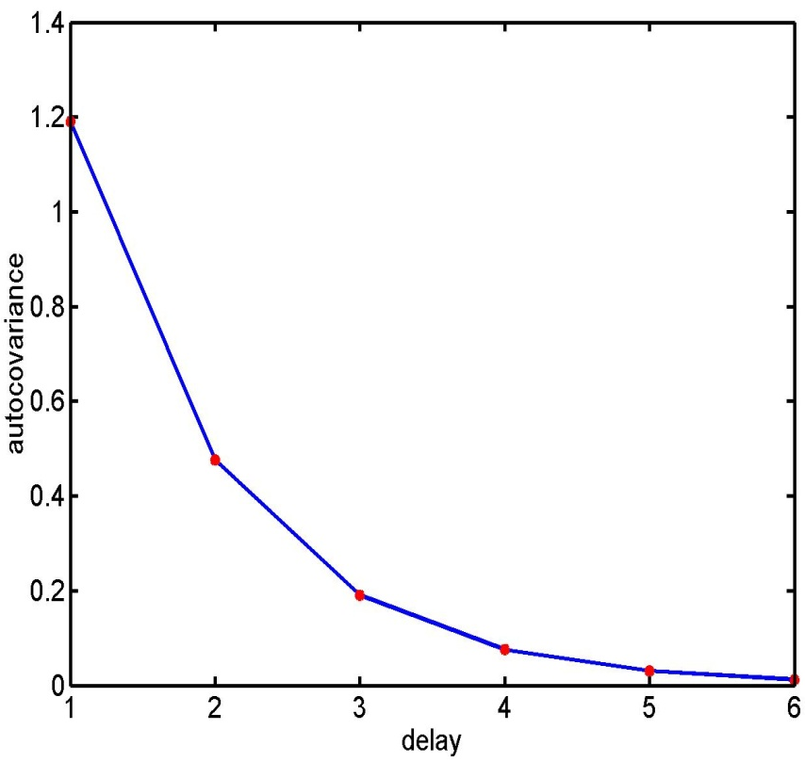
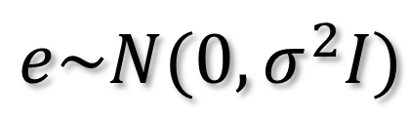
Problem 3: Serial correlations
i.i.d:
$$e\sim N(0,σ^{2}I)$$
autocovariance
function

Slide 18
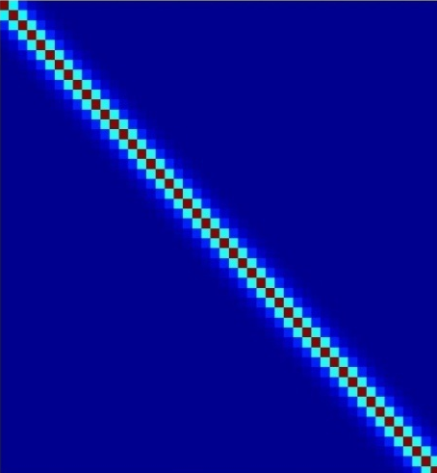
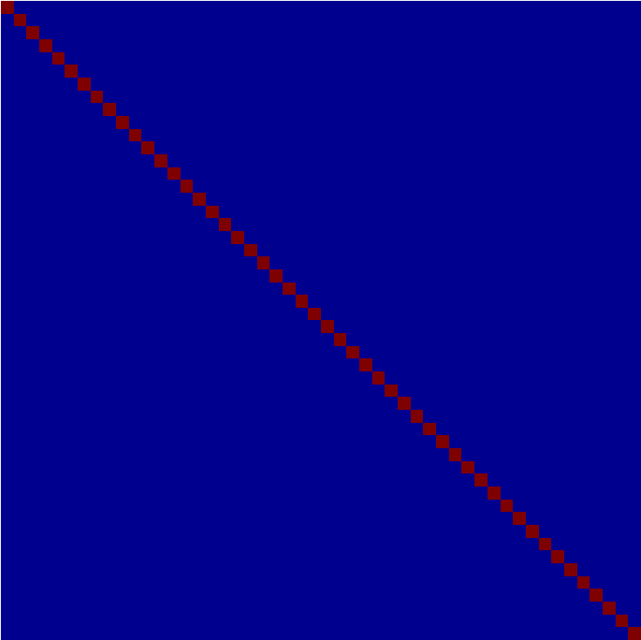
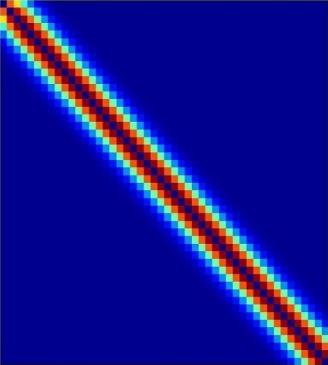
Multiple covariance components
enhanced noise model at voxel i
error covariance components Q and hyperparameters λ
V
Q₁
Q₂
=
λ₁
+ λ₂
Estimation of hyperparameters λ with ReML (Restricted Maximum Likelihood).

Slide 19
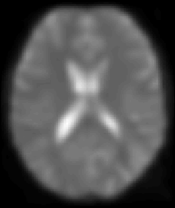
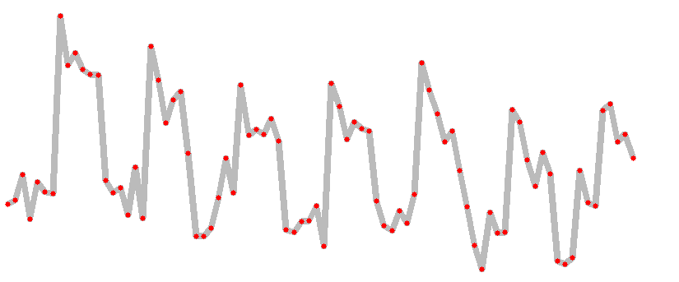
A mass-univariate approach
Summary
Time

Slide 20
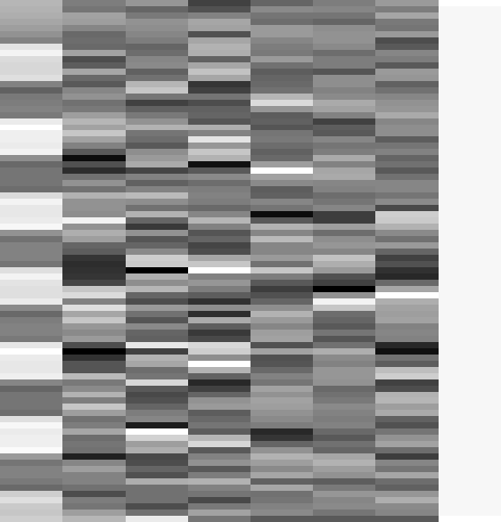

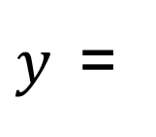
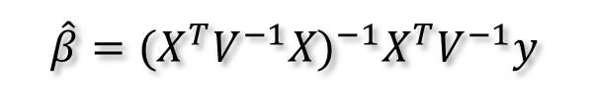
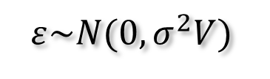
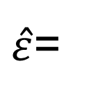



Estimation of the parameters
Summary
noise assumptions:
$$ε\sim N(0,σ^{2}V)$$
WLS:
$$\hat{β}={(X^{T}V^{−1}X)}^{−1}X^{T}V^{−1}y$$
$${\hat{β}}_{1}=3.9831$$
$$β$$
$${\hat{β}}_{2−7}=\{0.6871, 1.9598, 1.3902, 166.1007, 76.4770, −64.8189\}$$
$y$=
$$+ε$$
$${\hat{β}}_{8}=131.0040$$
$\hat{ε}$=

Slide 21
Image time-series
Spatial filter
Design matrix
Statistical Parametric Map
Realignment
Smoothing
General Linear Model
Statistical
Inference
RFT
Normalisation
Anatomical
reference
p <0.05
Parameter estimates

Slide 22
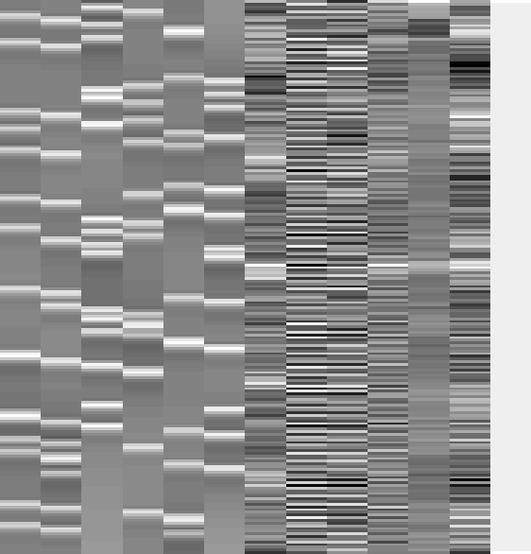
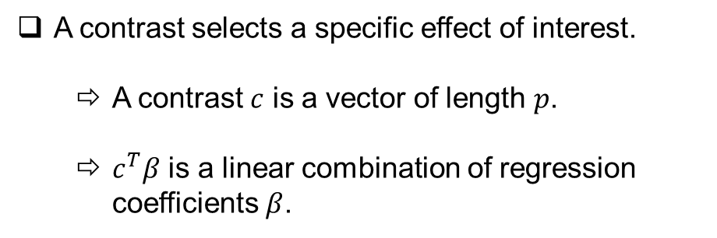
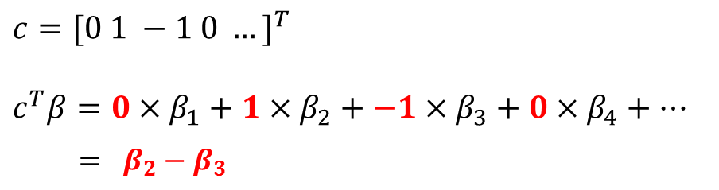
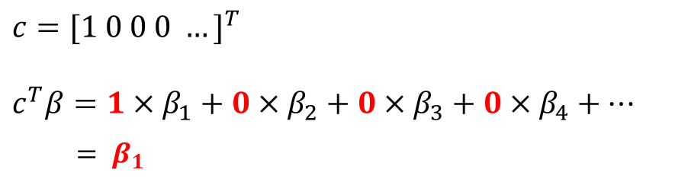
Contrasts
A contrast selects a specific effect of interest.
  A contrast $c$ is a vector of length $p$.
  $c^{T}β$ is a linear combination of regression coefficients $β$.
[1 0 0 0 0 0 0 0 0 0 0 0 0 0]
[0 1 -1 0 0 0 0 0 0 0 0 0 0 0]
$$c={[1 0 0 0 …]}^{T}$$
$$c^{T}β=1×β_{1}+0×β_{2}+0×β_{3}+0×β_{4}+…$$
$= β_{1}$
$$c={[0 1 −1 0 …]}^{T}$$
$$c^{T}β=0×β_{1}+1×β_{2}+−1×β_{3}+0×β_{4}+…$$
$$= β_{2}−β_{3}$$

Slide 23
Hypothesis Testing
To test an hypothesis, we construct “test statistics”.
Null Hypothesis H₀
Typically what we want to disprove (no effect).
⇨ The Alternative Hypothesis H_{A} expresses outcome of interest.
Test Statistic T
The test statistic summarises evidence about H₀.
Typically, test statistic is small in magnitude when the hypothesis H₀ is true and large when false.
⇨ We need to know the distribution of T under the null hypothesis.
Null Distribution of T

Slide 24
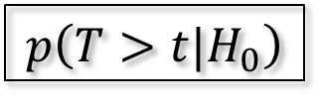
Hypothesis Testing
Significance level α:
Acceptable false positive rate α.
⇨ threshold u_{α}
Threshold u_{α} controls the false positive rate
u_{α}
α
Null Distribution of T
Conclusion about the hypothesis:
We reject the null hypothesis in favour of the alternative hypothesis if t > u_{α}
t
p-value:
A p-value summarises evidence against H₀.
This is the chance of observing value more extreme than t under the null hypothesis.
p-value
$$p\left(T>t|H_{0}\right)$$
Null Distribution of T

Slide 25
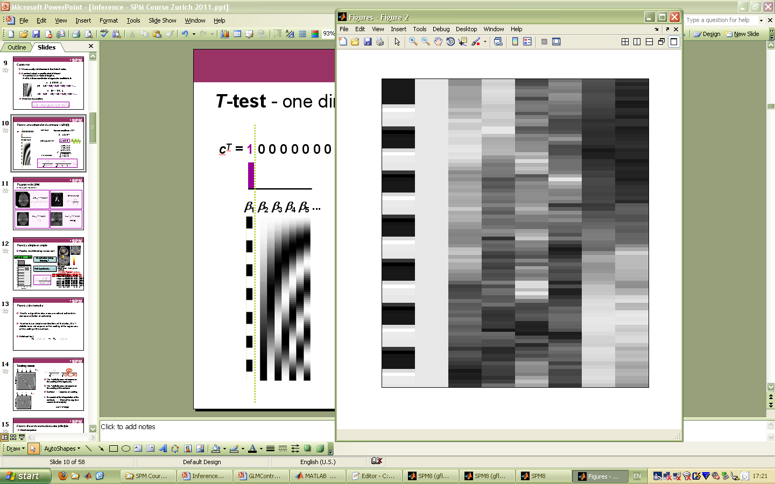
T-test - one dimensional contrasts – SPM{t}
Question:
Amplitude of cond 1 > 0 ?
i.e.
β₁ = c^{T}β> 0 ?
c^{T} = 1 0 0 0 0 0 0 0
β₁ β₂ β₃ β₄ β₅ ...
Null hypothesis:
H₀: c^{T}β = 0
H_{A}:
contrast of
estimated
parameters
Test statistic:
T =
variance
estimate

Slide 26
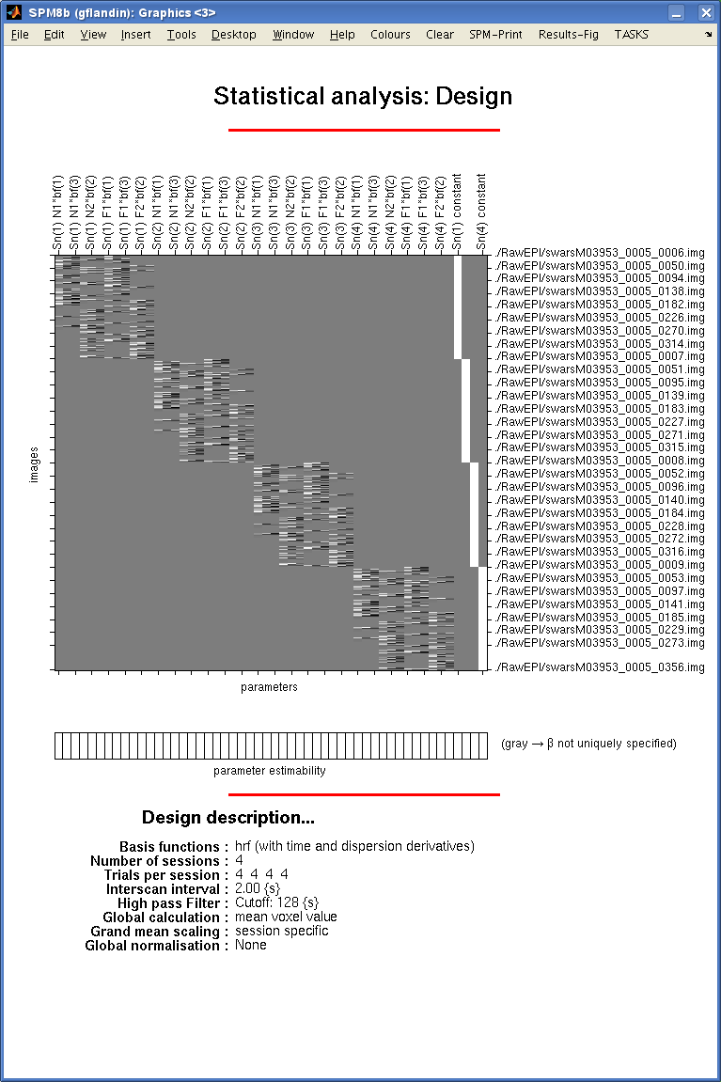
Scaling issue
[1 1 1 1 ]
/ 4
Subject 1
The T-statistic does not depend on the scaling of the regressors.
The T-statistic does not depend on the scaling of the contrast.
Contrast depends on scaling.
[1 1 1 ]
/ 3
Be careful of the interpretation of the contrasts themselves (eg, for a second level analysis):
sum ≠ average
Subject 5

Slide 27
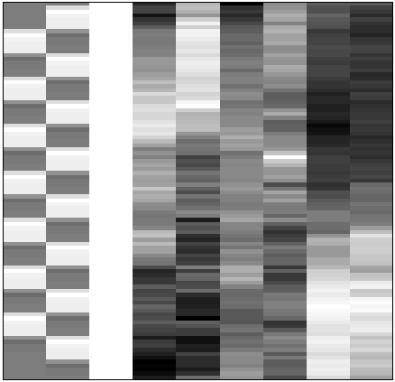
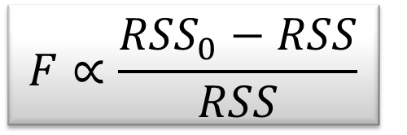
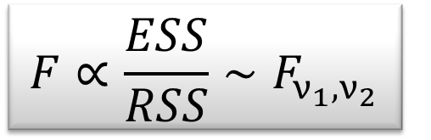
F-test - the extra-sum-of-squares principle
Model comparison:
Null Hypothesis H₀: True model is X₀ (reduced model)
X₀
X₁
X₀
Test statistic: ratio of explained variability and unexplained variability (error)
RSS
RSS₀
ν₁ = rank(X) – rank(X₀)
ν₂ = N – rank(X)
Full model ?
or Reduced model?

Slide 28
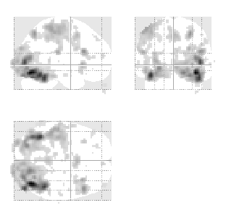
F-test - multidimensional contrasts – SPM{F}
Tests multiple linear hypotheses:
H₀: True model is X₀
H₀: β₄ = β₅ = ... = β₉ = 0
test H₀ : c^{T}β = 0 ?
X₀
X₁ (β₄₋₉)
X₀
0 0 0 1 0 0 0 0 0
0 0 0 0 1 0 0 0 0
0 0 0 0 0 1 0 0 0
0 0 0 0 0 0 1 0 0
0 0 0 0 0 0 0 1 0
0 0 0 0 0 0 0 0 1
c^{T} =
SPM{F_{6,322}}
Full model?
Reduced model?

Slide 29
F-test: summary
F-tests can be viewed as testing for the additional variance explained by a larger model wrt a simpler (nested) model
⇨ model comparison.
Hypotheses:
In testing uni-dimensional contrast with an F-test, for example β₁ – β₂, the result will be the same as testing β₂ – β₁. It will be exactly the square of the t-test, testing for both positive and negative effects.

Slide 30

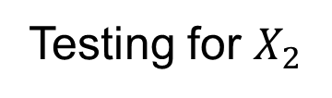
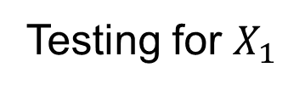
Orthogonal regressors
Variability described by $X_{1}$
Variability described by $X_{2}$
Testing for $X_{1}$
Testing for $X_{2}$
Variability in Y

Slide 31


Correlated regressors
Shared variance
Variability described by $X_{1}$
Variability described by $X_{2}$
Variability in Y

Slide 32


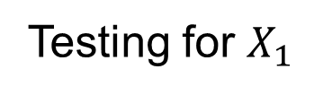
Correlated regressors
Testing for $X_{1}$
Variability described by $X_{1}$
Variability described by $X_{2}$
Variability in Y

Slide 33
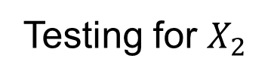
Correlated regressors
Testing for $X_{2}$
Variability described by $X_{1}$
Variability described by $X_{2}$
Variability in Y

Slide 34
Correlated regressors
Variability described by $X_{1}$
Variability described by $X_{2}$
Variability in Y

Slide 35


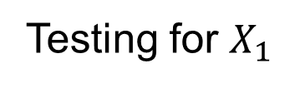
Correlated regressors
Testing for $X_{1}$
Variability described by $X_{1}$
Variability described by $X_{2}$
Variability in Y

Slide 36
Correlated regressors
Testing for $X_{2}$
Variability described by $X_{1}$
Variability described by $X_{2}$
Variability in Y

Slide 37
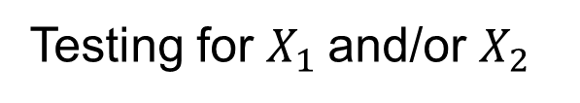
Correlated regressors
Testing for $X_{1}$and/or $X_{2}$
Variability described by $X_{1}$
Variability described by $X_{2}$
Variability in Y
Orthogonalization of Regressors in fMRI Models, Mumford et al, PlosOne, 2015

Slide 38
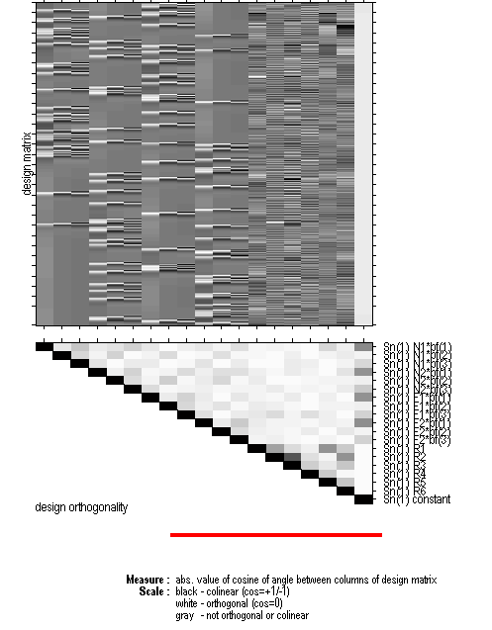
Design orthogonality
For each pair of columns of the design matrix, the orthogonality matrix depicts the magnitude of the cosine of the angle between them, with the range 0 to 1 mapped from white to black.
If both vectors have zero mean then the cosine of the angle between the vectors is the same as the correlation between the two variates.

Slide 39
Design efficiency
The aim is to minimize the standard error of a t-contrast (i.e. the denominator of a t-statistic).
This is equivalent to maximizing the efficiency e:
Noise variance
Design variance
If we assume that the noise variance is independent of the specific design:
This is a relative measure: all we can really say is that one design is more efficient than another (for a given contrast).

Slide 40
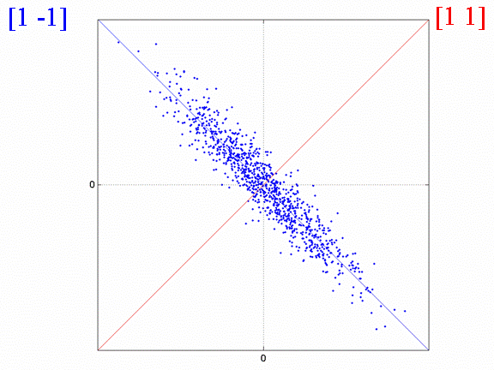

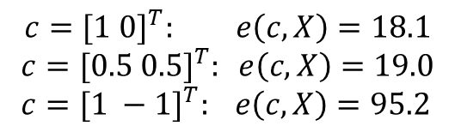
Design efficiency
A
B
$$c={[1 0]}^{T}: e\left(c,X\right)=18.1$$
$$c={[0.5 0.5]}^{T}: e\left(c,X\right)=19.0 \\ c={[1 −1]}^{T}: e\left(c,X\right)=95.2$$
$$X^{T}X=\left(\begin{matrix}1 & −0.9 \\ −0.9 & 1\end{matrix}\right)$$
A+B
A-B
High correlation between regressors leads to low sensitivity to each regressor alone.
We can still estimate efficiently the difference between them.

Slide 41
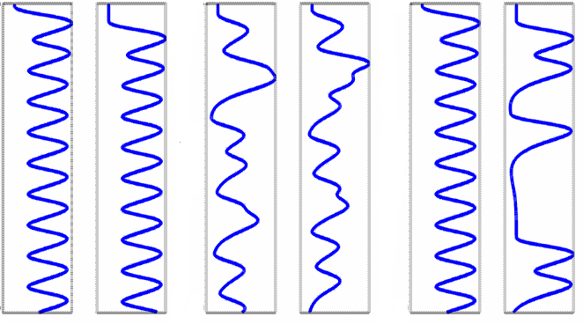
Example: working memory
A
B
C
Stimulus
Response
Stimulus
Response
Stimulus
Response
Time (s)
Time (s)
Time (s)
Correlation = -.65
Efficiency ([1 0]) = 29
Correlation = +.33
Efficiency ([1 0]) = 40
Correlation = -.24
Efficiency ([1 0]) = 47
B: Jittering time between stimuli and response.
C: Requiring a response on a randomly half of trials.

Slide 42
Image time-series
Spatial filter
Design matrix
Statistical Parametric Map
Realignment
Smoothing
General Linear Model
Statistical
Inference
RFT
Normalisation
Anatomical
reference
p <0.05
Parameter estimates

