Slide 1

Event-related fMRI
Guillaume Flandin
Wellcome Trust Centre for Neuroimaging
University College London
SPM Course
Chicago, 22-23 Oct 2015

Slide 2
BOLD response
Early event-related fMRI studies used a long Stimulus Onset Asynchrony (SOA) to allow BOLD response to return to baseline.
However, overlap between successive responses at short SOAs can be accommodated if the BOLD response is explicitly modeled, particularly if responses are assumed to superpose linearly.
Shape of the BOLD response add constraints on design efficiency.
Peak
Brief
Stimulus
Undershoot

Slide 3
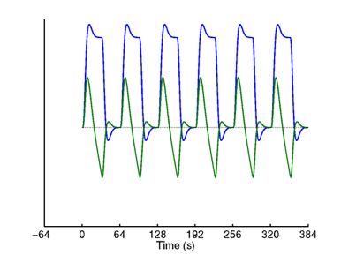
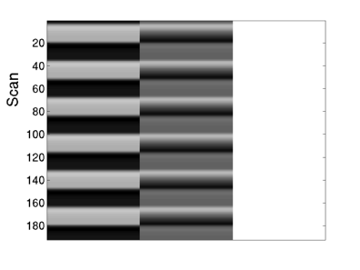
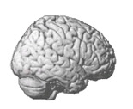
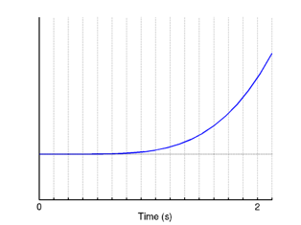
Slice Timing issue
t1 = 0 s
T=16, TR=2s
t16 = 2 s
t0 = 16
t0 = 8

Slide 4
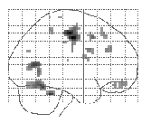
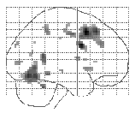
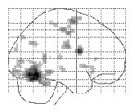
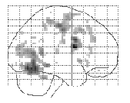
Slice Timing issue
Top slice
Bottom slice
“Slice-timing Problem”:
‣ Slices acquired at different times, yet
model is the same for all slices
‣ different results (using canonical HRF) for different reference slices
‣ (slightly less problematic if middle slice is selected as reference, and with short TRs)
Solutions:
1. Temporal interpolation of data
“Slice timing correction”
2. More general basis set (e.g., with
temporal derivatives)
Interpolated
TR=3s
Derivative
See Sladky et al, NeuroImage, 2012.

Slide 5
Timing issues: Sampling
TR=4s
Scans
Typical TR for 48 slice EPI at 3mm spacing is ~ 4s
Sampling at [0,4,8,12…] post- stimulus may miss peak signal.
Stimulus (synchronous)
Stimulus (asynchronous)
Stimulus (random jitter)
SOA=8s
Higher effective sampling by:
Asynchrony
eg SOA=1.5TR
2. Random Jitter
eg SOA=(2±0.5)TR

Slide 6
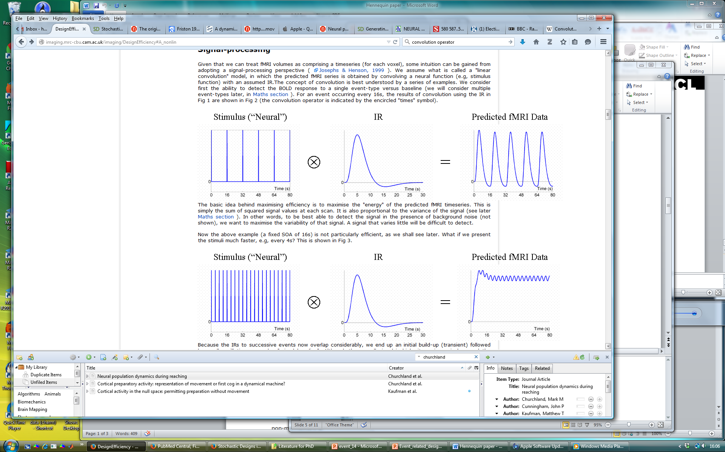
Optimal SOA?
16s SOA
Not very efficient…
4s SOA
Very inefficient…

Slide 7
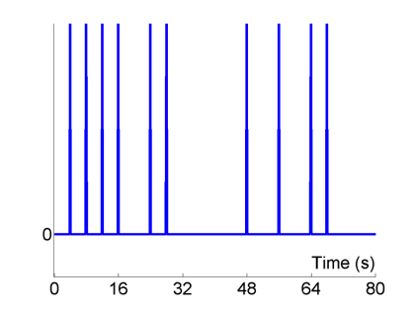
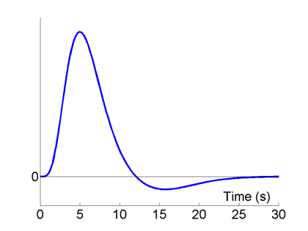
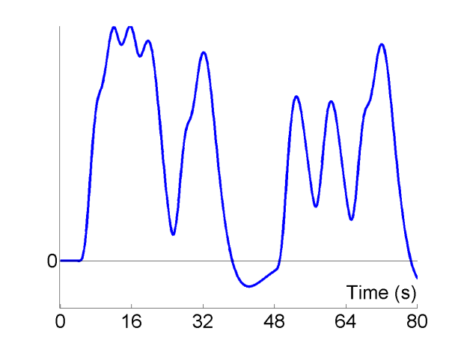
Short randomised SOA
Stimulus (“Neural”)
HRF
Predicted Data
⊗
=
Null events
More efficient!

Slide 8
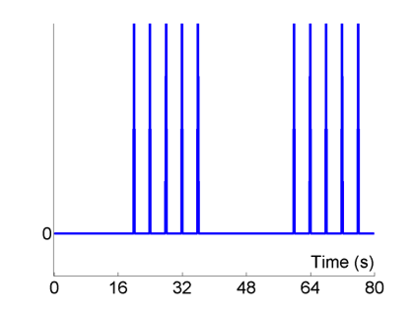
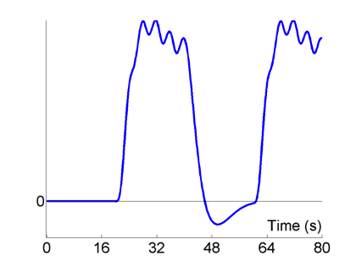
Block design SOA
Stimulus (“Neural”)
HRF
Predicted Data
⊗
=
Even more efficient!

Slide 9
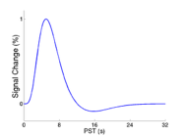
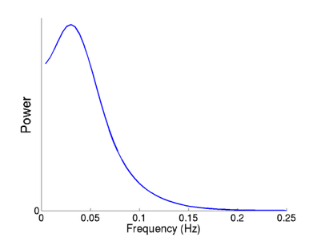
Design efficiency
HRF can be viewed as a filter.
We want to maximise the signal passed by this filter.
Dominant frequency of canonical HRF is ~0.03 Hz.
The most efficient design is a sinusoidal modulation of neuronal activity with period ~32s

Slide 10
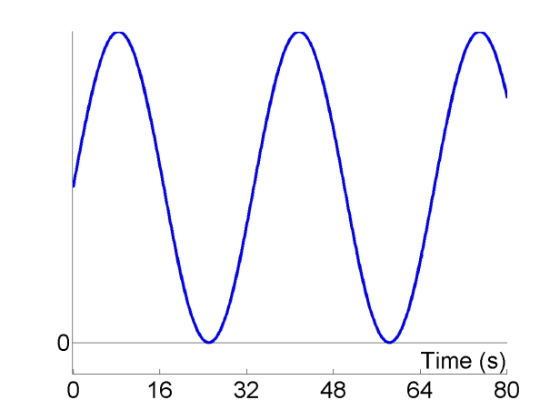

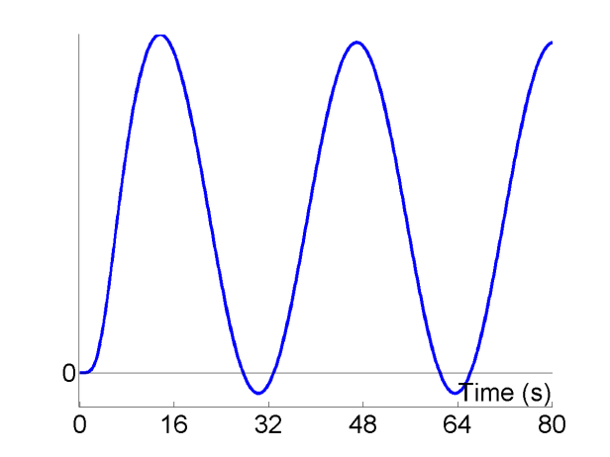
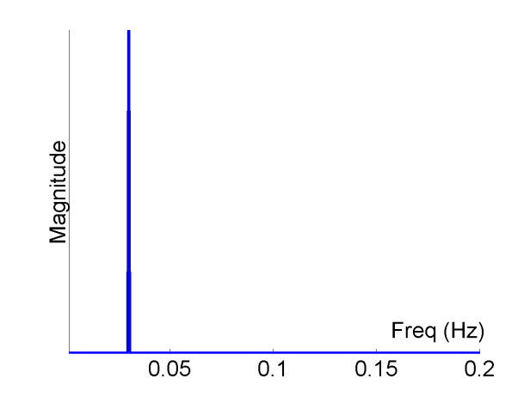
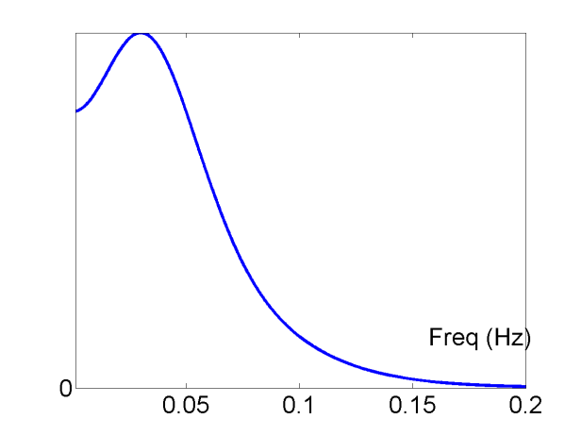
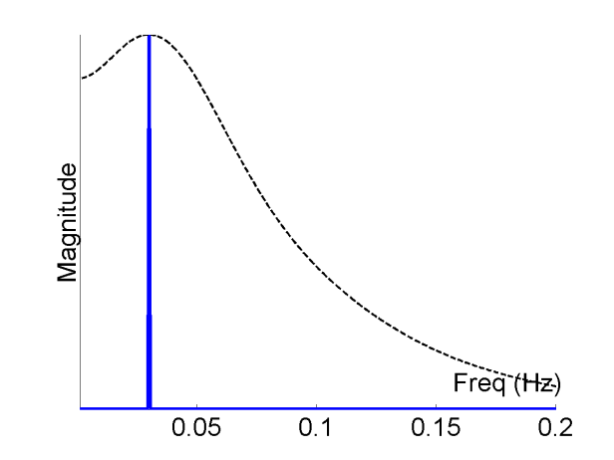
Sinusoidal modulation, f=1/32
Stimulus (“Neural”)
HRF
Predicted Data
⊗
=
=
Fourier Transform
Fourier Transform
×
=

Slide 11
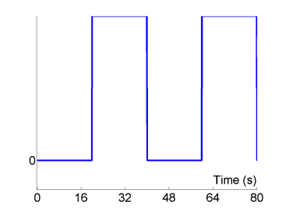
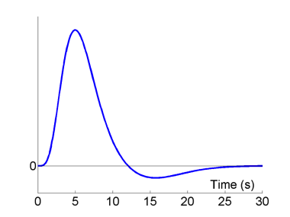
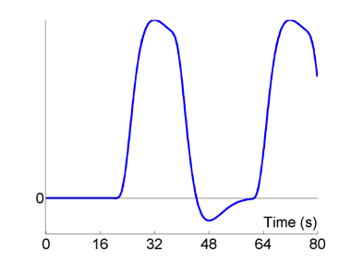
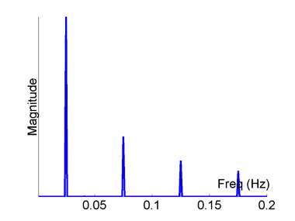
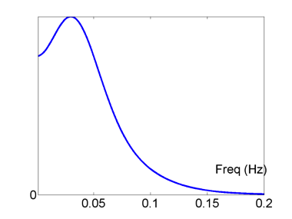
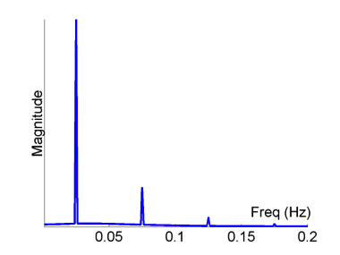
Blocked: epoch = 20s
Stimulus (“Neural”)
HRF
Predicted Data
⊗
=
Fourier Transform
Fourier Transform
×
=

Slide 12
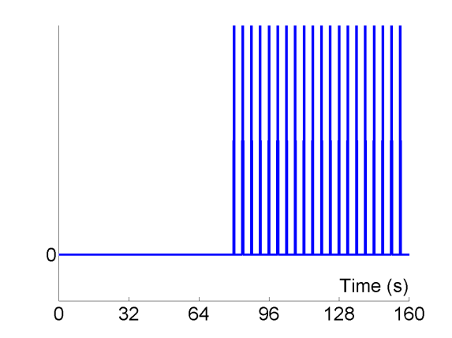
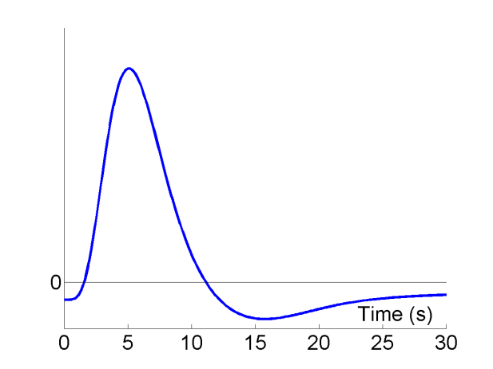
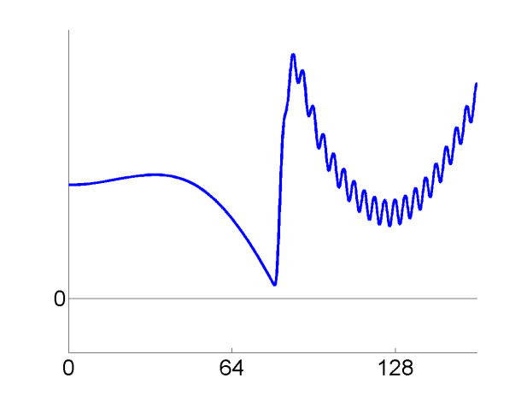
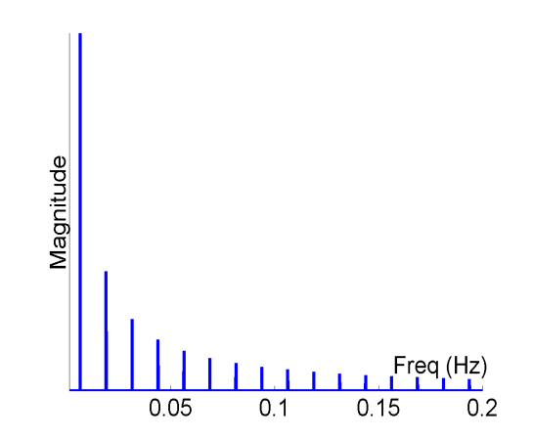
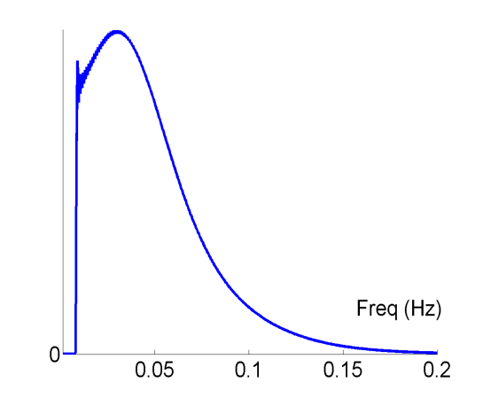
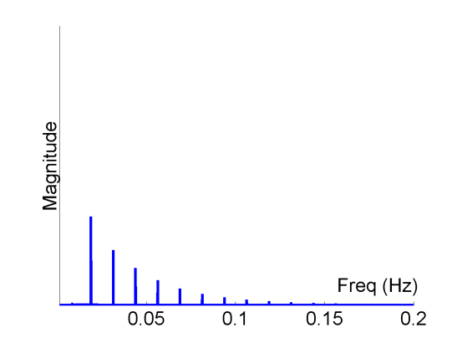
Blocked: epoch = 80s, high-pass filter = 1/120s
Stimulus (“Neural”)
HRF
Predicted Data
⊗
=
Fourier Transform
Fourier Transform
×
=

Slide 13
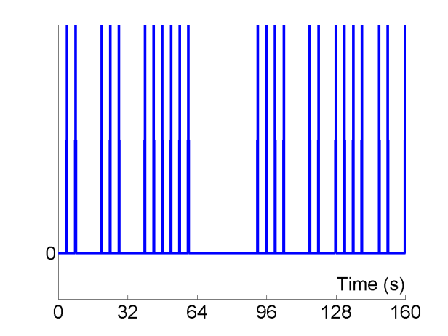

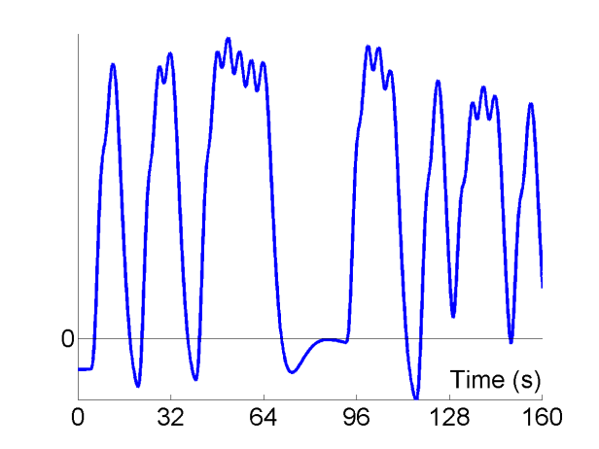
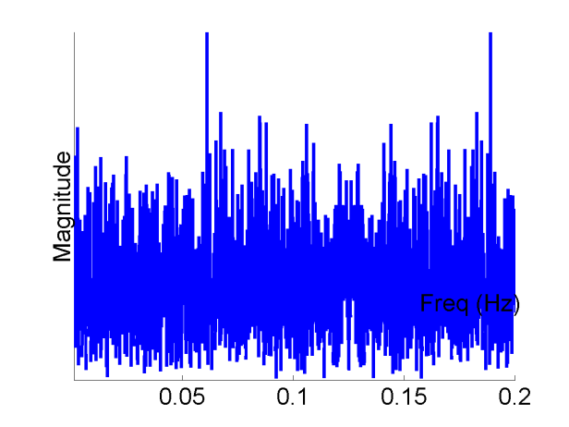
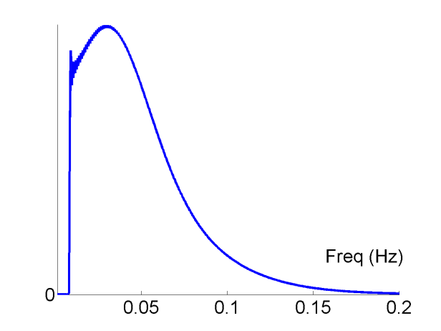
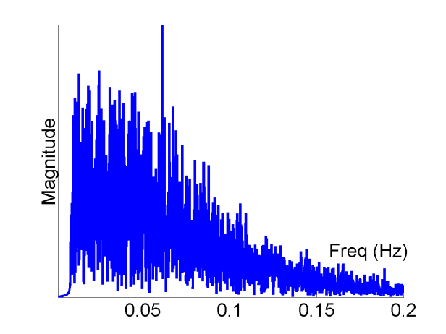
Randomised Design, SOA_{min} = 4s, high pass filter = 1/120s
Stimulus (“Neural”)
HRF
Predicted Data
⊗
=
Fourier Transform
Fourier Transform
×
=
Randomised design spreads power over frequencies

Slide 14
Design efficiency
The aim is to minimize the standard error of a t-contrast (i.e. the denominator of a t-statistic).
This is equivalent to maximizing the efficiency e:
Noise variance
Design variance
If we assume that the noise variance is independent of the specific design:
This is a relative measure: all we can really say is that one design is more efficient than another (for a given contrast).

Slide 15
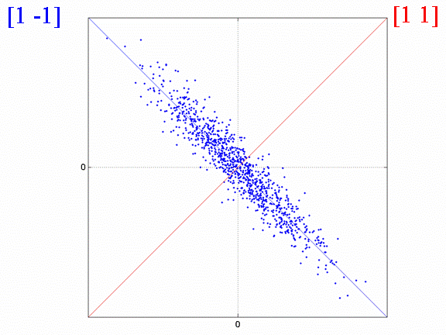

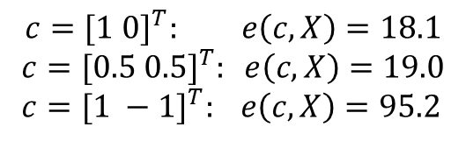
Design efficiency
A
B
$$c={[1 0]}^{T}: e\left(c,X\right)=18.1$$
$$c={[0.5 0.5]}^{T}: e\left(c,X\right)=19.0 \\ c={[1 −1]}^{T}: e\left(c,X\right)=95.2$$
$$X^{T}X=\left(\begin{matrix}1 & −0.9 \\ −0.9 & 1\end{matrix}\right)$$
A+B
A-B
High correlation between regressors leads to low sensitivity to each regressor alone.
We can still estimate efficiently the difference between them.

Slide 16
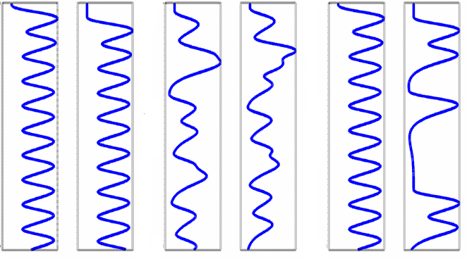
Example: working memory
A
B
C
Stimulus
Response
Stimulus
Response
Stimulus
Response
Time (s)
Time (s)
Time (s)
Correlation = -.65
Efficiency ([1 0]) = 29
Correlation = +.33
Efficiency ([1 0]) = 40
Correlation = -.24
Efficiency ([1 0]) = 47
B: Jittering time between stimuli and response.
C: Requiring a response on a randomly half of trials.

Slide 17
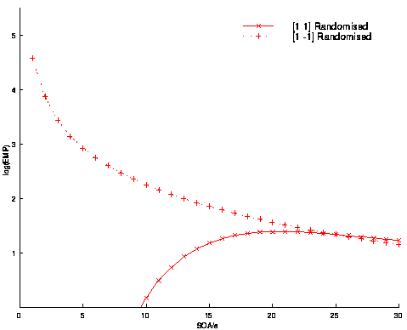
Optimising the SOA
Happy (A) vs sad (B) faces: need to know both (A-B) and (A + B)
Efficiency Example #1
Two event types, A and B
Randomly intermixed:
ABBAABABB…
Differential Effect (A-B)
Common Effect (A+B)
Efficiency
Transition matrix
 | A | B
A | 0.5 | 0.5
B | 0.5 | 0.5
SOA (s)

Slide 18
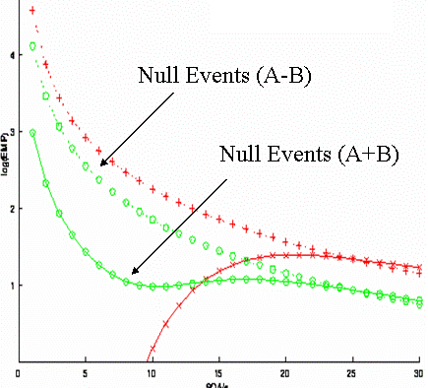
Optimising the SOA
Happy (A) vs sad (B) faces: need to know both (A-B) and (A + B)
Efficiency Example #2
Two event types, A and B
Randomly intermixed
with null events:
AB-BAA--B---ABB…
(A-B)
Efficiency
Transition matrix
(A+B)
 | A | B
A | 0.33 | 0.33
B | 0.33 | 0.33
Efficient for differential and main effects at short SOA
Equivalent to stochastic SOA
SOA (s)

Slide 19
Design efficiency
Block designs:
Generally efficient but often not appropriate.
Optimal block length 16s with short SOA
(beware of high-pass filter).
Event-related designs:
Efficiency depends on the contrast of interest
With short SOAs ‘null events’ (jittered ITI) can optimise efficiency across multiple contrasts.
Non-linear effects start to become problematic at SOA<2s
http://imaging.mrc-cbu.cam.ac.uk/imaging/DesignEfficiency

Slide 20
Multiple testing
(random field theory)
Guillaume Flandin
Wellcome Trust Centre for Neuroimaging
University College London
SPM Course
Chicago, 22-23 Oct 2015

Slide 21
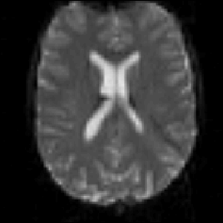
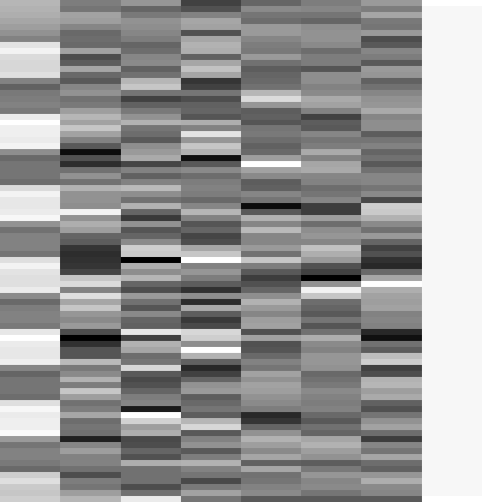
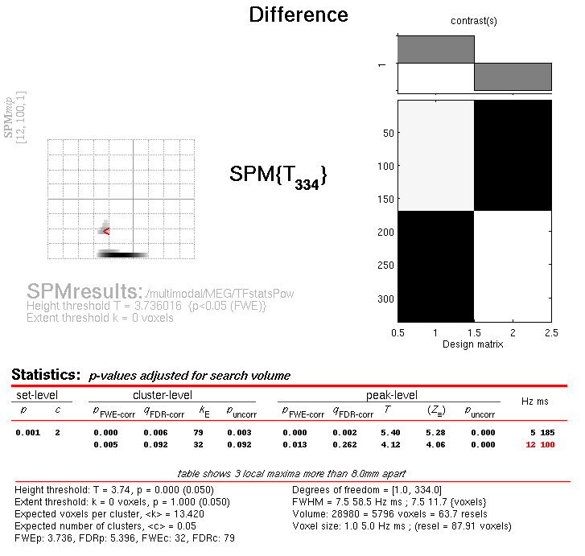
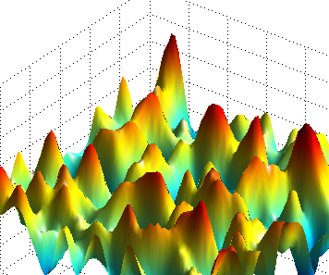
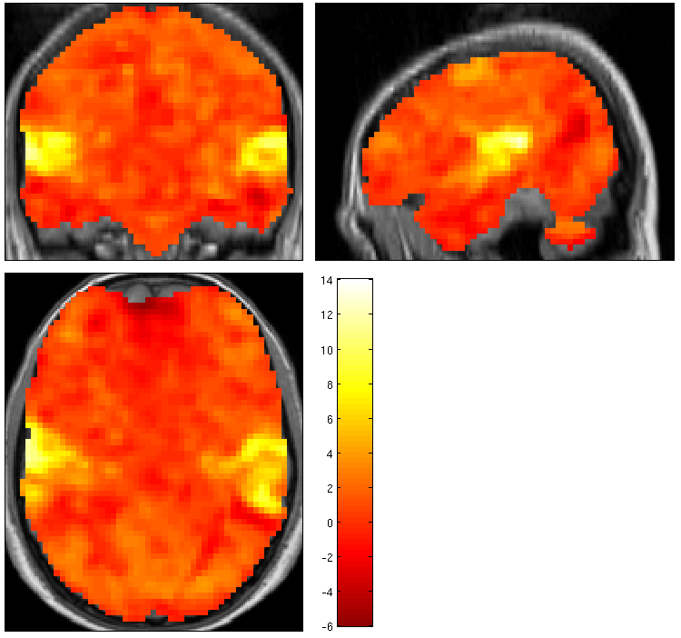
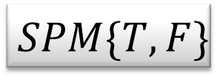
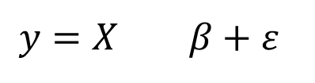


Random
Field Theory
$$y=X β+ε$$
Contrast c
Pre-
processings
General
Linear
Model
Statistical Inference
$$\hat{β}={\left(X^{T}X\right)}^{−1}X^{T}y$$
$${\hat{σ}}^{2}=\frac{{\hat{ε}}^{T}\hat{ε}}{rank(X)}$$
$$SPM\{T,F\}$$

Slide 22

Inference at a single voxel
u
Null Hypothesis H₀:
zero activation
Decision rule (threshold) u:
determines false positive
rate α
⇒ Choose u to give acceptable
α under H₀
Null distribution of test statistic T
$$α=p(t>u|H_{0})$$

Slide 23












Multiple tests
u_{α}
u_{α}
u_{α}
u_{α}
u_{α}
If we have 100,000 voxels,
α=0.05 ⇒ 5,000 false positive voxels.
This is clearly undesirable; to correct for this we can define a null hypothesis for a collection of tests.
u_{α}
α
α
t
α
t
α
t
α
t
α
t
t
Noise
Signal

Slide 24




















Multiple tests
u_{α}
u_{α}
u_{α}
u_{α}
u_{α}
If we have 100,000 voxels,
α=0.05 ⇒ 5,000 false positive voxels.
This is clearly undesirable; to correct for this we can define a null hypothesis for a collection of tests.
u_{α}
α
α
t
α
t
α
t
α
t
α
t
t
Use of ‘uncorrected’ p-value, α =0.1
11.3%
11.3%
12.5%
10.8%
11.5%
10.0%
10.7%
11.2%
10.2%
9.5%
Percentage of Null Pixels that are False Positives

Slide 25










Family-Wise Null Hypothesis
Family-Wise Null Hypothesis:
Activation is zero everywhere
If we reject a voxel null hypothesis at any voxel,
we reject the family-wise Null hypothesis
A FP anywhere in the image gives a Family Wise Error (FWE)
Family-Wise Error rate (FWER) = ‘corrected’ p-value
Use of ‘uncorrected’ p-value, α =0.1
Use of ‘corrected’ p-value, α =0.1
FWE

Slide 26


Bonferroni correction
The Family-Wise Error rate (FWER), α_{FWE}, for a family of N tests follows the inequality:
where α is the test-wise error rate.
$$α_{FWE}≤Nα$$
Therefore, to ensure a particular FWER choose:
$$α=\frac{α_{FWE}}{N}$$
This correction does not require the tests to be independent but becomes very stringent if dependence.

Slide 27


Spatial correlations
100 x 100 independent tests
Spatially correlated tests (FWHM=10)
Discrete data
Spatially extended data
Bonferroni is too conservative for spatially correlated data.

Slide 28
Topological inference
Peak level inference
Topological feature:
Peak height
intensity
space

Slide 29
Topological inference
Cluster level inference
Topological feature:
Cluster extent
intensity
u_{clus} : cluster-forming threshold
u_{clus}
space

Slide 30
Topological inference
Set level inference
Topological feature:
Number of clusters
intensity
u_{clus} : cluster-forming threshold
u_{clus}
space
c

Slide 31




RFT and Euler Characteristic
$$FWER=p\left(FWE\right)$$
$$≈ E\left[χ_{u}\right] \\ ∝λ\left(Ω\right){\left|Λ\right|}^{1/2} u exp⁡(−u^{2}/2)/{(2π)}^{3/2}$$
Roughness
(1/smoothness)
Search volume
Threshold

Slide 32

Random Field Theory
The statistic image is assumed to be a good lattice
representation of an underlying continuous stationary
random field.
Typically, FWHM > 3 voxels
(combination of intrinsic and extrinsic smoothing)
Smoothness of the data is unknown and estimated:
very precise estimate by pooling over voxels ⇒ stationarity
assumptions (esp. relevant for cluster size results).
A priori hypothesis about where an activation should be,
reduce search volume ⇒ Small Volume Correction:
  mask defined by (probabilistic) anatomical atlases
  mask defined by separate "functional localisers"
  mask defined by orthogonal contrasts
  (spherical) search volume around previously reported coordinates

Slide 33
Conclusion
There is a multiple testing problem and corrections have to be applied on p-values (for the volume of interest only (see Small Volume Correction)).
Inference is made about topological features (peak height, spatial extent, number of clusters).
Use results from the Random Field Theory.
Control of FWER (probability of a false positive anywhere in the image): very specific, not so sensitive.
Control of FDR (expected proportion of false positives amongst those features declared positive (the discoveries)): less specific, more sensitive.

Slide 34




Statistical Parametric Maps
M/EEG 2D time-frequency
fMRI, VBM,
M/EEG source reconstruction
frequency
mm
time
time
M/EEG 1D channel-time
mm
mm
M/EEG
2D+t
scalp-time
mm
mm
time

Slide 35
Group Analyses
Guillaume Flandin
Wellcome Trust Centre for Neuroimaging
University College London
SPM Course
Chicago, 22-23 Oct 2015

Slide 36



Image time-series
Spatial filter
Design matrix
Statistical Parametric Map
Realignment
Smoothing
General Linear Model
Statistical
Inference
RFT
Normalisation
Anatomical
reference
p <0.05
Parameter estimates

Slide 37









GLM: repeat over subjects
fMRI data
Design Matrix
Contrast Images
SPM{t}
Subject 1
Subject 2
…
Subject N

Slide 38


Fixed effects analysis (FFX)
Subject 1
Modelling all subjects at once
Simple model
Lots of degrees of freedom
Large amount of data
Assumes common variance over subjects at each voxel
Subject 2
Subject 3
…
Subject N

Slide 39

Fixed effects analysis (FFX)
Modelling all subjects at once
Simple model
Lots of degrees of freedom
Large amount of data
Assumes common variance over subjects at each voxel
=
+

Slide 40










Random effects
$σ_{w}^{2}$
$σ_{b}^{2}$
Probability model underlying random effects analysis

Slide 41
Fixed vs random effects
With Fixed Effects Analysis (FFX) we compare the group effect to the within-subject variability. It is not an inference about the population from which the subjects were drawn.
With Random Effects Analysis (RFX) we compare the group effect to the between-subject variability. It is an inference about the population from which the subjects were drawn. If you had a new subject from that population, you could be confident they would also show the effect.

Slide 42
Fixed vs random effects
Fixed isn’t “wrong”, just usually isn’t of interest.
Summary:
  Fixed effects inference:
  “I can see this effect in this cohort”
  Random effects inference:
  “If I were to sample a new cohort from the same
  population I would get the same result”

Slide 43
Hierarchical models
Example: Two level model
=
+
=
+
Second level
First level
Mixed-effects and fMRI studies. Friston et al., NeuroImage, 2005.

Slide 44



Summary Statistics RFX Approach
First level
Second level
fMRI data
Design Matrix
Contrast Images
One-sample t-test @ second level
Subject 1
…
Subject N
  Generalisability, Random Effects & Population Inference. Holmes & Friston, NeuroImage,1998.
Notes:
Two-stage procedure

Slide 45
Summary Statistics RFX Approach
Assumptions
The summary statistics approach is exact if for each session/subject:
  Within-subjects variances the same
  First level design the same (e.g. number of trials)
Other cases: summary statistics approach is robust against typical violations.
Mixed-effects and fMRI studies. Friston et al., NeuroImage, 2005.
Statistical Parametric Mapping: The Analysis of Functional Brain Images. Elsevier, 2007.
  Simple group fMRI modeling and inference. Mumford & Nichols. NeuroImage, 2009.
Notes:
Might use a hierarchical model in epilepsy research where number of seizures is not under experimental control and is highly variable over subjects.
Balanced designs

Slide 46
ANOVA & non-sphericity
One effect per subject:
  Summary statistics approach
  One-sample t-test at the second level
More than one effect per subject or multiple groups:
  Non-sphericity modelling
  Covariance components and ReML

Slide 47
Summary
Group Inference usually proceeds with RFX analysis, not FFX. Group effects are compared to between rather than within subject variability.
Hierarchical models provide a gold-standard for RFX analysis but are computationally intensive.
Summary statistics approach is a robust method for RFX group analysis.
Can also use ‘ANOVA’ or ‘ANOVA within subject’ at second level for inference about multiple experimental conditions or multiple groups.

Slide 48








One-sample t-test
Two-sample t-test
Paired t-test
One-way ANOVA
One-way ANOVA within-subject
Full Factorial
Flexible Factorial
Flexible Factorial

Slide 49
2x2 factorial design
Color
1
2
A1
A2
B1
B2
A
Shape
B
Main effect of Shape:
(A1+A2) – (B1+B2) : 1 1 -1 -1
Main effect of Color:
(A1+B1) – (A2+B2) : 1 -1 1 -1
Interaction Shape x Color:
(A1-B1) – (A2-B2) : 1 -1 -1 1

Slide 50
2x3 factorial design
Color
1
2
3
A1
A2
A3
B1
B2
B3
A
Shape
B
Main effect of Shape:
(A1+A2+A3) – (B1+B2+B3) : 1 1 1 -1 -1 -1
Main effect of Color:
(A1+B1) – (A2+B2) : 1 -1 0 1 -1 0
(A2+B2) – (A3+B3) : 0 1 -1 0 1 -1
(A1+B1) – (A3+B3) : 1 0 -1 1 0 -1
Interaction Shape x Color:
(A1-B1) – (A2-B2) : 1 -1 0 -1 1 0
(A2-B2) – (A3-B3) : 0 1 -1 0 -1 1
(A1-B1) – (A3-B3) : 1 0 -1 -1 0 1

