Slide 1
The M/EEG inverse problem and solutions
Gareth R. Barnes

Slide 2
Format
The inverse problem
Choice of prior knowledge in some popular algorithms
Why the solution is important.

Slide 3
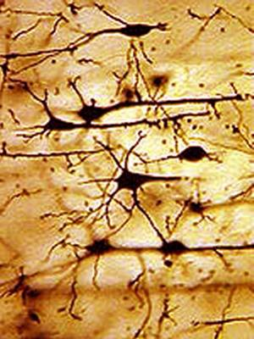
Magnetic field
MEG pick-up coil
Electrical potential difference (EEG)
scalp
skull
cortex
Volume currents
5-10nAm
Aggregate post-synaptic potentials
of ~10,000 pyrammidal neurons

Slide 4
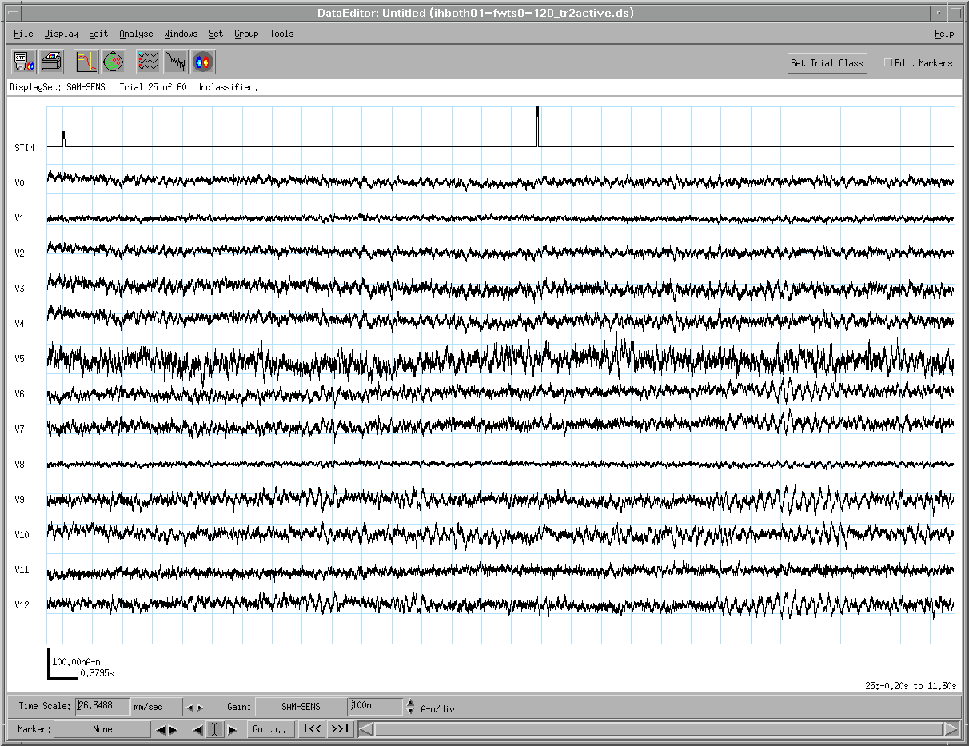
MEG measurement
What we’ve got
Forward problem
Inverse problem
pick-up coils
1pT
Active
Passive
Local field potential (LFP)
1nAm
1s
What we want

Slide 5
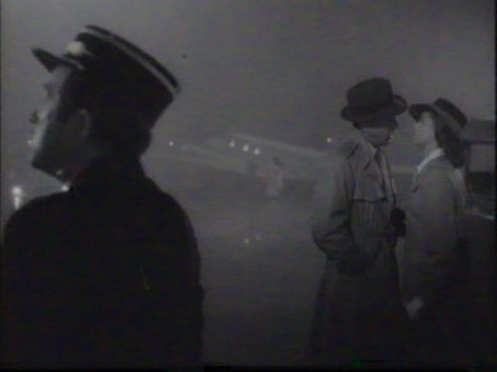

Slide 6
Useful priors cinema audiences
Things further from the camera appear smaller
People are about the same size
Planes are much bigger than people

Slide 7
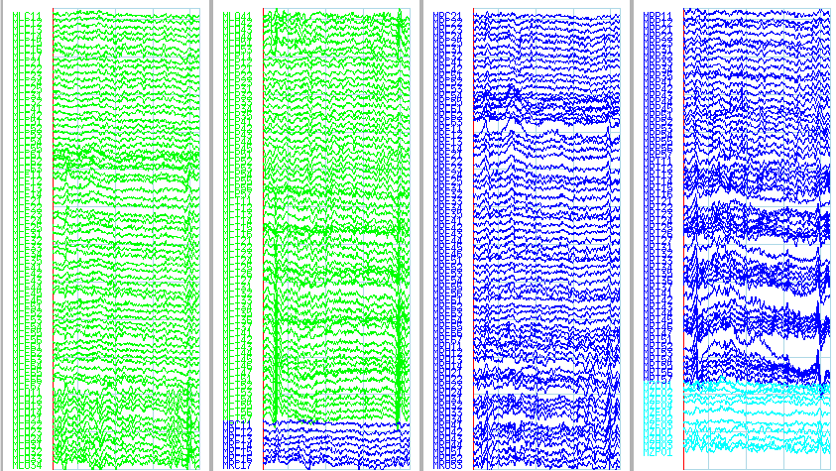
Where does the data come from ?
1pT
1s

Slide 8
Useful priors for MEG analysis
At any given time only a small number of sources are active. (dipole fitting)
All sources are active but overall their energy is minimized. (Minimum norm)
As above but there are also no correlations between distant sources (Beamformers)

Slide 9
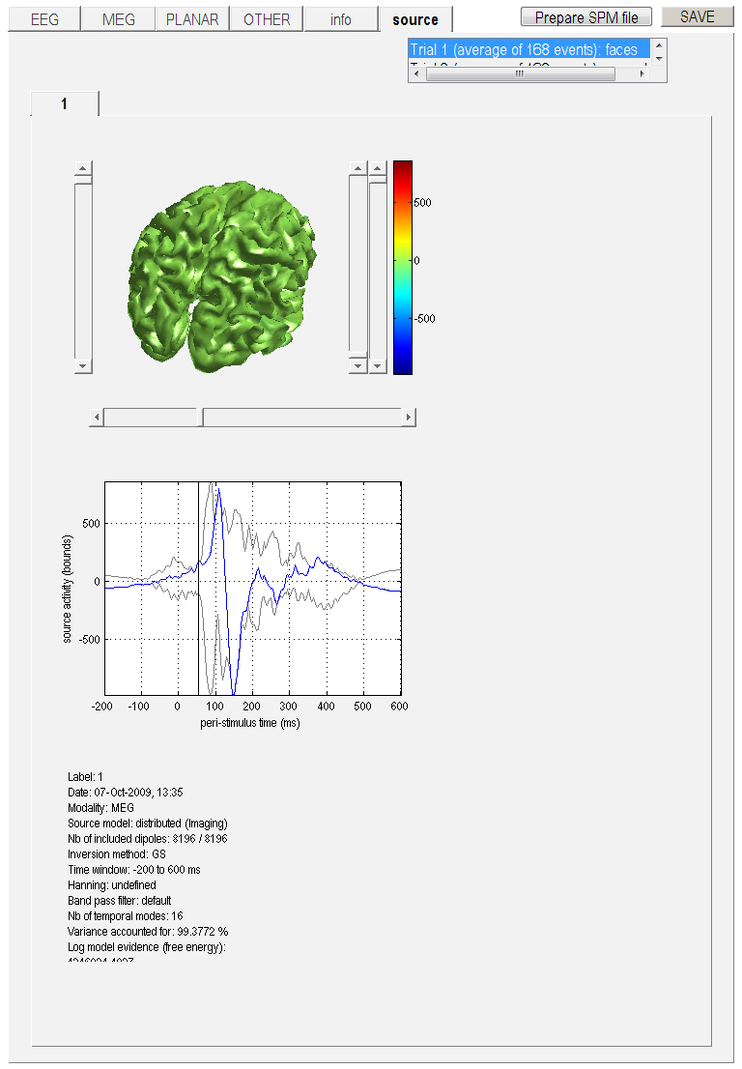
The source covariance matrix
Source number
Source number

Slide 10
Dipole Fitting
Estimated position
Estimated data
Measured data
?

Slide 11
Dipole fitting
Estimated data/
Channel covariance matrix
Measured data/
Channel covariance
Prior source covariance
True source covariance

Slide 12
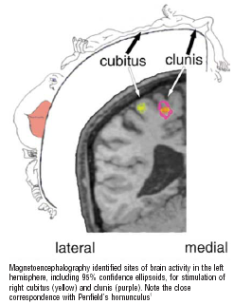
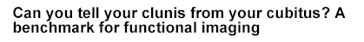
Dipole fitting
Effective at modelling short (<200ms) latency evoked responses
Clinically very useful: Pre-surgical mapping of sensory /motor cortex ( Ganslandt et al 1999)
Need to specify number of dipoles (but see Kiebel et al. 2007), non-linear minimization becomes unstable for more sources.
Fisher et al. 2004

Slide 13
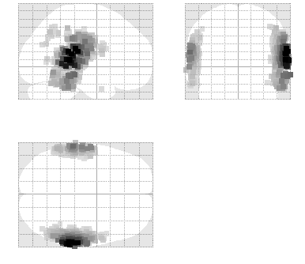
Minimum norm
- allow all sources to be active, but keep energy to a minimum
Solution
True
(Single
Dipole)
Prior

Slide 14
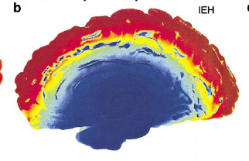
Problem is that superficial elements have much larger lead fields
Basic Minimum norm solutions
Solutions are diffuse and have superficial bias
(where source power can be smallest).
But unlike dipole fit, no need to specify the
number of sources in advance.
Can we extend the assumption set ?
MEG sensitivity

Slide 15
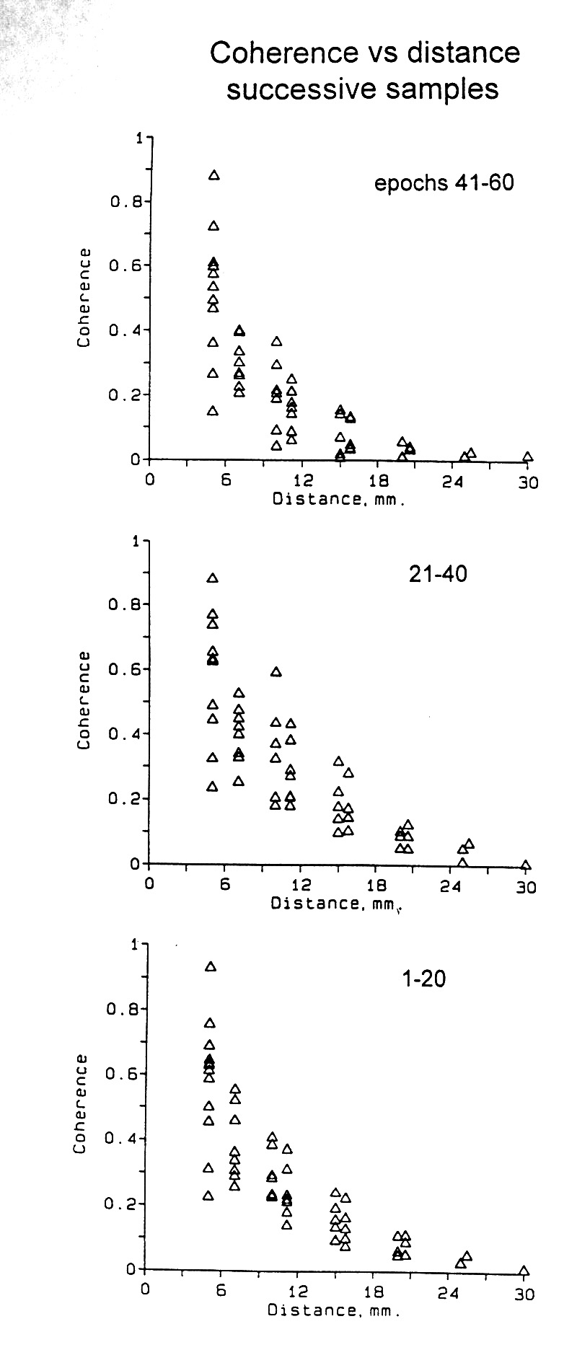
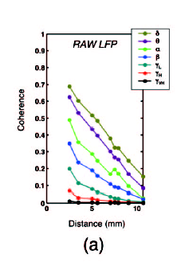
Cortical oscillations have local domains
0 0.5 1.0
8-13Hz band
Coherence
“We have managed to check the alpha band rhythm with intra-cerebral electrodes in the occipital-parietal cortex; in regions which are practically adjacent and almost congruent one finds a variety of alpha rhythms, some are blocked by opening and closing the eyes, some are not, some respond in some way to mental activity, some do not.” Grey Walter 1964
0 12 24 30mm
Distance
Bullock et al. 1989
Leopold et al. 2003.

Slide 16
Beamformer: if you assume no correlations between sources, can calculate a prior covariance matrix from the data
True
Prior,
Estimated
From data

Slide 17
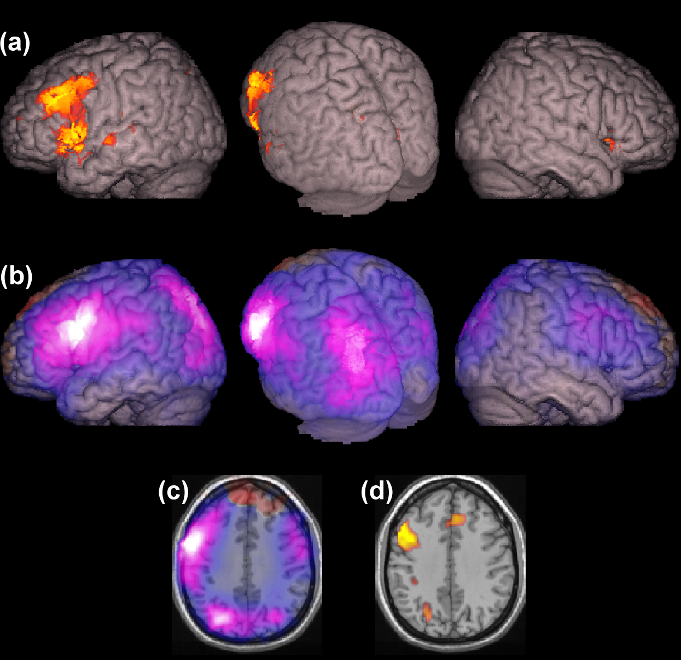
Oscillatory changes are co-located with haemodynamic changes
fMRI
Beamformers
Robust localisation of induced changes,
not so good at evoked responses.
Excellent noise immunity.
Clincally also very useful
(Hirata et al. 2004; Gaetz et al. 2007)
But what happens if there are correlated
sources ?
MEG composite
Singh et al. 2002

Slide 18
Beamformer for correlated sources
True Sources
Prior
(estimated
from data)

Slide 19
Dipole fitting
Estimated data/
Channel covariance matrix
Measured data/
Channel covariance
Prior source covariance
?
True source covariance

Slide 20
Multiple Sparse Priors (MSP)
True
P(λ)
λ
-4
e^{λ1}
+
Priors
e^{λ2}
e^{λn}
Estimated (based on data)
= sensitivity (lead field matrix)
(Covariance estimates are made in channel space)

Slide 21
Accuracy
Free Energy
Compexity

Slide 22
Can use model evidence to choose between solutions
Free energy

Slide 23
So it is possible, but why bother ?

Slide 24
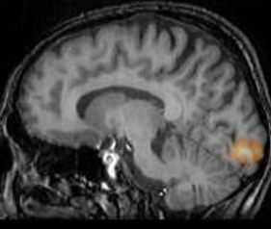
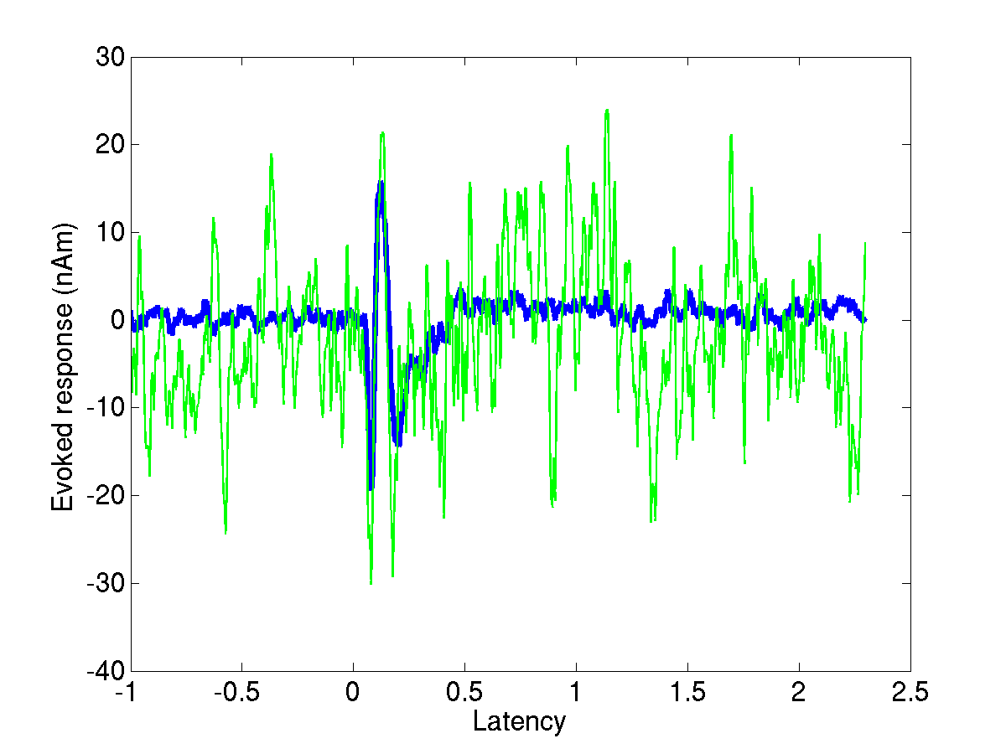
Correct inversion algorithm
Stimulus(3cpd,1.5º)
Single trial data
Correct location information
Correct unmixing of sensor data = best estimate of source level time series
Higher SNR (~ sqrt (Nchans))
Duncan et al . 2010

Slide 25
Conclusion
MEG inverse problem can be solved.. If you have some prior knowledge.
All prior knowledge encapsulated in a source covariance matrix
Can test between priors in a Bayesian framework.
Exciting part is the millisecond temporal resolution we can now exploit.

Slide 26
Thanks to
Vladimir Litvak
Will Penny
Jeremie Mattout
Guillaume Flandin
Tim Behrens
Karl Friston and methods group

