Slide 1

Group analysis
Kherif Ferath
Wellcome Trust Centre for Neuroimaging
University College London
SPM Course
London, Oct 2010

Slide 2



GLM : individual level
Image time-series
Spatial filter
Design matrix
Statistical Parametric Map
Realignment
Smoothing
General Linear Model
Statistical
Inference
RFT
Normalisation
Anatomical
reference
p <0.05
Parameter estimates

Slide 3
GLM : individual level
=
+
Error Covariance
Model is specified by
Design matrix X
Assumptions about ε
N: number of scans
p: number of regressors

Slide 4
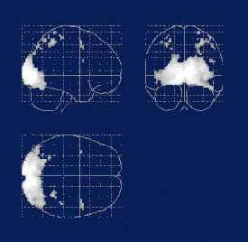
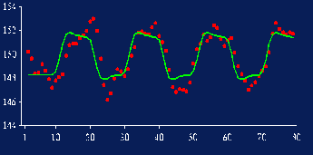
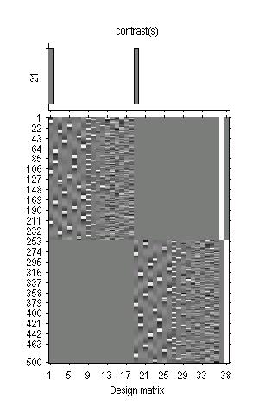
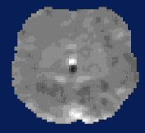
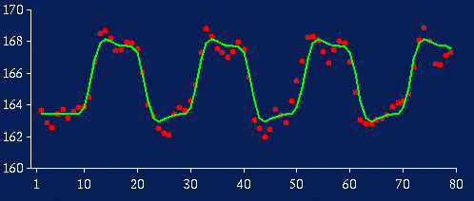
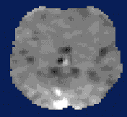
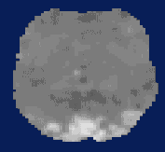
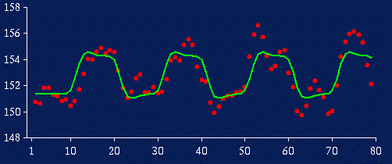
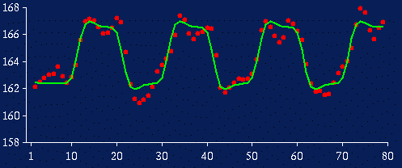
GLM : Several individuals
SPM(t)
Data Design Matrix Contrast Images

Slide 5
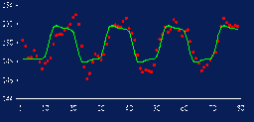
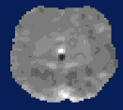
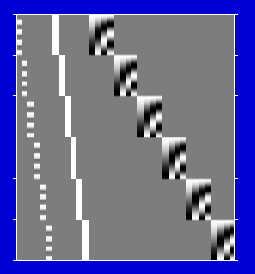

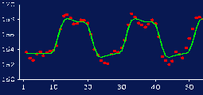
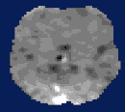
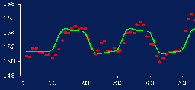
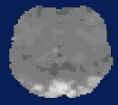
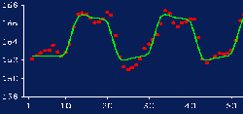
Fixed effect
SPM(t)
subj. 1
subj. 2
subj. 3
Grand GLM approach
(model all subjects at once)

Slide 6
Fixed effect modelling in SPM
Fixed effect
Grand GLM approach
(model all subjects at once)
Good:
  max dof
  simple model
subj. 1
subj. 2
subj. 3

Slide 7

Fixed effect
Grand GLM approach
(model all subjects at once)
Bad:
  assumes common variance
  over subjects at each voxel
=
+

Slide 8
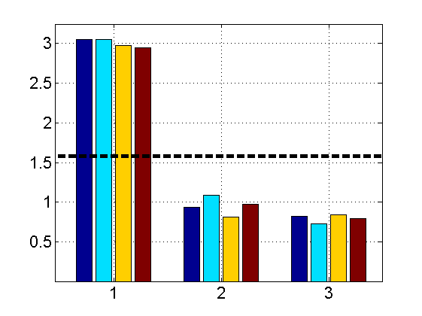
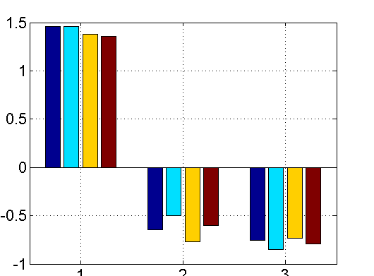
Fixed effect
Between subjects variability
RTs: 3 subjects, 4 conditions
Standard GLM
assumes only one source
of i.i.d. random variation
But, in general, there are at least two sources:
  within subj. variance
  between subj. variance
Causes dependences in ε
subject 1
subject 2
subject 3
residuals
subject 1
subject 2
subject 3

Slide 9
Lexicon
Hierarchical models
Mixed effect models
Random effect (RFX) models
Components of variance
… all the same
… all alluding to multiple sources of variation
(in contrast to fixed effects)

Slide 10
Hierarchical model
Hierarchical model
Multiple variance components at each level
At each level, distribution of parameters is given by level above.
What we don’t know: distribution of parameters and variance parameters.

Slide 11
Hierarchical model
Example: Two level model
=
+
=
+
Second level
First level

Slide 12
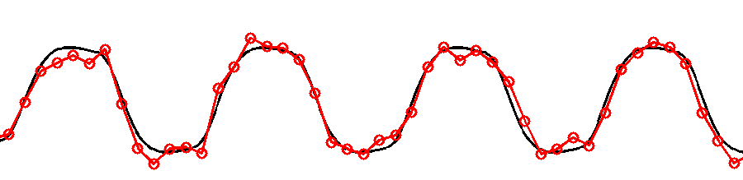
Fixed effect
Only source of variation (over sessions)
is measurement error
True response magnitude is fixed

Slide 13
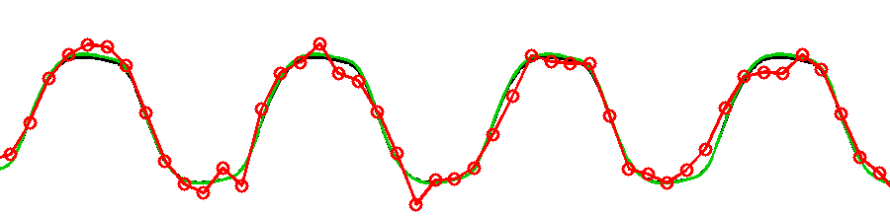
Random effects
Two sources of variation
measurement errors + response magnitude (over subjects)
Response magnitude is random
  each subject/session has random magnitude
  but note, population mean magnitude is fixed

Slide 14
Fixed vs random effects
Distributions of
each subject’s
estimated effect
σ²_{FFX}
Fixed effects:
Intra-subjects variation
suggests all these subjects
different from zero
Random effects:
Inter-subjects variation
suggests population
not different from zero
subj. 1
subj. 2
subj. 3
subj. 4
subj. 5
subj. 6
0
σ²_{RFX}
Distribution of
population effect

Slide 15
Group analysis in practice
Many 2-level models are just too big to compute.
And even if, it takes a long time!
Is there a fast approximation?

Slide 16
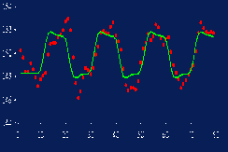
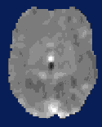
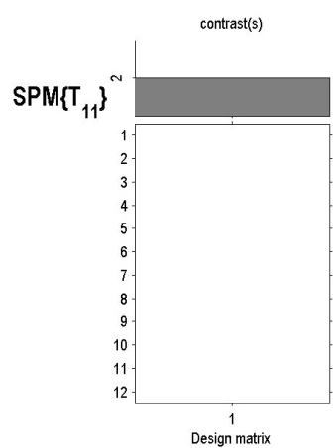
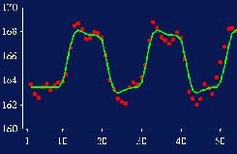


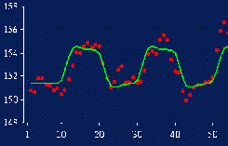
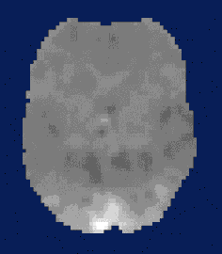
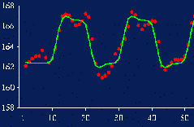
Summary Statistics approach
First level
Data Design Matrix Contrast Images
SPM(t)
Second level

Slide 17
Summary Statistics approach
Procedure:
  Fit GLM for each subject i
  and compute contrast estimate (first level)
  Analyze (second level)
1- or 2- sample t test on contrast image
  intra-subject variance not used

Slide 18
Assumptions
Summary Statistics approach
Distribution
  Normality
  Independent subjects
Homogeneous variance:
  Residual error the same for all subjects
  Balanced designs

Slide 19
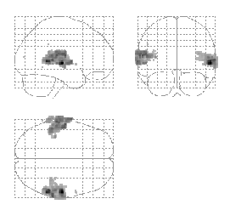

Robustness
Summary Statistics approach
Summary
statistics
Hierarchical
Model
Friston et al. (2004) Mixed effects and fMRI studies, Neuroimage

Slide 20
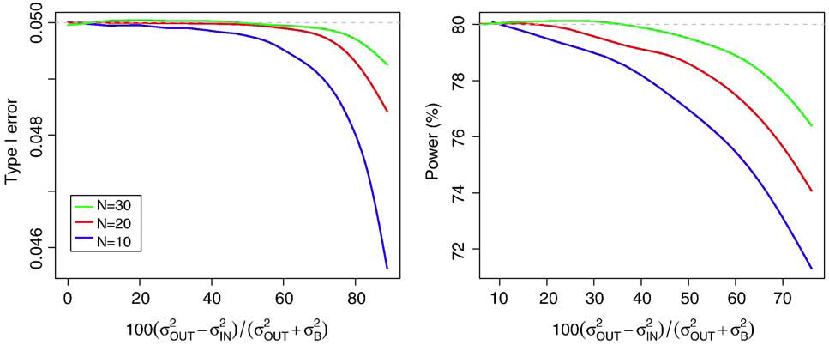
HF approach: robustness
In practice, validity and efficiency are excellent
  For 1-sample case, HF impossible to break
  Mumford & Nichols. Simple group fMRI modeling and inference. Neuroimage, 47(4):1469--1475, 2009.
2-sample and correlation might give trouble
  Dramatic imbalance and/or heteroscedasticity

Slide 21
Non sphericity modelling – basics
1 effect per subject
  Summary statistics approach
>1 effects per subject
  non sphericity modelling
  Covariance components and ReML

Slide 22
Example 1: data
Stimuli:
  Auditory presentation (SOA = 4 sec)
  250 scans per subject, block design
  Words, e.g. “book”
  Words spoken backwards, e.g. “koob”
Subjects:
  12 controls
  11 blind people

Slide 23
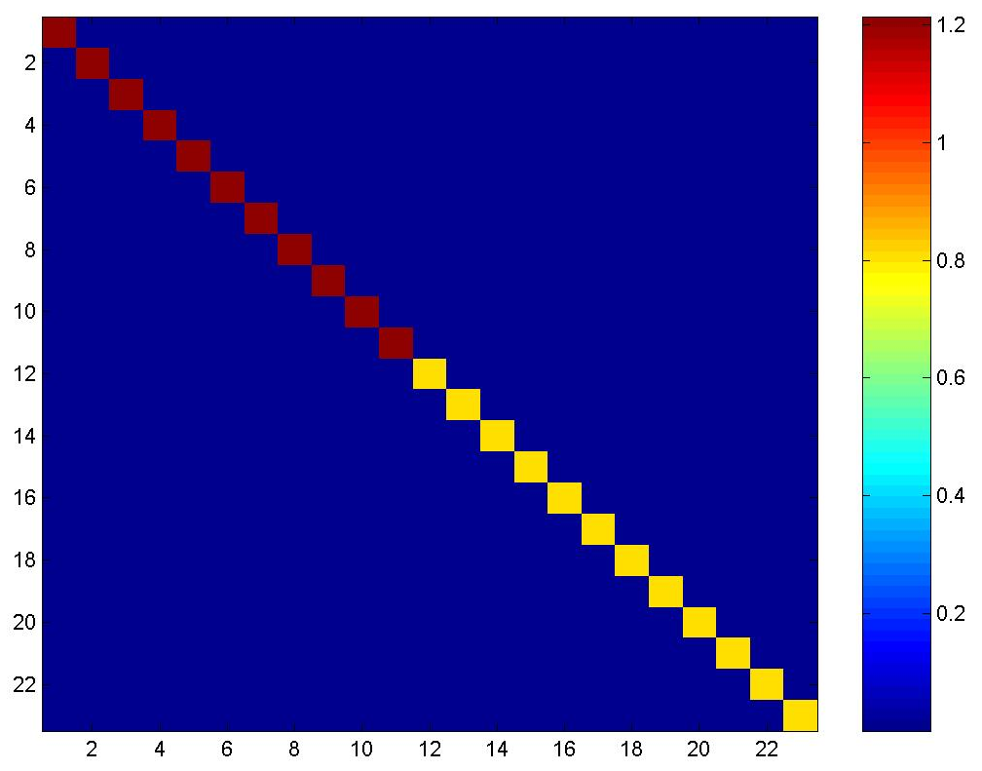
Multiple covariance components (I)
E.g., 2-sample t-test
  Errors are independent
  but not identical.
  2 covariance components
Q_{k}’s:
residuals covariance matrix

Slide 24
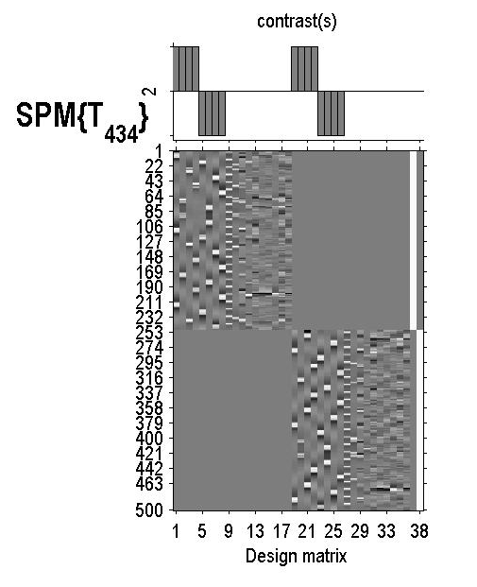


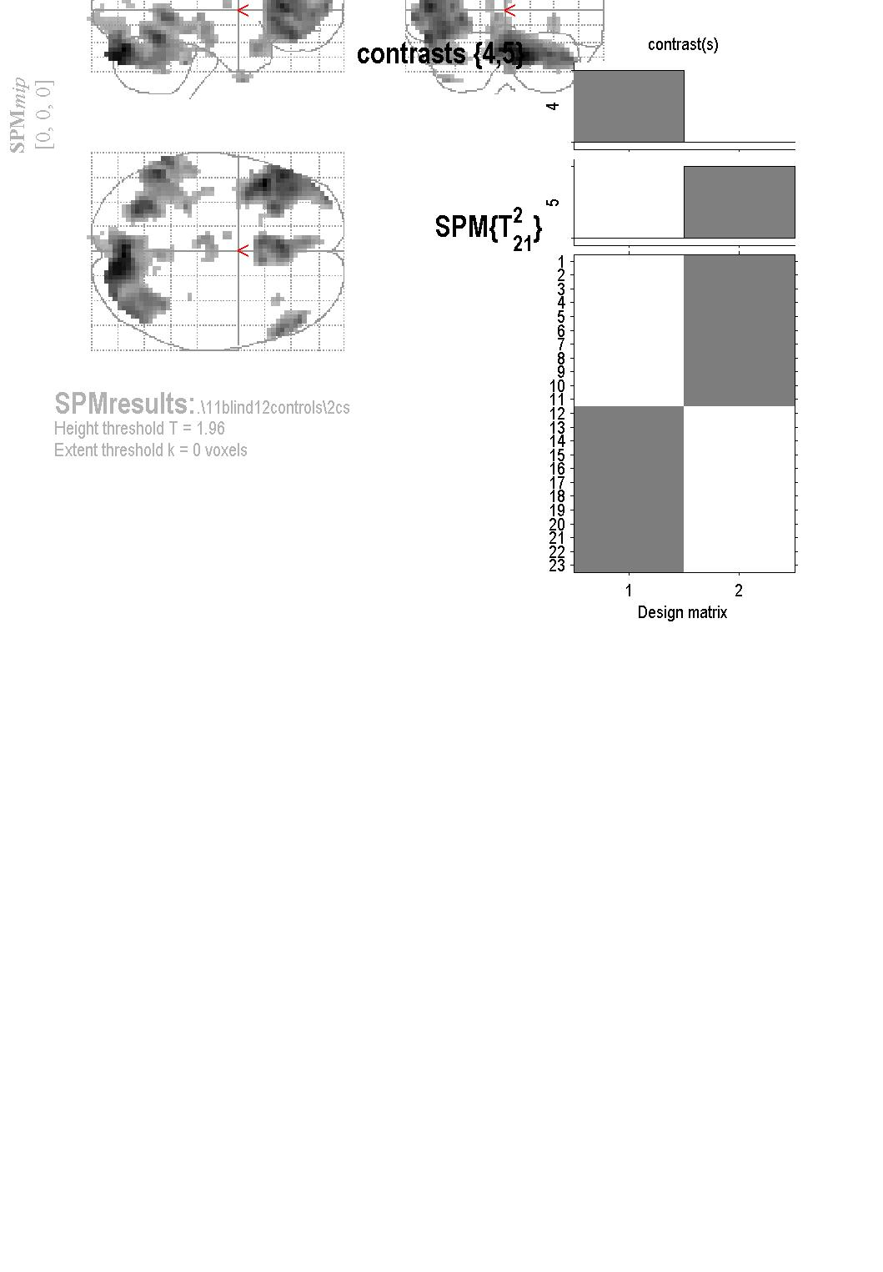
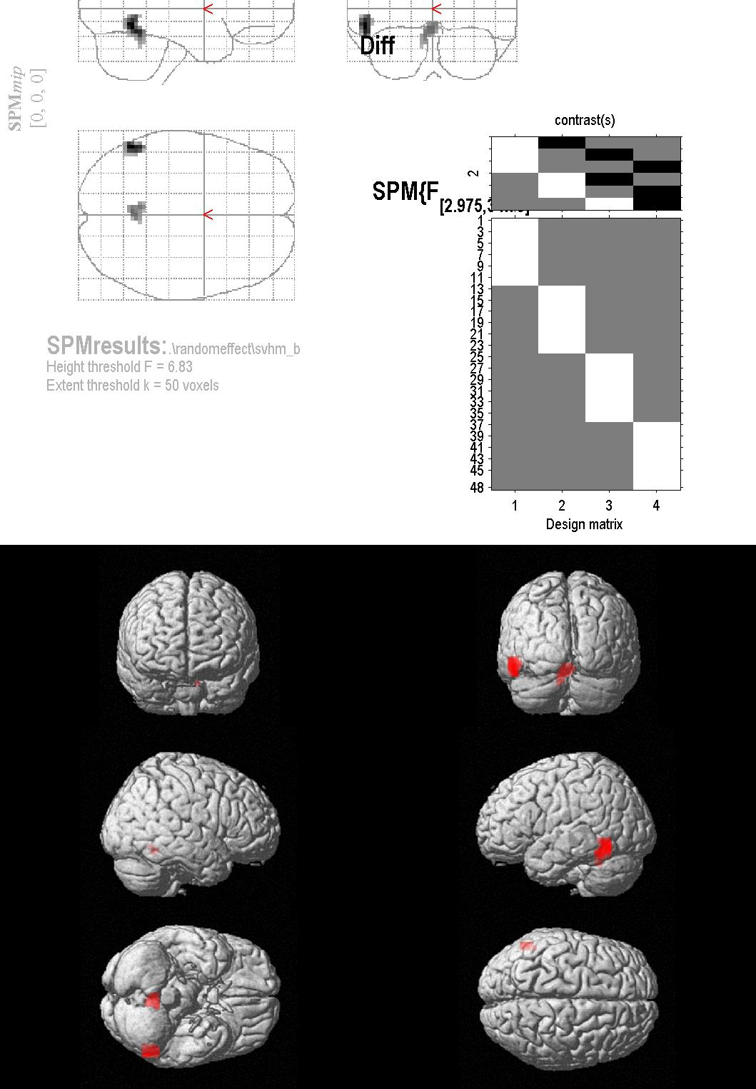
Example 1: population differences
controls
blinds
1st level
2nd level
design matrix

Slide 25
Example 2
Stimuli:
  Auditory presentation (SOA = 4 sec)
  250 scans per subject, block design
  Words:
Subjects:
  12 controls
Motion
Sound
Visual
Action
“jump”
“click”
“pink”
“turn”
Question:
  What regions are affected by the semantic content of the words?

Slide 26
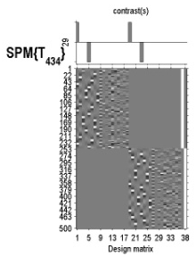
Example 2: repeated measures ANOVA
1: motion
2: sounds
3: visual
4: action
1st level
2nd level
?
=
?
=
?
=

Slide 27
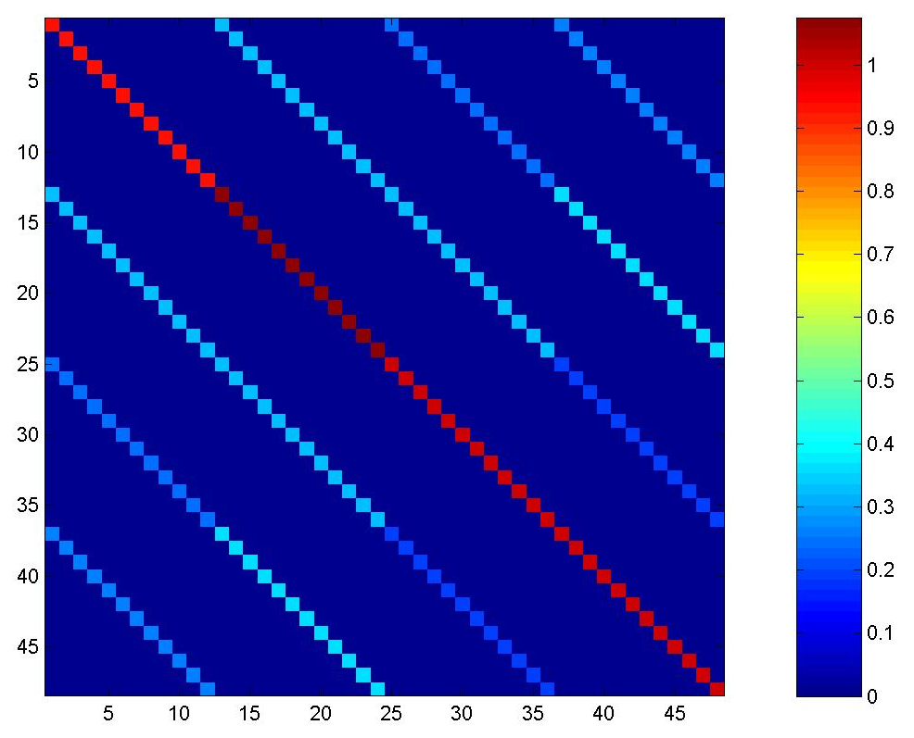
Multiple covariance components (II)
residuals covariance matrix
Errors are not independent
and not identical
Q_{k}’s:

Slide 28

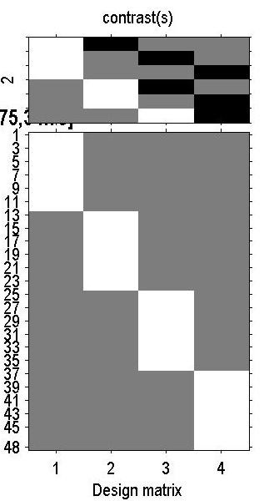

Example 2: repeated measures ANOVA
1: motion
2: sounds
3: visual
4: action
1st level
2nd level
?
=
?
=
?
=
design matrix

Slide 29
Fixed vs random effects
Fixed isn’t “wrong”, just usually isn’t of interest
Summary:
  Fixed effect inference:
  “I can see this effect in this cohort”
  Random effect inference:
  “If I were to sample a new cohort from the same
  population I would get the same result”

Slide 30
Group analysis: efficiency and power
Efficiency = 1/ [estimator variance]
  goes up with n (number of subjects)
  c.f. “experimental design” talk
Power = chance of detecting an effect
  goes up with degrees of freedom (dof = n-p).

Slide 31
Overview
Group analysis: fixed versus random effects
Two RFX methods:
  summary statistics approach
  non-sphericity modelling
Examples

Slide 32
HF approach: efficiency & validity
If assumptions true
  Optimal, fully efficient
  Exact p-values
If σ²_{FFX} differs btw subj.
  Reduced efficiency
  Biased σ²_{RFX}
  Liberal dof
  (here 3 subj. dominate)
subj. 1
subj. 2
subj. 3
subj. 4
subj. 5
subj. 6
0
σ²_{RFX}

Slide 33
Overview
Group analysis: fixed versus random effects
Two RFX methods:
  summary statistics approach
  non-sphericity modelling
Examples

Slide 34

Bibliography:
Statistical Parametric Mapping: The Analysis of Functional Brain Images. Elsevier, 2007.
  Generalisability, Random Effects & Population Inference.
  Holmes & Friston, NeuroImage,1999.
Classical and Bayesian inference in neuroimaging: theory.
Friston et al., NeuroImage, 2002.
Classical and Bayesian inference in neuroimaging: variance component estimation in fMRI.
Friston et al., NeuroImage, 2002.
  Simple group fMRI modeling and inference.
  Mumford & Nichols, Neuroimage, 2009.
With many thanks to G. Flandin, J.-B. Poline and Tom Nichols for slides.

