Slide 1
Multiple testing
Justin Chumbley
Laboratory for Social and Neural Systems Research
Institute for Empirical Research in Economics
University of Zurich
With many thanks for slides & images to:
FIL Methods group

Slide 2



Overview of SPM
Image time-series
Kernel
Design matrix
Statistical parametric map (SPM)
Realignment
Smoothing
General linear model
Statistical
inference
Gaussian
field theory
Normalisation
p <0.05
Template
Parameter estimates
Notes:
Describe thresholded images
One number for each spatial location (that gives the estimated effect size).
Two schools: 1) decide on voxels 2) decide on regions/blobs
(voxels are arbitrary in number and location, and smoothing means that effects are blurred and don’t really have voxel resolution).

Slide 3
Inference at a single voxel
t
contrast of
estimated
parameters
t =
variance
estimate
Notes:
SURPRISING HIGH UNDER THE NULL? → p-value …
SURPRISING HEIGHT, EXTENT NUMBER under the null.. (RFT)

Slide 4
Inference at a single voxel
H₀ , H₁: zero/non-zero activation
α
t
contrast of
estimated
parameters
t =
variance
estimate

Slide 5
Inference at a single voxel
Decision:
H₀ , H₁: zero/non-zero activation
h
α
t
contrast of
estimated
parameters
t =
variance
estimate
Notes:
Aim: Deciding which dn the data came from
How? Decision rule

Slide 6
Inference at a single voxel
Decision:
H₀ , H₁: zero/non-zero activation
h
α
t
contrast of
estimated
parameters
t =
variance
estimate
Notes:
LIKE THROWING A DICE. YOU CAN CONTROL THE FALSE POSITIVE RATE.

Slide 7
Multiple tests
h
h
h
h
What is the problem?
α
α
α
α
t
t
t
contrast of
estimated
parameters
t =
variance
estimate
Notes:
LIKE THROWING A DICE. YOU CAN CONTROL THE FALSE POSITIVE RATE.

Slide 8
Multiple tests
h
h
h
h
α
α
α
α
t
t
t
contrast of
estimated
parameters
t =
variance
estimate
Notes:
LIKE THROWING A DICE. YOU CAN CONTROL THE FALSE POSITIVE RATE.

Slide 9
Multiple tests
h
h
h
h
α
α
α
α
t
t
t
Convention: Choose h to limit
assuming family-wise H₀
contrast of
estimated
parameters
t =
variance
estimate
Notes:
LIKE THROWING A DICE. YOU CAN CONTROL THE FALSE POSITIVE RATE.
Assume tests are spatially independent, which in turn assumes measurement errors are spatially independent

Slide 10
Smooth errors: the facts
intrinsic smoothness
  MRI signals are aquired in k-space (Fourier space); after projection on anatomical space, signals have continuous support
  diffusion of vasodilatory molecules has extended spatial support
extrinsic smoothness
  resampling during preprocessing
  matched filter theorem
  → deliberate additional smoothing to increase SNR
→ Model errors as Gaussian random fields

Slide 11
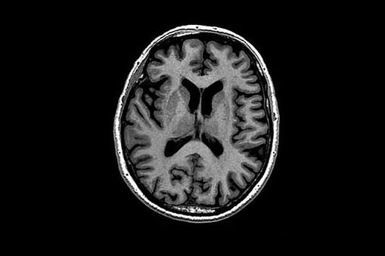
Notes:
Anticipate the conclusions…
Powerful tests on which regions are active in response to a stimulus…
Measures of relative activity between regions…
Theory of continuous random fields can assist in these aims.
Defining region: not a priori or a priori>
Defining error.
Which are real which false
Executive summaries
What is the problem
Present the conclusions first…

Slide 16
Notes:
Anticipate the conclusions…
Powerful tests on which regions are active in response to a stimulus…
Measures of relative activity between regions…
Theory of continuous random fields can assist in these aims.
Defining region: not a priori or a priori>
Defining error.
Which are real which false
Executive summaries
What is the problem
Present the conclusions first…

Slide 17
Notes:
If there was no effect, in the absence of confounds like scanner drift…

Slide 22
Surprising qualitative features in this landscape?
Notes:
… in this landscape…
(forget about voxels)
How would I answer this?

Slide 23
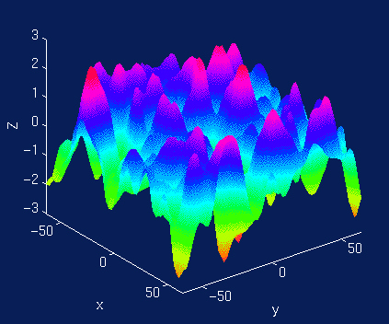
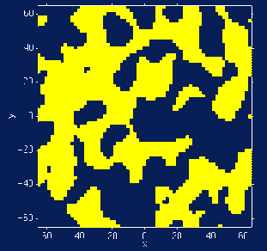
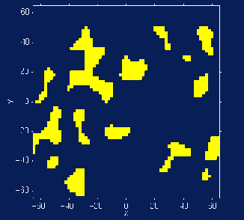
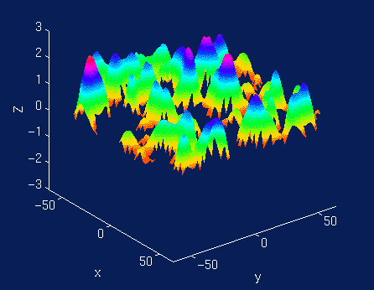
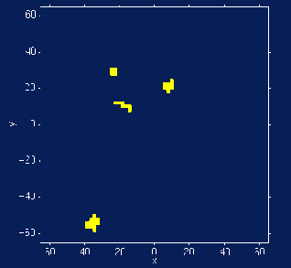
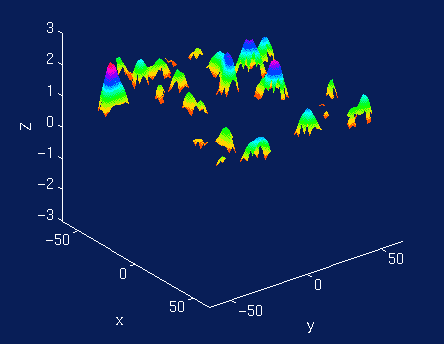
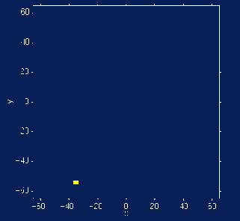
Notes:
Two surprising features!
Two thresholds!

Slide 24
Height
Spatial extent
Location
Total number
Notes:
Two surprising features!
Two thresholds!

Slide 25
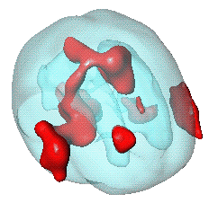
Number of regions, Q?
General form for expected Euler characteristic
    χ², F, & t fields
    restricted search regions
    <Q ; h> = _{Σ} R_{d} (Ω) ρ_{d} (h)
A_{u}
Ω
R_{d} (Ω): RESEL count; depends on
the search region – how big, how
smooth, what shape ?
ρ_{d} (h): EC density; depends on
type of field (eg. Gaussian, t) and the
threshold, h.
Worsley et al. (1996), HBM

Slide 26
Number of regions, Q?
General form for expected Euler characteristic
    χ², F, & t fields
    restricted search regions
    <Q ; h> = _{Σ} R_{d} (Ω) ρ_{d} (h)
A_{u}
Ω
R_{d} (Ω): RESEL count
R₀(Ω) = χ(Ω) Euler characteristic of Ω
R₁(Ω) = resel diameter
R₂(Ω) = resel surface area
R₃(Ω) = resel volume
ρ_{d} (h): d-dimensional EC density –
E.g. Gaussian RF:
ρ₀(h) = 1- Φ(u)
ρ₁(h) = (4 ln2)^{1/2} exp(-u²/2) / (2π)
ρ₂(h) = (4 ln2) exp(-u²/2) / (2π)^{3/2}
ρ₃(h) = (4 ln2)^{3/2} (u² -1) exp(-u²/2) / (2π)²
ρ₄(h) = (4 ln2)² (u³ -3u) exp(-u²/2) / (2π)^{5/2}
Worsley et al. (1996), HBM

Slide 27
Size of a region, S?
height, h
Space
Notes:
Exceedence probability

Slide 28
Location of events?
‘Poisson clumping heuristic’
  high maxima locations follow a spatial Poisson process.
Number of events: Poisson distributed,
under high thresholds (Adler & Hasofer, 1981).
Space
Notes:
Cortical, subcortical left, right

Slide 29
Location of events?
‘Poisson clumping heuristic’
  high maxima locations follow a spatial Poisson process - Thinned
Number of events: Poisson distributed,
under high thresholds (Adler & Hasofer, 1981).
Space
Notes:
Cortical, subcortical left, right

Slide 30
‘F W E’ decisions
  Induce a set of regions,
  Ensure
Each element of A→ departure from flat signal
Notes:
1. Use a joint threshold on h,s to induce regions, each with this qualitative property
2. Calibrate h,s to ensure that A is mostly empty p(|A|=0)= .95
This is defining a decision rule with F W E control over regions
Of course this can also give corrected (conditional) p-values
- This is straightforward for extent, can show for high
(2) Involves estimate parameters of the random statistic-field assuming S = 0
(RFT: volume, shape, spatial covariance).

Slide 31
F W E
Advantage
  Adaptive to spatial noise (unlike voxel-wise approaches, voxBonf/voxFDR).
Disadvantage
  Stingy
Notes:
stringent

Slide 32
FDR
Consider A …
  not a set of positive decisions
  a set of candidates, with unknown noise/ signal partition
Decide on a partition?
  BH algorithm
    Arranges candidates according to ‘improbability’
    Determines a partition
Notes:
The middle is a tighter upper bound on the FDR
It is defined to be zero in the case where there are no nulls (e.g. in voxel-wise FDR).
Ignoring the subtelty that |A| may be empty.
Different partitions: according to which attribute of the elements we consider (peak/extent)

Slide 33
FDR
JRSS-B (1995)
57:289-300
Select desired limit on FDR
Order p-values,
    p₍₁₎ ≤ p₍₂₎ ≤ ... ≤ p_{(V)}
Let r be largest i such that
i.e. decides on a partition of A controlling
1
p_{(i)}
p-value
(i/|A|) ×
0
0
i/|A|
1
i/|A|= proportion of all selected regions

Slide 34
Conclusions
There is a multiple testing problem
  (From either ‘voxel’ or ‘blob’ perspective)
‘Corrections’ necessary to counterbalance this
  FWE
    Random Field Theory
      Inference about blobs (peaks, clusters)
      Excellent for large sample sizes (e.g. single-subject analyses or large group analyses)
      Afford littles power for group studies with small sample size → consider non-parametric methods (not discussed in this talk)
  FDR
      represents false positive risk over whole set of regions
Height, spatial extent, total number

Slide 35
Further reading
Friston KJ, Frith CD, Liddle PF, Frackowiak RS. Comparing functional (PET) images: the assessment of significant change. J Cereb Blood Flow Metab. 1991 Jul;11(4):690-9.
Genovese CR, Lazar NA, Nichols T. Thresholding of statistical maps in functional neuroimaging using the false discovery rate. Neuroimage. 2002 Apr;15(4):870-8.
Worsley KJ Marrett S Neelin P Vandal AC Friston KJ Evans AC. A unified statistical approach for determining significant signals in images of cerebral activation. Human Brain Mapping 1996;4:58-73.

Slide 36
Thank you

