Slide 1
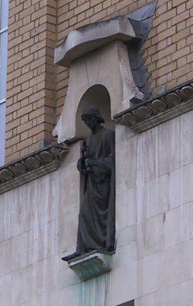
Voxel-Based Morphometry
John Ashburner
Wellcome Trust Centre for Neuroimaging,
12 Queen Square, London, UK.

Slide 2

Inter-subject variability
...diverse and dissimilar fish [brains] can be referred as a whole to identical functions of very different coordinate systems...
D’Arcy Thompson (1917). GROWTH AND FORM
Morphometry is defined as:
  Measurement of the form of organisms or of their parts.
  The American Heritage® Medical Dictionary

Slide 3
What kind of differences are we looking for?
Usually, we try to localise regions of difference.
  Mass-univariate models.
  Using methods similar to SPM
  Typically localising volumetric differences
Some anatomical differences can not be localised.
  Need multivariate models.
  Differences in terms of proportions among measurements.
This talk is about a mass-univariate method - VBM.

Slide 4
Voxel-Based Morphometry - VBM
Based on comparing regional volumes of tissue.
Suitable for studying focal volumetric differences of grey matter.
Assumes independence among voxels
  Shows differences that are easier to interpret
Produce a map of statistically significant differences among populations of subjects.
  e.g. compare a patient group with a control group.
  or identify correlations with age, test-score etc.
The data are pre-processed to sensitise the tests to regional tissue volumes.

Slide 5
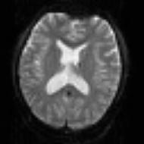
SPM for group fMRI
Group-wise
statistics
fMRI time-series
Preprocessing
Stat. modelling
Results query
spm T
Image
“Contrast”
Image
fMRI time-series
Preprocessing
Stat. modelling
Results query
“Contrast”
Image
fMRI time-series
Preprocessing
Stat. modelling
Results query
“Contrast”
Image

Slide 6
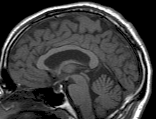
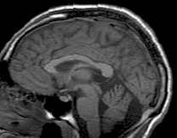
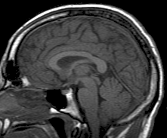
SPM for structural MRI
?
Group-wise
statistics
High-res T1 MRI
?
High-res T1 MRI
?
High-res T1 MRI
?

Slide 7
The need for tissue segmentation
High-resolution MRI reveals fine structural detail in the brain, but not all of it reliable or interesting
  Noise, intensity-inhomogeneity, vasculature, …
MR Intensity is usually not quantitatively meaningful (in the same way that e.g. CT is)
  fMRI time-series allow signal changes to be analysed statistically, compared to baseline or global values
Regional volumes of the three main tissue types: gray matter, white matter and CSF, are well-defined and potentially very interesting

Slide 8
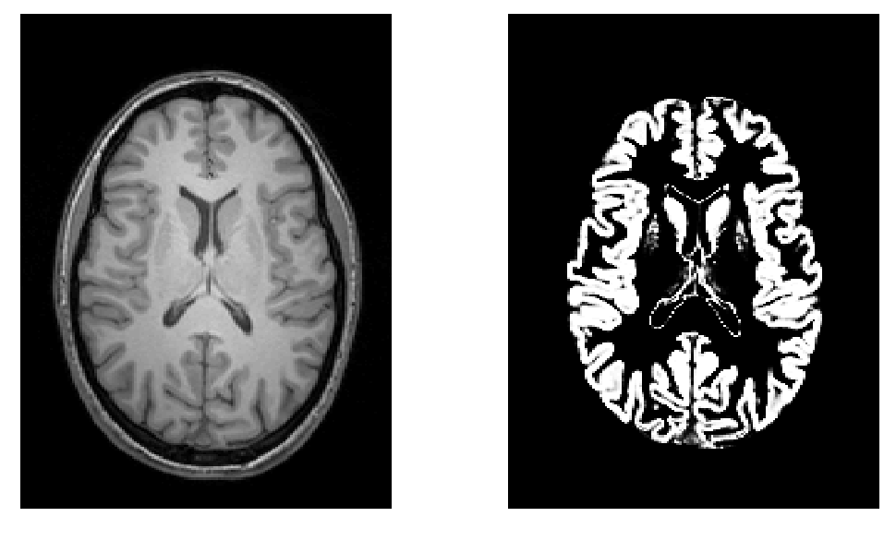
Volumetry
T1-Weighted MRI
Grey Matter

Slide 9
Spatial Normalisation
Brains of different subjects vary in shape and size.
Need to bring them all into a common anatomical space.
  Examine homologous regions across subjects
    Improve anatomical specificity
    Improve sensitivity
  Report findings in a common anatomical space (eg MNI space)
In SPM, alignment is achieved by matching grey matter with grey matter and white matter with white matter.
  Need to segment.

Slide 10
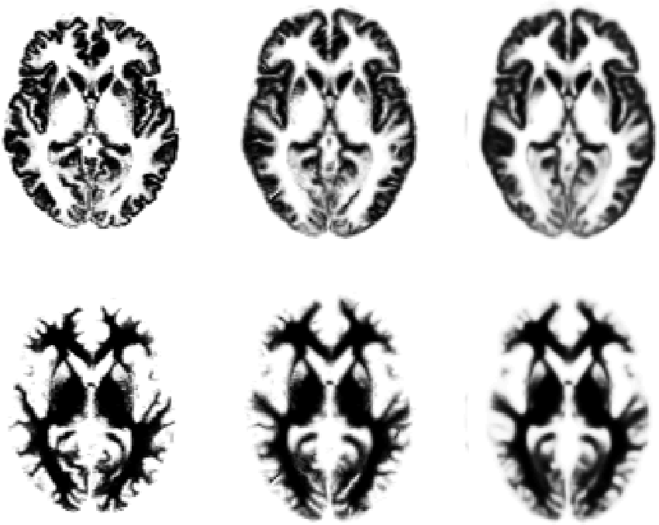
Original
Warped
Template

Slide 11
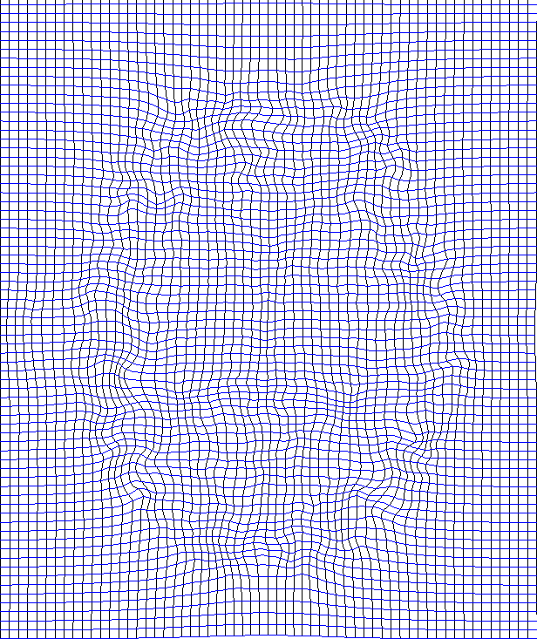
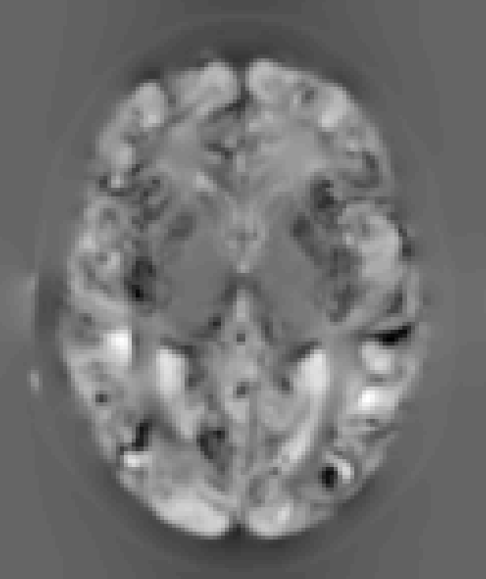
“Modulation” – change of variables.
Deformation Field
Jacobians determinants
Encode relative volumes.

Slide 12

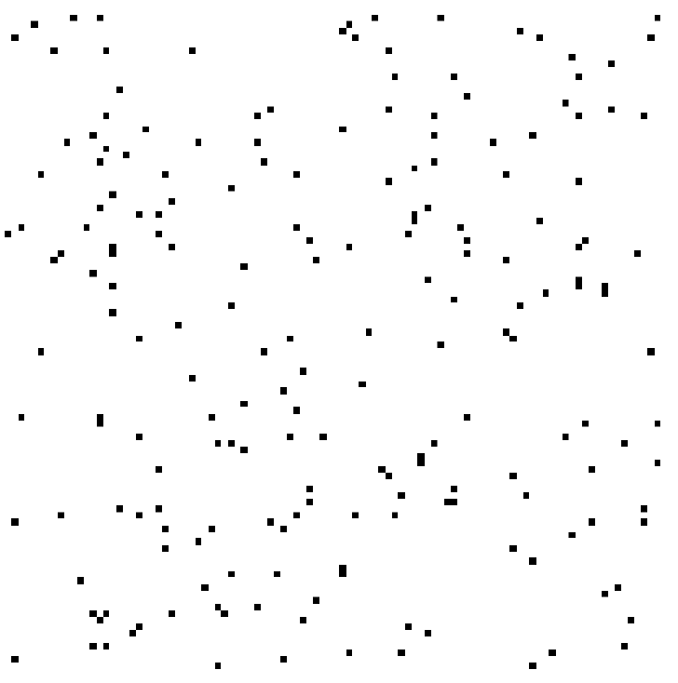

Smoothing
Each voxel after smoothing effectively becomes the result of applying a weighted region of interest (ROI).
Before convolution
Convolved with a circle
Convolved with a Gaussian

Slide 13
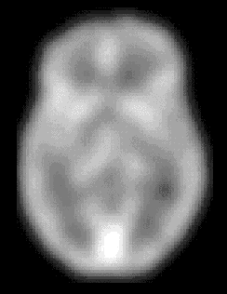
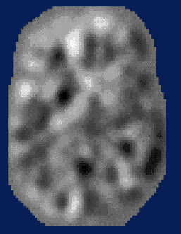
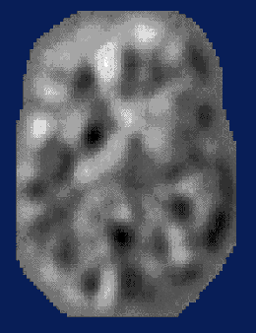
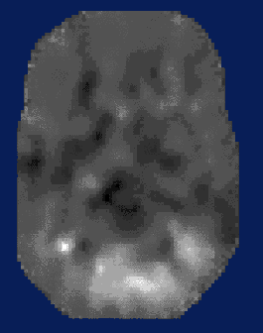
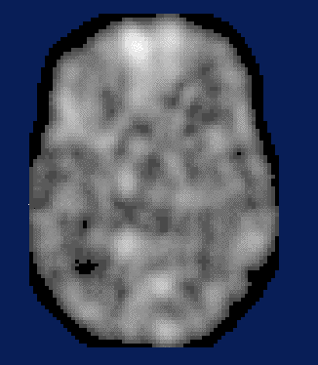
Statistical Parametric Mapping…
–
parameter estimate
standard error
group 1
group 2
statistic image
or
SPM
=
voxel by voxel
modelling

Slide 14
Some Explanations of the Differences
Mis-classify
Mis-register
Folding
Thinning
Thickening
Mis-register
Mis-classify

Slide 15
VBM Pre-processing in SPM8
Use New Segment for characterising intensity distributions of tissue classes, and writing out “imported” images that DARTEL can use.
Run DARTEL to estimate all the deformations.
DARTEL warping to generate smoothed, “modulated”, warped grey matter.
Statistics.

Slide 16
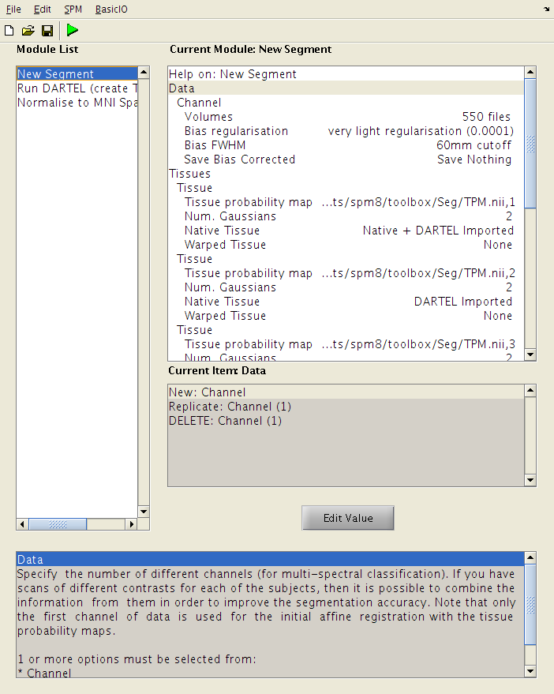
New Segment
Generate low resolution GM and WM images for each subject (“DARTEL imported”).
Generate full resolution GM map for each subject.

Slide 17
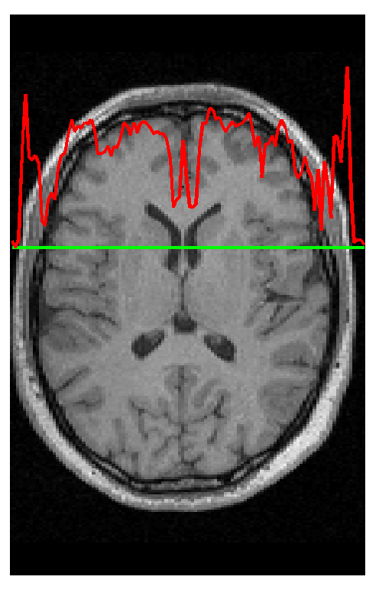
Segmentation
Segmentation in SPM8 also estimates a spatial transformation that can be used for spatially normalising images.
It uses a generative model, which involves:
  Mixture of Gaussians (MOG)
  Bias Correction Component
  Warping (Non-linear Registration) Component

Slide 18
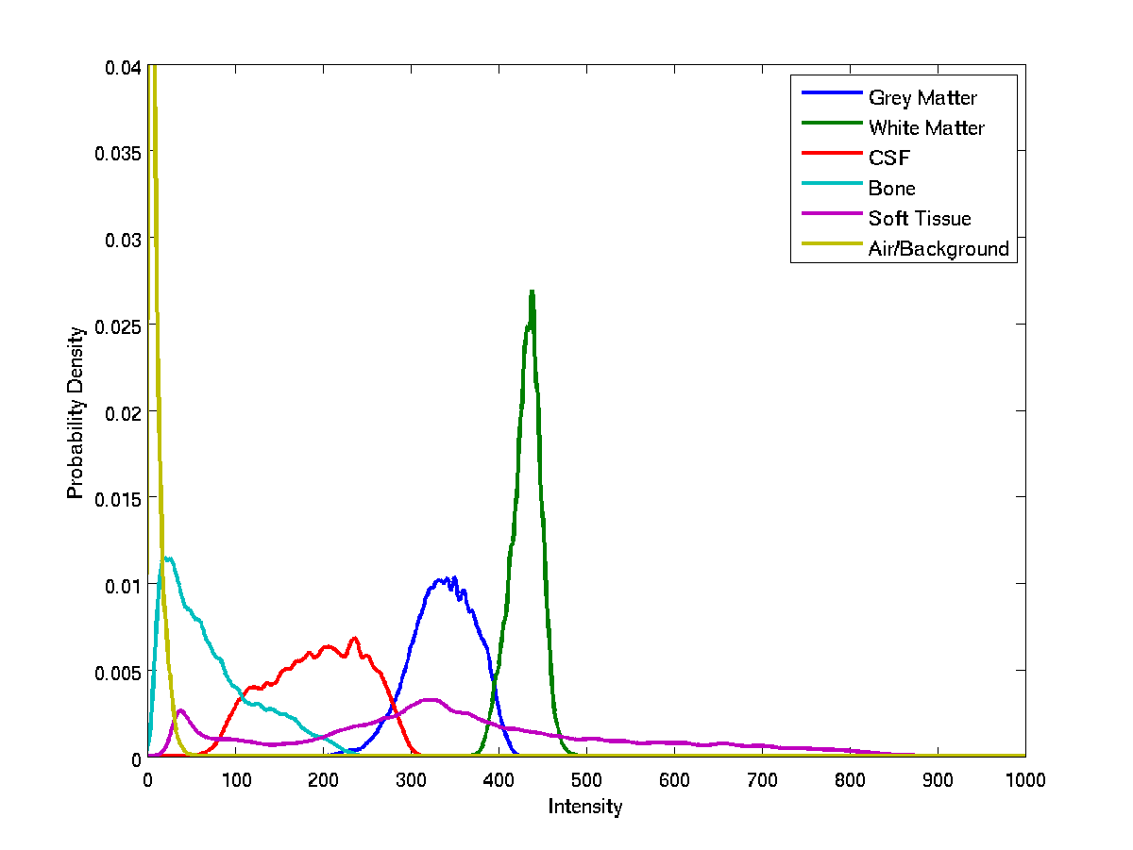
Image Intensity Distributions (T1-weighted MRI)

Slide 19
Mixture of Gaussians (MOG)
Classification is based on a Mixture of Gaussians model (MOG), which represents the intensity probability density by a number of Gaussian distributions.
Frequency
Image Intensity

Slide 20
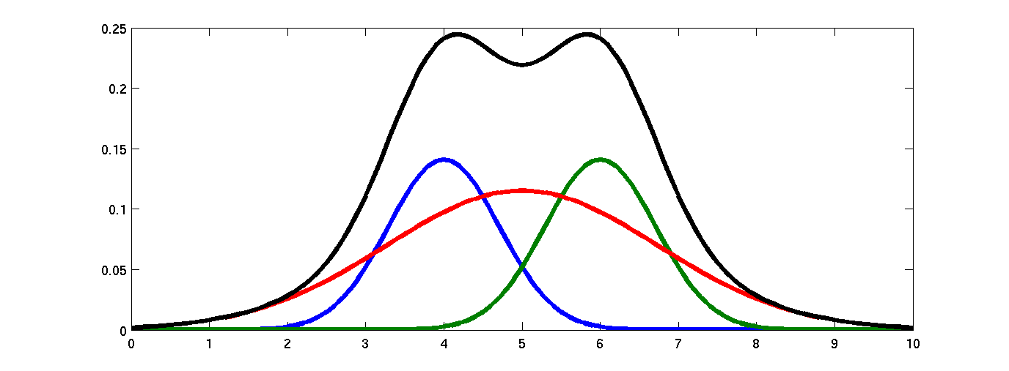
Belonging Probabilities
Belonging probabilities are assigned by normalising to one.

Slide 21
Non-Gaussian Intensity Distributions
Multiple Gaussians per tissue class allow non-Gaussian intensity distributions to be modelled.
  E.g. accounting for partial volume effects

Slide 22
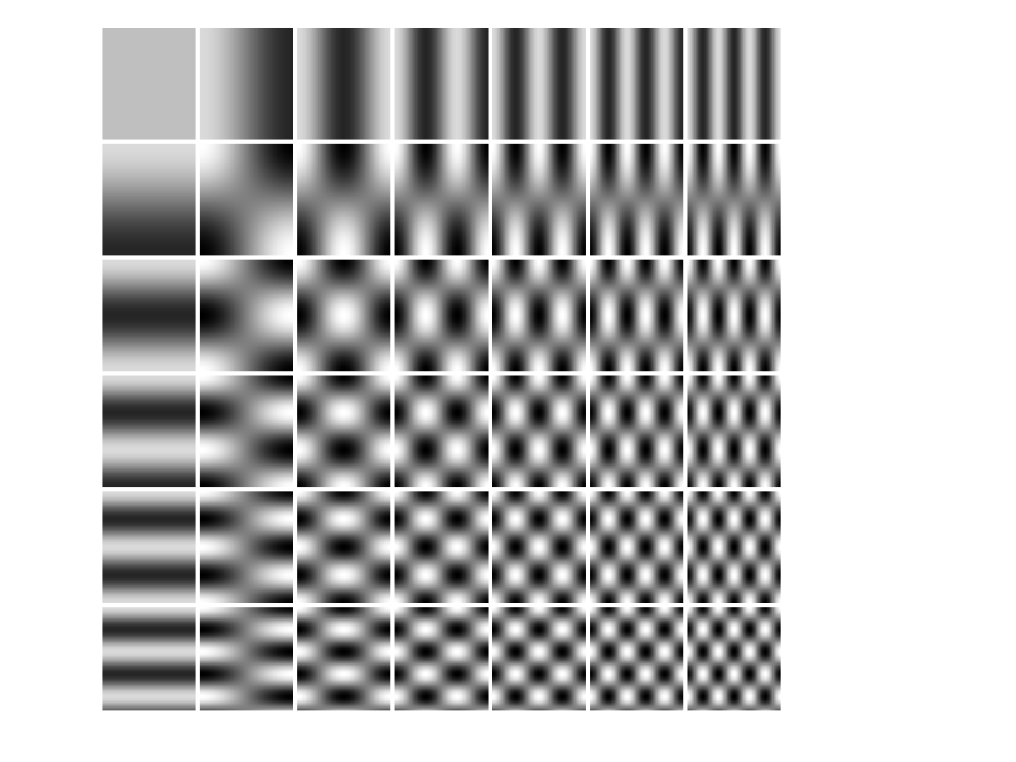
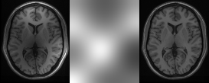
Modelling a Bias Field
A bias field is modelled as a linear combination of basis functions.
Corrupted image
Bias Field
Corrected image

Slide 23
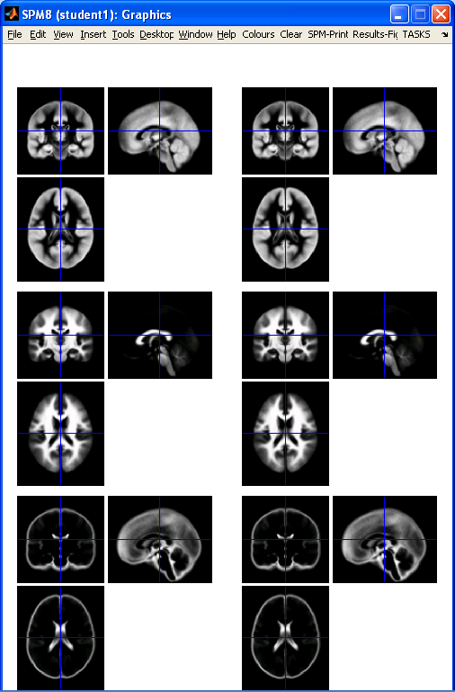
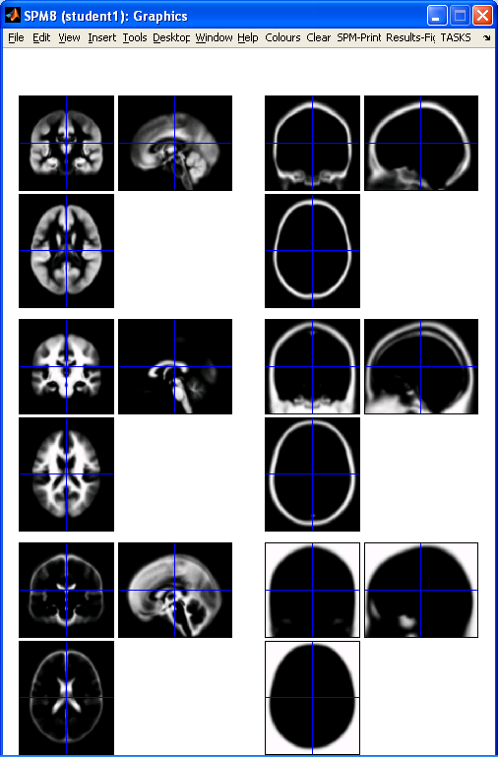
New Segmentation – TPMs
Segment button
New Seg Toolbox

Slide 24
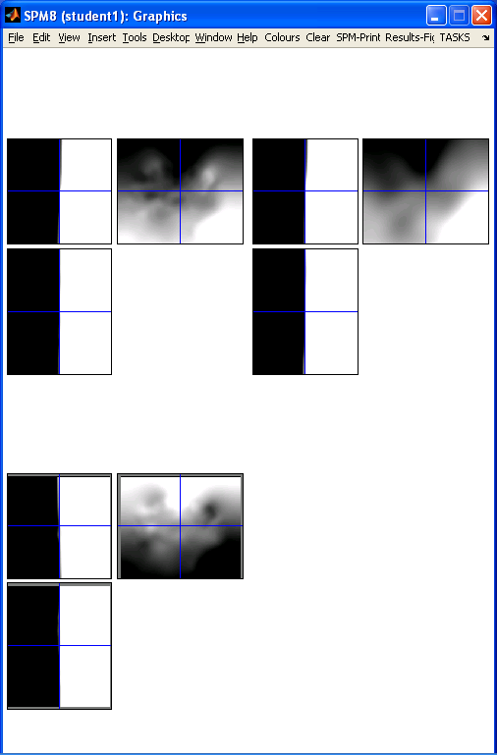
New Segmentation – registration
Segment button
New Seg Toolbox
9×10×9 × 3 = 2,430
59×70×59 × 3 = 731,010

Slide 25
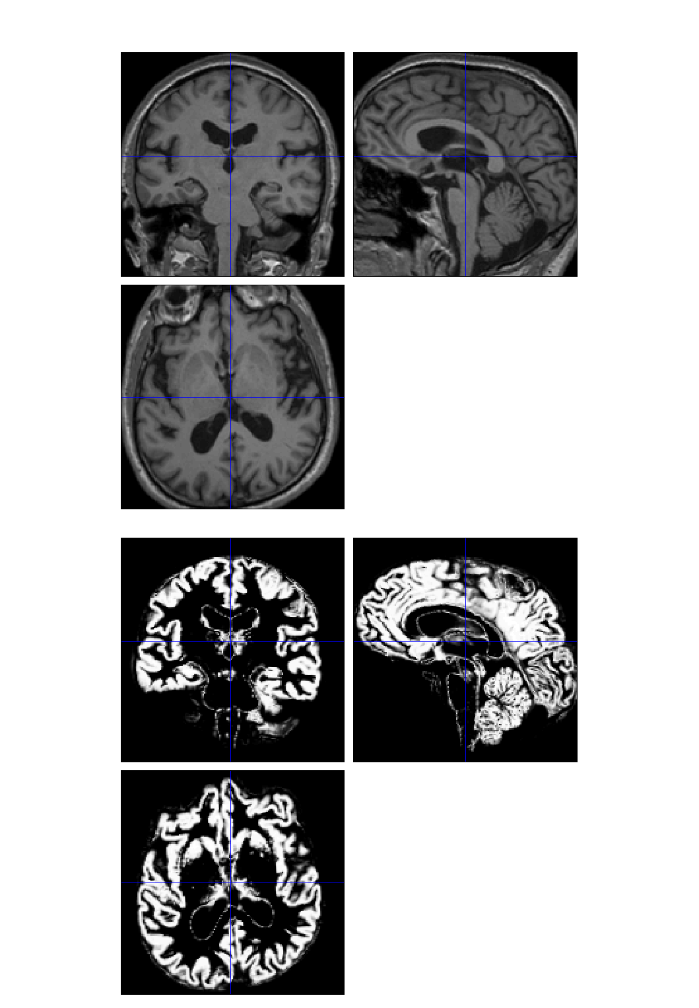
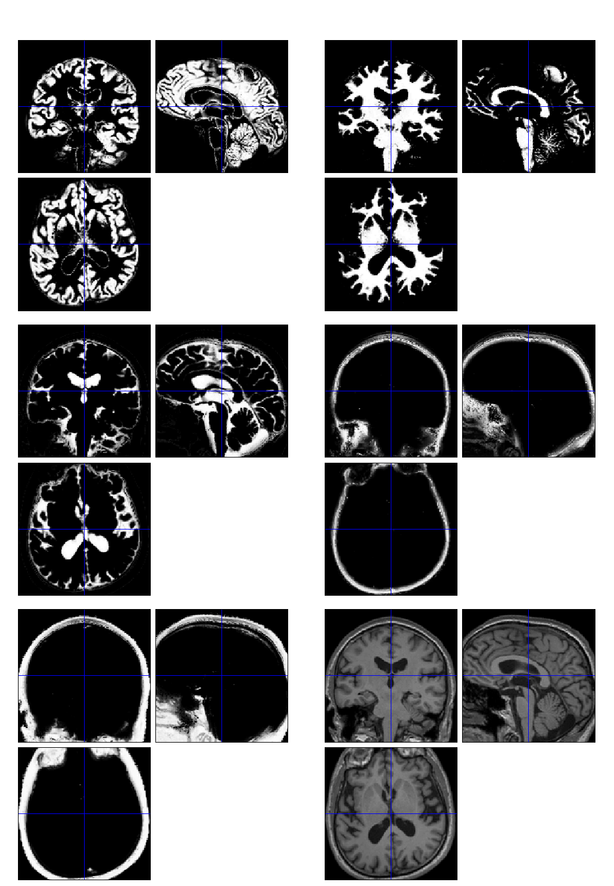

Slide 26
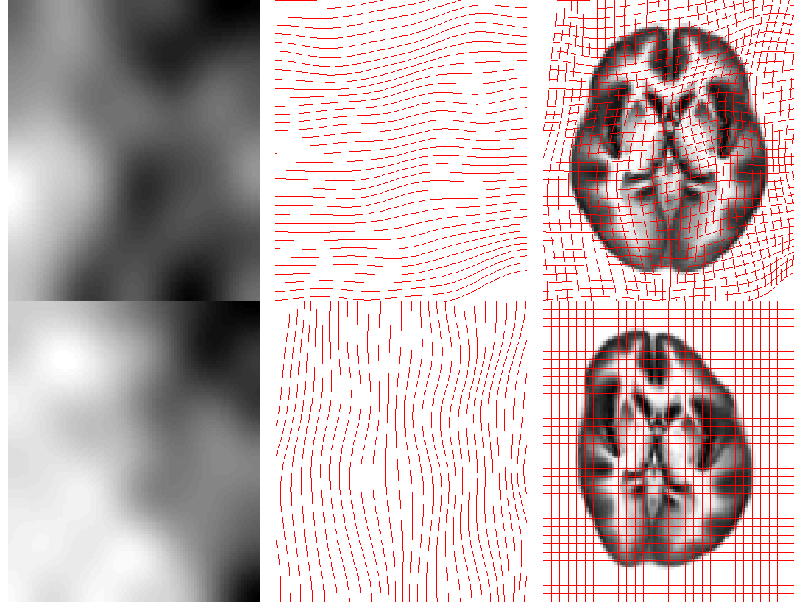
Deforming the Tissue Probability Maps
Tissue probability images are deformed so that they can be overlaid on top of the image to segment.

Slide 27
Optimisation
The “best” parameters are those that minimise this objective function.
Optimisation involves finding them.
Begin with starting estimates, and repeatedly change them so that the objective function decreases each time.

Slide 28
Searching for the optimum
Start
Optimum
Alternate between optimising different groups of parameters

Slide 29
Limitations of the current model
Assumes that the brain consists of only the tissues modelled by the TPMs
  No allowance for lesions (stroke, tumours, etc)
Prior probability model is based on relatively young and healthy brains
  Less appropriate for subjects outside this population
Needs reasonable quality images to work with
  No severe artefacts
  Good separation of intensities
  Good initial alignment with TPMs...

Slide 30
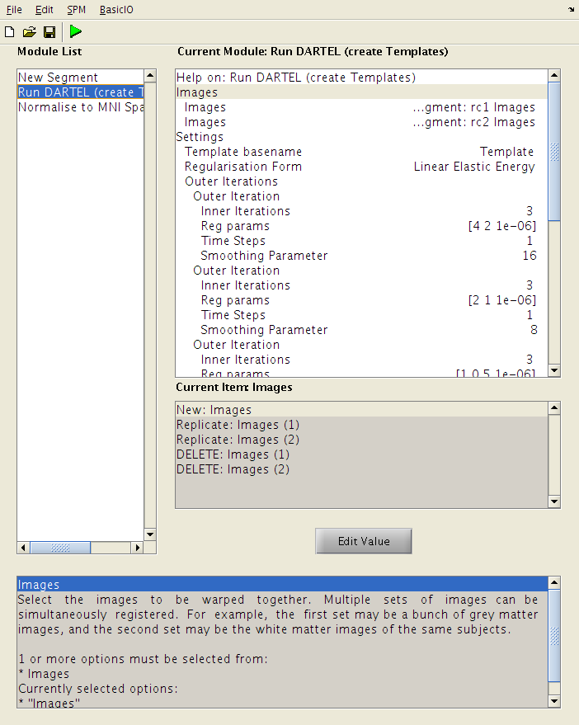
Run DARTEL (create Templates)
Simultaneously align “DARTEL imported” GM and WM for all subjects.
Generates templates and parameterisations of relative shapes.

Slide 31
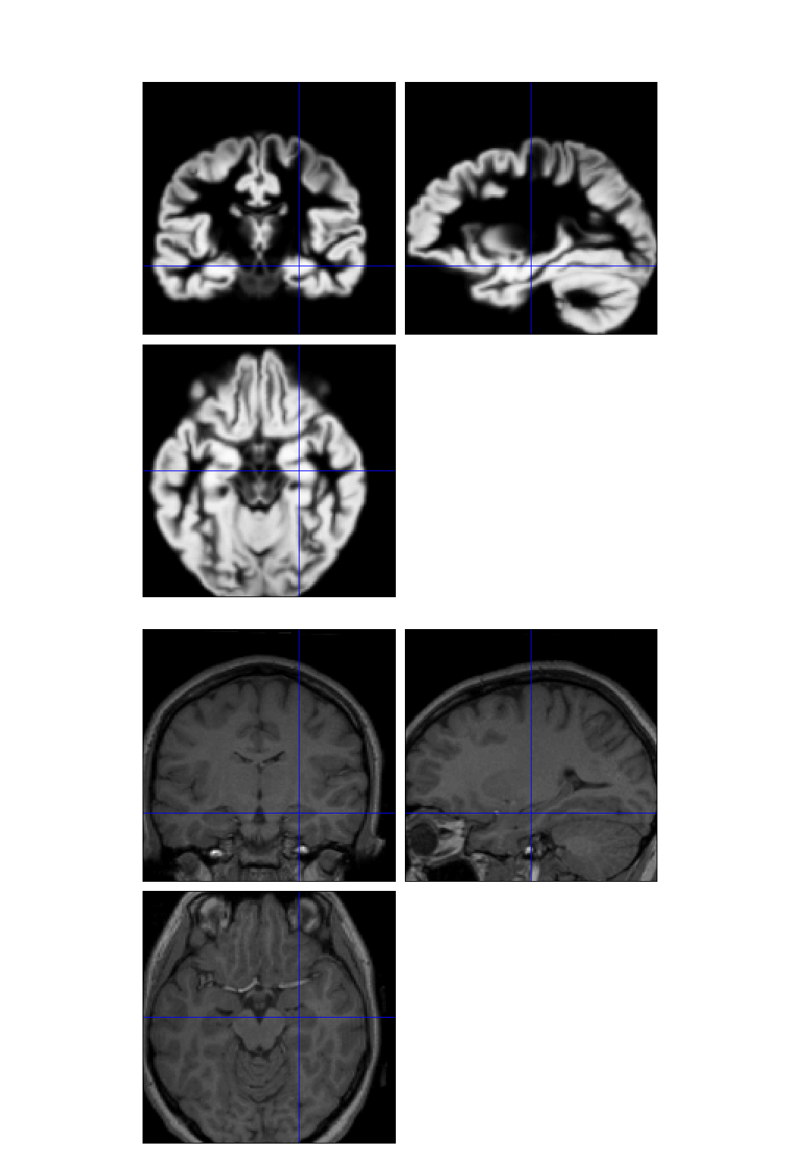
DARTEL Image Registration
Uses fast approximations
  Deformation integrated using scaling and squaring
Uses Levenberg-Marquardt optimiser
  Multi-grid matrix solver
Matches GM with GM, WM with WM etc
Diffeomorphic registration takes about 30 mins per image pair (121×145×121 images).
Grey matter template warped to individual
Individual scan

Slide 32
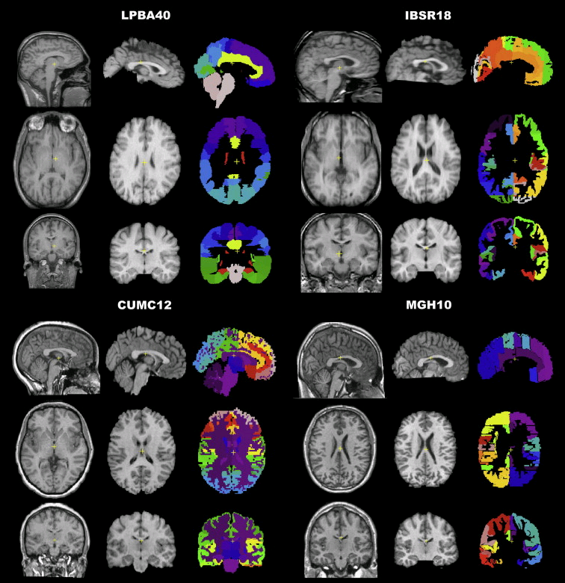
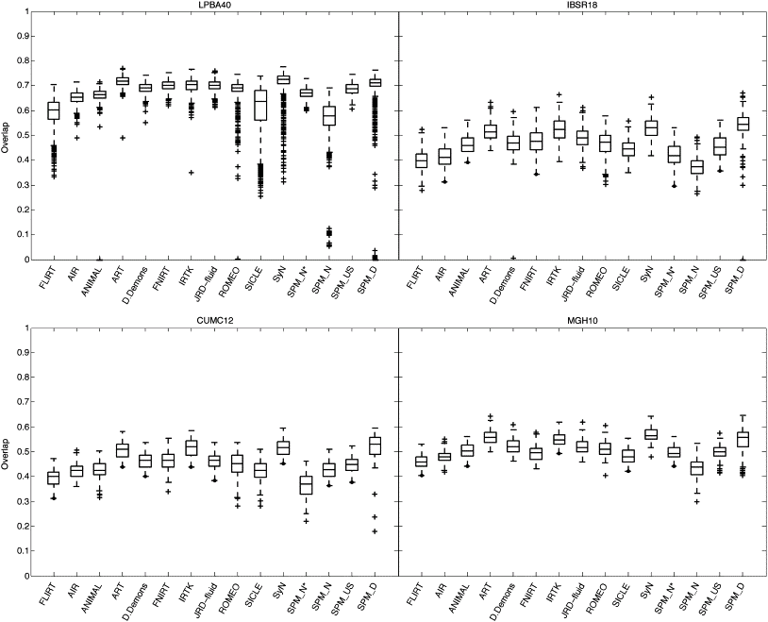
Evaluations of nonlinear registration algorithms

Slide 33
One-to-one mapping
One-to-one mappings (no folding of the deformations).
Positive Jacobian determinants (relative volumes).
Hard to achieve with the usual small deformation models.
Jacobian determinants
(should be positive)

Slide 34
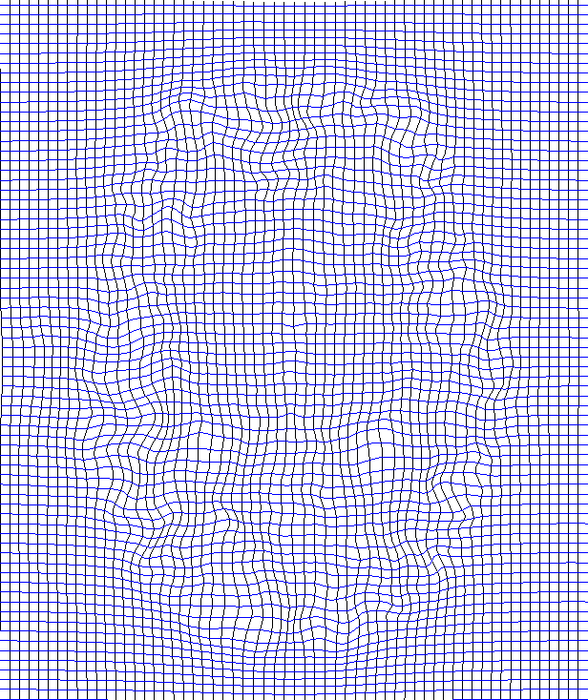
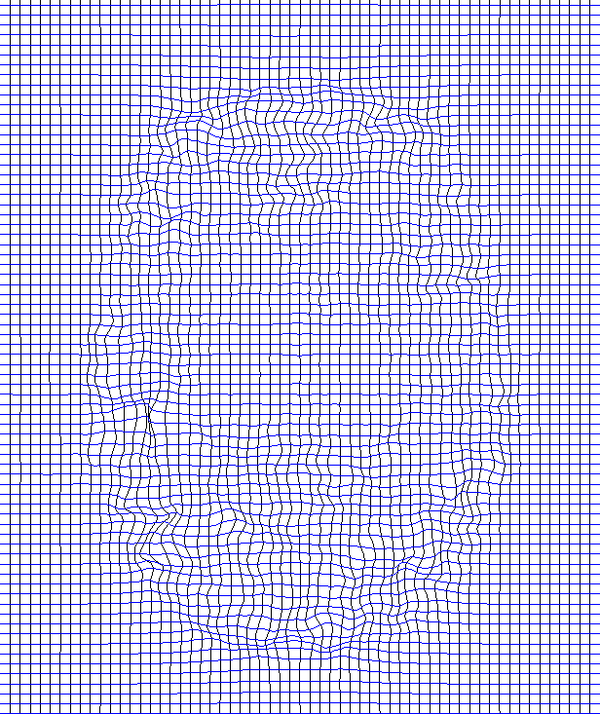


Displacements don’t add linearly
Forward
Inverse
Subtracted
Composed

Slide 35
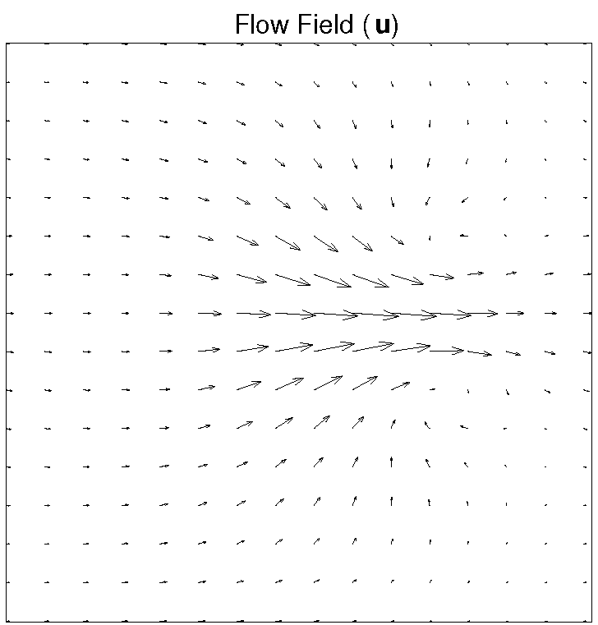
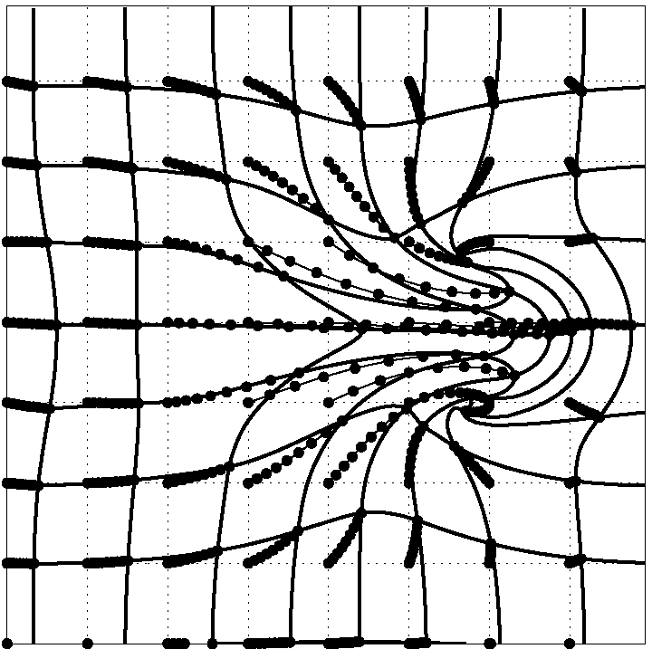
DARTEL
Parameterising the deformation
φ⁽⁰⁾ = Identity
φ⁽¹⁾ = ∫ u(φ^{(t)})dt
u is a flow field to be estimated
Scaling and squaring is used to generate deformations.
1
t=0

Slide 36
Scaling and squaring example

Slide 37
Registration objective function
Simultaneously minimize the sum of:
  Matching Term
    Drives the matching of the images.
    Multinomial assumption
  Regularisation term
    A measure of deformation roughness
    Regularises the registration.
A balance between the two terms.

Slide 38

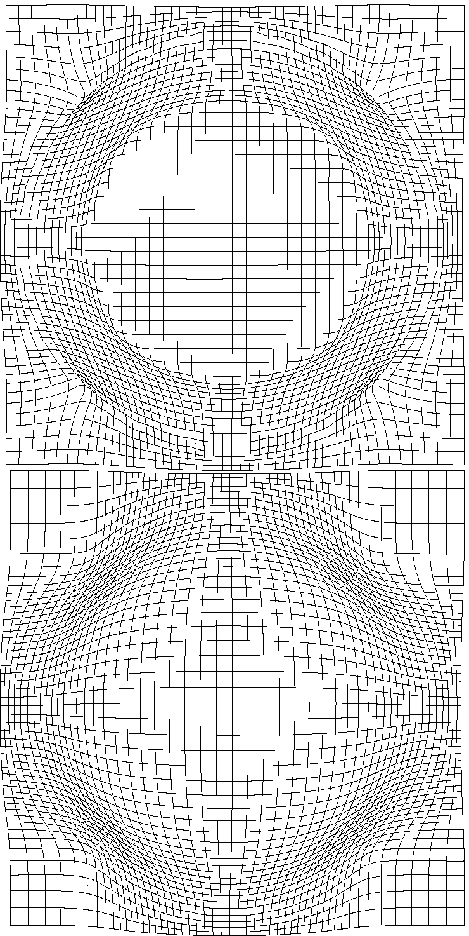
Effect of Different Regularisation Terms

Slide 39
Simultaneous registration of GM to GM and WM to WM
Grey matter
Subject 1
White matter
Grey matter
Subject 3
White matter
Grey matter
White matter
Grey matter
Template
Grey matter
White matter
White matter
Subject 2
Subject 4

Slide 40
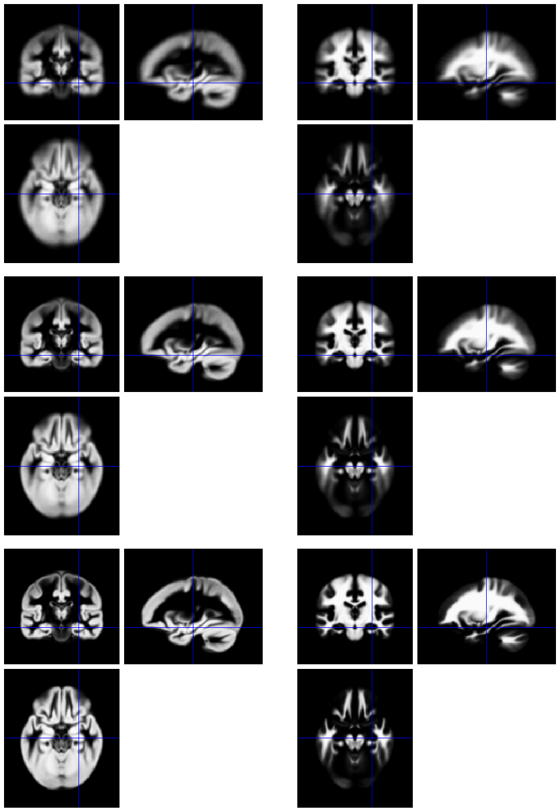
Template
Initial Average
Iteratively generated from all subjects in study
Begin with rigidly aligned tissue probability maps
After a few iterations
Final template

Slide 41
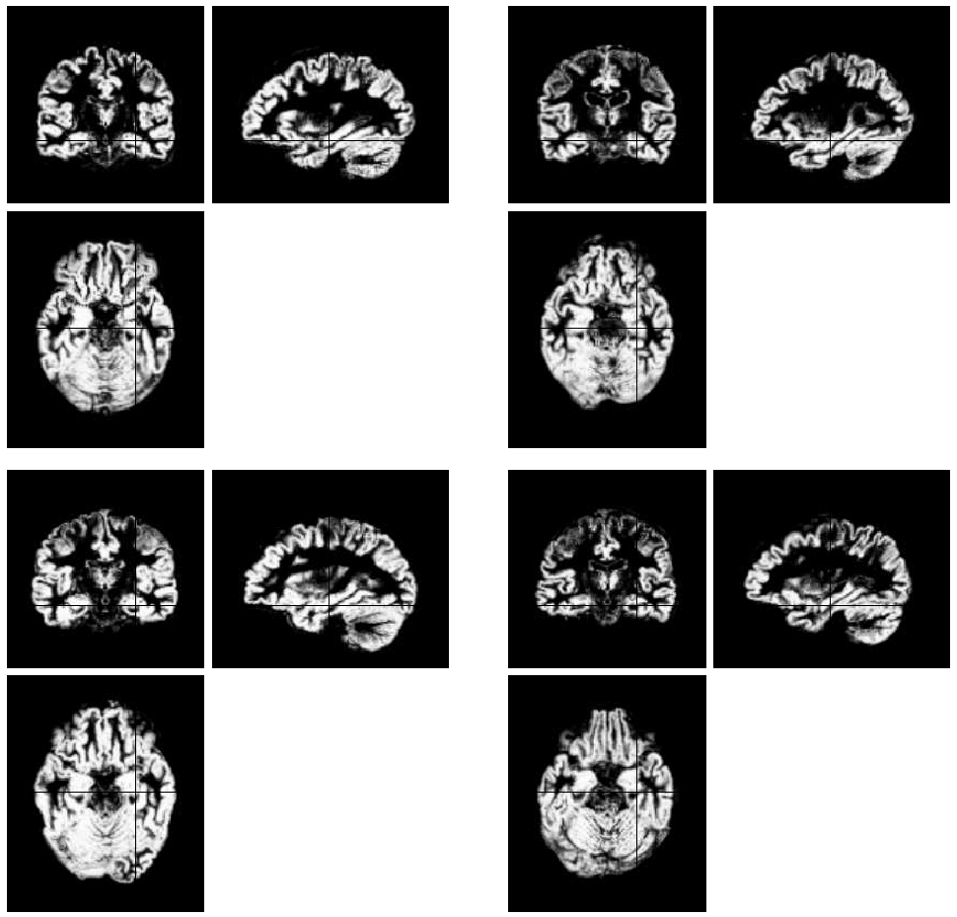
Initial
GM images

Slide 42
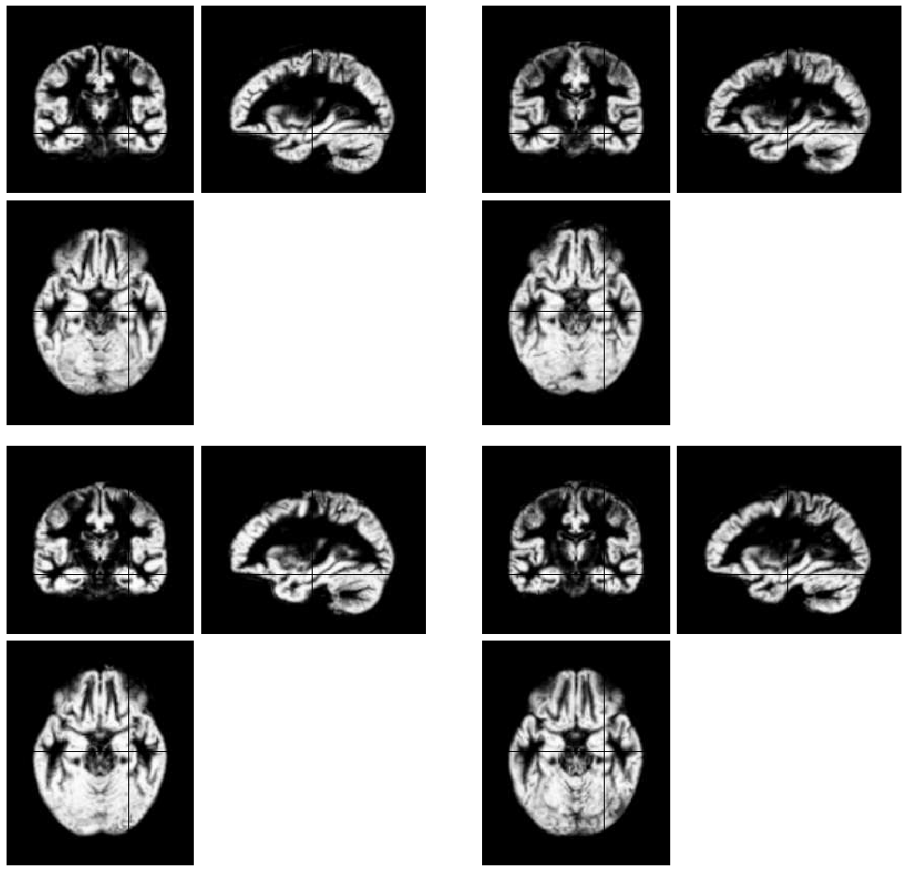
Warped
GM images

Slide 43
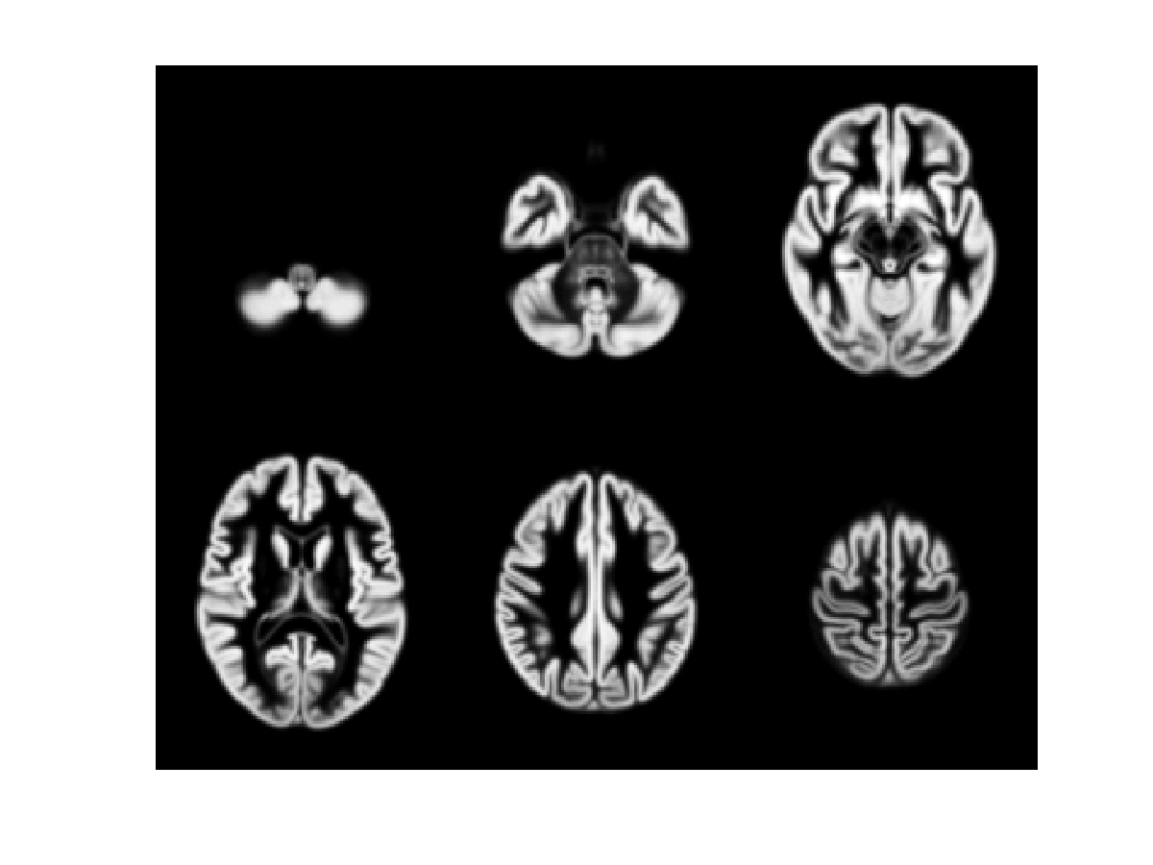

Slide 44
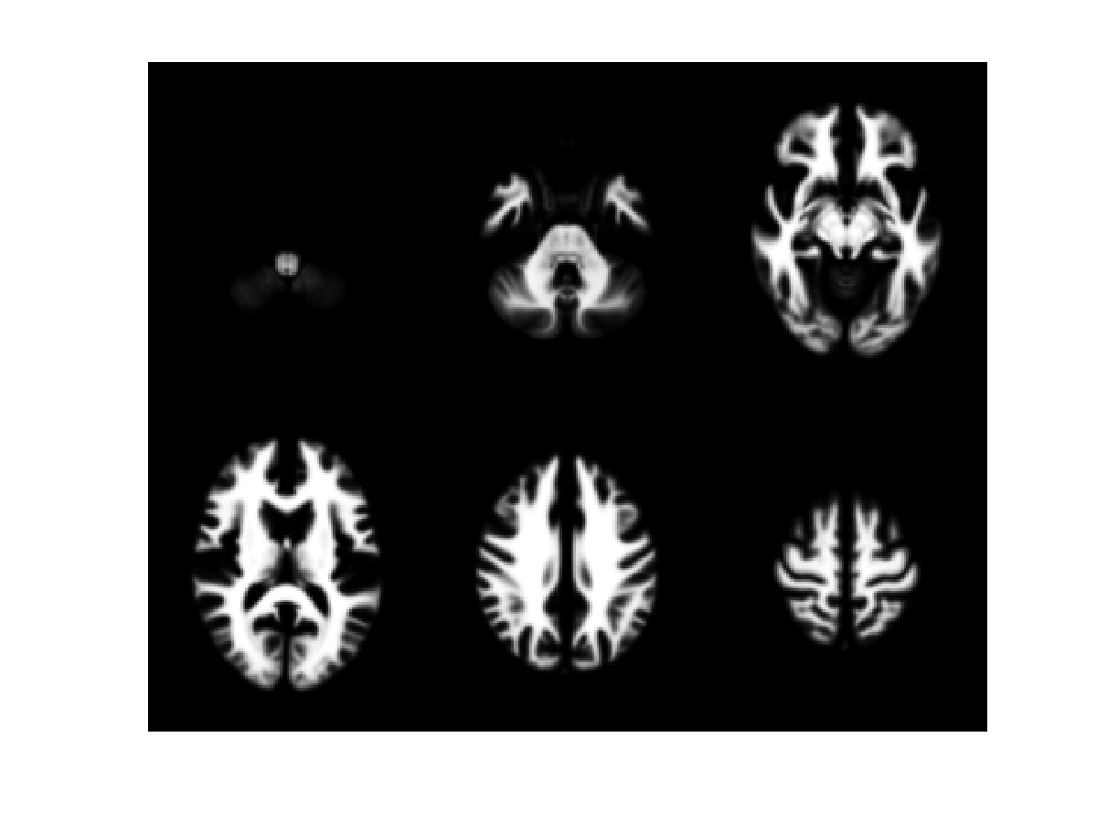

Slide 45
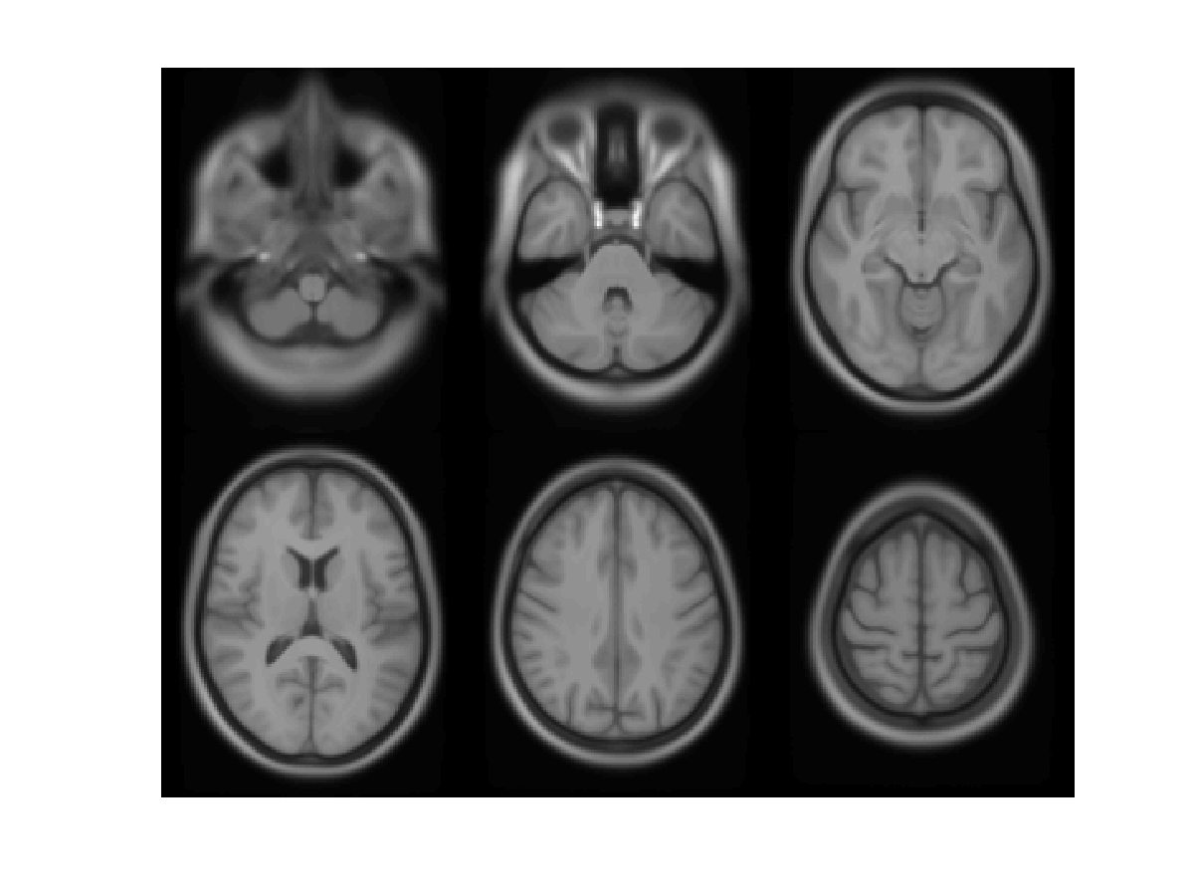

Slide 46
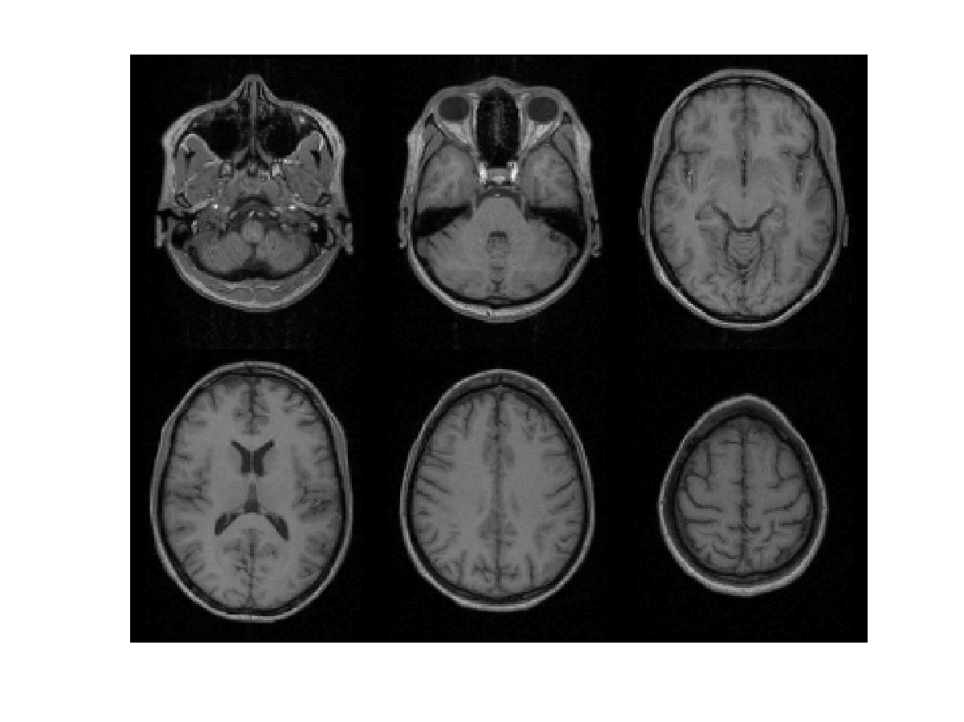

Slide 48
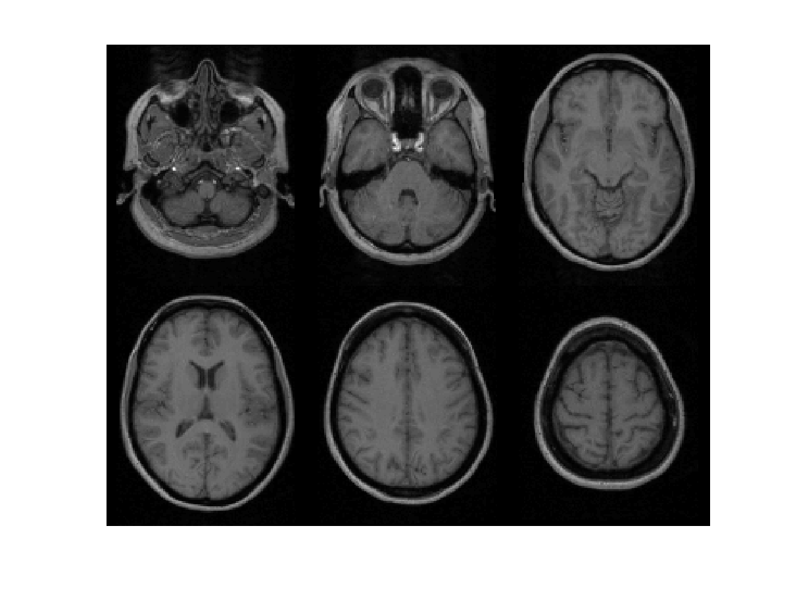

Slide 50
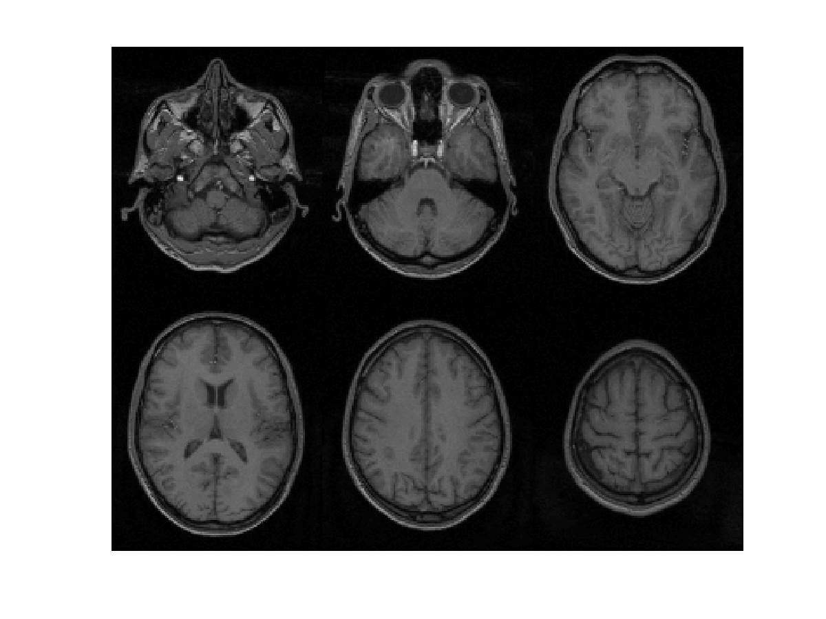

Slide 52
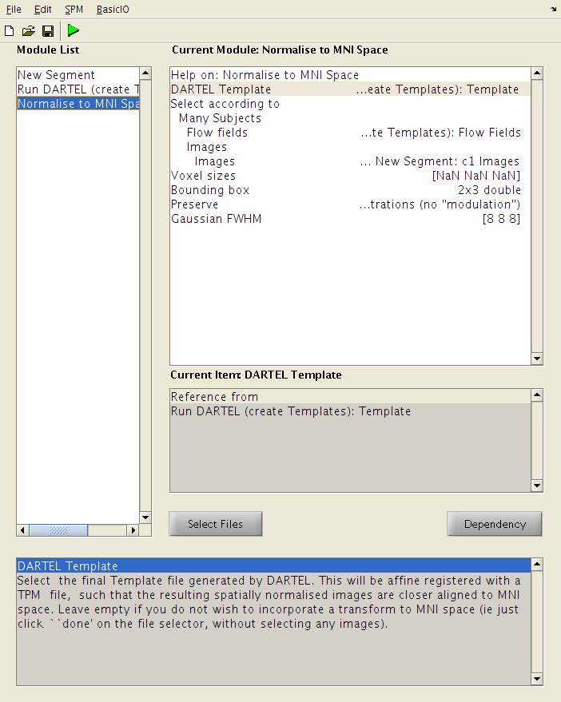
Normalise to MNI Space
Use shape parameterisations to generate smoothed Jacobian scaled and spatially normalised GM images for each subject.

Slide 53
MNI Space
Grey matter average of 452 subjects – affine

Slide 54
Population Space
Grey matter average of 471 subjects - nonlin

Slide 55
“Modulation” – change of variables.
Deformation Field
Jacobians determinants
Encode relative volumes.

Slide 56
Smoothing
The analysis will be most sensitive to effects that match the shape and size of the kernel
The data will be more Gaussian and closer to a continuous random field for larger kernels
Results will be rough and noise-like if too little smoothing is used
Too much will lead to distributed, indistinct blobs

Slide 57
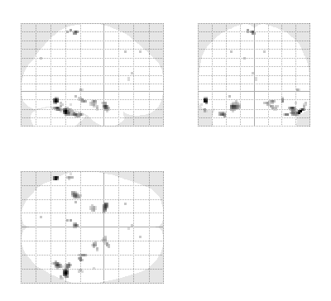
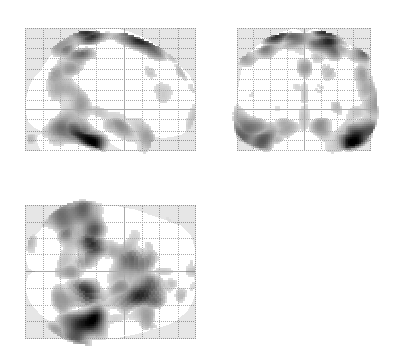
Smoothing
Between 7 and 14mm is probably best
  (lower is okay with better registration, e.g. DARTEL)
The results below show two fairly extreme choices, 5mm on the left, and 16mm, right

Slide 58
Some References
Ashburner & Friston. “Voxel-based morphometry-the methods”. Neuroimage 11(6):805-821, 2000.
Ashburner & Friston. “Unified Segmentation”. NeuroImage 26:839-851, 2005.
Ashburner. “A Fast Diffeomorphic Image Registration Algorithm”. NeuroImage 38:95-113 (2007).
Ashburner & Friston. “Computing Average Shaped Tissue Probability Templates”. NeuroImage 45:333-341, 2009.
Klein et al. Evaluation of 14 nonlinear deformation algorithms applied to human brain MRI registration. NeuroImage 46(3):786-802 (2009).
Ashburner. “Computational Anatomy with the SPM software”. Magnetic Resonance Imaging 27(8):1163-1174, 2009.

Slide 59
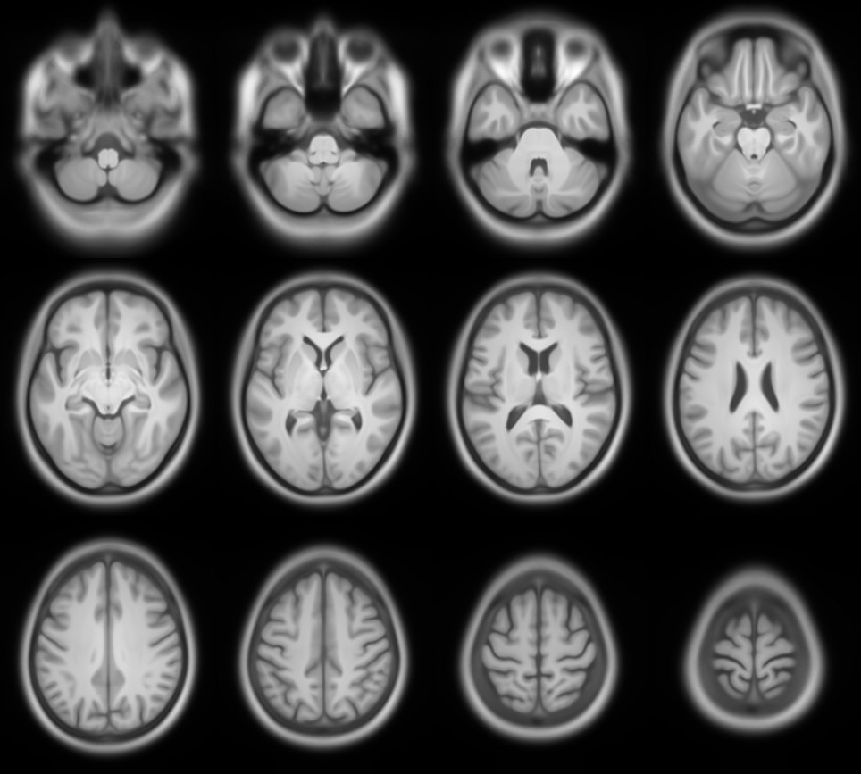

Slide 60
A brief history of VBM with SPM
A Voxel-Based Method for the Statistical Analysis of Gray and White Matter Density… Wright, McGuire, Poline, Travere, Murrary, Frith, Frackowiak & Friston. NeuroImage 2(4), 1995 (!)
  Rigid reorientation (by eye), semi-automatic scalp editing and segmentation, 8mm smoothing, SPM statistics, global covars.
Voxel-Based Morphometry – The Methods. Ashburner and Friston. NeuroImage 11(6), 2000
  Non-linear spatial normalisation, automatic segmentation
  Thorough consideration of assumptions and confounds
A Voxel-Based Morphometric Study of Ageing… Good, Johnsrude, Ashburner, Henson and Friston. NeuroImage 14(1), 2001
  “Optimised” GM-normalisation (ad hoc procedure), modulation of segments with Jacobian determinants
Unified Segmentation. Ashburner and Friston. NeuroImage 26(3), 2005
  Principled generative model for segmentation using deformable priors
A Fast Diffeomorphic Image Registration Algorithm. Ashburner. Neuroimage 38(1), 2007
  Large deformation normalisation to average shape templates

Slide 61
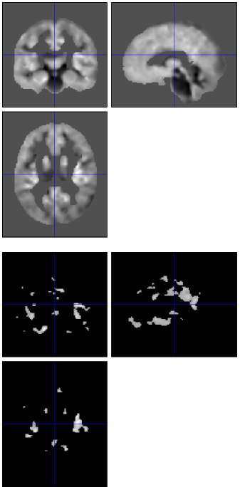


General Linear Model

Slide 62

“Globals” for VBM
Shape is really a multivariate concept
  Dependencies among volumes in different regions
SPM is mass univariate
  Combining voxel-wise information with “global” integrated tissue volume provides a compromise
  Using either ANCOVA or proportional scaling
Above: (ii) is globally thicker, but locally thinner than (i) – either of these effects may be of interest to us.
Below: The two “cortices” on the right both have equal volume…
Figures from: Voxel-based morphometry of the human brain… Mechelli, Price, Friston and Ashburner. Current Medical Imaging Reviews 1(2), 2005.
Notes:
Note globals don’t help distinguish the thickened or folded cortex...

Slide 63
Total Intracranial Volume (TIV/ICV)
“Global” integrated tissue volume may be correlated with interesting regional effects
  Correcting for globals in this case may overly reduce sensitivity to local differences
  Total intracranial volume integrates GM, WM and CSF, or attempts to measure the skull-volume directly
    Not sensitive to global reduction of GM+WM (cancelled out by CSF expansion – skull is fixed!)
  Correcting for TIV in VBM statistics may give more powerful and/or more interpretable results
    See also Pell et al (2009) doi:10.1016/j.neuroimage.2008.02.050

Slide 64
VBM’s statistical validity
Residuals are not normally distributed
  Little impact on uncorrected statistics for experiments comparing reasonably sized groups
  Probably invalid for experiments that compare single subjects or tiny groups with a larger control group
    Need to use nonparametric tests that make less assumptions, e.g. permutation testing with SnPM

Slide 65
VBM’s statistical validity
Correction for multiple comparisons
  RFT correction based on peak heights should be OK
Correction using cluster extents is problematic
  SPM usually assumes that the smoothness of the residuals is spatially stationary
    VBM residuals have spatially varying smoothness
    Bigger blobs expected in smoother regions
  Toolboxes are now available for non-stationary cluster-based correction
    http://www.fmri.wfubmc.edu/cms/NS-General

Slide 66
Longitudinal VBM
The simplest method for longitudinal VBM is to use cross-sectional preprocessing, but longitudinal statistical analyses
  Standard preprocessing not optimal, but unbiased
  Non-longitudinal statistics would be severely biased
    (Estimates of standard errors would be too small)
  Simplest longitudinal statistical analysis: two-stage summary statistic approach (common in fMRI)
    Within subject longitudinal differences or beta estimates from linear regressions against time

Slide 67
Longitudinal VBM variations
Intra-subject registration over time is much more accurate than inter-subject normalisation
  Different approaches suggested to capitalise
A simple approach is to apply one set of normalisation parameters (e.g. Estimated from baseline images) to both baseline and repeat(s)
  Draganski et al (2004) Nature 427: 311-312
“Voxel Compression mapping” – separates expansion and contraction before smoothing
  Scahill et al (2002) PNAS 99:4703-4707

Slide 68
Longitudinal VBM variations
Can also multiply longitudinal volume change with baseline or average grey matter density
  Chételat et al (2005) NeuroImage 27:934-946
  Kipps et al (2005) JNNP 76:650
  Hobbs et al (2009) doi:10.1136/jnnp.2009.190702
Note that use of baseline (or repeat) instead of average might lead to bias
  Thomas et al (2009) doi:10.1016/j.neuroimage.2009.05.097
  Unfortunately, the explanations in this reference relating to interpolation differences are not quite right... there are several open questions here...

Slide 69



Alzheimer’s Disease example
Baseline Image
Standard clinical MRI
1.5T T1 SPGR
1x1x1.5mm voxels
Repeat image
12 month follow-up
rigidly registered
Subtraction image

Slide 70



Longitudinal VBM variations
_{Late}
_{Early}
_{Late CSF}
_{Early CSF}
_{Late CSF - Early CSF}
_{Late CSF - modulated CSF}
_{Smoothed}
CSF “modulated” by relative volume
_{Warped early}
_{Difference}
_{Relative volumes}

