Slide 1
General Linear Model & Classical Inference
Stefan Kiebel
Max Planck Institute for
Human Cognitive and Brain Sciences
Leipzig, Germany

Slide 2
Overview
Introduction
  ERP example
General Linear Model
  Definition & design matrix
  Parameter estimation
  Hypothesis testing
  t-test and contrast
  F-test and contrast

Slide 3
Overview
Introduction
  ERP example
General Linear Model
  Definition & design matrix
  Parameter estimation
  Hypothesis testing
  t-test and contrast
  F-test and contrast

Slide 4
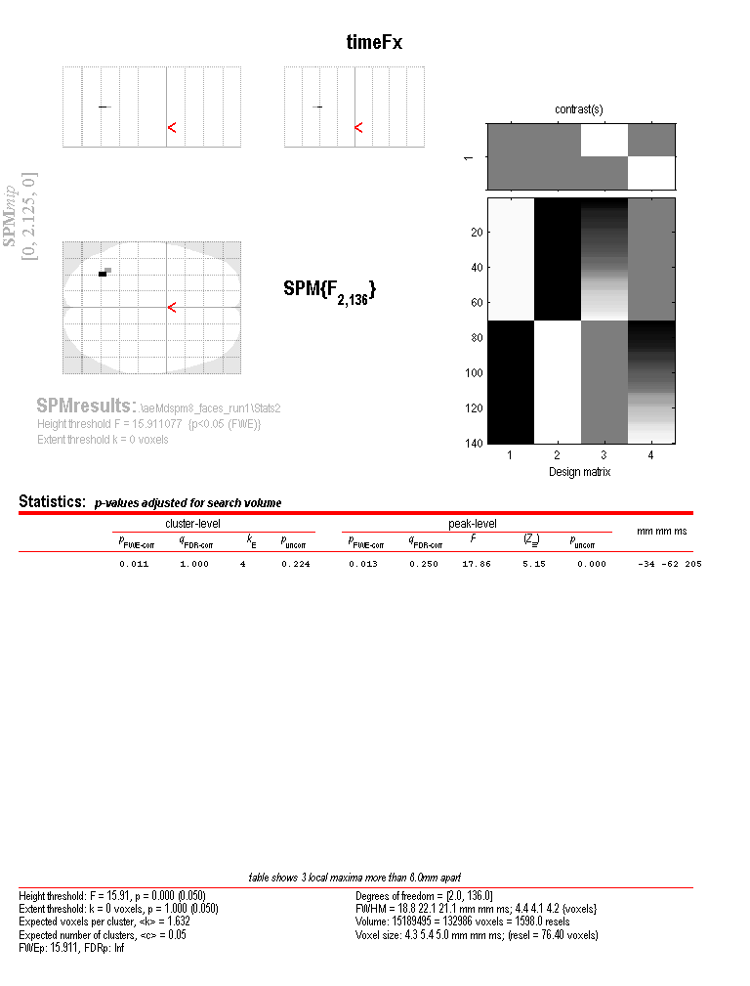
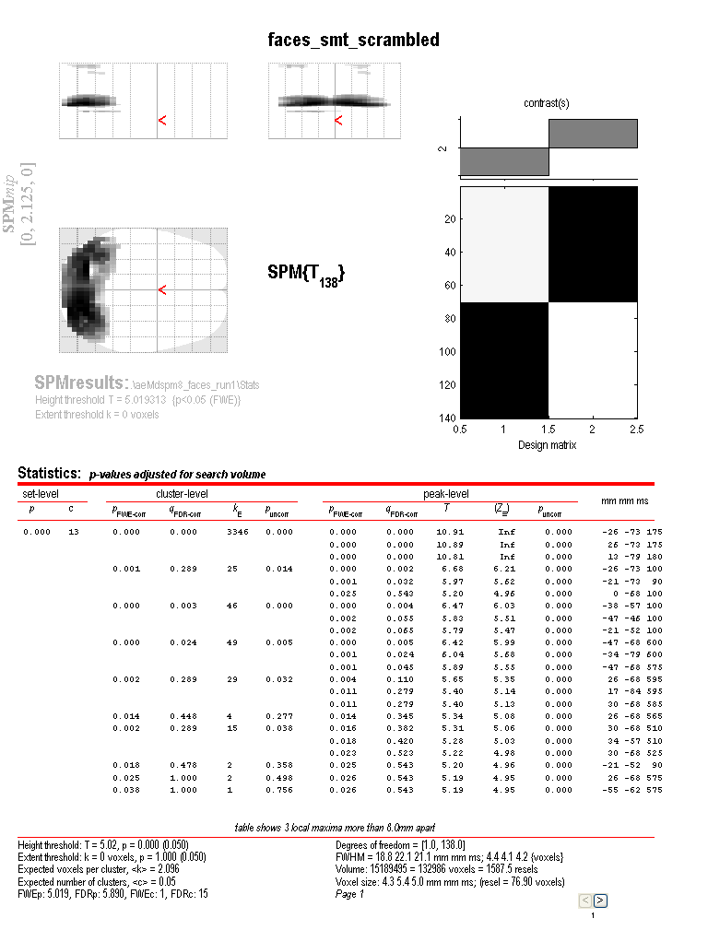
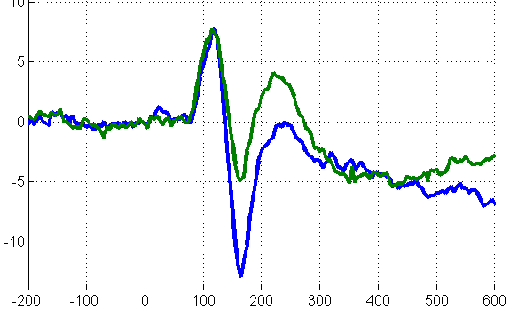
Overview of SPM
Raw EEG/MEG data
Statistical Parametric Map (SPM)
Design matrix
Pre-processing:
Converting
Filtering
Resampling
Re-referencing
Epoching
Artefact rejection
Time-frequency transformation
…
General Linear Model
Inference & adjustment for multiple comparisons
Image conversion
Parameter estimates
Contrast:
c’ = [-1 1]

Slide 5
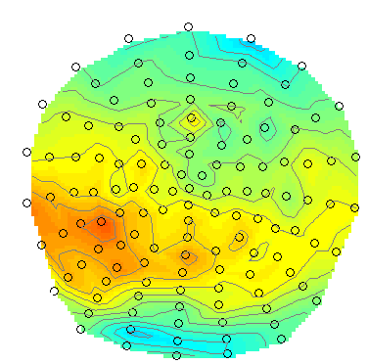
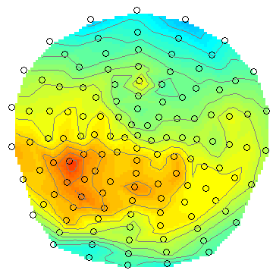
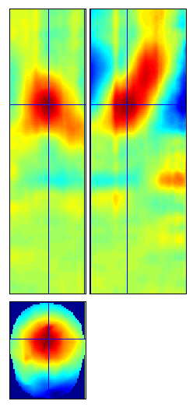
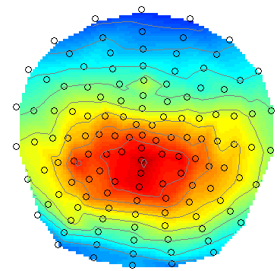
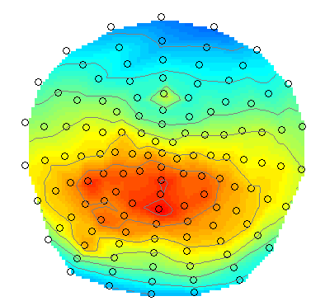
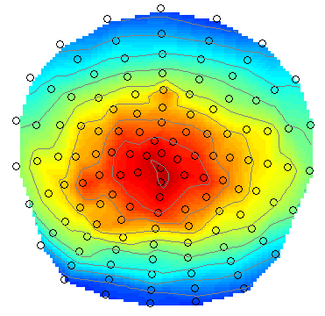
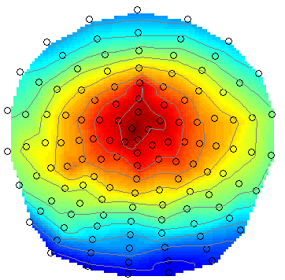
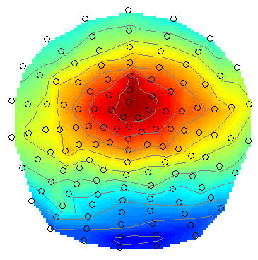
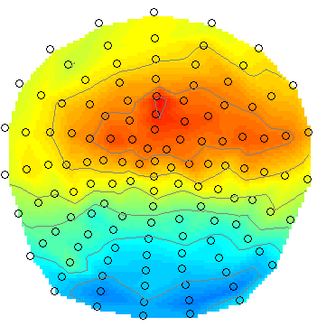
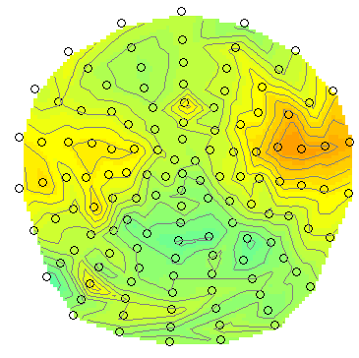
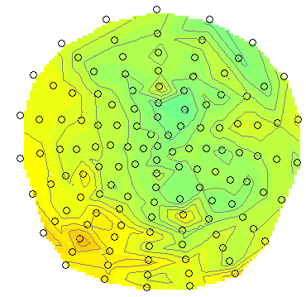
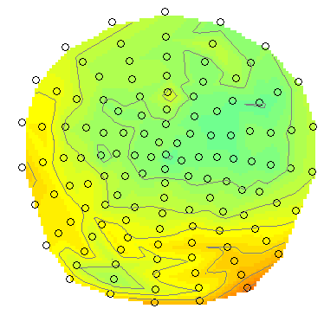
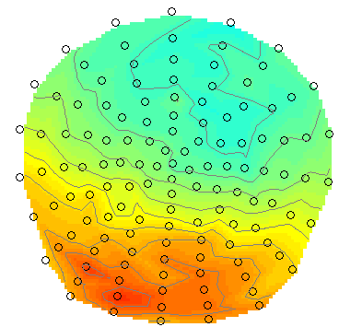
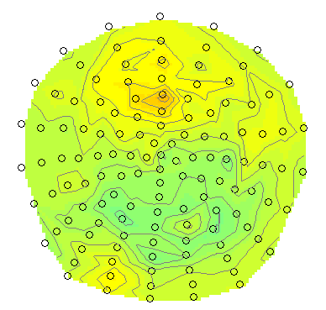
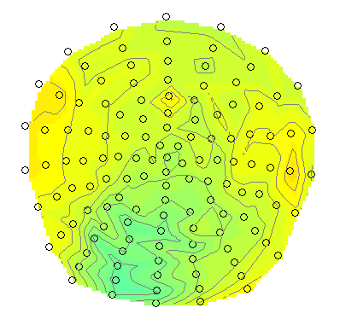
Evoked response image
Sensor to voxel
transform
Time
Transform data for all subjects and conditions
SPM: Analyze data at each voxel

Slide 6
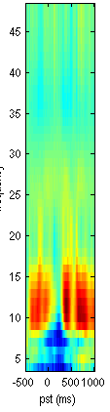
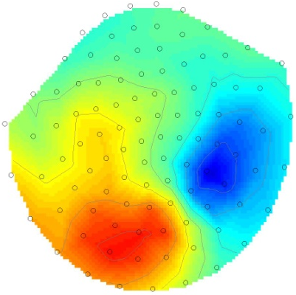
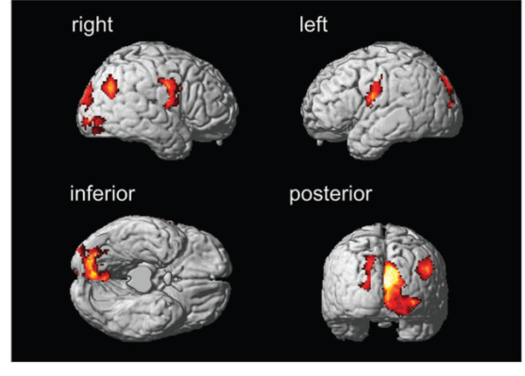
Types of images
2D topography
Source reconstructed
Time-
Frequency
Time
Time
Location
Experimental design (conditions and repetitions, e.g. subjects)

Slide 7
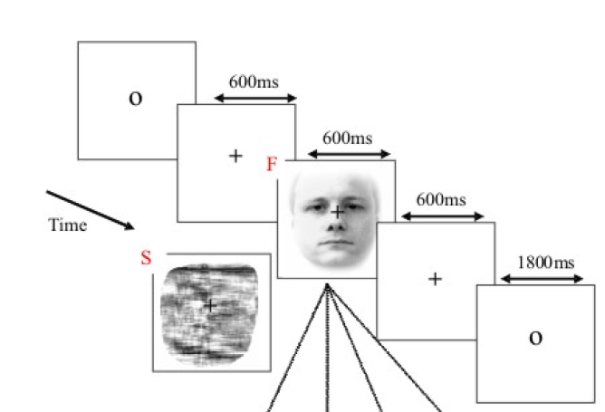
ERP example – Single subject
Random presentation of ‘faces’ and ‘scrambled faces’
70 trials of each type
128 EEG channels
Question:
is there a difference between the ERP of ‘faces’ and ‘scrambled’?

Slide 8
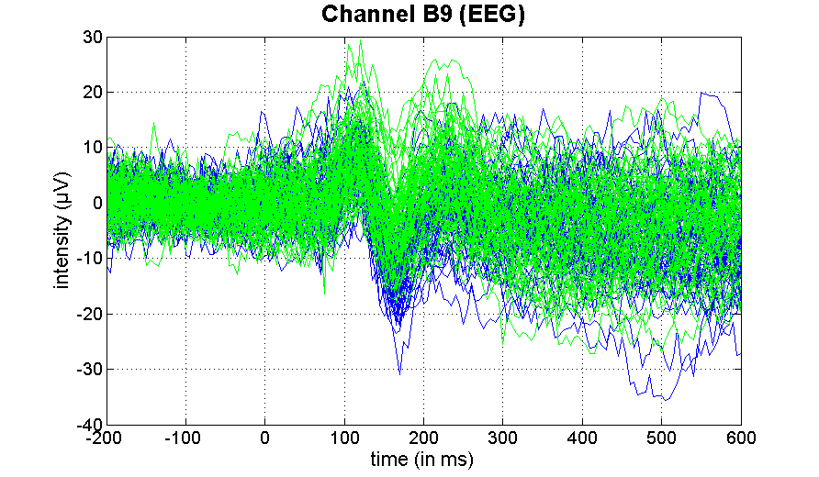
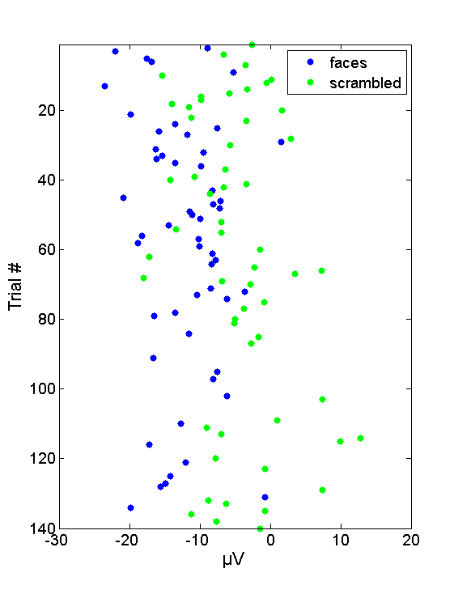
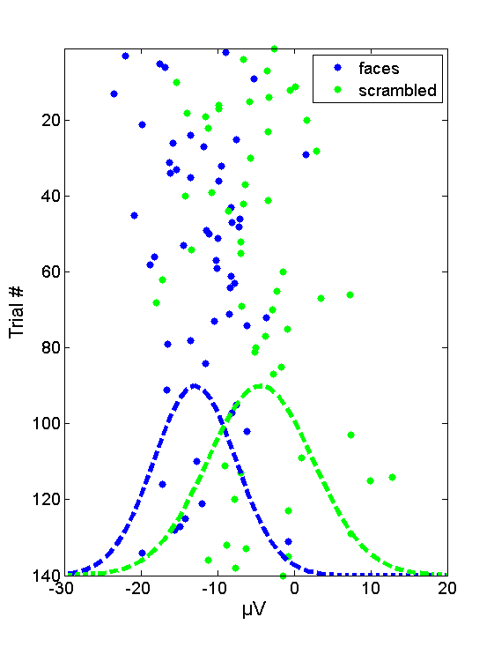
ERP example: channel B9
Focus on N170
compares size of effect to its error standard deviation

Slide 9
Overview
Introduction
  ERP example
General Linear Model
  Definition & design matrix
  Parameter estimation
  Hypothesis testing
  t-test and contrast
  F-test and contrast

Slide 10
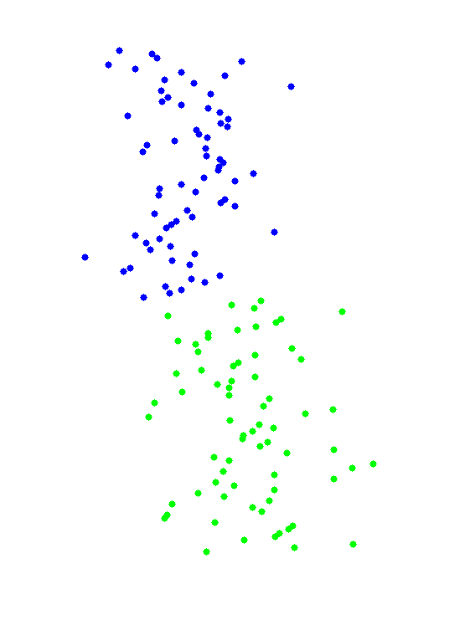
Data modeling
Data
Faces
Scrambled
=
β₁
+
β₂
+
Error
Y
=
β₁
•
X₁
+
β₂
•
X₂
+
ε

Slide 11

Design matrix
Design matrix
Parameter vector
Error vector
Data vector
β₁
=
+
β₂
Y
=
X
•
β
+
ε

Slide 12
General Linear Model
N: # trials
p: # regressors
=
X
+
Y
design matrix X
GLM defined by
error distribution

Slide 13
General Linear Model
The design matrix embodies available knowledge about experimentally controlled factors and potential confounds.
Applied to each voxel
Mass-univariate parametric analysis
  one sample t-test
  two sample t-test
  paired t-test
  Analysis of Variance (ANOVA)
  factorial designs
  linear regression
  multiple regression

Slide 14
Overview
Introduction
  ERP example
General Linear Model
  Definition & design matrix
  Parameter estimation
  Hypothesis testing
  t-test and contrast
  F-test and contrast

Slide 15

Parameter estimation
β₁
=
+
Residuals:
β₂
Assume iid. error:
Estimate parameters
Ordinary Least Squares parameter estimate
such that
minimal

Slide 16
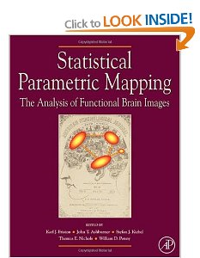
Geometric perspective
OLS estimates
y
Residual forming matrix R
e
x₂
x₁
Projection matrix P
Design space defined by X

Slide 17
Overview
Introduction
  ERP example
General Linear Model
  Definition & design matrix
  Parameter estimation
  Hypothesis testing
  t-test and contrast
  F-test and contrast

Slide 18
Hypothesis Testing
The Null Hypothesis H₀
Typically what we want to disprove (i.e. no effect).
⇒ Alternative Hypothesis H_{A} = outcome of interest.
The Test Statistic T
Summary statistic for which null distribution is known (under assumptions of general linear model)
Observed t-statistic small in magnitude when H₀ is true and large when false.
Null Distribution of T

Slide 19
Hypothesis Testing
Significance level α:
Acceptable false positive rate α.
⇒ threshold u_{α}, controls the false positive rate
Observation of test statistic t, a realisation of T
⇒ Conclusion about the hypothesis:
reject H₀ in favour of H_{a} if t > u_{α}
⇒ p-value:
summarises evidence against H₀.
= chance of observing value more extreme than t under H₀.
u_{α}
α
Null Distribution of T
t
p-value
Null Distribution of T

Slide 20
Overview
Introduction
  ERP example
General Linear Model
  Definition & design matrix
  Parameter estimation
  Hypothesis testing
  t-test and contrast
  F-test and contrast

Slide 21
Contrast & t-test
Contrast : specifies linear combination of parameter vector:
c^{T} = -1 +1
SPM-t over time & space
ERP: faces < scrambled ?
=
Test H₀:
contrast of
estimated
parameters
t =
variance
estimate

Slide 22
T-test: summary
T-test = signal-to-noise measure (ratio of size of estimate to its standard deviation).
T-statistic: NO dependency on scaling of the regressors or contrast
T-contrasts = simple linear combinations of the betas

Slide 23
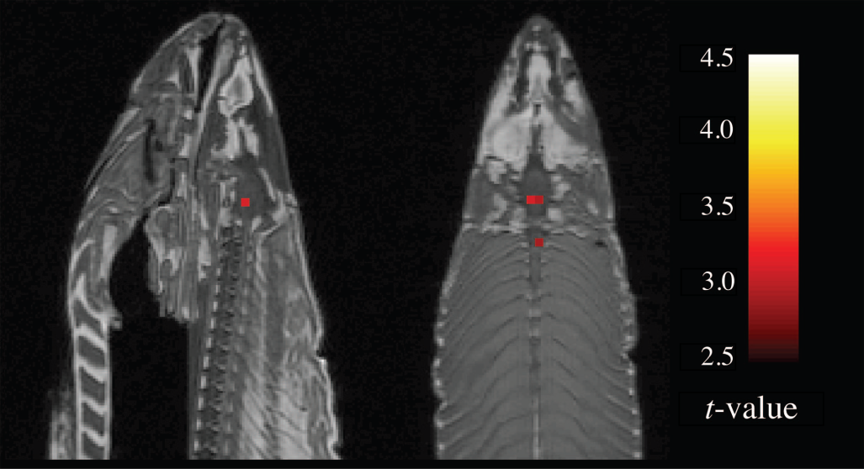
Adjustment for multiple comparisons
Neural Correlates of Interspecies Perspective Taking in
the Post-Mortem Atlantic Salmon: An Argument For
Proper Multiple Comparisons Correction
Bennett et al. (in press) Journal of Serendipitous and Unexpected Results
Final sentence of paper:
‘While we must guard against the elimination of
legitimate results through Type II error, the alternative of continuing forward with uncorrected statistics cannot be an option.’

Slide 24
Overview
Introduction
  ERP example
General Linear Model
  Definition & design matrix
  Parameter estimation
  Hypothesis testing
  t-test and contrast
  F-test and contrast

Slide 25
Extra-sum-of-squares & F-test
Model comparison: Full vs. Reduced model?
Null Hypothesis H₀: True model is X₀ (reduced model)
X₀
X₁
X₀
Test statistic: ratio of explained and unexplained variability (error)
RSS
RSS₀
ν₁ = rank(X) – rank(X₀)
ν₂ = N – rank(X)
Full model ?
Or reduced model?

Slide 26
F-test & multidimensional contrasts
Tests multiple linear hypotheses:
H₀: True model is X₀
H₀: β₃ = β₄ = 0
test H₀ : c^{T}β = 0 ?
X₀
X₁ (β₃₋₄)
X₀
c^{T} =
0 0 1 0
0 0 0 1
Full or reduced model?

Slide 27
Typical analysis
Evoked responses at sensor level:
multiple subjects, multiple conditions
Convert all data to images (pulldown menu ‚other‘)
Use 2nd-level statistics, e.g. paired t-test or
ANOVA if more than 2 conditions
Alternatively:
Convert all data to images (pulldown menu ‚other‘)
Compute contrast for each subject,
e.g. taking a difference (pulldown menu ‚other‘)
Use 1-sample t-test

Slide 28
Thank you
Thanks to Chris and the methods group for the borrowed slides!

