Slide 1

Statistical Parametric Mapping for fMRI, PET and VBM
Ged Ridgway
Wellcome Trust Centre for Neuroimaging
UCL Institute of Neurology
SPM Course
October 2011

Slide 2
Contents
Historical background
Positron emission tomography (PET)
Statistical parametric mapping (SPM)
Functional magnetic resonance imaging (fMRI)
Voxel-based morphometry

Slide 3
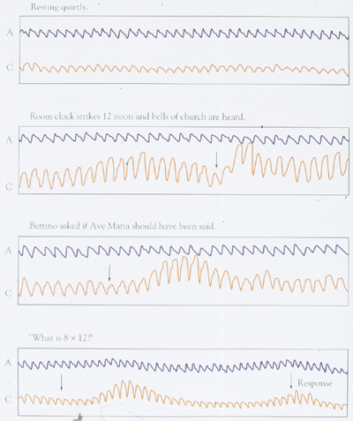
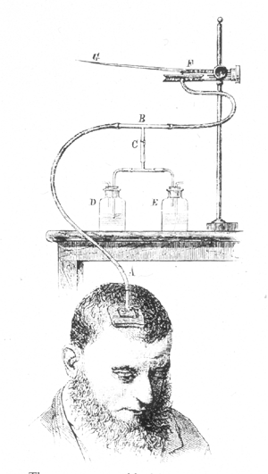
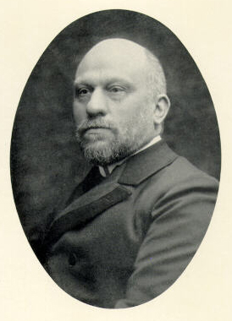
Part I: 19th Century (!)
Angelo Mosso, Turin 1846 – 1910
Figures from
David Heeger
Notes:
Resting quietly
Clock strikes 12, bells of church
Asked if Ave Maria should have been said
What is 8 x 12
Amazing, but not very specific…

Slide 4
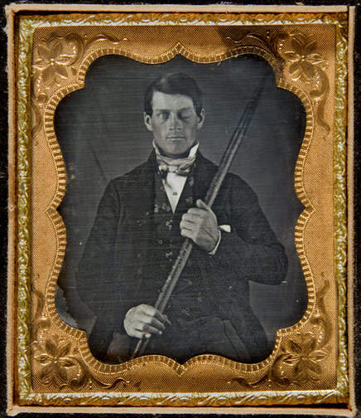
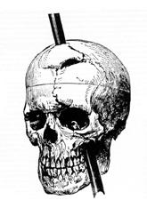
Part I: 19th Century (!)
Early evidence for functional segregation from damage
E.g. Phineas Gage, 1823-1860, studied by John Martyn Harlow, 1819-1907.
“Previous to his injury he possessed a well-balanced mind … the equilibrium between his intellectual faculties and animal propensities, seems to have been destroyed. He is fitful, irreverent, indulging in the grossest profanity”
From the collection of Jack and Beverly Wilgus

Slide 5
Haemodynamics
Roy & Sherrington (1890), On the Regulation of the Blood-supply of the Brain, J Physiol 11(1-2)
Fulton (1928) Observations upon the vascularity of the human occipital lobe during visual activity, Brain 51(3)
Raichle (1998), PNAS 95(3):765-772
  “introduction of an in vivo tissue autoradiographic measurement of regional blood flow in laboratory animals by Kety’s group provided the first glimpse of quantitative changes in blood flow in the brain related directly to brain function”
  William Landau [in Kety’s group]: “this is a very secondhand way of determining physiological activity; it is rather like trying to measure what a factory does by measuring the intake of water and the output of sewage. This is only a problem of plumbing”

Slide 6
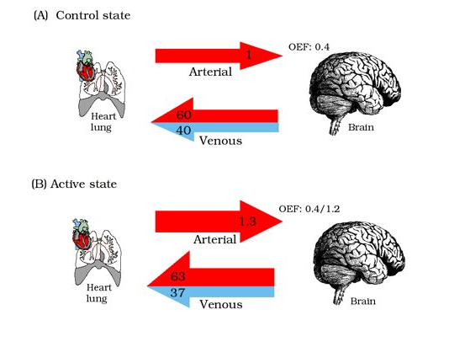
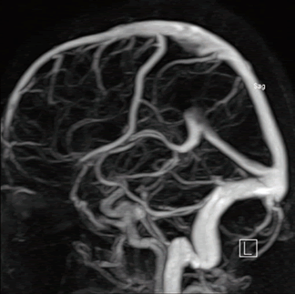
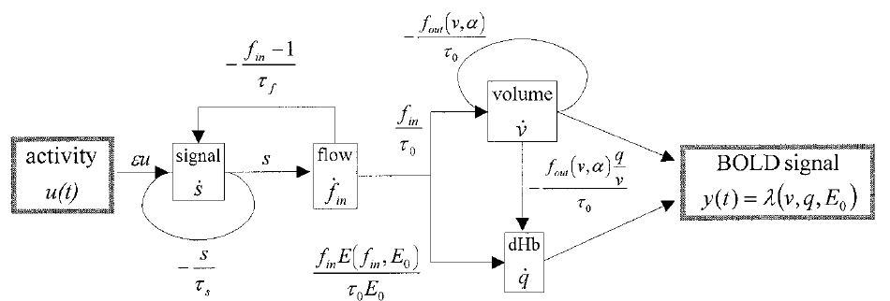
Haemodynamics
Please see Kerstin Preuschoff’s Zurich SPM Course slides for more
Friston et al. (2000) NeuroImage 12:466-477

Slide 7
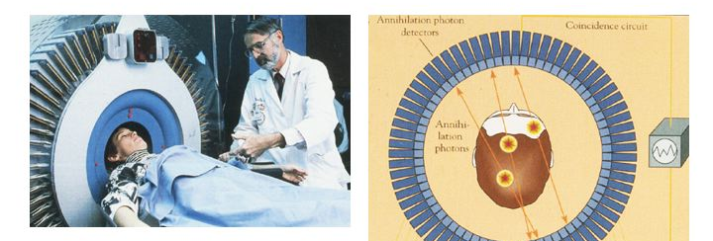
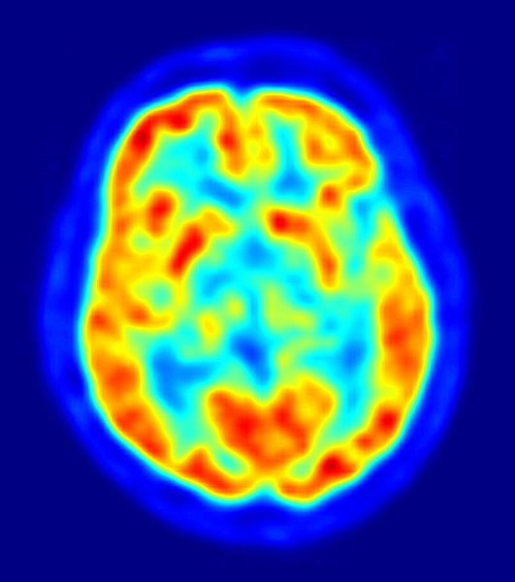
Positron emission tomography (PET)
A tracer (radionuclide) emits a positron, which annihilates with an electron, emitting a pair of gamma rays in opposite directions
The detected lines can be grouped into projection images (sinograms) and reconstructed into tomographic images
Different tracers allow various properties to be measured
  ¹⁵O can measure blood flow relatively quickly (<1 min) but requires a cyclotron because of its short 2 minute half-life
  ¹⁸F Fluorodeoxyglucose (FDG) measures glucose metabolism, and has a half life of 110 minutes
  Other tracers exist that bind to interesting receptors (e.g. dopamine, serotonin) or beta-amyloid plaques

Slide 8
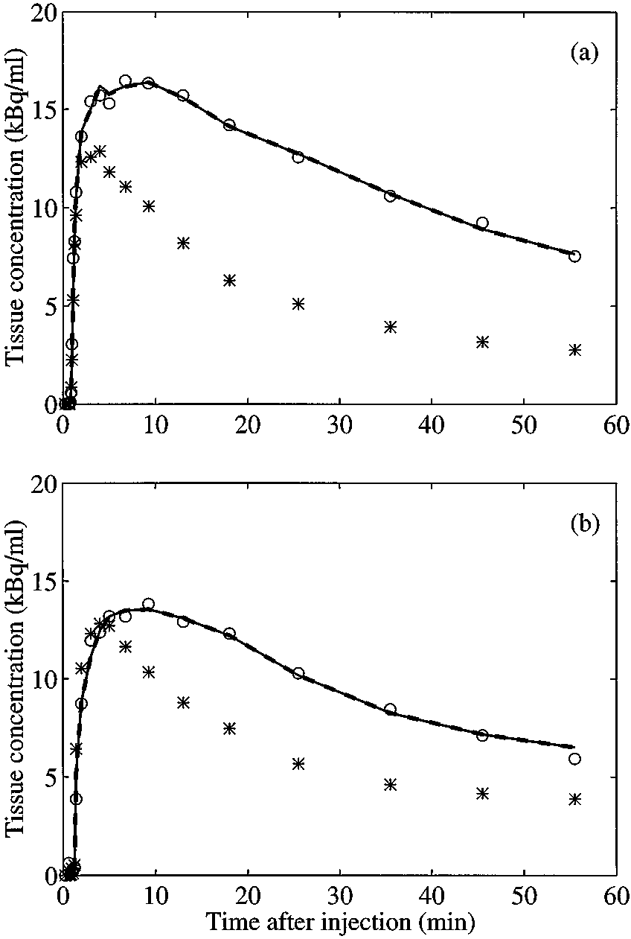
Parametric mapping
Early PET focussed on quantitation of parameters
See also Lammertsma & Hume (1996) [source of figure]
Prof Terry Jones interviewed by UCL Centre for History of Medicine:
“It was as if I could take a bit of my brain out and then put it into a laboratory well counter … how many megabecques or microcuries of radioactivity per ml of tissue … I pointed out if we could measure the concentration in the artery and the tissue at the same time, you could solve these equations for blood flow and oxygen consumption”

Slide 9
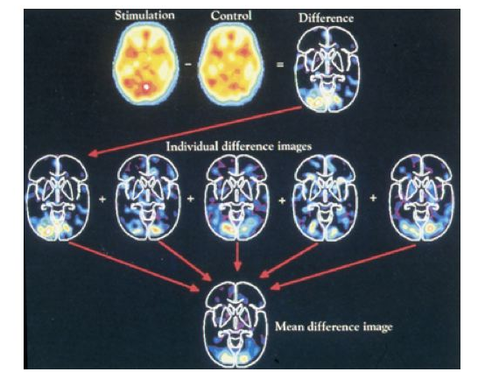
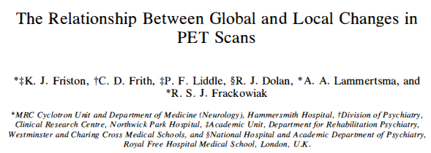
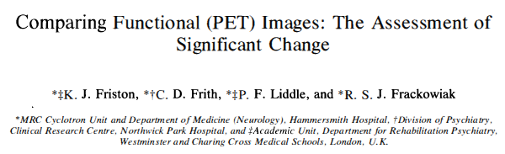
Statistical parametric mapping
Often the interest is not the quantities, but their differences in different conditions
Terry Jones: “And here was this guy Friston, sort of running roughshod over all this [quantitation], and saying, ‘Oh, I’ll take five of those, and five of those, and look for statistical differences…”

Slide 10
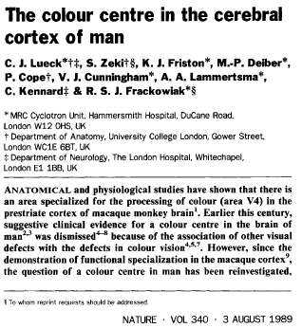
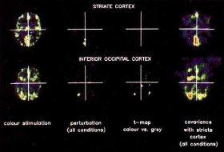
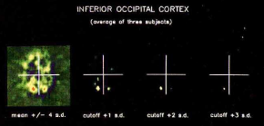
Statistical parametric mapping

Slide 11
Statistical parametric mapping
Some questions you might ask at this point
  Can we test more interesting hypotheses than condition A vs. B?
    Answer: The general linear model and experimental design
  How significant is a particular voxel’s t-score, given consideration of so many voxels over the brain?
    Multiple comparison correction using random field theory
  What if the subject moves during the scan or between scans? How can we report locations of findings? How can we combine data from multiple subjects?
    Image registration and spatial normalisation; hierarchical models
  What about functional integration of multiple brain regions?
    Functional and effective connectivity, dynamic causal modelling

Slide 12



Image time-series
Spatial filter
Design matrix
Statistical Parametric Map
Realignment
Smoothing
General Linear Model
Statistical
Inference
RFT
Normalisation
Anatomical
reference
p <0.05
Parameter estimates

Slide 13
Functional magnetic resonance imaging (fMRI)
Some disadvantages of PET
  Slow, even compared to haemodynamic delays
  Low spatial resolution
  Ionising radiation
Magnetic resonance imaging
  Quantum mechanical property of spin, e.g. of hydrogen nuclei
  Spins align with and precess around an applied magnetic field
  Inputting RF energy perturbs the established equilibrium and puts spins in phase with each other; a signal can be measured
  Spins relax back to equilibrium and de-phase with each other
    Different longitudinal (T1) and transverse (T2) relaxation times
    Field inhomogeneities accelerate the T2 relaxation (T2*)

Slide 14
Functional magnetic resonance imaging (fMRI)
Blood contains oxygenated and deoxygenated haemoglobin, with different magnetic properties
Paramagnetic deoxyhaemoglobin distorts the magnetic field, leading to faster T2* decay
The influx of blood following activity changes the proportion of oxy- and deoxyhaemoglobin, and hence the T2 or T2*-weighted MRI signal
This Blood Oxygenation Level Dependent (BOLD) effect allows functional imaging with MRI
See also Kerstin’s slides and Ogawa & Sung (2007)

Slide 15
More on the BOLD effect

Slide 16
More Karl on the BOLD effect
Friston (2009)
  How many times have you read, “We know very little about the relationship between fMRI signals and their underlying neuronal causes”?
  In fact, decades of careful studies have clarified an enormous amount about the mapping between neuronal activity and hemodynamics
  Furthermore, we know more than is sufficient to use fMRI for brain mapping. This is because the statistical models used to infer regionally specific responses make no assumptions about how neuronal responses are converted into measured signals

Slide 17
The imaging bit of MRI…
… is complicated!
The rate of precesssion is field-strength dependent
Electromagnetic coils can setup spatial gradients in field-strength, which cause gradients in precession frequency
A frequency gradient persisting for a certain time establishes a sinusoidal phase gradient
The overall signal is stronger if the spatial frequency of the object (e.g. some cortical folds) matches this
Can effectively measure the 2D Fourier transform or spectrum of an object, and hence reconstruct an image

Slide 18
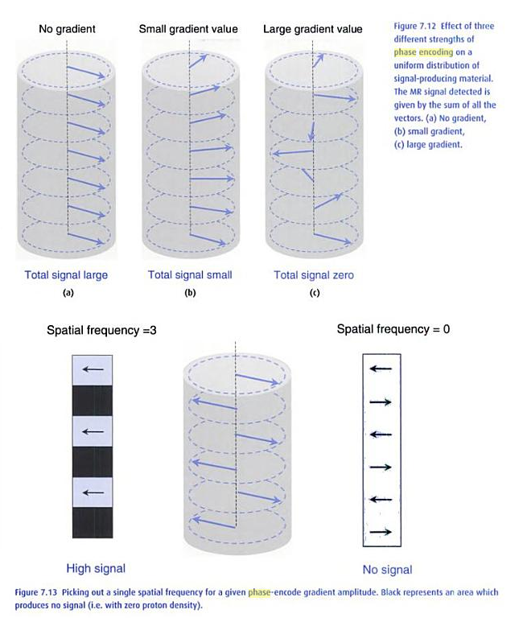
The imaging bit of MRI…
MRI from picture to proton has one of the clearest explanations and some great examples of how spatial frequency space (k-space) relates to features in the image space

Slide 19
Temporal modelling of fMRI data
With PET we can acquiring some scans in one condition and some in another, and test statistically for differences
With fMRI, we typically acquire a scan every few seconds, and wish to study “event-related” responses
  (also recently sub-second sampling, e.g. Feinberg et al., 2009)
We do this by creating a model of what the haemodynamic response to a sequence of events or conditions would look like in time (with its ~6s delay, undershoot, etc.) and fitting this model to the data

Slide 20
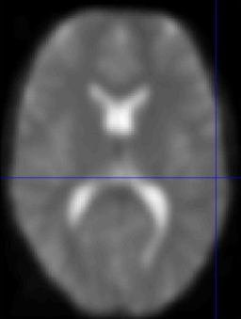
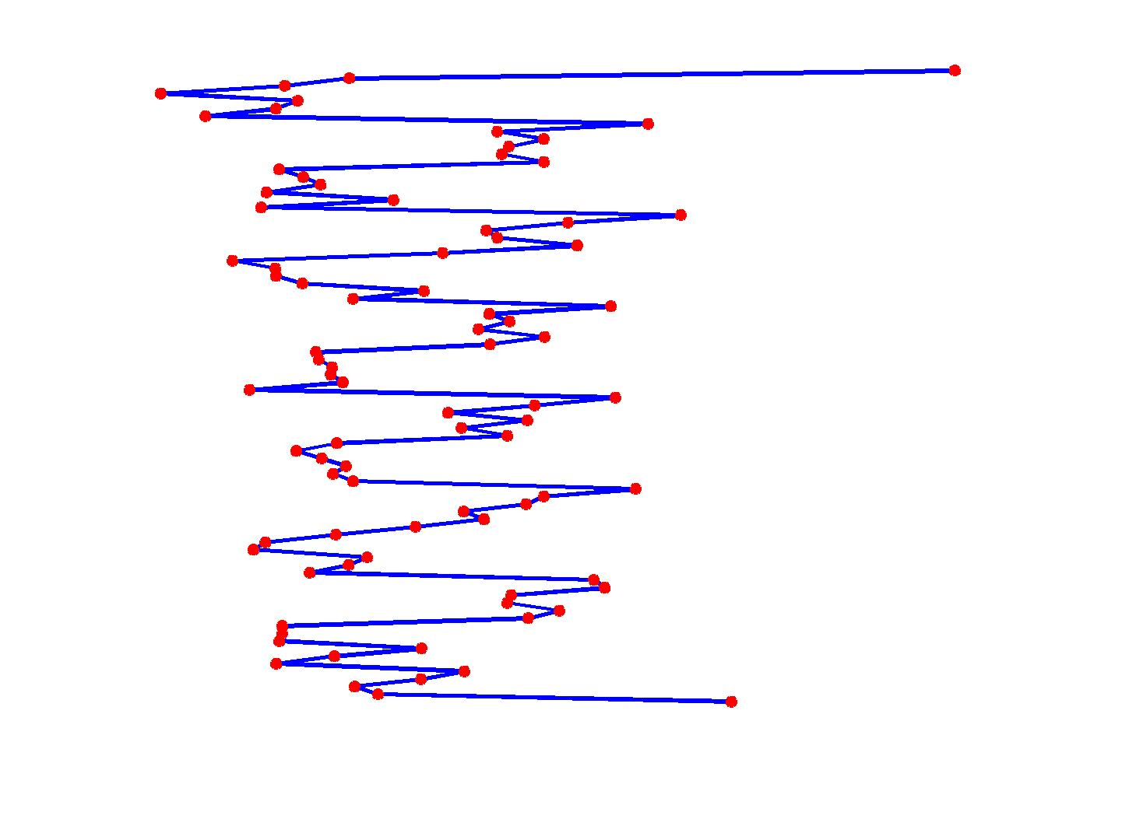
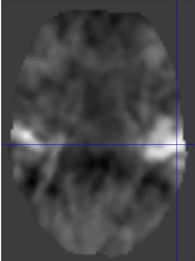
Voxel-wise time series analysis
Model
specification
Parameter
estimation
Time
Hypothesis
Statistic
Time
BOLD signal
single voxel
time series
SPM

Slide 21
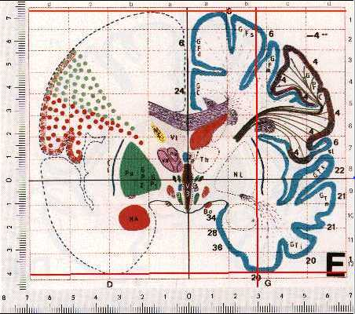
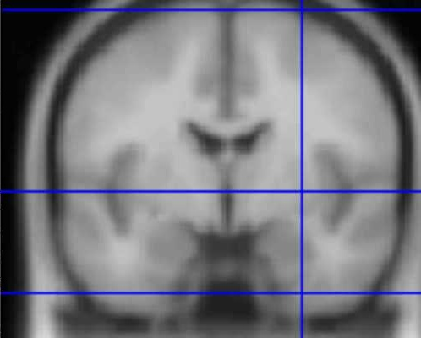
Multiple subjects and standard space
The Talairach Atlas
(single subject, post-mortem)
The MNI/ICBM AVG152 Template
(average of 152 in-vivo MRI)

Slide 22
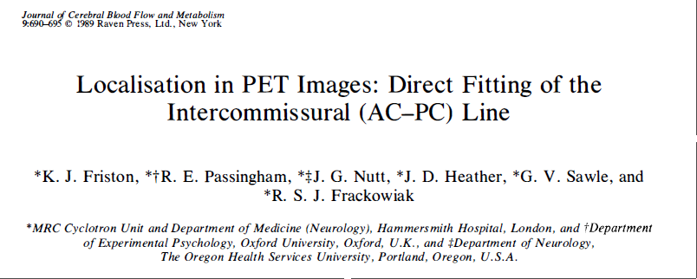
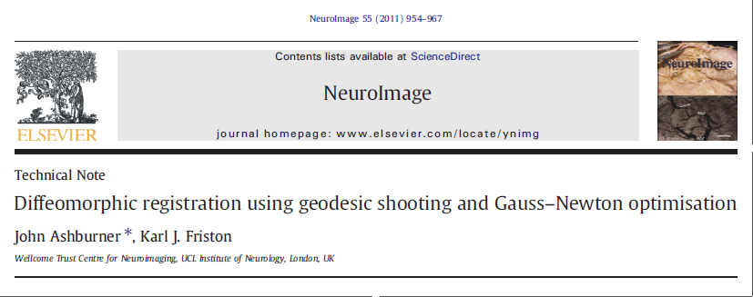
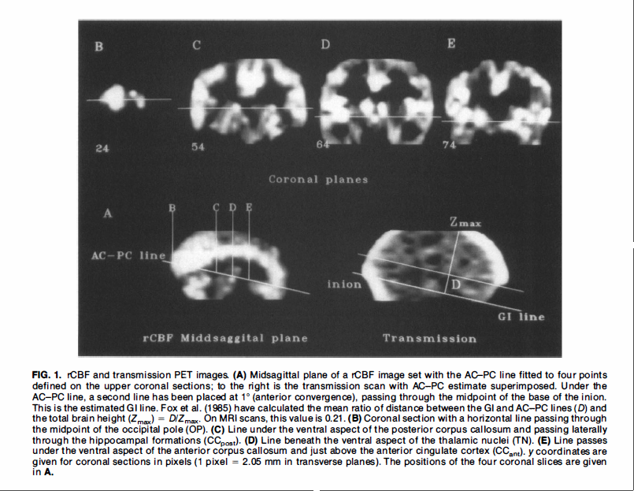
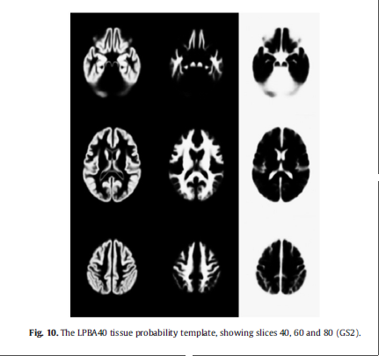
Spatial normalisation

Slide 23
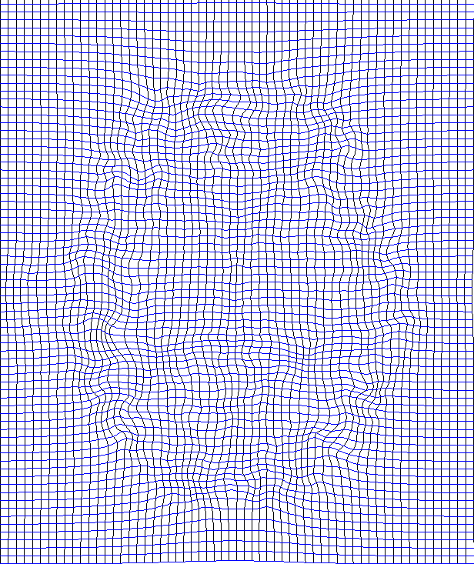
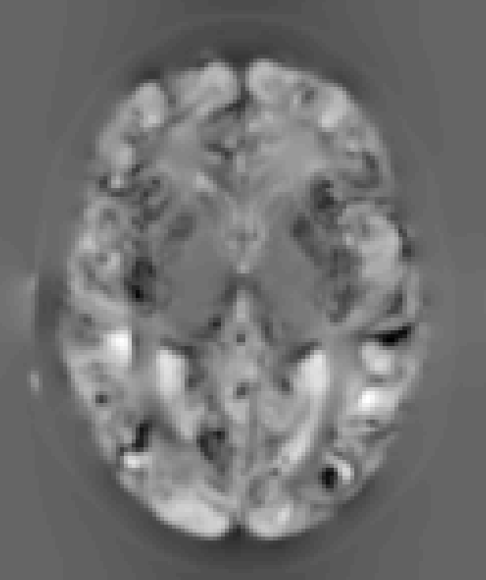
Computational anatomy
If we can estimate the transformations that align and warp each subject to match a template, then we can study individual differences in these transformations or derivatives
E.g. deformation-based and tensor-based morphometry
  Changes in local volume are interesting and interpretable

Slide 24
Voxel based morphometry (VBM)
VBM involves creating spatially normalised images, whose intensities at each point relate to the local volume of a particular brain tissue (e.g. gray matter) at the corresponding point in the original (unnormalised) image
This requires tissue segmentation, spatial normalisation, and a “change of variables” to account for volume changes occuring in the normalisation process
Spatial smoothing helps to ameliorate residual anatomical differences after imperfect normalisation
The same general linear modelling & RFT machinery in SPM can then be used to study differences in structure

Slide 25
Image time-series
Spatial filter
Design matrix
Statistical Parametric Map
Realignment
Smoothing
General Linear Model
Statistical
Inference
RFT
Normalisation
Anatomical
reference
p <0.05
Parameter estimates

Slide 26
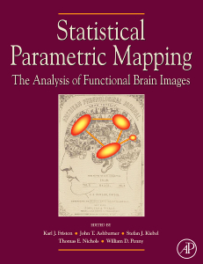
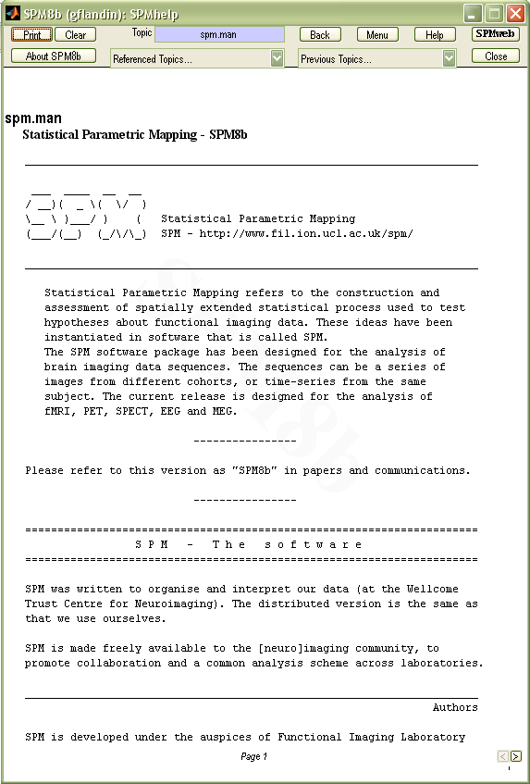
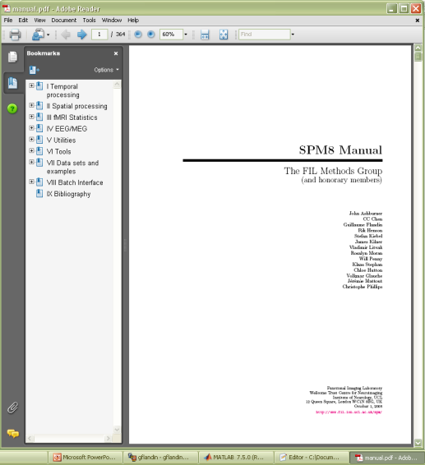
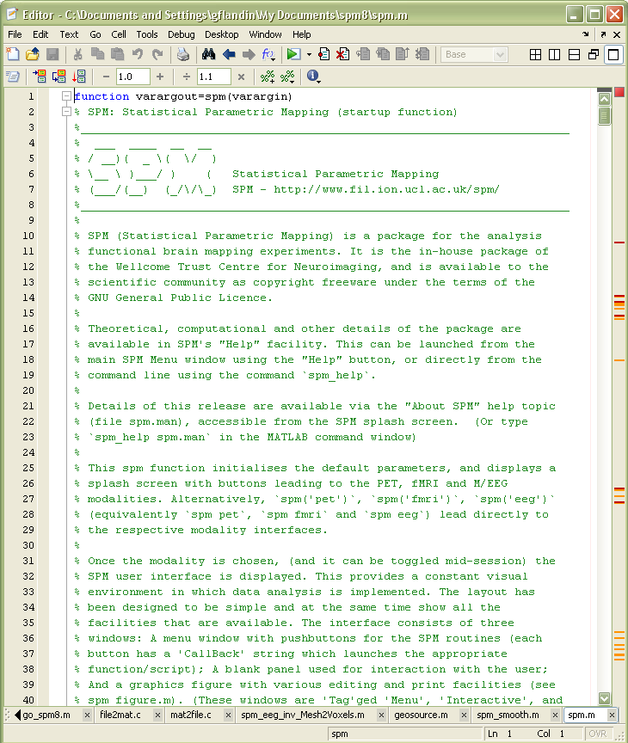
SPM Documentation
SPM Books:
Human Brain Function I & II
Statistical Parametric Mapping
Peer reviewed literature
Online help
& function
descriptions
SPM Manual

