Slide 1
SPM Course Oct 2011
Voxel-Based Morphometry
Ged Ridgway
With thanks to John Ashburner
and the FIL Methods Group

Slide 2
Aims of computational neuroanatomy
Many interesting and clinically important questions might relate to the shape or local size of regions of the brain
For example, whether (and where) local patterns of brain morphometry help to:
  Distinguish schizophrenics from healthy controls
  Explain the changes seen in development and aging
  Understand plasticity, e.g. when learning new skills
  Find structural correlates (scores, traits, genetics, etc.)
  Differentiate degenerative disease from healthy aging
    Evaluate subjects on drug treatments versus placebo

Slide 3
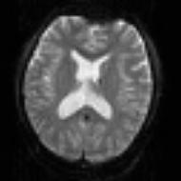
SPM for group fMRI
Group-wise
statistics
fMRI time-series
Preprocessing
Stat. modelling
Results query
spm T
Image
“Contrast”
Image
fMRI time-series
Preprocessing
Stat. modelling
Results query
“Contrast”
Image
fMRI time-series
Preprocessing
Stat. modelling
Results query
“Contrast”
Image

Slide 4
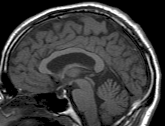
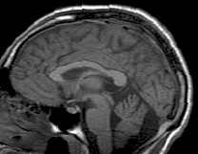
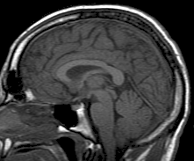
SPM for structural MRI
?
Group-wise
statistics
High-res T1 MRI
?
High-res T1 MRI
?
High-res T1 MRI
?

Slide 5
Segmentation into principal tissue types
High-resolution MRI reveals fine structural detail in the brain, but not all of it reliable or interesting
  Noise, intensity-inhomogeneity, vasculature, …
MR Intensity is usually not quantitatively meaningful (in the same way that e.g. CT is)
  fMRI time-series allow signal changes to be analysed statistically, compared to baseline or global values
Regional volumes of the three main tissue types: gray matter, white matter and CSF, are well-defined and potentially very interesting
  Other aspects (and other sequences) can also be of interest

Slide 6
Summary of unified segmentation
Unifies tissue segmentation and spatial normalisation
  Principled Bayesian formulation: probabilistic generative model
Gaussian mixture model with deformable tissue prior probability maps (from segmentations in MNI space)
  The inverse of the transformation that aligns the TPMs can be used to normalise the original image to standard space
Bias correction is included within the model

Slide 7
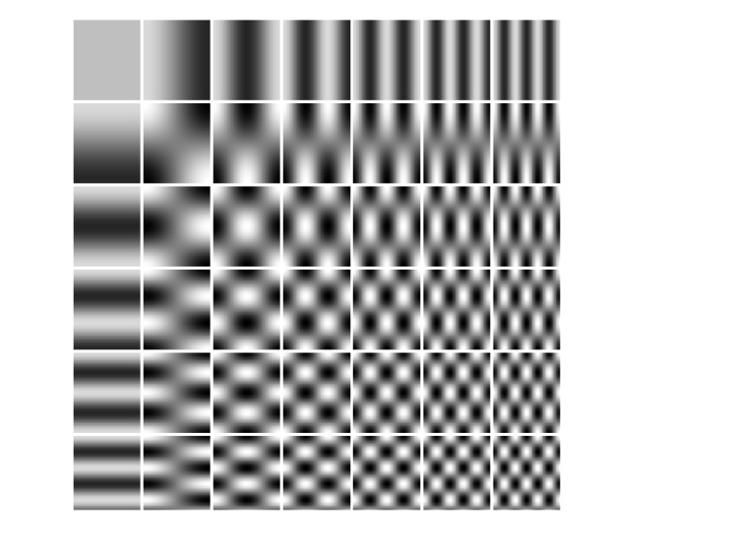
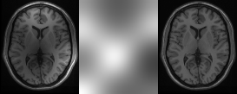
Modelling inhomogeneity
MR images are corrupted by spatially smooth intensity variations (worse at high field strength)
A multiplicative bias correction field is modelled as a linear combination of basis functions.
Corrupted image
Bias Field
Corrected image

Slide 8
Gaussian mixture model (GMM or MoG)
Classification is based on a Mixture of Gaussians (MoG) model fitted to the intensity probability density (histogram)
Frequency
Image Intensity

Slide 9
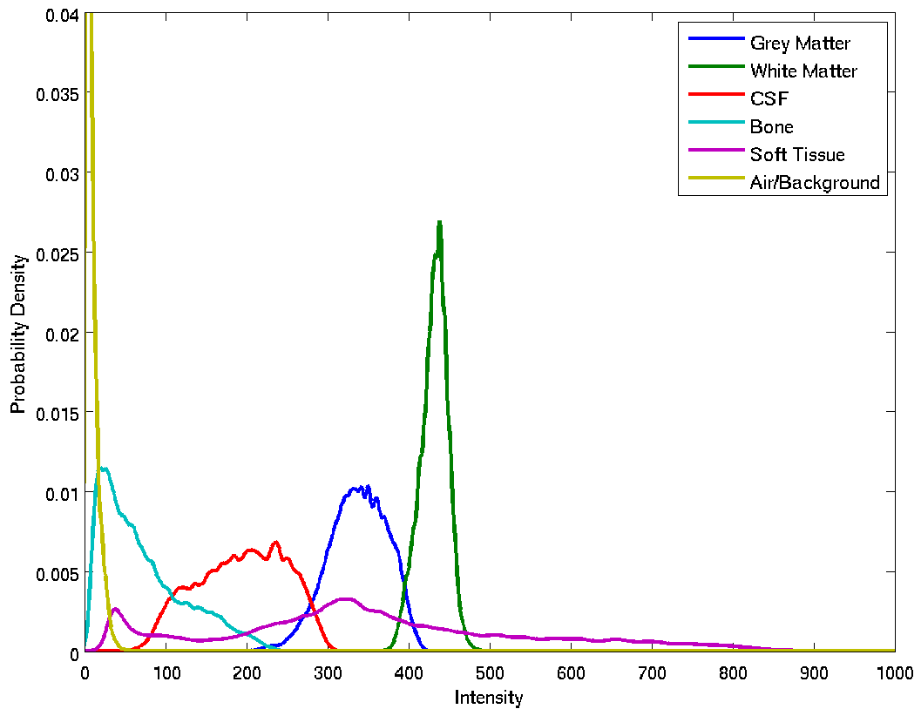
Tissue intensity distributions (T1-w MRI)

Slide 10
Non-Gaussian Intensity Distributions
Multiple Gaussians per tissue class allow non-Gaussian intensity distributions to be modelled.
  E.g. accounting for partial volume effects

Slide 11
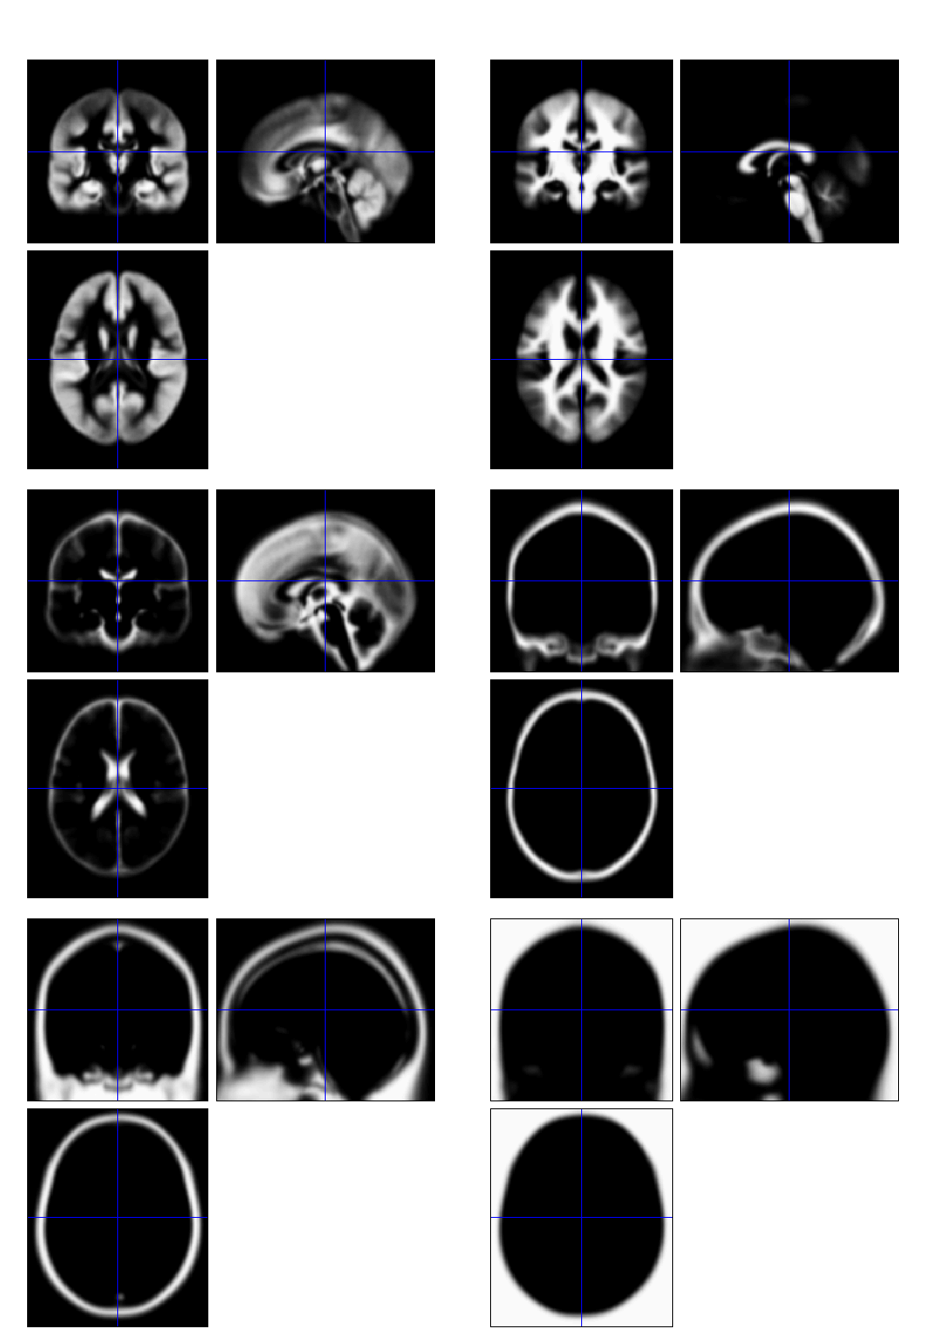
TPMs – Tissue prior probability maps
Each TPM indicates the prior probability for a particular tissue at each point in MNI space
  Fraction of occurrences in previous segmentations
TPMs are warped to match the subject
  The inverse transform normalises to MNI space

Slide 12
Limitations of the current model
Assumes that the brain consists of only the tissues modelled by the TPMs
  No spatial knowledge of lesions (stroke, tumours, etc)
Prior probability model is based on relatively young and healthy brains
  Less appropriate for subjects outside this population
Needs reasonable quality images to work with
  No severe artefacts
  Good separation of intensities
  Good initial alignment with TPMs...

Slide 13
Possible extensions
Deeper Bayesian philosophy
  E.g. priors over means and variances
  Marginalisation of nuisance variables
  Model comparison, e.g. for numbers of Gaussians
Groupwise model (enormous!)
Combination with DARTEL (see later)
More tissue priors e.g. separating cortical and deep grey
Imaging physics
  See Fischl et al. (2004), as cited in A&F (2005) introduction

Slide 14
Voxel-Based Morphometry
In essence VBM is Statistical Parametric Mapping of regional segmented tissue density or volume
The exact interpretation of gray matter density or volume is complicated, and depends on the preprocessing steps used
  It is not interpretable as neuronal packing density or other cytoarchitectonic tissue properties
  The hope is that changes in these microscopic properties may lead to macro- or mesoscopic VBM-detectable differences

Slide 15
VBM methods overview
Unified segmentation and spatial normalisation
  More flexible groupwise normalisation using DARTEL
[Optional] modulation with Jacobian determinant
Optional computation of tissue totals/globals
Gaussian smoothing
Voxel-wise statistical analysis

Slide 16
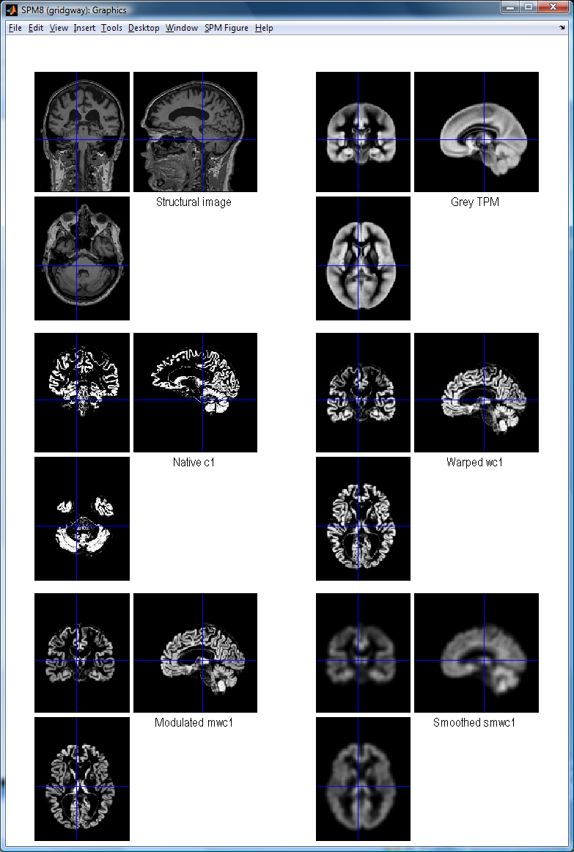
VBM in pictures
Segment
Normalise

Slide 17
VBM in pictures
Segment
Normalise
Modulate
Smooth

Slide 18
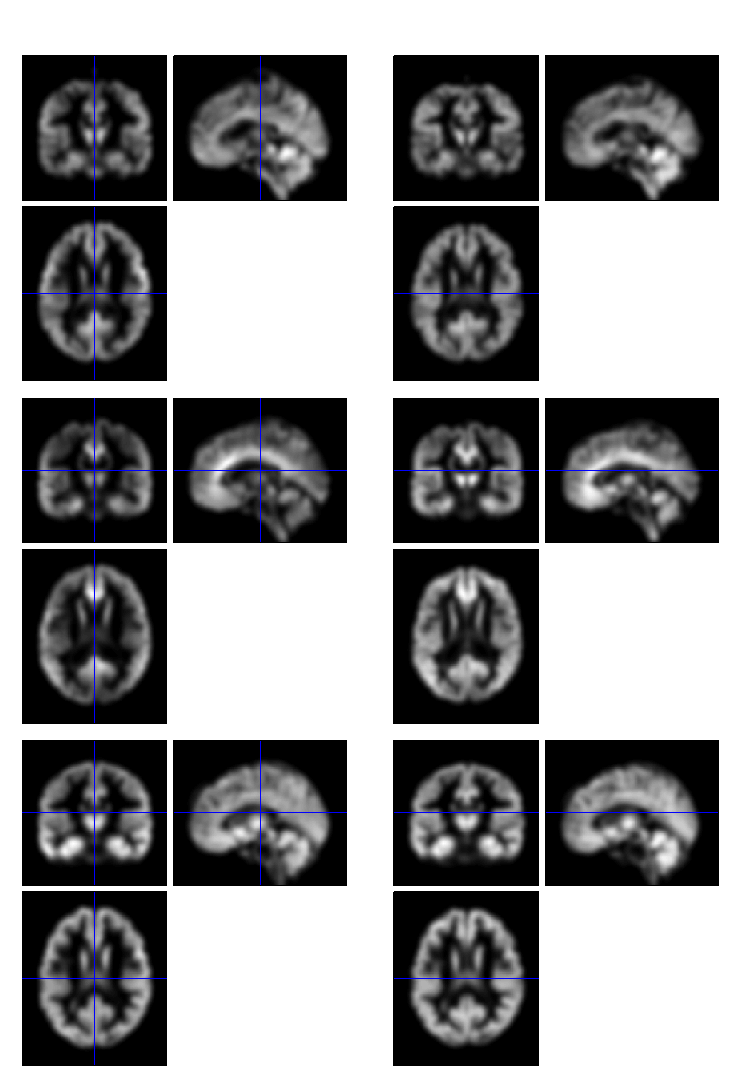
VBM in pictures
Segment
Normalise
Modulate
Smooth
Voxel-wise statistics

Slide 19
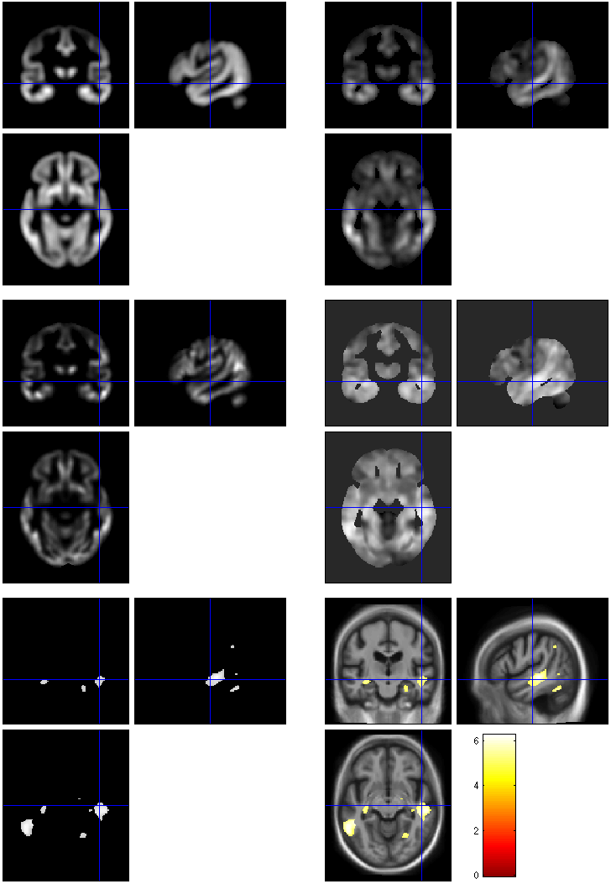
VBM in pictures
beta_0001
con_0001
Segment
Normalise
Modulate
Smooth
Voxel-wise statistics
ResMS
spmT_0001
FWE < 0.05

Slide 20
VBM Subtleties
Whether to modulate
How much to smooth
Interpreting results
Adjusting for total GM or Intracranial Volume
Limitations of linear correlation
Statistical validity

Slide 21
Modulation
1 1
Native
intensity = tissue density
Multiplication of the warped (normalised) tissue intensities so that their regional or global volume is preserved
  Can detect differences in completely registered areas
Otherwise, we preserve concentrations, and are detecting mesoscopic effects that remain after approximate registration has removed the macroscopic effects
  Flexible (not necessarily “perfect”) registration may not leave any such differences
Unmodulated
1 1 1 1
Modulated
2/3 1/3 1/3 2/3
Notes:
Clarify, modulation not a step (as spm2) but an option in the segment and the normalise GUIs

Slide 22
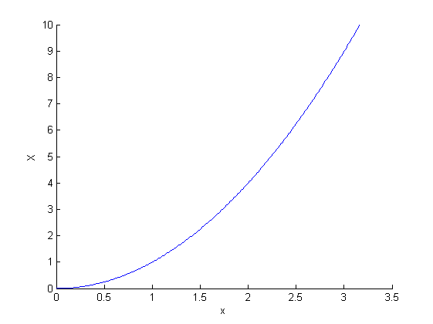
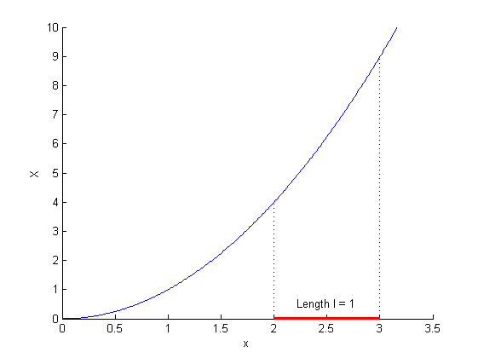
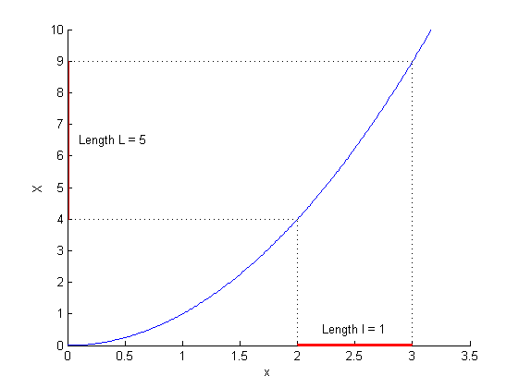
Modulation tutorial
X = x²
X’ = dX/dx = 2x
X’(2.5) = 5
Available from http://tinyurl.com/ModulationTutorial

Slide 23
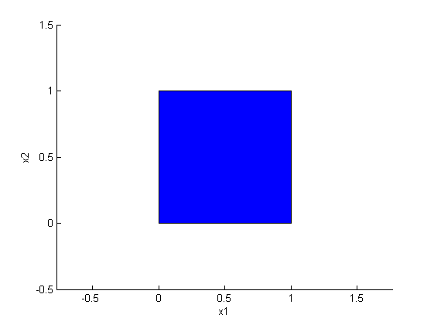
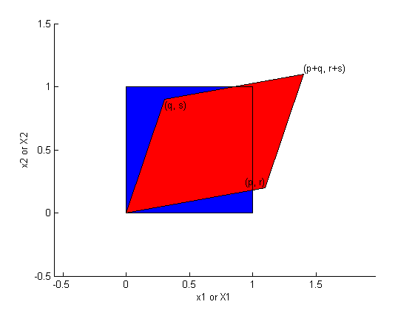
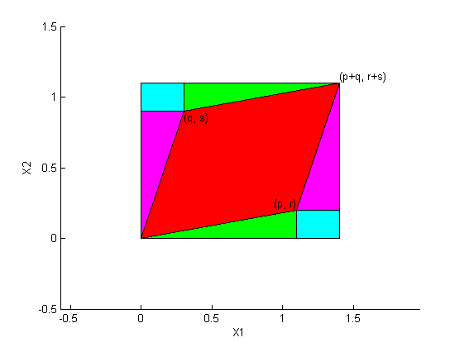
Modulation tutorial
Square area =
(p+q)(r+s) =
pr+ps+qr+qs
Red area =
Square – cyan – magenta – green =
pr+ps+qr+qs – 2qr – qs – pr = ps – qr

Slide 24
Smoothing
The analysis will be most sensitive to effects that match the shape and size of the kernel
The data will be more Gaussian and closer to a continuous random field for larger kernels
Results will be rough and noise-like if too little smoothing is used
Too much will lead to distributed, indistinct blobs

Slide 25
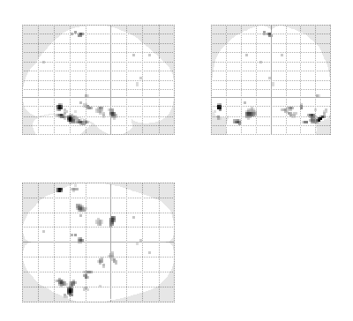
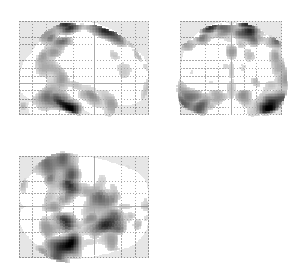
Smoothing
Between 7 and 14mm is probably reasonable
  (DARTEL’s greater precision allows less smoothing)
  The results below show two fairly extreme choices, 5mm on the left, and 16mm, right

Slide 26
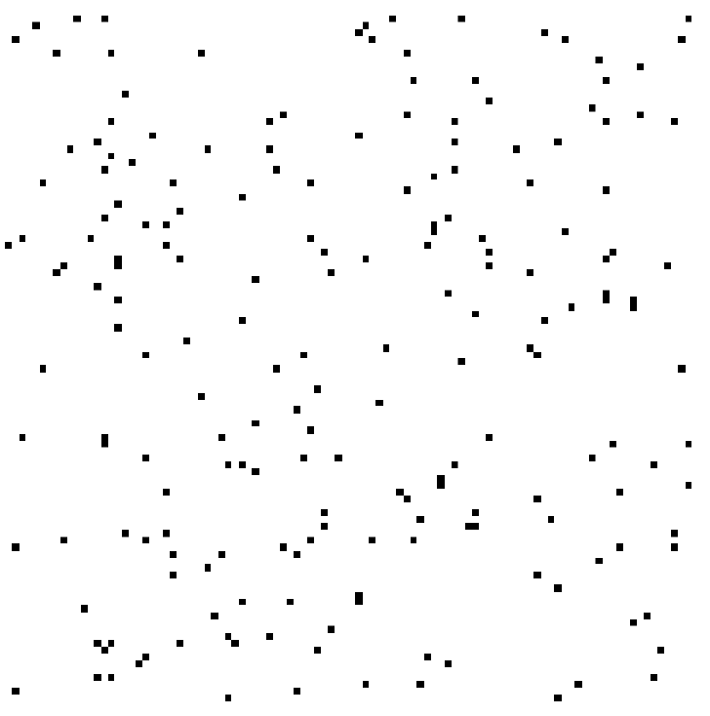
Interpreting findings
Mis-classify
Mis-register
Folding
Thinning
Thickening
Mis-register
Mis-classify

Slide 27
“Globals” for VBM
Shape is really a multivariate concept
  Dependencies among volumes in different regions
SPM is mass univariate
  Combining voxel-wise information with “global” integrated tissue volume provides a compromise
  Using either ANCOVA or proportional scaling
(ii) is globally thicker, but locally thinner than (i) – either of these effects may be of interest to us.
Fig. from: Voxel-based morphometry of the human brain… Mechelli, Price, Friston and Ashburner. Current Medical Imaging Reviews 1(2), 2005.
Notes:
Note globals don’t help distinguish the thickened or folded cortex...

Slide 28
Total Intracranial Volume (TIV/ICV)
“Global” integrated tissue volume may be correlated with interesting regional effects
  Correcting for globals in this case may overly reduce sensitivity to local differences
  Total intracranial volume integrates GM, WM and CSF, or attempts to measure the skull-volume directly
    Not sensitive to global reduction of GM+WM (cancelled out by CSF expansion – skull is fixed!)
  Correcting for TIV in VBM statistics may give more powerful and/or more interpretable results
    See e.g. Barnes et al., (2010), NeuroImage 53(4):1244-55

Slide 29

Nonlinearity
Caution may be needed when interpreting linear relationships between grey matter concentrations and some covariate of interest.
Circles of uniformly increasing area.
Plot of intensity at circle centres versus area
Smoothed

Slide 30
VBM’s statistical validity
Residuals are not normally distributed
  Little impact on uncorrected statistics for experiments comparing reasonably sized groups
  Probably invalid for experiments that compare single subjects or tiny patient groups with a larger control group
  Mitigate with large amounts of smoothing
  Or use nonparametric tests that make fewer assumptions, e.g. permutation testing with SnPM

Slide 31
VBM’s statistical validity
Correction for multiple comparisons
  RFT correction based on peak heights is fine
Correction using cluster extents is problematic
  SPM usually assumes that the smoothness of the residuals is spatially stationary
    VBM residuals have spatially varying smoothness
    Bigger blobs expected in smoother regions
  Cluster-based correction accounting for nonstationary smoothness is under development
    See also Satoru Hayasaka’s nonstationarity toolbox
    http://www.fmri.wfubmc.edu/cms/NS-General
  Or use SnPM…

Slide 32
VBM’s statistical validity
False discovery rate
  Less conservative than FWE
  Popular in morphometric work
    (almost universal for cortical thickness in FreeSurfer)
  Recently questioned…
Topological FDR (for clusters and peaks)
  See SPM8 release notes and Justin’s papers
  http://dx.doi.org/10.1016/j.neuroimage.2008.05.021
  http://dx.doi.org/10.1016/j.neuroimage.2009.10.090

Slide 33
Longitudinal VBM
The simplest method for longitudinal VBM is to use cross-sectional preprocessing, but longitudinal statistical analyses
  Standard preprocessing not optimal, but unbiased
  Non-longitudinal statistics would be severely biased
    (Estimates of standard errors would be too small)
  Simplest longitudinal statistical analysis: two-stage summary statistic approach (common in fMRI)
    Within subject longitudinal differences or beta estimates from linear regressions against time

Slide 34
Longitudinal VBM variations
Intra-subject registration over time is much more accurate than inter-subject normalisation
  Different approaches suggested to capitalise
A simple approach is to apply one set of normalisation parameters (e.g. Estimated from baseline images) to both baseline and repeat(s)
  Draganski et al (2004) Nature 427: 311-312
“Voxel Compression mapping” – separates expansion and contraction before smoothing
  Scahill et al (2002) PNAS 99:4703-4707

Slide 35
Longitudinal VBM variations
Can also multiply longitudinal volume change with baseline or average grey matter density
  Chételat et al (2005) NeuroImage 27:934-946
  Kipps et al (2005) JNNP 76:650
  Hobbs et al (2009) doi:10.1136/jnnp.2009.190702
Note that use of baseline (or repeat) instead of average might lead to bias
  Thomas et al (2009) doi:10.1016/j.neuroimage.2009.05.097
  Unfortunately, the explanations in this reference relating to interpolation differences are not quite right... there are several open questions here...

Slide 36
Spatial normalisation with DARTEL
VBM is crucially dependent on registration performance
  Limited flexibility (low DoF) registration has been criticised
  Inverse transformations are useful, but not always well-defined
  More flexible registration requires careful modelling and regularisation (prior belief about reasonable warping)
  MNI/ICBM templates/priors are not universally representative
The DARTEL toolbox combines several methodological advances to address these limitations
Evaluations show DARTEL performs at state-of-the art
  E.g. Klein et al., (2009) NeuroImage 46(3):786-802
  …

Slide 37
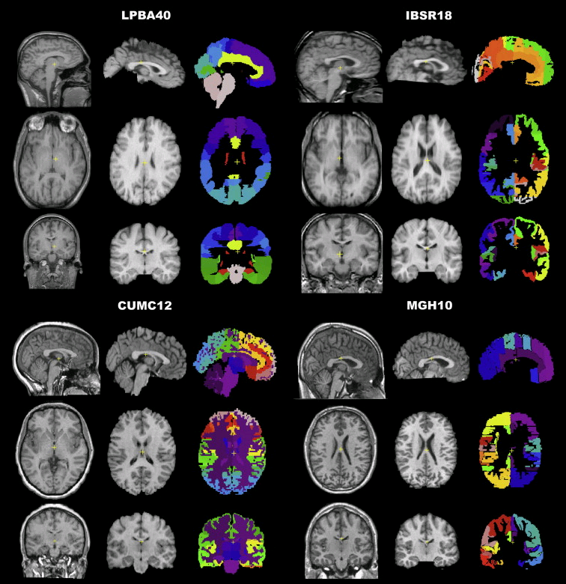
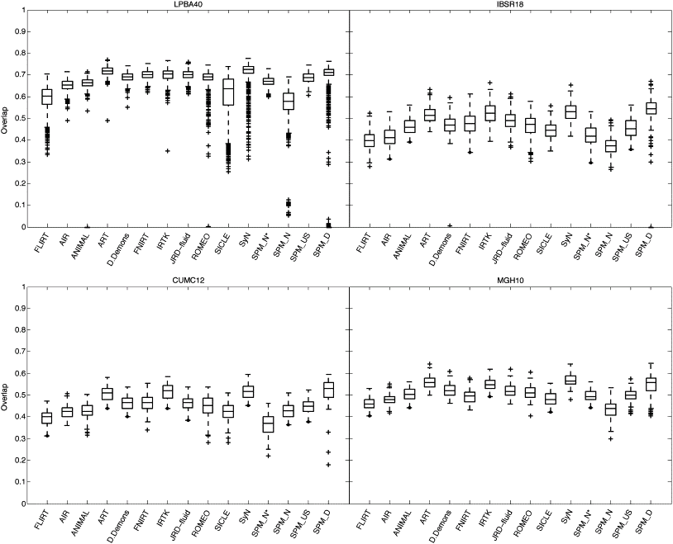
Part of Fig.1 in Klein et al.
Part of Fig.5 in Klein et al.
Notes:
Recent papers comparing different approaches have favoured more flexible methods
DARTEL usually outperforms DCT normalisation
Also comparable to the best algorithms from other software packages
(though note that DARTEL and others have many tunable parameters...)

Slide 38
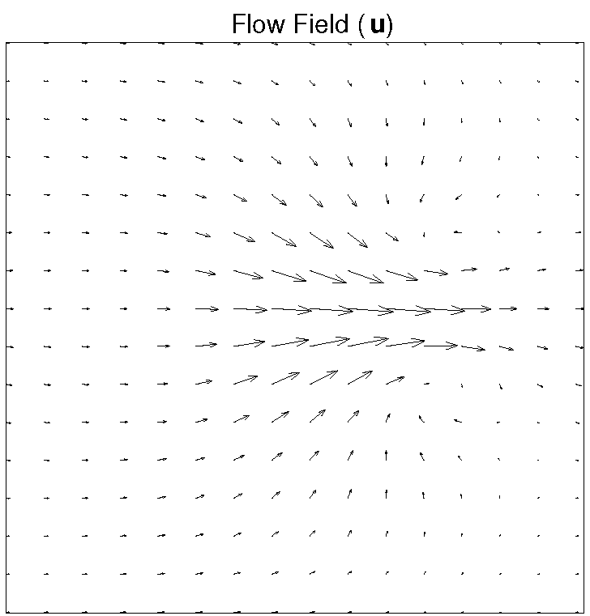
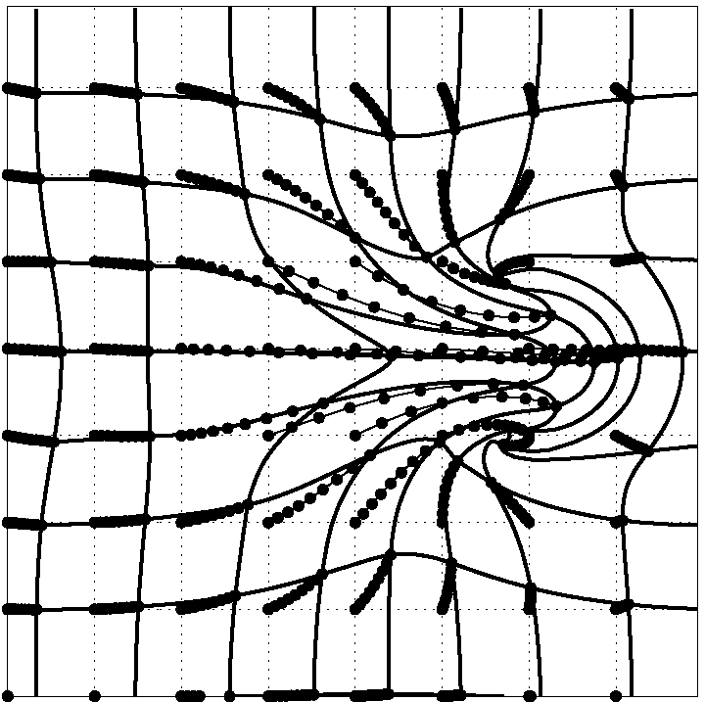
DARTEL Transformations
Estimate (and regularise) a flow u
  (think syrup rather than elastic)
  3 (x,y,z) parameters per 1.5mm³ voxel
  10^6 degrees of freedom vs. 10^3 DF for old discrete cosine basis functions
φ⁽⁰⁾(x) = x
φ⁽¹⁾(x) = ∫ u(φ^{(t)}(x))dt
Scaling and squaring is used to generate deformations
Inverse simply integrates -u
1
t=0

Slide 39
DARTEL objective function
Likelihood component (matching)
  Specific for matching tissue segments to their mean
  Multinomial distribution (cf. Gaussian)
Prior component (regularisation)
  A measure of deformation (flow) roughness = ½u^{T}Hu
Need to choose H and a balance between the two terms
  Defaults usually work well (e.g. even for AD)
  Though note that changing models (priors) can change results

Slide 40
Simultaneous registration of GM to GM and WM to WM, for a group of subjects
Grey matter
Subject 1
White matter
Grey matter
Subject 3
White matter
Grey matter
White matter
Grey matter
Template
Grey matter
White matter
White matter
Subject 2
Subject 4

Slide 41
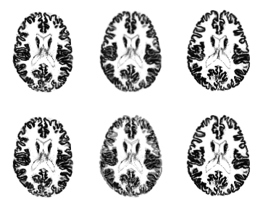
Example geodesic shape average
Uses average flow field
Average on Riemannian manifold
Linear Average
(Not on Riemannian manifold)

Slide 42
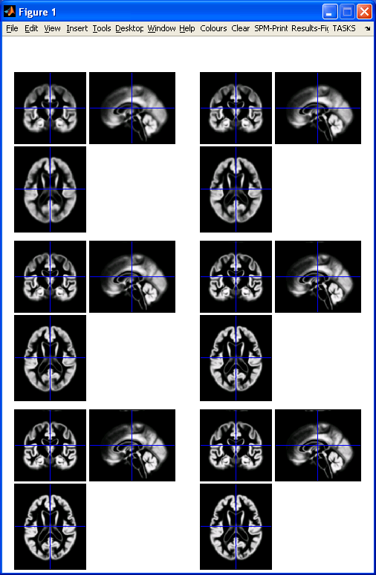
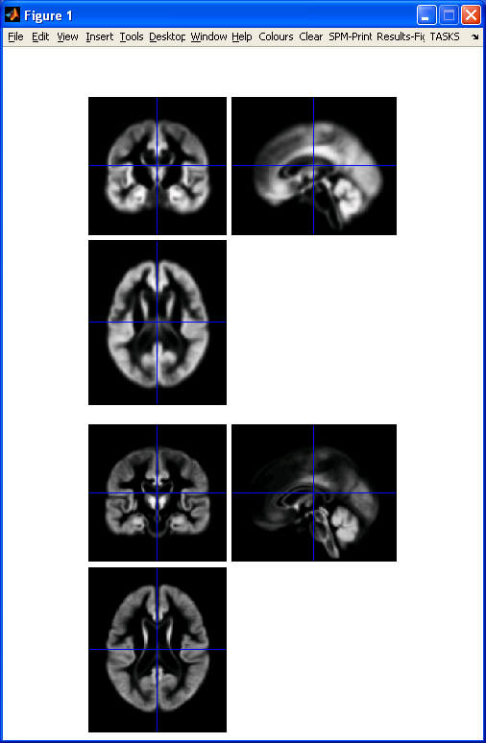
DARTEL average template evolution
Template
1
Rigid average
(Template_0)
Average of
mwc1 using
segment/DCT
Template
6
Notes:
60 images from OASIS cross-sectional data (as in VBM practical)

Slide 43
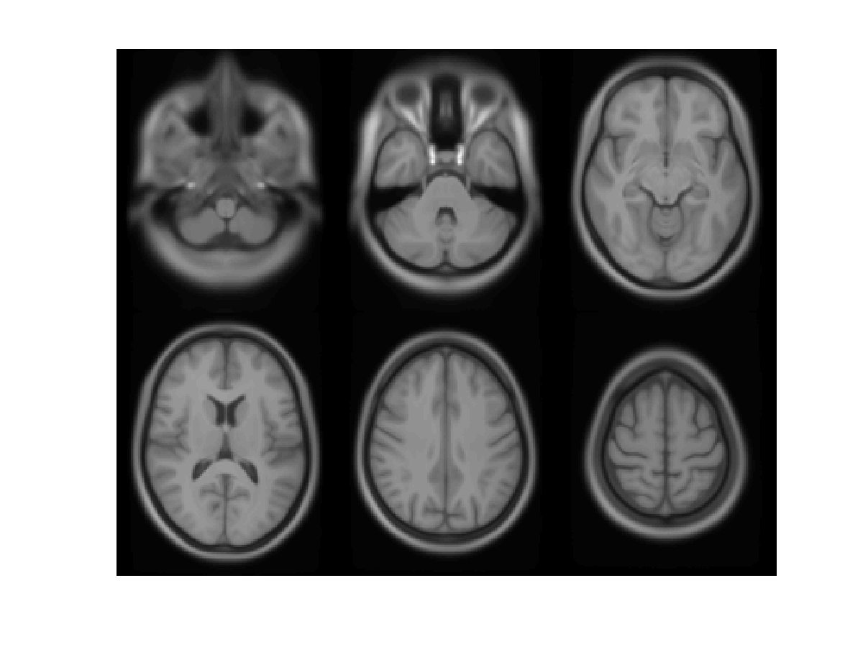

Slide 44
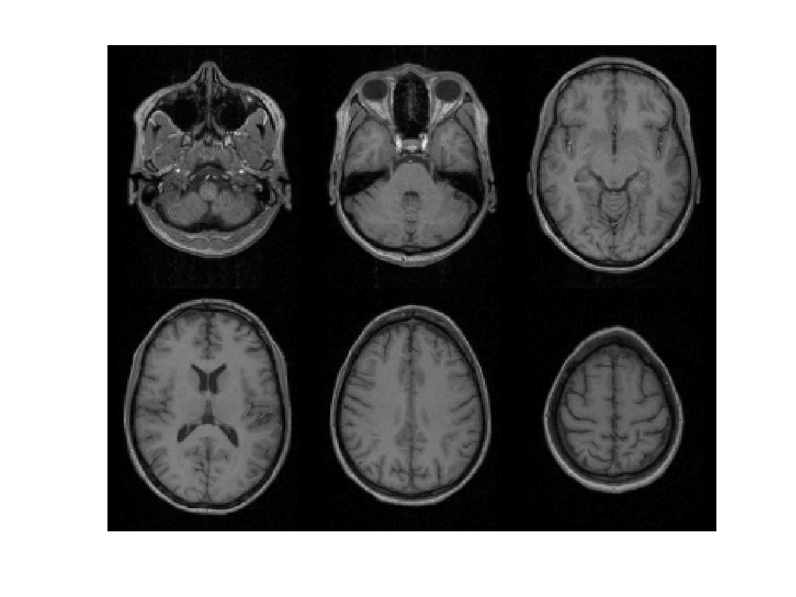

Slide 45
Summary
VBM performs voxel-wise statistical analysis on smoothed (modulated) normalised tissue segments
SPM8 performs segmentation and spatial normalisation in a unified generative model
  Based on Gaussian mixture modelling, with DCT-warped spatial priors, and multiplicative bias field
  The new segment toolbox includes non-brain priors and more flexible/precise warping of them
Subsequent (currently non-unified) use of DARTEL improves normalisation for VBM
  And perhaps also fMRI...

Slide 46
Historical bibliography of VBM
A Voxel-Based Method for the Statistical Analysis of Gray and White Matter Density… Wright, McGuire, Poline, Travere, Murrary, Frith, Frackowiak and Friston (1995 (!)) NeuroImage 2(4)
  Rigid reorientation (by eye), semi-automatic scalp editing and segmentation, 8mm smoothing, SPM statistics, global covars.
Voxel-Based Morphometry – The Methods. Ashburner and Friston (2000) NeuroImage 11(6 pt.1)
  Non-linear spatial normalisation, automatic segmentation
  Thorough consideration of assumptions and confounds

Slide 47
Historical bibliography of VBM
A Voxel-Based Morphometric Study of Ageing… Good, Johnsrude, Ashburner, Henson and Friston (2001) NeuroImage 14(1)
  Optimised GM-normalisation (“a half-baked procedure”)
Unified Segmentation. Ashburner and Friston (2005) NeuroImage 26(3)
  Principled generative model for segmentation using
  deformable priors
A Fast Diffeomorphic Image Registration Algorithm. Ashburner (2007) Neuroimage 38(1)
  Large deformation normalisation
Computing average shaped tissue probability templates. Ashburner & Friston (2009) NeuroImage 45(2): 333-341

Slide 48
Extra material

Slide 49
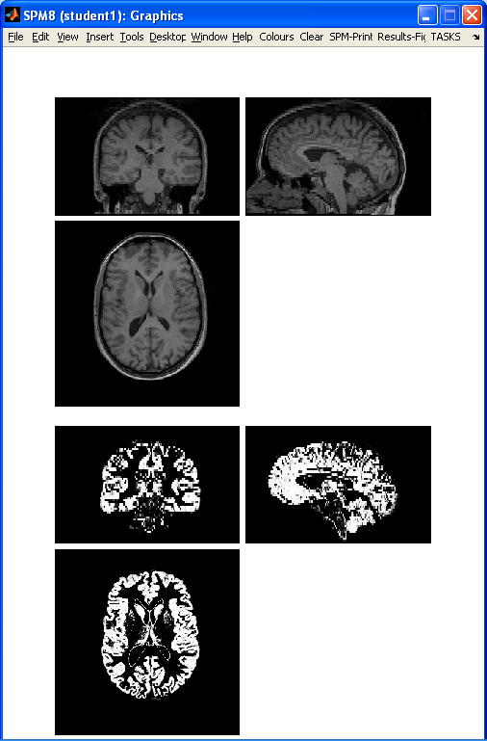
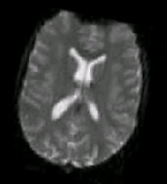
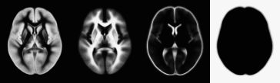
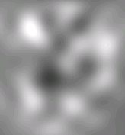

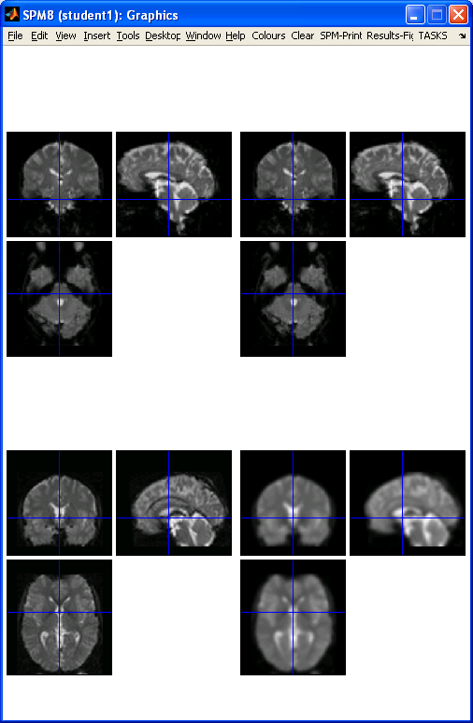
Preprocessing overview
Input
Output
fMRI time-series
Anatomical MRI
TPMs
Segmentation
Transformation
(seg_sn.mat)
Kernel
REALIGN
COREG
SEGMENT
NORM WRITE
SMOOTH
Mean functional
(Headers changed)
Motion corrected
MNI Space
ANALYSIS

Slide 50
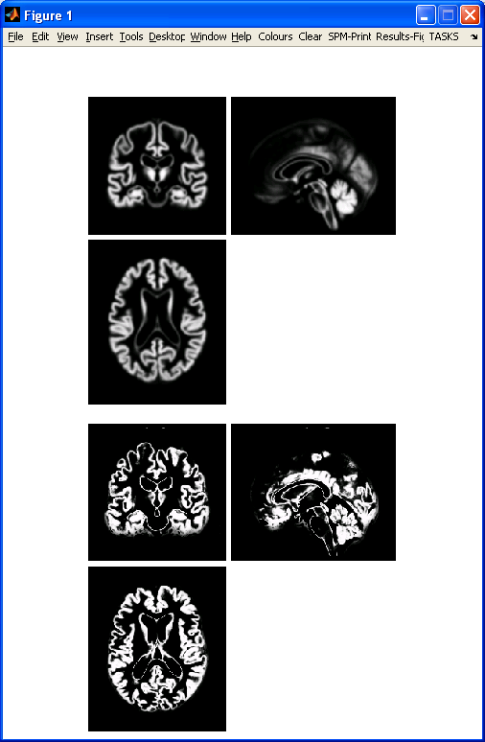
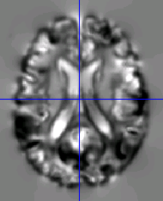
Preprocessing with Dartel
...
fMRI time-series
Anatomical MRI
TPMs
DARTEL CREATE TEMPLATE
REALIGN
COREG
SEGMENT
DARTEL NORM 2 MNI & SMOOTH
Mean functional
(Headers changed)
Motion corrected
ANALYSIS

Slide 51
Mathematical advances in computational anatomy
VBM is well-suited to find focal volumetric differences
Assumes independence among voxels
  Not very biologically plausible
  But shows differences that are easy to interpret
Some anatomical differences can not be localised
  Need multivariate models
  Differences in terms of proportions among measurements
  Where would the difference between male and female faces be localised?

Slide 52
Mathematical advances in computational anatomy
In theory, assumptions about structural covariance among brain regions are more biologically plausible
  Form influenced by spatio-temporal modes of gene expression
Empirical evidence, e.g.
  Mechelli, Friston, Frackowiak & Price. Structural covariance in the human cortex. Journal of Neuroscience 25:8303-10 (2005)
Recent introductory review:
  Ashburner & Klöppel. “Multivariate models of inter-subject anatomical variability”. NeuroImage 56(2):422-439 (2011)

Slide 53
Conclusion
VBM uses the machinery of SPM to localise patterns in regional volumetric variation
  Use of “globals” as covariates is a step towards multivariate modelling of volume and shape
More advanced approaches typically benefit from the same preprocessing methods
  New segmentation and DARTEL close to state of the art
  Though possibly little or no smoothing
Elegant mathematics related to transformations (diffeomorphism group with Riemannian metric)
VBM – easier interpretation – complementary role

