Slide 1




Dynamic Causal Modelling
for fMRI
André Marreiros
Friday 22nd Oct. 2010
SPM fMRI course
Wellcome Trust Centre
for Neuroimaging
London

Slide 2
Overview
Brain connectivity: types & definitions
  Anatomical connectivity
    Functional connectivity
    Effective connectivity
  Dynamic causal models (DCMs)
  Neuronal model
    Hemodynamic model
    Estimation: Bayesian framework
  Applications & extensions of DCM to fMRI data

Slide 3
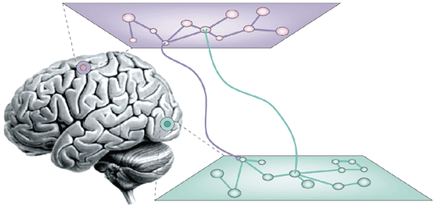
Principles of Organisation
Functional specialization
Functional integration

Slide 4
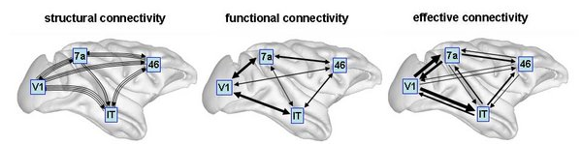
Structural, functional & effective connectivity
Sporns 2007, Scholarpedia
anatomical/structural connectivity
= presence of axonal connections
functional connectivity
= statistical dependencies between regional time series
effective connectivity
= causal (directed) influences between neurons or neuronal populations

Slide 5
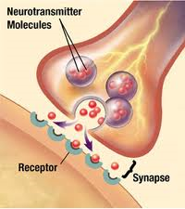
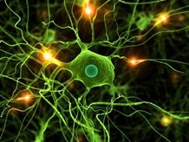
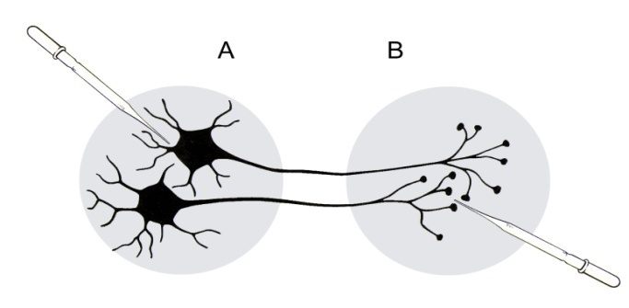
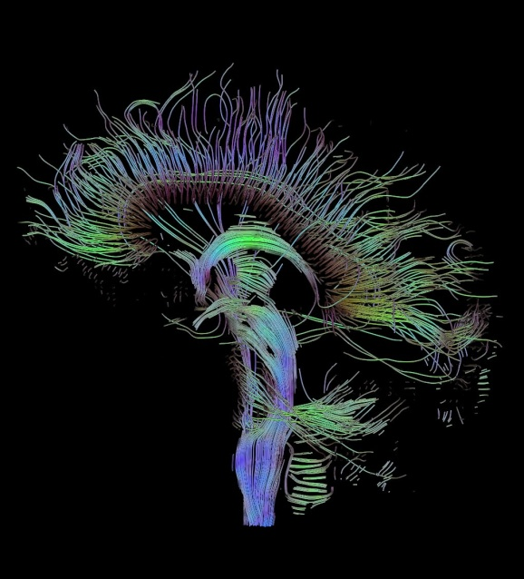
Anatomical connectivity
Definition:
presence of axonal connections
neuronal communication via synaptic contacts
Measured with
  tracing techniques
  diffusion tensor imaging (DTI)

Slide 6
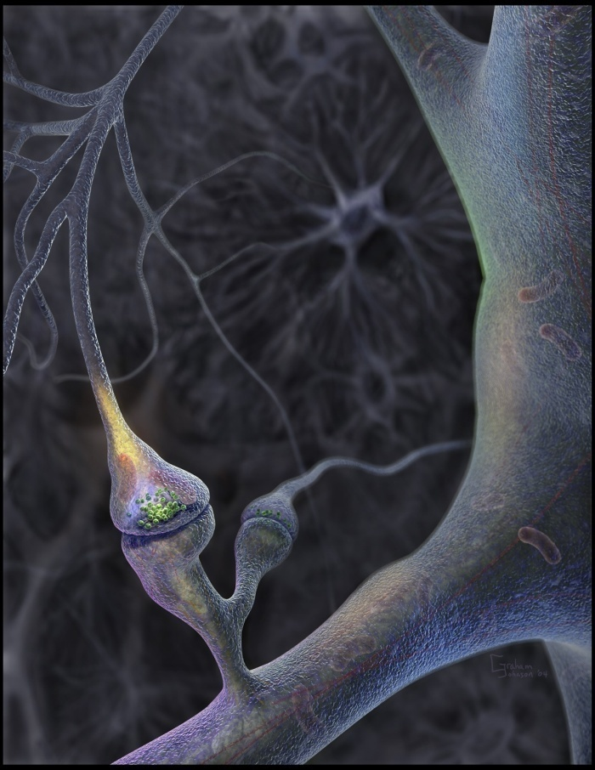
Knowing anatomical connectivity is not enough...
Context-dependent recruiting of connections :
  Local functions depend on network activity
Connections show synaptic plasticity
  change in the structure and transmission properties of a synapse
  even at short timescales
Look at functional and effective connectivity

Slide 7
Functional connectivity
Definition: statistical dependencies between regional time series
Seed voxel correlation analysis
Coherence analysis
Eigen-decomposition (PCA, SVD)
Independent component analysis (ICA)
any technique describing statistical dependencies amongst regional time series

Slide 8
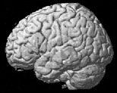
Seed-voxel correlation analyses
hypothesis-driven choice of a seed voxel
extract reference time series
voxel-wise correlation with time series from all other voxels in the brain
seed voxel

Slide 9
Pros & Cons of functional connectivity analysis
Pros:
  useful when we have no experimental control over the system of interest and no model of what caused the data (e.g. sleep, hallucinations, etc.)
Cons:
  interpretation of resulting patterns is difficult / arbitrary
  no mechanistic insight
  usually suboptimal for situations where we have a priori knowledge / experimental control
→ Effective connectivity

Slide 10
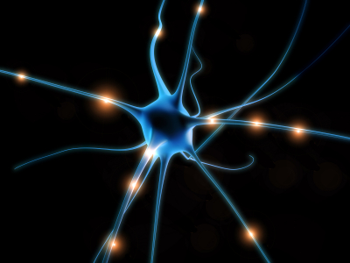
Effective connectivity
Definition: causal (directed) influences between neurons or neuronal populations
In vivo and in vitro stimulation and recording
Models of causal interactions among neuronal populations
  explain regional effects in terms of interregional connectivity

Slide 11
Some models for computing effective connectivity from fMRI data
Structural Equation Modelling (SEM)
McIntosh et al. 1991, 1994; Büchel & Friston 1997; Bullmore et al. 2000
regression models
(e.g. psycho-physiological interactions, PPIs)
Friston et al. 1997
Volterra kernels
Friston & Büchel 2000
Time series models (e.g. MAR, Granger causality)
Harrison et al. 2003, Goebel et al. 2003
Dynamic Causal Modelling (DCM)
bilinear: Friston et al. 2003; nonlinear: Stephan et al. 2008

Slide 12
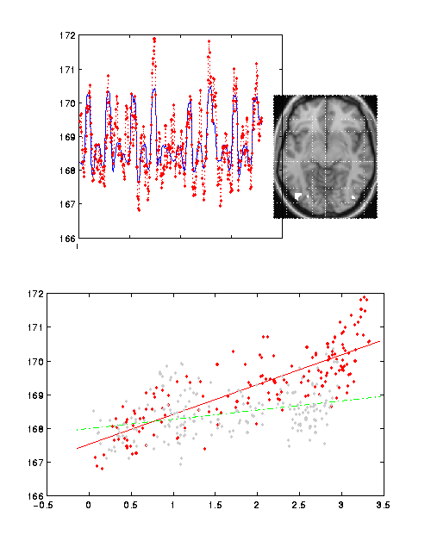
Psycho-physiological interaction (PPI)
bilinear model of how the psychological context A changes the influence of area B on area C :
B x A → C
A PPI corresponds to differences in regression slopes for different contexts.
attention
V1 x Att.
V5
V5 activity
no attention
Friston et al. 1997, NeuroImage
Büchel & Friston 1997, Cereb. Cortex
V1 activity

Slide 13
Pros & Cons of PPIs
Pros:
  given a single source region, we can test for its context-dependent connectivity across the entire brain
  easy to implement
Cons:
  only allows to model contributions from a single area
  operates at the level of BOLD time series (SPM 99/2).
  SPM 5/8 deconvolves the BOLD signal to form the proper interaction term, and then reconvolves it.
  ignores time-series properties of the data
Dynamic Causal Models
needed for more robust statements of effective connectivity.

Slide 14
Overview
Brain connectivity: types & definitions
  Anatomical connectivity
    Functional connectivity
    Effective connectivity
  Dynamic causal models (DCMs)
  Basic idea
    Neuronal model
    Hemodynamic model
    Parameter estimation, priors & inference
  Applications & extensions of DCM to fMRI data

Slide 15
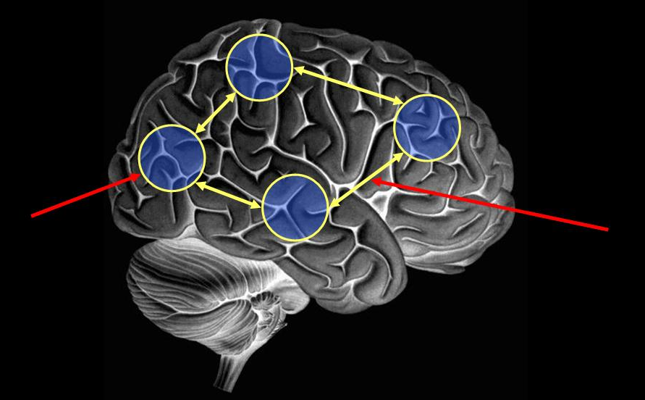
Basics of Dynamic Causal Modelling
DCM allows us to look at how areas within a network interact:
Investigate functional integration & modulation of specific cortical pathways
  Temporal dependency of activity within and between areas (causality)

Slide 16
Temporal dependence and causal relations
Seed voxel approach, PPI etc.
Dynamic Causal Models
timeseries (neuronal activity)

Slide 17
Basics of Dynamic Causal Modelling
DCM allows us to look at how areas within a network interact:
Investigate functional integration & modulation of specific cortical pathways
  Temporal dependency of activity within and between areas (causality)
  Separate neuronal activity from observed BOLD responses

Slide 18
Basics of DCM:
Neuronal and BOLD level
Cognitive system is modelled at its underlying neuronal level (not directly accessible for fMRI).
The modelled neuronal dynamics (Z) are transformed into area-specific BOLD signals (y) by a hemodynamic model (λ).
Z
λ
The aim of DCM is to estimate parameters at the neuronal level such that the modelled and measured BOLD signals are optimally similar.
y
Notes:
The basic idea of DCM for fMRI is that we use a bilinear state equation to model a cognitive system at the neuronal level, which we can’t measure using fMRI, and then the modelled neural dynamics are transformed into area-specific BOLD signals by a hemodynamic forward model.
This is the same idea but implemented in a somewhat more complicated way when you specify your GLM in a standard analysis, and then convolve this with the HRF.
Then the aim of the DCM is to estimate parameters at the neuronal level so that the modelled and measured bold signals are optimally similar
A bit of a disclaimer: this is true to an approximation. Actually it’s to optimise the free energy F, but you’ll hear about that tomorrow or maybe even during the practical session later on.
Compare mechanisms of an effect that we’ve already decided exists
The aim of DCM is to investigate functional integration, and the modulation of specific cortical pathways.
We model stimulus-bound perturbing inputs that drive the system, for example visual input, and stimulus-independent contextual inputs such as attention, that modulate the system’s connectivity.
It’s the latter that in DCM in general we are most interested in, to investigate how the connectivity of a system is modulated by something that’s under experimental control, such as attention or drugs or learning.

Slide 19
Neuronal systems are represented by differential equations
system
z(t) state
A System is a set of elements z_{n}(t) which interact in a spatially and temporally specific fashion
Input u(t)
connectivity parameters θ
State changes of the system states are dependent on:
  the current state z
  external inputs u
  its connectivity θ
  time constants & delays
Notes:
First of all, what is a system actually?
So z_{n}(t) is the hidden level, which we can not observe using fMRI, and it represents a simple model of neuronal dynamics for a system of n coupled regions.
Then we have the change of the sate vector in time that depends on the interaction between the elements z, u, θ, ...
Overall, DCM models the temporal evolution of the neuronal state vector as a function of the current state z, the inputs u, and some parameters θ – that define the functional architecture and interactions among brain regions at a neuronal level.

Slide 20
DCM parameters = rate constants
Generic solution to the ODEs in DCM:
z₁
Half-life τ
Decay function
1
0.8
0.6
0.4
0.2
0
-0.1
0
0.1
0.2
0.3
0.4
0.5
0.6
0.7
0.8
0.9

Slide 21
DCM parameters = rate constants
Generic solution to the ODEs in DCM:
z₁
Decay function
If A→B is 0.10 s⁻¹ this means that, per unit time, the increase in activity in B corresponds to 10% of the activity in A
1
A
0.8
0.10
0.6
0.4
B
0.2
0
-0.1
0
0.1
0.2
0.3
0.4
0.5
0.6
0.7
0.8
0.9

Slide 22
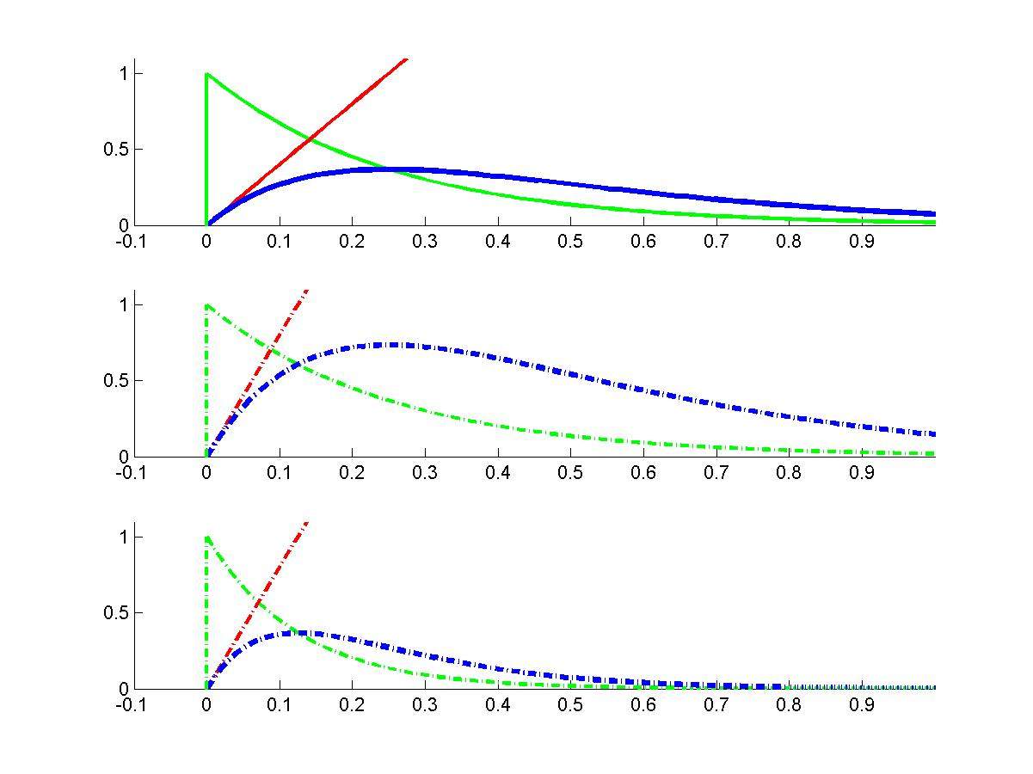
Linear dynamics: 2 nodes
z₁
z₂
z₁
sa₂₁t
z₂

Slide 23
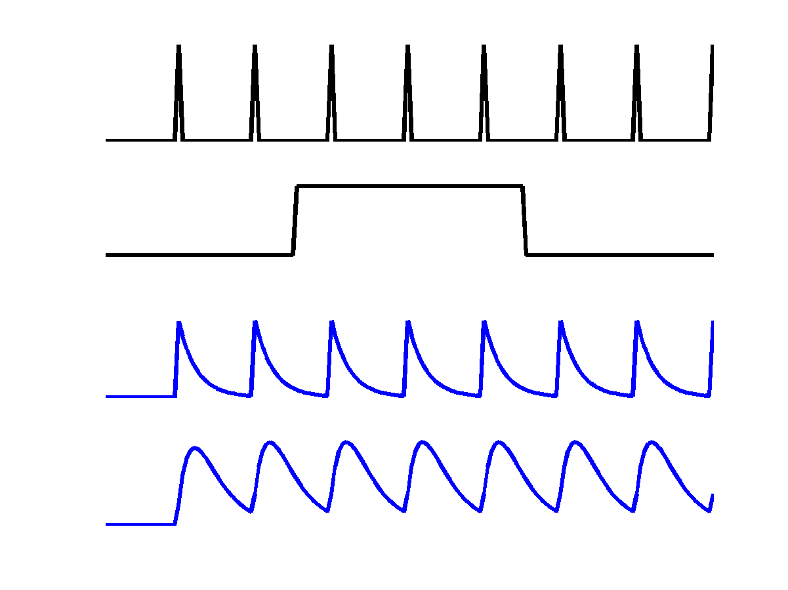
Neurodynamics: 2 nodes with input
u₁
u₁
u₂
z₁
z₁
z₂
z₂
activity in z₂ is coupled to z₁ via coefficient a₂₁

Slide 24
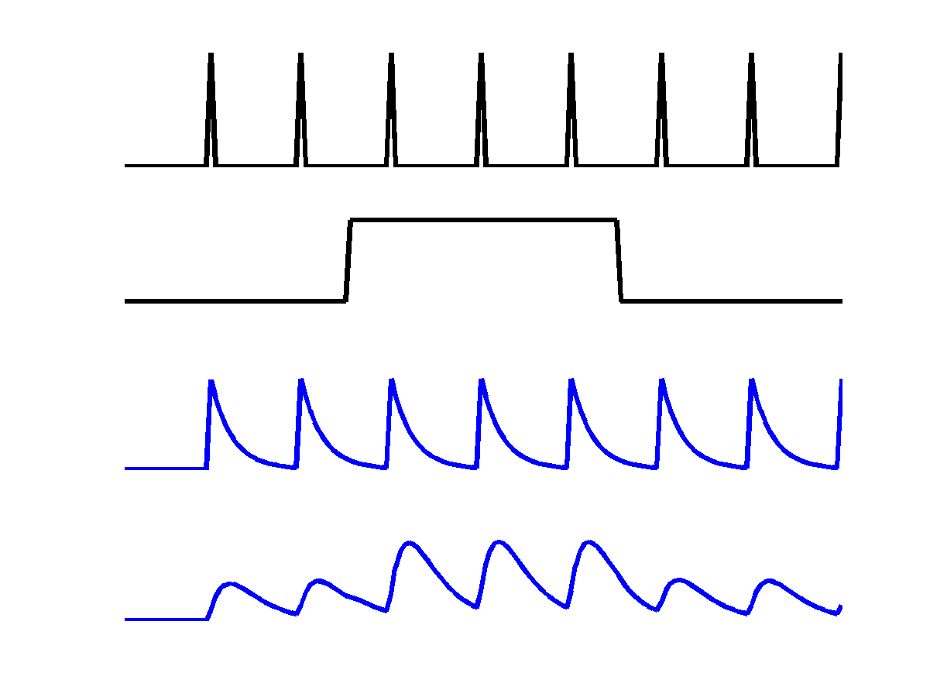
Neurodynamics: positive modulation
u₁
u₁
u₂
u₂
z₁
z₁
z₂
z₂
index, not squared
modulatory input u₂ activity through the coupling a₂₁

Slide 25
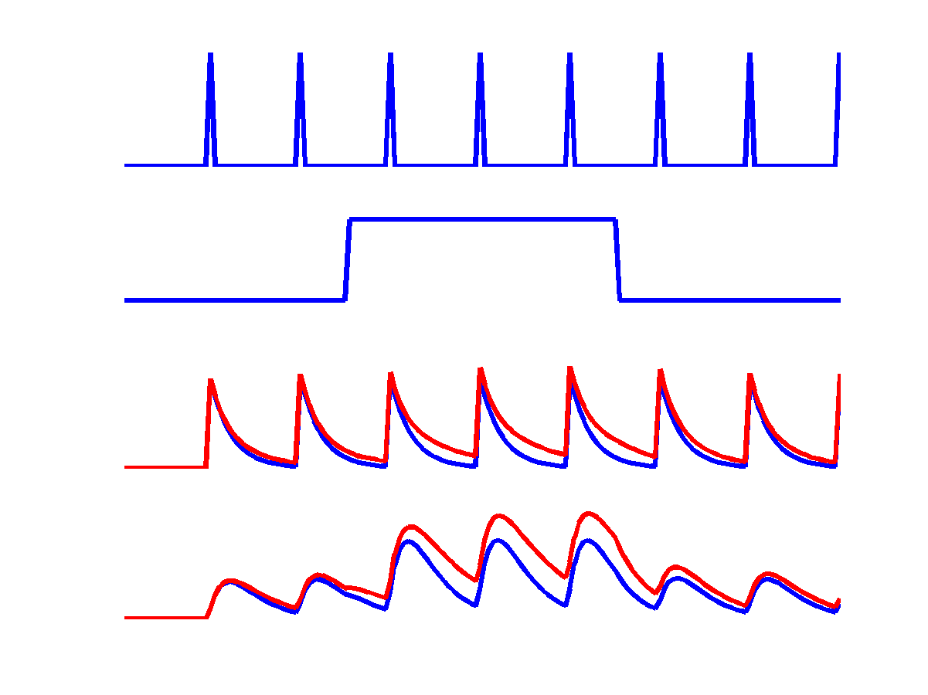
Neurodynamics: reciprocal connections
u₁
u₁
u₂
u₂
z₁
z₁
z₂
z₂
reciprocal connection
disclosed by u₂

Slide 26
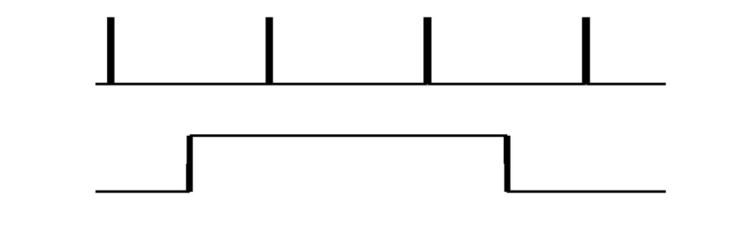
Haemodynamics: reciprocal connections
u₁
BOLD
(without noise)
u₂
h₁
z₁
BOLD
(without noise)
z₂
h₂
blue: neuronal activity
red: bold response
h(u,θ) represents the BOLD response (balloon model) to input

Slide 27
Haemodynamics: reciprocal connections
u₁
BOLD
with
Noise added
u₂
y₁
z₁
z₂
y₂
BOLD
with
Noise added
blue: neuronal activity
red: bold response
y represents simulated observation of BOLD response, i.e. includes noise

Slide 28
Bilinear state equation in DCM for fMRI
state
changes
modulation of
connectivity
state vector
direct
inputs
external
inputs
connectivity
n regions
m mod inputs
m drv inputs

Slide 29
Conceptual overview
Neuronal state equation
The bilinear model
effective connectivity
modulation of
connectivity
Input
u(t)
direct inputs
c₁
b₂₃
integration
neuronal
states
z
a₁₂
activity
z₂(t)
activity
z₃(t)
activity
z₁(t)
λ
haemodynamic
model
y
y
y
BOLD
y
Friston et al. 2003,
NeuroImage

Slide 30

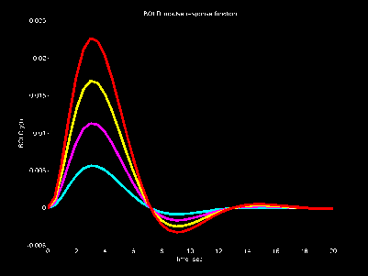
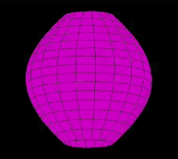

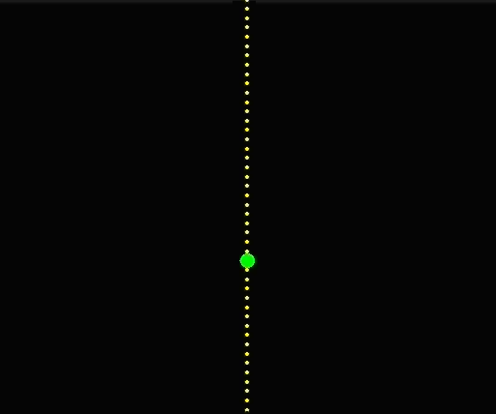
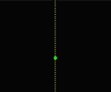
The hemodynamic “Balloon” model
Region-specific HRFs!
6 haemodynamic parameters
Friston et al. 2000, NeuroImage
Stephan et al. 2007, NeuroImage

Slide 31
DCM roadmap
Neuronal
dynamics
Hemodynamics
State space
Model
Priors
Posterior densities
of parameters
Model inversion
using
Expectation-maximization
fMRI data
Model
selection

Slide 32
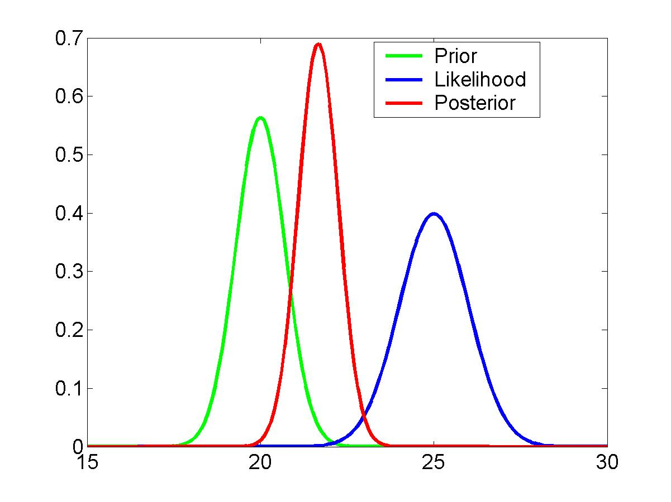
Estimation: Bayesian framework
Models of
Haemodynamics in a single region
Neuronal interactions
Constraints on
Haemodynamic parameters
Connections
likelihood term
prior
posterior
Bayesian estimation

Slide 33
stimulus function u
Overview:
parameter estimation
neuronal state
equation
Specify model (neuronal and haemodynamic level)
Make it an observation model by adding measurement error e and confounds X (e.g. drift).
Bayesian parameter estimation using expectation-maximization.
Result:
(Normal) posterior parameter distributions, given by mean η_{θ|y} and Covariance C_{θ|y}.
parameters
hidden states
state equation
η_{θ|y}
modeled
BOLD response
observation model

Slide 34
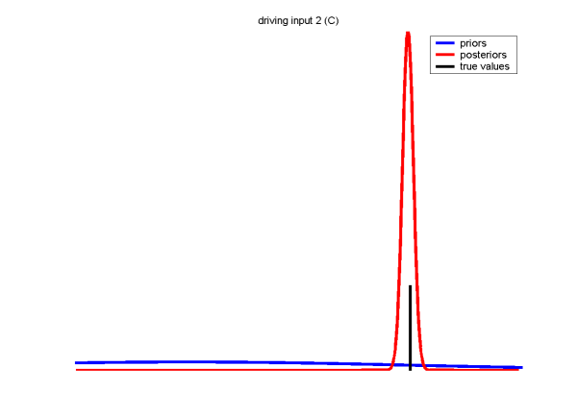
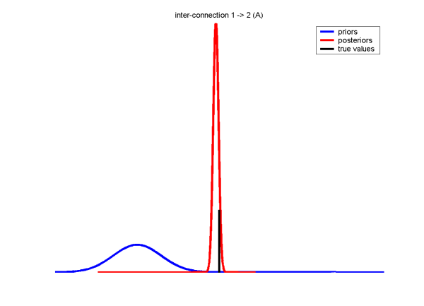
Parameter estimation: an example
Input coupling, c₁
u₁
Simulated response
z₁
Forward coupling, a₂₁
z₂
Prior density Posterior density true values

Slide 35
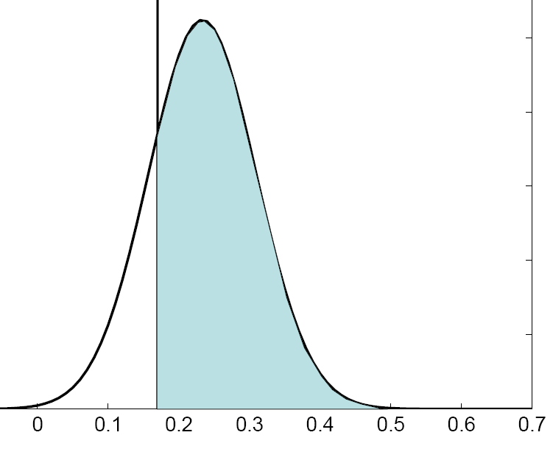
Inference about DCM parameters
Bayesian single subject analysis
The model parameters are distributions that have a mean η_{θ|y} and covariance C_{θ|y}.
  Use of the cumulative normal distribution to test the probability that a certain parameter is above a chosen threshold γ:
Classical frequentist test across groups
Test summary statistic: mean η_{θ|y}
  One-sample t-test: Parameter > 0?
  Paired t-test: parameter 1 > parameter 2?
  rmANOVA: e.g. in case of multiple sessions per subject
γ
η_{θ|y}
Bayesian parameter averaging

Slide 36
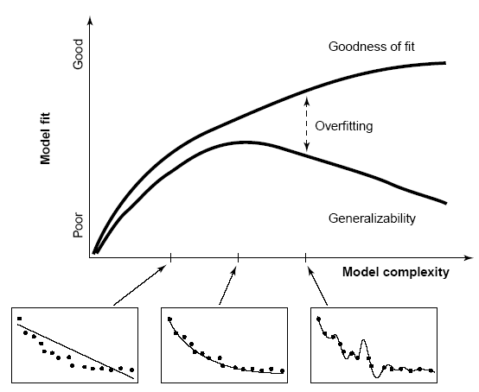
Model comparison and selection
Given competing hypotheses, which model is the best?
Pitt & Miyung (2002), TICS

Slide 37
Inference on model space
Model evidence: The optimal balance of fit and complexity
Comparing models
Which is the best model?

Slide 38
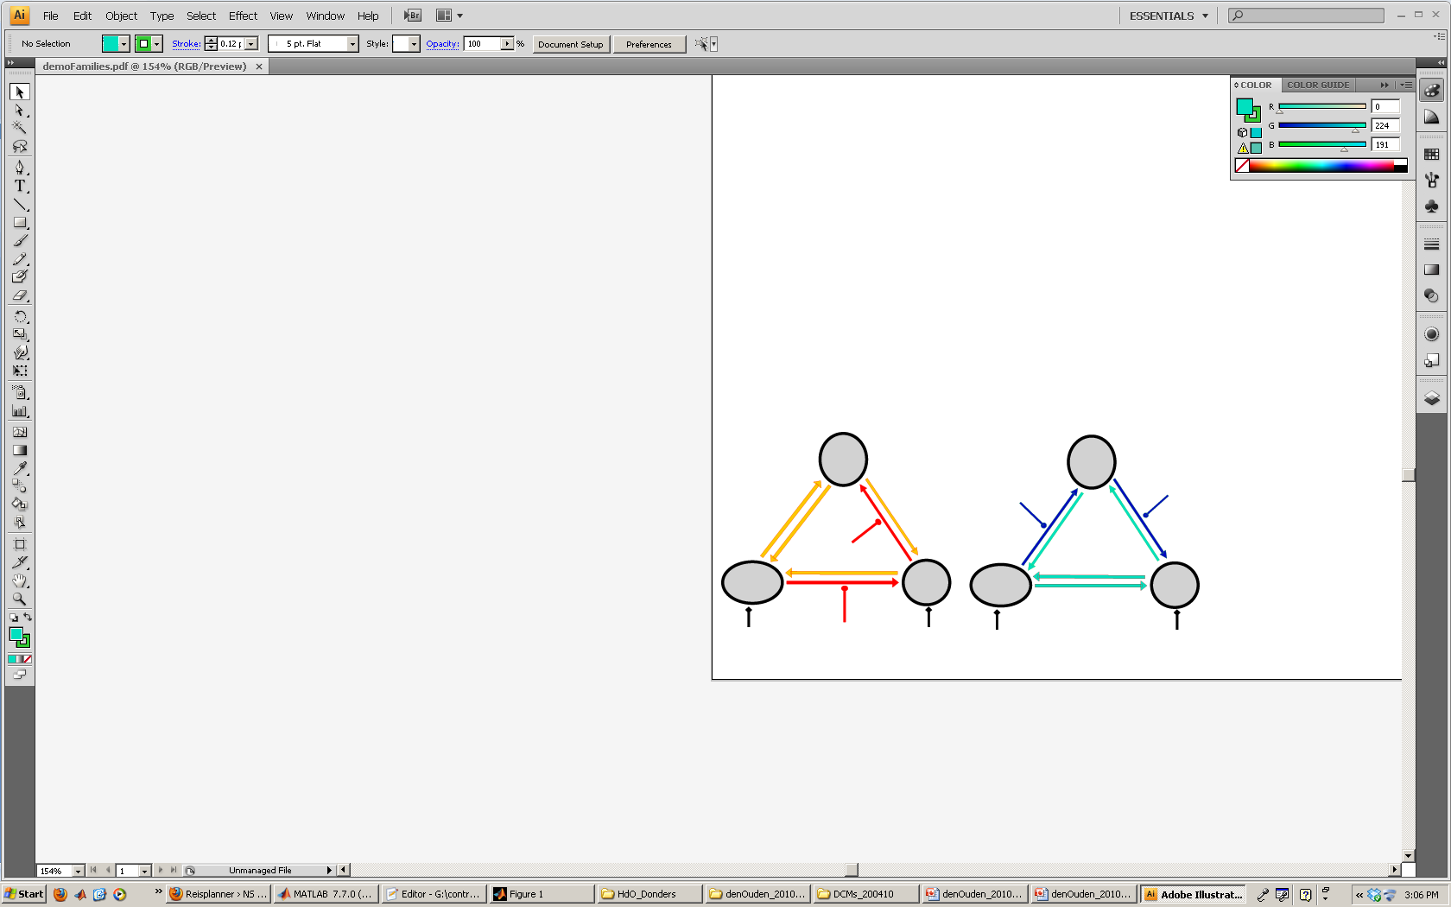
Inference on model space
Model evidence: The optimal balance of fit and complexity
Comparing models
Which is the best model?
Comparing families of models
What type of model is best?
  Feedforward vs feedback
  Parallel vs sequential processing
  With or without modulation

Slide 39
Inference on model space
Model evidence: The optimal balance of fit and complexity
Comparing models
Which is the best model?
Comparing families of models
What type of model is best?
  Feedforward vs feedback
  Parallel vs sequential processing
  With or without modulation
Only compare models with the same data
C
D
C
A
A
B
B

Slide 40
Overview
Brain connectivity: types & definitions
  Anatomical connectivity
    Functional connectivity
    Effective connectivity
  Dynamic causal models (DCMs)
  Neuronal model
    Hemodynamic model
    Estimation: Bayesian framework
  Applications & extensions of DCM to fMRI data

Slide 41
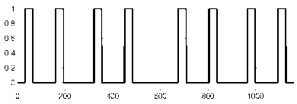
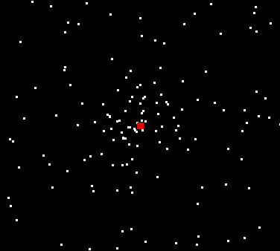
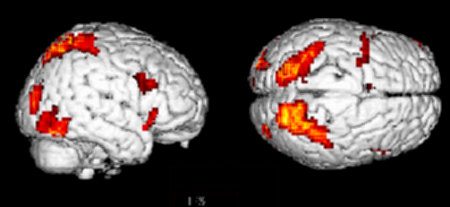

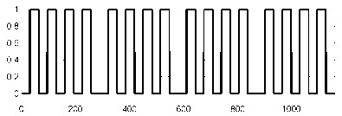
Attention to motion in the visual system
We used this model to assess the site of attention modulation during visual motion processing in an fMRI paradigm reported by Büchel & Friston.
Attention
Time [s]
?
SPC
Photic
  - fixation only
  observe static dots + photic → V1
  - observe moving dots + motion → V5
  task on moving dots + attention → V5 + parietal cortex
V5
V1
Motion
Friston et al. 2003,
NeuroImage

Slide 42
Comparison of two simple models
Model 1:
attentional modulation
of V1→V5
Model 2:
attentional modulation
of SPC→V5
Photic
Photic
Attention
0.85
SPC
0.55
SPC
0.70
0.86
0.75
1.36
0.84
1.42
V1
V1
0.89
0.57
-0.02
0.56
-0.02
V5
V5
Motion
0.23
Motion
Attention
Bayesian model selection: Model 1 better than model 2
→ Decision for model 1: in this experiment, attention
primarily modulates V1→V5

Slide 43
Extension I: Slice timing model
potential timing problem in DCM:
temporal shift between regional time series because of multi-slice acquisition
2
slice acquisition
1
visual
input
Solution:
  Modelling of (known) slice timing of each area.
  Slice timing extension now allows for any slice timing differences!
  Long TRs (> 2 sec) no longer a limitation.
  (Kiebel et al., 2007)

Slide 44
Extension II: Two-state model
Single-state DCM
Two-state DCM
input
∂
x
=
u
+
∂
(
AB
)
x
Cu
t
⎡
−
e
A
EE
−
e
A
EI
L
e
A
0
⎤
⎡
x
E
⎤
⎢
11
11
1
N
⎥
⎢
1
⎥
⎢
e
A
IE
−
e
A
II
0
0
⎥
⎢
x
I
⎥
11
11
1
A
=
⎢
M
O
M
⎥
x
(
t
)
=
⎢
M
⎥
⎢
⎥
⎢
⎥
⎢
e
A
N
1
0
−
e
A
EE
−
e
A
EI
⎥
⎢
x
E
⎥
⎢
NN
NN
⎥
N
0
0
L
e
A
IE
−
e
A
II
⎢
x
I
⎥
⎣
NN
NN
⎦
⎣
N
⎦
Extrinsic (between-region) coupling
Intrinsic (within-region) coupling

Slide 45
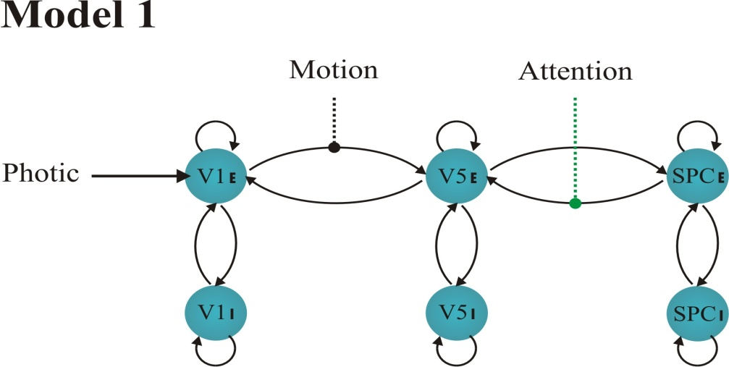


- BCW
DCM for Büchel & Friston
Attention
b
- Intr
Attention
Example: Two-state Model Comparison
- FWD
Attention

Slide 46
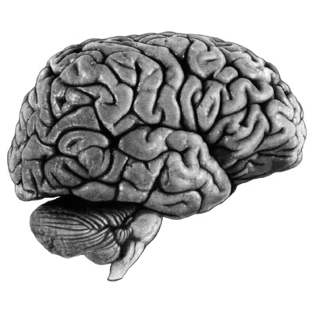
Extension III: Nonlinear DCM for fMRI
bilinear DCM
nonlinear DCM
u₂
u₂
u₁
u₁
Bilinear state equation
Nonlinear state equation
Here DCM can model activity-dependent changes in connectivity; how connections are enabled or gated by activity in one or more areas.

Slide 47
Extension III: Nonlinear DCM for fMRI
Can V5 activity during attention to motion be explained by allowing activity in SPC to modulate the V1-to-V5 connection?
attention
.
0.19
(100%)
SPC
The posterior density of indicates that this gating existed with 97% confidence.
(The D matrix encodes which of the n neural units gate which connections in the system)
0.03
(100%)
0.01
(97.4%)
visual
stimulation
1.65
(100%)
V1
V5
0.04
(100%)
motion

Slide 48
So, DCM….
enables one to infer hidden neuronal processes from fMRI data
allows one to test mechanistic hypotheses about observed effects
  uses a deterministic differential equation to model neuro-dynamics (represented by matrices A,B and C).
is informed by anatomical and physiological principles.
uses a Bayesian framework to estimate model parameters
is a generic approach to modelling experimentally perturbed dynamic systems.
  provides an observation model for neuroimaging data, e.g. fMRI, M/EEG
  DCM is not model or modality specific (Models will change and the method extended to other modalities e.g. ERPs, LFPs)

Slide 49
Some useful references
The first DCM paper: Dynamic Causal Modelling (2003). Friston et al. NeuroImage 19:1273-1302.
Physiological validation of DCM for fMRI: Identifying neural drivers with functional MRI: an electrophysiological validation (2008). David et al. PLoS Biol. 6 2683–2697
Hemodynamic model: Comparing hemodynamic models with DCM (2007). Stephan et al. NeuroImage 38:387-401
Nonlinear DCMs:Nonlinear Dynamic Causal Models for FMRI (2008). Stephan et al. NeuroImage 42:649-662
Two-state model: Dynamic causal modelling for fMRI: A two-state model (2008). Marreiros et al. NeuroImage 39:269-278
Group Bayesian model comparison: Bayesian model selection for group studies (2009). Stephan et al. NeuroImage 46:1004-10174
10 Simple Rules for DCM (2010). Stephan et al. NeuroImage 52.

Slide 50
Thank you for your attention!!!

