Slide 1

DCM:
Advanced Topics
Rosalyn Moran
SPM Course October 20th – 22nd 2011

Slide 2
Outline
Bayesian model selection (BMS)
Families of Models
Nonlinear DCM for fMRI
Stochastic DCM
Post-hoc selection of deterministic DCM
Integrating tractography and DCM

Slide 3
Outline
Bayesian model selection (BMS)
Families of Models
Nonlinear DCM for fMRI
Stochastic DCM
Post-hoc selection of deterministic DCM
Integrating tractography and DCM

Slide 4
Bayesian Model Selection
Relative Log Model Evidence
attention
M1
M2
PPC
PPC
M2 better than M1
attention
BF ≈ 2966
ΔF = 7.995
stim
V1
V5
stim
V1
V5
M1
M2
M3
M4
M3
attention
PPC
M3 better than M2
BF ≈ 12
ΔF = 2.450
stim
V1
V5
Posterior Model Probability
M4
attention
PPC
M4 better than M3
BF ≈ 23
ΔF = 3.144
stim
V1
V5
Notes:
Posterior model probability in lower plot is a normalised probability:
p(m_i|y) = p(y|m_i)/sum(p(y|m_i))
Note that under flat model priors p(m_i|y) = p(y|m_i)

Slide 5
Bayes factors
For a given dataset, to compare two models, we compare their evidences.
positive value, [0; ∞[
B₁₂ | p(m₁|y) | Evidence
1 to 3 | 50-75% | weak
3 to 20 | 75-95% | positive
20 to 150 | 95-99% | strong
≥ 150 | ≥ 99% | Very strong
Kass & Raftery classification:
or their log evidences
Kass & Raftery 1995, J. Am. Stat. Assoc.

Slide 6
The negative free energy approximation
KL
F
balance between fit and complexity = accuracy - complexity
Deviation of posterior mean from prior mean
Independent Priors
Dependent Posteriors

Slide 7
Fixed effects BMS at group level
Group Bayes factor (GBF) for 1...K subjects:
or
Problems:
blind with regard to group heterogeneity
sensitive to outliers
Generative Model:
Select one of K models from a multinomial distribution and then generate data, under this model, for each of the N subjects

Slide 8
Fixed/Random effects BMS for group studies
Generative Model:
Select one of K models from a multinomial distribution and then generate data, under this model, for each of the N subjects
Generative Model:
Select a model for each subject by sampling from a multinomial distribution, and then generate data under that subject-specific model:
Stephan et al. 2009, NeuroImage
Notes:
Want: the density from which models are sampled to generate subject-specific data.
we seek the conditional estimates of the multinomial parameters, i.e. the model probabilities , that generate switches or indicator variables, , prescribing the model for the i-th subject; where . Since the model probabilities r follow a Dirichlet distribution , the conditional expectations encode the expected probability that the k-th model will be selected for any randomly selected subject. Also, the cumulative probability density of can be used to quantify our belief that a given model m1 has a higher probability of having generated the observed data across the group than a second model m2; below, we will call this the "exceedance probability". In the following, we describe a hierarchical Bayesian model that can be inverted to obtain the Dirichlet parameters .
Using the Dirichlet density for model comparison
After the above optimization of the Dirichlet parameters, α, the Dirichlet density can be used for model comparisons at the group level. There are several ways to report the results of this comparison. The simplest option is to report the Dirichlet parameter estimates (c.f. Eq. 20). Another possibility is to use to compute the expected multinomial parameters and thus the expected likelihood of obtaining a particular model, i.e. for any randomly selected subject [1]
(20)
Either the Dirichlet parameter estimates α or the expected multinomial parameters can be used, with equivalent results, to rank models at the group level.
A third option, which is perhaps the most useful one when two models (or model subsets, see below) are compared against each other, is to use the cumulative probability density of to quantify our belief that one model is more likely than a second one, given the group data. For example, when comparing two models, m1 and m2, the belief that m1 has the higher probability of having generated the observed data across the group corresponds to the "exceedance probability"
[1] Note that for the special case of "drawing" a single "sample" (model), the multinomial distribution of models reduces to . Therefore, for any given subject, represents the conditional expectation that the k-th model generated her/his data.
This enables us to estimate the Dirichlet parameters given observations or samples from a multinomial distribution
We consider the same problem in Bayesian terms and describe a novel hierarchical model, which is optimised to furnish a probability density on the models themselves. This new method rests on a variational approach to estimating the parameters of a Dirichlet distribution, which define a multinomial distribution of how likely it is that a specific model generated the data from a specific subject. Using empirical and synthetic data, we show that optimising a conditional density of the model probabilities, given the log-evidences for each model over subjects
the Dirichlet distribution is the conjugate prior of the categorical distribution and multinomial distribution. That is, its probability density function returns the belief that the probabilities of K rival events are xi given that each event has been observed αi − 1 times.
The support of the Dirichlet distribution is a K-dimensional vector of real numbers in the range (0,1), all of which sum to 1. These can be viewed as the probabilities of a K-way categorical event. Another way to express this is that the domain of the Dirichlet distribution is itself a probability distribution, specifically a K-dimensional discrete distribution
In probability theory, the multinomial distribution is a generalization of the binomial distribution.
The binomial distribution is the probability distribution of the number of "successes" in n independent Bernoulli trials, with the same probability of "success" on each trial. In a multinomial distribution, the analog of the Bernoulli distribution is the categorical distribution, where each trial results in exactly one of some fixed finite number k of possible outcomes, with probabilities p1, ..., pk (so that pi ≥ 0 for i = 1, ..., k and ), and there are n independent trials. Then let the random variables Xi indicate the number of times outcome number i was observed over the n trials. The vector X = (X1, ..., Xk) follows a multinomial distribution with parameters n and p, where p = (p1, ..., pk).
rm as the frequency with which
model m is used in the population.

Slide 9
Random effects BMS for group studies
Dirichlet parameters
= “occurrences” of models in the population
Dirichlet distribution of model probabilities
Multinomial distribution of model labels
Model inversion by Variational Bayes (VB)
Measured data y
estimate the parameters α of the posterior
Stephan et al. 2009, NeuroImage
Notes:
Want: the density from which models are sampled to generate subject-specific data.
we seek the conditional estimates of the multinomial parameters, i.e. the model probabilities , that generate switches or indicator variables, , prescribing the model for the i-th subject; where . Since the model probabilities r follow a Dirichlet distribution , the conditional expectations encode the expected probability that the k-th model will be selected for any randomly selected subject. Also, the cumulative probability density of can be used to quantify our belief that a given model m1 has a higher probability of having generated the observed data across the group than a second model m2; below, we will call this the "exceedance probability". In the following, we describe a hierarchical Bayesian model that can be inverted to obtain the Dirichlet parameters .
Using the Dirichlet density for model comparison
After the above optimization of the Dirichlet parameters, α, the Dirichlet density can be used for model comparisons at the group level. There are several ways to report the results of this comparison. The simplest option is to report the Dirichlet parameter estimates (c.f. Eq. 20). Another possibility is to use to compute the expected multinomial parameters and thus the expected likelihood of obtaining a particular model, i.e. for any randomly selected subject [1]
(20)
Either the Dirichlet parameter estimates α or the expected multinomial parameters can be used, with equivalent results, to rank models at the group level.
A third option, which is perhaps the most useful one when two models (or model subsets, see below) are compared against each other, is to use the cumulative probability density of to quantify our belief that one model is more likely than a second one, given the group data. For example, when comparing two models, m1 and m2, the belief that m1 has the higher probability of having generated the observed data across the group corresponds to the "exceedance probability"
[1] Note that for the special case of "drawing" a single "sample" (model), the multinomial distribution of models reduces to . Therefore, for any given subject, represents the conditional expectation that the k-th model generated her/his data.
This enables us to estimate the Dirichlet parameters given observations or samples from a multinomial distribution
We consider the same problem in Bayesian terms and describe a novel hierarchical model, which is optimised to furnish a probability density on the models themselves. This new method rests on a variational approach to estimating the parameters of a Dirichlet distribution, which define a multinomial distribution of how likely it is that a specific model generated the data from a specific subject. Using empirical and synthetic data, we show that optimising a conditional density of the model probabilities, given the log-evidences for each model over subjects
the Dirichlet distribution is the conjugate prior of the categorical distribution and multinomial distribution. That is, its probability density function returns the belief that the probabilities of K rival events are xi given that each event has been observed αi − 1 times.
The support of the Dirichlet distribution is a K-dimensional vector of real numbers in the range (0,1), all of which sum to 1. These can be viewed as the probabilities of a K-way categorical event. Another way to express this is that the domain of the Dirichlet distribution is itself a probability distribution, specifically a K-dimensional discrete distribution
In probability theory, the multinomial distribution is a generalization of the binomial distribution.
The binomial distribution is the probability distribution of the number of "successes" in n independent Bernoulli trials, with the same probability of "success" on each trial. In a multinomial distribution, the analog of the Bernoulli distribution is the categorical distribution, where each trial results in exactly one of some fixed finite number k of possible outcomes, with probabilities p1, ..., pk (so that pi ≥ 0 for i = 1, ..., k and ), and there are n independent trials. Then let the random variables Xi indicate the number of times outcome number i was observed over the n trials. The vector X = (X1, ..., Xk) follows a multinomial distribution with parameters n and p, where p = (p1, ..., pk).
rm as the frequency with which
model m is used in the population.

Slide 10
Reporting RXF for group studies
The occurences in the population
The expected likelihood: of obtaining
the k-th model for any randomly
selected member of the population
The exceedance probability: belief that a model is more likely than another model (of the K tested) given the group data
Notes:
Alpha, the occurences,
<r> the expected likelihood of obtaining a particular model for any randomly selected subject
. For example, when comparing two models, m1 and m2, the belief that m1 has the higher probability of having generated the observed data across the group corresponds to the "exceedance probability

Slide 11
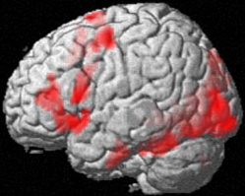
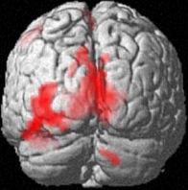
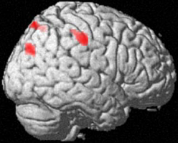
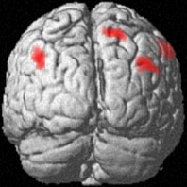
Eg:
Task-driven lateralisation
Does the word contain the letter A or not?
letter decisions > spatial decisions
•
•
group analysis (random effects),
n=16, p<0.05 corrected
analysis with SPM2
•
time
Is the red letter left or right from the midline of the word?
spatial decisions > letter decisions
Stephan et al. 2003, Science
Notes:
Testing whether hemispheric specialisation was processing-dependent rather than stimulus dependent

Slide 12
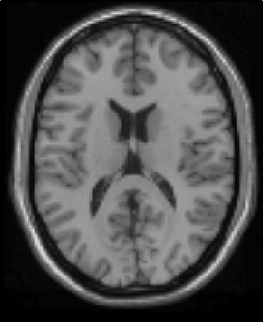
Theories on inter-hemispheric integration during lateralised tasks
Information transfer
(for left-lateralised task)
|RVF
T
±
+
T
|LVF
LVF
RVF
Predictions:
modulation by task conditional on visual field
asymmetric connection strengths
Notes:
Left lateralisized task language: letter decisions

Slide 13
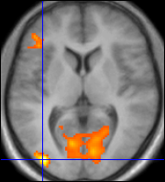
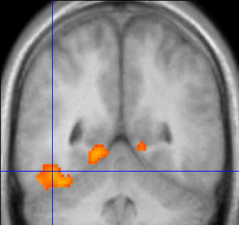
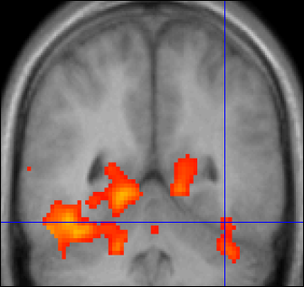
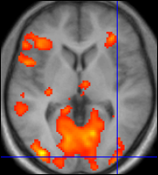
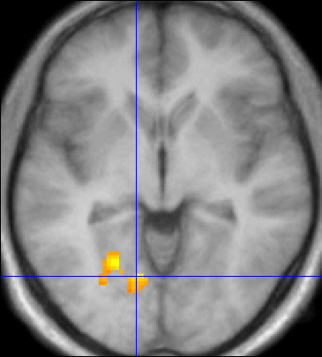
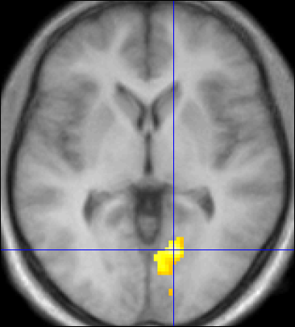
Ventral stream & letter decisions
Stephan et al. 2007, J. Neurosci.
Left MOG
-38,-90,-4
Left FG
-44,-52,-18
Right FG
38,-52,-20
Right MOG
-38,-94,0
LD|LVF
LD>SD, p<0.05 cluster-level corrected
(p<0.001 voxel-level cut-off)
p<0.01 uncorrected
MOG
left
FG
left
FG
right
MOG
right
LD>SD masked incl. with RVF>LVF
LD>SD masked incl. with LVF>RVF
Left LG
-12,-70,-6
LG
left
LG
right
Left LG
-14,-68,-2
RVF
stim.
LVF
stim.
M1: Inter-hemispheric connections modulated by letter decision (LD) task
conditional on visual field of stimulus presentation.
Intra-hemispheric connections modulated by letter decision task alone.

Slide 14
Ventral stream & letter decisions
Stephan et al. 2007, J. Neurosci.
Left MOG
-38,-90,-4
Left FG
-44,-52,-18
Right FG
38,-52,-20
Right MOG
-38,-94,0
LD>SD, p<0.05 cluster-level corrected
(p<0.001 voxel-level cut-off)
p<0.01 uncorrected
MOG
left
FG
left
FG
right
MOG
right
LD>SD masked incl. with RVF>LVF
LD>SD masked incl. with LVF>RVF
Left LG
-12,-70,-6
LG
left
LG
right
Left LG
-14,-68,-2
LD|LVF
RVF
stim.
LVF
stim.
M2: Inter-hemispheric connections modulated by letter decision (LD) task alone.
Intra-hemispheric connections modulated by letter decision task
conditional on visual field of stimulus presentation.

Slide 15
Winner! Fixed Effects
m₂
LD
LD|LVF
m₁
MOG
FG
FG
MOG
MOG
FG
FG
MOG
LD|RVF
LD|LVF
LD
LD
LG
LG
LG
LG
RVF
stim.
LD
LVF
stim.
RVF
stim.
LD|RVF
LVF
stim.
m₂
m₁
Stephan et al. 2009, NeuroImage

Slide 16
RFX Analysis
m₂
m₁

Slide 17
Outline
Bayesian model selection (BMS)
Families of Models
Nonlinear DCM for fMRI
Stochastic DCM
Post-hoc selection of deterministic DCM
Integrating tractography and DCM

Slide 18
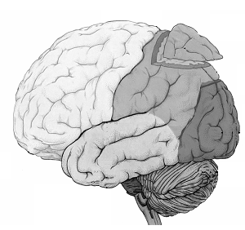
Families of Models
Dynamics of intelligible speech vs reversed speech, (Leff et al. 2008):
“She came out of the house”/ ”esuoh eht fo tuo emac ehS”
Posterior Superior Temporal Sulcus (P)
P
Pars Orbitalis of
Inferior Frontal Gyrus
(F)
F
A
Anterior Superior Temporal Sulcus (A)
Where does the auditory driving input enter?
Notes:
the cortical dynamics of intelligible
Speech
activity among three key multimodal
regions: the left posterior and anterior superior temporal sulcus
(subsequently referred to as regions P and A respectively) and pars
orbitalis of the inferior frontal gyrus (region F). The aim of the
study was to see how connections among regions depended on
whether the auditory input was intelligible speech or time-reversed
speech.

Slide 19
Families of Models
P
P
P
P
F
F
A
F
A
F
A
A
P
P
P
P
F
F
F
A
F
A
A
A
Family: f2
Family: f1
Where does the
driving input enter?
Partition
Notes:
the cortical dynamics of intelligible
Speech
activity among three key multimodal
regions: the left posterior and anterior superior temporal sulcus
(subsequently referred to as regions P and A respectively) and pars
orbitalis of the inferior frontal gyrus (region F). The aim of the
study was to see how connections among regions depended on
whether the auditory input was intelligible speech or time-reversed
speech.

Slide 20
Families of Models
f1
f2
P
P
P
P
F
F
A
F
A
F
A
A
P
P
P
P
F
F
F
A
A
A
F
A
FFX:
RFX:
Notes:
Dirichlet distribution has agglomerative property:

Slide 21
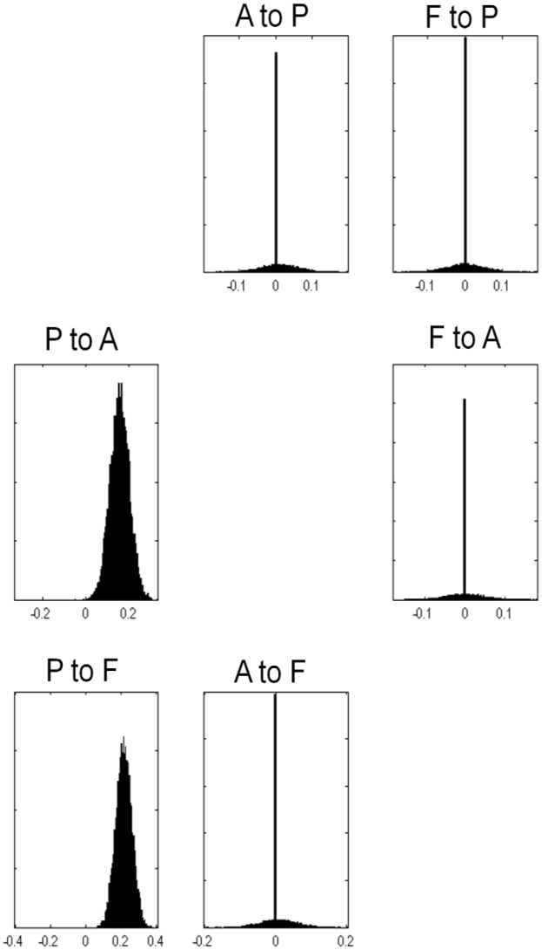
Parameters of a family
e.g. Modulatory connections
P
P
F
F
A
A
Winning Family: f1
*
P
P
F
F
A
A
*
BMA: weight posterior parameter
densities with model probabilities
Penny et al., 2010
Notes:
Using BMA within a family we can summarise family-specific coupling parameters in a way that avoids brittle assumptions about any particular model

Slide 22
Outline
Bayesian model selection (BMS)
Families of Models
Nonlinear DCM for fMRI
Stochastic DCM
Post-hoc selection of deterministic DCM
Integrating tractography and DCM

Slide 23
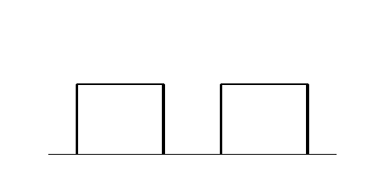
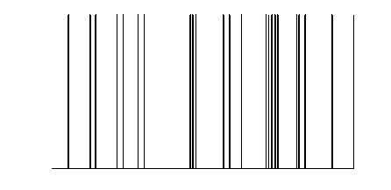
y
y
y
BOLD
y
−
−
λ
−
hemodynamic
model
activity
x₂(t)
activity
x₃(t)
activity
x₁(t)
neuronal
states
x
modulatory
input u₂(t)
integration
driving
input u₁(t)
t
Neural state equation
intrinsic connectivity
t
modulation of
connectivity
direct inputs
Stephan & Friston (2007),
Handbook of Brain Connectivity

Slide 24
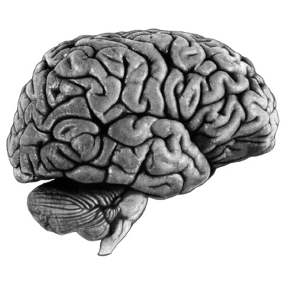
bilinear DCM
non-linear DCM
modulation
driving
input
driving
input
modulation
Two-dimensional Taylor series (around x₀=0, u₀=0):
A
C
B
D
Bilinear state equation:
Nonlinear state equation:

Slide 25
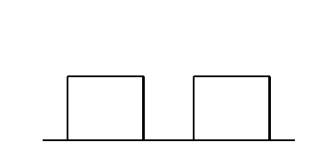
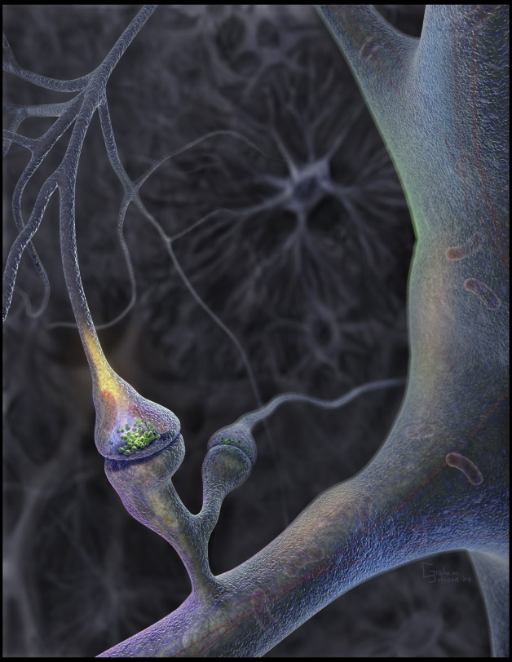
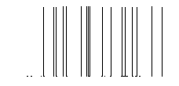
Neural population activity
u₂
u₁
x₃
fMRI signal change (%)
x₁
x₂
Nonlinear dynamic causal model (DCM):
Stephan et al. 2008, NeuroImage

Slide 26
attention
❶
M1
M2
modulation of back-
ward or forward
connection?
PPC
PPC
M2 better than M1
attention
BF = 2966
stim
V1
V5
stim
V1
V5
❷
additional driving
effect of attention
on PPC?
M3
attention
PPC
BF = 12
M3 better than M2
stim
V1
V5
❸
bilinear or nonlinear
modulation of
forward connection?
M4
attention
PPC
BF = 23
M4 better than M3
stim
V1
V5
Stephan et al. 2008, NeuroImage

Slide 27
Outline
Bayesian model selection (BMS)
Families of Models
Nonlinear DCM for fMRI
Stochastic DCM
Post-hoc selection of deterministic DCM
Integrating tractography and DCM

Slide 28
Stochastic DCMs
Uncertainty was previously assumed at only the point of observation
Stochastic DCMs accommodate random fluctuations in hidden states and physiological states i.e. endogenous dynamics not explained by experimental perturbation
The DCM now comprises a generative model of random differential equations (cf ω):
Log-Precision
hyperparameter
Smoothness
hyperparameter
Three quantities must now be inferred:
Parameters {A,B,C}, Hyperparameters {σ,π},And the states themselves {x,v,h}
Inversion: Generalised filtering (under the Laplace assumption)
(outperforms DEM which depends on conditional independence between quantities)
Li et al. 2011

Slide 29
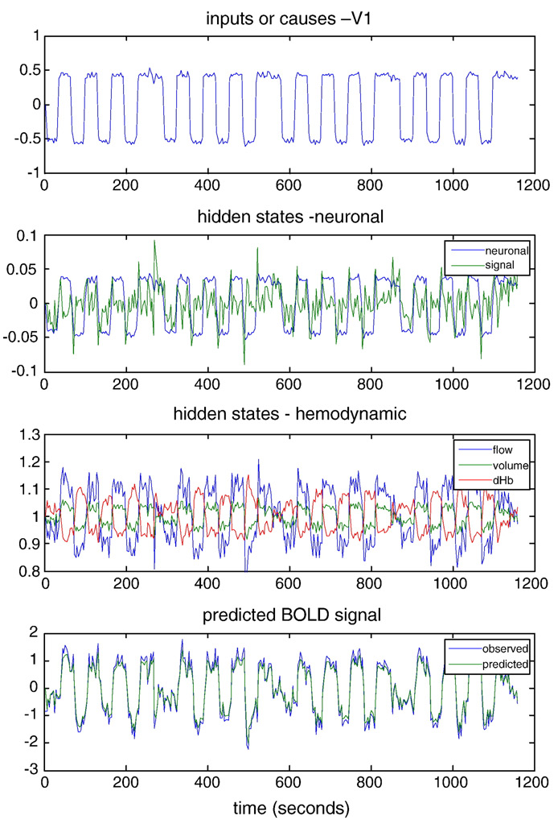
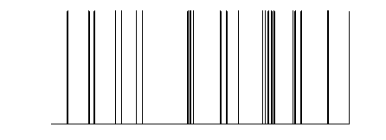
Stochastic DCMs
A new dimension: Hidden causes
~an estimate of afferent neuronal
activity elicited by experimental input
activity
x₂(t)
activity
x₃(t)
activity
x₁(t)
driving
input u₁(t)
neuronal
states
modulatory
input u₂(t)
t
Li et al. 2011
t

Slide 30
Outline
Bayesian model selection (BMS)
Families of Models
Nonlinear DCM for fMRI
Stochastic DCM
Post-hoc selection of deterministic DCM
Integrating tractography and DCM

Slide 31
Connection Combinatorics
18 possible “A” connections…. >2.6 million models
MOG
left
FG
left
FG
right
MOG
right
LG
left
LG
right
RVF
stim.
LVF
stim.

Slide 32
Overcoming Connection Combinatorics
Post-hoc evidence approach (Friston & Penny, 2001):
Post-hoc estimation of model evidence and parameters for any nested model within a larger model is possible through a function of the posterior density of the full model and priors of the reduced model
Assumption: existence of full model, m_{F} which shares likelihood with
reduced models m_{i}, ∨i: m_{i} m_{F}

Slide 33
Overcoming Connection Combinatorics
Post-hoc evidence approach (Friston & Penny, 2001):
Post-hoc estimation of model evidence and parameters for any nested model within a larger model is possible through a function of the posterior density of the full model and priors of the reduced model
Assumption: existence of full model, m_{F} which shares likelihood with
reduced models m_{i}, ∨i: m_{i} m_{F} (identical observation noise)

Slide 34
Post-hoc Evidence
Given the Laplace assumption
Log Model Evidence for any reduced model is an analytic function of means
and precisions of full & reduced model prior and posteriors
Means and precisions of reduced model posteriors available through simple algebra

Slide 35
Post-hoc Evidence
Generalization of Savage-Dickey Density Ratio (Dickey, 1971)
Delta point parameters on reduced
(u)Unique to full
(c) Common to both

Slide 36
Post-hoc Evidence

Slide 37
Outline
Bayesian model selection (BMS)
Families of Models
Nonlinear DCM for fMRI
Stochastic DCM
Post-hoc selection of deterministic DCM
Integrating tractography and DCM

Slide 38
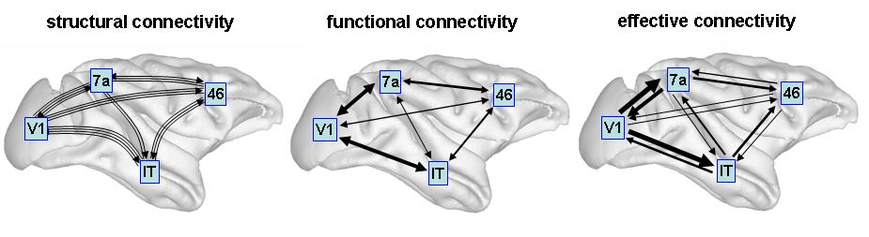
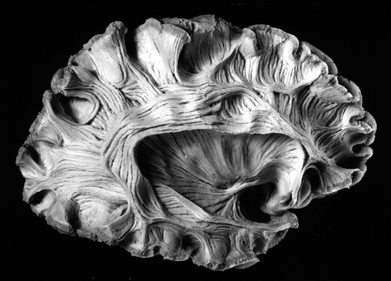
Diffusion-tensor imaging
Sporns, Scholarpedia
Parker & Alexander, 2005,
Phil. Trans. B

Slide 39
Probabilistic tractography: Kaden et al. 2007, NeuroImage
computes local fibre orientation density by deconvolution of the diffusion-weighted signal
estimates the spatial probability distribution of connectivity from given seed regions
anatomical connectivity = proportion of fibre pathways originating in a specific source region that intersect a target region
Asymmetry in metric accounted for by taking average of seed and target regions when interchanged

Slide 40
Integration of tractography and DCM
R₁
R₂
low probability of anatomical connection
→ small prior variance of effective connectivity parameter
R₁
R₂
Stephan, Tittgemeyer et al. 2009, NeuroImage
high probability of anatomical connection
→ large prior variance of effective connectivity parameter

Slide 41
LD|LVF
probabilistic
tractography
φ₃₄ = 6.5%
FG
(x₃)
FG
(x₄)
FG
left
FG
right
LD
LD
φ₁₃ = 15.7%
φ₂₄ = 43.6%
LG
(x₁)
LG
(x₂)
LG
left
LG
right
φ₁₂ = 34.2%
◆ DCM structure
LD|RVF
❖ anatomical connectivity
RVF
stim.
BVF
stim.
LVF
stim.
φ₃₄ = 6.5%
⬥ Hypothesised connection-specific priors for coupling parameters
Stephan, Tittgemeyer et al. 2009, NeuroImage
φ₃₄ = 43.6%

Slide 42
Connection-specific prior variance Σ as a function of anatomical connection probability ϕ
m1: a=-32,b=-32
m2: a=-16,b=-32
m3: a=-16,b=-28
m4: a=-12,b=-32
m5: a=-12,b=-28
m6: a=-12,b=-24
m7: a=-12,b=-20
m8: a=-8,b=-32
1
m9: a=-8,b=-28
1
1
1
1
1
1
1
1
0.5
0.5
0.5
0.5
0.5
0.5
0.5
0.5
0.5
0
0
0.5
1
0
0
0.5
1
0
0
0.5
1
0
0
0.5
1
0
0
0.5
1
0
0
0.5
1
0
0
0.5
1
0
0
0.5
1
0
0
0.5
1
m10: a=-8,b=-24
m11: a=-8,b=-20
m12: a=-8,b=-16
m13: a=-8,b=-12
m14: a=-4,b=-32
m15: a=-4,b=-28
m16: a=-4,b=-24
m17: a=-4,b=-20
m18: a=-4,b=-16
1
1
1
1
1
1
1
1
1
0.5
0.5
0.5
0.5
0.5
0.5
0.5
0.5
0.5
0
0
0.5
1
0
0
0.5
1
0
0
0.5
1
0
0
0.5
1
0
0
0.5
1
0
0
0.5
1
0
0
0.5
1
0
0
0.5
1
0
0
0.5
1
m19: a=-4,b=-12
m20: a=-4,b=-8
m21: a=-4,b=-4
1
m22: a=-4,b=0
1
m23: a=-4,b=4
1
m24: a=0,b=-32
1
m25: a=0,b=-28
1
m26: a=0,b=-24
1
m27: a=0,b=-20
1
1
1
64 different mappings by systematic search across hyper-parameters α and β
yields anatomically informed (intuitive and counterintuitive) and uninformed priors
0.5
0.5
0.5
0.5
0.5
0.5
0.5
0.5
0.5
0
0
0.5
1
0
0
0.5
1
0
0
0.5
1
0
0
0.5
1
0
0
0.5
1
0
0
0.5
1
0
0
0.5
1
0
0
0.5
1
0
0
0.5
1
1
m28: a=0,b=-16
1
m29: a=0,b=-12
1
m30: a=0,b=-8
1
m31: a=0,b=-4
1
m32: a=0,b=0
1
m33: a=0,b=4
1
m34: a=0,b=8
1
m35: a=0,b=12
1
m36: a=0,b=16
0.5
0.5
0.5
0.5
0.5
0.5
0.5
0.5
0.5
0
0
0.5
1
0
0
0.5
1
0
0
0.5
1
0
0
0.5
1
0
0
0.5
1
0
0
0.5
1
0
0
0.5
1
0
0
0.5
1
0
0
0.5
1
1
m37: a=0,b=20
1
m38: a=0,b=24
1
m39: a=0,b=28
1
m40: a=0,b=32
1
m41: a=4,b=-32
0.5
0.5
0.5
0.5
0.5
0
0
0.5
1
0
0
0.5
1
0
0
0.5
1
0
0
0.5
1
0
0
0.5
1
0
0.5
1
Notes:
Change image !!

Slide 43
Notes:
Fixed effects!!

Slide 44
m1: a=-32,b=-32
m2: a=-16,b=-32
m3: a=-16,b=-28
m4: a=-12,b=-32
m5: a=-12,b=-28
m6: a=-12,b=-24
m7: a=-12,b=-20
m8: a=-8,b=-32
m9: a=-8,b=-28
1
1
1
1
1
1
1
1
1
0.5
0.5
0.5
0.5
0.5
0.5
0.5
0.5
0.5
0
0
0.5
1
0
0
0.5
1
0
0
0.5
1
0
0
0.5
1
0
0
0.5
1
0
0
0.5
1
0
0
0.5
1
0
0
0.5
1
0
0
0.5
1
m10: a=-8,b=-24
m11: a=-8,b=-20
m12: a=-8,b=-16
m13: a=-8,b=-12
m14: a=-4,b=-32
m15: a=-4,b=-28
m16: a=-4,b=-24
m17: a=-4,b=-20
m18: a=-4,b=-16
1
1
1
1
1
1
1
1
1
0.5
0.5
0.5
0.5
0.5
0.5
0.5
0.5
0.5
0
0
0.5
1
0
0
0.5
1
0
0
0.5
1
0
0
0.5
1
0
0
0.5
1
0
0
0.5
1
0
0
0.5
1
0
0
0.5
1
0
0
0.5
1
m19: a=-4,b=-12
m20: a=-4,b=-8
m21: a=-4,b=-4
m22: a=-4,b=0
m23: a=-4,b=4
m24: a=0,b=-32
m25: a=0,b=-28
m26: a=0,b=-24
m27: a=0,b=-20
1
1
1
1
1
1
1
1
1
0.5
0.5
0.5
0.5
0.5
0.5
0.5
0.5
0.5
0
0
0.5
1
0
0
0.5
1
0
0
0.5
1
0
0
0.5
1
0
0
0.5
1
0
0
0.5
1
0
0
0.5
1
0
0
0.5
1
0
0
0.5
1
m28: a=0,b=-16
m29: a=0,b=-12
m30: a=0,b=-8
m31: a=0,b=-4
m32: a=0,b=0
m33: a=0,b=4
m34: a=0,b=8
m35: a=0,b=12
m36: a=0,b=16
1
1
1
1
1
1
1
1
1
0.5
0.5
0.5
0.5
0.5
0.5
0.5
0.5
0.5
0
0
0.5
1
0
0
0.5
1
0
0
0.5
1
0
0
0.5
1
0
0
0.5
1
0
0
0.5
1
0
0
0.5
1
0
0
0.5
1
0
0
0.5
1
m37: a=0,b=20
m38: a=0,b=24
m39: a=0,b=28
m40: a=0,b=32
m41: a=4,b=-32
1
1
1
1
1
0.5
0.5
0.5
0.5
0.5
0
0
0.5
1
0
0
0.5
1
0
0
0.5
1
0
0
0.5
1
0
0
0.5
1
0
0.5
1
Stephan, Tittgemeyer et al. 2009, NeuroImage

Slide 45
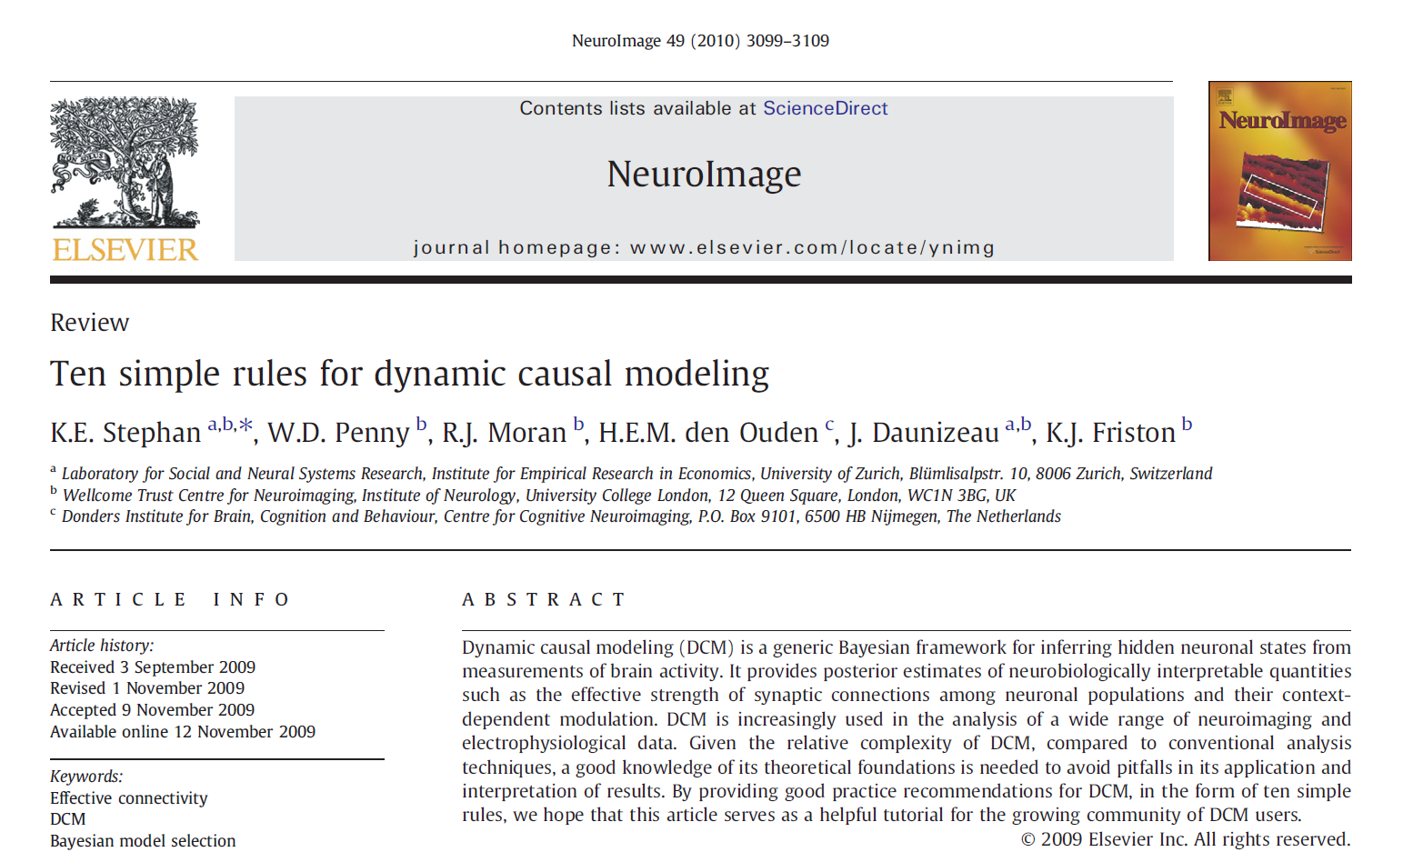

Slide 46
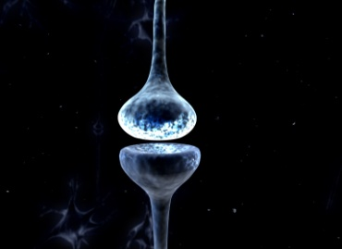
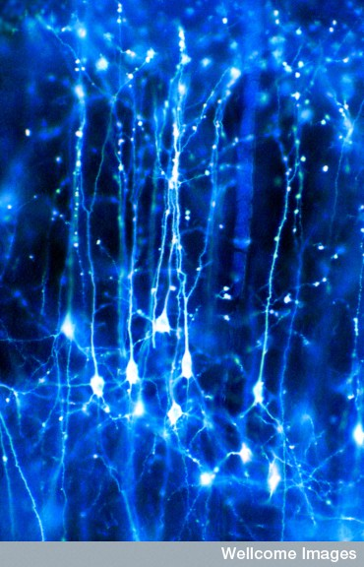
Thank You
With thanks to the FIL Methods Group
for slides and images
In particular Klaas Stephan, Maria Joao and Will Penny

