Slide 1

Introduction to SPM
Guillaume Flandin
Wellcome Trust Centre for Neuroimaging
University College London
SPM fMRI Course
London, May 2012

Slide 2
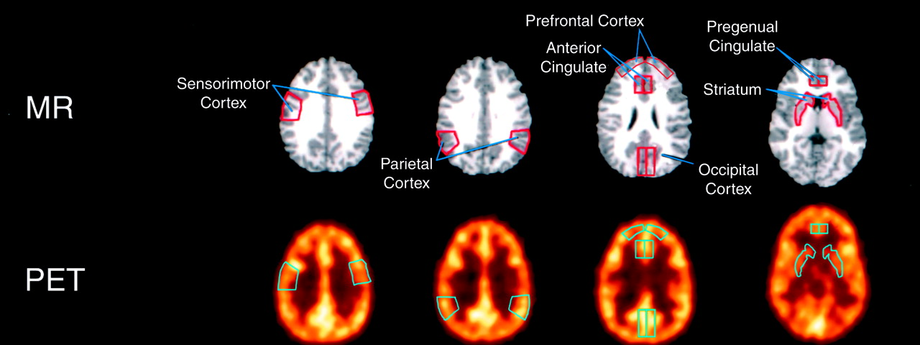
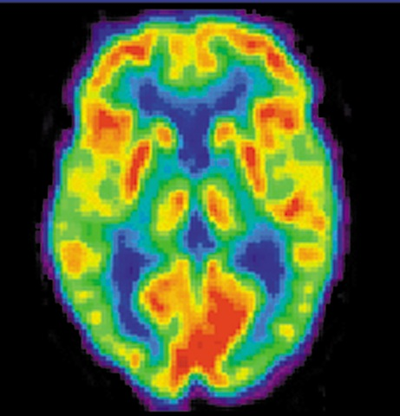
From PET analyses using ROIs…

Slide 3
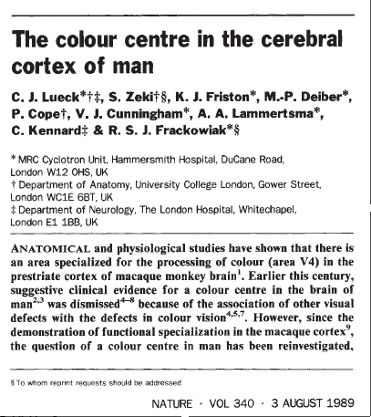
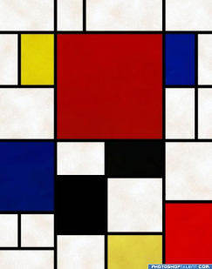
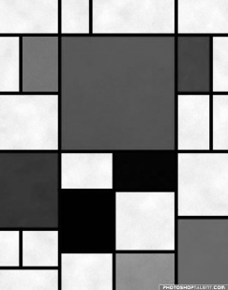
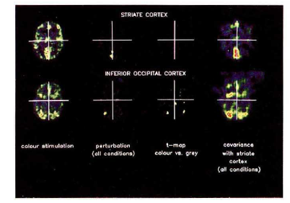
…to the very first SPM{t}
An area specialised for the processing of colour, the“colour centre” (V4) highlighted by cognitive substraction using PET.
Three subjects:
Compatible with earlier findings on monkeys using electrophysiology .
Colour trials
(2 scans)
Grey trials
(2 scans)
Notes:
3

Slide 4



Image time-series
Spatial filter
Design matrix
Statistical Parametric Map
Realignment
Smoothing
General Linear Model
Statistical
Inference
RFT
Normalisation
Anatomical
reference
p <0.05
Parameter estimates

Slide 5
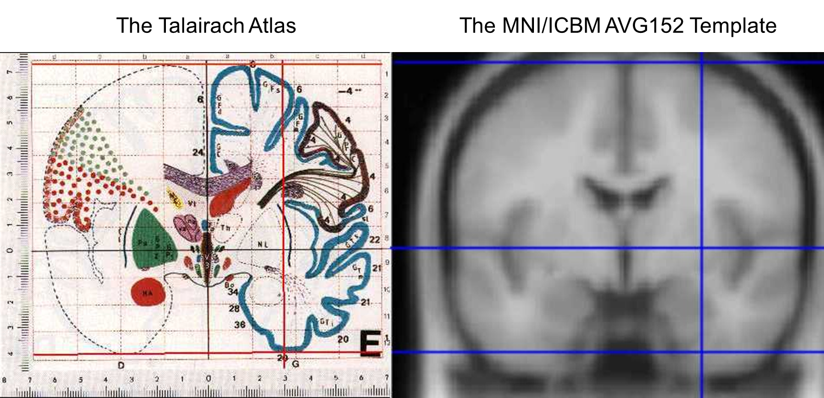
Spatial Normalisation
Talairach et al, 1967.
Talairach and Tournoux, 1988.
International Consortium for
Brain Mapping (ICBM)
Evans et al, 1993.

Slide 6
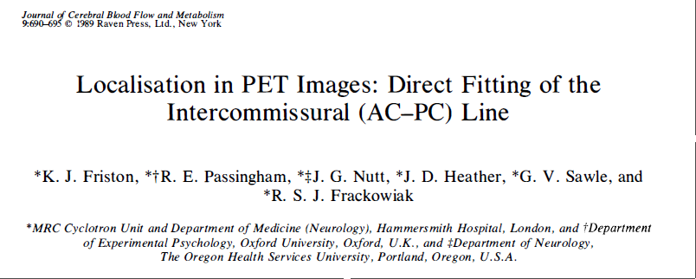
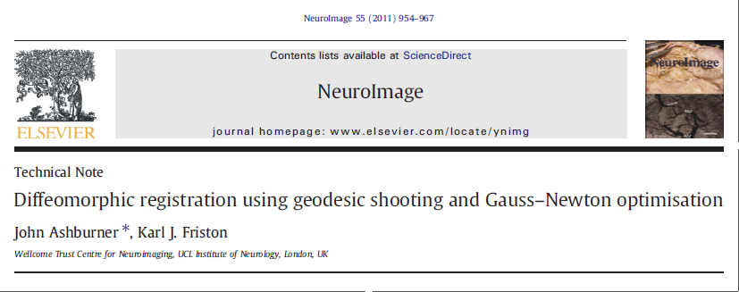
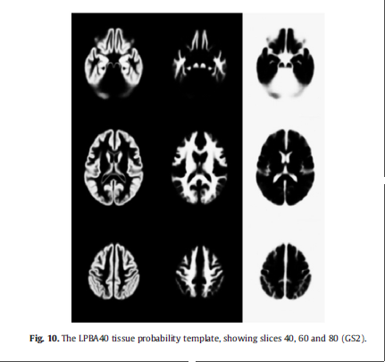
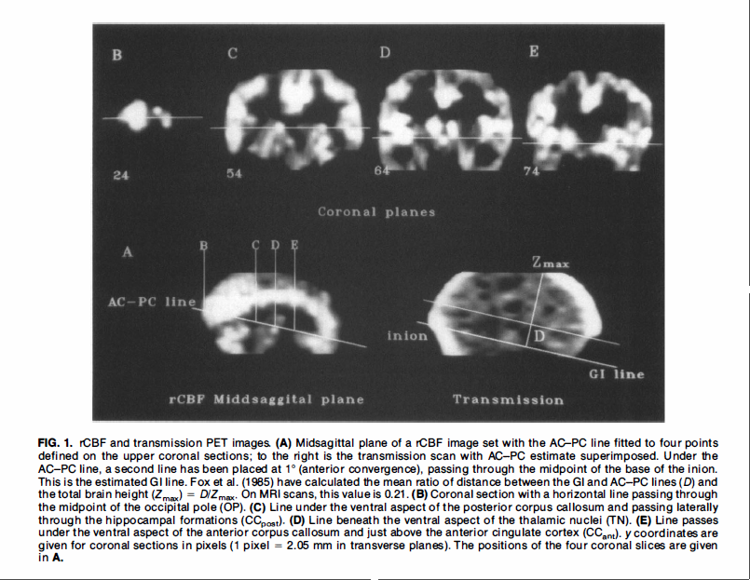
Spatial Normalisation

Slide 7
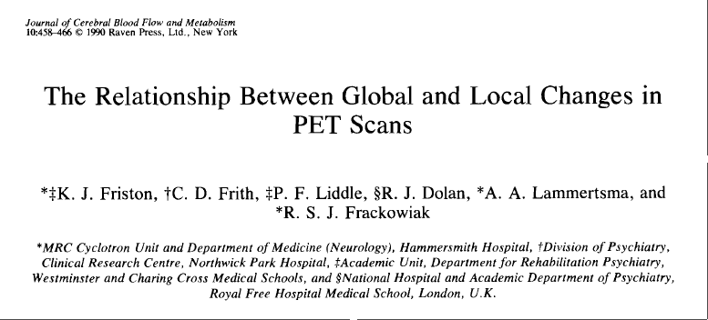
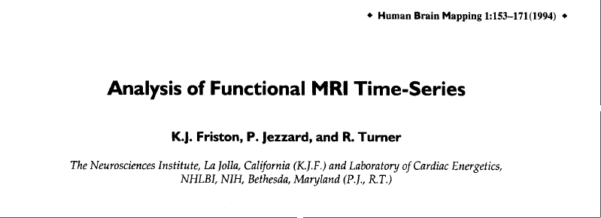
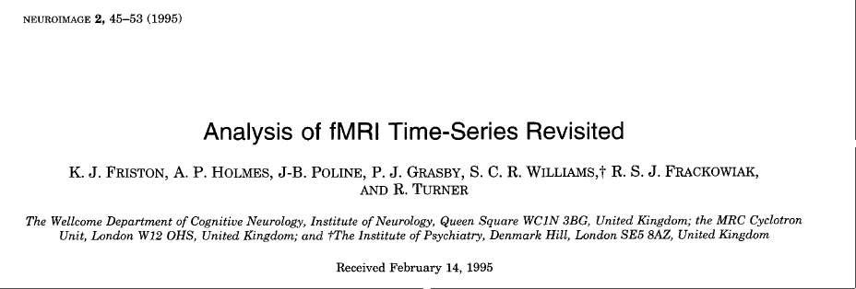
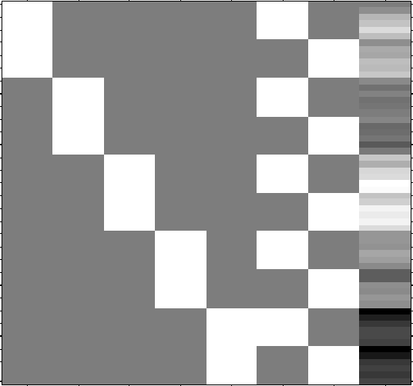
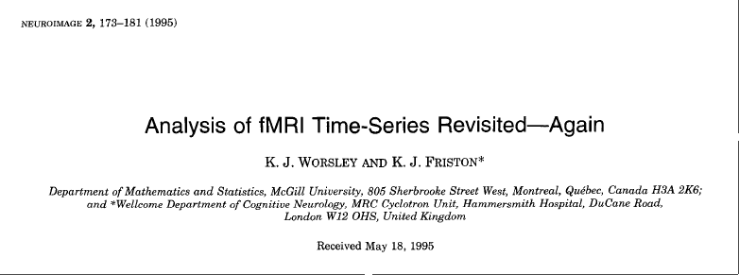
The General Linear Model
… convolution model for fMRI
One sample t-test
Two sample t-test
Paired t-test
Analysis of Variance (ANOVA)
Analysis of Covariance (ANCOVA)
Multiple regression

Slide 8
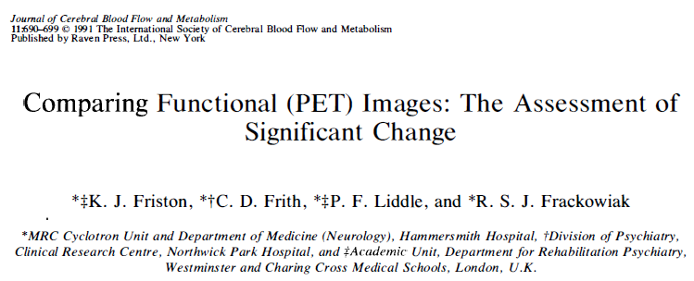
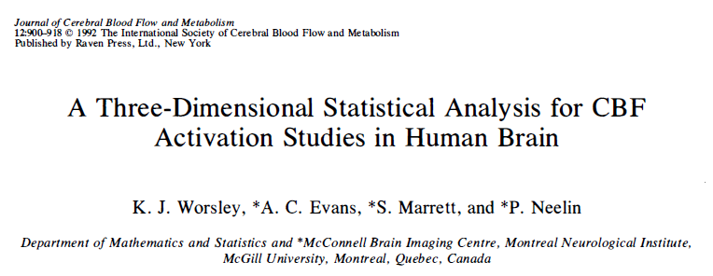
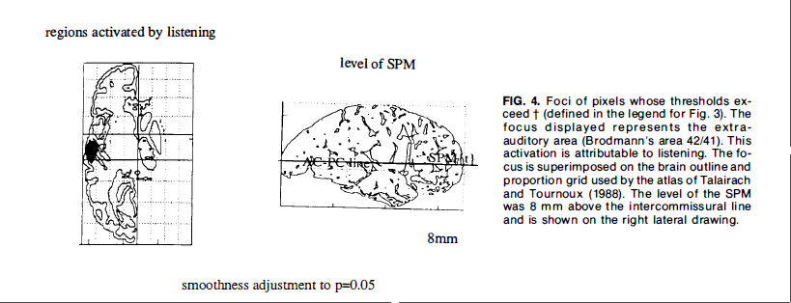
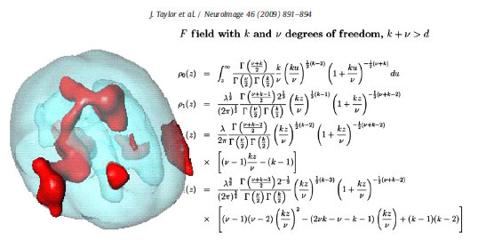
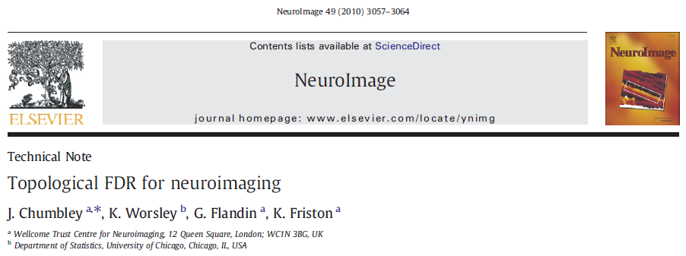

Topological Inference

Slide 9
Image time-series
Spatial filter
Design matrix
Statistical Parametric Map
Realignment
Smoothing
General Linear Model
Statistical
Inference
RFT
Normalisation
Anatomical
reference
p <0.05
Parameter estimates

Slide 10
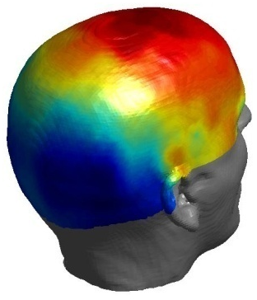
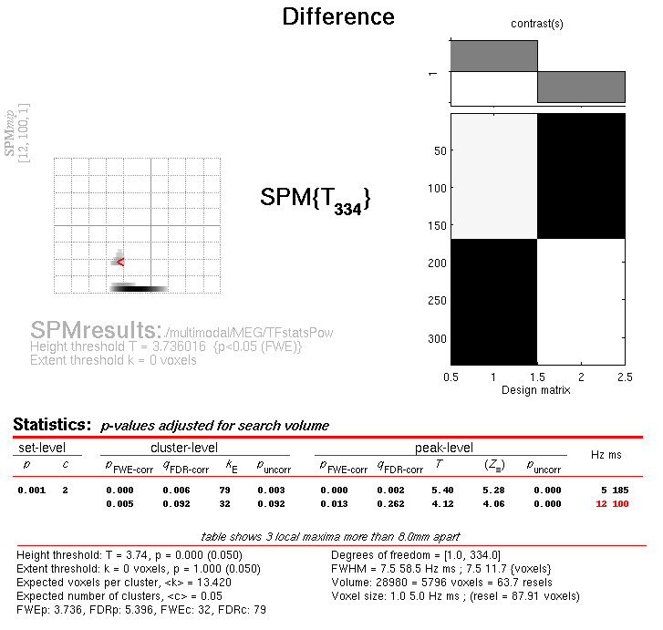
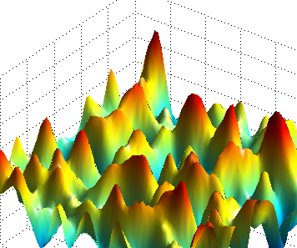
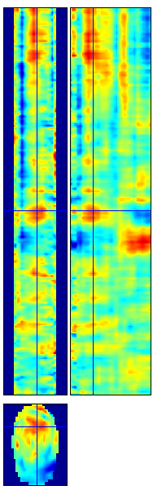
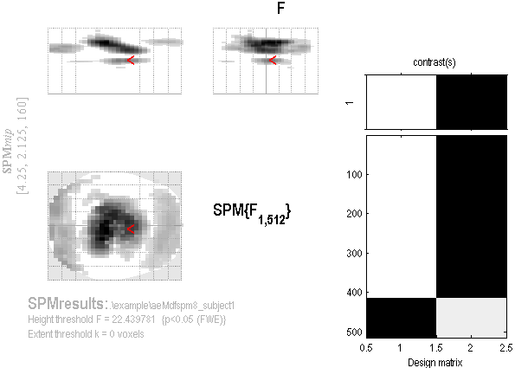
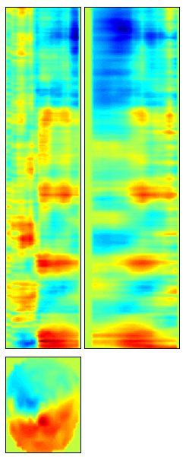
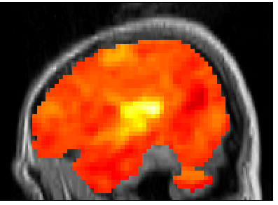
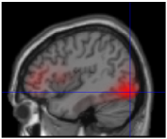
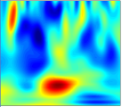
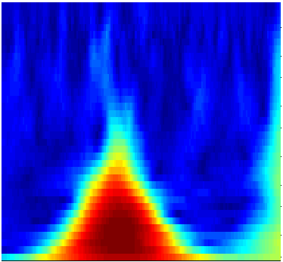

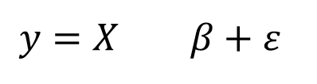

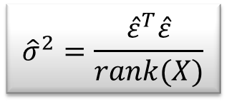
M/EEG Data Analysis
Random
Field Theory
$$y=X β+ε$$
Contrast c
Pre-
processings
General
Linear
Model
Statistical Inference
$$\hat{β}={\left(X^{T}X\right)}^{−1}X^{T}y$$
$${\hat{σ}}^{2}=\frac{{\hat{ε}}^{T}\hat{ε}}{rank(X)}$$
$$SPM\{T,F\}$$

Slide 11
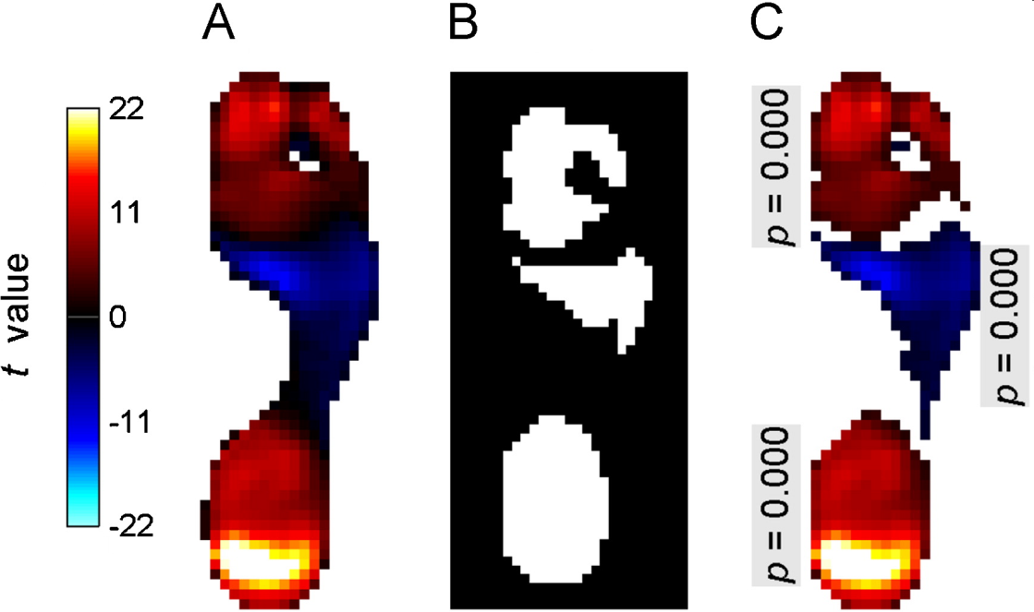
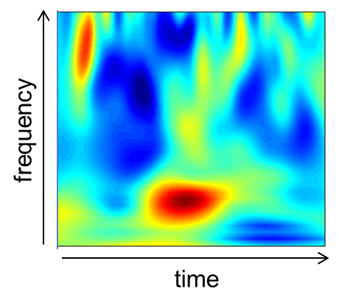
Statistical Parametric Mapping refers to the construction and assessment of spatially extended statistical processes used to test hypotheses about functional imaging data.
Topological inference for EEG and MEG, J. Kilner and K.J. Friston, Annals of Applied Statistics, 2010.
Pedobarographic statistical parametric mapping (pSPM), T. Pataky, Journal of Foot and Ankle Research, 2008.

Slide 12
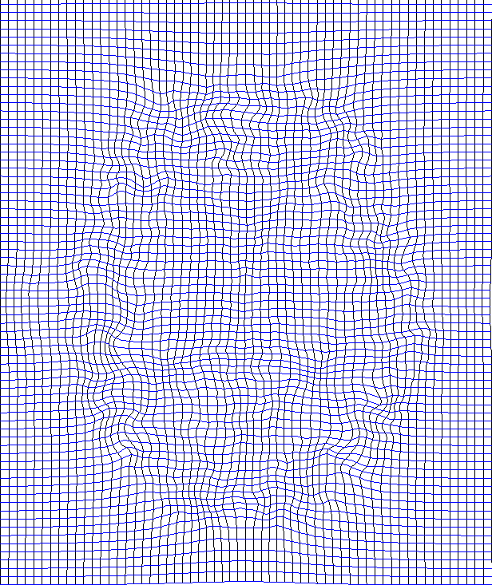
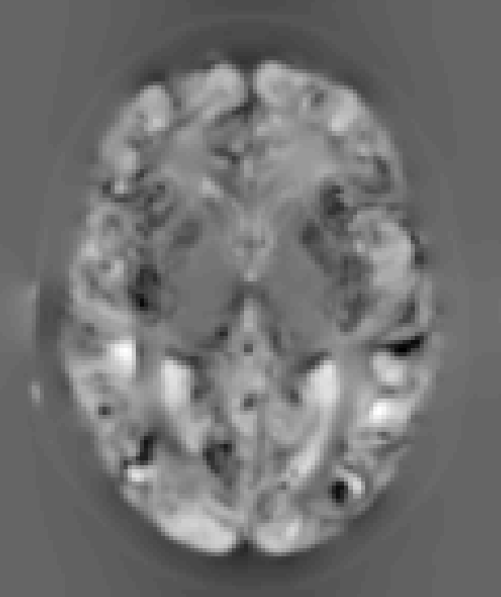
Computational anatomy
If we can estimate the transformations that align and warp each subject to match a template, then we can study individual differences in these transformations or derivatives.
E.g. deformation-based and tensor-based morphometry.

Slide 13
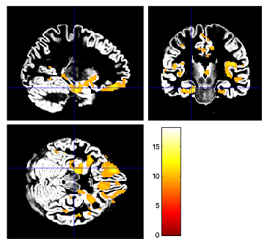
Voxel based morphometry (VBM)
VBM involves creating spatially normalised images whose intensities at each point relate to the local volume of a particular brain tissue (e.g. gray matter).
This requires tissue segmentation, spatial normalisation, and a “change of variables” to account for volume changes occuring in the normalisation process.
The same general linear modelling & RFT machinery in SPM can then be used to study differences in structure.

Slide 14
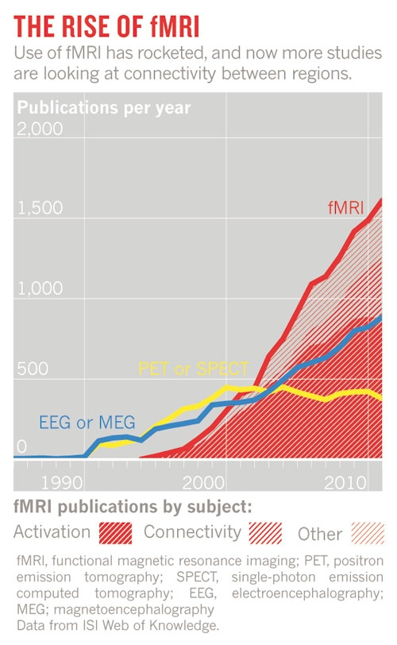

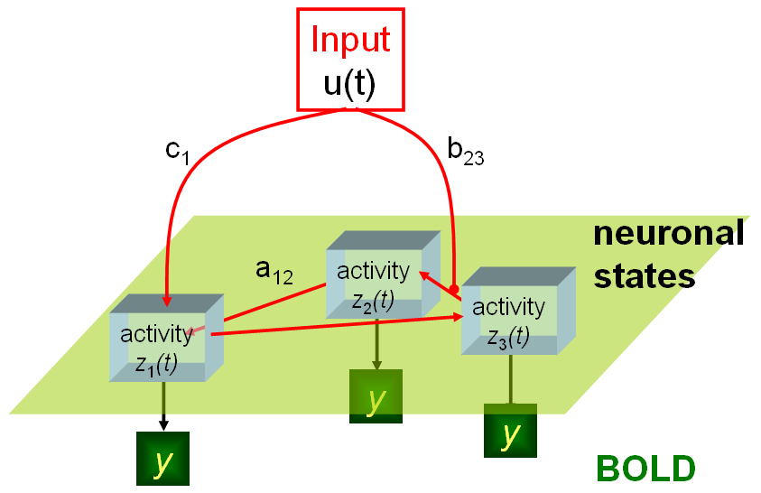
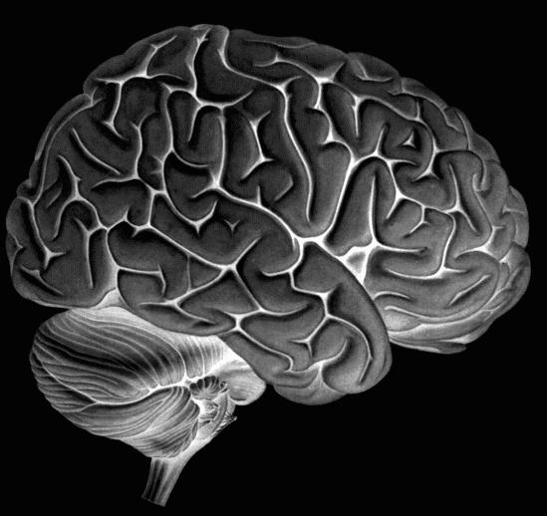
Dynamic Causal Models
Nature, April 2012

Slide 15
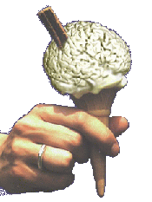
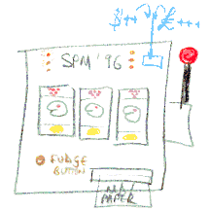
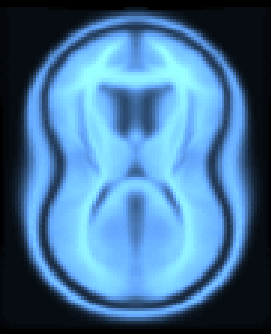
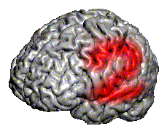
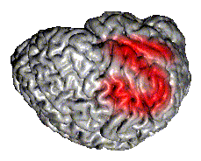
SPM Software
“The SPM software was originally developed by Karl Friston for the routine statistical analysis of functional neuroimaging data from PET while at the Hammersmith Hospital in the UK, and made available to the emerging functional imaging community in 1991 to promote collaboration and a common analysis scheme across laboratories.”
SPMclassic, SPM’94, SPM’96, SPM’99, SPM2, SPM5 and SPM8 represent the ongoing theoretical advances and technical improvements of the original version.

Slide 16




Software: SPM8
Free and Open Source Software (GPL)
Requirements:
  MATLAB: 7.1 (R14SP3) to 7.14 (R2012a)
  no MathWorks toolboxes required
  Supported platforms:
SPM8 standalone version available.
Linux (32 and 64 bit)
Windows (32 and 64 bit)
Mac Intel (32 and 64 bit)

Slide 17
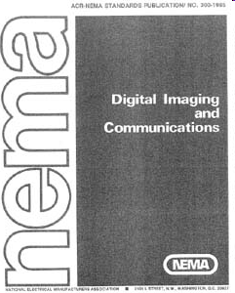
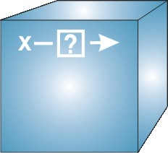
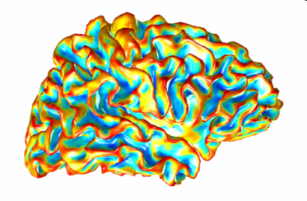
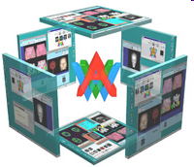
Data File Formats
DICOM: Digital Imaging and Communications in Medicine
NIfTI: Neuroimaging Informatics Technology Initiative
  NifTI: volumetric data format (*.hdr/*.img, *.nii, *.nii.gz)
  GIfTI: geometry data format (*.gii)
AnalyzeTM: Mayo Clinic Analyze 7.5 file format
(*.hdr/*.img)
Interoperability:
  Compatible with AFNI, BrainVISA, BrainVoyager, Caret, Freesurfer, FSL, …

Slide 18

SPM Website
http://www.fil.ion.ucl.ac.uk/spm/

Slide 19





SPM Documentation
Peer reviewed literature
SPM Manual
Online help
& function
descriptions
SPM Book

Slide 20

SPM datasets
PET, fMRI (1st and 2nd level), PPI, DCM, EEG, MEG, LFP.

Slide 21

SPM Mailing List
http://www.fil.ion.ucl.ac.uk/spm/support/
spm@jiscmail.ac.uk

Slide 22

SPM Toolboxes
User-contributed SPM extensions:
http://www.fil.ion.ucl.ac.uk/spm/ext/

Slide 23


References
Twenty years of functional MRI: The science and the stories. P. Bandettini, NeuroImage, 2012.
http://dx.doi.org/10.1016/j.neuroimage.2012.04.026
SPM: A history. J. Ashburner, NeuroImage, 2011.
http://dx.doi.org/10.1016/j.neuroimage.2011.10.025
SPM’s 20th Anniversary, K.J. Friston.
http://www.fil.ion.ucl.ac.uk/spm/course/video/#Overview

