Slide 1

The General Linear Model
Guillaume Flandin
Wellcome Trust Centre for Neuroimaging
University College London
SPM fMRI Course
London, May 2012

Slide 2



Image time-series
Spatial filter
Design matrix
Statistical Parametric Map
Realignment
Smoothing
General Linear Model
Statistical
Inference
RFT
Normalisation
Anatomical
reference
p <0.05
Parameter estimates

Slide 3
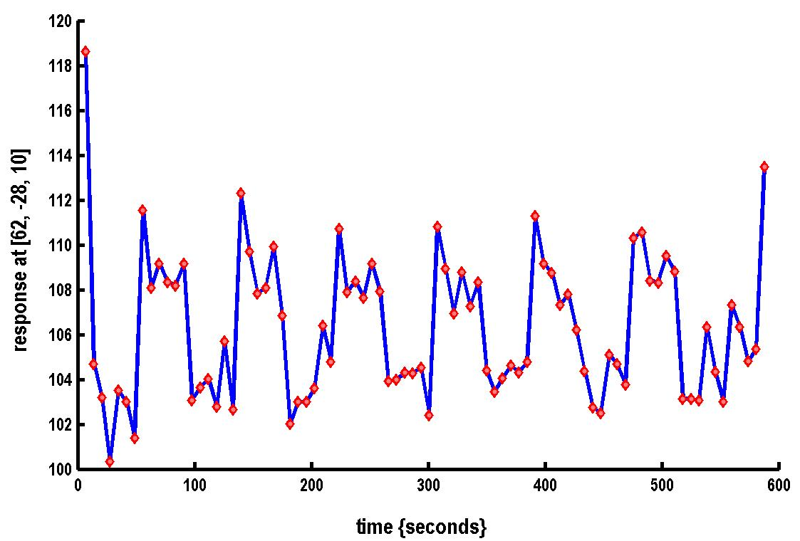

A very simple fMRI experiment
One session
Passive word listening
versus rest
7 cycles of
rest and listening
Blocks of 6 scans
with 7 sec TR
Stimulus function
Question: Is there a change in the BOLD response between listening and rest?

Slide 4
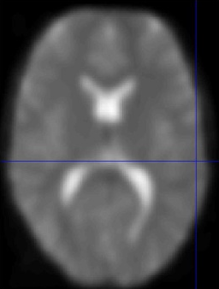
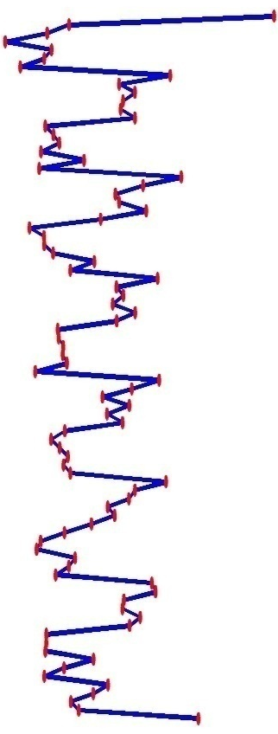
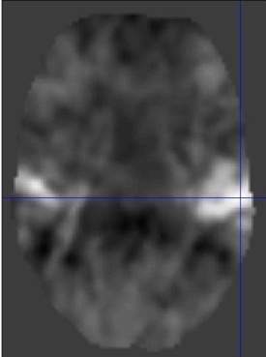
Voxel-wise time series analysis
Model
specification
Parameter
estimation
Time
Hypothesis
Statistic
Time
BOLD signal
single voxel
time series
SPM

Slide 5

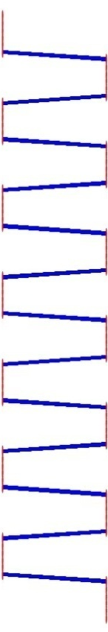

Single voxel regression model
error
=
β₁
+
β₂
+
Time
x₁
x₂
e
BOLD signal

Slide 6
Mass-univariate analysis: voxel-wise GLM
X
y
+
=
Model is specified by
Design matrix X
Assumptions about e
N: number of scans
p: number of regressors
The design matrix embodies all available knowledge about experimentally controlled factors and potential confounds.

Slide 7
GLM: a flexible framework for parametric analyses
    one sample t-test
    two sample t-test
    paired t-test
    Analysis of Variance (ANOVA)
    Analysis of Covariance (ANCoVA)
    correlation
    linear regression
    multiple regression

Slide 8



Parameter estimation
Objective:
estimate parameters to minimize
=
+
y
X
Ordinary least squares estimation (OLS) (assuming i.i.d. error):

Slide 9
Problems of this model with fMRI time series
The BOLD response has a delayed and dispersed shape.
The BOLD signal includes substantial amounts of low-frequency noise (eg due to scanner drift).
Due to breathing, heartbeat & unmodeled neuronal activity, the errors are serially correlated. This violates the assumptions of the noise model in the GLM.

Slide 10
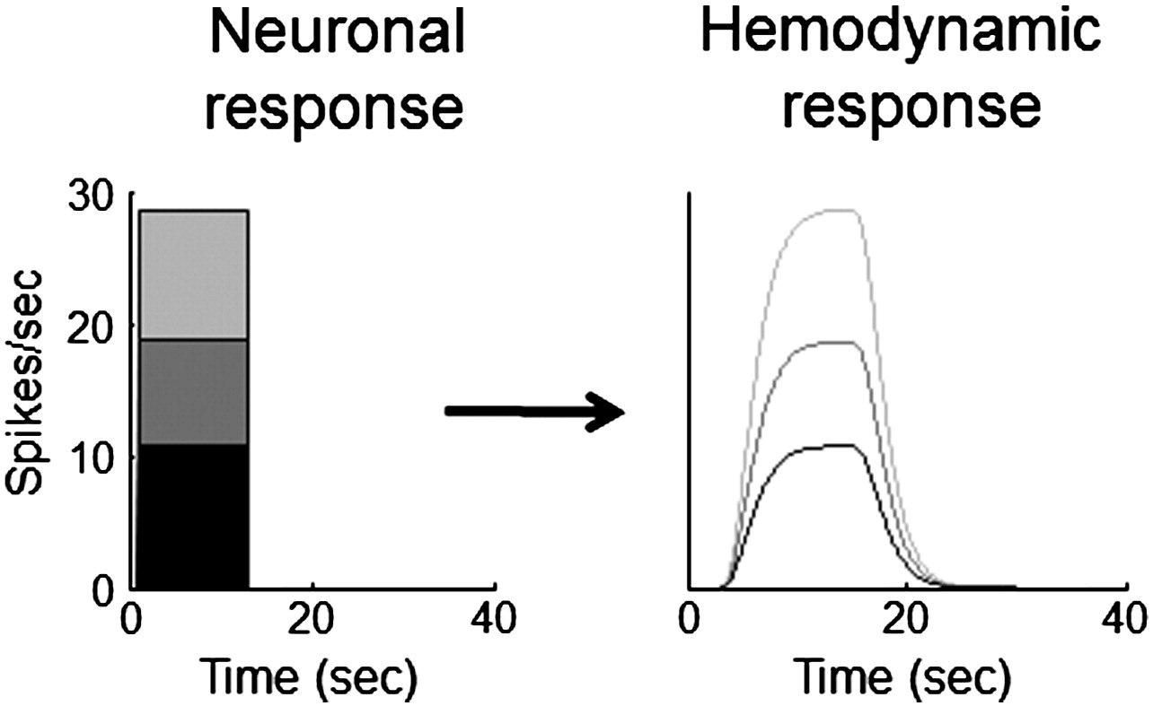
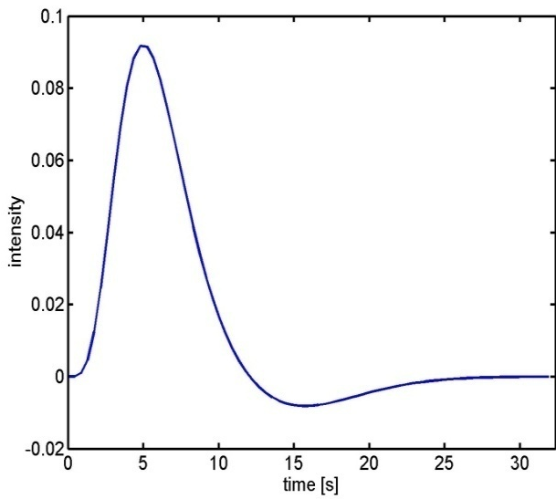
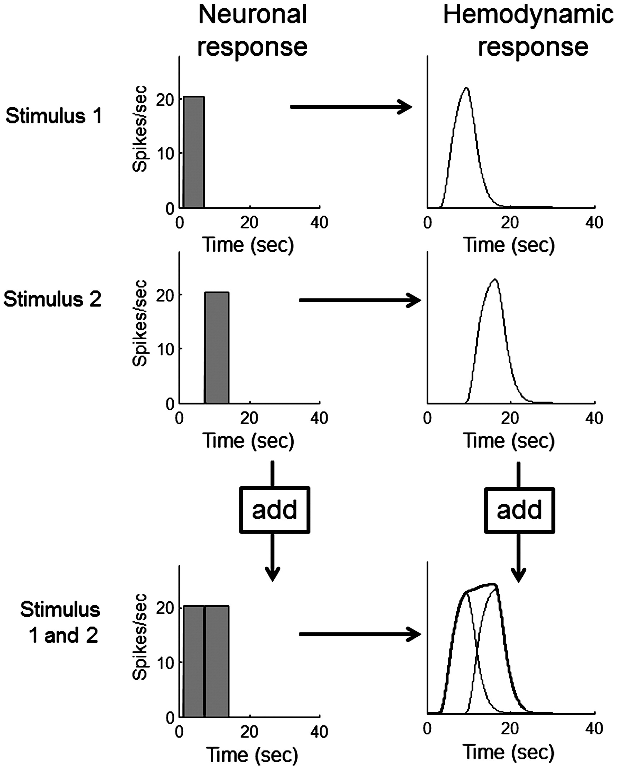
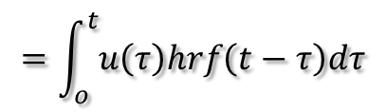

Problem 1: BOLD response
Hemodynamic response function (HRF):
Scaling
Shift
invariance
Linear time-invariant (LTI) system:
u(t)
hrf(t)
x(t)
Convolution operator:
$$x\left(t\right)=u\left(t\right)∗hrf\left(t\right)$$
Additivity
$$=\int_{o}^{t}{u\left(τ\right)hrf\left(t−τ\right)dτ}$$
Boynton et al, NeuroImage, 2012.

Slide 11
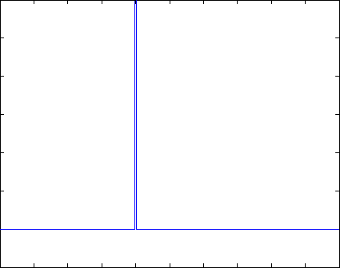
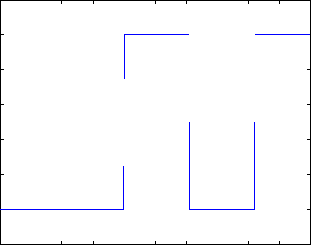
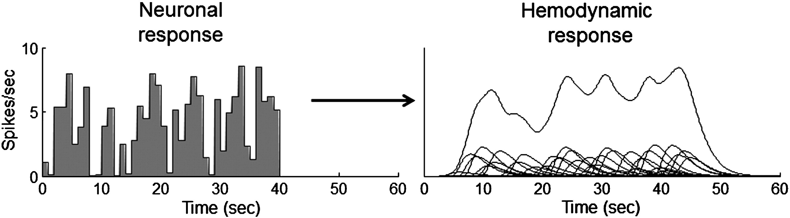
Problem 1: BOLD response
Solution: Convolution model

Slide 12
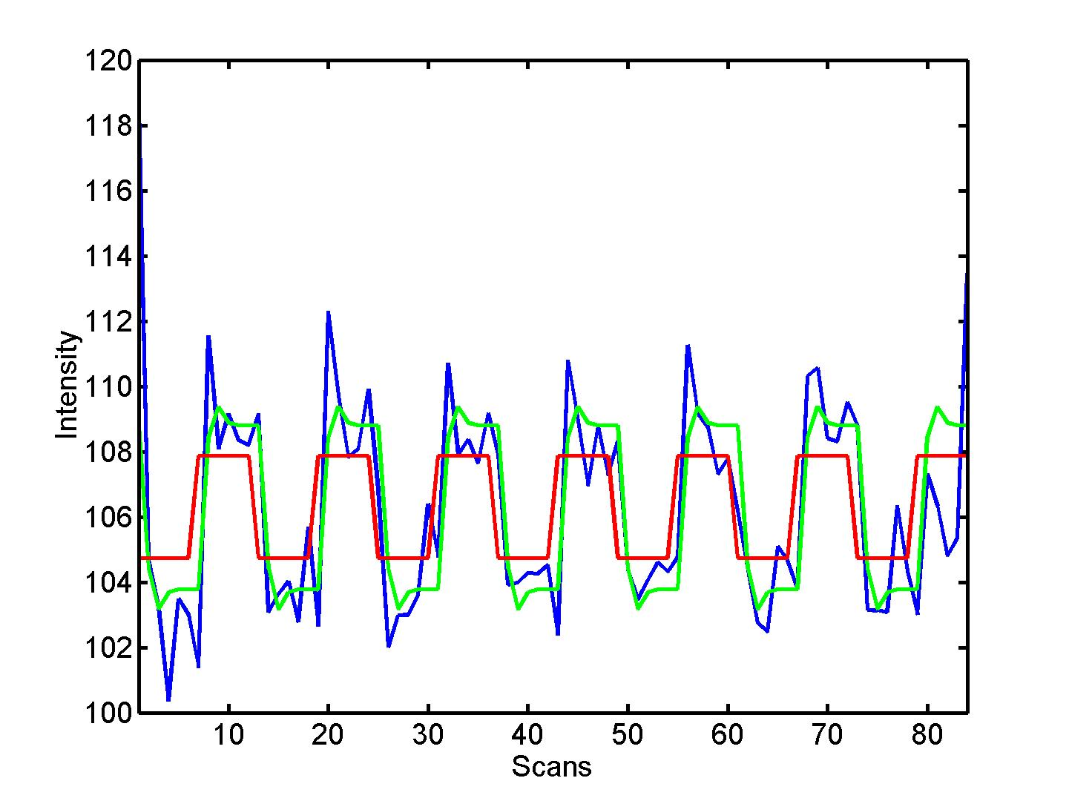


Convolution model of the BOLD response
Convolve stimulus function with a canonical hemodynamic response function (HRF):
⊗ HRF

Slide 13
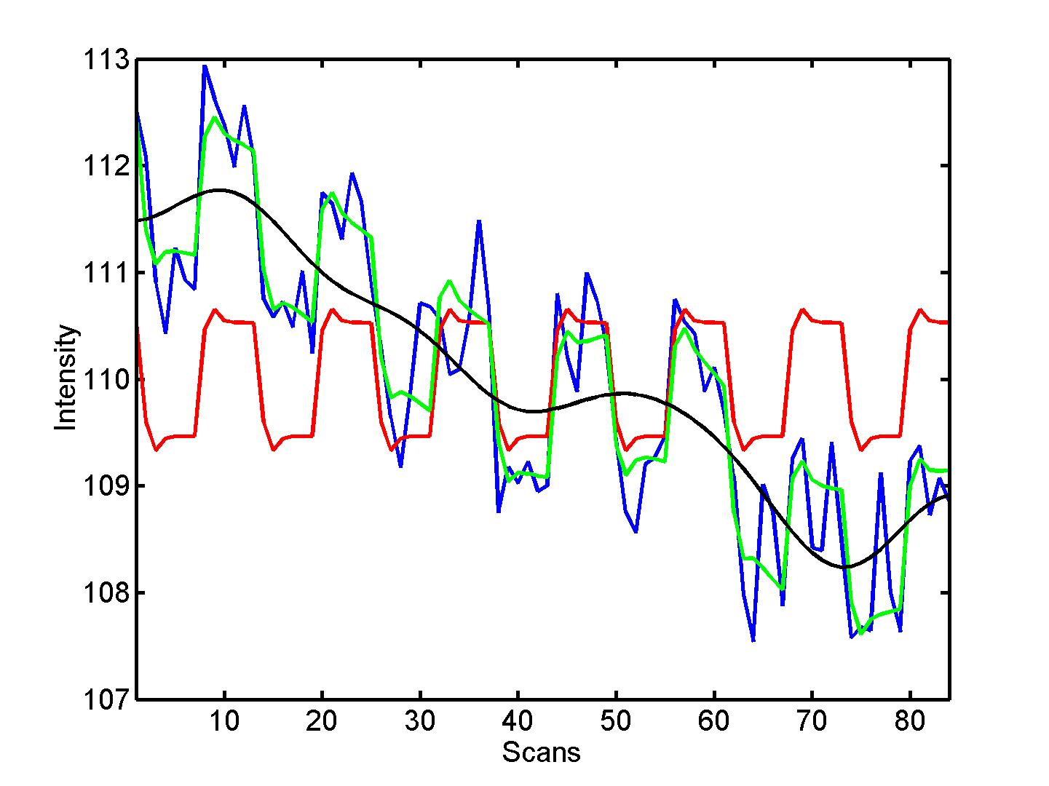
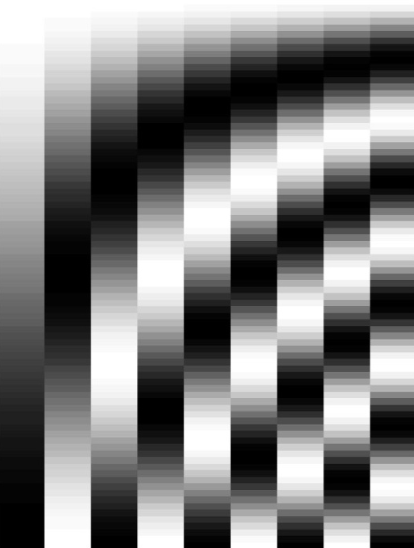
Problem 2: Low-frequency noise
Solution: High pass filtering
blue = data
black = mean + low-frequency drift
green = predicted response, taking into account low-frequency drift
red = predicted response, NOT taking into account low-frequency drift
discrete cosine transform (DCT) set

Slide 14
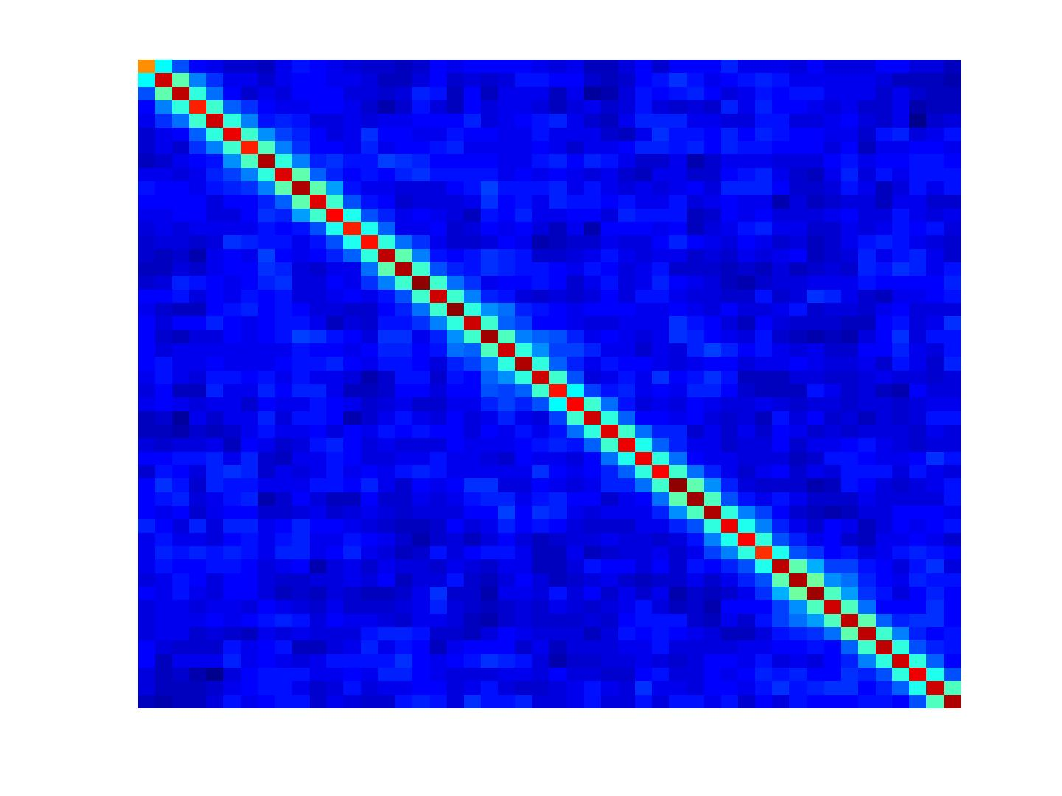
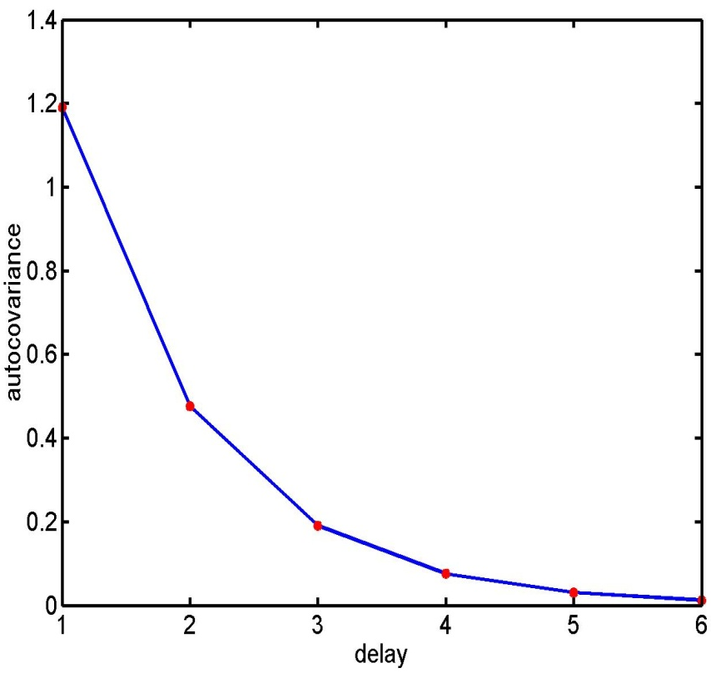
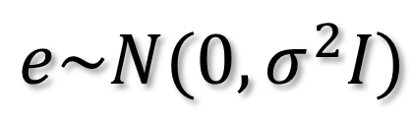
Problem 3: Serial correlations
i.i.d:
$$e\sim N(0,σ^{2}I)$$
autocovariance
function

Slide 15
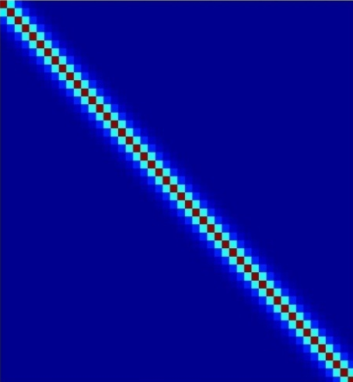
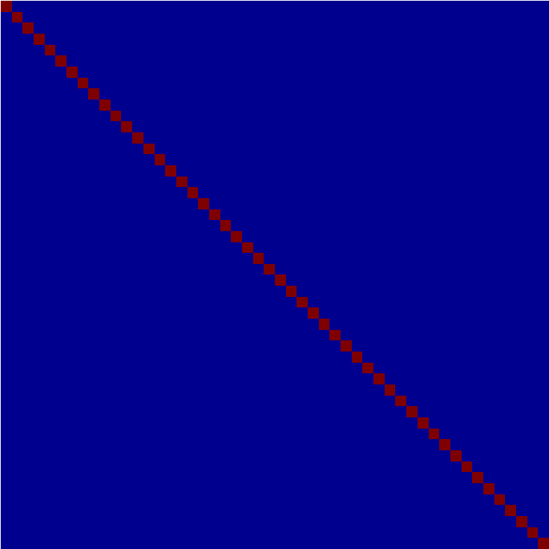
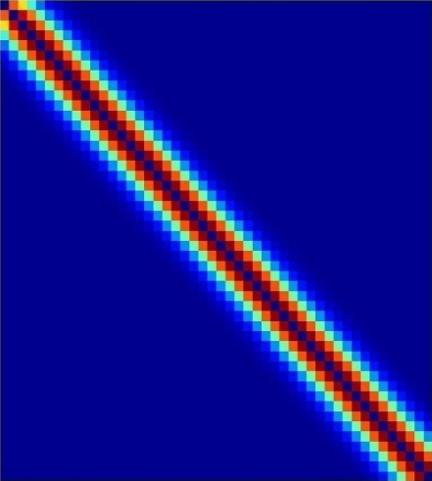
Multiple covariance components
enhanced noise model at voxel i
error covariance components Q and hyperparameters λ
V
Q₁
Q₂
=
λ₁
+ λ₂
Estimation of hyperparameters λ with ReML (Restricted Maximum Likelihood).

Slide 16
Weighted Least Squares (WLS)
Let
Then
WLS equivalent to
OLS on whitened
data and design
where

Slide 17
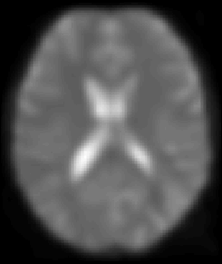
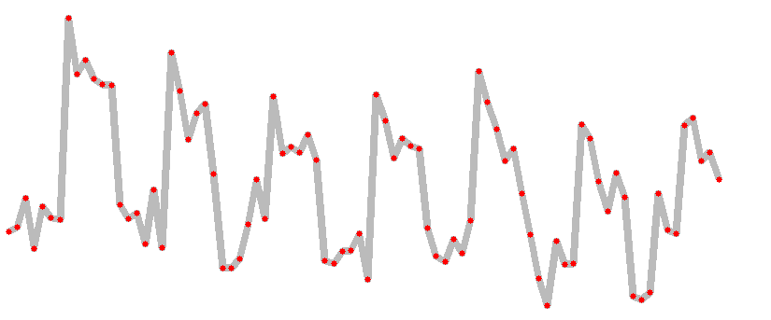
A mass-univariate approach
Summary
Time

Slide 18
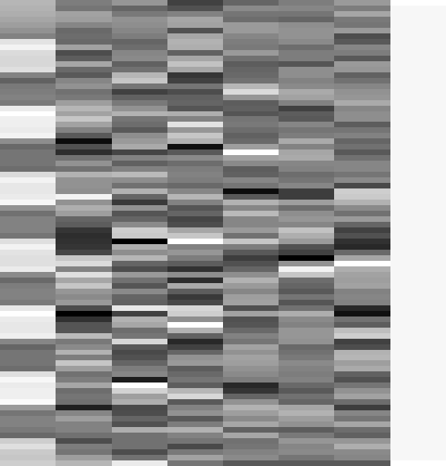


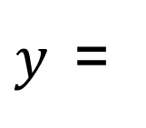
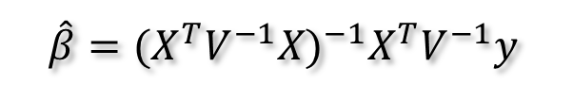
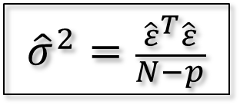
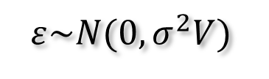
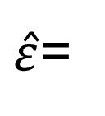



Estimation of the parameters
Summary
noise assumptions:
$$ε\sim N(0,σ^{2}V)$$
WLS:
$$\hat{β}={(X^{T}V^{−1}X)}^{−1}X^{T}V^{−1}y$$
$${\hat{β}}_{1}=3.9831$$
$${\hat{β}}_{2−7}=\{0.6871, 1.9598, 1.3902, 166.1007, 76.4770, −64.8189\}$$
$$β$$
$${\hat{β}}_{8}=131.0040$$
$y$=
$$+ε$$
$\hat{ε}$=
$${\hat{σ}}^{2}=\frac{{\hat{ε}}^{T}\hat{ε}}{N−p}$$
$$\hat{β}\sim N\left(β,σ^{2}{(X^{T}X)}^{−1}\right)$$

Slide 19
References
Statistical parametric maps in functional imaging: a general linear approach, K.J. Friston et al, Human Brain Mapping, 1995.
Analysis of fMRI time-series revisited – again, K.J. Worsley and K.J. Friston, NeuroImage, 1995.
The general linear model and fMRI: Does love last forever?, J.-B. Poline and M. Brett, NeuroImage, 2012.
Linear systems analysis of the fMRI signal, G.M. Boynton et al, NeuroImage, 2012.

