Slide 1


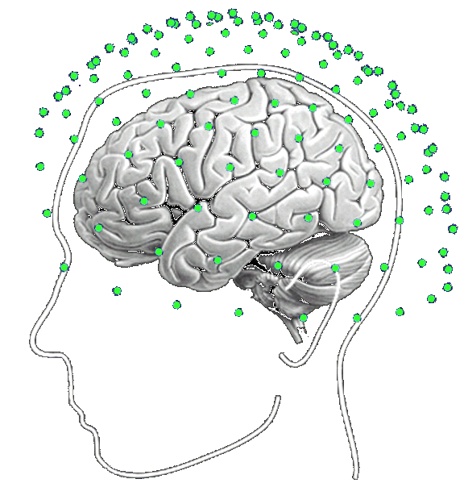
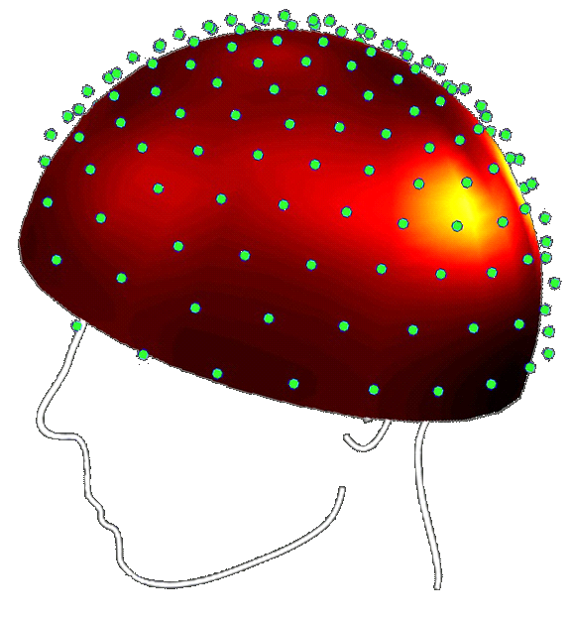
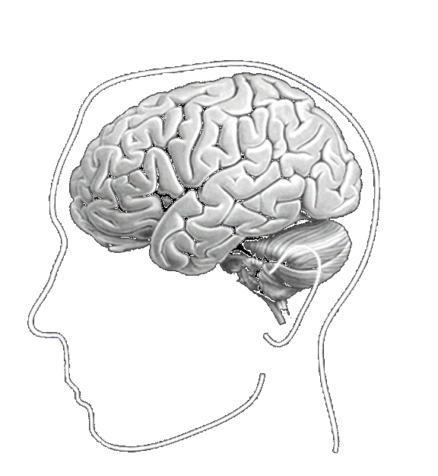
DCM demo
André Bastos and Martin Dietz
Wellcome Trust Centre for Neuroimaging

Slide 2
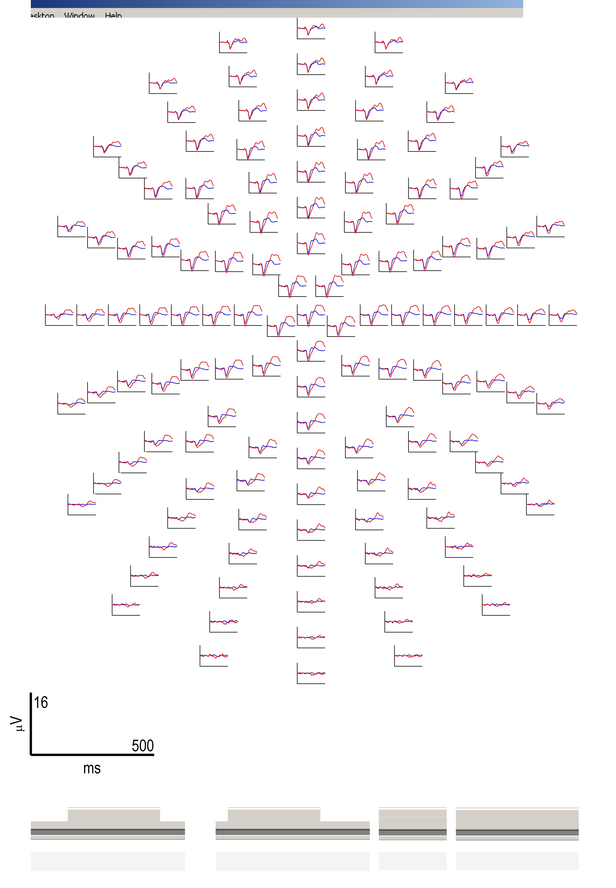
Mismatch negativity (MMN) paradigm and hypothesis
Paradigm:
standards
deviants
pseudo-random auditory sequence
80% standard tones – 500 Hz
20% deviant tones – 550 Hz
time
Hypothesis:
MMN is caused by recurrent
dynamics enabled by backward
connections
+
amplitude (μV)
Deviant ERP
Standard ERP
0
-
0
200
time (ms)
Garrido et al., Neuroimage 2007
Notes:
Deviants minus standards gives you a negativity around 90-190ms
Plotted is C21 (frontocentral electrode)

Slide 3
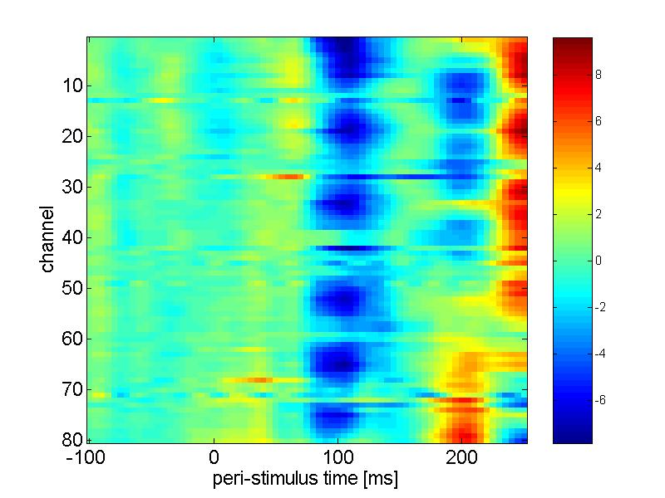
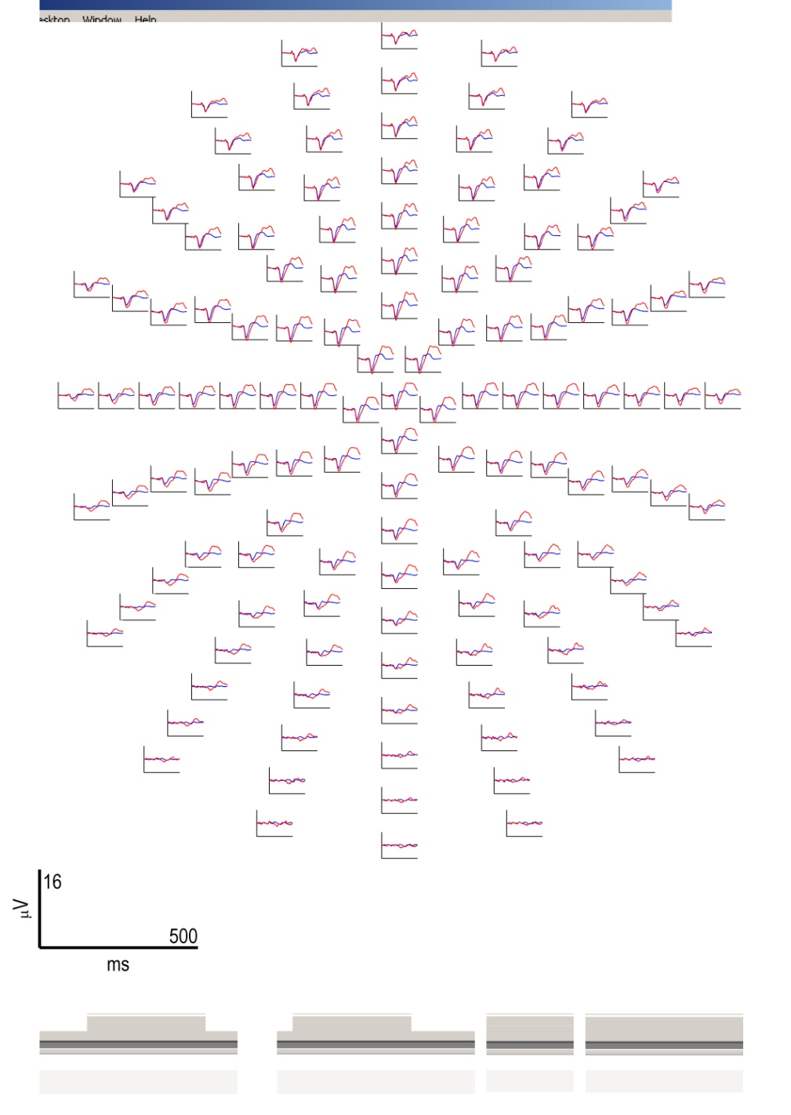
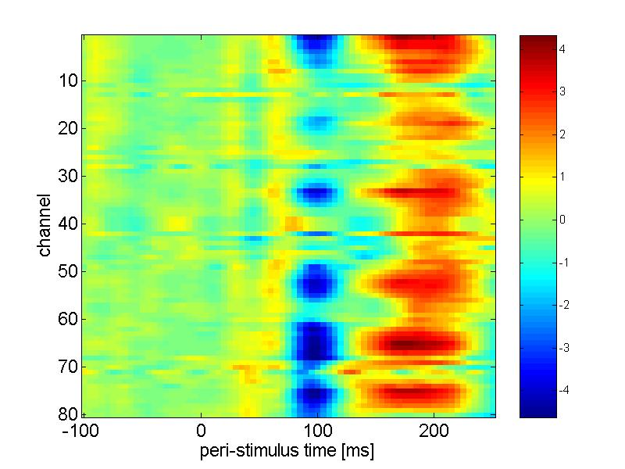
Mismatch Negativity scalp topography of ERPs
Hypothesis:
+
Deviant ERP
Standard ERP
MMN is caused by recurrent
dynamics enabled by backward
connections
amplitude (μV)
0
time (ms)
-
0
200
standard
time (ms)
sensors
deviant
sensors
0
100
200

Slide 4
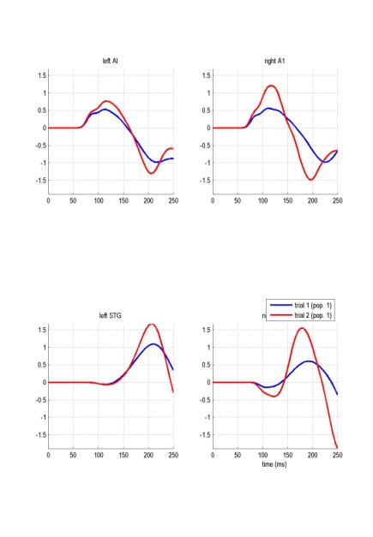
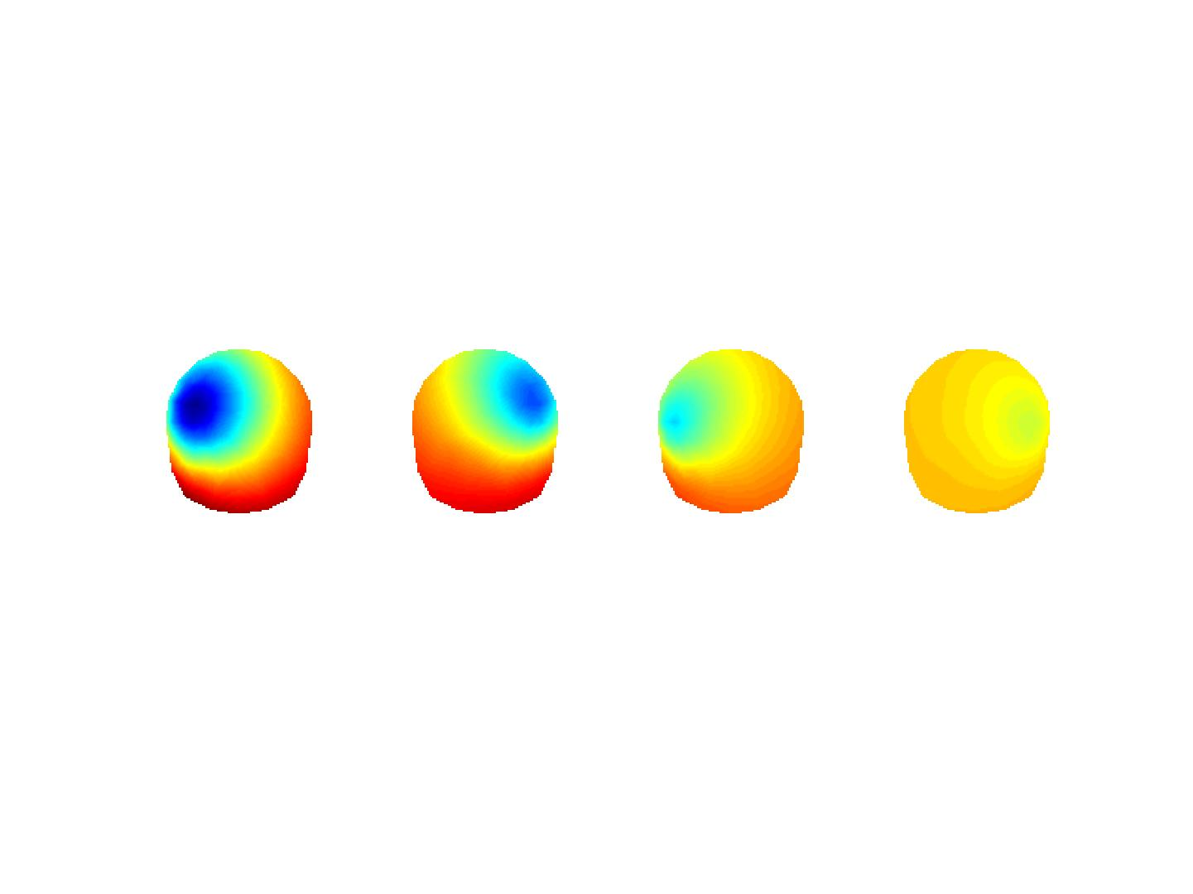
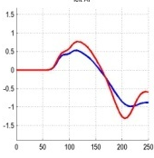
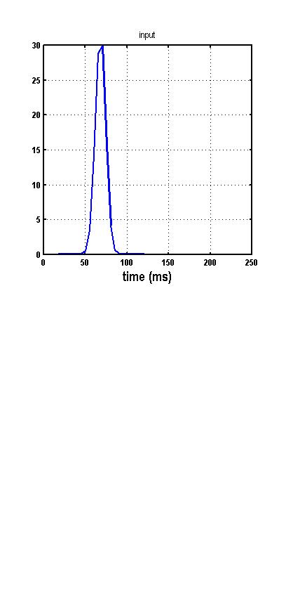
The generative model
Source dynamics f
Observation model g
states x
Evoked response
parameters θ
data y
Input u
David et al., Neuroimage 2006; Kiebel et al., Neuroimage 2006
Notes:
4
1- Modelling: capture data tendencies/regularities
But: model quality <-> predictive ability
=> Parameters estimation
2- 2 forms of uncertainty:
- stochastic
- epistemological (=> reducible)
-> Definition of “noise”
3- - Model sufficiently complex -> perfect data fit but suboptimal predictions
- Model too simple -> poor data fit …
4- Link modelling to some measure of the uncertainty which is propagated through the model:
model relevance is related to the quality of the information we can extract from the data about the modelled system…

Slide 5
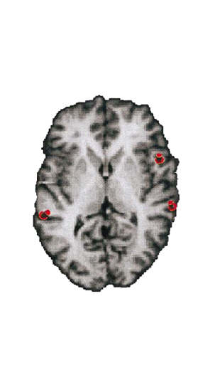
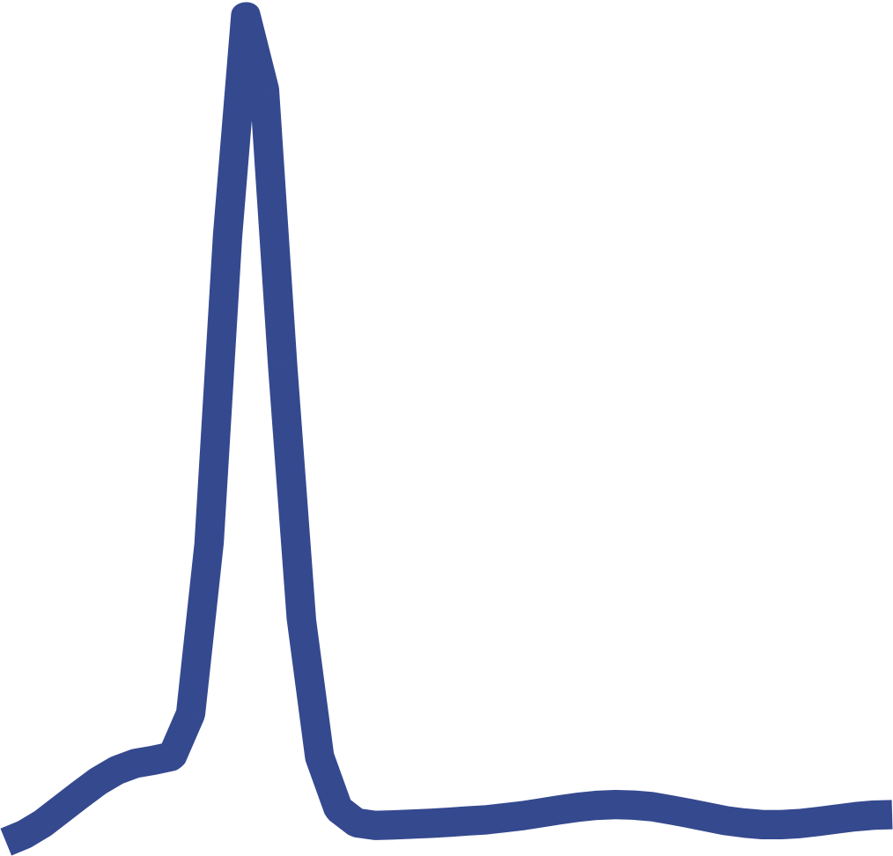
DCM specification
What set of areas and interconnections caused the MMN?
several plausible models…
Forward - F
IFG
5
Backward - B
Both - FB
+
amplitude (μV)
rIFG
3
STG
STG
4
0
lSTG
rSTG
-
0
200
time (ms)
1
A1
A1
2
Opitz et al., 2002
Deviant response
Standard response
input
modulation of effective connectivity
Garrido et al., Neuroimage 2007

Slide 6
DCM specification of different models
IFG
IFG
IFG
Forward and
Forward
-
F
Backward
-
B
Backward
-
FB
STG
STG
STG
STG
STG
STG
STG
A1
A1
A1
A1
A1
A1
input
input
input
Forward
Forward
Forward
Backward
Backward
Backward
Lateral
Lateral
Lateral
modulation of effective connectivity
Garrido et al., Neuroimage 2007
Notes:
Each model is a different hypothesis about what neural architectures caused the data

Slide 7
Analysis steps
0. Have a HYPOTHESIS!
Preprocessing and SVD decomposition
Model specification: specify cortical areas and inter-areal connections for various competing models that you think might explain your data
Model inversion: find the parameters that minimize differences between observed measurements and model predictions for each of the competing models
Bayesian model comparison: make a statistical inferences about which model best describes the data

