Slide 1

SPM for EEG/MEG
Guillaume Flandin
Wellcome Trust Centre for Neuroimaging
University College London
SPM Course
London, May 2013

Slide 2
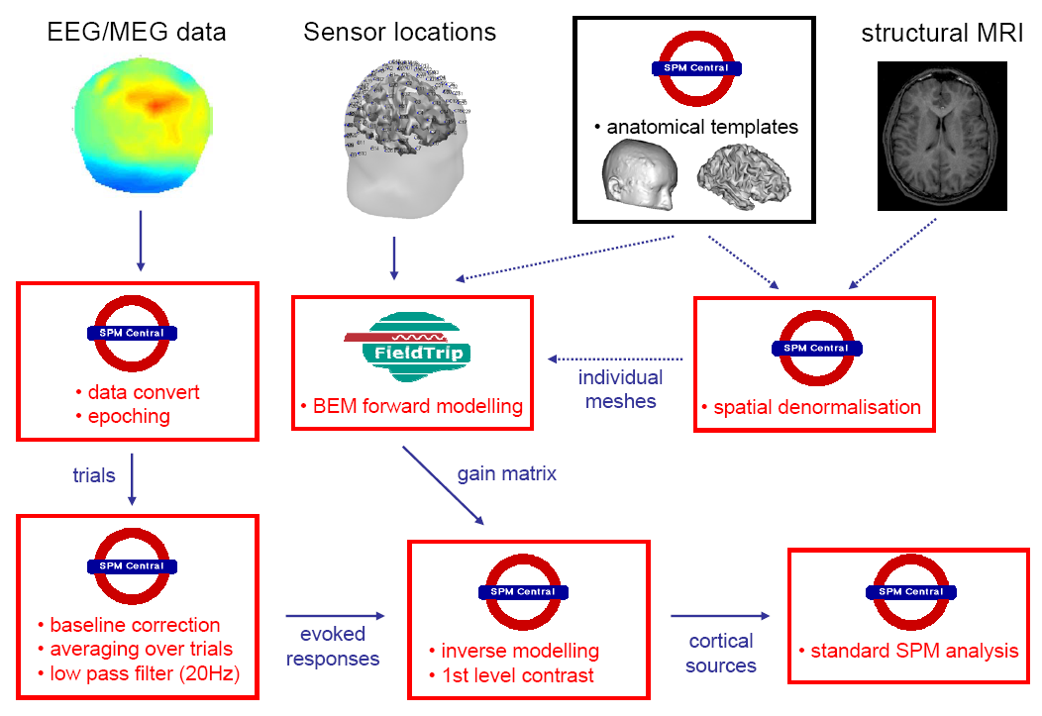
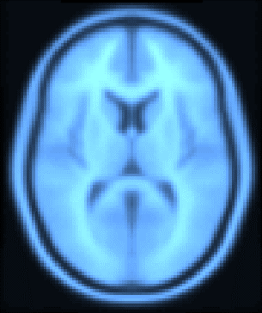

Slide 3



Image time-series
Spatial filter
Design matrix
Statistical Parametric Map
Realignment
Smoothing
General Linear Model
Statistical
Inference
RFT
Normalisation
Anatomical
reference
p <0.05
Parameter estimates

Slide 4
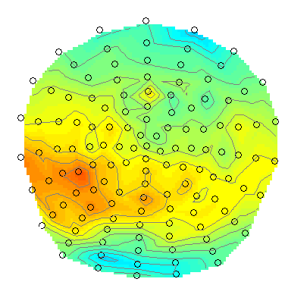
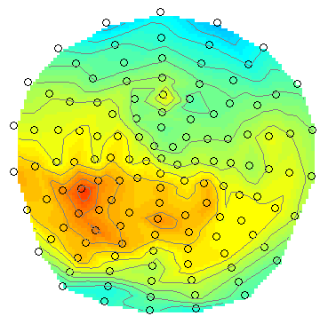
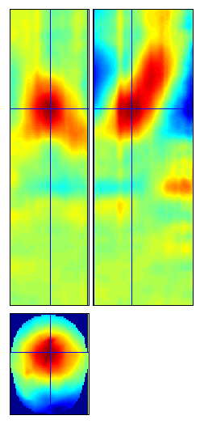
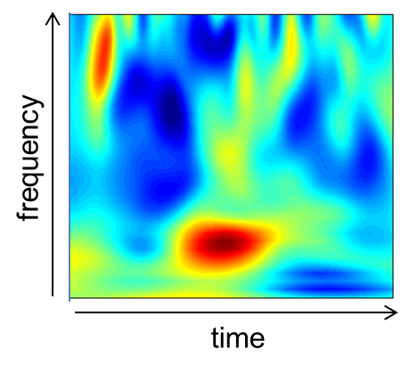
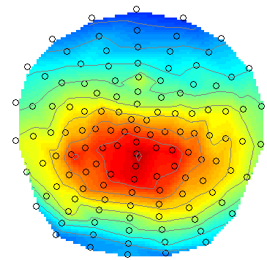
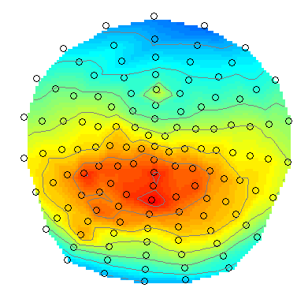
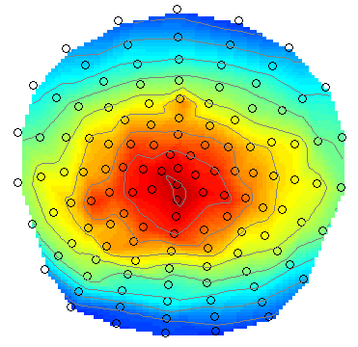
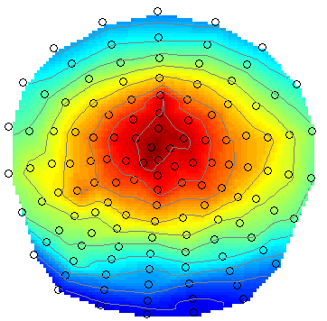
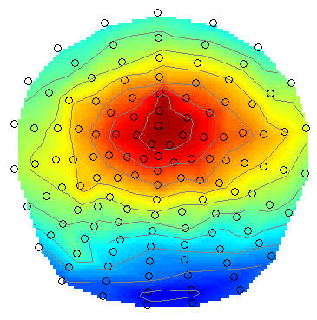
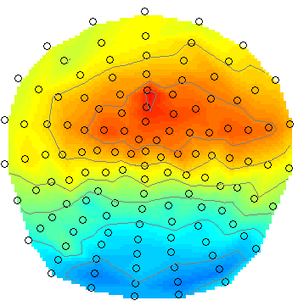
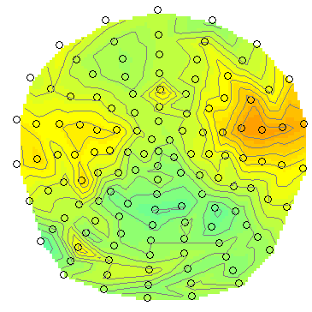
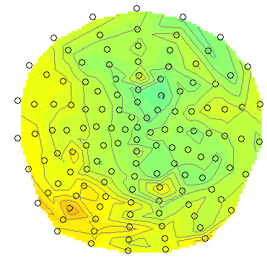
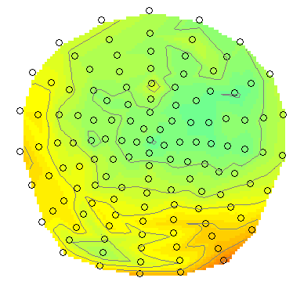
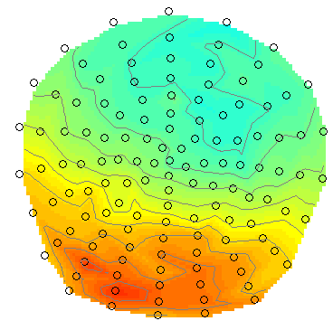
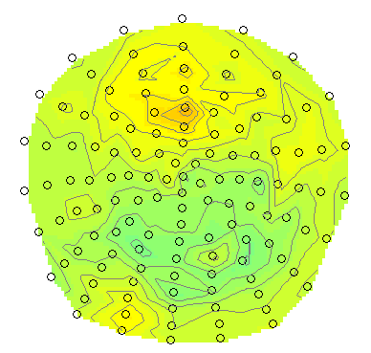
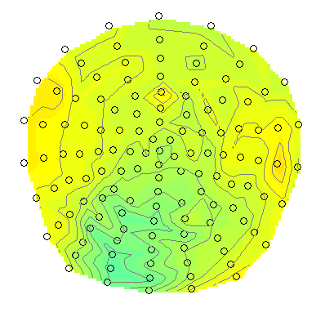
Statistical Parametric Mapping refers to the construction and assessment of spatially extended statistical processes used to test hypotheses about functional imaging data.
Sensor to voxel
transform
Time
Statistical Parametric Mapping for Event-Related Potentials I: Generic Considerations. S.J. Kiebel and K.J. Friston. NeuroImage, 2004.
Topological inference for EEG and MEG, J. Kilner and K.J. Friston, Annals of Applied Statistics, 2010.

Slide 5
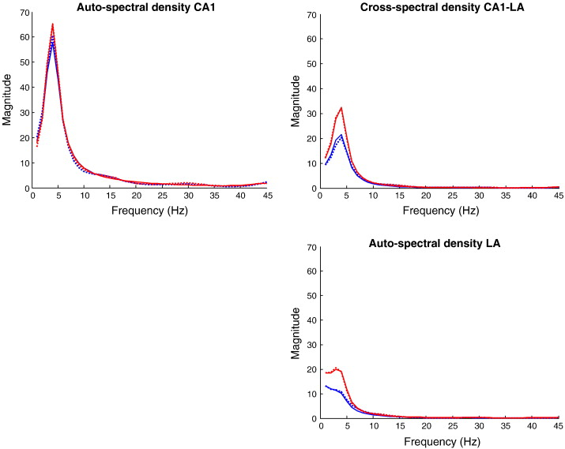
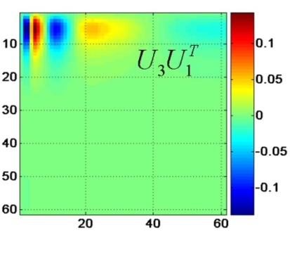
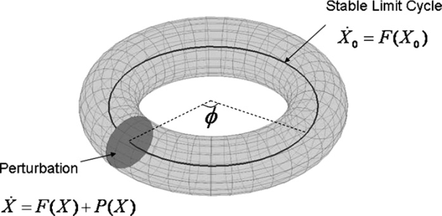
DCMs for M/EEG
input
depolarization
1st and 2d order moments
250
0
0
200
-20
-20
150
-40
-40
• DCM for evoked responses
100
-60
-60
50
-80
-80
0
0
100
200
300
-100
0
100
200
300
-100
0
100
200
300
time (ms)
time (ms)
time (ms)
auto-spectral density
LA
auto-spectral density
CA1
cross-spectral density
CA1-LA
• DCM for steady-state responses
frequency (Hz)
frequency (Hz)
frequency (Hz)
• DCM for induced responses
• DCM for phase coupling
Notes:
5

Slide 6
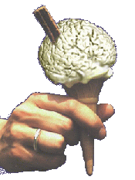
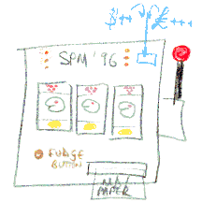
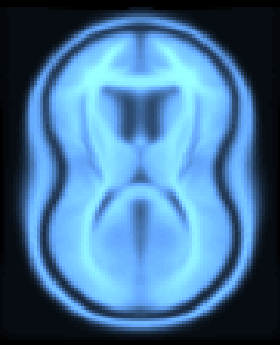
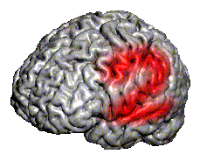
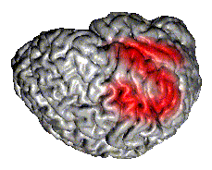
SPM Software
“The SPM software was originally developed by Karl Friston for the routine statistical analysis of functional neuroimaging data from PET while at the Hammersmith Hospital in the UK, and made available to the emerging functional imaging community in 1991 to promote collaboration and a common analysis scheme across laboratories.”
SPMclassic, SPM’94, SPM’96, SPM’99, SPM2, SPM5, SPM8 and SPM12 represent the ongoing theoretical advances and technical improvements of the original version.

Slide 7
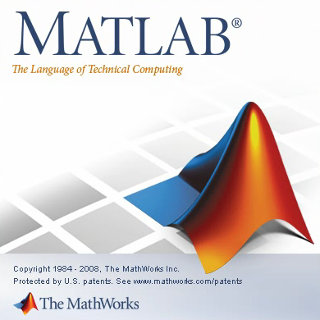



Software: SPM8 / SPM12
Free and Open Source Software (GPL)
Requirements:
  MATLAB: 7.4 (R2007a) to 8.1 (R2013a)
  no MathWorks toolboxes required
  Supported platforms:
  Standalone version also available.
File formats:
  Volumetric images: NIfTI (DICOM import)
  Geometric images: GIfTI
  M/EEG: most manufacturers (FieldTrip’s fileio)
Linux (64 bit)
Windows (32 and 64 bit)
Mac Intel (64 bit)

Slide 8
SPM Website
http://www.fil.ion.ucl.ac.uk/spm/
SPM software:
SPM5, SPM8, SPM12
Documentation &
Bibliography
Example data sets
SPM extensions

Slide 9
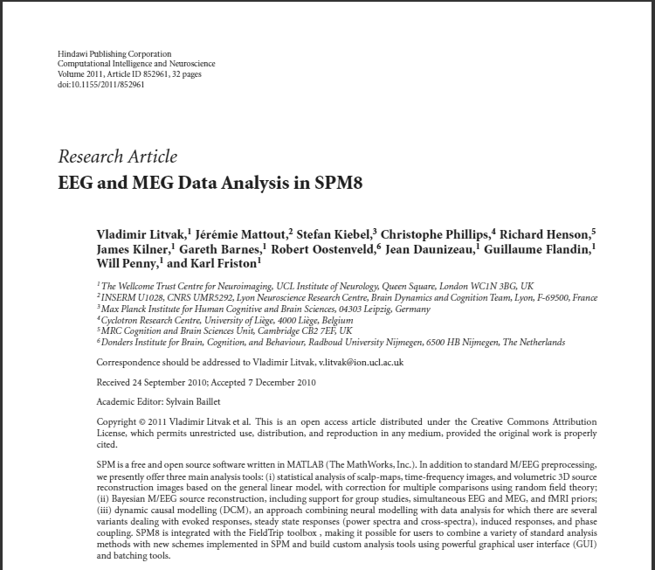
Litvak et al, EEG and MEG Data Analysis in SPM8, Computational Intelligence and Neuroscience, id:852961, 2011.

Slide 10
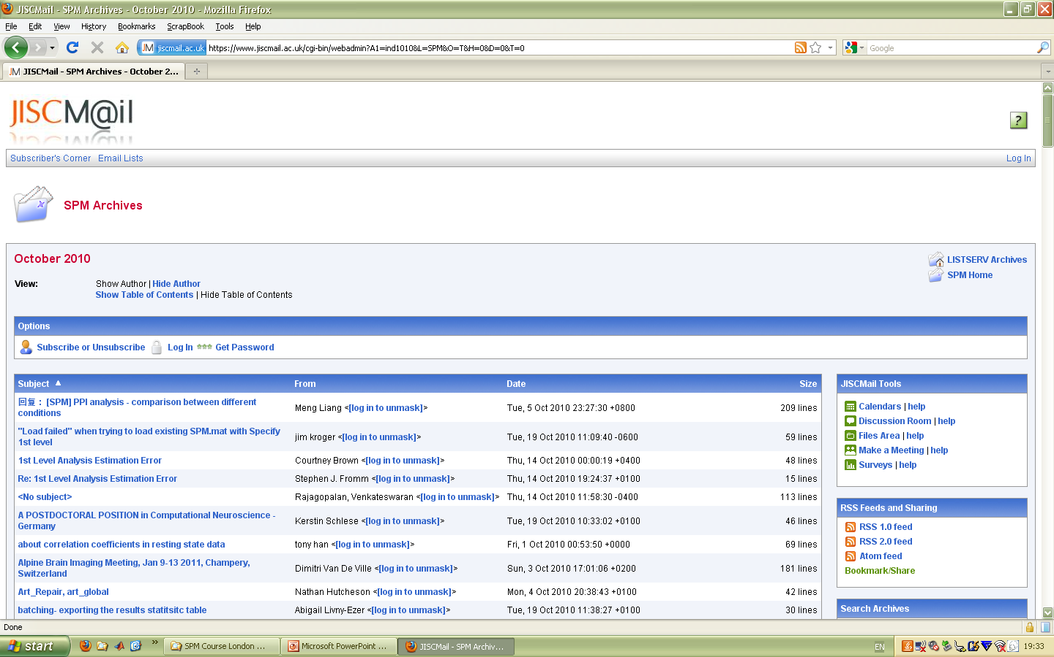
SPM Mailing List
http://www.fil.ion.ucl.ac.uk/spm/support/
spm@jiscmail.ac.uk

Slide 11
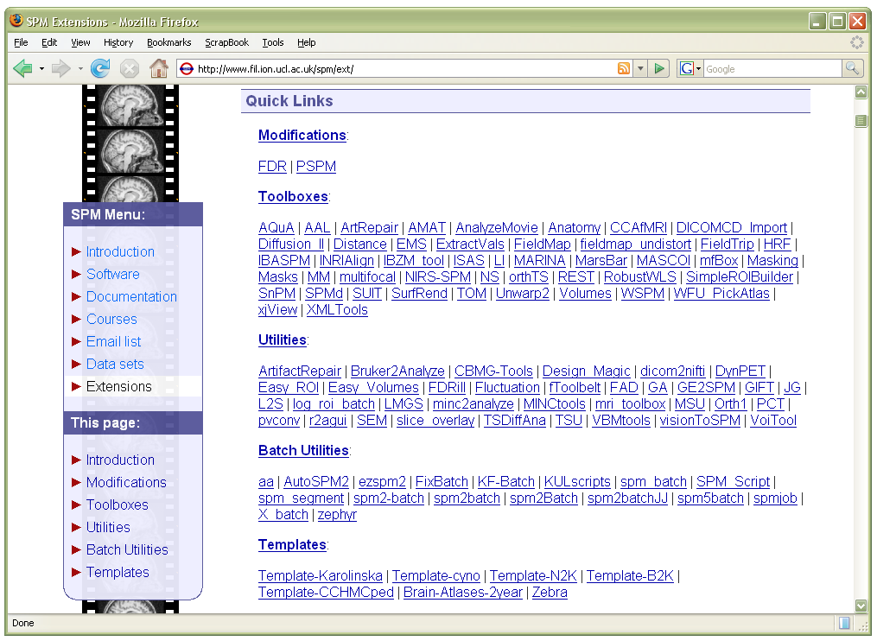
SPM Toolboxes
User-contributed SPM extensions:
http://www.fil.ion.ucl.ac.uk/spm/ext/

Slide 12
References
EEG and MEG Analysis in SPM8. V. Litvak et al, Computational Intelligence and Neuroscience, 2011.
http://dx.doi.org/10.1155/2011/852961
SPM: A history. J. Ashburner, NeuroImage, 2011.
http://dx.doi.org/10.1016/j.neuroimage.2011.10.025
A Short History of Statistical Parametric Mapping in Functional Neuroimaging. K.J. Friston.
http://www.fil.ion.ucl.ac.uk/spm/doc/history.html
SPM’s 20th Anniversary, K.J. Friston.
http://www.fil.ion.ucl.ac.uk/spm/course/video/#Overview

Slide 13
The SPM co-authors
Jesper Andersson
John Ashburner
Nelson Trujillo-Barreto
Gareth Barnes
Matthew Brett
Christian Buchel
CC Chen
Jean Daunizeau
Olivier David
Guillaume Flandin
Karl Friston
Darren Gitelman
Daniel Glaser
Volkmar Glauche
Lee Harrison
Rik Henson
Andrew Holmes
Chloe Hutton
Maria Joao
Stefan Kiebel
James Kilner
Vladimir Litvak
Andre Marreiros
Jérémie Mattout
Rosalyn Moran
Tom Nichols
Will Penny
Christophe Phillips
Jean-Baptiste Poline
Ged Ridgway
Klaas Stephan

