Slide 1
What are we measuring with M/EEG?
Luzia Troebinger

Slide 2
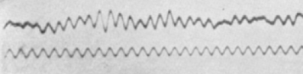
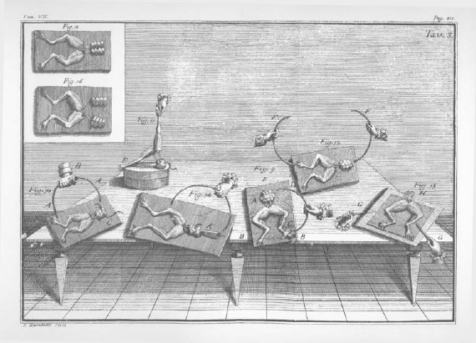
The birth of electrophysiology
“I am attacked by two very opposite sects—the
scientists and the know-nothings. Both laugh at me—calling me “the frogs’ dancing-master”. Yet I know that I have discovered one of the greatest forces in nature.”
Luigi Galvani
First electrophysiological measurements starting in 17th century
Luigi Galvani and his wife Lucia Galeazzi study contractions of isolated frog muscle preparations
1875: Richard Caton reports using galvanometer to measure electrical impulses from the surface of animal brains
Hans Berger develops the first EEG and provides the first recordings in human subjects – first characterisations of normal/abnormal oscillatory activity

Slide 3
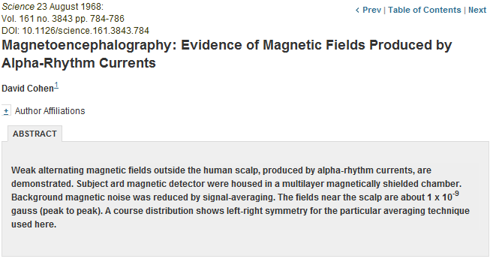
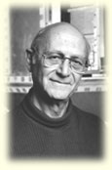
History of MEG
Josephson effect discovered in 1962 – important later for development of SQUIDs
David Cohen published paper on first MEG recordings in 1968 (Science)
SQUID is invented in 1965 by Robert Jaklevic, John J. Lambe, Arnold Silver, and James E. Zimmermann
Notes:
Josephson junction – sandwiching thin layer of non-superconducting material between layers of superconducting material
At low enough temperatures, no resistance and current can flow freely –

Slide 4
Instrumentation

Slide 5
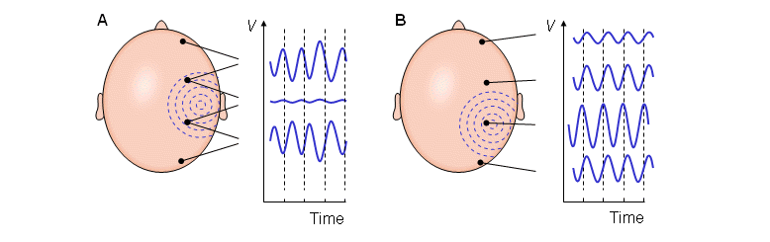
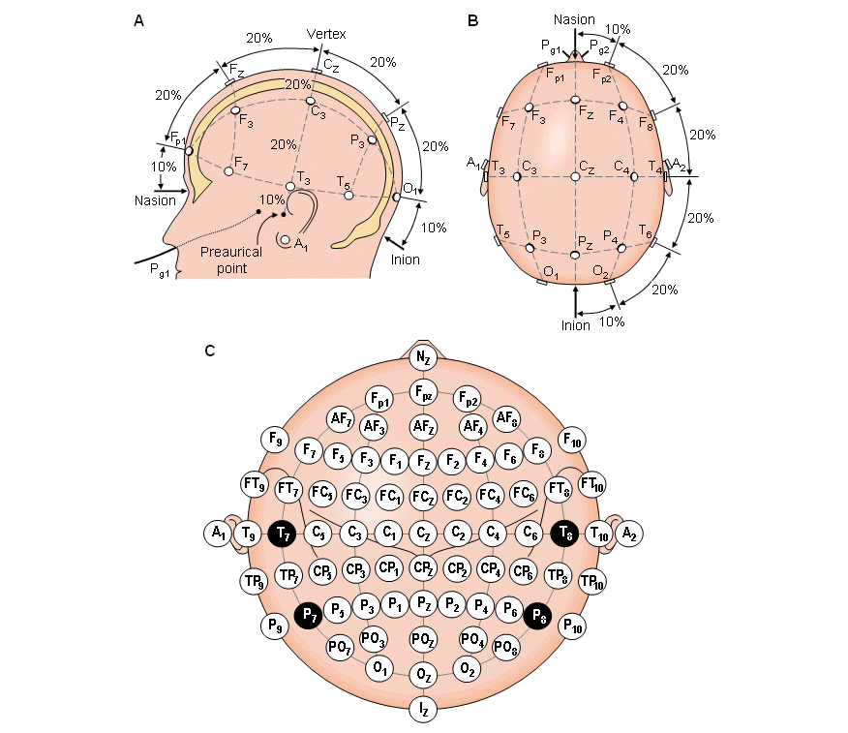
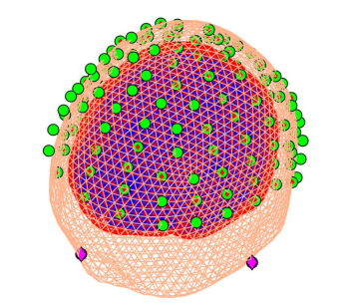
EEG
Bipolar measurements
Unipolar measurements
Potential difference between active/reference electrodes is amplified and filtered
Bipolar Montage: each channel represents difference between adjacent electrodes
Unipolar/Referential Montage: each channel is potential difference between electrode/designated reference electrode
10-20 Electrode System
Notes:
Bipolar: Potential difference between pair of electrodes (between two electrodes)
Unipolar: Take potential from each electrode and compare to average/neutral electrode

Slide 6
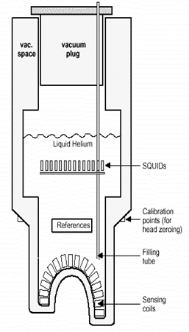
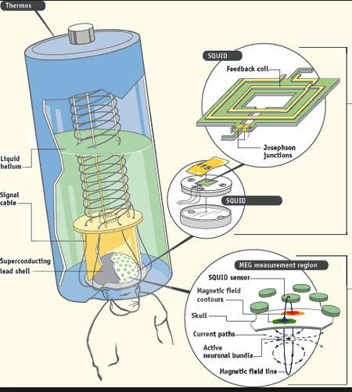
MEG
Thermically isolated by surrounding vacuum space
Liquid Helium
Sensors: fixed location inside the dewar.

Slide 7
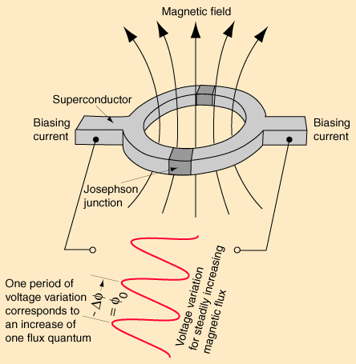
SQUID
Superconducting Quantum Interference Device
Highly sensitive
Can measure field changes in the order of femto-Tesla (10⁻¹⁵ T)
Earth’s magnetic field: 10⁻⁴ T
Basically consists of a superconducting ring interrupted by two Josephson Junctions

Slide 8
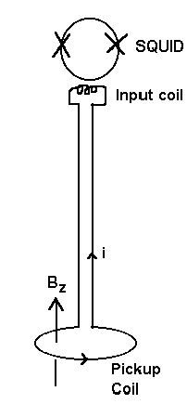
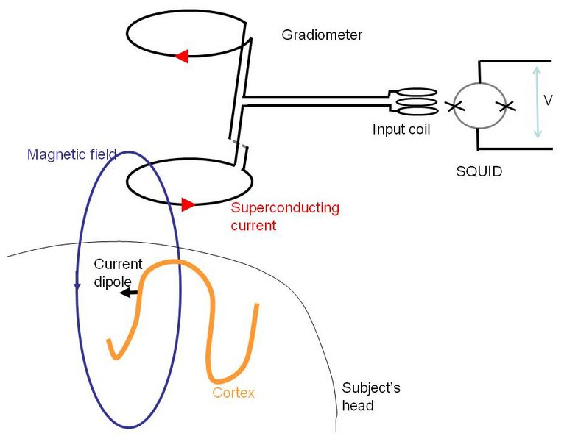
Flux Transformers
Magnetometer
  -consist of a single superconducting coil
  -highly sensitive, but also pick up environmental noise
Gradiometers:
  -consist of two oppositely wound coils
  -sources in the brain - differentially affect the two coils
  -environmental sources have the SAME EFFECT on both coils → 0 net current flow
Notes:
Magnetometer – single coil; would work in theory but affected by environmental noise
Gardiometer – based on two oppositely wound coils: this is great because env. Noise will affect both electrodes in the same way – sources are closer to lower coil, so get net effect

Slide 9
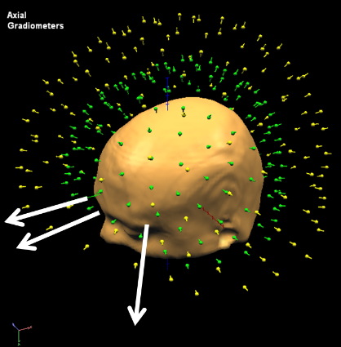
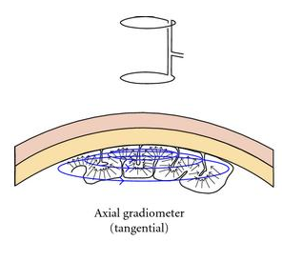
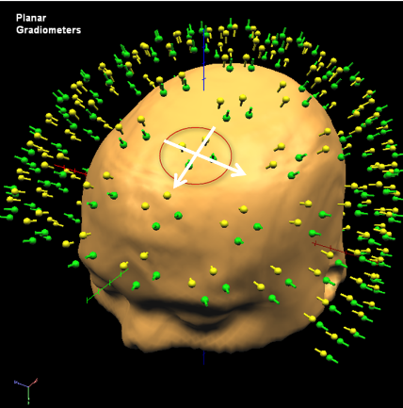
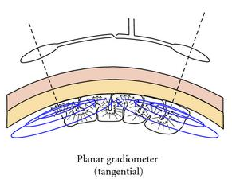
Planar/axial gradiometers
Axial Gradiometer MEG sensors…
…are aligned orthogonally to the scalp
…record gradient of magnetic field along the radial direction
Planar Gradiometer MEG sensors…
…two detector coils on the same plane
…have sensitivity distribution similar to bipolar EEG setup
Notes:
Axial – both coils are coaxial; two magentometers placed in series (one above the other); signal = difference between them at that point
Planar – both coils are coplanar; two magnetometers placed next to each other; signal = difference between the two loops

Slide 10
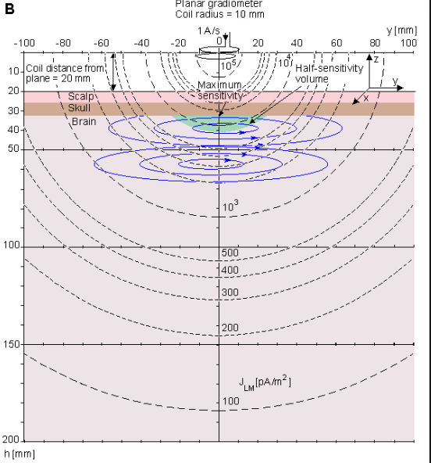
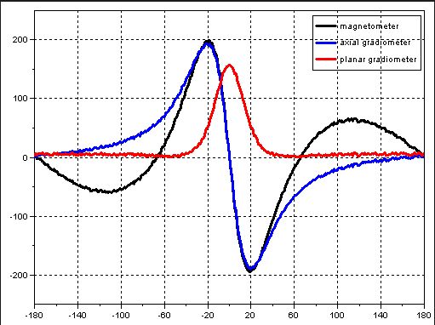
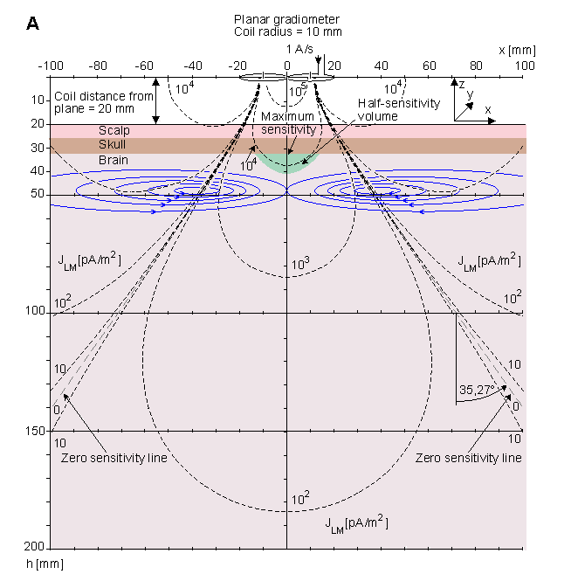

Slide 11
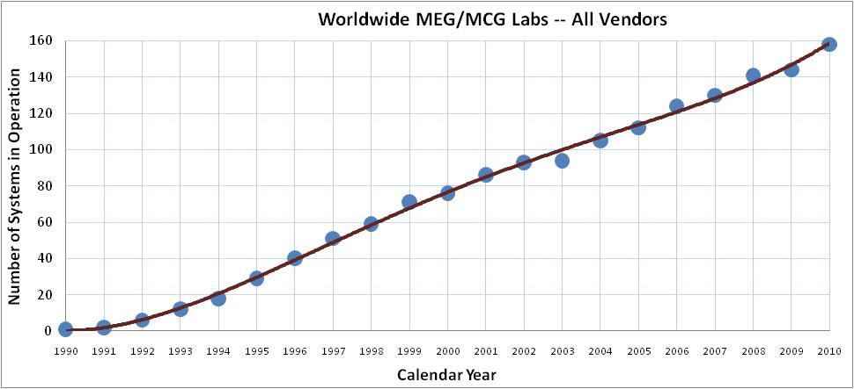
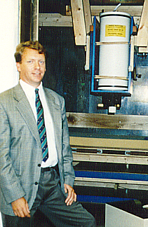
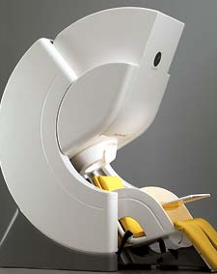
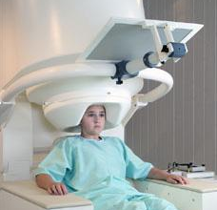
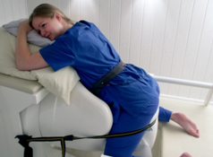
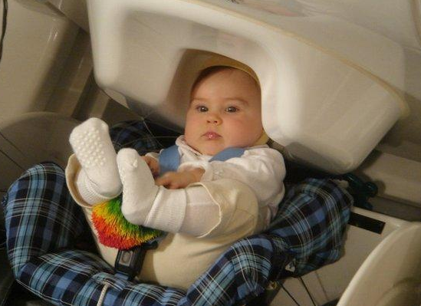
MEG today…

Slide 12
What are we measuring?

Slide 13
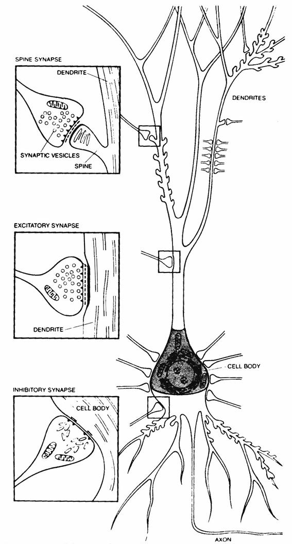
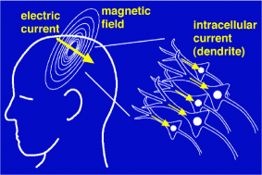
Where does the signal come from?
Signals stem from synchronous activity of large (~1000s) groups of neurons close to each other and exhibiting similar patterns of activity
Most of the signal generated by pyramidal neurons in the cortex (parallel to each other, oriented perpendicular to the surface)
M/EEG measures synaptic currents, not action potentials (currents flow in opposite directions and cancel out!)

Slide 14
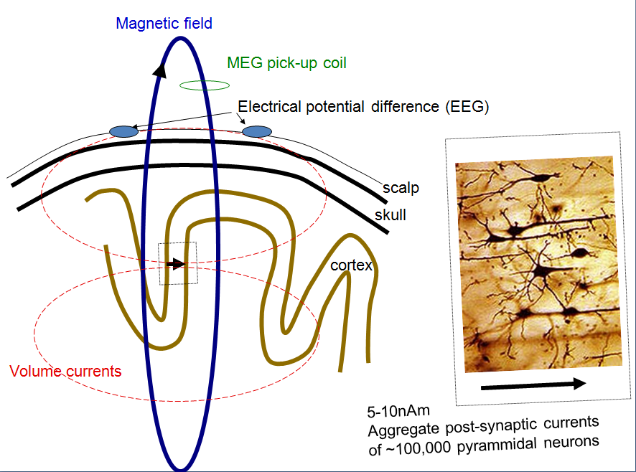
Building the connection…

Slide 15
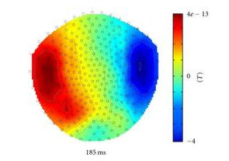
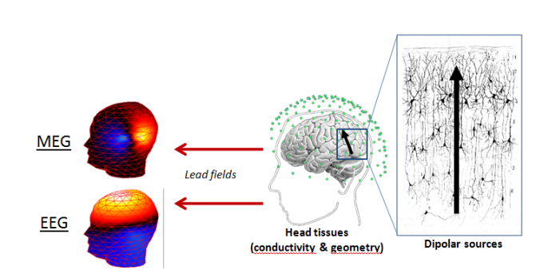
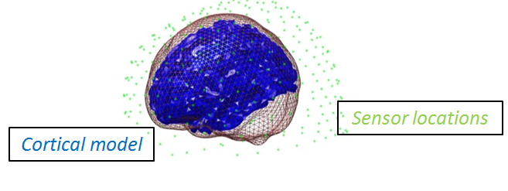
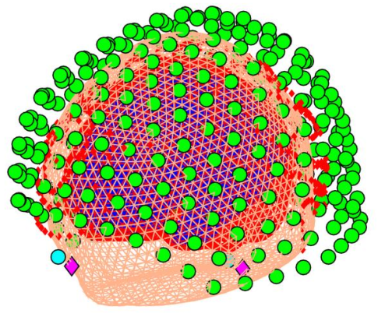
The Forward problem: From Sensor to Source Level
Forward Model
Sensor level data
Head model
Source Level
Head Position?

Slide 16
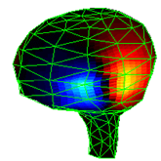
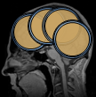
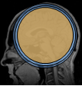
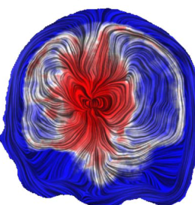
Head Models
We need a link between the signal in the brain and what we measure at the sensors
Different head models available:
Multiple Spheres
Finite Element
Single Sphere
Boundary Element

Slide 17
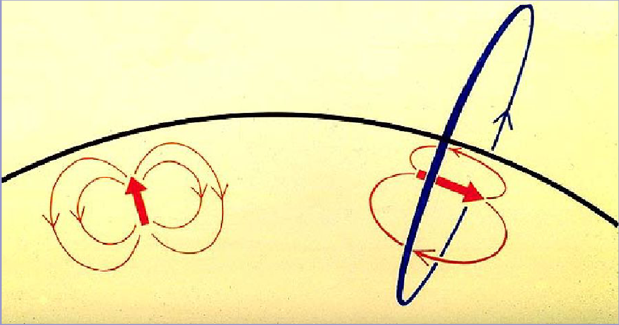
But isn’t MEG ‘blind’ to gyral sources?
Given a perfect spherically symmetric volume conductor, radial sources do not give rise to an external magnetic field.
Assume sources on crests of gyri (as radial as it gets)
Perfectly spherical head model
these sources are very close to the sensors
Surrounded by off-radial cortex to which MEG is highly sensitive
Signal is spatial summation over ~mm² of cortex
Sources remain partly visible
(Hillebrand and Barnes, 2002)

Slide 18
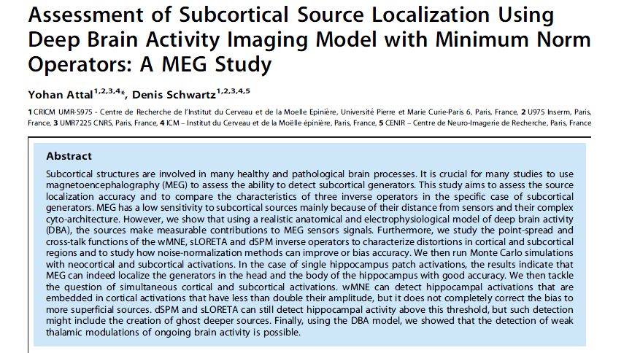
What about deeper structures?
Source depth is an issue since magnetic fields fall off sharply with distance from source
Complex cytoarchitecture of deeper structures
Depends on a lot of things (forward model, SNR of data, priors about origin of our data)
Using realistic anatomical and electrophysiological models, it is possible to detect activity from deeper structures (Attal et al)

Slide 19
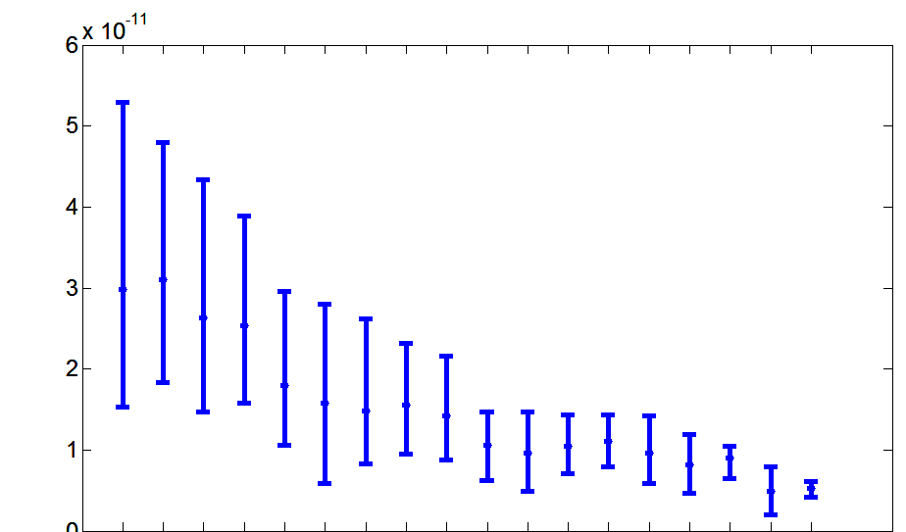
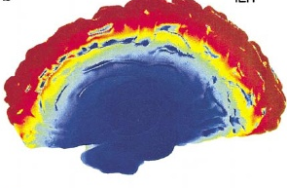
MEG Sensitivity to depth
Cornwell et al. 2008; Riggs et al. 2009
Hung et al. 2010; Cornwell et al. 2007, 2008
RMS Lead field
Over subjects and voxels
Parkonen et al. 2009
Supp_Motor_Area
Parietal_Sup
Frontal_Inf_Oper
Occipital_Mid
Frontal_Med_Orb
Calcarine
Heschl
Insula
Cingulum_Ant
ParaHippocampal
Hippocampus
Putamen
Amygdala
Caudate
Cingulum_Post
Brainstem
Thalamus
STN
Timmerman et al. 2003

Slide 20
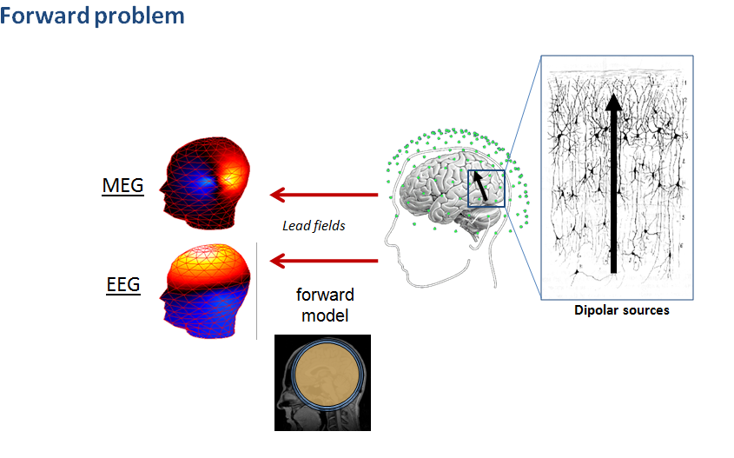
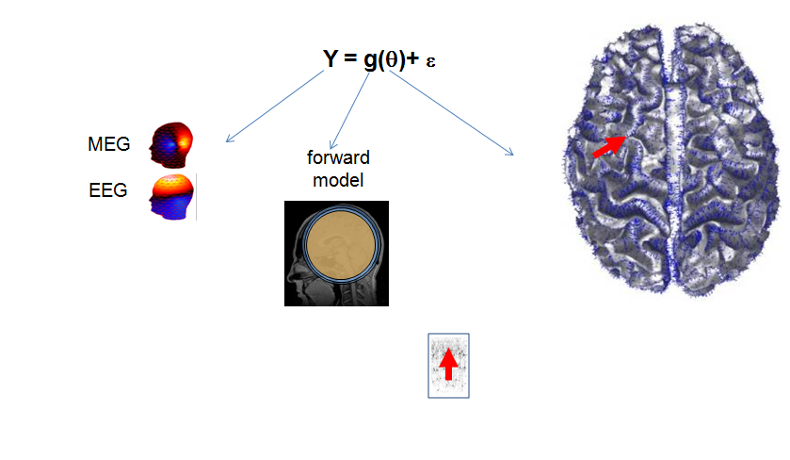
Inversion
Inverse problem is ill posed – many possible solutions!
Need some prior information about what’s going on.
Link what’s happening in the brain to what we are measuring at the sensors.

Slide 21
Conclusions
Measuring signals due to aggregate post-synaptic currents (modeled as dipoles)
Lead fields are the predicted signal produced by a dipole of unit amplitude.
MEG – limited by SNR: Increasing SNR will increase sensitivity to deeper structures
EEG - limited by head models. More accurate head models will lead to more accurate reconstruction.

