Slide 1

Multiple comparisons in M/EEG analysis
Gareth Barnes
Wellcome Trust Centre for Neuroimaging
University College London
SPM M/EEG Course
London, May 2013

Slide 2
Format
What problem ?- multiple comparisons and post-hoc testing.
Some possible solutions
Random field theory

Slide 3
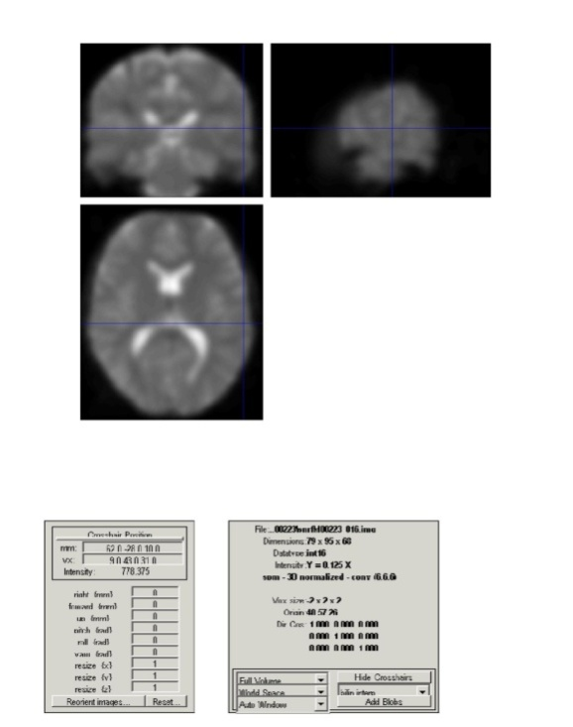
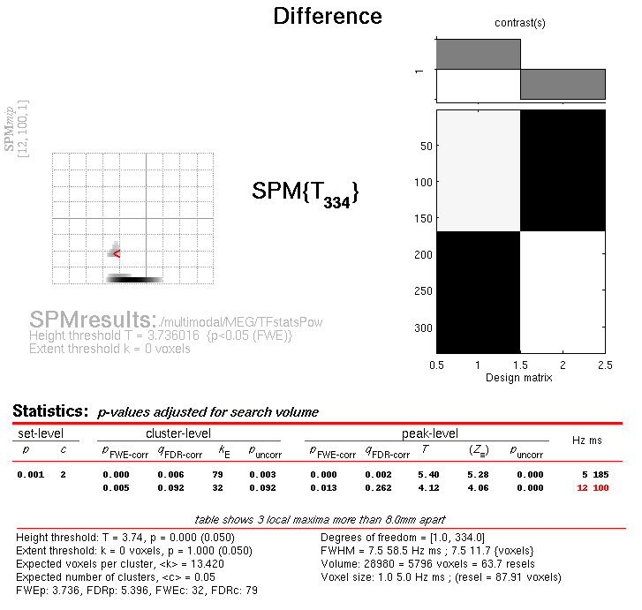
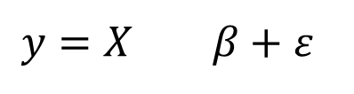
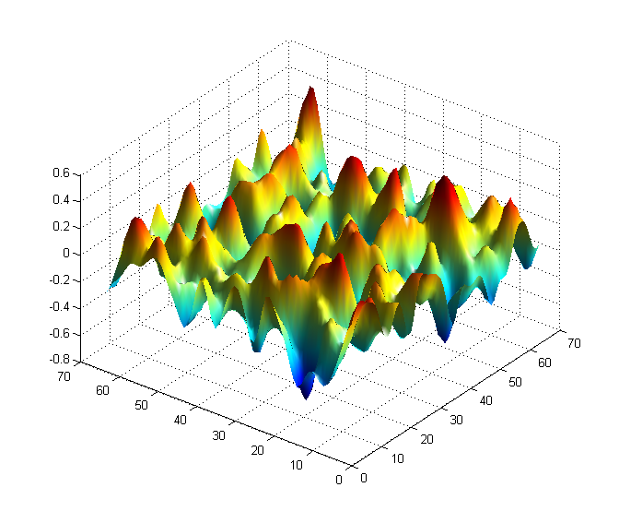
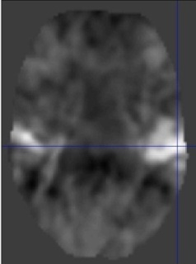
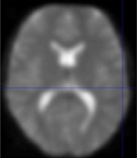
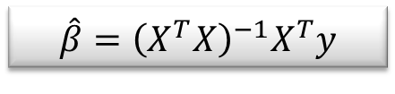
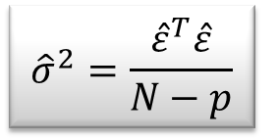
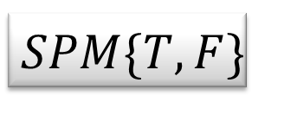
Random
Field Theory
Contrast c
Pre-
processing
General
Linear
Model
Statistical Inference

Slide 4
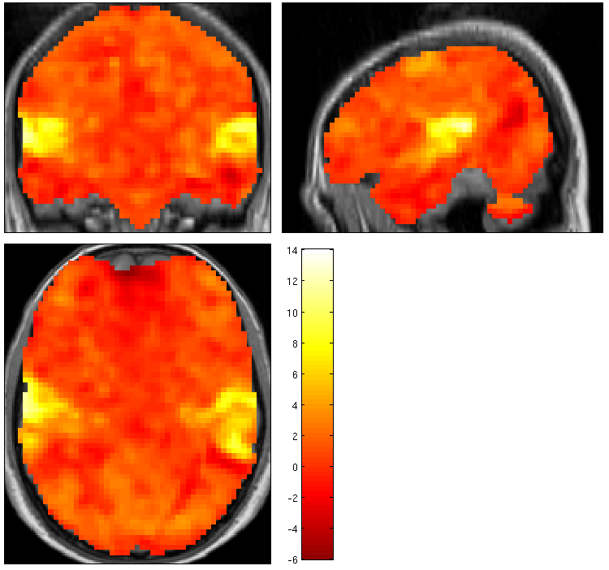
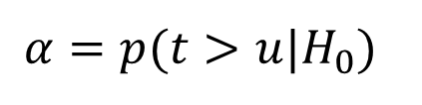
T test on a single voxel / time point
T value
Test only this
Ignore these
1.66
Task A
T distribution
Task B
P=0.05
u
Threshold
Null distribution of test statistic T

Slide 5
T test on many voxels / time points
T value
Test all of this
Task A
T distribution
Task B
P= ?
u
Threshold ?
Null distribution of test statistic T

Slide 6
What not to do..

Slide 7
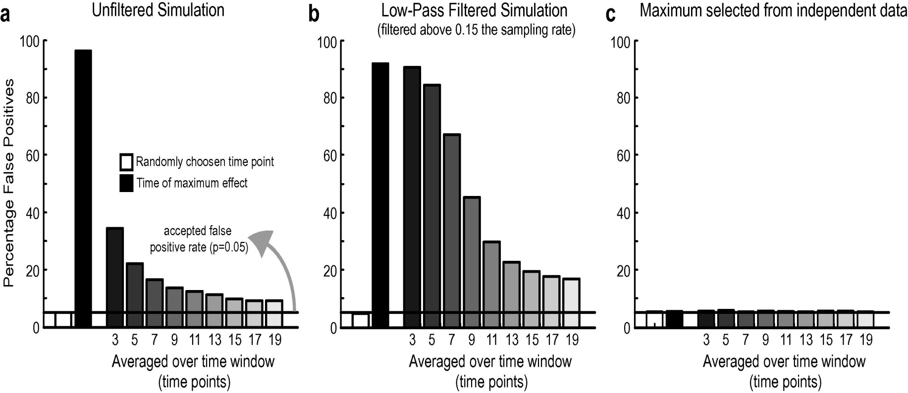
Don’t do this :
SPM t
With no prior hypothesis.
Test whole volume.
Identify SPM peak.
Then make a test assuming
a single voxel/ time of interest.
James Kilner. Clinical Neurophysiology 2013.

Slide 8



Slide 9
What to do:

Slide 10




















Multiple tests in space
u_{α}
u_{α}
u_{α}
u_{α}
u_{α}
If we have 100,000 voxels,
α=0.05 ⇒ 5,000 false positive voxels.
This is clearly undesirable; to correct for this we can define a null hypothesis for a collection of tests.
u_{α}
α
α
t
α
t
α
t
α
t
α
t
t
signal
Use of ‘uncorrected’ p-value, α =0.1
11.3%
11.3%
12.5%
10.8%
11.5%
10.0%
10.7%
11.2%
10.2%
9.5%
Percentage of Null Pixels that are False Positives

Slide 11
Multiple tests in time
signal
P<0.05
(independent samples)

Slide 12
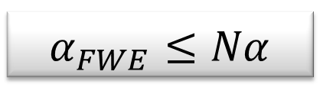
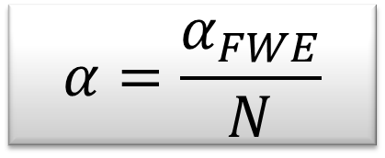
Bonferroni correction
The Family-Wise Error rate (FWER), α_{FWE}, for a family of N tests follows the inequality:
where α is the test-wise error rate.
Therefore, to ensure a particular FWER choose:
This correction does not require the tests to be independent but becomes very stringent if they are not.

Slide 13










Family-Wise Null Hypothesis
Family-Wise Null Hypothesis:
Activation is zero everywhere
If we reject a voxel null hypothesis at any voxel,
we reject the family-wise Null hypothesis
A FP anywhere in the image gives a Family Wise Error (FWE)
False
positive
Family-Wise Error rate (FWER) = ‘corrected’ p-value
Use of ‘uncorrected’ p-value, α =0.1
Use of ‘corrected’ p-value, α =0.1

Slide 14
Multiple tests- FWE corrected
P<0.05
200
P<0.05
(independent samples)

Slide 15
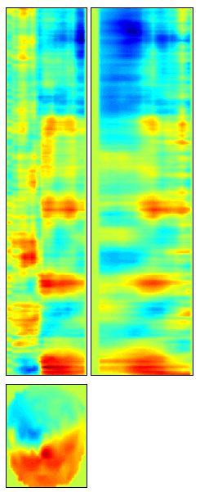
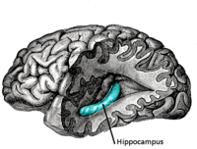
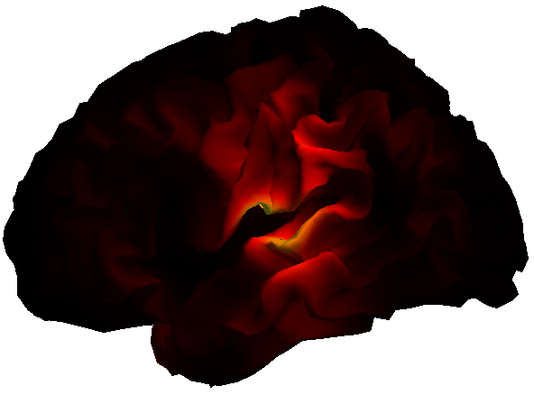
What about data with different topologies and smoothness..
Bonferroni works fine for independent tests but ..
Volumetric ROIs
Surfaces
Smooth time
Different smoothness
In time and space

Slide 16
Non-parametric inference: permutation tests
to control FWER
Parametric methods
  Assume distribution of
  max statistic under null
  hypothesis
Nonparametric methods
  Use data to find
  distribution of max statistic
  under null hypothesis
  any max statistic
5%
5%

Slide 17
Random Field Theory
In a nutshell :
Number peaks= intrinsic volume * peak density
Keith Worsley, Karl Friston, Jonathan Taylor, Robert Adler and colleagues

Slide 18
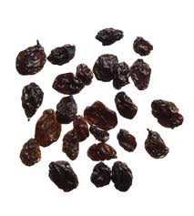
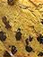
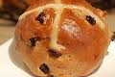
Currant bun analogy
Number peaks= intrinsic volume * peak density
Number of currants = volume of bun * currant density

Slide 19
How do we specify the number of peaks
Number peaks= intrinsic volume* peak density

Slide 20
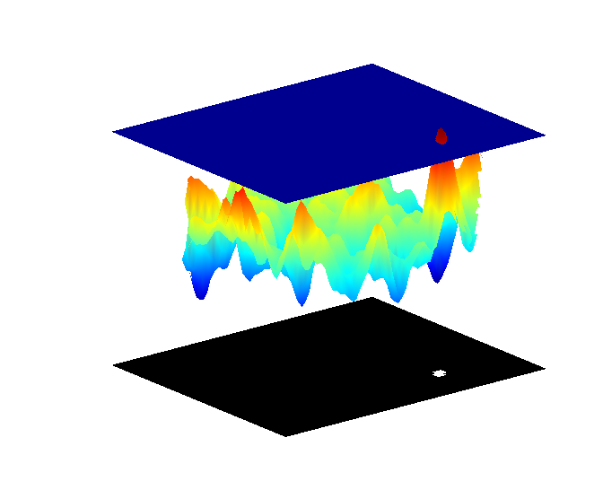
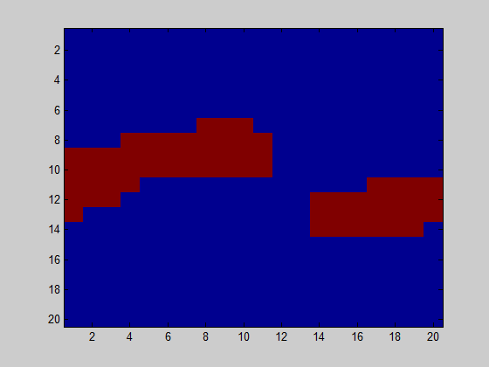
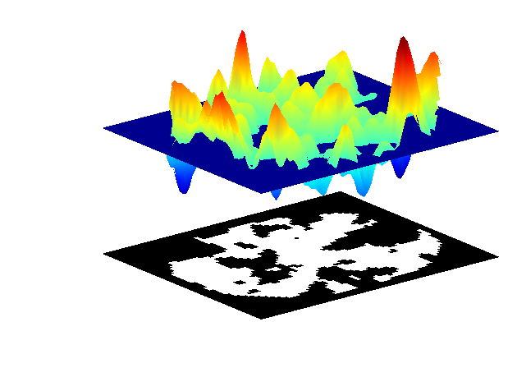
How do we specify the number of peaks
Euler characteristic (EC) at threshold u = Number blobs- Number holes
EC=2
EC=1
At high thresholds there are no holes so EC= number blobs

Slide 21
How do we specify peak (or EC) density
Number peaks= intrinsic volume * peak density

Slide 22
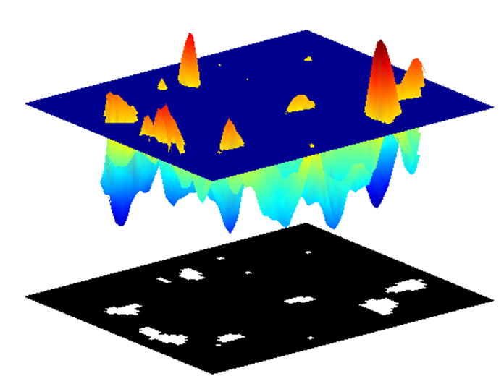
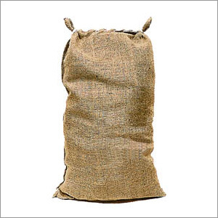
EC density, ρ_{d}(u)
Number peaks= intrinsic volume * peak density
The EC density - depends only on the type of random field (t, F, Chi etc ) and the dimension of the test.
Number of currants = bun volume * currant density
X²
t
F
peak densities for the different fields are known
See J.E. Taylor, K.J. Worsley. J. Am. Stat. Assoc., 102 (2007), pp. 913–928

Slide 23
Currant bun analogy
Number peaks= intrinsic volume * peak density
Number of currants = bun volume * currant density

Slide 24
Which field has highest intrinsic volume ?
A
B
Equal
volume
More samples (higher volume)
C
D
Smoother ( lower volume)

Slide 25
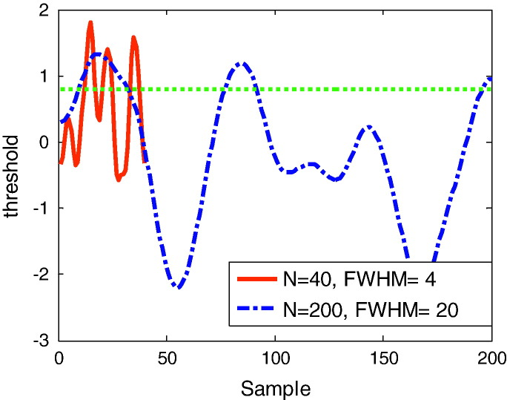
LKC or resel estimates normalize volume
The intrinsic volume (or the number of resels or the Lipschitz-Killing Curvature) of the two fields is identical
Notes:
An example of two one-dimensional fields with identical intrinsic volume or Lipschitz–Killing curvature. Both curves are one-sample SPM{t}, based on 200 samples of Gaussian white noise. In one case (red—solid) the noise has smoothness FWHM = 4 and extends over 40 samples, in the other (blue—dotted) has FWHM = 20 and extends over 200 samples. The ‘intrinsic volumes’ of these curves, or the FWHM per unit length, are therefore identical (LKC = [1 16.65] or resels = [1 10]). The dotted green line is some arbitrary threshold u (= 0.8). The observed Euler characteristic for both processes at this threshold is 3 (there are 3 blobs above threshold). The Gaussian Kinematic Formula (Eq. (6)) for a random t-field of this intrinsic volume predicts an Euler characteristic of 2.9.

Slide 26
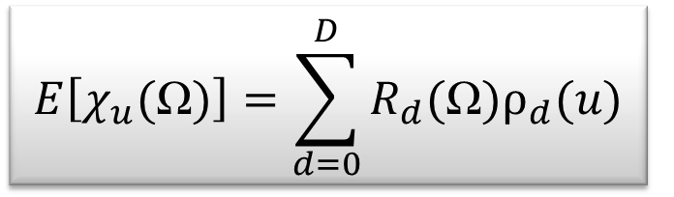
Gaussian Kinematic formula
Threshold u
Expected Euler
Characteristic
From
=2.9 (in this example)
Intrinsic volume
(depends on shape and smoothness of space)
Depends only on type
of test and dimension
Notes:
An example of two one-dimensional fields with identical intrinsic volume or Lipschitz–Killing curvature. Both curves are one-sample SPM{t}, based on 200 samples of Gaussian white noise. In one case (red—solid) the noise has smoothness FWHM = 4 and extends over 40 samples, in the other (blue—dotted) has FWHM = 20 and extends over 200 samples. The ‘intrinsic volumes’ of these curves, or the FWHM per unit length, are therefore identical (LKC = [1 16.65] or resels = [1 10]). The dotted green line is some arbitrary threshold u (= 0.8). The observed Euler characteristic for both processes at this threshold is 3 (there are 3 blobs above threshold). The Gaussian Kinematic Formula (Eq. (6)) for a random t-field of this intrinsic volume predicts an Euler characteristic of 2.9.

Slide 27
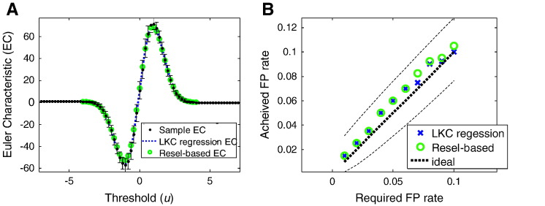
Gaussian Kinematic formula
-- EC observed
o EC predicted
EC=1-0
Expected Euler
Characteristic
From
Intrinsic volume (depends on shape and smoothness of space)
Depends only on type
of test and dimension
Number peaks= intrinsic volume * peak density
Notes:
A. The average Euler characteristic as a function of threshold, for the standardised residual fields (black) with error bars showing the standard deviation over realisations. The green circles show the estimate of the Euler characteristic of the underlying random field—as predicted from the Gaussian Kinematic Formula (Eq. (6)) using the standard smoothness (resel) estimator (Eq. (9)). The blue dotted line shows the estimate of the Euler characteristic of the underlying random field as predicted from the average regression LKC estimates over realisations (Eq. (17)). B. The achieved false positive rate against the anticipated false positive rate controlling for a single supra-threshold cluster in the SPM. The threshold is set either by the standard (resel) estimator (green circles) or the regression estimator (blue crosses). This confirms that the curves in Fig. 2A are almost identical at high threshold. The dashed lines are binomial 95% confidence intervals around the anticipated false positive rate (black, dotted).

Slide 28
Gaussian Kinematic formula
EC=2-1
Expected EC
0.05
i.e. we want one false positive every 20 realisations (FWE=0.05)
Threshold
FWE threshold
Expected Euler
Characteristic
From
Intrinsic volume (depends on shape and smoothness of space)
Depends only on type
of test and dimension
Notes:
A. The average Euler characteristic as a function of threshold, for the standardised residual fields (black) with error bars showing the standard deviation over realisations. The green circles show the estimate of the Euler characteristic of the underlying random field—as predicted from the Gaussian Kinematic Formula (Eq. (6)) using the standard smoothness (resel) estimator (Eq. (9)). The blue dotted line shows the estimate of the Euler characteristic of the underlying random field as predicted from the average regression LKC estimates over realisations (Eq. (17)). B. The achieved false positive rate against the anticipated false positive rate controlling for a single supra-threshold cluster in the SPM. The threshold is set either by the standard (resel) estimator (green circles) or the regression estimator (blue crosses). This confirms that the curves in Fig. 2A are almost identical at high threshold. The dashed lines are binomial 95% confidence intervals around the anticipated false positive rate (black, dotted).

Slide 29
Getting FWE threshold
Know test (t) and dimension (1) so can get threshold u
(u)
From
0.05
Know intrinsic volume
(10 resels)
Want only a 1 in 20
Chance of a false positive
Notes:
An example of two one-dimensional fields with identical intrinsic volume or Lipschitz–Killing curvature. Both curves are one-sample SPM{t}, based on 200 samples of Gaussian white noise. In one case (red—solid) the noise has smoothness FWHM = 4 and extends over 40 samples, in the other (blue—dotted) has FWHM = 20 and extends over 200 samples. The ‘intrinsic volumes’ of these curves, or the FWHM per unit length, are therefore identical (LKC = [1 16.65] or resels = [1 10]). The dotted green line is some arbitrary threshold u (= 0.8). The observed Euler characteristic for both processes at this threshold is 3 (there are 3 blobs above threshold). The Gaussian Kinematic Formula (Eq. (6)) for a random t-field of this intrinsic volume predicts an Euler characteristic of 2.9.

Slide 30
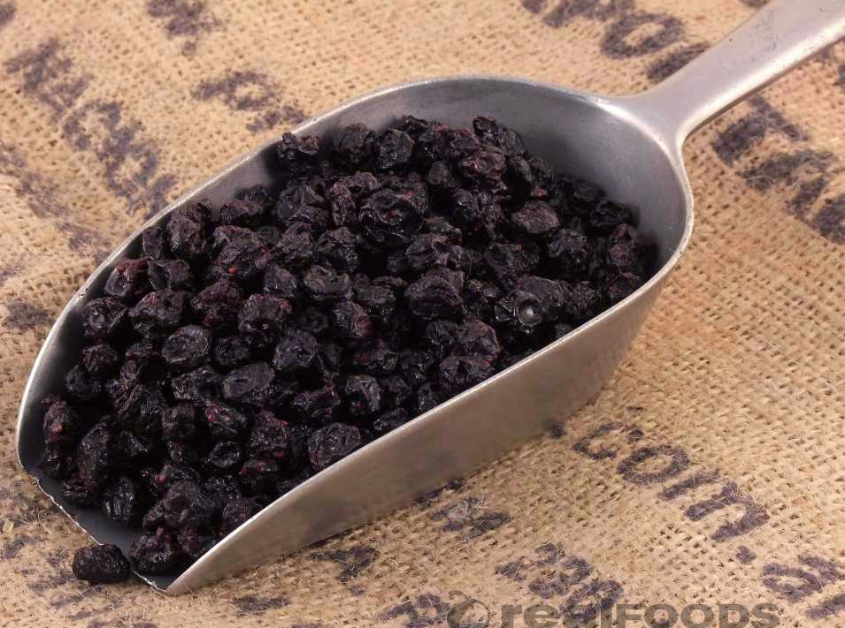
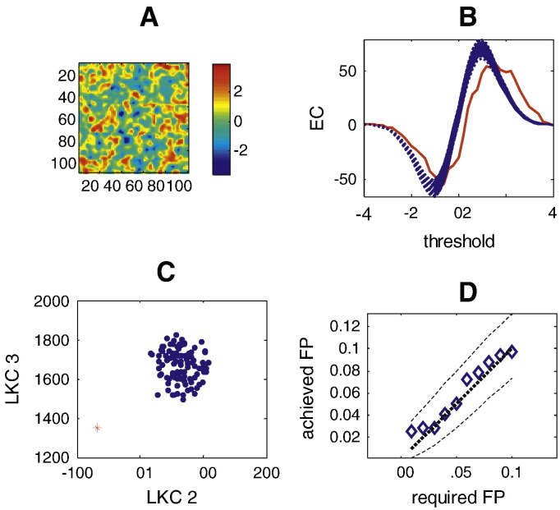
Testing for signal
SPM t
Random field
Observed EC

Slide 31
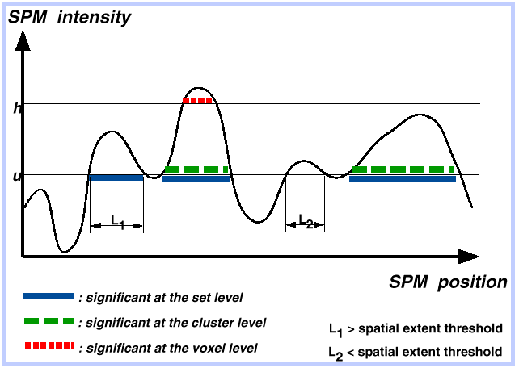
Peak, cluster and set level inference
set
EC
peak
Sensitivity
Regional specificity
threshold
Peak level test:
height of local maxima
Cluster level test:
spatial extent above u
Set level test:
number of clusters above u

: significant at the set level

: significant at the cluster level
L₁ > spatial extent threshold
L₂ < spatial extent threshold
: significant at the peak level

Slide 32
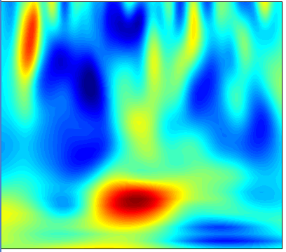
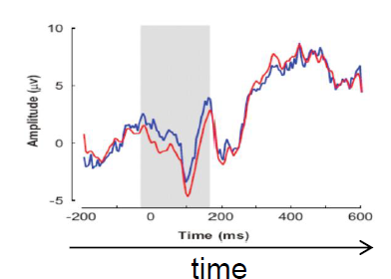
Can get correct FWE for any of these..
M/EEG
2D time-frequency
fMRI, VBM,
M/EEG source reconstruction
frequency
mm
time
time
M/EEG
1D channel-time
mm
mm
M/EEG 2D+t
scalp-time
mm
mm

Slide 33
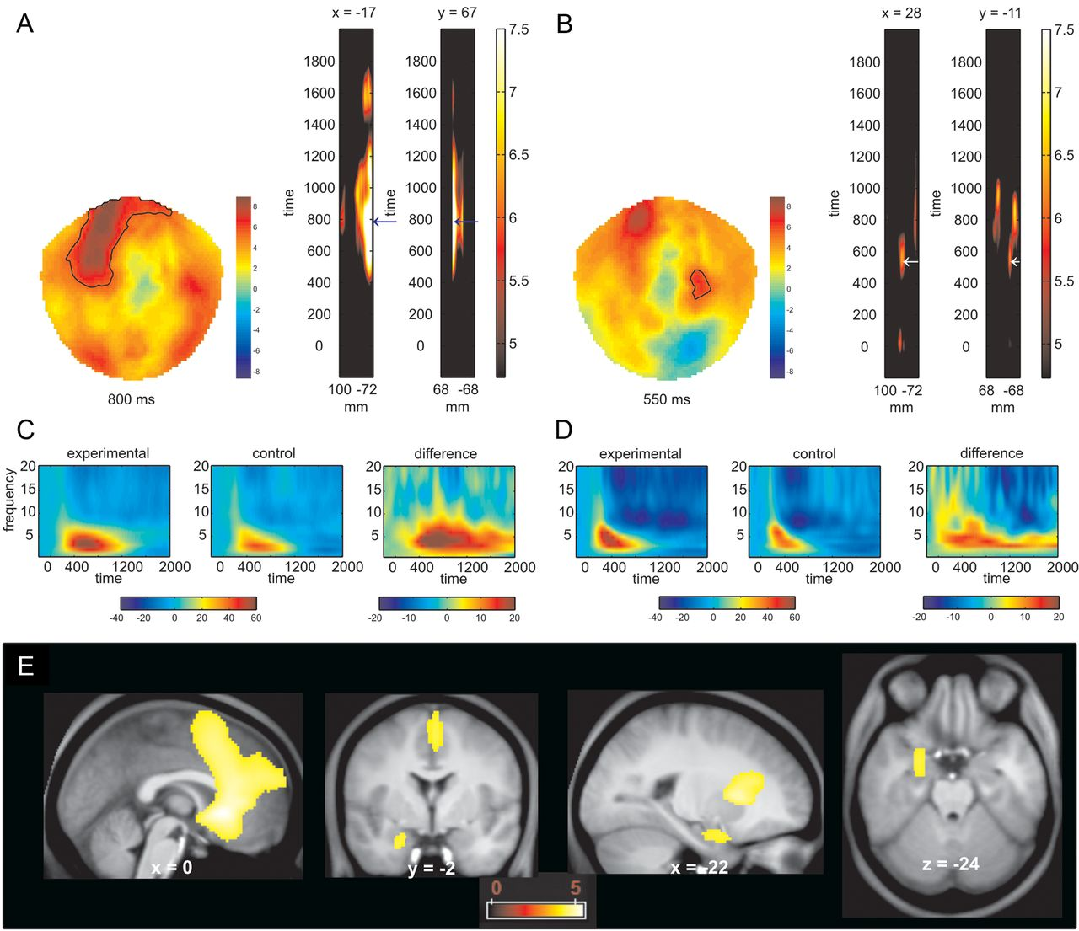
Peace of mind
P<0.05 FWE
Guitart-Masip M et al. J. Neurosci. 2013;33:442-451
Notes:
Time frequency analysis. A, B, The topographical maps of the T values (sensor space) and thresholded (p < 0.05; whole brain FWE) T maps in the time domain that result from contrasting active versus forced choice trials show higher induced theta power in the active choice conditions over frontal and centrotemporal sensors. C, D, Group-averaged time frequency activity (pooled from all channels included within the highlighted areas in A and B) for the active choice, the forced choice, and their difference. E, Anatomical localization of the sources of the differences in theta power between active and forced choice conditions detected a medial prefrontal cortex and an anterior hippocampal cluster (p < 0.05, FWE). The color scale indicates T values.

Slide 34
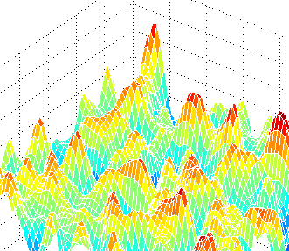
Random Field Theory
The statistic image is assumed to be a good lattice
representation of an underlying continuous stationary
random field. Typically, FWHM > 3 voxels
Smoothness of the data is unknown and estimated:
very precise estimate by pooling over voxels ⇒ stationarity
assumptions (esp. relevant for cluster size results).
But can also use non-stationary random field theory to correct over volumes with inhomogeneous smoothness
A priori hypothesis about where an activation should be,
reduce search volume ⇒ Small Volume Correction:

Slide 35
Conclusions
Because of the huge amount of data there is a multiple comparison problem in M/EEG data.
Strong prior hypotheses can reduce this problem.
Random field theory is a way of predicting the number of peaks you would expect in a purely random field (without signal).
Can control FWE rate for a space of any dimension and shape.

Slide 36
Acknowledgments
Guillaume Flandin
Vladimir Litvak
James Kilner
Stefan Kiebel
Rik Henson
Karl Friston
Methods group at the FIL

Slide 37
References
Friston KJ, Frith CD, Liddle PF, Frackowiak RS. Comparing functional (PET) images: the assessment of significant change. J Cereb Blood Flow Metab. 1991 Jul;11(4):690-9.
Worsley KJ, Marrett S, Neelin P, Vandal AC, Friston KJ, Evans AC. A unified statistical approach for determining significant signals in images of cerebral activation. Human Brain Mapping 1996;4:58-73.
Chumbley J, Worsley KJ , Flandin G, and Friston KJ. Topological FDR for neuroimaging. NeuroImage, 49(4):3057-3064, 2010.
Chumbley J and Friston KJ. False Discovery Rate Revisited: FDR and Topological Inference Using Gaussian Random Fields. NeuroImage, 2008.
Kilner J and Friston KJ. Topological inference for EEG and MEG data. Annals of Applied Statistics, in press.
Bias in a common EEG and MEG statistical analysis and how to avoid it. Kilner J. Clinical Neurophysiology 2013.

