Slide 1
DCM for evoked responses
Harriet Brown
SPM for M/EEG course, 2013
Notes:
Introduce myself
I’m going to talk about evoked responses – which are…
DCM for MEG/EEG interchangeable so when I say ERP I mean ERP/ERF. Only difference is the lead field.
Cover some of Jean’s talk again
Next talk will go through it step by step

Slide 2
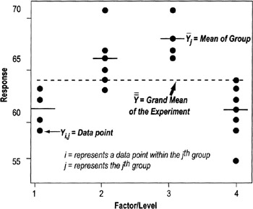
The DCM analysis pathway
Notes:
Every time you do a statistical test it’s an exercise in modelling, it’s just that these models are bit more complex. E.g. here is a model comparison (sort of)

Slide 3
The DCM analysis pathway
Build model(s)
Fit your model parameters to the data
Pick the best model
Make an inference (conclusion)
Collect data
Notes:
This is what you do

Slide 4
The DCM analysis pathway
Build model(s)
Fit your model parameters to the data
Pick the best model
Make an inference (conclusion)
Collect data
Notes:
Collect data – mostly been covered in preprocessing

Slide 5
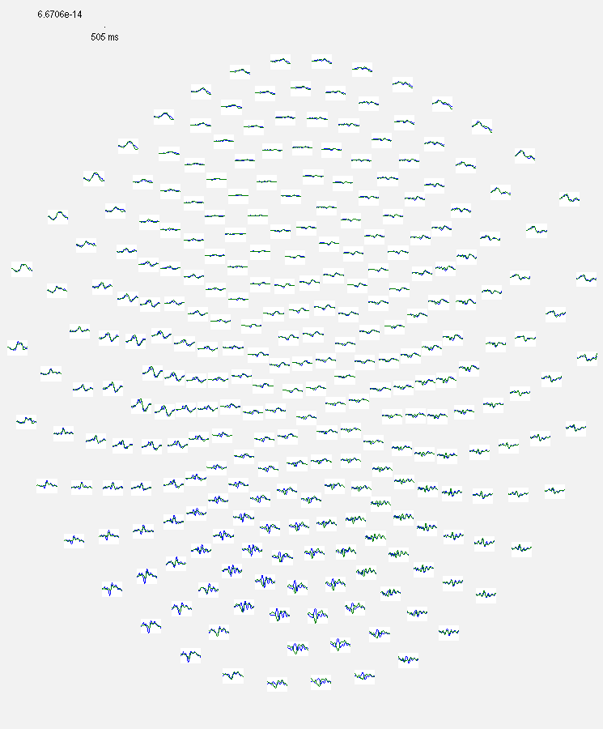
Data for DCM for ERPs
Downsample
Filter (1-40Hz)
Epoch
Remove artefacts
Average
Notes:
Data should be processed like this to leave ERPs for each condition

Slide 6
The DCM analysis pathway
Build model(s)
Fit your model parameters to the data
Pick the best model
Make an inference (conclusion)
Collect data
Notes:
You also need to build models of your data. We’ll build them in the ways described in Jean’s talk, and then use our data to refine them

Slide 7
The DCM analysis pathway
‘hardwired’ model features
Build model(s)
Fit your model parameters to the data
Pick the best model
Make an inference (conclusion)
Collect data
Notes:
We’ve done a lot of the work for you! Many features of the DCM, particularly the representation of neuronal systems, are hardwired. This includes the neural mass model and the way inputs, intrinsic and extrinsic connections enter the model, and how data is retrieved from the model. First I’ll talk about the neural mass models

Slide 8
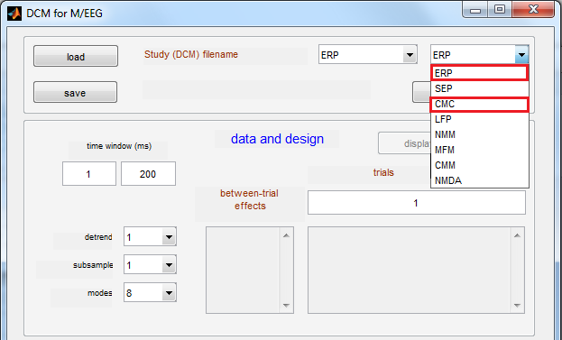
Models
Notes:
I’m going to talk about these models here

Slide 9
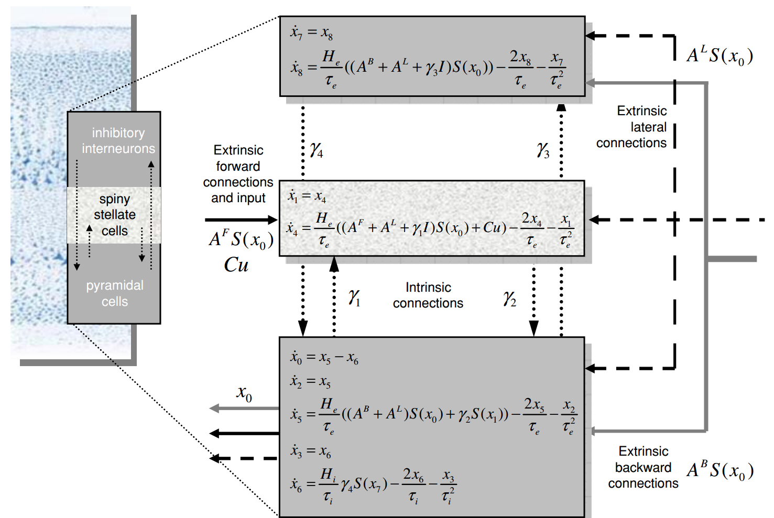
Standard 3-population model (‘ERP’)

Slide 10
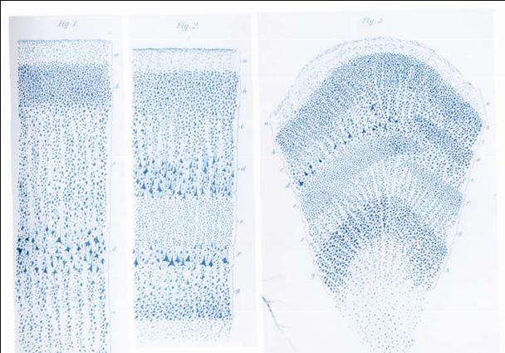

Canonical Microcircuit Model (‘CMC’)
Output equation:
Supra-granular
Layer
Granular
Layer
Infra-granular
Layer

Slide 11
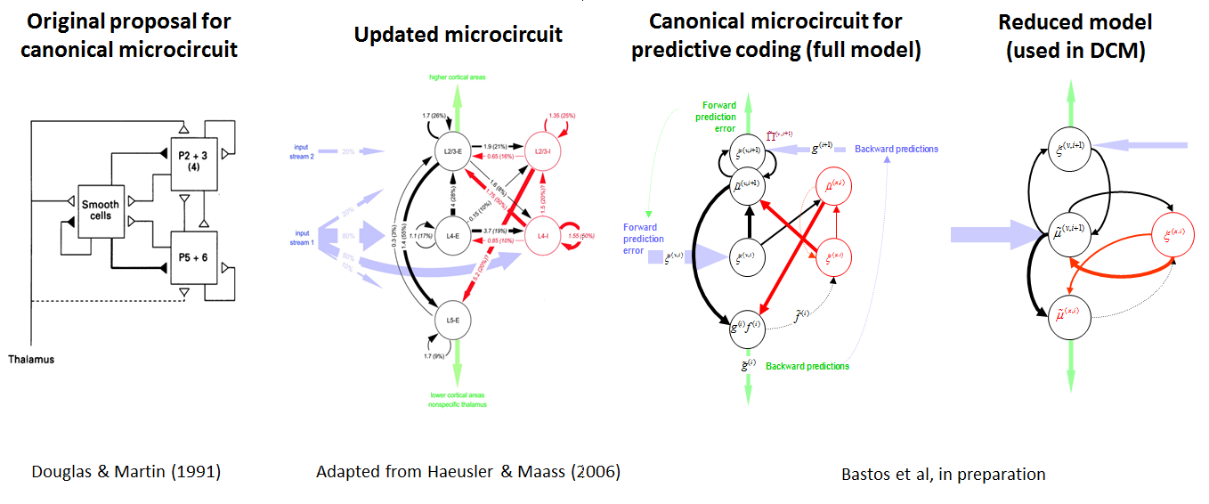
Canonical Microcircuit Model (‘CMC’)

Slide 12
Canonical Microcircuit Model (‘CMC’)
Supra-
granular
Layer
Granular
Layer
Infra-granular
Layer

Slide 13
Canonical Microcircuit Model (‘CMC’)
Inhibitory Interneurons
Superficial Pyramidal
Cells
Supra-granular
Layer
Spiny Stellate Cells
Granular
Layer
Infra-granular
Layer
Deep Pyramidal
Cells

Slide 14
Canonical Microcircuit Model (‘CMC’)
Inhibitory Interneurons
Superficial Pyramidal
Cells
Supra-granular
Layer
Spiny Stellate Cells
Granular
Layer
Infra-granular
Layer
Deep Pyramidal
Cells

Slide 15
Canonical Microcircuit Model (‘CMC’)
Inhibitory Interneurons
Superficial Pyramidal
Cells
Supra-granular
Layer
Spiny Stellate Cells
Granular
Layer
Infra-granular
Layer
Deep Pyramidal
Cells

Slide 16
Canonical Microcircuit Model (‘CMC’)
Inhibitory Interneurons
Superficial Pyramidal
Cells
Supra-granular
Layer
Spiny Stellate Cells
Granular
Layer
Infra-granular
Layer
Deep Pyramidal
Cells

Slide 17
Canonical Microcircuit Model (‘CMC’)
Inhibitory Interneurons
Superficial Pyramidal
Cells
Supra-granular
Layer
Spiny Stellate Cells
Granular
Layer
Infra-granular
Layer
Deep Pyramidal
Cells

Slide 18
Canonical Microcircuit Model (‘CMC’)
Inhibitory Interneurons
Superficial Pyramidal
Cells
Supra-granular
Layer
Spiny Stellate Cells
Granular
Layer
Infra-granular
Layer
Deep Pyramidal
Cells

Slide 19
Canonical Microcircuit Model (‘CMC’)
Inhibitory Interneurons
Superficial Pyramidal
Cells
Supra-granular
Layer
Spiny Stellate Cells
Granular
Layer
Infra-granular
Layer
Deep Pyramidal
Cells

Slide 20
Canonical Microcircuit Model (‘CMC’)
Inhibitory Interneurons
Superficial Pyramidal
Cells
Supra-granular
Layer
Spiny Stellate Cells
Granular
Layer
Infra-granular
Layer
Deep Pyramidal
Cells

Slide 21
Canonical Microcircuit Model (‘CMC’)

Slide 22
Canonical Microcircuit Model (‘CMC’)
Supra-granular
Layer
Granular
Layer
Infra-granular
Layer

Slide 23
Canonical Microcircuit Model (‘CMC’)
Output equation:
Supra-granular
Layer
Granular
Layer
Infra-granular
Layer

Slide 24
The DCM analysis pathway
‘hardwired’ model features
Build model(s)
Fit your model parameters to the data
Pick the best model
Make an inference (conclusion)
Collect data
Notes:
So that’s what’s hardwired. Now: how do you set up a model? What can you change?

Slide 25
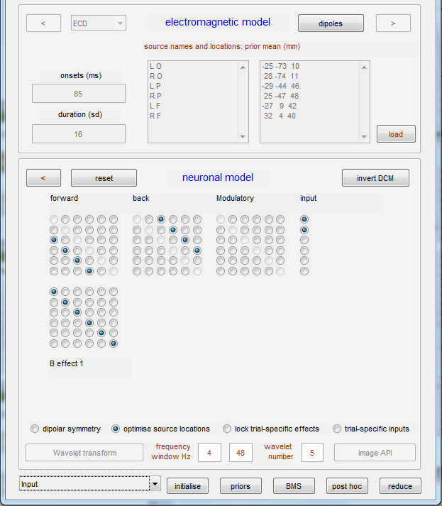
Designing your model
Area 1
Area 2
Area 3
Area 4

Slide 26
Designing your model
35
input
input (1)
30
25
20
15
10
5
0
0
50
100
time (ms)
150
200
250
Area 1
Area 2
Area 3
Area 4

Slide 27
Designing your model
35
input
input (1)
30
25
20
15
10
5
0
0
50
100
time (ms)
150
200
250
Area 1
Area 2
Area 3
Area 4

Slide 28
Designing your model
35
input
input (1)
30
25
20
15
10
5
0
0
50
100
time (ms)
150
200
250
Area 1
Area 2
Area 3
Area 4

Slide 29
Designing your model
35
input
input (1)
30
25
20
15
10
5
0
0
50
100
time (ms)
150
200
250
Area 1
Area 2
Area 3
Area 4

Slide 30
Designing your model
35
input
input (1)
30
25
20
15
10
5
0
0
50
100
time (ms)
150
200
250
Area 1
Area 2
Area 3
Area 4

Slide 31
Designing your model
35
input
input (1)
30
25
20
15
10
5
0
0
50
100
time (ms)
150
200
250
Area 1
Area 2
Area 3
Area 4

Slide 32
The DCM analysis pathway
Build model(s)
Fit your model parameters to the data
Pick the best model
Make an inference (conclusion)
Collect data
Notes:
Now it’s time to change the parameters of the model to find the set of values which best approximates the data. This is v. complicated and is done automatically.

Slide 33
The DCM analysis pathway
fixed parameters
Build model(s)
Fit your model parameters to the data
Pick the best model
Make an inference (conclusion)
Collect data

Slide 34
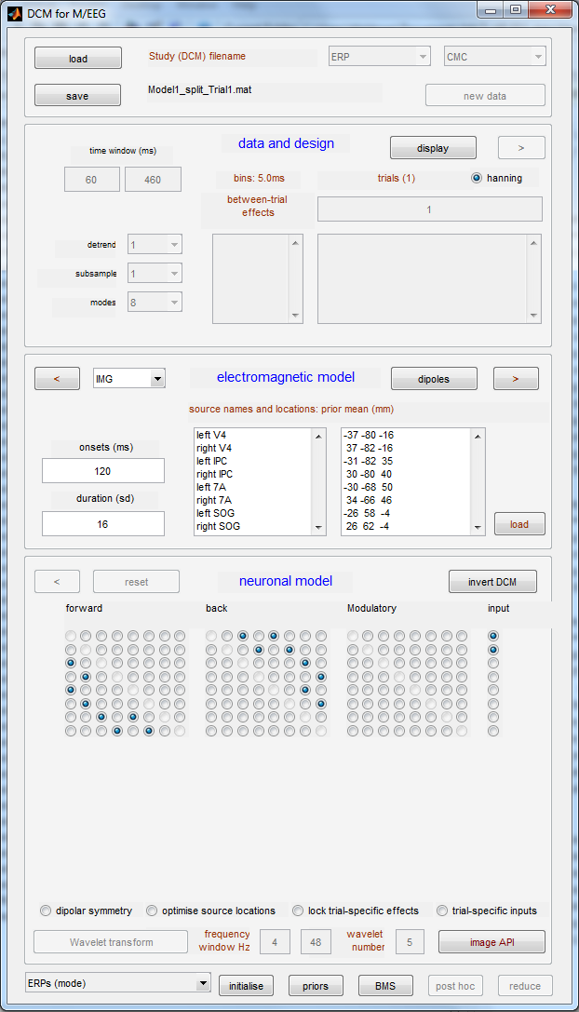
Fitting DCMs to data
Notes:
In theory this should take 1s of work and 45mins drinking coffee.

Slide 35
Fitting DCMs to data
Notes:
You should end up with something like this. This is nicely fitted data because…..

Slide 36
Fitting DCMs to data
Notes:
But sometimes this happens. This is poorly fitted data because…

Slide 37
Fitting DCMs to data
Check your data
Notes:
Do you have a clear ERP which differs between conditions? If not, check your artefact rejection and other sources of noise in the data.

Slide 38
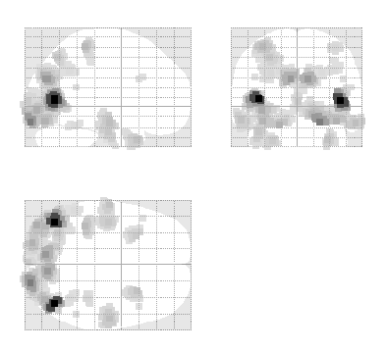
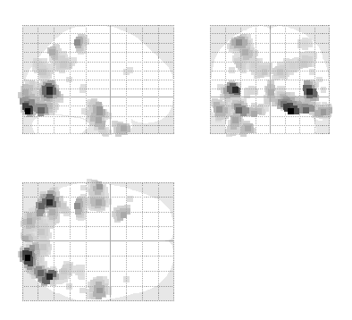
Fitting DCMs to data
Check your data
Check your sources
Notes:
Are they in locations of greatest source activity as identified by source localisation? Does the fit improve a lot if you allow the source locatiosn to be optimised?

Slide 39
OFC
OFC
Fitting DCMs to data
A19
IPL
A19
IPL
Check your data
Check your sources
Check your model
V4
V4
Model 1
IPL
IPL
V4
V4
Model 2
Notes:
e.g. does the model have enough explanatory power or enough areas? What about the input?

Slide 40
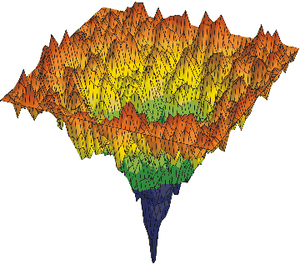
Fitting DCMs to data
Check your data
Check your sources
Check your model
Re-run model fitting
Notes:
Sometimes you know the model is sound but a few datasets are being stubborn. Might be due to the free energy landscape. If you’re fitting individual subject data, try re-initialising with the posteriors form a previous subject.

Slide 41
The DCM analysis pathway
Build model(s)
Fit your model parameters to the data
Pick the best model
Make an inference (conclusion)
Collect data

Slide 42
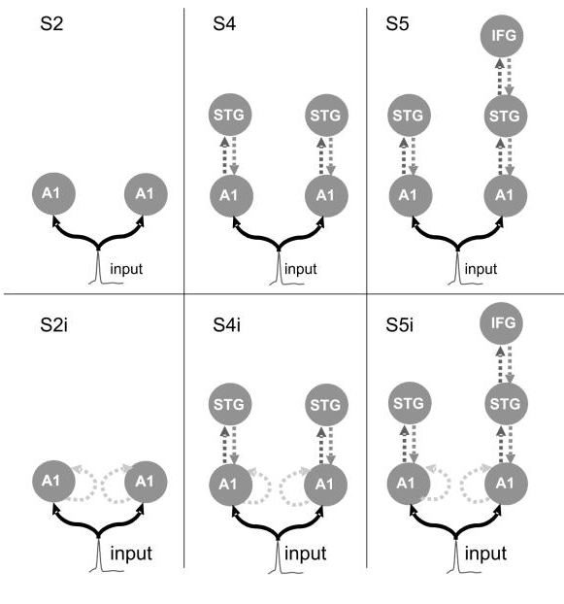
What questions can I ask with DCM for ERPs?
Questions about functional networks causing ERPs
Garrido et al. (2008)

Slide 43
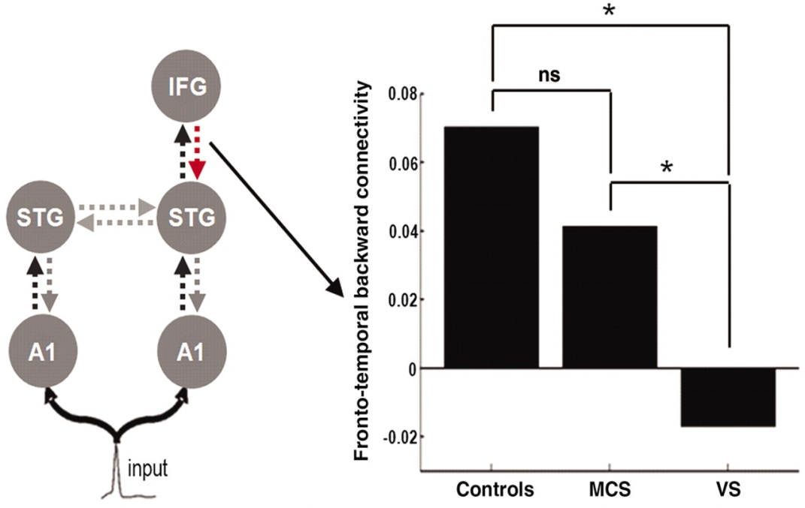
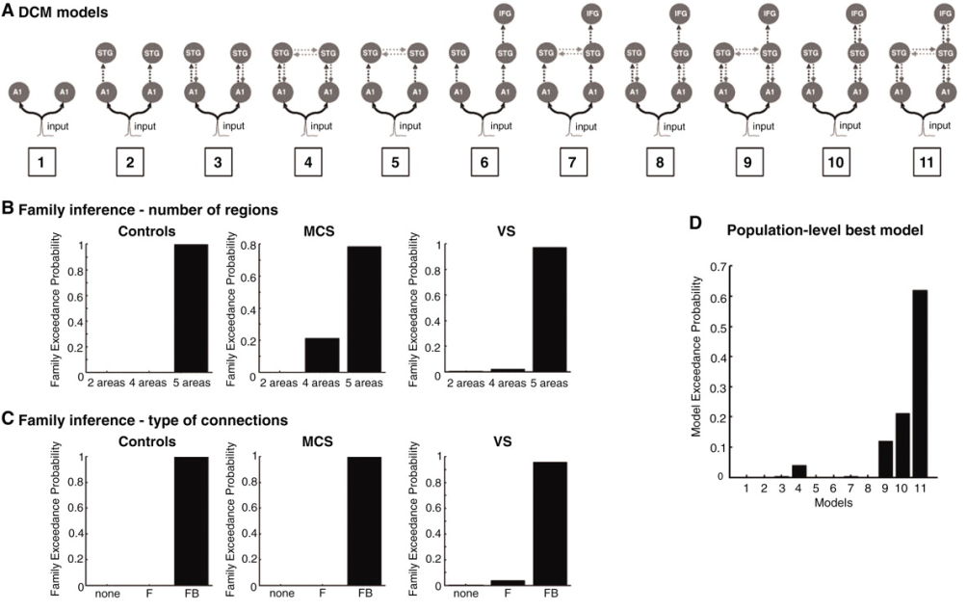
What questions can I ask with DCM for ERPs?
Questions about connectivity changes in different conditions or groups
Boly et al. (2011)

Slide 44
What questions can I ask with DCM for ERPs?
-3
mode 1
-3
mode 2
3
x 10
3
x 10
2
2
Questions about the neurobiological processes underlying ERPs
Deep Pyramidal Cell gain changed
1
1
0
0
-1
-1
-2
-2
-3
50
100
150
200
250
300
350
400
-3
50
100
150
200
250
300
350
400
peri-stimulus time (ms)
peri-stimulus time (ms)
3
x 10
-3
mode 1
3
x 10
-3
mode 2
Superficial Pyramidal Cell gain changed
2
2
1
1
0
0
-1
-1
-2
-2
-3
50
100
150
200
250
300
350
400
-3
50
100
150
200
250
300
350
400
peri-stimulus time (ms)
peri-stimulus time (ms)
0.25
0.2
0.15
0.1
Parameter value
0.05
0
-0.05
-0.1
V4
IPL
Area
Area 18
SOG

Slide 45
How to use DCM for ERPs well
A DCM study is only as good as its hypotheses…

