Slide 1
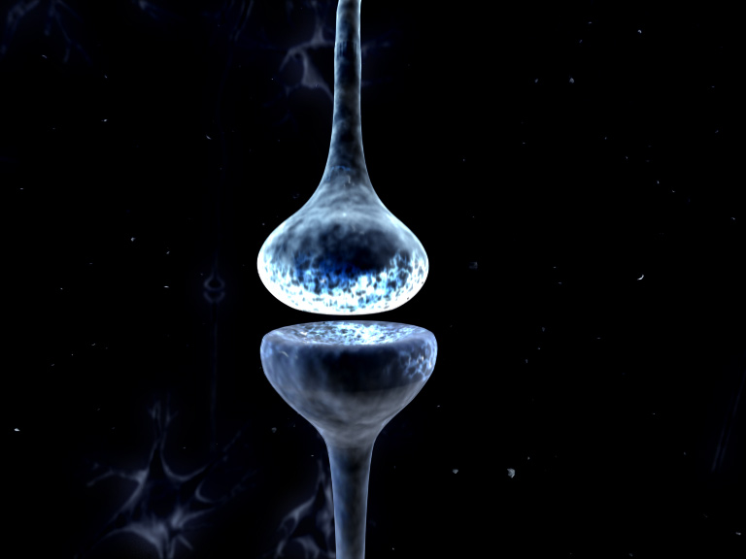
Dynamic Causal Modelling for
Cross Spectral Densities
Rosalyn Moran
Virginia Tech Carilion Research Institute

Slide 2
Outline
DCM & Spectral Data Features (the Basics)
DCM for CSD vs DCM for SSR
DCM for CSD Example

Slide 3
Outline
DCM & Spectral Data Features (the Basics)
DCM for CSD vs DCM for SSR
DCM for CSD Example

Slide 4
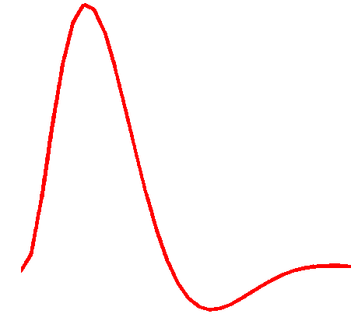
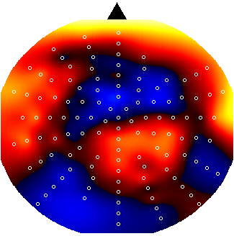
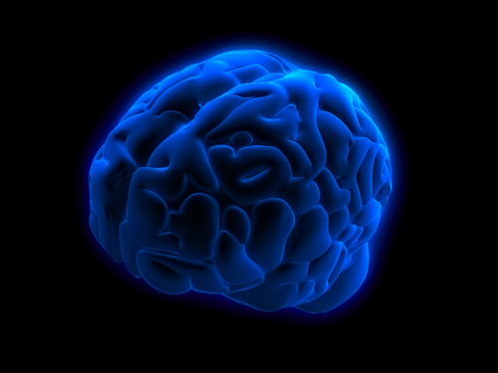
Dynamic Causal Modelling: Generic Framework
Electromagnetic
forward model:
neural activity EEG
MEG
LFP
Time Domain ERP Data
Phase Domain Data
Time Frequency Data
Steady State Frequency Data
Hemodynamic
forward model:
neural activity BOLD
Time Domain Data
Cross Spectral Densities (Frequency Domain)
Neural state equation:
fMRI
EEG/MEG
complicated neuronal model
Fast time scale
simple neuronal model
Slow time scale

Slide 5
Dynamic Causal Modelling: Generic Framework
“theta”
Hemodynamic
forward model:
neural activity BOLD
Time Domain Data
Electromagnetic
forward model:
neural activity EEG
MEG
LFP
CSDs
Power (mV²)
Frequency (Hz)
Neural state equation:
fMRI
EEG/MEG
complicated neuronal model
Fast time scale
simple neuronal model
Slow time scale

Slide 6
Dynamic Causal Modelling: Framework
Empirical Data
Hemodynamic
forward model:
Electromagnetic
forward model:
Neural state equation:
Generative Model
fMRI
EEG/MEG
Bayesian Inversion
simple neuronal model
complicated neuronal model
Model Structure/ Model Parameters

Slide 7


Dynamic Causal Modelling: Framework
Bayes’ rules:
Free Energy:
max
Inference on models
Inference on parameters
Bayesian Inversion
Model 1
Model 2
Model 1
Model comparison via Bayes factor:
accounts for both accuracy and complexity of the model
allows for inference about structure (generalisability) of the model

Slide 8
Dynamic Causal Modelling: Framework
Bayes’ rules:
Free Energy:
max
Inference on models
Inference on parameters
Bayesian Inversion
Model 1
Model 2
Model 1
Model comparison via Bayes factor:
accounts for both accuracy and complexity of the model
allows for inference about structure (generalisability) of the model

Slide 9


Dynamic Causal Modelling: Neural Mass Model
EEG/MEG/LFP
signal
Properties of tens of thousands of neurons approximated by their average response
Intrinsic Connections
inhibitory interneurons
neuronal (source) model
spiny stellate cells
Pyramidal
Cells
Internal Parameters
Extrinsic Connections
State equations

Slide 10
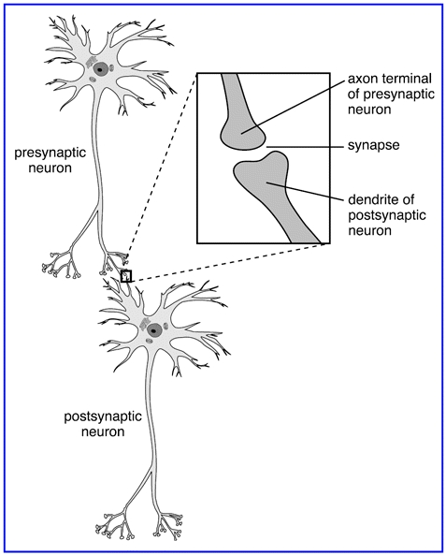

Dynamic equations mimic physiology and produce electrophysiological responses
Neurotransmitters: Glu/GABA
  AMPA receptors
A Neural Mass Model (6) layer cortical regions)
  GABAa receptors
State equations: A dynamical systems description
of anatomy and physiology
Extrinsic
Connections
Intrinsic
Connections
Supragranular Pyramidal Cells + inhibitory interneurons
Internal
Parameters
Eg.
Time constants of Sodium ion channels
spiny stellate cells
Deep Pyramidal
Cells + inhibitory interneurons
Notes:
Layers: 80: 20 mix: intrinsic connections among inhibitory interneuons: time constants

Slide 11


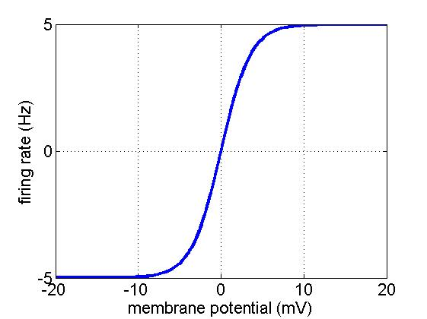
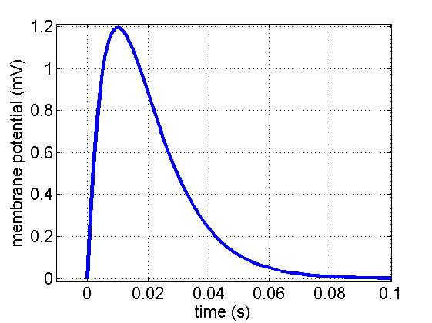
Dynamics mimicked at AMPA and GABA receptors
Neurotransmitters: Glu/GABA
  AMPA receptors
Cortico-cortical connection
  GABAa receptors
AP generation zone
Supragranular
Layer:
Inhibitory Cells
Intrinsic Connection
Granular
Layer:
Excitatory Cells
synapses
Infragranular
Layer:
Pyramidal Cells
AP generation zone
Cortico-cortical connection
Notes:
11

Slide 12
Parameters quantify contributions at AMPA and GABA receptors
Neurotransmitters: Glu/GABA
  AMPA receptors
  GABAa receptors
AP generation zone
Supragranular
Layer:
Inhibitory Cells
Intrinsic Connection
Granular
Layer:
Excitatory Cells
synapses
Infragranular
Layer:
Pyramidal Cells
Cortico-cortical connection
Notes:
12

Slide 13
State equations in a 6 layer cortical model
Extrinsic lateral connections
inhibitory interneurons
Extrinsic
forward connections
spiny stellate cells
Intrinsic connections
pyramidal cells
Extrinsic backward connections
Notes:
13

Slide 14
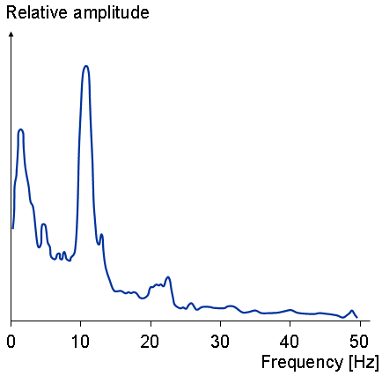
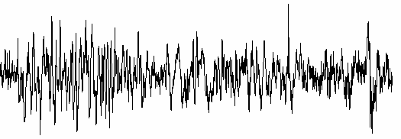
State equations to Spectra
Time Differential
Equations
State Space
Characterisation
Transfer Function
Frequency Domain
Linearise
mV
Moran, Kiebel, Stephan, Reilly, Daunizeau, Friston (2007) A neural mass model of spectral responses in electrophysiology. NeuroImage

Slide 15

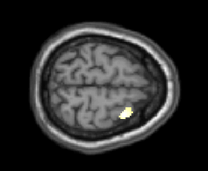

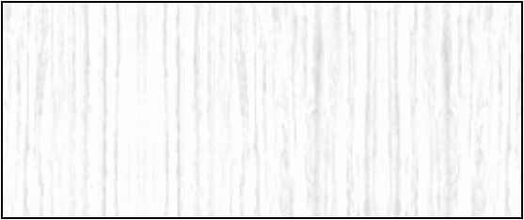
Given an empirical recording: estimate parameters of the model
  GABAa receptor density
  AMPA receptor density
Superficial layers
Measurement
γ
5
GABA
release
Increased activity at GABA
receptors
in supragranular layers
γ
Granular layers
γ
4
γ
3
3
Excitatory spiny cells in granular layers
1.4
&
=
x
x
1
=
4
1.3
1.4
16
&
κ
H
(
γ
s
(
x
−
a
+
−
κ
−
κ
2
L-Dopa
Placebo
x
)
u
)
2
x
x
4
e
e
1
9
e
4
e
1
1.2
1.3
14
Deep layers
Normalised Power (a.u.)
γ
1.2
12
γ
γ
Glutamate
release
1.1
Normalised Power (a.u.)
2
1.1
1
2
1
1
10
Frequency (Hz)
0.9
0.9
8
0.8
0.8
6
0.7
0.7
0
2
4
6
8
10
12
14
16
18
4
  GABAa TC
Frequency (Hz)
2
800
  AMPA time constant
0
6
11
16
Frequency (Hz)
Bayesian Inversion
Predicted response
(Pyramidal Cell Depolarization)
Moran, Stephan, Seidenbecher, Pape, Dolan, Friston (2009) Dynamic Causal Model of Steady State Responses. NeuroImage
Friston, Bastos, Litvak, Stephan, Fries, Moran (2012) DCM for complex data: cross-spectra, coherence and phase-delays. NeuroImage
Notes:
2007: one region
2009: multiple regions
Bayesian Inversion: a whole talk or a two day seminar … Systems analysis

Slide 16
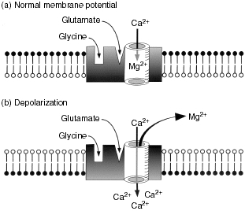

A conductance model offers more biological plausibility
Neurotransmitters: Glu/GABA
Superficial layers
Neuromodulators: Acetylcholine/Dopamine
Sodium Channel
Chloride Channel
Granular layers
Potassium Channel
Deep layers
AMPA/NMDA Ratio higher in Prefrontal Regions
than Parietal Regions
Depolarization dependent
Calcium Channel
1.4
1.4
1.3
1.3
1.2
1.2
1.1
1.1
1
f
Normalised Power (a.u.)
Frequency (Hz)
=
NMDA mediated switch
1
0.9
8
Mg
0.9
0.8
6
0.8
0.7
0
2
4
6
8
10
12
14
16
18
4
Normalised Power (a.u.)
Frequency (Hz)
2
800
0.7
0
6
11
16
Frequency (Hz)
Moran, Stephan, Dolan, Friston (2011) Consistent Spectral Predictors for Dynamic Causal Models of Steady State Responses. NeuroImage
Notes:
ketamine

Slide 17
Roadmap
Extract Data Features
Specify model
Maximise the model evidence (~-F)
Find your experimental data
Test models or MAP parameters

Slide 18
Summary:
DCM for Steady
State Responses
Prediction
Prediction
Prediction
Generative Model
| H₂(ω) . H₂*(ω) |
| H₁(ω) . H₁*(ω) |
| H₁(ω) . H₂*(ω) |
dx/dt = Ax + B
Cortical Macrocolumns and free parameters

Slide 19
Summary:
DCM for Steady
State Responses
Model Inversion
| H₂(ω) . H₂*(ω) |
| H₁(ω) . H₁*(ω) |
| H₁(ω) . H₂*(ω) |
dx/dt = Ax + B
Cortical Macrocolumns and free parameters

Slide 20
Outline
DCM & Spectral Data Features (the Basics)
DCM for CSD vs DCM for SSR
DCM for CSD Example

Slide 21
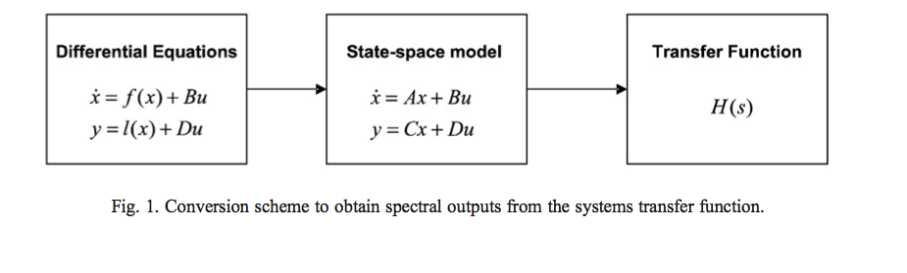
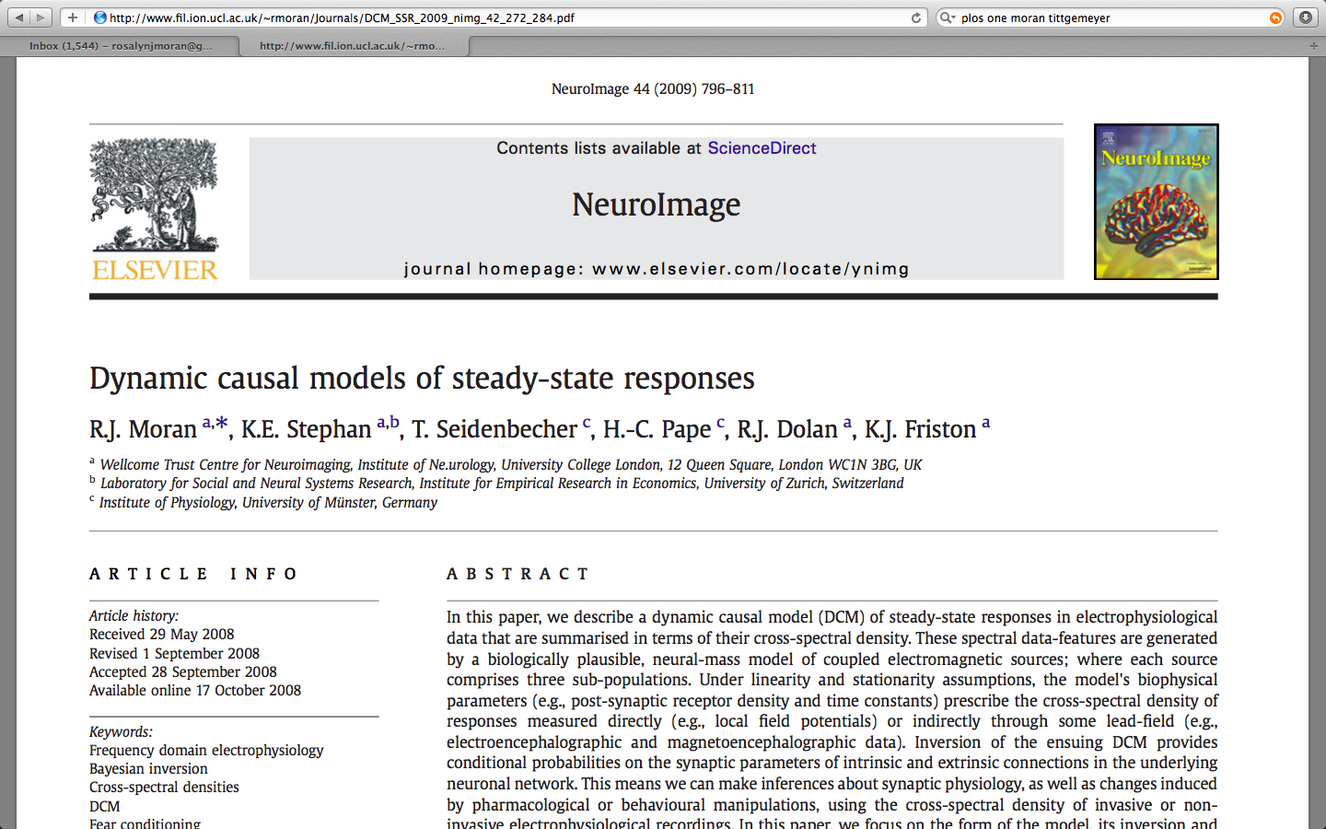
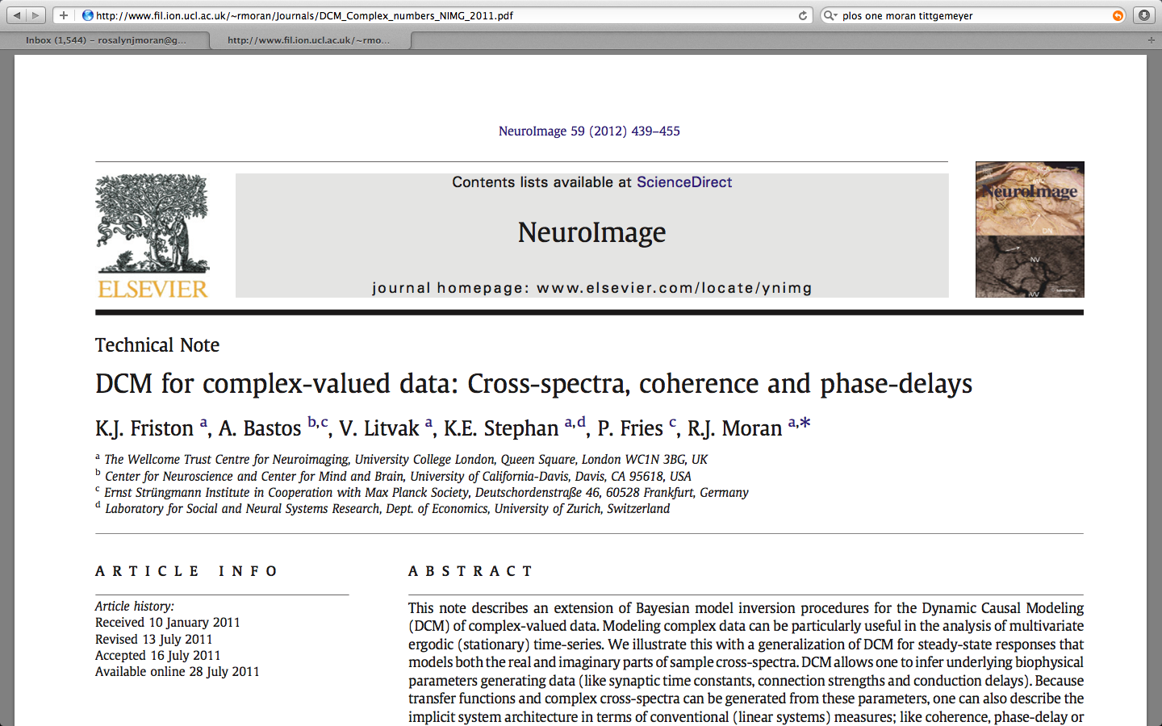
Time to Frequency Domain
Linearise around a stable fixed point or LC
DCM for SSR
DCM for CSD

Slide 22
DCM for
Cross Spectral
Densities
Prediction
Prediction
Prediction
Generative Model
H₂(ω) . H₂*(ω)
H₁(ω) . H₁*(ω)
Spectra and Phase lag
Coherence
Cross Correlations
H₁(ω) . H₂*(ω)
dx/dt = Ax + B
Cortical Macrocolumns and free parameters

Slide 23
DCM for
Cross Spectral
Densities
Prediction
Prediction
Prediction
Model Inversion using
full complex signal
H₂(ω) . H₂*(ω)
H₁(ω) . H₁*(ω)
Spectra and Phase lag
Coherence
Cross Correlations
H₁(ω) . H₂*(ω)
dx/dt = Ax + B
Cortical Macrocolumns and free parameters

Slide 24
Accommodating Imaginary Numbers
F
Real and imaginary
errors
Real and imaginary
derivatives wrt fx, G
E:
M:

Slide 25
Roadmap
Extract Data Features
Maximise the model evidence (~-F)
Specify model
Test models or MAP parameters
Find your experimental data
And also report phase lags coherence & delays
In channel or source space
Interface Additions
New CSD routines, similar to SSR
SPM_NLSI_GN accommodates imag numbers, slopes, curvatures
A host of new results features, in channel and source space!

Slide 26
Conditional Estimates:
Spectral Power
mode 1 to 1
mode 2 to 1
Abs(H₁(ω) . H₁*(ω)) Abs(H₁(ω) . H₂*(ω))
Abs(H₂(ω) . H₁*(ω)) Abs(H₂(ω) . H₂*(ω))
18
18
16
16
14
14
12
12
Power
10
10
8
8
6
6
4
4
2
2
0
10
20
30
40
0
10
20
30
40
frequency Hz
frequency Hz
mode 2 to 2
Spectral density over modes
18
predicted: trial 1
(in channel-space)
observed: trial 1
Hipp
predicted: mode 1
16
15
observed: mode 1
14
predicted: mode 2
PFC
observed: mode 2
12
abs(CSD)
10
10
5
8
6
0
4
10
20
30
40
2
frequency (Hz)
0
10
20
30
40
frequency Hz

Slide 27
Conditional Estimates:
Coherence
|(H₁(ω).H₂*(ω))|²
______________________
{(H₁(ω).H₁*(ω)) + (H₂(ω).H₂*(ω))}
Coh: pfc to hipp
Channels: 2 to 1
1
1
0.9
1
0.8
1
0.7
1
0.6
0.5
1
0.4
1
0.3
0.2
1
0.1
1
0
0
10
20
30
40
50
0
10
20
30
40
50
frequency Hz
frequency Hz
Hipp
predicted: trial 1
PFC
observed: trial 1

Slide 28
Conditional Estimates:
Covariance
F⁻¹(H₁(ω).H₁*(ω)) F⁻¹(H₁(ω).H₂*(ω))
F⁻¹(H₂(ω).H₁*(ω)) F⁻¹(H₂(ω).H₂*(ω))
mode 1 to 1
mode 2 to 1
0.2
0.2
0.15
0.15
0.1
0.1
0.05
0.05
0
0
-0.05
-0.05
-100
-50
0
50
100
-100
-50
0
50
100
lag (ms)
lag (ms)
mode 2 to 2
Auto-covariance
0.2
trial 1
(in channel-space)
0.2
channel 1
0.15
Hipp
0.15
channel 2
0.1
0.1
PFC
auto-covariance
0.05
0.05
0
-0.05
0
-100
-50
0
50
100
-0.05
Lag (ms)
-100
-50
0
50
100
lag (ms)

Slide 29
Conditional Estimates:
Delays
arg(H₁(ω).H₂*(ω))
____________
ω
Delay (ms) PfC to Hipp
Delay (ms) 2 to 1
10
5
trial 1
predicted: trial 1
5
0
observed: trial 1
0
-5
-5
-10
-10
-15
-15
-20
-20
-25
0
10
20
30
40
50
-25
0
10
20
30
40
50
Frequency Hz
frequency Hz
Hipp
PFC

Slide 30
Outline
DCM & Spectral Data Features (the Basics)
DCM for CSD vs DCM for SSR
DCM for CSD Examples

Slide 31
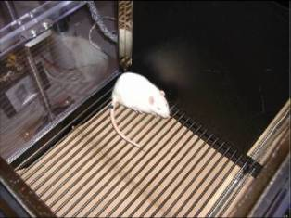
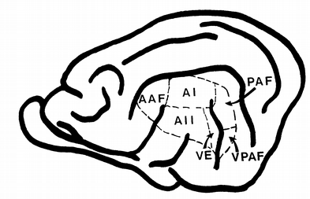
Pharmacological Manipulation of Glutamate and GABA
4 levels of anaesthesia: each successively decreasing glutamate and increasing GABA
(Larsen et al Brain Research 1994; Lingamaneni et al Anesthesiology 2001; Caraiscos et al J Neurosci 2004 ; de Sousa et al Anesthesiology 2000 )
LFP recordings from primary auditory cortex (A1) & posterior auditory field (PAF)
White noise stimulus & Silence
1.4 % Isoflurane | 1.8 % Isoflurane | 2.4 % Isoflurane | 2.8 % Isoflurane
A1
0.12
0.12
0.06
LFP
0.06
0
mV
0
mV
-
-
0.06
0.06
A2
0.12
0.12
0.06
0.06
0
mV
0
mV
-
-
0.06
0.06

Slide 32
Summary
DCM for CSD:
Suitable for long time series with trial-specific spectral features eg pronounced beta
Fits complex spectral data features
Offers similar connectivity estimates to DCM for ERPs
With estimates of frequency specific delays and coherence
Can be used with all biophysical, Neural Mass Models (CMC, LFP etc.)

Slide 33

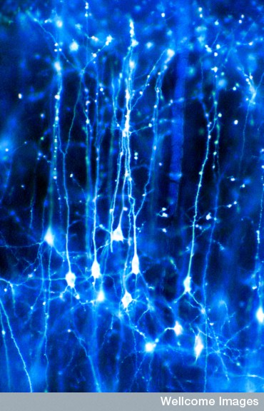
Thank You
Acknowledgments
The FIL Methods Group
Karl Friston
Dimitris Pinotsis
Marco Leite
Vladimir Litvak
Jean Daunizeau
Stephan Kiebel
Will Penny
Klaas Stephan
Andre Bastos
Pascal Fries

