Slide 1
Multiple testing
Justin Chumbley
Laboratory for Social and Neural Systems Research
University of Zurich
With many thanks for slides & images to:
FIL Methods group

Slide 2



Detect an effect of unknown extent & location
Image time-series
Kernel
Design matrix
Statistical parametric map (SPM)
Realignment
Smoothing
General linear model
Statistical
inference
Voluminous
Dependent
Normalisation
p <0.05
Template
Parameter estimates
Notes:
Describe thresholded images
One number for each spatial location (that gives the estimated effect size).
Two schools: 1) decide on voxels 2) decide on regions/blobs
(voxels are arbitrary in number and location, and smoothing means that effects are blurred and don’t really have voxel resolution).

Slide 3
Error at a single voxel
t
contrast of
estimated
parameters
t =
variance
estimate

Slide 4
Error at a single voxel
H₀ , H₁: zero/non-zero activation
α
t
contrast of
estimated
parameters
t =
variance
estimate

Slide 5
Error at a single voxel
Decision:
H₀ , H₁: zero/non-zero activation
h
α
t
contrast of
estimated
parameters
t =
variance
estimate
Notes:
Aim: Deciding which dn the data came from
How? Decision rule

Slide 6
Error at a single voxel
Decision:
H₀ , H₁: zero/non-zero activation
h
α
t
contrast of
estimated
parameters
t =
variance
estimate
Notes:
LIKE THROWING A DICE. YOU CAN CONTROL THE FALSE POSITIVE RATE.

Slide 7
Error at a single voxel
Decision:
H₀ , H₁: zero/non-zero activation
h
α
t
contrast of
estimated
parameters
t =
variance
estimate
Notes:
LIKE THROWING A DICE. YOU CAN CONTROL THE FALSE POSITIVE RATE.

Slide 8
Error at a single voxel
Decision:
H₀ , H₁: zero/non-zero activation
h
α
t
Decision rule (threshold) h,
determines related error rates ,
Convention: Penalize complexity
Choose h to give acceptable under H₀
contrast of
estimated
parameters
t =
variance
estimate
Notes:
LIKE THROWING A DICE. YOU CAN CONTROL THE FALSE POSITIVE RATE.

Slide 9
Types of error
Reality
H₀
H₁
False positive (FP)
True positive (TP)
H₁
Decision
True negative (TN)
False negative (FN)
H₀
specificity: 1-
= TN / (TN + FP)
= proportion of actual negatives which are correctly identified
sensitivity (power): 1-
= TP / (TP + FN)
= proportion of actual positives which are correctly identified
Notes:
Deciding which distribution the data comes from (between two probability models) .

Slide 10
Multiple tests
h
What is the problem?
h
h
h
α
α
α
α
t
t
t
contrast of
estimated
parameters
t =
variance
estimate
Notes:
LIKE THROWING A DICE. YOU CAN CONTROL THE FALSE POSITIVE RATE.

Slide 11
Multiple tests
h
Penalize each independent
opportunity for error.
h
h
h
α
α
α
α
t
t
t
contrast of
estimated
parameters
t =
variance
estimate
Notes:
LIKE THROWING A DICE. YOU CAN CONTROL THE FALSE POSITIVE RATE.

Slide 12
Multiple tests
h
h
h
h
α
α
α
α
t
t
t
Convention: Choose h to limit
assuming family-wise H₀
contrast of
estimated
parameters
t =
variance
estimate
Notes:
LIKE THROWING A DICE. YOU CAN CONTROL THE FALSE POSITIVE RATE.

Slide 13
Issues
1. Voxels or regions
2. Bonferroni too harsh (insensitive)
  Unnecessary penalty for sampling resolution (#voxels/volume)
  Unnecessary penalty for independence
Notes:
Suprathreshold BLOBS not voxels, under the null
Not really interested in infering voxels anyway

Slide 14
intrinsic smoothness
  MRI signals are aquired in k-space (Fourier space); after projection on anatomical space, signals have continuous support
  diffusion of vasodilatory molecules has extended spatial support
extrinsic smoothness
  resampling during preprocessing
  matched filter theorem
  → deliberate additional smoothing to increase SNR
  Robustness to between-subject anatomical differences

Slide 15
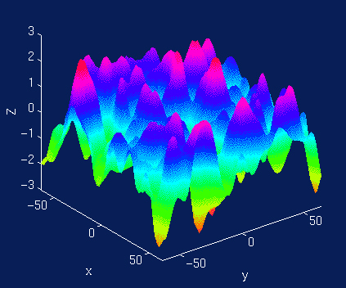
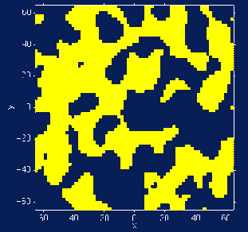
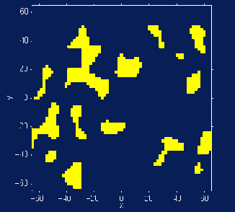
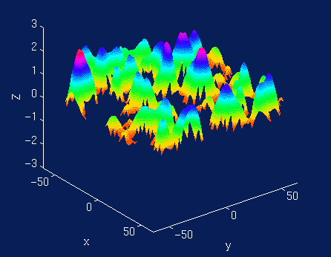
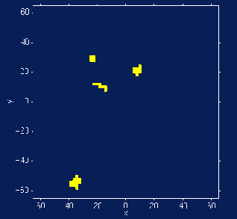
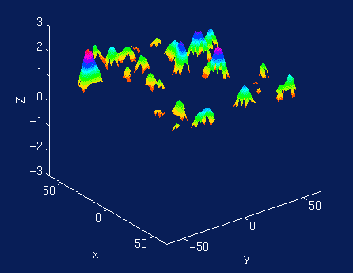
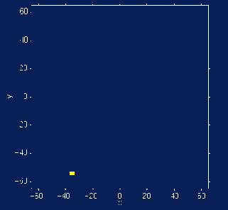
Acknowledge/estimate dependence
Detect effects in smooth landscape, not voxels
Apply high threshold: identify improbably high peaks
Apply lower threshold: identify improbably broad peaks
Total number of regions?
Notes:
Return to inference on smooth images
Aims: identify surprising/improbable features in this smooth null image.
Apply high threshold: identify improbably high peaks
Apply low threshold: identify improbably fat peaks
Two surprising features: Two thresholds.

Slide 16
Null distribution?
1. Simulate null experiments
2. Model null experiments
Notes:
Improbability statements require a null distribution:
1. Simulations of null experiments
2. A model for null experiments.

Slide 17
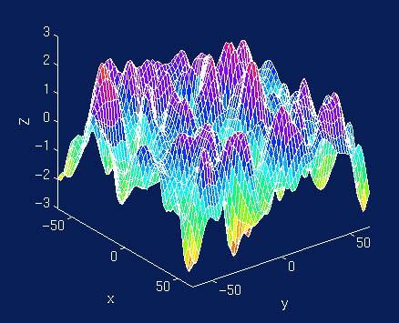
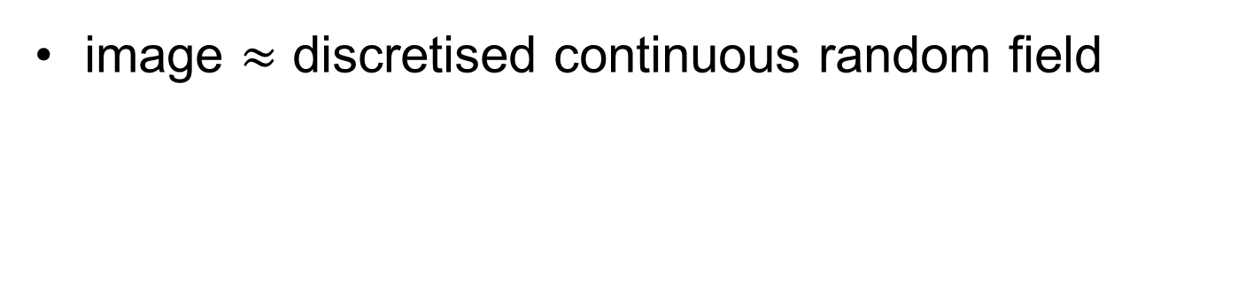
Use continuous random field theory
image $≈$ discretised continuous random field
Discretisation
(“lattice approximation”)
Smoothness quantified: resolution elements (‘resels’)
similar, but not identical to # independent observations
computed from spatial derivatives of the residuals
Notes:
What is a grf?
resel = size of image part that corresponds to the FWHM (full width half maximum) of the Gaussian convolution kernel that would have produced the observed image when applied to independent voxel values

Slide 18

Euler characteristic (χ_{h})
  threshold an image at high h
  χ_{h} ∝ # blobs
  FWER $≈$ E [χ_{h}]
  = p (blob)
Notes:
Why use grf: because of these results.
EC is an integer defined on excursion set for any threshold.

Slide 19
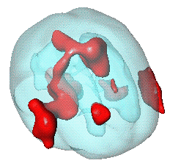
Unified Formula
General form for expected Euler characteristic
    χ², F, & t fields
E[χ_{h}(Ω)] = _{Σd} R_{d} (Ω) ρ_{d} (h)
Small volumes: Anatomical atlas, ‘functional localisers’, orthogonal contrasts, volume around previously reported coordinates…
R_{d} (Ω): d-dimensional Minkowski
functional of Ω
– function of dimension,
space Ω and smoothness:
R₀(Ω) = χ(Ω) Euler characteristic of Ω
R₁(Ω) = resel diameter
R₂(Ω) = resel surface area
R₃(Ω) = resel volume
ρ_{d} (Ω): d-dimensional EC density of Z(x)
– function of dimension and threshold,
specific for RF type:
E.g. Gaussian RF:
ρ₀(h) = 1- Φ(h)
ρ₁(h) = (4 ln2)^{1/2} exp(-h²/2) / (2π)
ρ₂(h) = (4 ln2) exp(-h²/2) / (2π)^{3/2}
ρ₃(h) = (4 ln2)^{3/2} (h² -1) exp(-h²/2) / (2π)²
ρ₄(h) = (4 ln2)² (h³ -3h) exp(-h²/2) / (2π)^{5/2}
Ω
Notes:
Worsley et al. 1996. A unified statistical approach for determining significant signals in images of cerebral activation. Human Brain Mapping, 4, 58–83.

Slide 20
Euler characteristic (EC) for 2D images
R = number of resels
h = threshold
Set h such that E[EC] = 0.05
Example: For 100 resels, E [EC] = 0.049 for a Z threshold of 3.8. That is, the probability of getting one or more blobs where Z is greater than 3.8, is 0.049.
Expected EC values for an image of 100 resels
Notes:
R depends on search volume and smoothness
Assumptions
Multivariate Normal
Stationary*
ACF twice differentiable at 0
Stationarity
Results valid w/out stationarity
More accurate when stat. holds

Slide 21
Spatial extent: similar

Slide 22
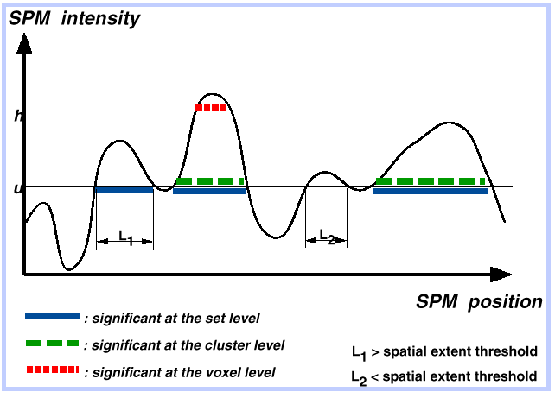
Voxel, cluster and set level tests
e
u
h

Slide 23
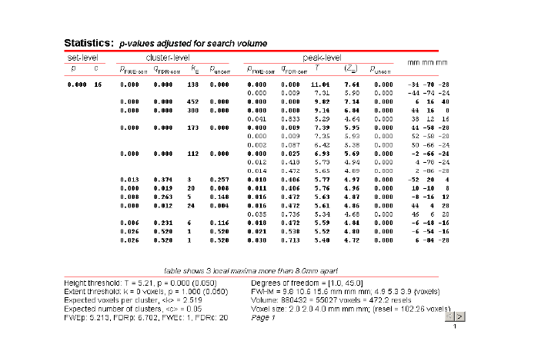

Slide 24



Detect an effect of unknown extent & location
There is a multiple testing problem (‘voxel’ or ‘blob’ perspective).
More corrections needed as ..
Volume $↑$, Independence$↑$
FWE
FDR
ROI
Voxel
Field
ROI
Voxel
Field
‘volume’ $↑$
resolution*$↑$
Height
Extent
Height
Extent
volume $↑$
independence$↑$
*voxels/volume
Notes:
There is a multiple testing problem (‘voxel’ or ‘blob’ perspective).
Corrections necessary.

Slide 25
Further reading
Friston KJ, Frith CD, Liddle PF, Frackowiak RS. Comparing functional (PET) images: the assessment of significant change. J Cereb Blood Flow Metab. 1991 Jul;11(4):690-9.
Genovese CR, Lazar NA, Nichols T. Thresholding of statistical maps in functional neuroimaging using the false discovery rate. Neuroimage. 2002 Apr;15(4):870-8.
Worsley KJ Marrett S Neelin P Vandal AC Friston KJ Evans AC. A unified statistical approach for determining significant signals in images of cerebral activation. Human Brain Mapping 1996;4:58-73.

