Slide 1
Bayesian Inference
Chris Mathys
Wellcome Trust Centre for Neuroimaging
UCL
SPM Course
London, October 25, 2013
Thanks to Jean Daunizeau and Jérémie Mattout for previous versions of this talk

Slide 2

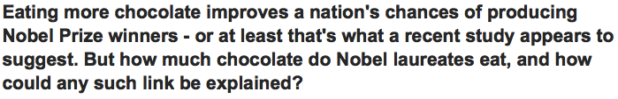
A spectacular piece of information

Slide 3
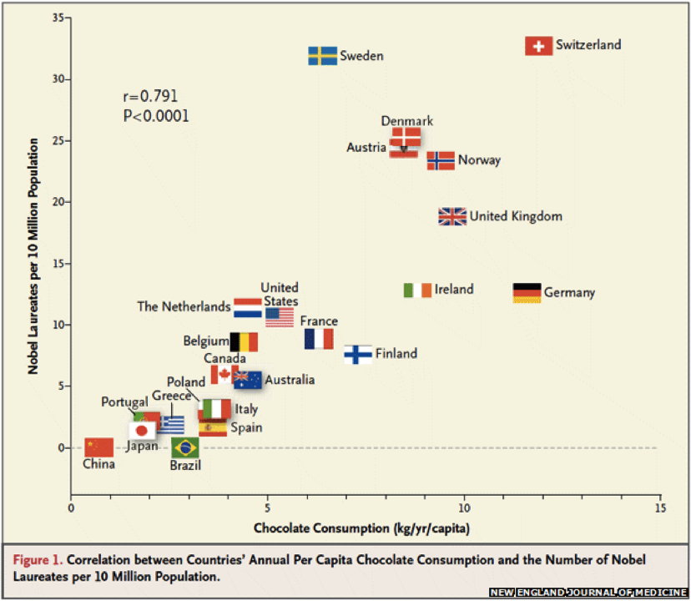
A spectacular piece of information
Messerli, F. H. (2012). Chocolate Consumption, Cognitive Function, and Nobel Laureates. New England Journal of Medicine, 367(16), 1562–1564.

Slide 4
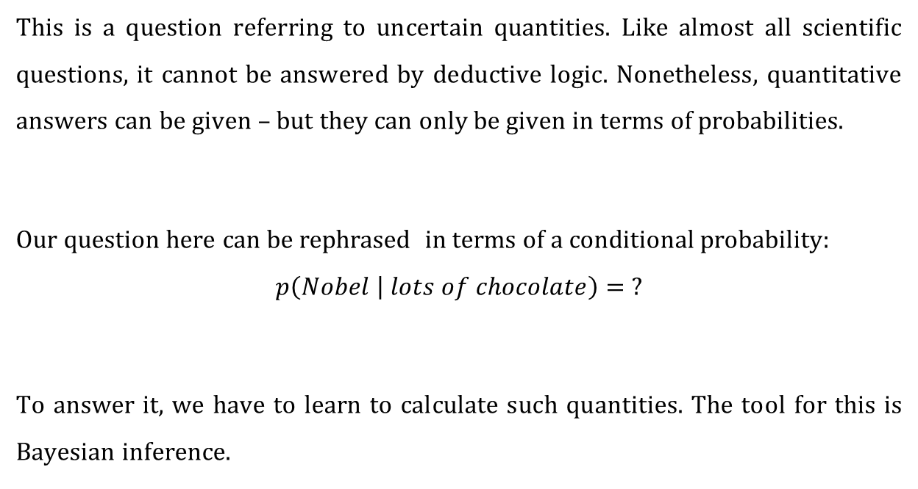
So will I win the Nobel prize if I eat lots of chocolate?
This is a question referring to uncertain quantities. Like almost all scientific questions, it cannot be answered by deductive logic. Nonetheless, quantitative answers can be given – but they can only be given in terms of probabilities.
Our question here can be rephrased in terms of a conditional probability:
$$p\left(Nobel | lots of chocolate\right)= ?$$
To answer it, we have to learn to calculate such quantities. The tool for this is Bayesian inference.

Slide 5
«Bayesian» = logical and logical = probabilistic
«The actual science of logic is conversant at present only with things either certain, impossible, or entirely doubtful, none of which (fortunately) we have to reason on. Therefore the true logic for this world is the calculus of probabilities, which takes account of the magnitude of the probability which is, or ought to be, in a reasonable man's mind.»
— James Clerk Maxwell, 1850

Slide 6
«Bayesian» = logical and logical = probabilistic
But in what sense is probabilistic reasoning (i.e., reasoning about uncertain quantities according to the rules of probability theory) «logical»?
R. T. Cox showed in 1946 that the rules of probability theory can be derived from three basic desiderata:
Representation of degrees of plausibility by real numbers
Qualitative correspondence with common sense (in a well-defined sense)
Consistency

Slide 7
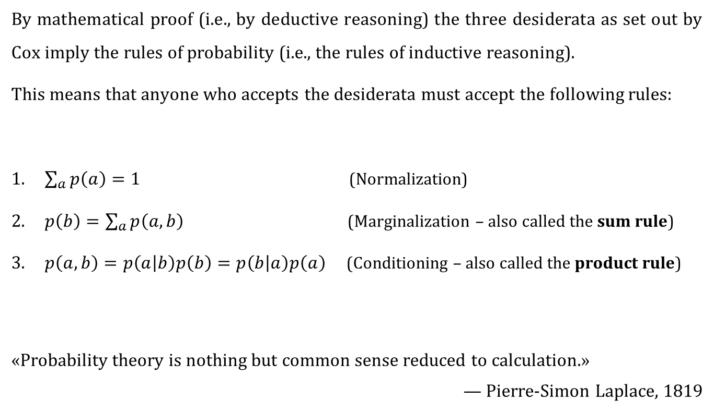
The rules of probability
By mathematical proof (i.e., by deductive reasoning) the three desiderata as set out by Cox imply the rules of probability (i.e., the rules of inductive reasoning).
This means that anyone who accepts the desiderata must accept the following rules:
$\sum_{a}{p\left(a\right)=1}$ (Normalization)
$p\left(b\right)=\sum_{a}{p\left(a,b\right)}$ (Marginalization – also called the sum rule)
$p\left(a,b\right)=p\left(a | b\right)p\left(b\right)=p\left(b | a\right)p\left(a\right)$ (Conditioning – also called the product rule)
«Probability theory is nothing but common sense reduced to calculation.»
— Pierre-Simon Laplace, 1819

Slide 8
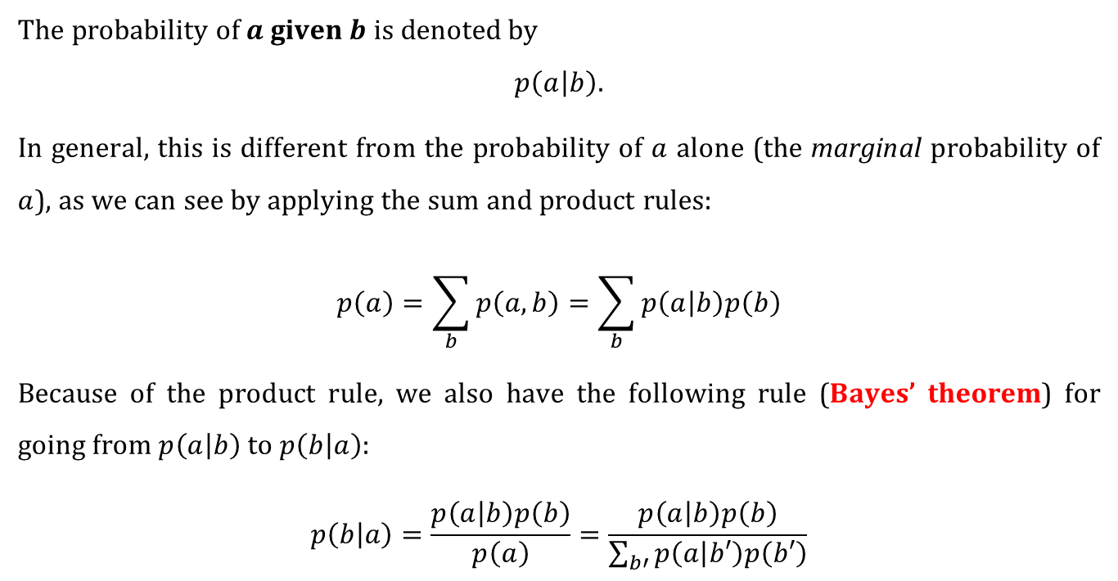
Conditional probabilities
The probability of $a$ given $b$ is denoted by
$$p\left(a | b\right).$$
In general, this is different from the probability of $a$ alone (the marginal probability of $a$), as we can see by applying the sum and product rules:
$$p\left(a\right)=\sum_{b}{p\left(a,b\right)=\sum_{b}{p\left(a | b\right)p\left(b\right)}}$$
Because of the product rule, we also have the following rule (Bayes’ theorem) for going from $p\left(a | b\right)$ to $p\left(b | a\right)$:
$$p\left(b | a\right)=\frac{p\left(a | b\right)p\left(b\right)}{p\left(a\right)}=\frac{p\left(a | b\right)p\left(b\right)}{\sum_{b′}{p\left(a | b′\right)p\left(b′\right)}}$$

Slide 9
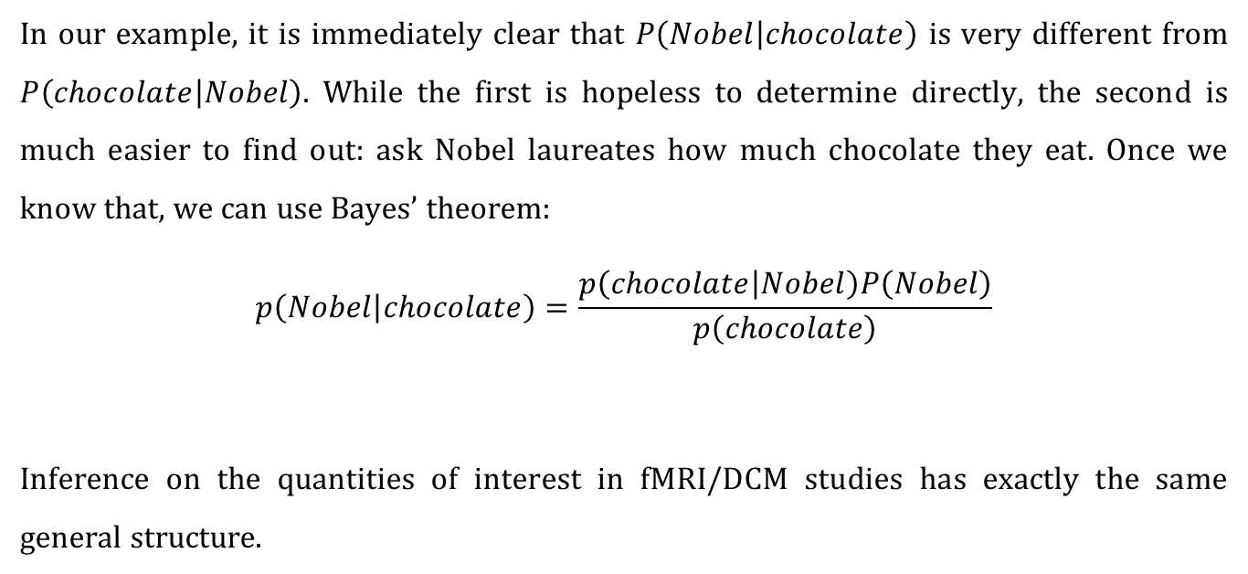
The chocolate example
In our example, it is immediately clear that $P\left(Nobel | chocolate\right)$ is very different from $P\left(chocolate | Nobel\right)$. While the first is hopeless to determine directly, the second is much easier to find out: ask Nobel laureates how much chocolate they eat. Once we know that, we can use Bayes’ theorem:
$$p\left(Nobel | chocolate\right)=\frac{p\left(chocolate | Nobel\right)P\left(Nobel\right)}{p\left(chocolate\right)}$$
Inference on the quantities of interest in fMRI/DCM studies has exactly the same general structure.
likelihood
model
prior
posterior
evidence

Slide 10
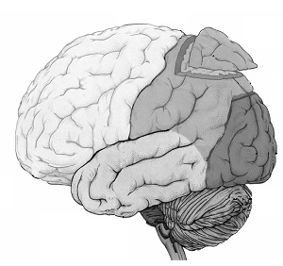
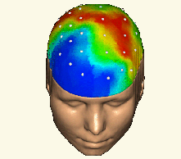


Inference in SPM
forward problem
$$p\left(y | θ,m\right)$$
likelihood
posterior distribution
$$p\left(θ | y,m\right)$$
inverse problem
Notes:
10

Slide 11
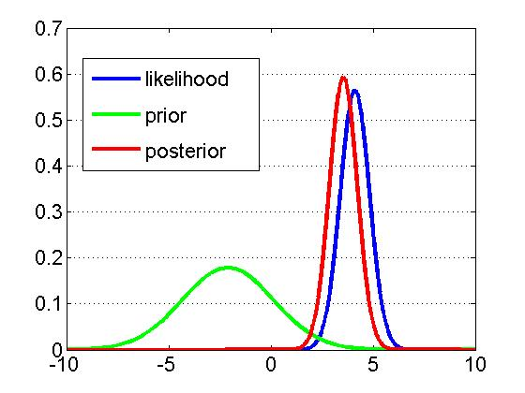
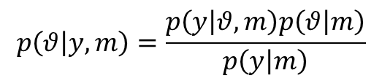



Inference in SPM
Likelihood:
$$p\left(y | θ,m\right)$$
Prior:
$$p\left(θ | m\right)$$
$$p\left(θ | y,m\right)=\frac{p\left(y | θ,m\right)p\left(θ | m\right)}{p\left(y | m\right)}$$
Bayes’ theorem:
generative model $m$
Notes:
EXAMPLE:
-Y : EEG electric potential measured on the scalp
-theta : connection strength between two nodes of a network

Slide 12


A simple example of Bayesian inference
(adapted from Jaynes (1976))
Two manufacturers, A and B, deliver the same kind of components that turn out to have the following lifetimes (in hours):
A:
B:
Assuming prices are comparable, from which manufacturer would you buy?
Notes:
EXAMPLE:
-Y : EEG electric potential measured on the scalp
-theta : connection strength between two nodes of a network

Slide 13
A simple example of Bayesian inference
How do we compare such samples?
By comparing their arithmetic means
Why do we take means?
If we take the mean as our estimate, the error in our estimate is the mean of the errors in the individual measurements
Taking the mean as maximum-likelihood estimate implies a Gaussian error distribution
A Gaussian error distribution appropriately reflects our prior knowledge about the errors whenever we know nothing about them except perhaps their variance
Notes:
EXAMPLE:
-Y : EEG electric potential measured on the scalp
-theta : connection strength between two nodes of a network

Slide 14








A simple example of Bayesian inference
What next?
Let’s do a t-test (but first, let’s compare variances with an F-test):
Is this satisfactory? No, so what can we learn by turning to probability theory (i.e., Bayesian inference)?
Variances not significantly different!
Means not significantly different!
Notes:
EXAMPLE:
-Y : EEG electric potential measured on the scalp
-theta : connection strength between two nodes of a network

Slide 15
A simple example of Bayesian inference
The procedure in brief:
Determine your question of interest («What is the probability that...?»)
Specify your model (likelihood and prior)
Calculate the full posterior using Bayes’ theorem
[Pass to the uninformative limit in the parameters of your prior]
Integrate out any nuisance parameters
Ask your question of interest of the posterior
All you need is the rules of probability theory.
(Ok, sometimes you’ll encounter a nasty integral – but that’s a technical difficulty, not a conceptual one).
Notes:
EXAMPLE:
-Y : EEG electric potential measured on the scalp
-theta : connection strength between two nodes of a network

Slide 16
A simple example of Bayesian inference
The question:
What is the probability that the components from manufacturer B have a longer lifetime than those from manufacturer A?
More specifically: given how much more expensive they are, how much longer do I require the components from B to live.
Example of a decision rule: if the components from B live 3 hours longer than those from A with a probability of at least 80%, I will choose those from B.
Notes:
EXAMPLE:
-Y : EEG electric potential measured on the scalp
-theta : connection strength between two nodes of a network

Slide 17
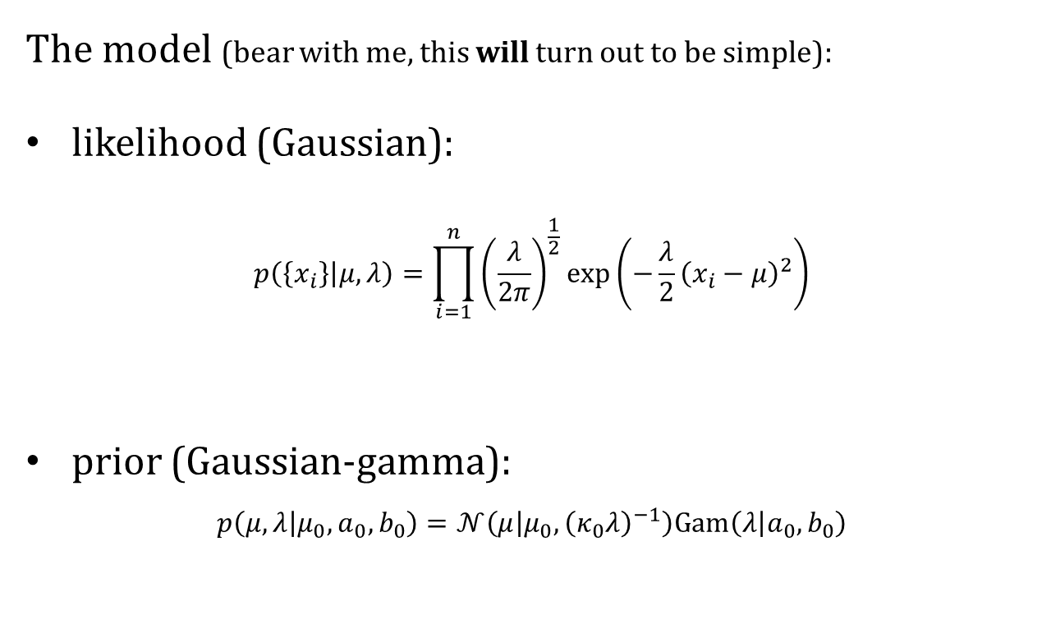
A simple example of Bayesian inference
The model (bear with me, this will turn out to be simple):
likelihood (Gaussian):
$$p\left(\left\{x_{i}\right\} | μ,λ\right)=\prod_{i=1}^{n}{{\left(\frac{λ}{2π}\right)}^{\frac{1}{2}}}\exp\left(−\frac{λ}{2}{\left(x_{i}−μ\right)}^{2}\right)$$
prior (Gaussian-gamma):
$$p\left(μ,λ | μ_{0},a_{0},b_{0}\right)=𝒩\left(μ | μ_{0},{\left(κ_{0}λ\right)}^{−1}\right)Gam\left(λ | a_{0},b_{0}\right)$$
Notes:
EXAMPLE:
-Y : EEG electric potential measured on the scalp
-theta : connection strength between two nodes of a network

Slide 18

A simple example of Bayesian inference
The posterior (Gaussian-gamma):
$$p\left(μ,λ | \left\{x_{i}\right\}\right)=𝒩\left(μ | μ_{n},{\left(κ_{n}λ\right)}^{−1}\right)Gam\left(λ | a_{n},b_{n}\right)$$
Parameter updates:
$$μ_{n}=μ_{0}+\frac{n}{κ_{0}+n}\left(\overline{x}−μ_{0}\right), κ_{n}=κ_{0}+n, a_{n}=a_{0}+\frac{n}{2}$$
$$b_{n}=b_{0}+\frac{n}{2}\left(s^{2}+\frac{κ_{0}}{κ_{0}+n}{\left(\overline{x}−μ_{0}\right)}^{2}\right)$$
with
$$\overline{x}≔\frac{1}{n}\sum_{i=1}^{n}{x_{i}}, s^{2}≔\frac{1}{n}\sum_{i=1}^{n}{{\left(x_{i}−\overline{x}\right)}^{2}}$$
Notes:
EXAMPLE:
-Y : EEG electric potential measured on the scalp
-theta : connection strength between two nodes of a network

Slide 19
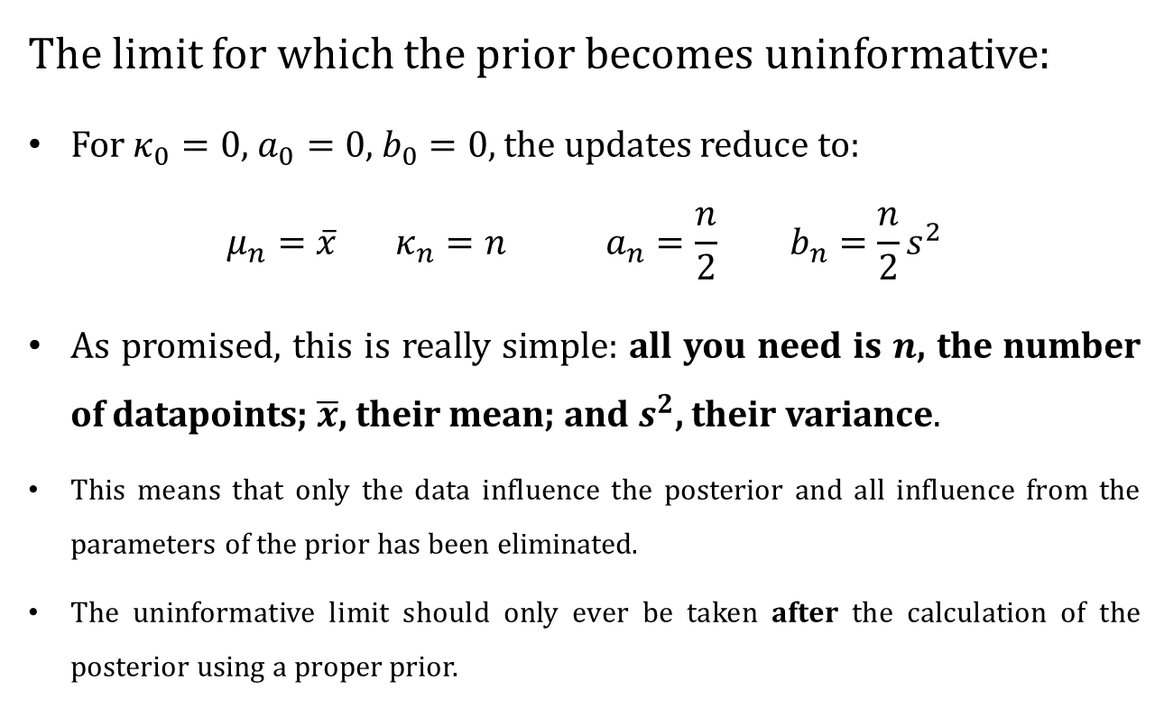
A simple example of Bayesian inference
The limit for which the prior becomes uninformative:
For $κ_{0}=0$, $a_{0}=0$, $b_{0}=0$, the updates reduce to:
$$μ_{n}=\overline{x} κ_{n}=n a_{n}=\frac{n}{2} b_{n}=\frac{n}{2}s^{2}$$
As promised, this is really simple: all you need is $n$, the number of datapoints; $\overline{x}$, their mean; and $s^{2}$, their variance.
This means that only the data influence the posterior and all influence from the parameters of the prior has been eliminated.
The uninformative limit should only ever be taken after the calculation of the posterior using a proper prior.
Notes:
EXAMPLE:
-Y : EEG electric potential measured on the scalp
-theta : connection strength between two nodes of a network

Slide 20
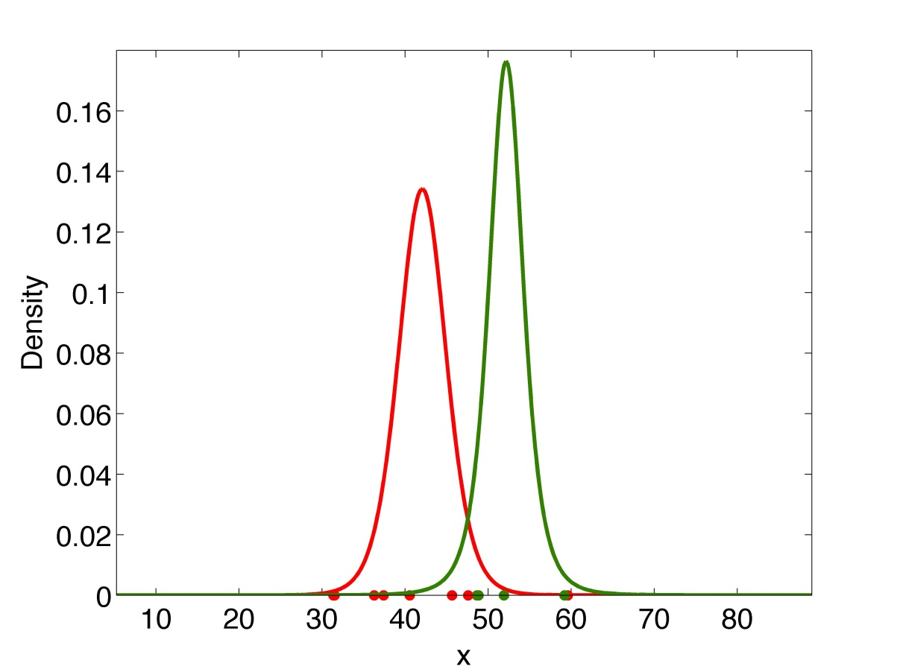
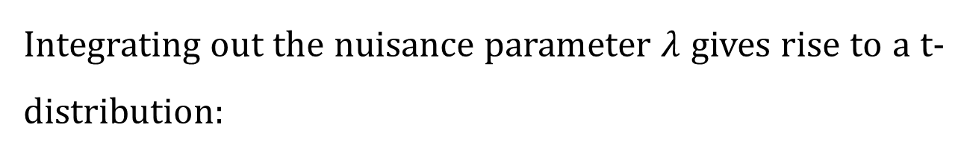
A simple example of Bayesian inference
Integrating out the nuisance parameter $λ$ gives rise to a t-distribution:
Notes:
EXAMPLE:
-Y : EEG electric potential measured on the scalp
-theta : connection strength between two nodes of a network

Slide 21
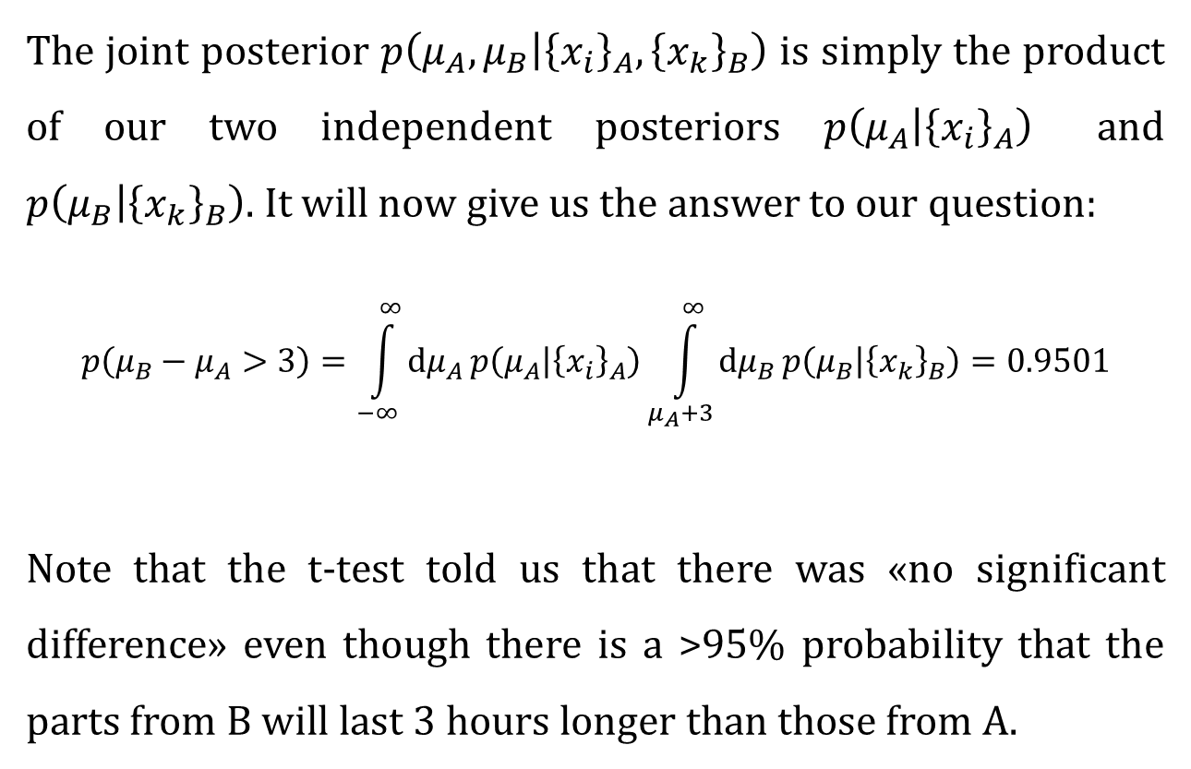
A simple example of Bayesian inference
The joint posterior $p\left(μ_{A},μ_{B} | {\left\{x_{i}\right\}}_{A},{\left\{x_{k}\right\}}_{B}\right)$ is simply the product of our two independent posteriors $p\left(μ_{A} | {\left\{x_{i}\right\}}_{A}\right)$ and $p\left(μ_{B} | {\left\{x_{k}\right\}}_{B}\right)$. It will now give us the answer to our question:
$$p\left(μ_{B}−μ_{A}>3\right)=\int_{−∞}^{∞}{dμ_{A}}p\left(μ_{A} | {\left\{x_{i}\right\}}_{A}\right)\int_{μ_{A}+3}^{∞}{dμ_{B}}p\left(μ_{B} | {\left\{x_{k}\right\}}_{B}\right)=0.9501$$
Note that the t-test told us that there was «no significant difference» even though there is a >95% probability that the parts from B will last 3 hours longer than those from A.
Notes:
EXAMPLE:
-Y : EEG electric potential measured on the scalp
-theta : connection strength between two nodes of a network

Slide 22
Bayesian inference
The procedure in brief:
Determine your question of interest («What is the probability that...?»)
Specify your model (likelihood and prior)
Calculate the full posterior using Bayes’ theorem
[Pass to the uninformative limit in the parameters of your prior]
Integrate out any nuisance parameters
Ask your question of interest of the posterior
All you need is the rules of probability theory.
Notes:
EXAMPLE:
-Y : EEG electric potential measured on the scalp
-theta : connection strength between two nodes of a network

Slide 23
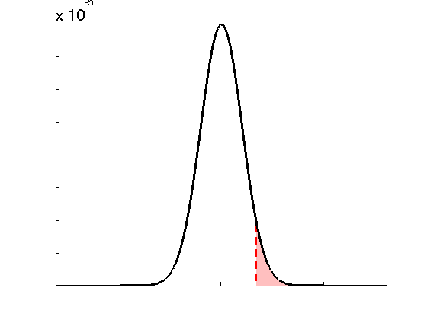
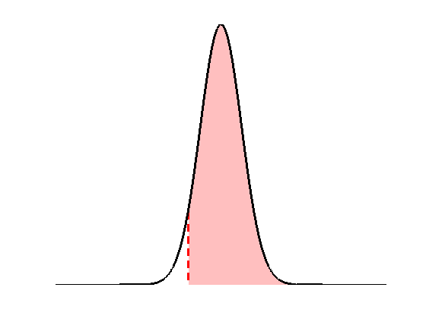










Frequentist (or: orthodox, classical) versus Bayesian inference: parameter estimation
Classical
Bayesian
• define the null, e.g.:
$$H_{0}:θ=0$$
• invert model (obtain posterior pdf)
$$p\left(t | H_{0}\right)$$
$$p\left(θ | y\right)$$
$$p\left(H_{0} | y\right)$$
$$p\left(t>t^{∗} | H_{0}\right)$$
$$t≡t\left(Y\right)$$
$$t^{∗}$$
• estimate parameters (obtain test stat.)
• define the null, e.g.:
$$H_{0}:θ>0$$
• apply decision rule, i.e.:
• apply decision rule, i.e.:
if
$$p\left(t>t^{∗} | H_{0}\right)≤α$$
then reject H₀
if
$$p\left(H_{0} | y\right)≥α$$
then accept H₀

Slide 24
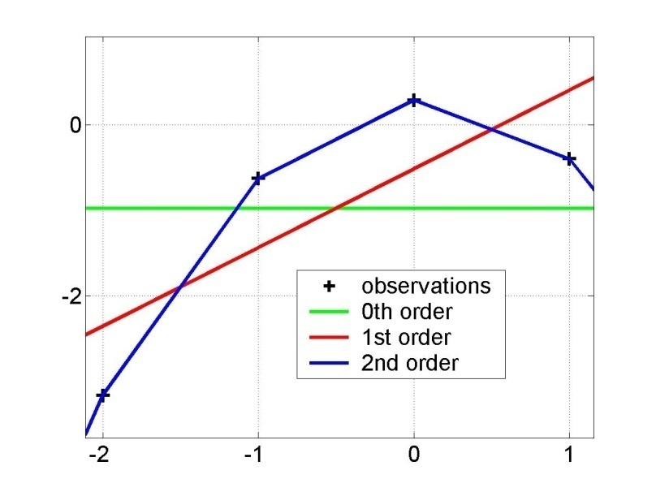
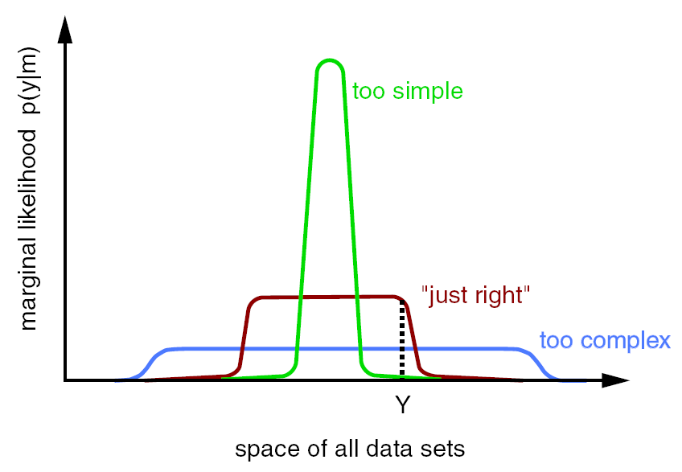
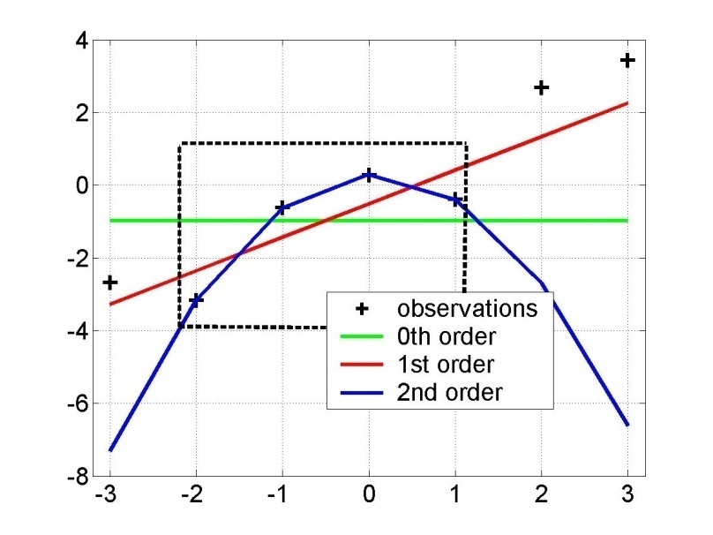
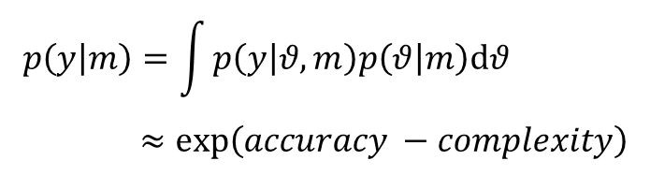
Model comparison
Principle of parsimony: «plurality should not be assumed without necessity»
Automatically enforced by Bayesian model comparison
Model evidence:
$$p\left(y | m\right)=\int{p\left(y | θ,m\right)p\left(θ | m\right)dθ} \\ ≈exp\left(accuracy −complexity\right)$$
y = f(x)
“Occam’s razor” :
x
model evidence p(y|m)
y=f(x)
space of all data sets

Slide 25
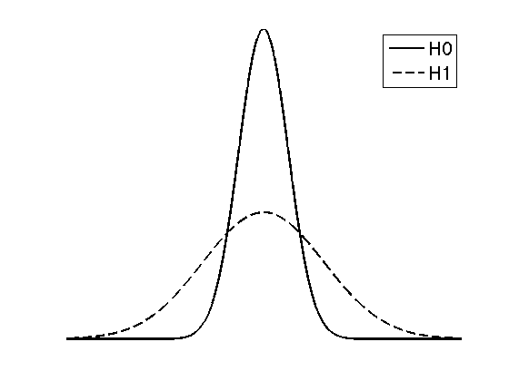
Frequentist (or: orthodox, classical) versus Bayesian inference: model comparison
• Define the null and the alternative hypothesis in terms of priors, e.g.:
space of all datasets
• Apply decision rule, i.e.:
if
then reject H₀

Slide 26
Applications of Bayesian inference

Slide 27



segmentation
and normalisation
posterior probability
maps (PPMs)
dynamic causal
modelling
multivariate
decoding
realignment
smoothing
general linear model
statistical
inference
Gaussian
field theory
normalisation
p <0.05
template

Slide 28
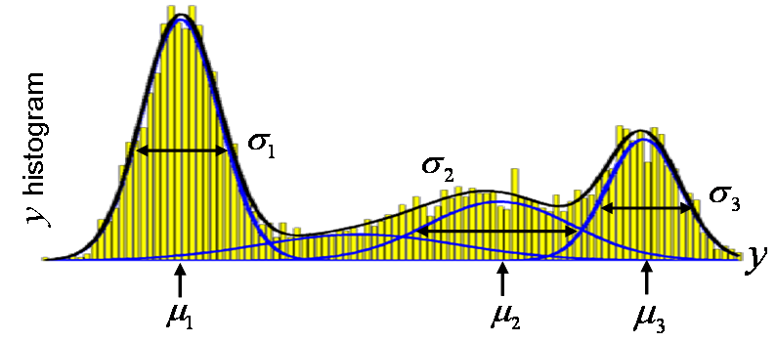
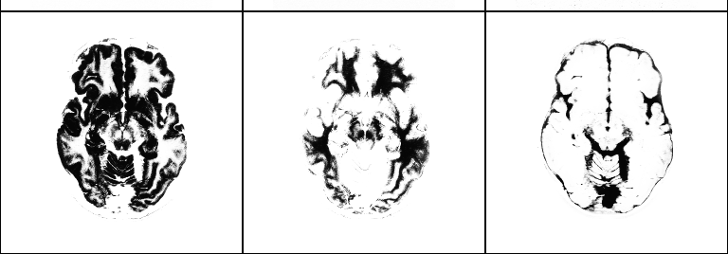
Segmentation (mixture of Gaussians-model)
class variances
…
i^{th} voxel
label
…
i^{th} voxel
value
class
frequencies
class
means
grey matter
white matter
CSF

Slide 29
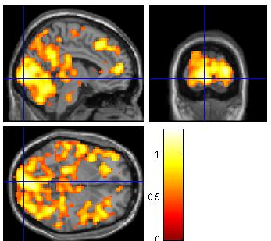
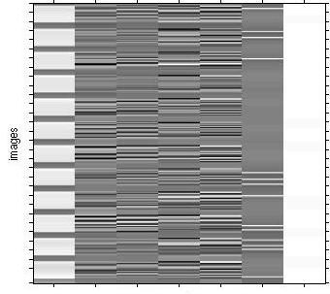
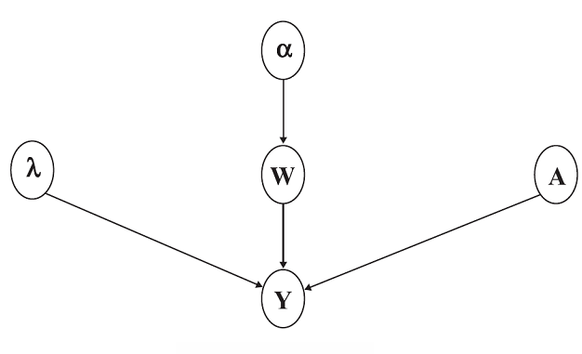
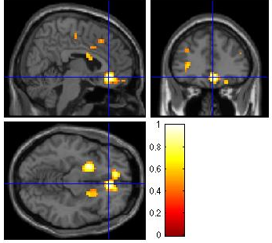
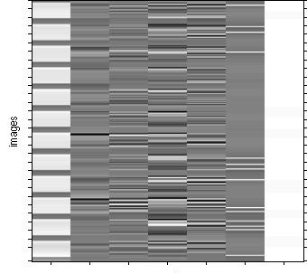
fMRI time series analysis
PPM: regions best explained
by short-term memory model
short-term memory
design matrix (X)
prior variance
of GLM coeff
prior variance
of data noise
AR coeff
(correlated noise)
GLM coeff
PPM: regions best explained by long-term memory model
fMRI time series
long-term memory
design matrix (X)

Slide 30
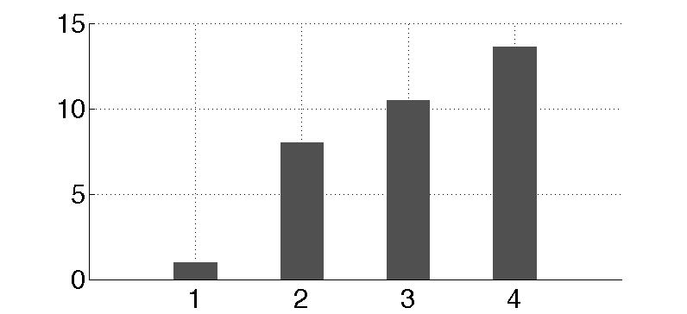
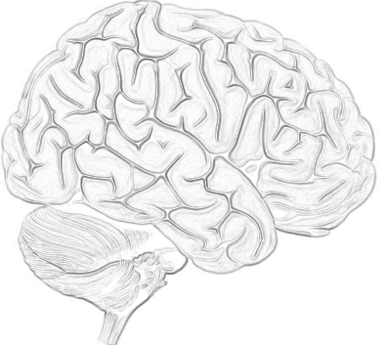
Dynamic causal modeling (DCM)
m₁
m₂
m₃
m₄
attention
attention
attention
attention
PPC
PPC
PPC
PPC
stim
V1
V5
stim
V1
V5
stim
V1
V5
stim
V1
V5
attention
models marginal likelihood
0.10
estimated
effective synaptic strengths
for best model (m₄)
15
PPC
0.39
10
1.25
0.26
stim
0.26
V1
0.13
V5
5
0.46
0
m₁
m₂
m₃
m₄

Slide 31
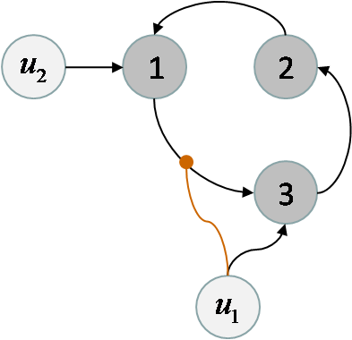
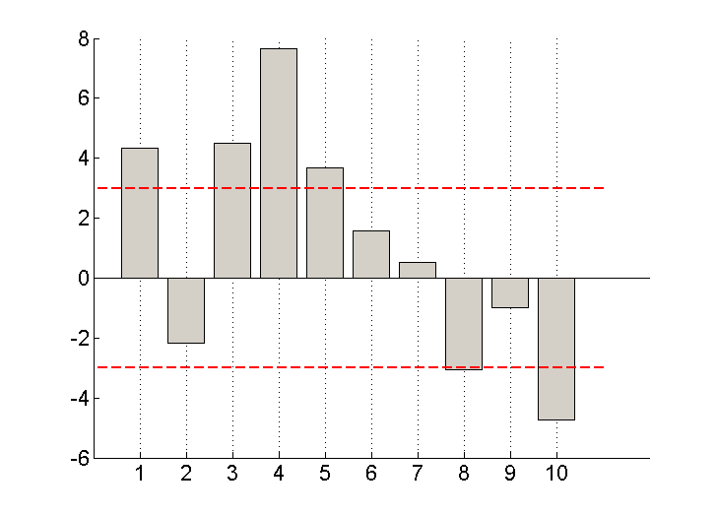
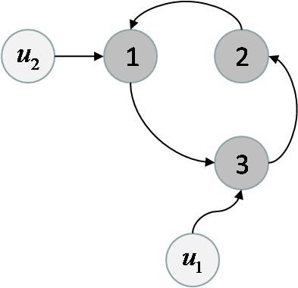
Model comparison for group studies
m₁
differences in log- model evidences
m₂
subjects
Fixed effect
Assume all subjects correspond to the same model
Random effect
Assume different subjects might correspond to different models

Slide 32
Thanks

