Slide 1
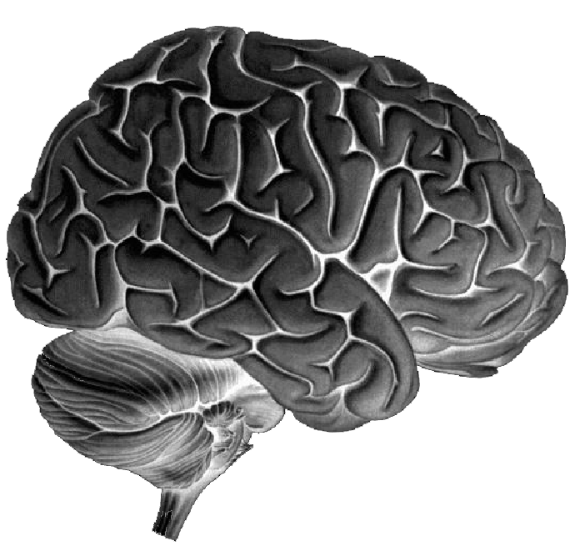
Dynamic Causal Modelling for fMRI
Rosalyn Moran
Virginia Tech Carilion Research Institute
Department of Electrical & Computer Engineering, Virginia Tech
ION Short Course, 15th – 17th May 2014
Notes:
Light blue RGB: 129 154 183
Purple: 173 35 63
Bullet points RGB: 69 87 129
Other stuff: 38 88 144
Text: 65 88 125

Slide 2
Dynamic Causal Modelling
DCM framework was introduced in 2003 for fMRI by Karl Friston, Lee Harrison and Will Penny (NeuroImage 19:1273-1302)
part of the SPM software package
>300 papers published

Slide 3
Overview
Dynamic causal models (DCMs)
  Basic idea
  Neural level
  Hemodynamic level
  Parameter estimation, priors & inference
Applications of DCM to fMRI data
  Attention to motion in the visual system
  Modelling synesthesia
  The Status Quo Bias
Notes:
Here is a quick overview of what I will be talking about today. First I will discuss what we mean by brain connectivity, and will touch upon a couple of definitions and ways of measuring brain connectivity. Then I will talk about the theory behind DCM, and I will finish with some examples of simulations and a practical example

Slide 4
Overview
Dynamic causal models (DCMs)
  Basic idea
  Neural level
  Hemodynamic level
  Parameter estimation, priors & inference
Applications of DCM to fMRI data
  Attention to motion in the visual system
  Modelling synesthesia
  The Status Quo Bias
Notes:
Here is a quick overview of what I will be talking about today. First I will discuss what we mean by brain connectivity, and will touch upon a couple of definitions and ways of measuring brain connectivity. Then I will talk about the theory behind DCM, and I will finish with some examples of simulations and a practical example

Slide 5
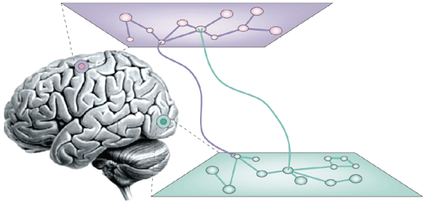
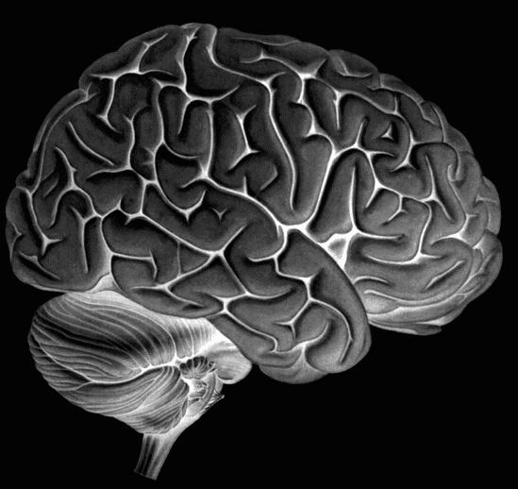
Principles of organisation: complementary approaches
Functional Specialisation
Functional Integration
Notes:
The principle of functional specialisation is well established in functional neuroimaging, and rests on a much longer tradition of lesion studies where specific impairments follow lesions in certain regions. The question of functional specialisation is the question which regions respond to what experimental input.
It is clear that all these processes need to be integrated to eventually result into actions. For example, conflicting motivations that may involve very different parts of your brain. How do you decide whether to get up and raid your fridge, or to continue writing your next grant application? You need to integrate very different short and long term goals. So you need to integrate processes taking part in different parts of your brain.
The question of functional integration is a more recent one, and addresses how regions influence each other, so a question of brain connectivity. Functional specialisation and integration are not exclusive but complementary: each makes sense only in context of the other. In this session we will look different ways of looking at functional integration in functional neuroimaging.

Slide 6
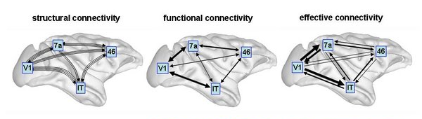
Structural, functional & effective connectivity
Sporns 2007, Scholarpedia
anatomical/structural connectivity
presence of axonal connections
functional connectivity
statistical dependencies between regional time series
effective connectivity
causal (directed) influences between neurons or neuronal populations
Mechanism - free
Mechanistic
Notes:
Here are different classes of connectivity displayed on a macaque brain. So, anatomical or structural connectivity is simply the presence of axonal connections. Functional connectivity is defined as statistical dependencies between regional timeseries. So this is something that is specific to a particular point in time, but is not directional, they are simply correlations (hence the bidirectional arrows). Finally, effective connectivity describes causal influences between neuronal populations, so specifically how one region influences another region.

Slide 7
Functional vs Effective Connectivity
Functional connectivity is defined in terms of statistical dependencies: an operational concept that underlies the detection of a functional connection, without any commitment to how that connection was caused
Assessing mutual information & testing for significant departures from zero
Simple assessment: patterns of correlations
Undirected or Directed Functional Connectivity eg. Granger Connectivity
Effective connectivity is defined at the level of hidden neuronal states generating measurements. Effective connectivity is always directed and rests on an explicit (parameterised) model of causal influences — usually expressed in terms of difference (discrete time) or differential (continuous time) equations.
DCM
SEM

Slide 8
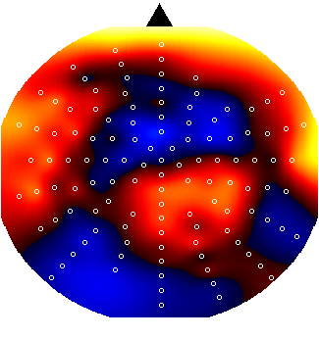
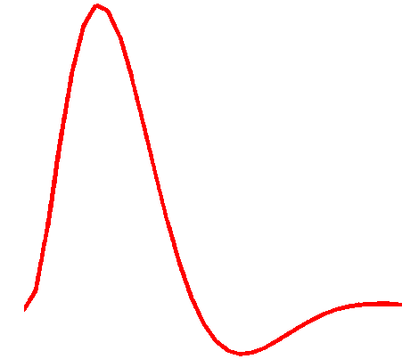
Dynamic Causal Modelling (DCM)
Hemodynamic
forward model:
neural activity→BOLD
Electromagnetic
forward model:
neural activity→EEG
MEG
LFP
Neural state equation:
fMRI
EEG/MEG
simple neuronal model
complicated forward model
complicated neuronal model
simple forward model

Slide 9
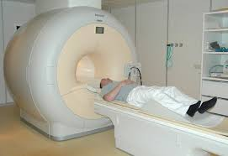
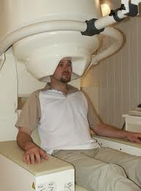
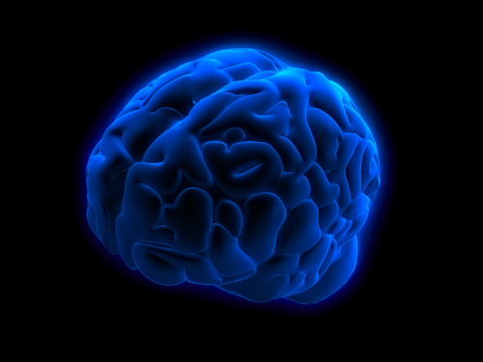
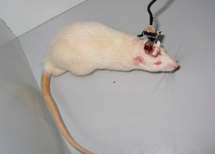
Dynamic Causal Modelling
DCM is not intended for ‘modelling’
DCM is an analysis framework for empirical data
DCM does not describe a time series
DCM uses a times series to test mechanistic hypotheses
Hypotheses are constrained by the underlying dynamic generative (biological) model
Time Series
Friston et al 2003; Stephan et al 2008
Kiebel et al, 2006; Garrido et al, 2007
David et al, 2006; Moran et al, 2007

Slide 10
Deterministic DCM for fMRI
y
y
H{2}
x₂
H{1}
A(2,2)
A(2,1)
x₁
A(1,2)
C(1)
B(1,2)
u1
A(1,1)
u2
Notes:
The elements of this connectivity matrix are not a function of the input, and can be considered as an endogenous or condition-invariant. Second, the elements of B^{(j)} represent the changes of connectivity induced by the inputs, u_{j}. These condition-specific modulations or bilinear terms B^{(j)} are usually the interesting parameters. The endogenous and condition-specific matrices are mixed to form the total connectivity or Jacobian matrix I. Third, there is a direct exogenous influence of each input u_{j} on each area, encoded by the matrix C. The parameters of this system, at the neuronal level, are given by θ^{n} ⊇ A, B¹,…, B^{Nu}, C. At this level, one can specify which connections one wants to include in the model. Connections (i.e., elements of the matrices) are removed by setting their prior mean and variance to zero. We will illustrate this later.

Slide 11
Overview
Dynamic causal models (DCMs)
  Basic idea
  Neural level
  Hemodynamic level
  Parameter estimation, priors & inference
Applications of DCM to fMRI data
  Attention to motion in the visual system
  Modelling synesthesia
  The Status Quo Bias
Notes:
Here is a quick overview of what I will be talking about today. First I will discuss what we mean by brain connectivity, and will touch upon a couple of definitions and ways of measuring brain connectivity. Then I will talk about the theory behind DCM, and I will finish with some examples of simulations and a practical example

Slide 12
Neuronal model
Aim: model temporal evolution of a set of neuronal states x_{t}
System states x_{t}
State changes are dependent on:
  the current state x
  external inputs u
  its connectivity θ
x1
x2
x3
Inputs u_{t}
Connectivity parameters θ
Notes:
What is this cognitive system at the neuronal level that we want to look at? Well, we want to model the temporal evolution of a set of neuronal states, or nodes in our model. This is a very general approach, from engineering, to model sets of interacting nodes
So z_{n}(t) is the hidden level, which we can not observe using fMRI, and it represents a simple model of neuronal dynamics for a system of n coupled regions.
Then we have the change of the state vector in time that depends on the interaction between the elements z, u, θ, ...
Overall, DCM models the temporal evolution of the neuronal state vector as a function of the current state z, the inputs u, and some parameters θ – that define the functional architecture and interactions among brain regions at a neuronal level.

Slide 13
Example: a linear model of interacting visual regions
Visual input in the visual field
- left (LVF)
- right (RVF)
LG = lingual gyrus
FG = fusiform gyrus
x₃
FG
left
FG
right
x₄
x₁
LG
left
LG
right
x₂
RVF
u₂
LVF
u₁

Slide 14
Example: a linear model of interacting visual regions
Visual input in the visual field
- left (LVF)
- right (RVF)
LG = lingual gyrus
FG = fusiform gyrus
x₃
FG
left
FG
right
x₄
x₁
LG
left
LG
right
x₂
RVF
u₂
LVF
u₁

Slide 15
Example: a linear model of interacting visual regions
Visual input in the visual field
- left (LVF)
- right (RVF)
LG = lingual gyrus
FG = fusiform gyrus
x₃
FG
left
FG
right
x₄
x₁
LG
left
LG
right
x₂
RVF
u₂
LVF
u₁
state
changes
effective
connectivity
system
state
input
parameters
external
inputs

Slide 16
Example: a linear model of interacting visual regions
x₃
FG
left
FG
right
x₄
x₁
LG
left
LG
right
x₂
RVF
u₂
LVF
u₁
ATTENTION
u₃

Slide 17
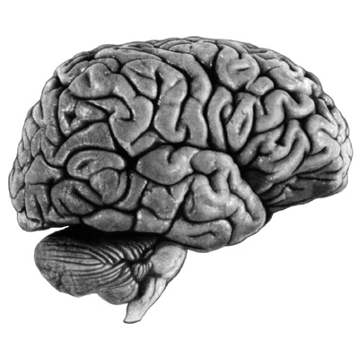
Deterministic Bilinear DCM
Simply a two-dimensional
taylor expansion (around x₀=0, u₀=0):
driving
input
modulation
Bilinear state equation:

Slide 18
DCM parameters = rate constant
x₁
Decay function
1
A
If A→B is 0.10 s⁻¹ this means that, per unit time, the increase in activity in B corresponds to 10% of the current activity in A
0.8
0.6
0.10
0.4
0.2
B
0
-0.1
0
0.1
0.2
0.3
0.4
0.5
0.6
0.7
0.8
0.9
Notes:
So what are the parameters in this model? Let me explain this to you with the simplest DCM possible: A node with a selfconnection.
If I want to look at the temporal dynamics
There is a generic solution to such a system of linear differential equations: if we integrate the equation we get an gives an exponential function, where the self connection strength s a is inversely proportion to the half life tau of x(t). So if we have an input that boosts z1 to go up to I (i.e. z0 = 1), then over time, with a negative self-connection, activity in Z will go down.
The self-connection determines the half life of z(t), and thus describes the speed of the change
So the coupling parameters are rate constants that describes the speed of the exponential change in z(t). This means that if the connection from A→B is 0.1 hz, this means that, per unit time, the increase in activity in B corresponds to 10% of the activity in A
Let me actually show how that works visually, but now for 2 nodes

Slide 19
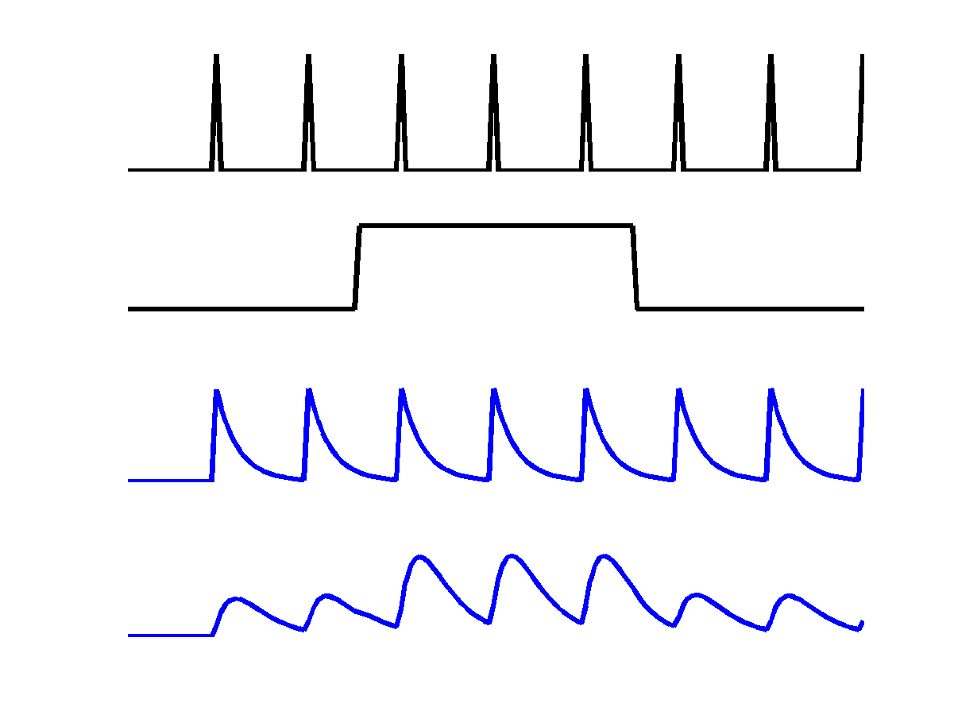
Example: context-dependent enhancement
stimulus u₁
u₁
context u₂
x₁
u₂
x₁
x₂
x₂
Notes:
Now we make this system a little bit more complicated: we actually add a modulatory connection, which is a context-dependent input that modulates the influence of z1 on z2.

Slide 20
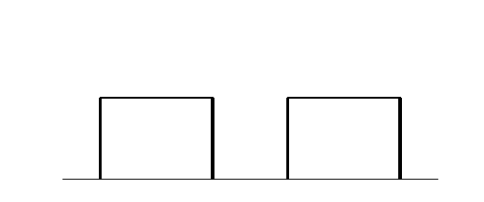
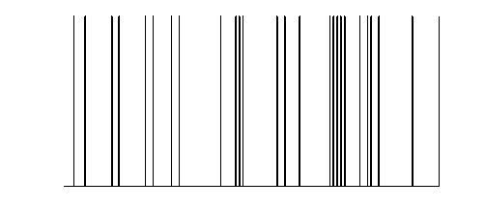
DCM for fMRI: the full picture
BOLD
y
y
y
y
λ
hemodynamic
model
activity
z₂(t)
activity
z₃(t)
activity
z₁(t)
z
Neuronal states
integration
modulatory
input u₂(t)
Neural state equation
driving
input u₁(t)
endogenous connectivity
t
modulation of
connectivity
t
direct inputs
Stephan & Friston (2007), Handbook of Brain Connectivity
Notes:
Here is the same concept displayed differently once more. So we have discussed the neural state equation, with the endogenous connectivity A, the modulation of the connectivity B and the direct inputs C. But we can’t directly measure the output of this model: what we measure is the BOLD response, so we have to pass the predicted neural timeseries through a hemodynamic model to get the predicted BOLD response

Slide 21
Overview
Dynamic causal models (DCMs)
  Basic idea
  Neural level
  Hemodynamic level
  Parameter estimation, priors & inference
Applications of DCM to fMRI data
  Attention to motion in the visual system
  Modelling synesthesia
  The Status-Quo Bias
Notes:
Here is a quick overview of what I will be talking about today. First I will discuss what we mean by brain connectivity, and will touch upon a couple of definitions and ways of measuring brain connectivity. Then I will talk about the theory behind DCM, and I will finish with some examples of simulations and a practical example

Slide 22
DCM: Neuronal and hemodynamic level
Cognitive system is modelled at its underlying neuronal level (not directly accessible for fMRI).
The modelled neuronal dynamics (x) are transformed into area-specific BOLD signals (y) by a hemodynamic model (λ).
  Overcomes regional variability at the hemodynamic level
  DCM not based on temporal precedence at measurement level
x
λ
y
Notes:
Like I said, the basic idea of DCM for fMRI is that we use a bilinear state equation to model a cognitive system at the neuronal level, which we can’t measure using fMRI, and then the modelled neural dynamics are transformed into area-specific BOLD signals by a hemodynamic forward model.

Slide 23
DCM: Neuronal and hemodynamic level
x
“Connectivity analysis applied directly on fMRI signals failed because hemodynamics varied between regions, rendering temporal precedence irrelevant” ….The neural driver was identified using DCM, where these effects are accounted for…
λ
y
Notes:
Like I said, the basic idea of DCM for fMRI is that we use a bilinear state equation to model a cognitive system at the neuronal level, which we can’t measure using fMRI, and then the modelled neural dynamics are transformed into area-specific BOLD signals by a hemodynamic forward model.

Slide 24
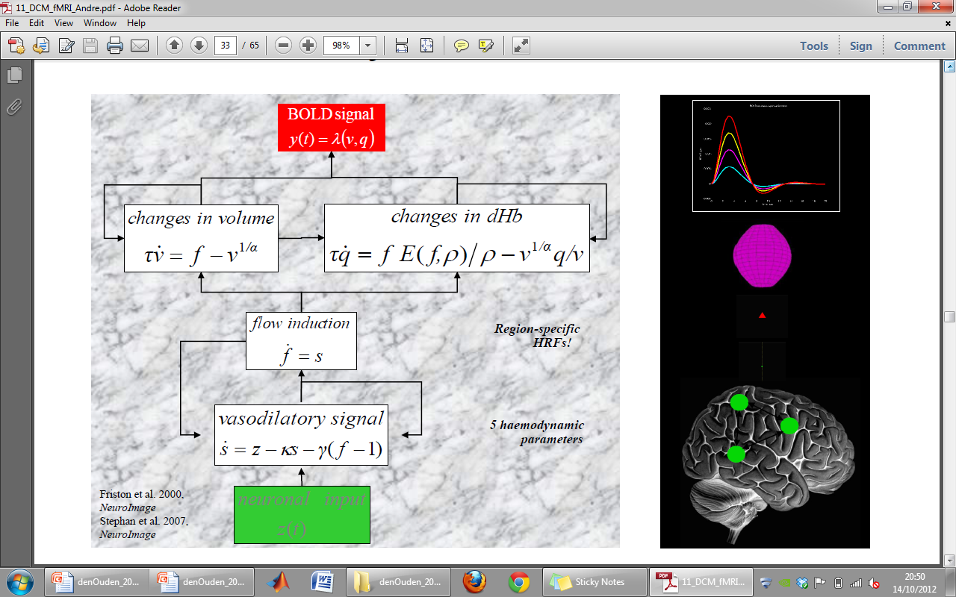
The hemodynamic “Balloon” model
3 hemodynamic parameters
Region-specific HRFs
Important for model fitting, but of no interest
Notes:
Using the first 2 principal components for the 5 hemodynamic parameters, so effectively you estimate 2 params! (delay and height?)

Slide 25
Hemodynamic model
y represents the simulated observation of the bold response, including noise, i.e.
y = h(u,θ)+e
u₁
u₂
BOLD
(with noise added)
z₁
y₁
z₂
y₂
BOLD
(with noise added)
Z: neuronal activity
Y: BOLD response
Notes:
So if we want to compare our neuronal model to the data that we’ve measured, we need to transform the neuronal responses into bold repsonses, which is what we do using a hemodynamic model

Slide 26
How independent are neural and hemodynamic parameter estimates?
A
B
C
θ^{h}
ε
Stephan et al. (2007) NeuroImage

Slide 27
Overview
Dynamic causal models (DCMs)
  Basic idea
  Neural level
  Hemodynamic level
  Parameter estimation, priors & inference
Applications of DCM to fMRI data
  Attention to motion in the visual system
  Modelling synesthesia
  The Status-Quo Bias
Notes:
Here is a quick overview of what I will be talking about today. First I will discuss what we mean by brain connectivity, and will touch upon a couple of definitions and ways of measuring brain connectivity. Then I will talk about the theory behind DCM, and I will finish with some examples of simulations and a practical example

Slide 28
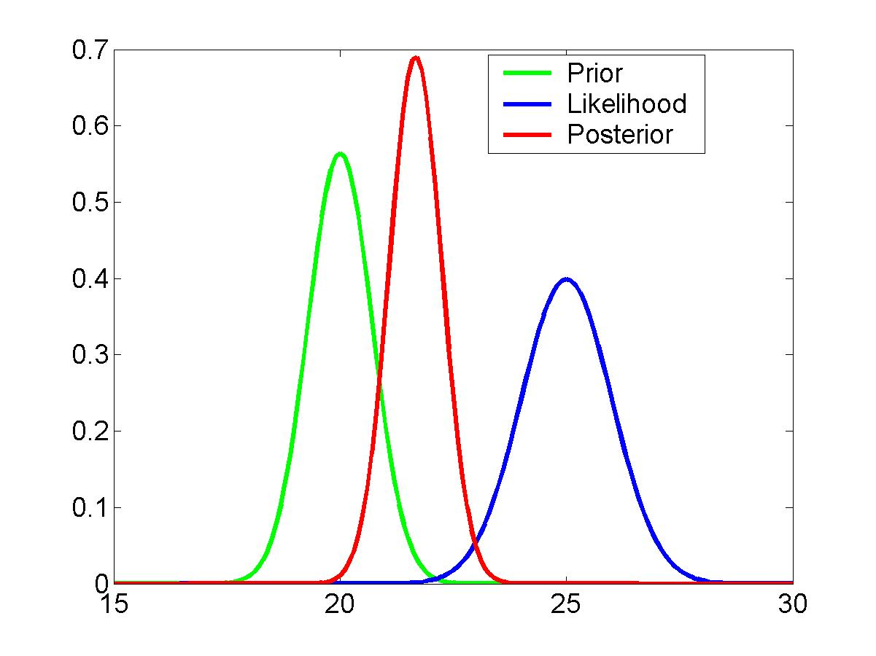
DCM is a Bayesian approach
new data
prior knowledge
posterior ∝ likelihood ∙ prior
parameter estimates
Bayes theorem allows one to formally incorporate prior knowledge into computing statistical probabilities.
Priors in DCM:
empirical, principled & shrinkage priors
The “posterior” probability of the parameters given the data is an optimal combination of prior knowledge and new data, weighted by their relative precision.
Notes:
In DCM we use a bayesian model inversion scheme to estimate the parameters that optimally fit the data. You just hear everything about bayes rule from Jean, and Klaas will say more about this, so I will just briefly touch on this.
To get the posterior probability of the parameters, we combine the new data with our prior knowledge, by weighing them by their relative precision. So what are these priors in DCM?
We have three different types of priors: the hemodynamic priors as I mentioned before, are empirical, i.e. derived from previous studies on the BOLD response. The coupling parameters of the self connections are principled: they are negative, so that we don’t get runaway dynamics. Finally, the priors of the parameters that we are most interested in, the parameters of other connections, are shrinkage priors. Shrinkage priors are basically very conservative priors that will resist the posterior to deviate from zero unless there are very clear effects, to make sure that we will not report any spurious results.
I would say that none of these priors are particularly controversial.

Slide 29
Parameter estimation: Bayesian inversion
Estimate neural & hemodynamic parameters such that the MODELLED and MEASURED BOLD signals are similar (model evidence is optimised), using variational EM under Laplace approximation
... What?
u₁
u₂
y₁
z₁
z₂
y₂
Notes:
Here is an example of the observed and modelled bold signal in the example DCM I showed you before. After the parameters have been optimised the modelled signal fits the data really quite well.

Slide 30
VB in a nutshell (mean-field approximation)
❶ Neg. free-energy approx. to model evidence.
❷ Mean field approx.
❸ Maximise neg. free energy wrt. q = minimise divergence,
by maximising variational energies
❹ Iterative updating of sufficient statistics of approx. posteriors by gradient ascent.

Slide 31
Bayesian inversion
Specify generative forward model
(with prior distributions of parameters)
Regional responses
Variational Expectation-Maximization algorithm
Iterative procedure:
Compute model response using
current set of parameters
Compare model response with data
Improve parameters, if possible
η_{θ|y}
Gaussian posterior distributions of parameters
Model evidence
Notes:
31

Slide 32
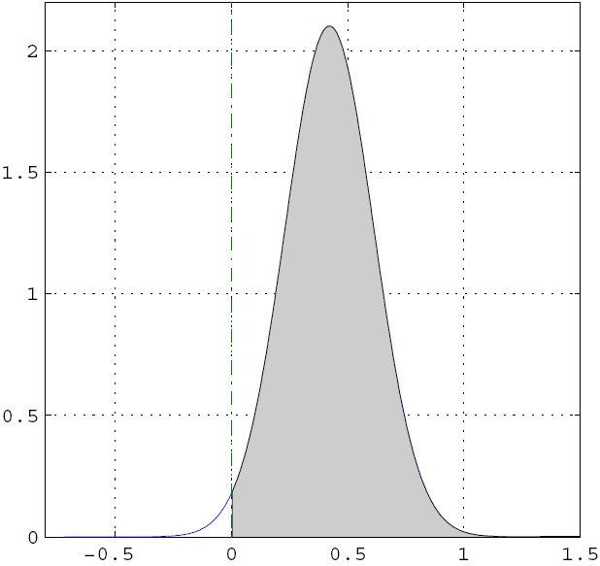
Inference about DCM parameters: Bayesian single subject analysis
Gaussian assumptions about the posterior distributions of the parameters
posterior probability that a certain parameter (or contrast of parameters) is above a chosen threshold γ:
By default, γ is chosen as zero – the prior ("does the effect exist?").
Notes:
Bayes: for doing parameter estimation, and for doing inference about the parameters
For single subject analysis,
Using the assumption that the posterior distributions of the parameters are gaussian, you can use the cumulative normal distribution to calculate the probability that a certain parameter is above a chosen threshold. Usually here we test whether an effect exists at all, so then gamma is chosen to be zero.
If you want to test whether there is consistent effect across groups, we just fit the same model for each subject and then for the parameters that we are interested in, we take the mean of this parameter for each subject and we can just apply classical frequentist statistics to test whether these parameters are consistently diferent from zero, or for example whether one parameter is bigger than another.
Later today Klaas will tell you about how you can compare different DCMs and find out which DCM is optimal in a group of models.

Slide 33
Inference about DCM parameters: Bayesian parameter averaging
FFX group analysis
Likelihood distributions from different subjects are independent
Under Gaussian assumptions, this is easy to compute
Simply ‘weigh’ each subject’s contribution by your certainty of the parameter
group
posterior covariance
individual
posterior covariances
group
posterior mean
individual posterior
covariances and means

Slide 34
Inference about DCM parameters: RFX analysis (frequentist)
Analogous to ‘random effects’ analyses in SPM, 2nd level analyses can be applied to DCM parameters
Separate fitting of identical models for each subject
Selection of parameters of interest
one-sample t-test:
parameter > 0 ?
paired t-test:
parameter 1 >
parameter 2 ?
rmANOVA:
e.g. in case of multiple sessions per subject

Slide 35
Inference about models: Bayesian model comparison
Prior / instead of to inference on parameters
Which of various mechanisms / models best explains my data
Use model evidence
accounts for both accuracy and complexity of the model
allows for inference about structure (generalisability) of the model
Fixed Effects Model selection via
log Group Bayes factor:
Random Effects Model selection
via Model probability:

Slide 36
Bayes factors
For a given dataset, to compare two models, we compare their evidences.
Kass & Raftery 1995, J. Am. Stat. Assoc.
B₁₂ | p(m₁|y) | Evidence
1 to 3 | 50-75% | weak
3 to 20 | 75-95% | positive
20 to 150 | 95-99% | strong
≥ 150 | ≥ 99% | Very strong
Kass & Raftery classification:
or their log evidences
Ketamine modulates:
All extrinsic connections,
Intrinsic NMDA and
Inhibitory / Modulatory processes (one of the red arrows) : use log bayes factors

Slide 37
Bayesian Model Comparison
u₁
The model goodness: Negative Free Energy
u₂
y₁
z₁
Accuracy - Complexity
z₂
y₂
The complexity term of F is higher
  the more independent the prior parameters (↑ effective DFs)
  the more dependent the posterior parameters
  the more the posterior mean deviates from the prior mean

Slide 38
Overview
Dynamic causal models (DCMs)
  Basic idea
  Neural level
  Hemodynamic level
  Parameter estimation, priors & inference
Applications of DCM to fMRI data
  Attention to motion in the visual system
  Modelling synesthesia
  The Status-Quo Bias
Notes:
Here is a quick overview of what I will be talking about today. First I will discuss what we mean by brain connectivity, and will touch upon a couple of definitions and ways of measuring brain connectivity. Then I will talk about the theory behind DCM, and I will finish with some examples of simulations and a practical example

Slide 39
Example 1: Attention to motion
Friston et al. (2003) NeuroImage

Slide 40
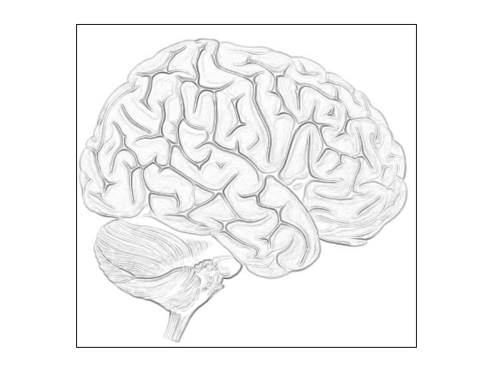
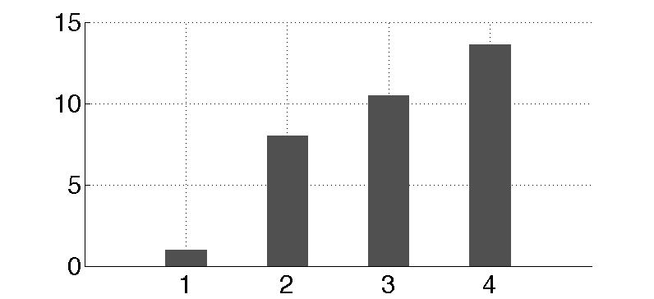
Bayesian model selection
m₁
m₂
m₃
m₄
Modulation
By attention
Modulation
By attention
Modulation
By attention
Modulation
By attention
PPC
PPC
PPC
PPC
External
stim
V1
V5
stim
V1
V5
stim
V1
V5
stim
V1
V5
models marginal likelihood
attention
0.10
PPC
0.39
1.25
0.26
stim
0.26
V1
0.13
V5
0.46
estimated
effective synaptic strengths
for best model (m₄)
Stephan et al. 2008, NeuroImage

Slide 41
Parameter inference
attention
MAP = 1.25
0.10
PPC
0.26
1.25
0.39
stim
0.26
V1
0.13
V5
0.46
0.50
motion
Stephan et al. 2008, NeuroImage

Slide 42
Data fits
motion &
attention
motion &
no attention
static
dots
V1
V5
PPC
observed
fitted

Slide 43
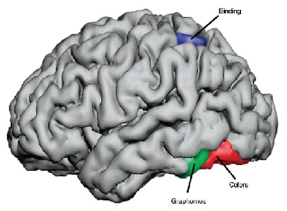
Example 2: Brain Connectivity in Synesthesia
Specific sensory stimuli lead to unusual, additional experiences
Grapheme-color synesthesia: color
Involuntary, automatic; stable over time, prevalence ~4%
Potential cause: aberrant cross-activation between brain areas
  grapheme encoding area
  color area V4
  superior parietal lobule (SPL)
Hubbard, 2007
Can changes in effective connectivity explain synesthesia activity in V4?
Notes:
43
Music can elicit a sensation of color and shapes can elicit tastes

Slide 44
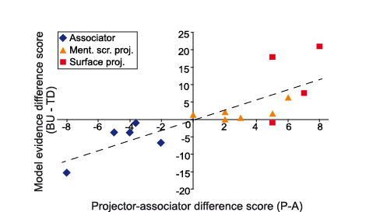
Relative model evidence predicts sensory experience
Van Leeuwen, den Ouden, Hagoort (2011) JNeurosci

Slide 45
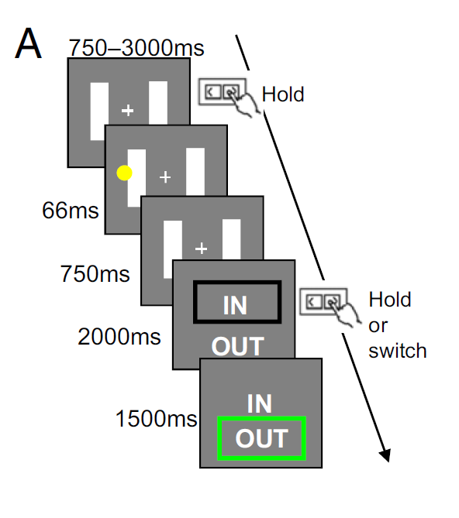
Example 3: The Status-Quo Bias
Decision
Accept Reject
Difficulty
Low High
Fleming et al PNAS 2010
Notes:
45
Music can elicit a sensation of color and shapes can elicit tastes

Slide 46
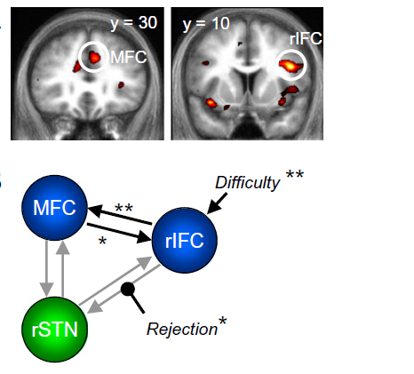
Example 3: The Status-Quo Bias
Decision
Accept Reject
Difficulty
Low High
Main effect of difficulty
in medial frontal and right inferior frontal cortex
Fleming et al PNAS 2010
Notes:
46
Music can elicit a sensation of color and shapes can elicit tastes

Slide 47
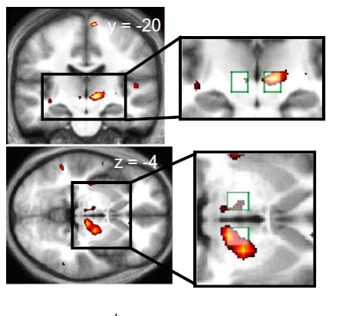
Example 3: The Status-Quo Bias
Decision
Accept Reject
Difficulty
Low High
Interaction of decision and difficulty
in region of subthalamic nucleus:
Greater activity in STN when default is rejected in difficult trials
Fleming et al PNAS 2010
Notes:
47
Music can elicit a sensation of color and shapes can elicit tastes

Slide 48
Example 3: The Status-Quo Bias
DCM: “aim was to establish a possible mechanistic explanation for the interaction effect seen in the STN.
Whether rejecting the default option is reflected in a modulation of connection strength from rIFC to STN, from MFC to STN, or both “…
MFC
rIFC
STN
Fleming et al PNAS 2010
Notes:
48
Music can elicit a sensation of color and shapes can elicit tastes

Slide 49
Example 3: The Status-Quo Bias
Difficulty
Difficulty
MFC
Difficulty
MFC
Difficulty
MFC
rIFC
rIFC
rIFC
Reject
Reject
Reject
STN
STN
STN
Difficulty
Difficulty
MFC
Difficulty
MFC
Difficulty
MFC
rIFC
rIFC
rIFC
STN
STN
Reject
STN
Reject
Reject
Difficulty
Difficulty
MFC
MFC
Difficulty
MFC
Difficulty
rIFC
rIFC
rIFC
Reject
Reject
STN
STN
Reject
Reject
Reject
STN
Reject

Slide 50
Example 3: The Status-Quo Bias
Difficulty
Difficulty
MFC
Difficulty
MFC
Difficulty
MFC
rIFC
rIFC
rIFC
Reject
Reject
Reject
STN
STN
STN
Difficulty
Difficulty
MFC
Difficulty
MFC
MFC
Difficulty
rIFC
rIFC
rIFC
STN
STN
Reject
STN
Reject
Reject
Difficulty
Difficulty
MFC
MFC
Difficulty
MFC
Difficulty
rIFC
rIFC
rIFC
Reject
Reject
STN
STN
Reject
Reject
Reject
STN
Reject

Slide 51
Example 3: The Status-Quo Bias
The summary statistic approach
Effects across subjects consistently greater than zero
P < 0.01 *
P < 0.001 **

Slide 52
Final note 1: The evolution of DCM in SPM
DCM is not one specific model, but a framework for Bayesian inversion of dynamic system models
The default implementation in SPM is evolving over time
  better numerical routines for inversion
  change in priors to cover new variants (e.g., stochastic DCMs, endogenous DCMs etc.)
To enable replication of your results, you should ideally state which SPM version you are using when publishing papers.

Slide 53
Final note 2: GLM vs. DCM
DCM tries to model the same phenomena (i.e. local BOLD responses) as a GLM, just in a different way (via connectivity and its modulation).
No activation detected by a GLM
→ no motivation to include this region in a deterministic DCM.
However, a stochastic DCM could be applied despite the absence of a local activation.
attention
attention
PPC
PPC
stim
V1
V5
stim
V1
V5
Stephan (2004) J. Anat.

Slide 54
Other exciting developments
Nonlinear DCM for fMRI: Could connectivity changes be mediated by another region? (Stephan et al. 2008)
Clustering DCM parameters: Classify patients, or even find new sub-categories (Brodersen et al. 2011Neuroimage)
Embedding computational models in DCMs: DCM can be used to make inferences on parametric designs like SPM (den Ouden et al. 2010, J Neurosci.)
Integrating tractography and DCM: Prior variance is a good way to embed other forms of information, test validity (Stephan et al. 2009, NeuroImage)
Stochastic DCM: Model resting state studies / background fluctuations (Li et al. 2011 Neuroimage, Daunizeau et al. Physica D 2009)

Slide 55
DCM Roadmap
neuronal
dynamics
haemodynamics
state-space
model
priors
posterior
parameters
Bayesian Model
Inversion
fMRI data
model
comparison

Slide 56
Some useful references
10 Simple Rules for DCM (2010). Stephan et al. NeuroImage 52.
The first DCM paper: Dynamic Causal Modelling (2003). Friston et al. NeuroImage 19:1273-1302.
Physiological validation of DCM for fMRI: Identifying neural drivers with functional MRI: an electrophysiological validation (2008). David et al. PLoS Biol. 6 2683–2697
Hemodynamic model: Comparing hemodynamic models with DCM (2007). Stephan et al. NeuroImage 38:387-401
Nonlinear DCM:Nonlinear Dynamic Causal Models for FMRI (2008). Stephan et al. NeuroImage 42:649-662
Two-state DCM: Dynamic causal modelling for fMRI: A two-state model (2008). Marreiros et al. NeuroImage 39:269-278
Stochastic DCM: Generalised filtering and stochastic DCM for fMRI (2011). Li et al. NeuroImage 58:442-457.
Bayesian model comparison: Comparing families of dynamic causal models (2010). Penny et al. PLoS Comput Biol. 6(3):e1000709.
Notes:
Look out for 10 simple rules

Slide 57

Thank you

Slide 58
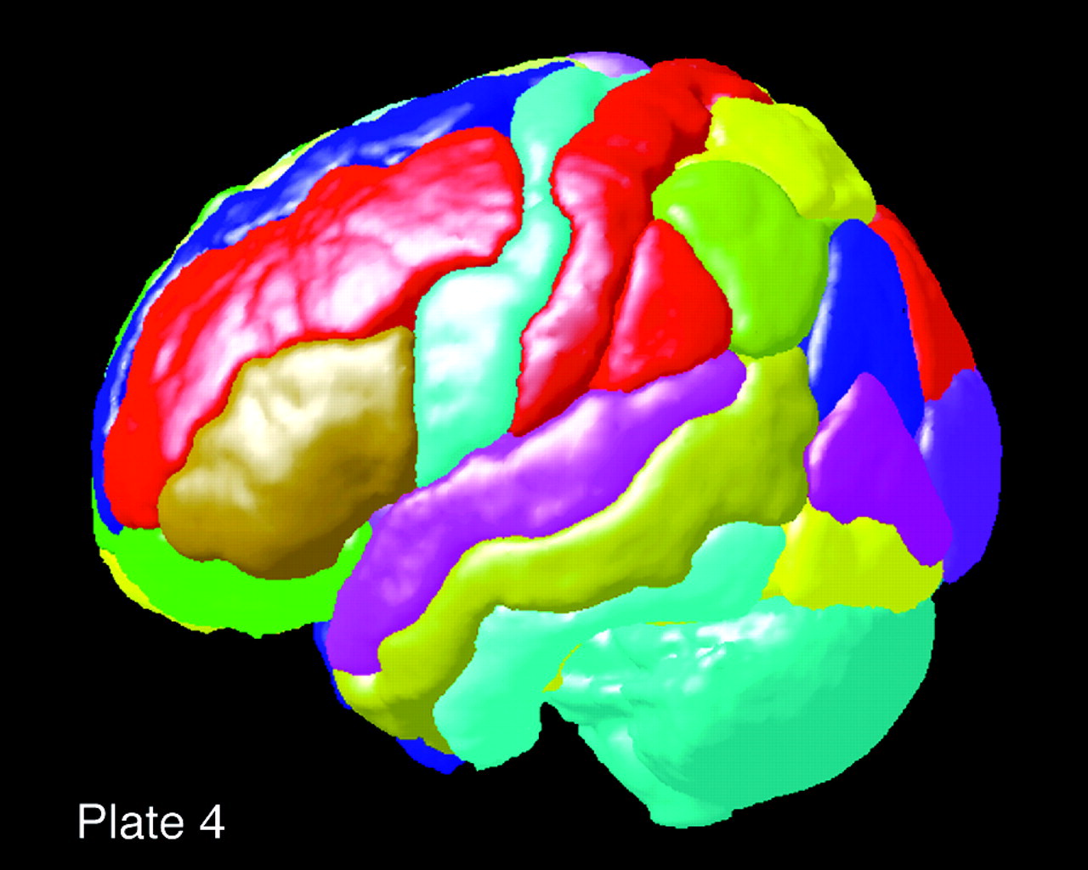
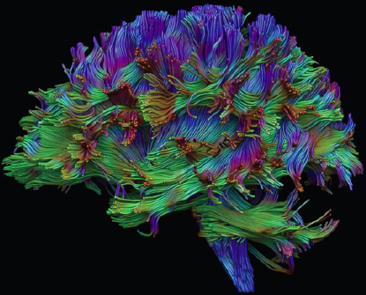
Use anatomical info and computational models to refine DCMs
9
Regions: location of nodes
  Probabilistic cytoarchitectonic atlas (SPM)
  Individual anatomical masks (FSL first)
Connections
  Tract tracing studies in monkeys
  Human DTI data to inform priors on connections (Stephan et al. 2009)
probabilistic
tractography
anatomical
connectivity ϕ
connection-specific priors for coupling params
FG
left
FG
right
LG
left
LG
right

Slide 59
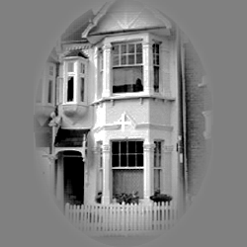
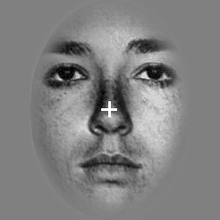
Use anatomical info and computational models to refine DCMs
9
Regions: locations of nodes
  Probabilistic cytoarchitectonic atlas (SPM)
  Individual anatomical masks (FSL first)
Connections
  Tract tracing studies in monkeys
  Human DTI data to inform priors on connections (Stephan et al. 2009)
Regions: modulation of other connections
(den Ouden et al. 2010)
Computational models
  Learning parametrically changes connections
Put
PMd
PPA
FFA

