Slide 1
DCM Advanced, Part II
Will Penny (Klaas Stephan)
Wellcome Trust Centre for Neuroimaging
Institute of Neurology
University College London
SPM Course 2014 @ FIL

Slide 2
Overview
Extended DCM for fMRI: nonlinear, two-state, stochastic
Embedding computational models in DCMs
Clinical Applications

Slide 3
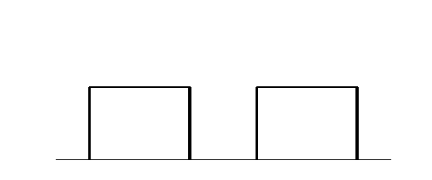
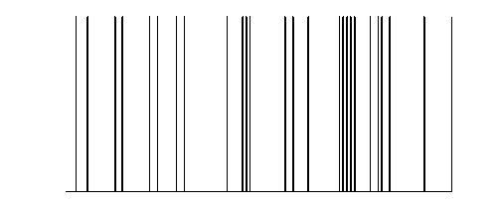
y
y
y
BOLD
y
−
−
λ
−
hemodynamic
model
activity
x₂(t)
activity
x₃(t)
activity
x₁(t)
neuronal
states
x
modulatory
input u₂(t)
integration
driving
input u₁(t)
t
Neural state equation
endogenous connectivity
t
modulation of
connectivity
The classical DCM:
a deterministic, one-state, bilinear model
direct inputs

Slide 4
Factorial structure of model specification in DCM
Three dimensions of model specification:
  bilinear vs. nonlinear
  single-state vs. two-state (per region)
  deterministic vs. stochastic
Specification via GUI.

Slide 5
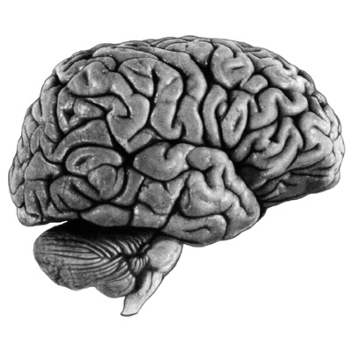
bilinear DCM
non-linear DCM
modulation
driving
input
driving
input
modulation
Two-dimensional Taylor series (around x₀=0, u₀=0):
Bilinear state equation:
Nonlinear state equation:

Slide 6
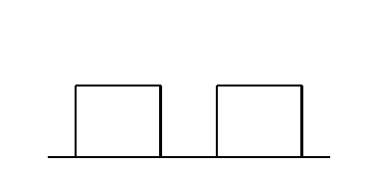
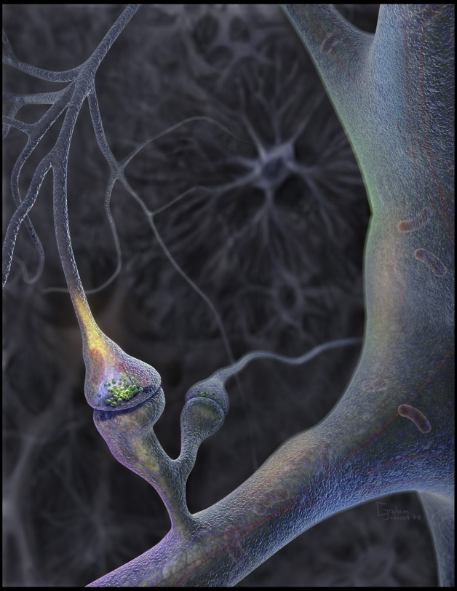
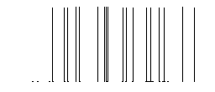
Neural population activity
u₂
u₁
x₃
fMRI signal change (%)
x₁
x₂
Nonlinear dynamic causal model (DCM)
Stephan et al. 2008, NeuroImage

Slide 7
attention
MAP = 1.25
0.10
PPC
0.26
1.25
0.39
stim
0.26
V1
0.13
V5
0.46
0.50
motion
Stephan et al. 2008, NeuroImage

Slide 8
motion &
attention
motion &
no attention
static
dots
V1
V5
PPC
observed
fitted

Slide 9
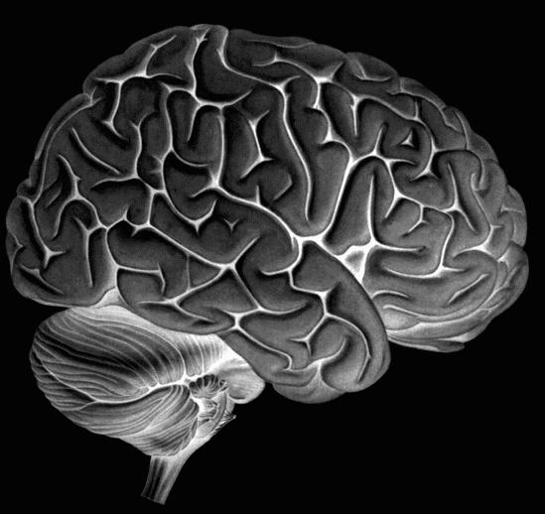
Two-state DCM
Single-state DCM
Two-state DCM
input
Extrinsic (between-region) coupling
Intrinsic (within-region) coupling
Marreiros et al. 2008, NeuroImage

Slide 10
Estimates of hidden causes and states
(Generalised filtering)
Stochastic DCM
random state fluctuations w^{(x)} account for endogenous fluctuations,
fluctuations w^{(v)} induce uncertainty about how inputs influence neuronal activity
can be fitted to resting state data
Li et al. 2011, NeuroImage

Slide 11
Estimates of hidden causes and states
(Generalised filtering)
Stochastic DCM
Good working knowledge of dDCM
sDCMs (esp. for nonlinear models) can have richer dynamics than dDCM
Model selection may be easier than with dDCM
See Daunizeau et al. ‘sDCM: Should we care about neuronal noise ?’, Neuroimage, 2012

Slide 12
Overview
Extended DCM for fMRI: nonlinear, two-state, stochastic
Embedding computational models in DCMs
Clinical Applications

Slide 13


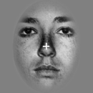

Learning of dynamic audio-visual associations
Conditioning Stimulus
Target Stimulus
1
CS
1
CS
2
0.8
or
or
0.6
p(face)
0.4
CS
TS
Response
0.2
0
200
400
600
800
2000 ± 650
Time (ms)
0
0
200
400
600
800
1000
trial
den Ouden et al. 2010, J. Neurosci.
Notes:
How I intend to study these questions in the future is perhaps best illustrated using a previously published study. Subjects performed a simple discrimination task on faces and houses. They could speed up their responses by learning the predictive strength of immediately preceding auditory cues. To enforce ongoing learning, the associative strength of the auditory cues were changing unpredictably over time.

Slide 14
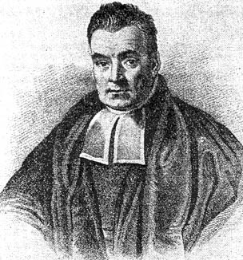
Hierarchical Bayesian learning model
prior on volatility
k
volatility
v_{t-1}
v_{t}
probabilistic association
r_{t}
r_{t+1}
observed events
u_{t}
u_{t+1}
Behrens et al. 2007, Nat. Neurosci.

Slide 15
Explaining RTs by different learning models
Reaction times
1
True
450
Bayes Vol
0.8
HMM fixed
440
HMM learn
RW
430
p(F)
0.6
RT (ms)
420
410
0.4
400
0.2
390
0.1
0.3
0.5
0.7
0.9
0
p(outcome)
400
440
480
Trial
520
560
600
5 alternative learning models:
categorical probabilities
hierarchical Bayesian learner
Rescorla-Wagner
Hidden Markov models
(2 variants)
Bayesian model selection:
hierarchical Bayesian model performs best
den Ouden et al. 2010, J. Neurosci.
Notes:
The behavioral data showed a very nice learning effect: responses accelerated significantly with increasing predictive strengths of the cues. Using Bayesian model selection, we tested which of five commonly used learning models best explained the trial-by-trial reaction times. We found that a hierarchical Bayesian model performed best across the group.

Slide 16

Stimulus-independent prediction error
Putamen
Premotor cortex
p < 0.05
(cluster-level whole- brain corrected)
p < 0.05 (SVC)
0
0
-0.5
-0.5
BOLD resp. (a.u.)
-1
BOLD resp. (a.u.)
-1
-1.5
-1.5
-2
p(F)
p(H)
-2
p(F)
p(H)
den Ouden et al. 2010, J. Neurosci .

Slide 17
Prediction error (PE) activity in the putamen
PE during active
sensory learning
PE during incidental
sensory learning
p < 0.05 (SVC)
den Ouden et al. 2009, Cerebral Cortex
PE during
reinforcement learning
PE = “teaching signal” for synaptic plasticity during learning
O'Doherty et al. 2004, Science
Could the putamen be regulating trial-by-trial changes of
task-relevant connections?

Slide 18
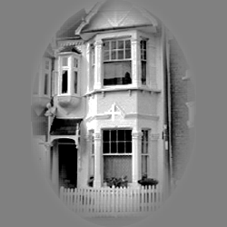

Prediction errors control plasticity during adaptive cognition
Hierarchical Bayesian learning model
Modulation of visuo-motor connections by striatal prediction error activity
Influence of visual areas on premotor cortex:
  stronger for surprising stimuli
  weaker for expected stimuli
PUT
p = 0.010
p = 0.017
PMd
PPA
FFA
den Ouden et al. 2010, J. Neurosci .
Notes:
There is a longstanding hypothesis by several learning theories that synaptic plasticity should be determined by prediction errors. We tested this hypothesis by embedding the computational learning model into a DCM of interactions between visual and motor cortex. Specifically, we used the Bayesian model to represent how trial-by-trial prediction error activity in the putamen gated the information flow from stimulus-specific visual areas to the premotor cortex. Indeed, we found that the strength of the visuo-motor connections increased with trial-specific prediction error.

Slide 19
Overview
Extended DCM for fMRI: nonlinear, two-state, stochastic
Embedding computational models in DCMs
Clinical Applications

Slide 20
Model-based predictions for single patients
model structure
BMS
set of
parameter estimates
model-based decoding
Notes:
Overall, Bayesian model selection is a generic and powerful procedure that has found widespread application in machine learning and neuroimaging. However, as every method, it has limitations and there are cases when it cannot be used at all. For these cases, we have been developing a new approach which we colloquially refer to as “model-based decoding”. This approach rests on using a model for theory-guided dimensionality reduction and selecting those data features which are used subsequently for classification. Here, different models can be compared, by cross-validation, in terms of how well their parameters preserve information about the relevant class labels.

Slide 21
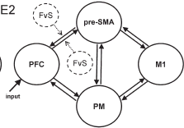
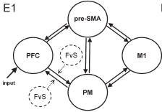
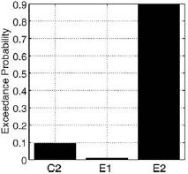
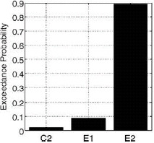
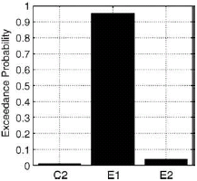
BMS: Parkison‘s disease and treatment
Age-matched controls
PD patients
on medication
PD patients
off medication
Rowe et al. 2010,
NeuroImage
Selection of action modulates
connections between PFC and SMA
DA-dependent functional disconnection
of the SMA

Slide 22
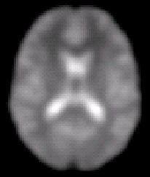





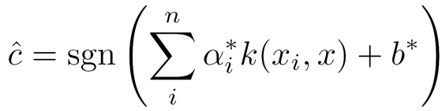
Model-based decoding by generative embedding
step 1 —
model inversion
A
step 2 —
kernel construction
A → B
A → C
B → B
B → C
B
C
measurements from an individual subject
subject-specific
inverted generative model
subject representation in the generative score space
A
step 4 —
interpretation
step 3 —
support vector classification
B
C
jointly discriminative
model parameters
separating hyperplane fitted to discriminate between groups
Brodersen et al. 2011, PLoS Comput. Biol.

Slide 23
Model-based decoding of disease status: mildly aphasic patients (N=11) vs. controls (N=26)
Connectional fingerprints from a 6-region DCM of auditory areas during speech perception
Brodersen et al. 2011, PLoS Comput. Biol.

Slide 24
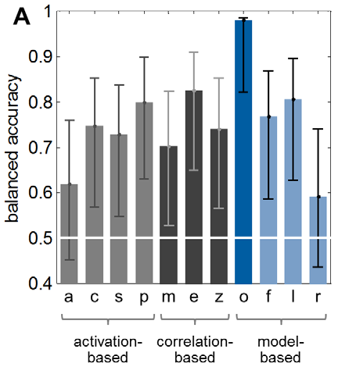
Model-based decoding of disease status: aphasic patients (N=11) vs. controls (N=26)
Classification accuracy
PT
PT
HG
(A1)
HG
(A1)
MGB
MGB
auditory stimuli
Brodersen et al. 2011, PLoS Comput. Biol.

Slide 25
Multivariate searchlight
classification analysis
Generative embedding
using DCM

Slide 26
Summary
Model Selection
Extended DCM for fMRI: nonlinear, two-state, stochastic
Embedding computational models in DCMs
Clinical Applications

