Slide 1
The M/EEG inverse problem
Gareth R. Barnes

Slide 2
Format
What is an inverse problem
Prior knowledge- links to popular algorithms.
Validation of prior knowledge/ Model evidence

Slide 3
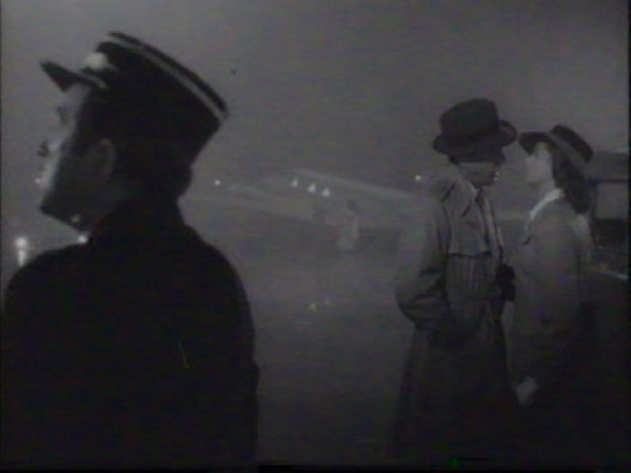
Inverse problems aren’t difficult

Slide 4
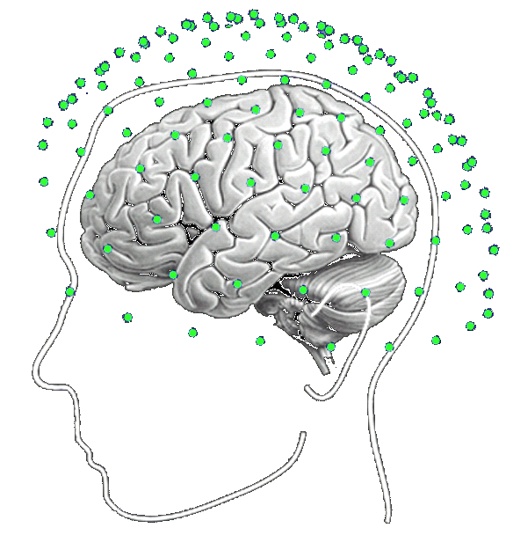
The forward problem
Prediction
M/EEG
sensors
Lead fields (determined by head model) describe the sensitivity of an M/EEG sensor to a dipolar source at a particular location
Lead fields (L)
Head Model
Dipolar source
Model describes
conductivity & geometry

Slide 5
Measurement (Y)
Prediction ( )
Forward
problem
Inverse problem
M/EEG sensors
Prior info
brain
?
Current density
Estimate

Slide 6
Measurement (Y)
Prediction ( )
Inverse problem
M/EEG sensors
Forward
problem
brain
?
Prior info
Current density
Estimate

Slide 7
Inversion depends on choice of source covariance matrix
(prior information)
sources
Sensor Noise
(known)
Lead field
(known)
sources
Source covariance matrix,
One diagonal element per source
Prior information

Slide 8
Single dipole fit
Y (measured field)
PREDICTED
Inverse problem
Prior info (source covariance)

Slide 9
Y (measured field)
Single dipole fit
PREDICTED
Inverse problem
Prior info (source covariance)

Slide 10
Y (measured field)
Two dipole fit
PREDICTED
Inverse problem
Prior info (source covariance)

Slide 11
Y (measured field)
Minimum norm
PREDICTED
Inverse problem
Prior info (source covariance)

Slide 12
Beamformer
Y (measured field)
PREDICTED
Inverse problem
Projection
onto
lead field*
Prior info (source covariance)
*Assuming no correlated sources

Slide 13
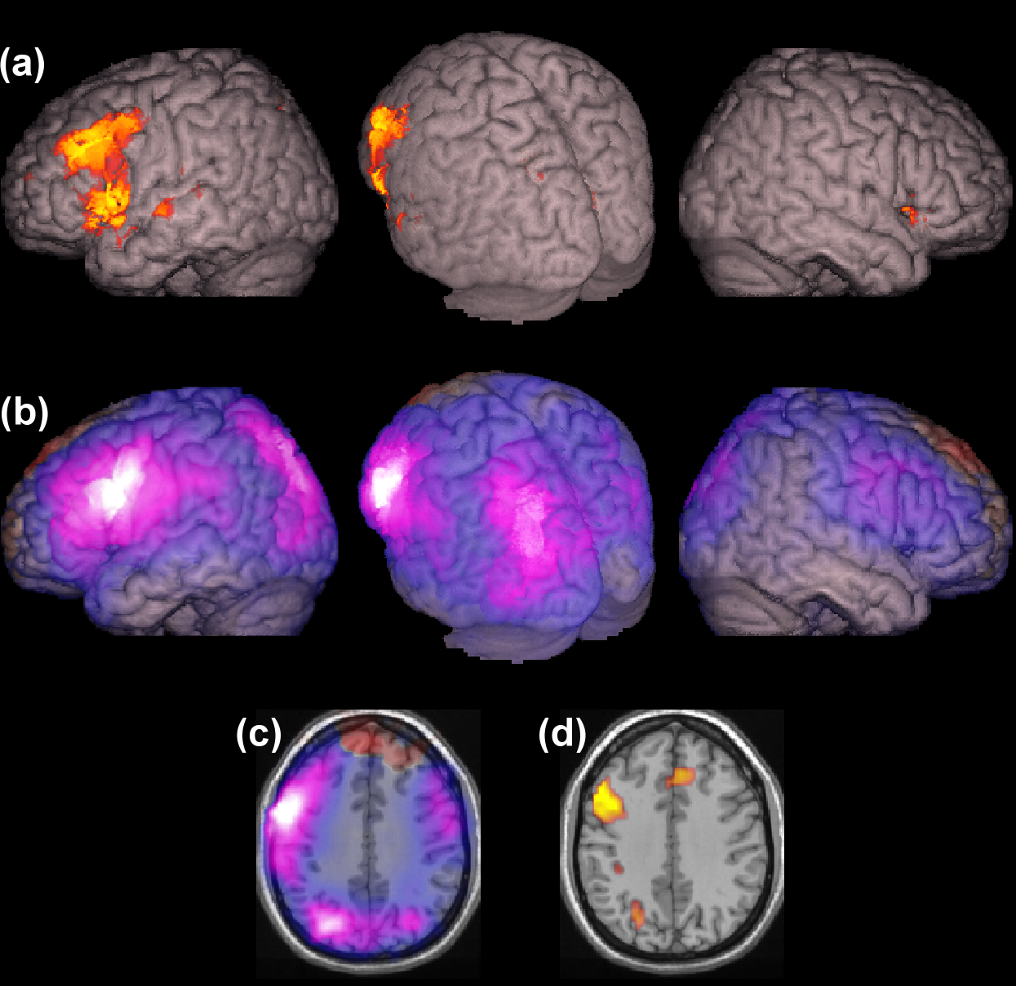
fMRI biased dSPM
(Dale et al. 2000)
Y (measured field)
PREDICTED
Inverse problem
Prior info (source covariance)
fMRI data
Maybe…

Slide 14
Some popular priors
SAM,DICs
Beamformer
Minimum norm
Dipole fit
LORETA
fMRI biased
dSPM
?

Slide 15
Summary
MEG inverse problem requires prior information in the form of a source covariance matrix.
Different inversion algorithms- SAM, DICS, LORETA, Minimum Norm, dSPM… just have different prior source covariance structure.
Historically- different MEG groups have tended to use different algorithms/acronyms.
See
Mosher et al. 2003, Friston et al. 2008, Wipf and Nagarajan 2009, Lopez et al. 2013

Slide 16
Software
SPM12: http://www.fil.ion.ucl.ac.uk/spm/software/spm12/
DAiSS- SPM12 toolbox for Data Analysis in Source Space (beamforming, minimum norm and related methods), developed by collaboration of UCL, Oxford and other MEG centres.https://code.google.com/p/spm-beamforming-toolbox/
Fieldtrip : http://fieldtrip.fcdonders.nl/
Brainstorm:http://neuroimage.usc.edu/brainstorm/
MNE: http://martinos.org/mne/stable/index.html

Slide 17
Which priors should I use ?
Compare to other modalities..
Use model comparison… rest of the talk.
fMRI
Singh et al. 2002
MEG
beamformer

Slide 18
Y (measured field)
How do we chose between priors ?
Prior
Variance
explained
11 % 96% 97% 98%

Slide 19

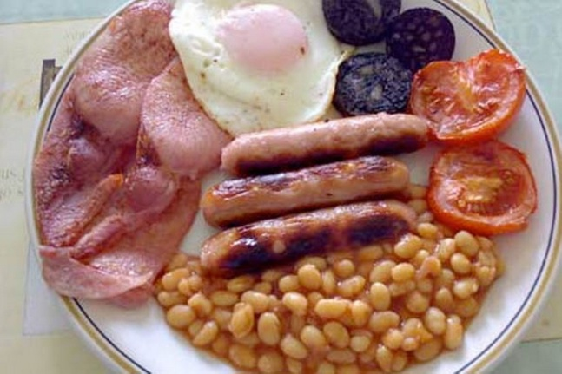
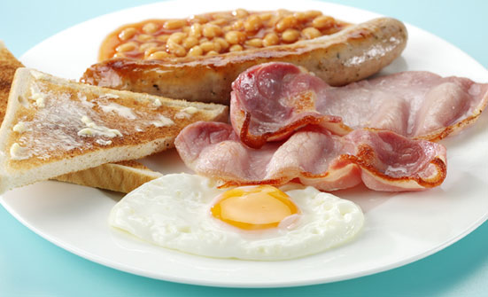

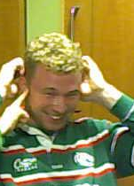
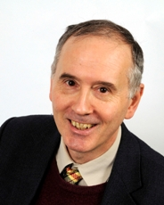
Measurement (Y)
Prediction ( )
Inverse problem
Forward
problem
Eyes
Estimated
recipe
True recipe
J

Slide 20
Use prior info (possible ingredients)
Measurement (Y)
Prediction ( )
Inverse problem
Forward
problem
Prior info (source covariance)
Diagonal elements correspond
to ingredients

Slide 21
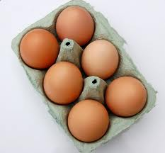
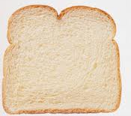
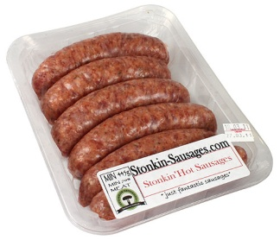
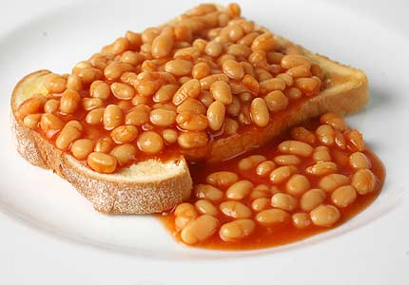

Possible priors
A
B
C

Slide 22
Which is most likely prior (which prior has highest evidence) ?
Measurement (Y)
Prediction ( )
Inverse problem
Forward
problem
Prior info (source covariance)
A
?
B
C

Slide 23

Consider 3 generative models
P(Y)
Evidence
Area under
each curve=1.0
Space of possible datasets (Y)
Complexity

Slide 24
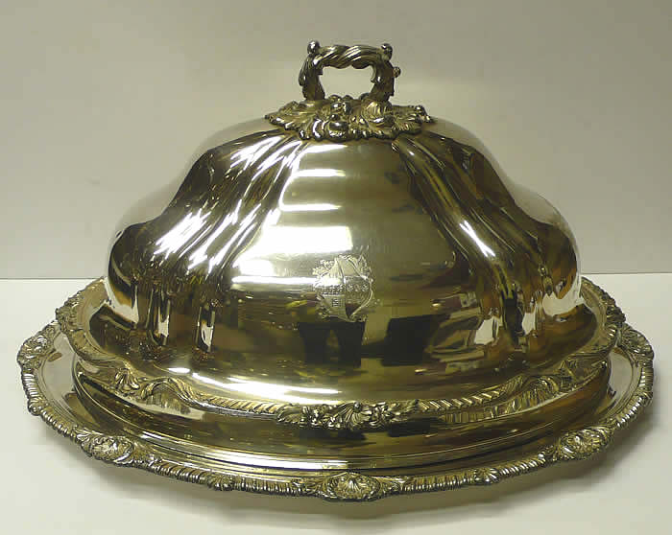
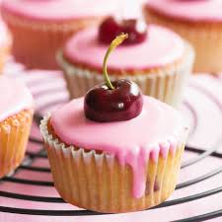
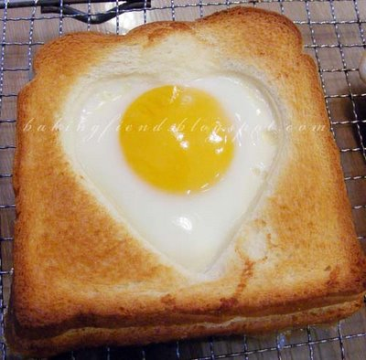
Cross validation or prediction of unknown data
Prediction ( )
Measurement (Y)
Inverse problem
Forward
problem
Prior info (source covariance)
A
?
B
C

Slide 25
Polynomial fit example
4 parameter fit
y
Training data
2 parameter fit
x
The more parameters in the model the more accurate the fit
(to training data).

Slide 26
Polynomial fit example
4 parameter fit
y
test data
2 parameter fit
x
The more parameters the more accurate the fit to training data,
but more complex model may not generalise to new (test) data.

Slide 27
Fit to training data
Training data
O
x
More complex model fits training data better

Slide 28
Fit to test data
O
x
Simpler model fits test data better

Slide 29
Relationship between model evidence and cross validation
Random priors
log
Cross validation error
Can be approximated analytically…

Slide 30
How do we chose between priors ?
Prior
Log model
evidence

Slide 31
Muliple Sparse Priors (MSP), Champagne
Candidate Priors
Prior to maximise model evidence
λ1
λ2
+
λ3
λn

Slide 32
Multiple Sparse priors
So now construct the priors to maximise model evidence
(minimise cross validation error).
Accuracy
Free Energy
Compexity

Slide 33
Conclusion
MEG inverse problem can be solved.. If you have some prior knowledge.
All prior knowledge encapsulated in a source covariance matrix.
Can test between priors (or develop new priors) using cross validation or Bayesian framework.

Slide 34
References
Mosher et al., 2003
J. Mosher, S. Baillet, R.M. Leahi
Equivalence of linear approaches in bioelectromagnetic inverse solutions
IEEE Workshop on Statistical Signal Processing (2003), pp. 294–297
Friston et al., 2008
K. Friston, L. Harrison, J. Daunizeau, S. Kiebel, C. Phillips, N. Trujillo-Barreto, R. Henson, G. Flandin, J. Mattout
Multiple sparse priors for the M/EEG inverse problem
NeuroImage, 39 (2008), pp. 1104–1120
Wipf and Nagarajan, 2009
D. Wipf, S. Nagarajan
A unified Bayesian framework for MEG/EEG source imaging
NeuroImage, 44 (2009), pp. 947–966

Slide 35
Thank you
Karl Friston
Jose David Lopez
Vladimir Litvak
Guillaume Flandin
Will Penny
Jean Daunizeau
Christophe Phillips
Rik Henson
Jason Taylor
Luzia Troebinger
Chris Mathys
Saskia Helbling
And all SPM developers

Slide 36


Analytical approximation to model evidence
Free energy= accuracy- complexity

Slide 37
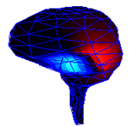
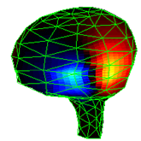
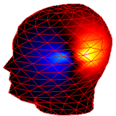
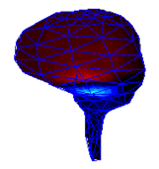
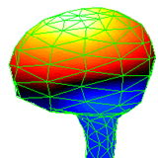
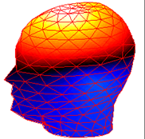
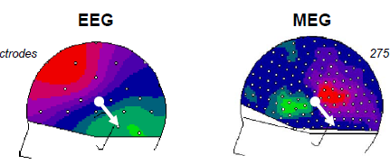
What do we measure with EEG & MEG ?
From a single source to the sensor: MEG
MEG
EEG

