Slide 1
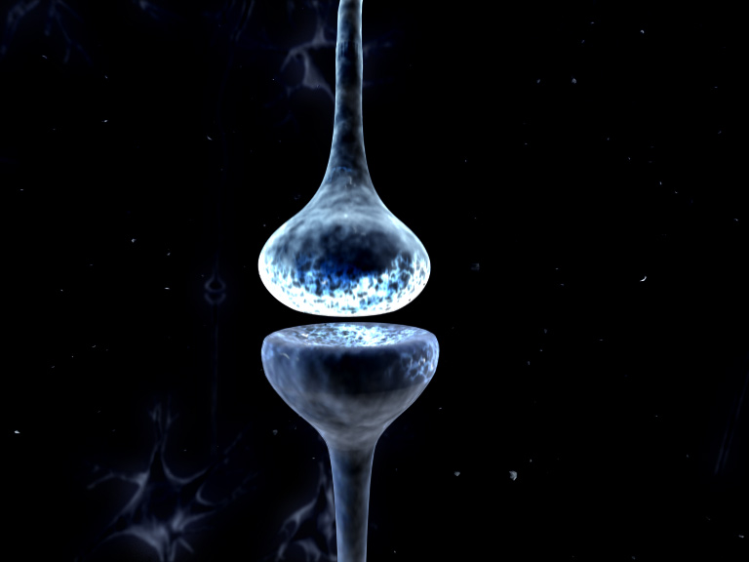
Dynamic Causal Modelling
For Cross-Spectral Densities
Rosalyn Moran
Virginia Tech Carilion Research Institute
Bradley Department of Electrical & Computer Engineering
Department of Psychiatry and Behavioral Medicine, VTC School of Medicine

Slide 2
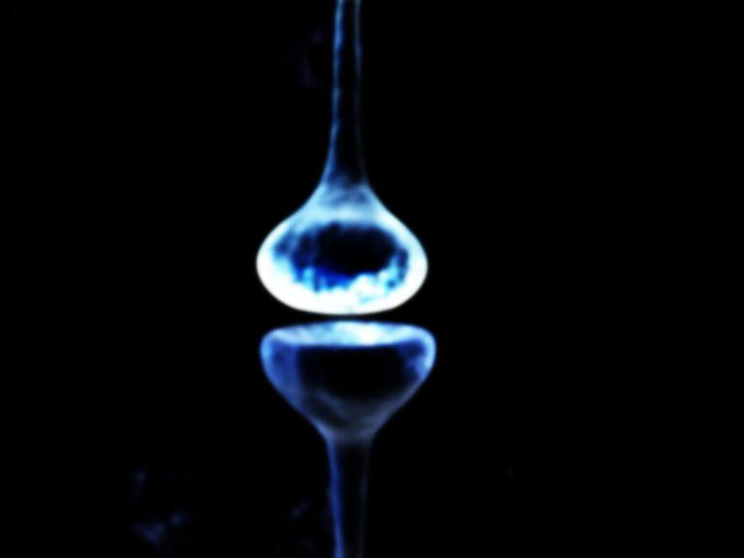
Outline
Data Features in DCM for CSD
Generative Models in the time domain
Generative Models in the frequency domain
DCM Inversion procedure
Example 1: L-Dopa Modulations of theta spectra using DCM for CSD
Example 2: Propofol Modulations of Delta and Gamma spectra using DCM for CSD

Slide 3
Outline
Data Features in DCM for CSD
Generative Models in the time domain
Generative Models in the frequency domain
DCM Inversion procedure
Example 1: L-Dopa Modulations of theta spectra using DCM for CSD
Example 2: Propofol Modulations of Delta and Gamma spectra using DCM for CSD

Slide 4
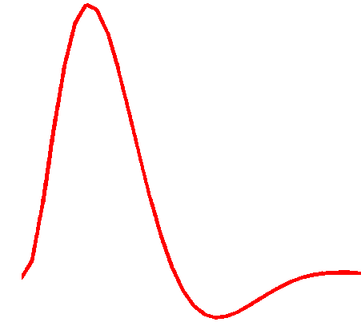
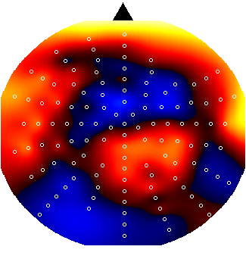
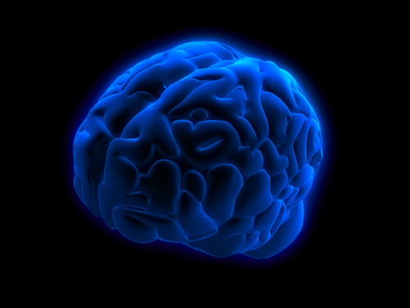
Dynamic Causal Modelling: Generic Framework
Hemodynamic
forward model:
neural activity BOLD
Time Domain Data
Resting State Data
Electromagnetic
forward model:
neural activity EEG
MEG
LFP
Time Domain ERP Data
Phase Domain Data
Time Frequency Data
Spectral Data
Neural state equation:
fMRI
EEG/MEG
detailed neuronal model
(synaptic time scales)
simple neuronal model
(slow time scale)

Slide 5
Dynamic Causal Modelling: Generic Framework
“theta”
Electromagnetic
forward model:
neural activity EEG
MEG
LFP
Time Domain ERP Data
Phase Domain Data
Time Frequency Data
Spectral Data
Hemodynamic
forward model:
neural activity BOLD
Time Domain Data
Resting State Data
Power (mV²)
Frequency (Hz)
Neural state equation:
fMRI
EEG/MEG
detailed neuronal model
(synaptic time scales)
simple neuronal model
(slow time scale)

Slide 6
DCM for Steady State Responses
Under linearity and stationarity assumptions, the model’s biophysical parameters (e.g. post-synaptic receptor density and time constants) prescribe the cross-spectral density of responses measured directly (e.g. local field potentials) or indirectly through some lead-field (e.g. electroencephalographic and magnetoencephalographic data).

Slide 7
Steady State
Statistically:
A “Wide Sense Stationary” signal has 1st and 2nd moments that do not vary with respect to time
Dynamically:
A system in steady state has settled to some equilibrium after a transient
Data Feature:
Quasi-stationary signals that underlie Spectral Densities in the Frequency Domain

Slide 8
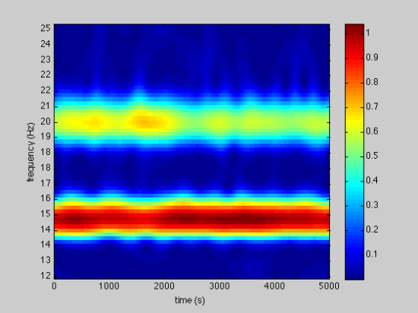
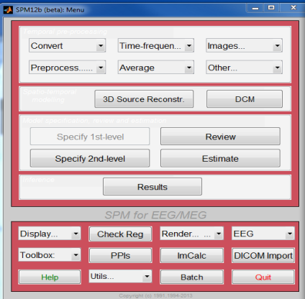

Dynamic Causal Modelling: Framework
Empirical Data
Competing Hypotheses (Models)
Explanandum
Generative Model
Bayesian Inversion
Optimization
under model constraints
Model Structure/ Model Parameters

Slide 9
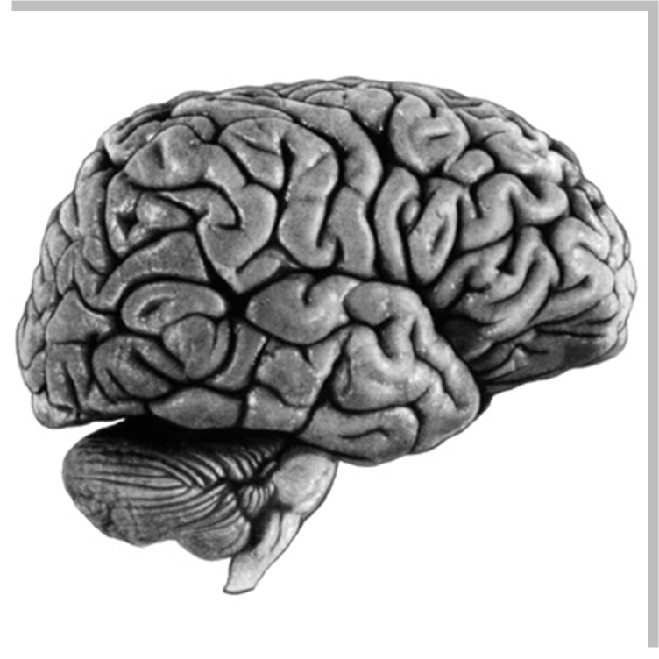
Spectral Densities
Spectral Density in Source 1
30
25
20
Power (uV²)
15
10
5
0
0
5
10
15
20
25
30
Frequency (Hz)
30
Spectral Density in Source 2
25
Power (uV²)
20
15
10
5
0
0
5
10
15
20
25
30
Frequency (Hz)

Slide 10
Spectral Densities
30
25
Cross-Spectral Density between Sources 1 & 2
Power (uV²)
20
15
Spectral Density in Source 1
10
30
5
25
0
0
5
10
15
20
25
30
20
Frequency (Hz)
Power (uV²)
15
10
5
0
0
5
10
15
20
25
30
Frequency (Hz)
30
Spectral Density in Source 2
25
Power (uV²)
20
15
10
5
0
0
5
10
15
20
25
30
Frequency (Hz)

Slide 11
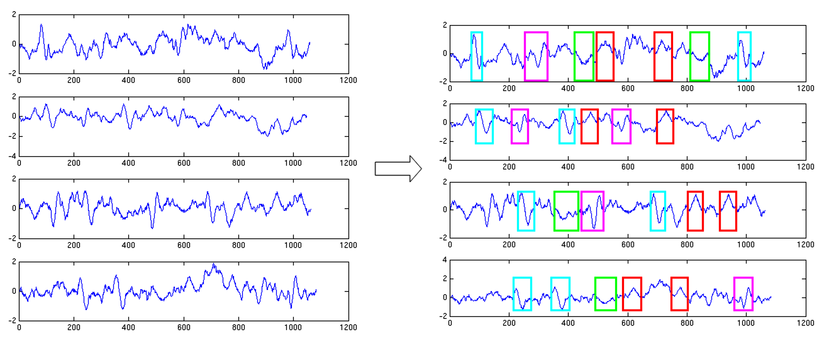
Cross Spectral Density: The Data
1
EEG - MEG – LFP Time Series
2
Cross Spectral Density
3
1
2
4
3
1
2
3
4
4
A few LFP channels or EEG/MEG spatial modes

Slide 12
Cross Spectral Density: The Data
Autoregressive Model used to extract spectral representations from data
Imaginary Numbers Retained
Averaged over trial types
Default order 8
AR coefficients prescribe the spectral densities
Real and
Imaginary
Data features

Slide 13
Outline
Data Features in DCM for CSD
Generative Models in the time domain
Generative Models in the frequency domain
DCM Inversion procedure
Example 1: L-Dopa Modulations of theta spectra using DCM for CSD
Example 2: Propofol Modulations of Delta and Gamma spectra using DCM for CSD

Slide 14
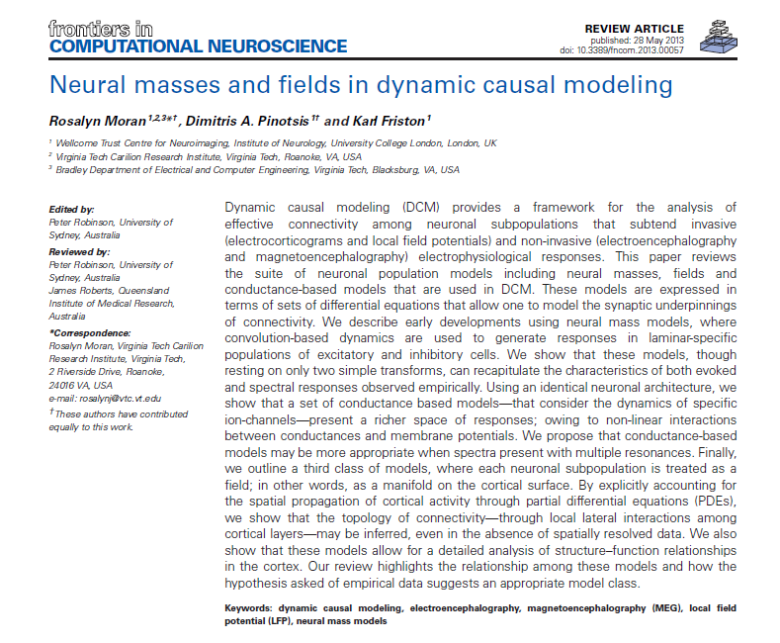
A selection of intrinsic architectures in SPM
A suite of neuronal population models including neural masses, fields and conductance-based models…expressed in terms of sets of differential equations

Slide 15


Neural Mass Models in DCM
EEG/MEG/LFP
signal
Properties of tens of thousands of neurons approximated by their average response
Intrinsic Connections
Supragranular Layer
neuronal (source) model
Granular Layer
Infragranular Layer
Internal Parameters
Extrinsic Connections
State equations

Slide 16
Conductance-Based
Neural Mass Models in DCM
Two governing equations: V = IR ……….. Ohms Law
I = C dV/dt ……. for a capacitor
Conductance
Current in
Potential Difference
Noise Term: Since properties of tens of thousands of neurons approximated by their average response

Slide 17
Conductance-Based
Neural Mass Models in DCM
Two governing equations: V = IR ……….. Ohms Law
I = C dV/dt ……. for a capacitor
Conductance
Current in
Potential Difference
Noise Term: Since properties of tens of thousands of neurons approximated by their average response
Time constant: κ
Afferent Spikes :
Strength of connection x σ
Channels already open: g

Slide 18
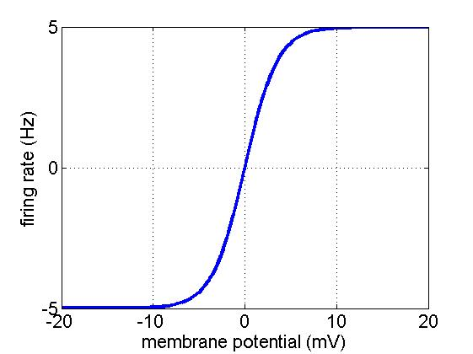
Conductance-Based
Neural Mass Models in DCM
Two governing equations: V = IR ……….. Ohms Law
I = C dV/dt ……. for a capacitor
Conductance
Current in
Potential Difference
Noise Term: Since properties of tens of thousands of neurons approximated by their average response
Time constant: κ
Afferent Spikes :
Strength of connection x σ
Channels already open: g
σ
μ - V

Slide 19

Conductance-Based
Neural Mass Models in DCM
Intrinsic Afferents
Extrinsic Afferents
Notes:
80 – 20 split

Slide 20
Conductance-Based
Neural Mass Models in DCM
Different Neurotransmitters and Receptors?
Different Cell Types in 3/6 Layers?
Notes:
80 – 20 split

Slide 21
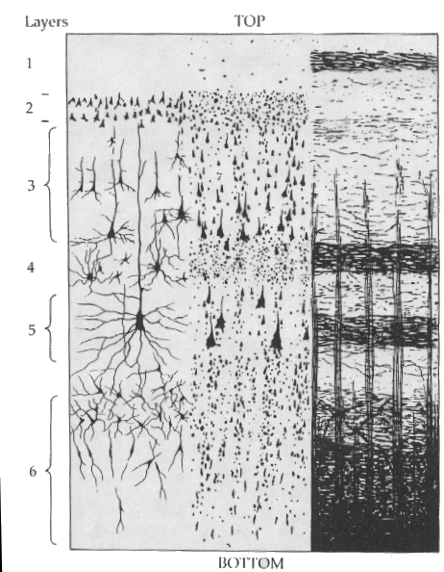
Conductance-Based Neural
Mass Models in DCM
Inhibitory cells in extragranular layers
Inhibitory interneuron
Exogenous input
Excitatory spiny cells in granular layers
Spiny stellate cells
Pyramidal cells
Measured response
Excitatory pyramidal cells in extragranular layers
Current
Conductance
Reversal Pot – Potential Diff
Firing Variance
Unit noise
Conductance
Time Constant
Afferent Firing
No. open channels

Slide 22
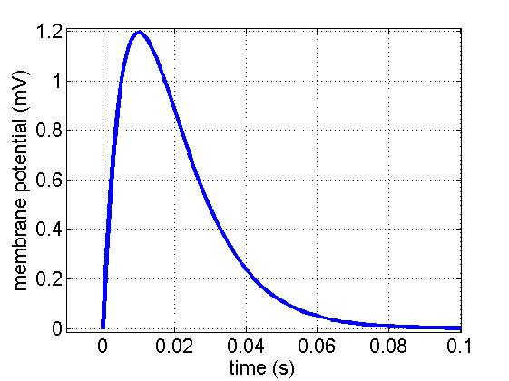
Convolution-Based Neural Mass
Models in DCM
Inhibitory interneuron
Extrinsic Backward Input
Extrinsic Forward Input
Spiny stellate cells
Pyramidal cells
Extrinsic Backward Input
Parameterised Sigmoid
Synaptic Kernel
Maximum
Post Synaptic Potential
H
Intrinsic
connectivity
Inverse
Time
Constant

Slide 23
Convolution-Based Neural Mass
Models in DCM
Inhibitory cells in extragranular layers
Inhibitory interneuron
Extrinsic Backward Input
γ
5
Extrinsic Forward Input
Spiny stellate cells
Excitatory spiny cells being granular layers
Exogenous input
Pyramidal cells
Extrinsic Backward Input
Parameterised Sigmoid
Synaptic Kernel
Maximum
Post Synaptic Potential
H
Excitatory pyramidal
cells in extragranular layers
Intrinsic
connectivity
Measured response
Inverse
Time
Constant

Slide 24
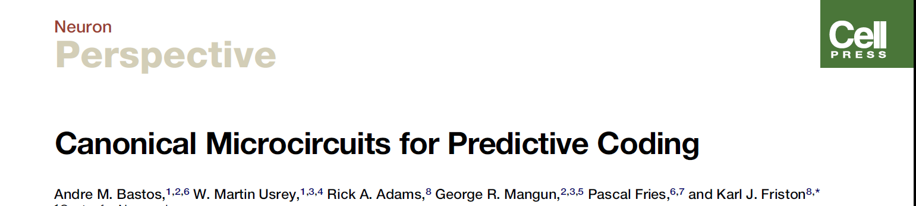
4 population Canonical
Micro-Circuit (CMC)
Inhibitory interneuron
Superficial pyramidal
Forward
Extrinsic Output
Extrinsic Backward Input
Extrinsic Backward Input
Spiny stellate
Extrinsic Forward Input
Extrinsic Forward Input
Spiny stellate
Extrinsic Backward Input
Inhibitory interneuron
Extrinsic Backward Input
Extrinsic Output
Pyramidal cells
Deep pyramidal
Backward
Extrinsic Output
GABA Receptors
AMPA Receptors
NMDA Receptors
4-subpopulation
Canonical Microcircuit
Temporal Derivatives

Slide 25
Outline
Data Features in DCM for CSD
Generative Models in the time domain
Generative Models in the frequency domain
DCM Inversion procedure
Example 1: L-Dopa Modulations of theta spectra using DCM for CSD
Example 2: Propofol Modulations of Delta and Gamma spectra using DCM for CSD

Slide 26
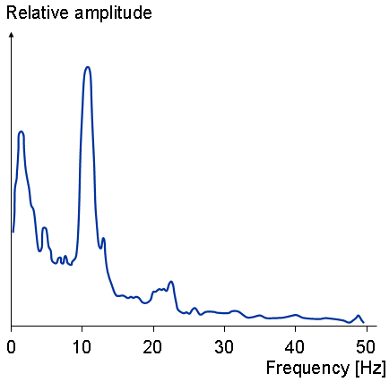
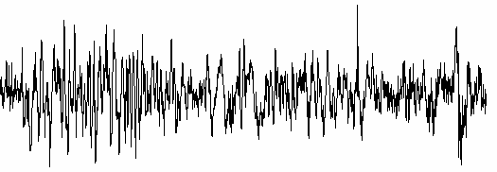
State equations to Spectra
Time Differential
Equations
State Space
Characterisation
Transfer Function
Frequency Domain
Linearise
mV
u: spectral innovations
White and colored noise
Moran, Kiebel, Stephan, Reilly, Daunizeau, Friston (2007) A neural mass model of spectral responses in electrophysiology. NeuroImage

Slide 27
Generative Model of Spectra
Populated According to the neural mass model equations
State Space
Characterisation
The Input State
(Stellate Cells)
The Output State
(Pyramidal Cells)
Moran, Kiebel, Stephan, Reilly, Daunizeau, Friston (2007) A neural mass model of spectral responses in electrophysiology. NeuroImage

Slide 28
Generative Model of Spectra
State Space
Characterisation
Output Spectrum (Y) = Modulation Transfer Function x Spectrum of Innovations
Modulation Transfer Function
An analytic mixture of state space parameters

Slide 29
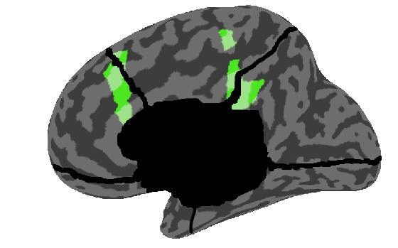


Generative Model of Spectra
Posterior Cingulate Cortex
4
Posterior Cingulate Cortex
4
3.5
6
3
8
2.5
Frequency
Log Power
10
2
12
1.5
14
1
16
0.5
4
5
6
7
8
0
2
4
6
8
10
12
14
16
NMDA connectivty
Frequency
Anterior Cingulate Cortex
Anterior Cingulate Cortex
4
12
6
10
8
Log Power
Frequency
8
10
6
12
4
14
2
16
4
5
6
7
8
NMDA connectivty
0
2
4
6
8
10
12
14
16
Frequency

Slide 30

Observer Model in the Frequency Domain
+ White Noise in Electrodes
Spectrum channel/mode 1
Cross-spectrum modes 1& 2
Power (mV²)
Power (mV²)
Frequency (Hz)
Frequency (Hz)
Power (mV²)
Frequency (Hz)
Spectrum mode 2

Slide 31
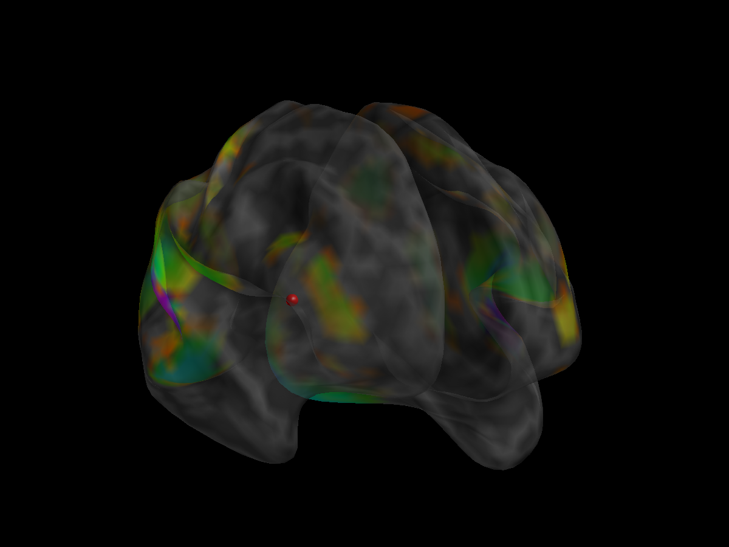
Summary: Neural Mass Models in DCM
Sensor Level
Spectral Responses
Lead Field
Interconnected
Neural mass models

Slide 32
Outline
Data Features in DCM for CSD
Generative Models in the time domain
Generative Models in the frequency domain
DCM Inversion procedure
Example 1: L-Dopa Modulations of theta spectra using DCM for CSD
Example 2: Propofol Modulations of Delta and Gamma spectra using DCM for CSD

Slide 33
Dynamic Causal Modelling: Inversion & Inference
Empirical Data
Hemodynamic
forward model:
Electromagnetic
forward model:
Neural
state equation:
fMRI
EEG/MEG
Generative Model
Bayesian Inversion
Model Structure/ Model Parameters

Slide 34


Dynamic Causal Modelling: Inversion & Inference
Bayes’ rules:
Free Energy:
max
Inference on models
Inference on parameters
Bayesian Inversion
Model 1
Model 2
Model 1
Model comparison via Bayes factor:
accounts for both accuracy and complexity of the model
allows for inference about structure (generalisability) of the model

Slide 35
Dynamic Causal Modelling: Inversion & Inference
Bayes’ rules:
Free Energy:
max
Inference on parameters
Inference on models
A Neural Mass Model
Bayesian Inversion
Model 1
Model 2
Model 1
Model comparison via Bayes factor:
accounts for both accuracy and complexity of the model
allows for inference about structure (generalisability) of the model

Slide 36
Inversion in the real & complex domain
prediction and response: E-Step: 32
prediction and response: E-Step: 32
3.5
1
3
0.8
0.6
2.5
0.4
2
0.2
real
0
imaginary
1.5
-0.2
1
-0.4
-0.6
0.5
-0.8
0
0
10
20
30
40
50
-1
0
10
20
30
40
50
Frequency (Hz)
Frequency (Hz)
conditional [minus prior] expectation
1.5
1
0.5
0
-0.5
-1
-1.5
-2
0
10
20
30
40
50
60
70
80
parameter

Slide 37
Outline
Data Features in DCM for CSD
Generative Models in the time domain
Generative Models in the frequency domain
DCM Inversion procedure
Example 1: L-Dopa Modulations of theta spectra using DCM for CSD
Example 2: Propofol Modulations of Delta and Gamma spectra using DCM for CSD

Slide 38
Dopaminergic modulation in Humans
Aim: Infer plausible synaptic effects of dopamine in humans via non-invasive imaging
Approach:
Double blind cross-over (within subject) design, with participants on placebo or levodopa
Use MEG to measure effects of increased dopaminergic transmission
Study a simple paradigm with “known” dopaminergic effects (from the animal literature): working memory maintenance
Apply DCM to one region (a region with sustained activity throughout maintenance prefrontal)
Moran, Symmonds, Stephan, Friston, Dolan (2011) An In Vivo Assay of Synaptic Function Mediating Human Cognition, Current Biology

Slide 39
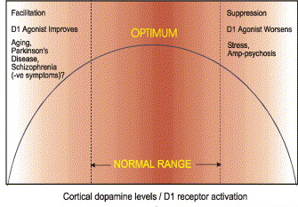
Working Memory
Animal unit recordings have shown selective persistent activity of dorsolateral prefrontal neurons during the delay period of a delayed-response visuospatial WM task (Goldman-Rakic et al, 1996)
The neuronal basis for sustained activity in prefrontal neurons involves recurrent excitation among pyramidal neurons and is modulated by dopamine (Gao, Krimer, Goldman-Rakic, 2001)
Dose dependant inverted U

Slide 40
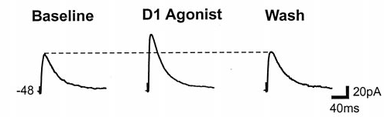
Dopamine in Working Memory
Wang et al, 1999
DA terminals converge on pyramidal cells and inhibitory interneurons in PFC (Sesack et al, 1998)
DA modulation occurs through several pre and post synaptic mechanisms (Seamans & Yang, 2004)
Gao et al, 2001
Seamans et al, 2001
  - Increase in NMDA mediated responses in pyramidal cells – postsynaptic D1 mechanism
  - Decrease in AMPA EPSPs in pyramidal cells – presynaptic D1 mechanism
  - Increase in spontaneous IPSP Amplitude and Frequency in GABAergic interneurons
  - Decrease in extrinsic input current
Notes:
Supported by modelling studies

Slide 41
WM Paradigm in MEG on and off levodopa
Memory
Memory
. .
Target Image
300 ms
Load titrated to 70% accuracy
(predrug)
. .
300 ms
. . . .
Probe Image
4 sec
Maintenance Period
. . . .
e.g. match
e.g. no match
2 sec
Notes:
4 and a half minutes per block
4 blocks of each condition = 35 minutes

Slide 42
Behavioural Results
*
77
Memory
76
Target Image
75
Probe Image
74
match
73
% Accuracy
72
71
Titration
70
69
68
Placebo
L-Dopa

Slide 43
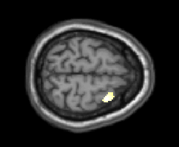
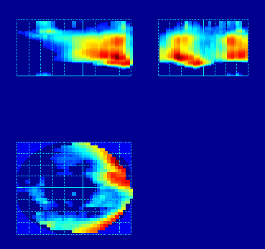
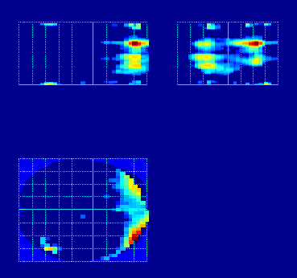
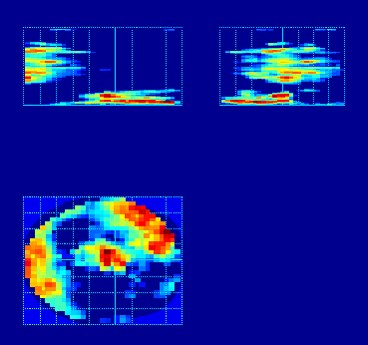
Activity at sensors during maintenance
Sustained Activity during memory maintenance:
Sensor Space
Significant effects of memory in different frequency bands
(channels over time)
Sustained effect throughout maintenance in delta - theta - alpha bands
Localised main effect and interaction in right prefrontal cortex
c
Broad Band Low Frequency Activity
Interaction: Memory and Dopamine
4
sensors
1.4
L-Dopa
Placebo
Frequency (Hz)
Time (s)
1.3
1.2
0
1.1
Normalised Power (a.u.)
P
A
P
A
P
A
1
0.9
0.8
0.7
0
2
4
6
8
10
12
Time (msec)
Frequency (Hz)
14
16
18

Slide 44
DCM Architecture
Cell Populations
Spiny Stellates (Population 1)
Inhibitory Interneurons (Population 2)
Pyramidal Cell (Population 3)
Receptor Types
AMPA receptors
NMDA receptors
GABAa receptors
γ : The strengths of presynaptic inputs to and postsynaptic conductances of transmitter-receptor pairs
i.e. a coupling measure that absorbs a number of biophysical processes, e.g.:
Receptor Density
Transmitter Reuptake
Notes:
44

Slide 45

Synaptic Hypotheses
inhibitory interneurons
pyramidal cells
spiny stellate cells
Extrinsic Cortical Input (u)
pyramidal cells
pyramidal cells
1
0.8
0.6
0.4
0.2
0
-100
-50
0
50
  L-Dopa relative to Placebo, Memory – No Memory Trials
  1. Decrease in AMPA coupling (decreased γ_{1,3})
  2. Increased sensitivity by NMDA receptors (increased α)
  3. Increase in GABA coupling (increased γ_{3,2})
  4. Decreased exogenous input (decreased u)
Membrane Potential (mV)
Notes:
45

Slide 46
Parameter Estimates
  L-Dopa : Memory – No Memory:
  Interaction of Parameter and Task on L-Dopa ( p = 0.009)
L-Dopa : Memory – No Memory
*
-4
0
0.16
0.08
0
x 10
-0.01
0.14
0.07
-1
-0.02
0.12
0.06
-2
-0.03
0.1
0.05
-3
-0.04
MAP Parameter estimates
0.08
0.04
-4
-0.05
0.06
0.03
-5
-0.06
-0.07
0.04
0.02
-6
-0.08
0.02
0.01
-7
*
γ_{1,3} α γ _{3,2} u
u
-0.09
0
0
-8
  L-Dopa relative to Placebo, Memory – No Memory Trials
  1. Decrease in AMPA coupling (decreased γ_{1,3})
  2. Increased sensitivity by NMDA receptors (increased α)
  3. Increase in GABA coupling (increased γ_{3,2})
  4. Decreased exogenous input (decreased u)
Moran, Symmonds, Stephan, Friston, Dolan (2011) An In Vivo Assay of Synaptic Function Mediating Human Cognition, Current Biology
Notes:
46

Slide 47
Individual Behaviour
L-Dopa : Memory – No Memory
*
x 10
-4
0
0.16
0.08
0
-0.01
0.14
0.07
-1
-0.02
0.12
0.06
-2
-0.03
0.1
0.05
-3
-0.04
MAP Parameter estimates
0.08
0.04
-4
-0.05
0.06
0.03
-5
  Decrease in AMPA coupling (decreased γ_{1,3})
  Increased sensitivity by NMDA receptors
  (increased α)
-0.06
-0.07
0.04
0.02
-6
-0.08
0.02
0.01
-7
*
γ_{1,3} α γ _{3,2} u
-0.09
0
0
-8
0.3
R = -0.51
p < 0.05
0.12
0.2
0.1
0.08
0.1
0.06
NMDA Nonlinearity α
AMPA connectivity γ_{1,3}
0.04
0
0.02
-0.1
0
-0.2
-0.02
-0.04
R = 0.59
p < 0.05
-0.3
-0.06
-0.4
-10
-5
0
5
10
15
20
-0.08
-10
-5
0
5
10
15
20
Performance Increase
Performance Increase
Moran, Symmonds, Stephan, Friston, Dolan (2011) An In Vivo Assay of Synaptic Function Mediating Human Cognition, Current Biology
Notes:
47

Slide 48
Outline
Data Features in DCM for CSD
Generative Models in the time domain
Generative Models in the frequency domain
DCM Inversion procedure
Example 1: L-Dopa Modulations of theta spectra using DCM for CSD
Example 2: Propofol Modulations of Delta and Gamma spectra using DCM for CSD

Slide 49

Connectivity changes underlying
spectral EEG changes during propofol-induced loss of consciousness.
Wake
Mild Sedation: Responsive to command
Deep Sedation: Loss of Consciousness
Boly, Moran, Murphy, Boveroux, Bruno, Noirhomme, Ledoux, Bonhomme, Brichant, Tononi, Laureys, Friston, J Neuroscience, 2012

Slide 50
Propofol-induced loss of consciousness
Wake
Mild Sedation: Responsive to command
Deep Sedation: Loss of Consciousness
Precuneus
/Posterior Cingulate
Anterior Cingulate/mPFC

Slide 51
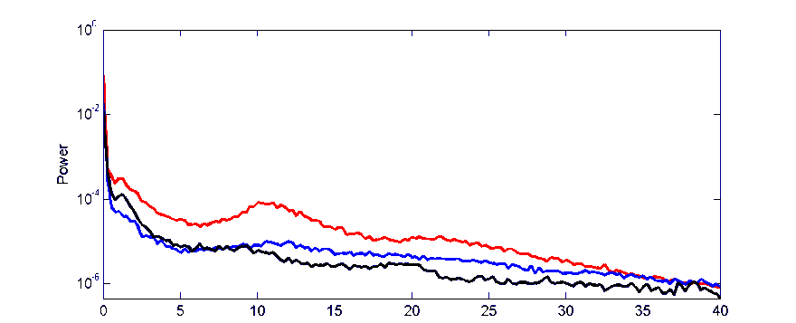
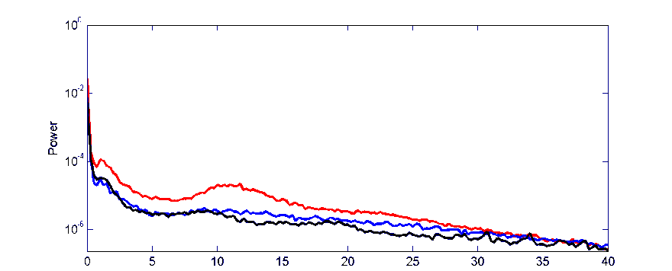
Propofol-induced loss of consciousness
Wake
Mild Sedation: Responsive to command
Deep Sedation: Loss of Consciousness
Precuneus
/Posterior Cingulate
Anterior Cingulate/mPFC
Murphy et al. 2011
Increased gamma power in Propofol vs Wake
Increased low frequency power when consiousness is lost

Slide 52
Bayesian Model Selection
Propofol-induced loss of consciousness
Wake
Mild Sedation
Deep Sedation
ACC
PCC
ACC
PCC
ACC
PCC
Thalamus
Thalami

Slide 53
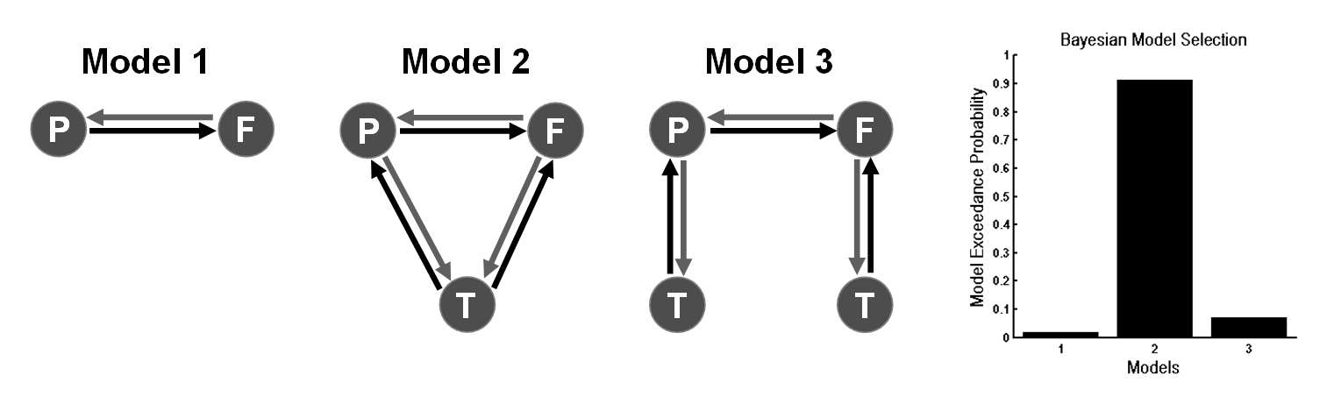
Propofol-induced loss of consciousness
Wake
Mild Sedation
Deep Sedation
ACC
PCC
ACC
PCC
ACC
PCC
Thalamus
Thalami

Slide 54
Parameters of Winning Model
Propofol-induced loss of consciousness
ACC
PCC
Wake
Thalamus

Slide 55
Propofol-induced loss of consciousness
ACC
PCC
Wake
Thalamus
ACC
PCC
Mild Sedation
Thalamus
:Increase in thalamic excitability

Slide 56
Propofol-induced loss of consciousness
ACC
PCC
Wake
Thalamus
ACC
PCC
ACC
PCC
Mild Sedation
Thalamus
:Increase in thalamic excitability
Thalamus
Loss of Consciousness
:Breakdown in Cortical Backward Connections

Slide 57
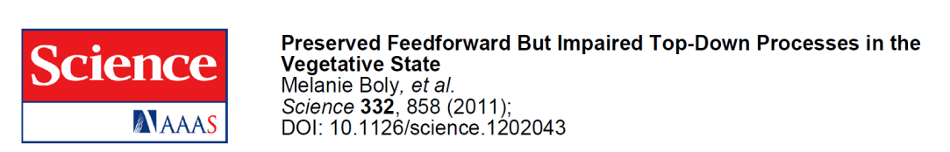
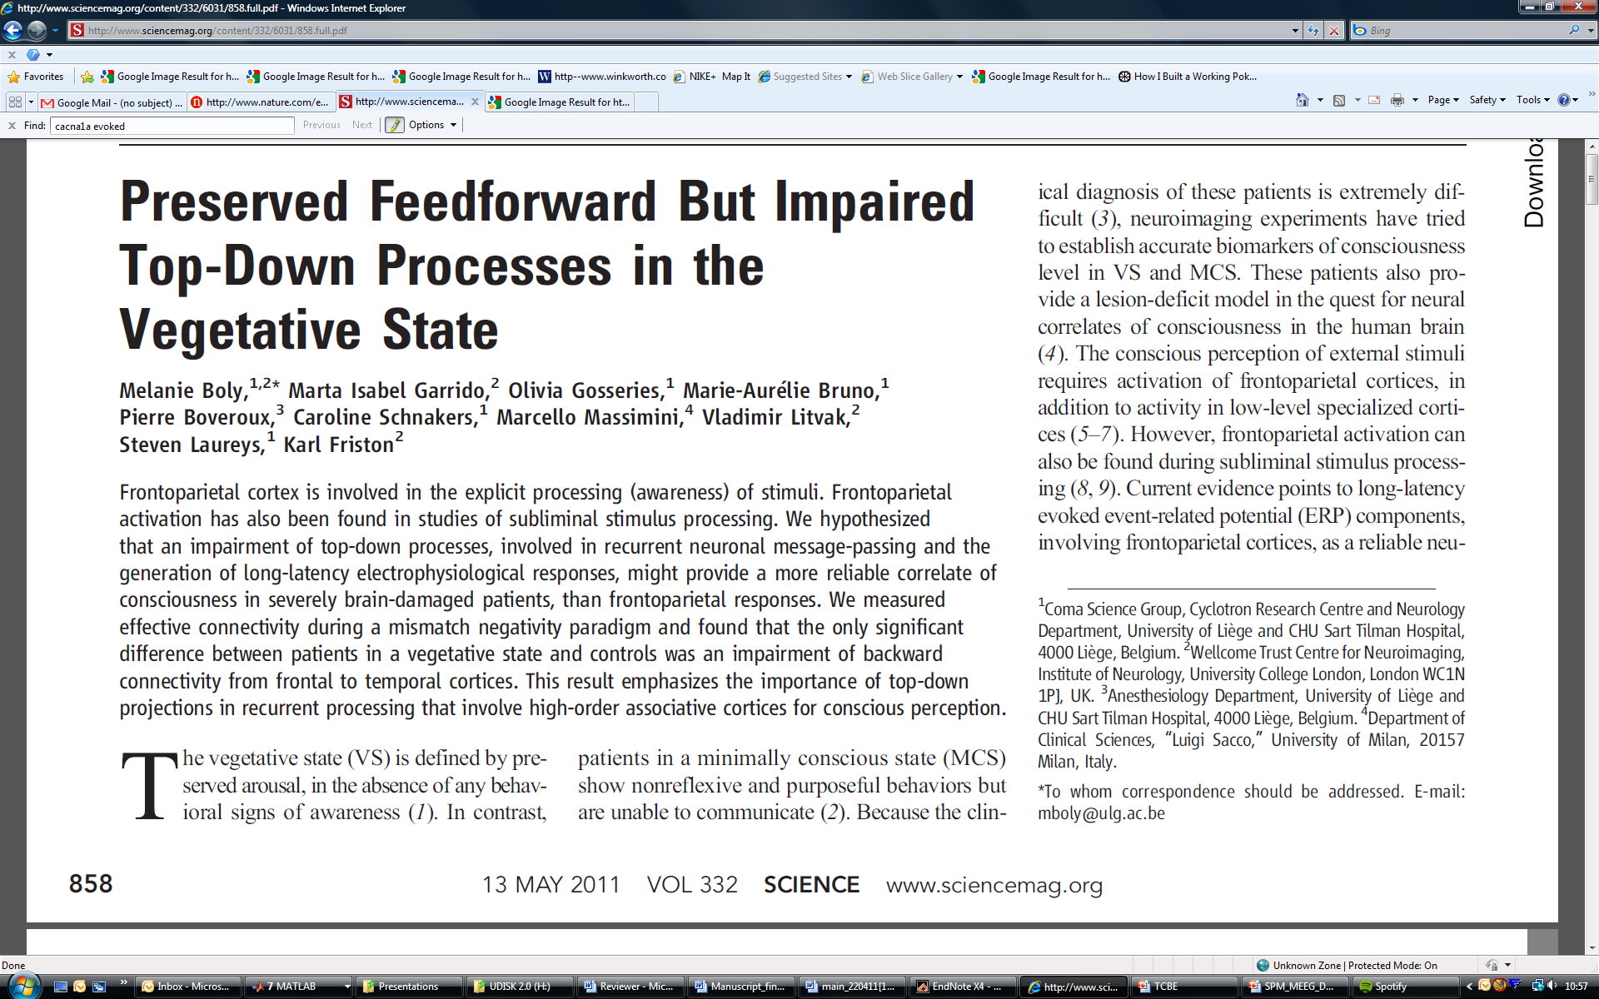
Propofol-induced loss of consciousness
ACC
PCC
Thalamus
Loss of Consciousness
:Breakdown in Cortical
Backward Connections
Boly, Moran, Murphy,
Boveroux, Bruno, Noirhomme,
Ledoux, Bonhomme, Brichant,
Tononi, Laureys, Friston, J Neuroscience, 2012

Slide 58
Summary
DCM is a generic framework for asking mechanistic questions of neuroimaging data
Neural mass models parameterise intrinsic and extrinsic ensemble connections and synaptic measures
DCM for SSR is a compact characterisation of multi- channel LFP or EEG data in the Frequency Domain
Bayesian inversion provides parameter estimates and allows model comparison for competing hypothesised architectures
Empirical results suggest valid physiological predictions

Slide 59
Thank You
FIL Methods Group

