Slide 1

Event-related fMRI
SPM course May 2015
Helen Barron
Wellcome Trust Centre for Neuroimaging
12 Queen Square

Slide 2
Overview
Event-related design vs block design
Modelling events
Optimising the design

Slide 3
Overview
Event-related design vs block design
Modelling events
Optimising the design

Slide 4




Scenes vs face processing
scenes
faces
scenes
faces
time
How should we order the presentation of the stimuli?
What timing should we use between presentations?
Center for Vital Longevity Face Database
Berkeley Segmentation Dataset

Slide 5
BOLD response
Initial undershoot
Peak 4-6s post-stimulus
Undershoot before returning to baseline
Peak
Brief
Stimulus
Undershoot
This is SLOW.
How should we present our stimuli?
Initial
Undershoot

Slide 6
Experimental Designs
scene
activity in scene area
face
activity in face area
Block / Epoch Design
Intermixed / Event-Related Design
time
time
Blocked designs have high statistical power so why would we want to use event-related design?
The order is random
Notes:
Blocked design: assume constant activity
Event related: explicitly account for each haemodynamic response. No longer constrained to blocking.

Slide 7
Event-Related Designs
Advantages over block designs:
Post-hoc classification of trials by the experimenter
  e.g. by subsequent memory, Wagner et al., 1998
Fixation trial (2 secs)
“Null event”
Word trial (2 secs)
cheese
+
+
time
750ms
1250ms
2000ms

Slide 8
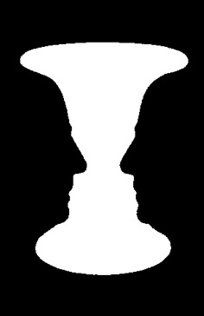
Event-Related Designs
Advantages over block designs:
Events which can only be indicated by the participant
  e.g. decision making, perceptual changes,
  Kleinschmidt et al., 1998

Slide 9
Event-Related Designs
Advantages over block designs:
Paradigms which cannot be blocked
  where surprise is important, oddball designs
time

Slide 10
Event-Related Designs
Advantages over block designs:
Post-hoc classification of trials by the experimenter
  e.g. by subsequent memory
Events which can only be indicated by the participant
  e.g. decision-making , perceptual changes
Paradigms that cannot be blocked
  e.g. oddball designs

Slide 11
Overview
Event-related design vs block design
Modelling events
Optimising the design

Slide 12
Modelling events
X
Block / Epoch
Design
Model
time
Event related
Design
Model
time
Notes:
Design: how we present the stimuli. Model: how we model the events to account for the haemodynamic response.

Slide 13
Terminology
for consistency with previous literature
Event: brief stimulus presentation thought to lead to a brief burst in neural activity
Epoch: sustained stimulus presentation thought to lead to sustained neural activity
Impulse response: BOLD response to an event
ITI
(Inter-Trial Interval)
ITI
(Inter-Trial Interval)
Trial
Trial
Trial
time
SOA
(Stimulus Offset Asynchrony)
Trial + ITI
Notes:
Inter-stimulus interval (ISI): time between the offset of one event/epoch and the onset of the next
Stimulus Onset Asynchrony (SOA): time between onsets of event/epoch

Slide 14
The GLM
=
X
+
To infer the contribution of a given voxel to house or scene processing we need to model the events in a design matrix

Slide 15
The design matrix
X=
Peak
Brief
Stimulus
Undershoot
Initial
Undershoot
Regressor 1: Face
Regressor 2: Scene
Regressor 3: Constant
We need to model the impulse response function

Slide 16
The design matrix
Events across time
Temporal basis
functions
time
convolution
down-sample for each scan
Design matrix

Slide 17
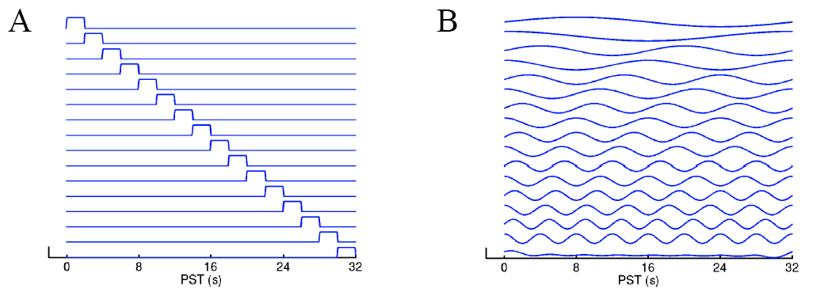
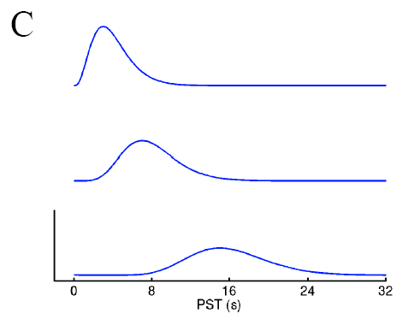
Temporal basis function
Finite Impulse Response (FIR)
Fourier
Gamma function
Notes:
A and B: flexible models. Can model almost any shape, even if biologically implausible. A linear combination across these basis functions can capture the BOLD response, using an F test to make inferences.
C: Actually try and model the haemodynamic response directly. Use different Gamma functions to model the different components of the HRF. Do F test across these to make inferences.

Slide 18
Temporal basis functions
the standard HRF
Canonical
Canonical Haemodynamic Response Function (HRF) used in SPM
2 gamma functions
Assumed to be the same everywhere in the brain
Notes:
The modelled BOLD response as a function of time:
Peak ~6s, followed by an undershoot at around 10-30s.
There is variation across individuals and brain regions.

Slide 19
Temporal basis functions
the standard HRF and derivatives
Negatively weight temporal
Positively weight temporal
Canonical Haemodynamic Response Function (HRF) used in SPM
2 gamma functions
+
Multivariate Taylor expansion in time (Temporal Derivative)
Canonical
Temporal

Slide 20
Temporal basis functions
the standard HRF and derivatives
Canonical Haemodynamic Response Function (HRF) used in SPM
2 gamma functions
+
Multivariate Taylor expansion in time (Temporal Derivative)
+
Multivariate Taylor expansion in width (Dispersion Derivative)
Canonical
Temporal
Dispersion
Now it is possible to account for variation between brain regions

Slide 21
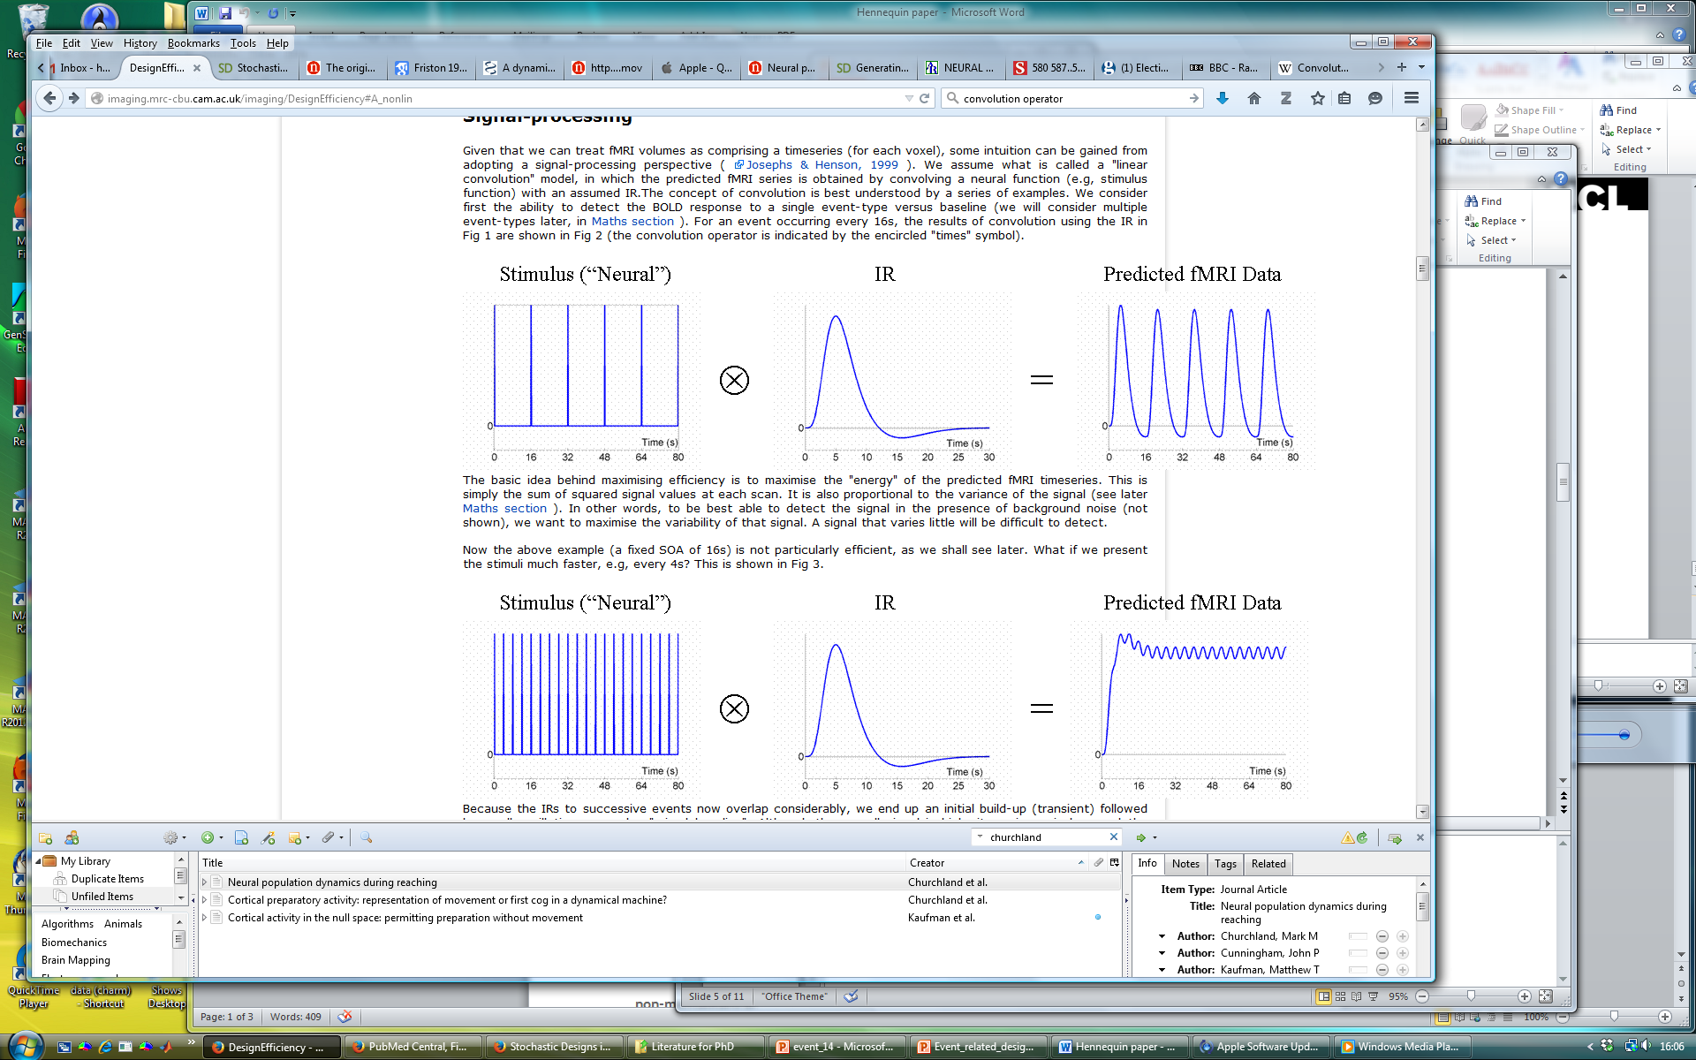
Simple convolution
Which design is more efficient?
Notes:
Illustrating the principle of convolution with a series of examples.
Let’s assume that we know what the impulse response function looks like, but we don’t know it’s amplitude.

Slide 22
Overview
Event-related design vs block design
Modelling events
Optimising the design

Slide 23
Optimising design: The Aim
We want to:
Maximize our t-statistic where there’s an effect – i.e. our efficiency or sensitivity
We need to choose a good:
Stimulus order
ITI
SOA

Slide 24
Which SOA is optimal?
16s SOA
Not very efficient…
4s SOA
Very inefficient…
Which design is more efficient? Neither are very good
Notes:
16s SOA is not very efficient. 4s SOA is also inefficient because the high pass filter will remove most of the signal.

Slide 25
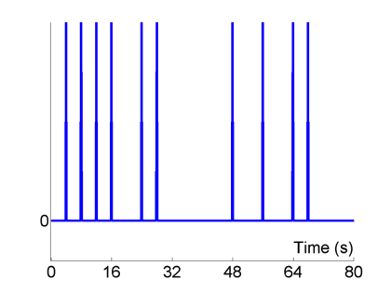
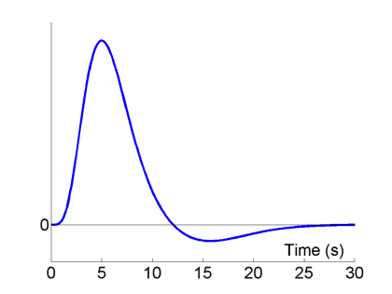
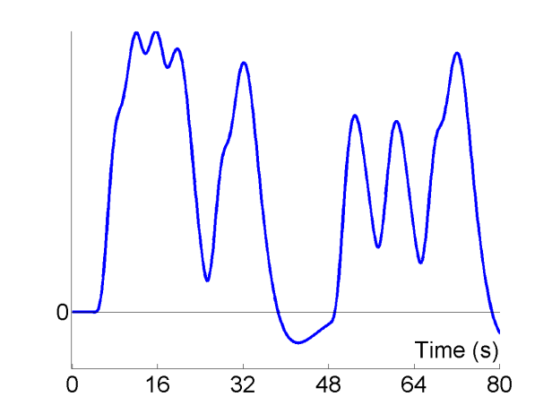
Short randomised SOA
Stimulus (“Neural”)
HRF
Predicted Data
⊗
=
Null events
More efficient…

Slide 26
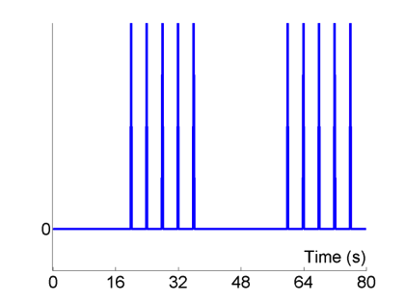
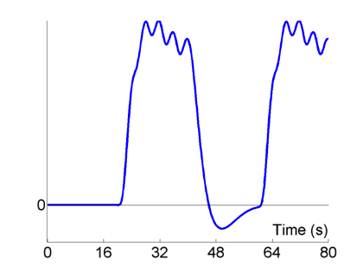
Block design SOA
Stimulus (“Neural”)
HRF
Predicted Data
⊗
=
Even more efficient…

Slide 27
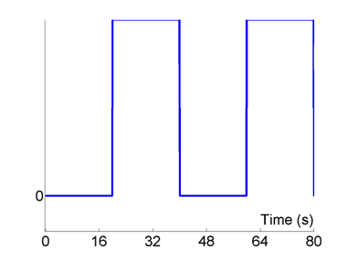
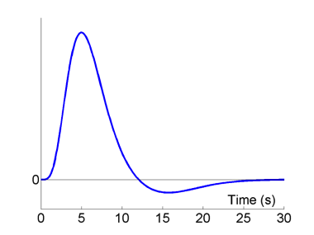
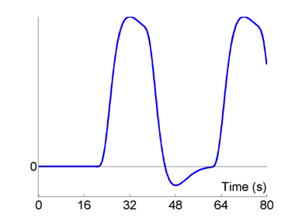
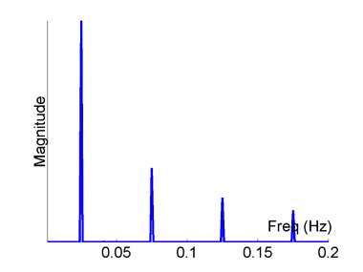
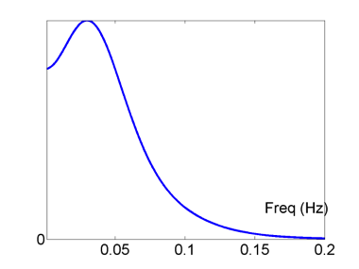
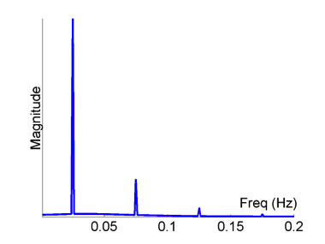
Analysing efficiency: Fourier transform
Block Design, blocks (epochs) = 20s, short ISI
Stimulus (“Neural”)
HRF
Predicted Data
⊗
=
Fourier Transform
Fourier Transform
×
=

Slide 28
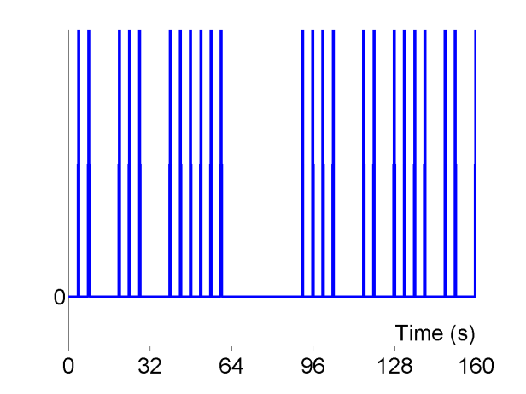
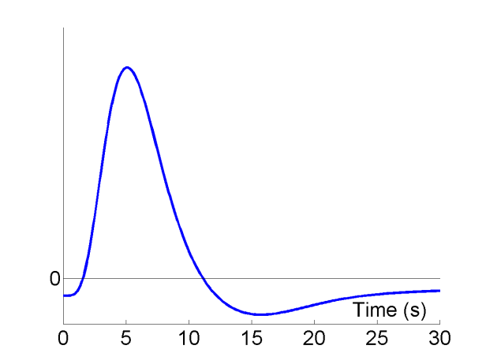
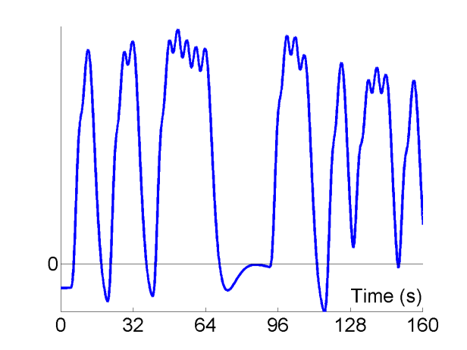
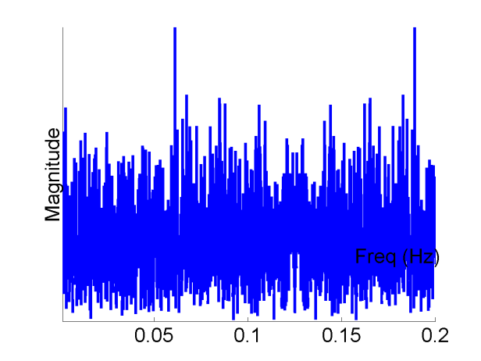
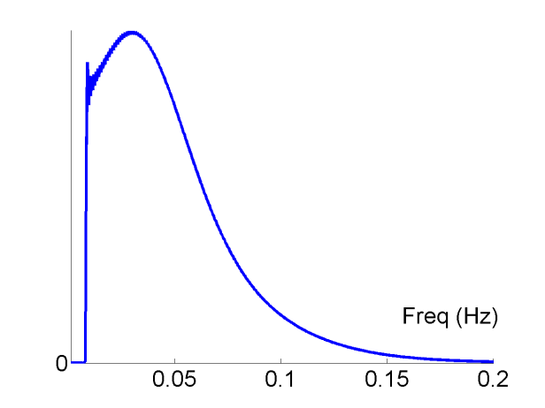
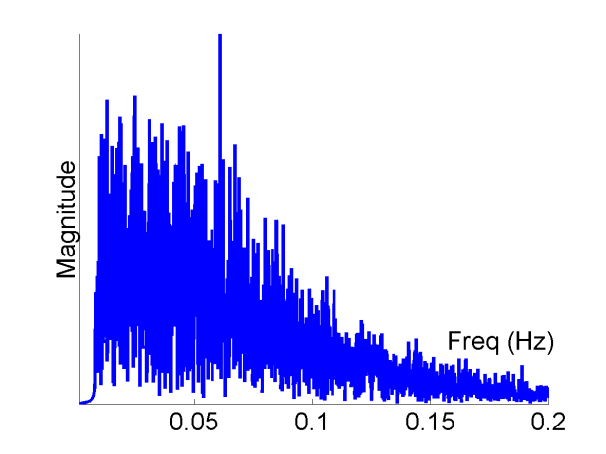
Analysing efficiency: Fourier transform
Randomised Design, SOA_{min} = 4s, highpass filter = 1/120s
Stimulus (“Neural”)
HRF
Predicted Data
⊗
=
Fourier Transform
Fourier Transform
×
=

Slide 29
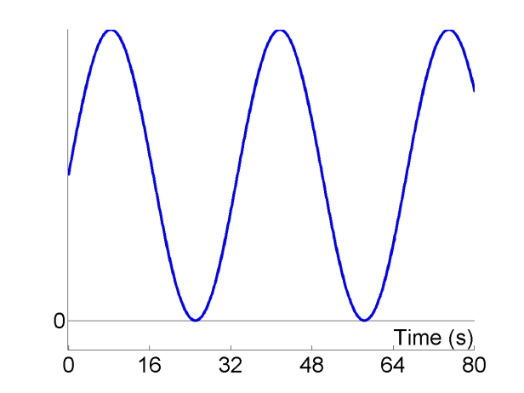

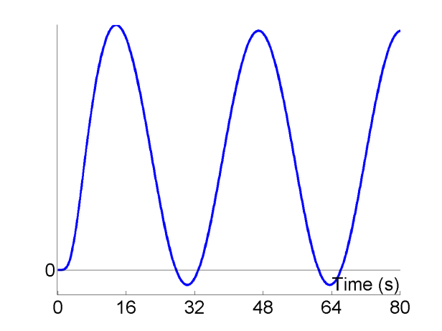
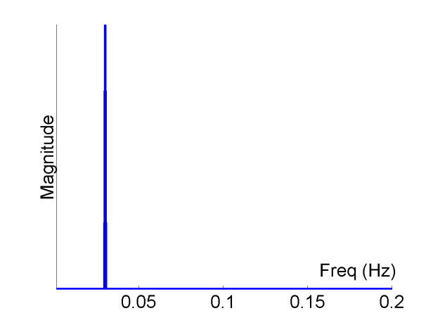
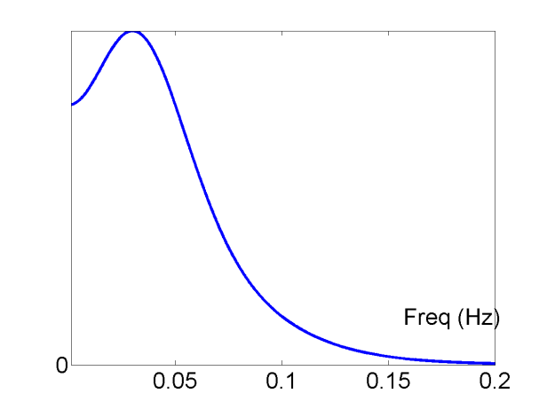
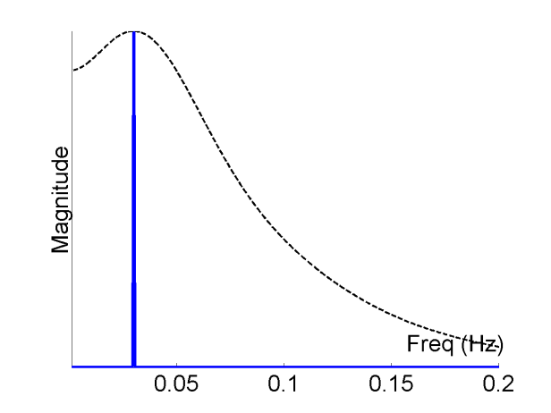
The optimal SOA
Sinusoidal modulation, f=1/33s
Stimulus (“Neural”)
HRF
Predicted Data
⊗
=
=
Fourier Transform
Fourier Transform
×
=

Slide 30

Analysing efficiency: maximising t value
X: design matrix
c: contrast vector
β: beta vector
Maximise t by minimising the squared variance
$$\hat{β}\sim N\left(β,σ^{2}{(X^{T}X)}^{−1}\right)$$
Assuming σ is independent of our design, taking a fixed contrast we can only alter our design matrix
Notes:
sigma^2 is an estimate of the error variance derived from the sum of squares of the residuals
e is a relative measure (no units)

Slide 31

Optimising the SOA
Happy (A) vs sad (B) faces: need to know both (A-B) and (A + B)
Efficiency Example #1
Two event types, A and B
Randomly intermixed (event-related):
ABBAABABB…
Question: What’s the best SOA to use?
Transition matrix
 | A | B
A | 0.5 | 0.5
B | 0.5 | 0.5
Values are probabilities of that condition occurring
Notes:
We want to know where in the brain responds to faces (face vs baseline) and where, within this region, is there a differential effect for happy vs sad?
For each event there is 50% probability of A occurring and 50% probability of B occurring.

Slide 32
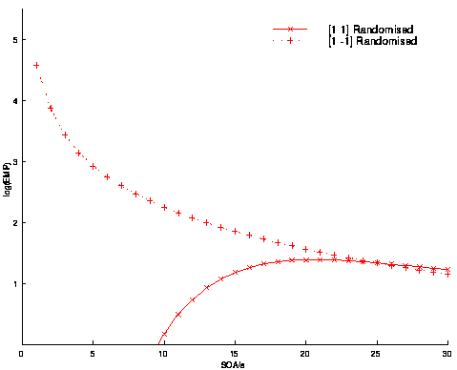
Efficiency Example #1
Contrast for Differential Effect (A-B)
Contrast for Common Effect (A+B)
Efficiency
SOA (s)
Optimal efficiency
A+B: 16-20s, A-B: →0s
Note: the optimal SOA for the two contrasts differ
Given a particular design matrix, the different contrasts have different efficiencies.
Notes:
But for the difference effect remember that under linear assumptions there is the issue of saturation at short SOAs

Slide 33
Efficiency Example #2
Two event types, A and B
Randomly intermixed (event-related) with null events:
AB-BAA--B---ABB…
Question: What’s the best SOA to use?
Transition matrix
 | A | B
A | 0.33 | 0.33
B | 0.33 | 0.33
Values are probabilities of that condition occurring
Notes:
Null events are just extensions of the ITI, i.e. fixation cross. They simply provide a convenient way of randomising the SOA between the events of interest.

Slide 34
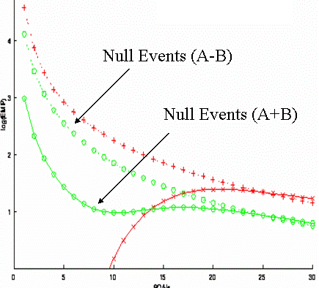
Efficiency Example #2
(A-B)
Efficiency
(A+B)
SOA (s)
Optimal efficiency
A+B: →0s, A-B: →0s
With the addition of null events the optimal SOA
is roughly matched for the two contrasts.
Should we just use SOAs of 0s?
Notes:
Why add null events? The efficiency for detecting the common effect at short SOAs is improved (with a small reduction of efficiency for detecting the differential effect).

Slide 35
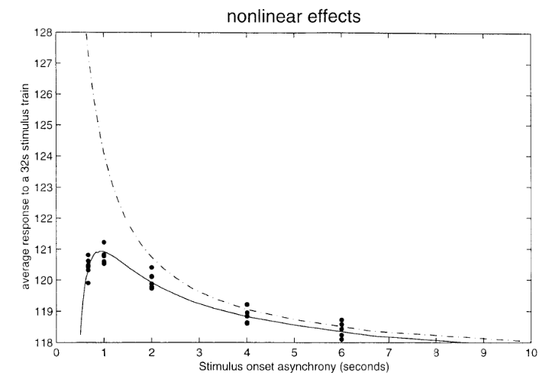
Non-linear effects
If the IRs sum in a linear manner then we are OK!
But at short SOAs we get non-linearities in the data (saturation effects).
Assume linear summation of BOLD response, up to a certain temporal proximity of event
Linear model
Linear model is good until SOAs of <1s-2s
Trade off between packing more events
in and having nonlinear saturation effects
which are not modelled.
Non linear data
(‘saturation effect’)
Friston et al., 1999
Notes:
Saturation: neural or haemodynamic or both

Slide 36
Efficiency Summary
Block designs:
Generally efficient but often not appropriate.
Optimal block length 16s with short SOA (beware of high-pass filter).
Event-related designs:
Efficiency depends on the contrast of interest
With short SOAs ‘null events’ (jittered ITI) can optimise efficiency across multiple contrasts.
Non-linear effects start to become problematic at SOA<2s

Slide 37
Summary
Choosing whether to use an event-related or block design
Choosing how to model the BOLD response
Optimising the timing of the experiment (design efficiency)

Slide 38
Further Reading
Books (http://www.fil.ion.ucl.ac.uk/spm/doc/)
  Statistical Parametric Mapping
  Human Brain Function
Online lectures
  SPM Course http://www.fil.ion.ucl.ac.uk/spm/course/video/
Websites
  http://mindhive.mit.edu/imaging

