Slide 1
Dynamic Causal Modelling
of fMRI timeseries
J. Daunizeau
ICM, Paris, France
ETH, Zurich, Switzerland

Slide 2
Overview
1 DCM: introduction
2 Dynamical systems theory
4 Bayesian inference
5 Conclusion

Slide 3
Overview
1 DCM: introduction
2 Dynamical systems theory
4 Bayesian inference
5 Conclusion

Slide 4
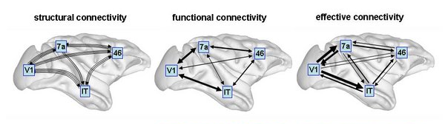
Introduction
structural, functional and effective connectivity
structural connectivity
functional connectivity
effective connectivity
O. Sporns 2007, Scholarpedia
structural connectivity
= presence of axonal connections
functional connectivity
= statistical dependencies between regional time series
effective connectivity
= causal (directed) influences between neuronal populations
! connections are recruited in a context-dependent fashion

Slide 5
Introduction
from functional segregation to functional integration
localizing brain activity:
functional segregation
effective connectivity analysis:
functional integration
A
B
A
B
?
u₁
u₂
u₁
u₂
u₁
u₁ X u₂
« Where, in the brain, did
my experimental manipulation
have an effect? »
« How did my experimental manipulation
propagate through the network? »
Notes:
Jusqu’à récemment, on utilisait la neuroimagerie pour localiser les régions impliquées dans telle ou telle tâche cognitive.
J’ai travaillé sur le développement de méthodes liées à ce problème pendant ma thèse. Cela a donné lieu à la publication de 8 articles dont 4 en premier auteur.
Aujourd’hui, on va plus loin et on analyse la connectivité cérébrale « effective ».
En fait, on cherche à savoir quelle est la nature de l’information qui passe d’une région A à une région B.
L’approche DCM se base sur des modèles réalistes décrivant la façon dont le cerveau est cablé, et comment il répond à la stimulation expérimentale.
En fittant ces modèles aux données, on peut alors montrer qu’une connexion est modulée par une propriété des stimuli qu’on manipule expérimentalement (comme la récompense à un choix).
Si tel est le cas, on a montré que cette connexion véhiculait l’information sur la récompense.
J’ai contribué aux aspects statistique et neurobiologique de DCM. Cela a mené à la publication de 18 articles dont 8 en premier ou dernier auteur.

Slide 6
Introduction
dynamical system theory
1
2
1
2
3
1
2
3
1
2
time
3
3
u

Slide 7
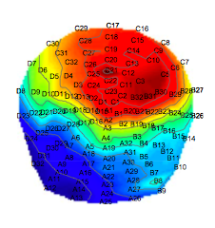
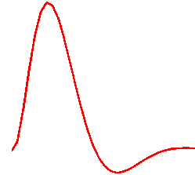
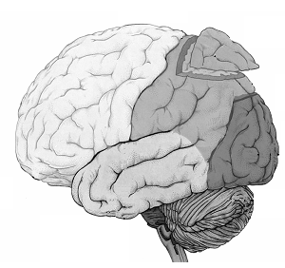
Introduction
DCM: evolution and observation mappings
Hemodynamic
observation model:
temporal convolution
Electromagnetic
observation model:
spatial convolution
neural states dynamics
fMRI
EEG/MEG
agnostic neuronal model
realistic observation model
realistic neuronal model
linear observation model
inputs

Slide 8
Introduction
DCM: a parametric statistical approach
• DCM: model structure
θ₂₄
2
likelihood
4
3
1
u
• DCM: Bayesian inference
parameter estimate:
priors on parameters
model evidence:

Slide 9


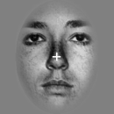

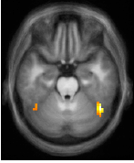


Introduction
DCM for fMRI: audio-visual associative learning
auditory cue
visual outcome
P(outcome|cue)
or
or
response
Put
0
200
400
600
800
time (ms)
2000
PMd
PPA
FFA
FFA
PPA
Put
PMd
cue-dependent surprise
cue-independent surprise
Den Ouden, Daunizeau et al., J. Neurosci., 2010

Slide 10
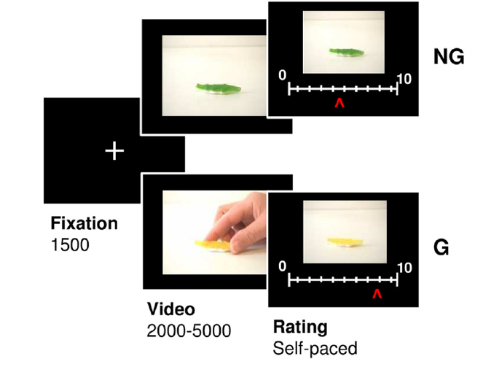
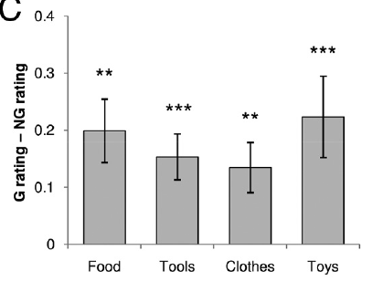
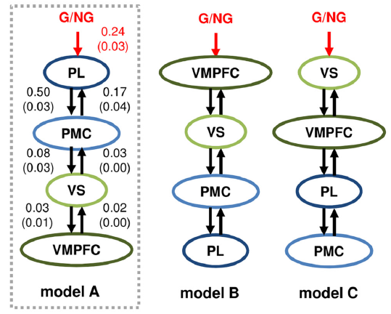
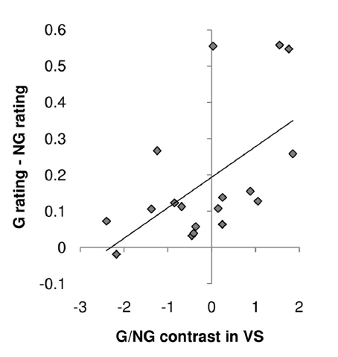
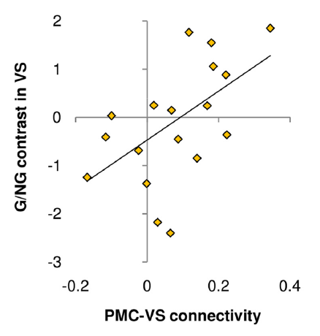
Introduction
DCM for fMRI: assessing mimetic desire in the brain
Lebreton et al., 2011

Slide 11
Overview
1 DCM: introduction
2 Dynamical systems theory
4 Bayesian inference
5 Conclusion

Slide 12
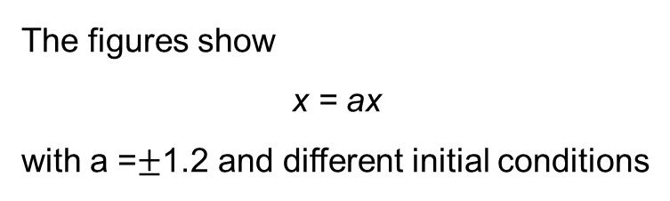
Dynamical systems theory
system’s stability
.
a<0
a>0
fixed point = stable
fixed point = unstable

Slide 13
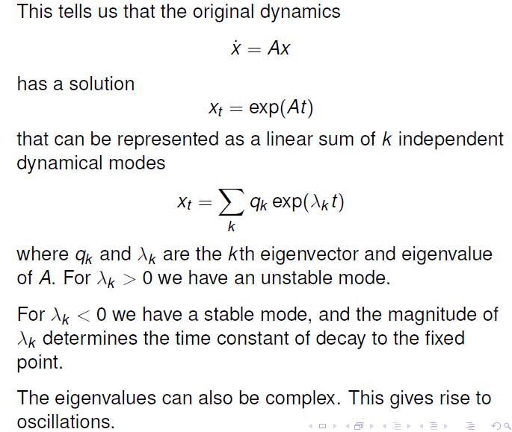
Dynamical systems theory
dynamical modes in ND

Slide 14
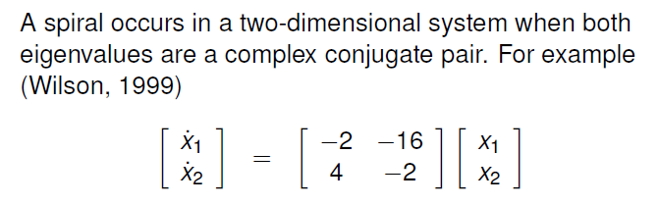
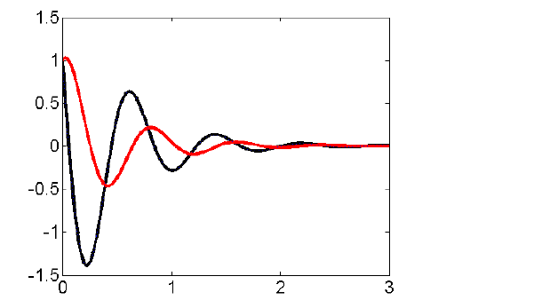
Dynamical systems theory
damped oscillations: spirals
x₁
x₂

Slide 15
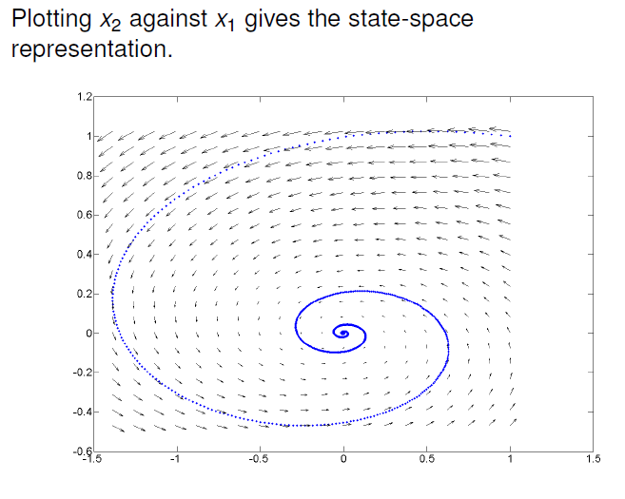
Dynamical systems theory
damped oscillations: states’ correlation structure

Slide 16
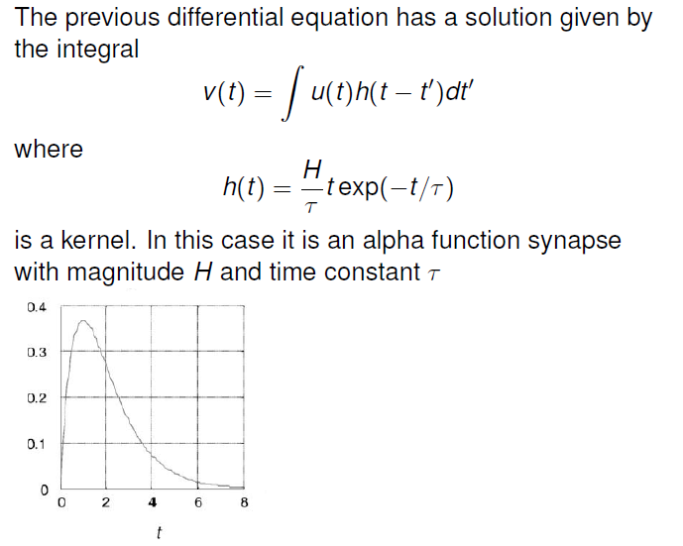

Dynamical systems theory
impulse response functions: convolution kernels
u
u

Slide 17
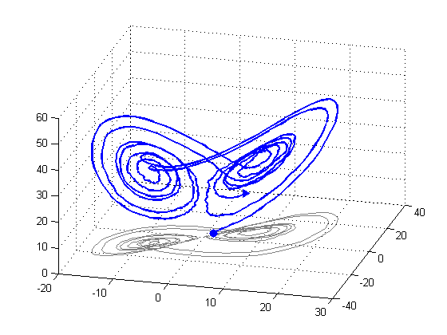
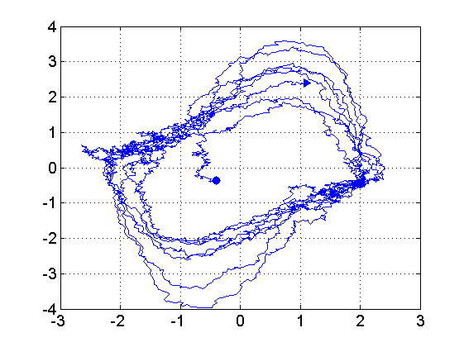
Dynamical systems theory
summary
Motivation: modelling reciprocal influences (feedback loops)
Linear dynamical systems can be described in terms of their impulse response
Dynamical repertoire depend on the system’s dimension (and nonlinearities):
  D>0: fixed points
  D>1: spirals
  D>1: limit cycles (e.g., action potentials)
  D>2: metastability (e.g., winnerless competition)
limit cycle (Vand Der Pol)
strange attractor (Lorenz)

Slide 18
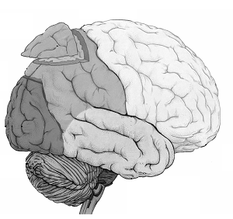
Dynamical systems theory
agnostic neural dynamics
b₁₂
a₂₄
d₂₄
gating effect
2
u₂
4
modulatory effect
1
3
c₁
u₁
driving input
bilinear state equation:
nonlinear state equation:
Stephan et al., 2008

Slide 19

Dynamical systems theory
the neuro-vascular coupling
u
neural states dynamics
t
experimentally controlled
stimulus
hemodynamic states dynamics
Balloon model
BOLD signal change observation
Friston et al., 2003

Slide 20
Overview
1 DCM: introduction
2 Dynamical systems theory
4 Bayesian inference
5 Conclusion

Slide 21
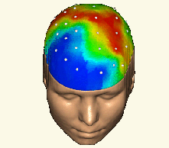
Bayesian inference
forward and inverse problems
forward problem
likelihood
posterior distribution
inverse problem

Slide 22

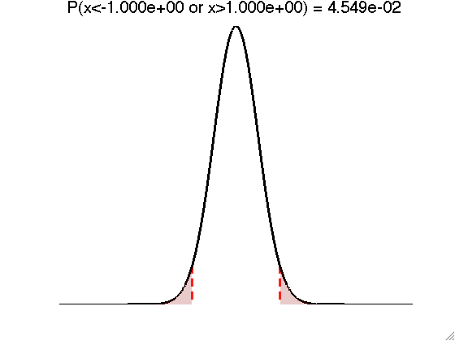
Bayesian paradigm
deriving the likelihood function
- Model of data with unknown parameters:
e.g., GLM:
- But data is noisy:
- Assume noise/residuals is ‘small’:
f
→ Distribution of data, given fixed parameters:
Notes:
Bayesian theory of probabilities furnishes:
- a language allowing to represent information and uncertainty.
- calculus tools able to manipulate these notions in a coherent manner.
It is an extension to formal logic, which works with propositions which are either true or false.
Theory of probabilities rather works with propositions which are more or less true or more or less false.
In other words, these propositions are characterized by their degree of plausibility.
D2: e.g., a higher degree of plausibility should correspond to a higher number.
D3: i.e. should not contain contradictions.
E.g., when a result can be derived in different ways, all calculus should yield the same result.
Finally, equal states of belief should correspond to equal degrees of plausibility.
- plausibility can be measured on probability scale (sum to 1)

Slide 23

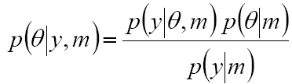
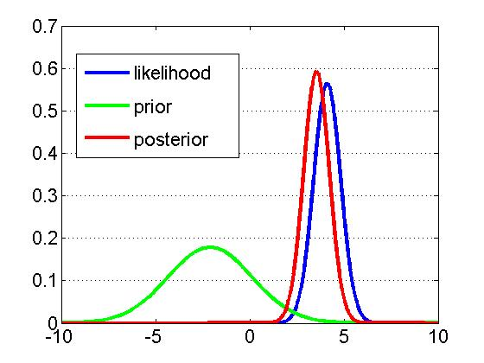
Bayesian paradigm
likelihood, priors and the model evidence
Likelihood:
Prior:
Bayes rule:
generative model m
Notes:
EXAMPLE:
-Y : EEG electric potential measured on the scalp
-theta : connection strength between two nodes of a network

Slide 24
Bayesian paradigm
the likelihood function of an alpha kernel
holding the parameters fixed
holding the data fixed
Notes:
Bayesian theory of probabilities furnishes:
- a language allowing to represent information and uncertainty.
- calculus tools able to manipulate these notions in a coherent manner.
It is an extension to formal logic, which works with propositions which are either true or false.
Theory of probabilities rather works with propositions which are more or less true or more or less false.
In other words, these propositions are characterized by their degree of plausibility.
D2: e.g., a higher degree of plausibility should correspond to a higher number.
D3: i.e. should not contain contradictions.
E.g., when a result can be derived in different ways, all calculus should yield the same result.
Finally, equal states of belief should correspond to equal degrees of plausibility.
- plausibility can be measured on probability scale (sum to 1)

Slide 25
Bayesian inference
type, role and impact of priors
Types of priors:
  Explicit priors on model parameters (e.g., connection strengths)
  Implicit priors on model functional form (e.g., system dynamics)
  Choice of “interesting” data features (e.g., ERP vs phase data)
Role of priors (on model parameters):
  Resolving the ill-posedness of the inverse problem
  Avoiding overfitting (cf. generalization error)
Impact of priors:
  On parameter posterior distributions (cf. “shrinkage to the mean” effect)
  On model evidence (cf. “Occam’s razor”)
  On free-energy landscape (cf. Laplace approximation)

Slide 26
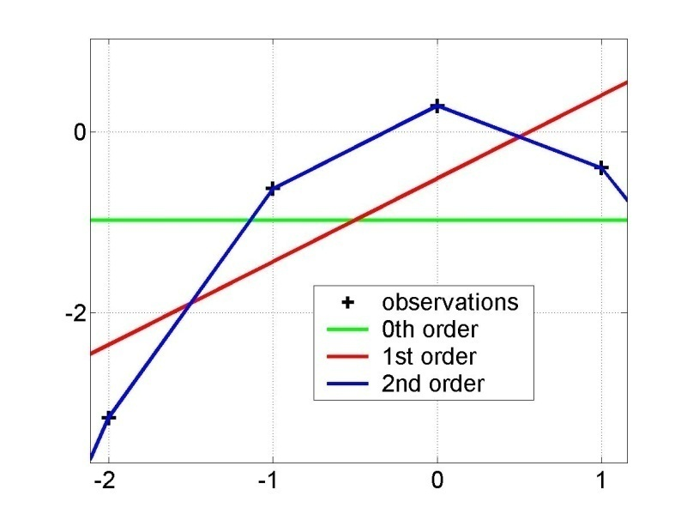
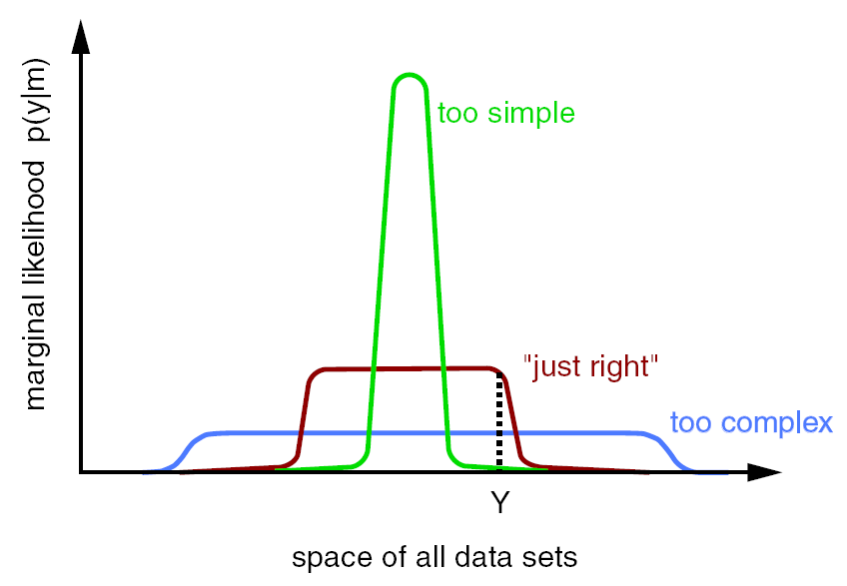
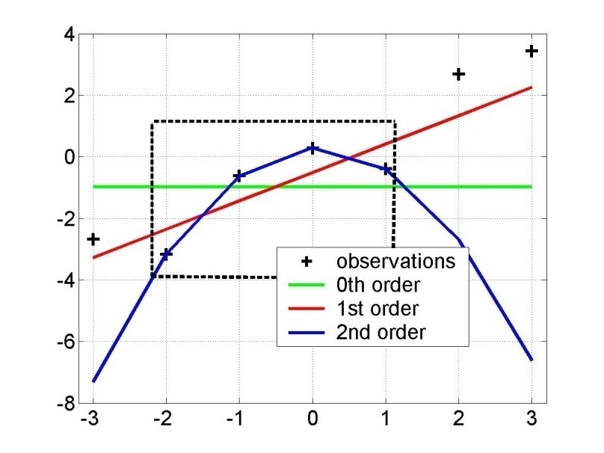
Bayesian inference
model comparison
Principle of parsimony :
« plurality should not be assumed without necessity »
Model evidence:
y = f(x)
“Occam’s razor” :
x
model evidence p(y|m)
y=f(x)
space of all data sets

Slide 27
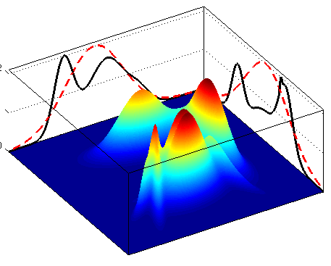
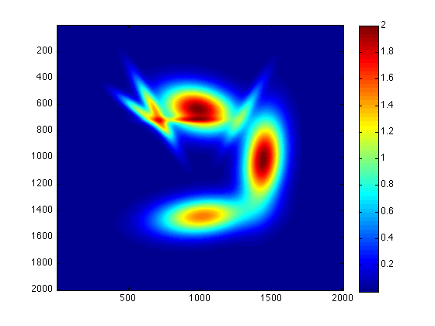
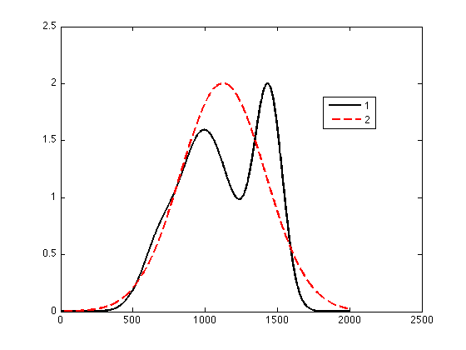
Bayesian inference
the variational Bayesian approach
free energy : functional of q
mean-field: approximate marginal posterior distributions:

Slide 28
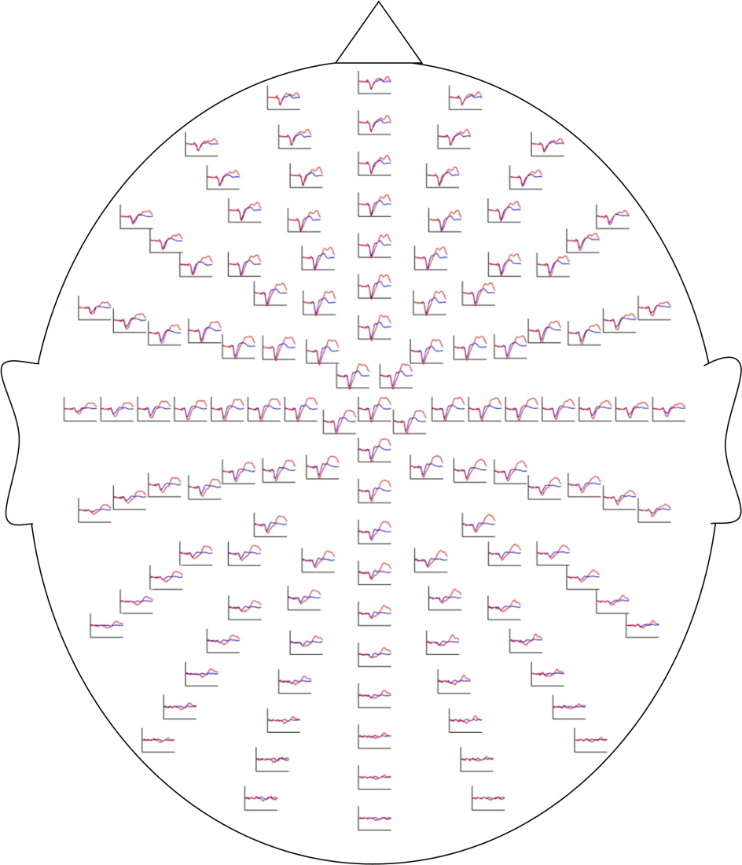
Bayesian inference
DCM: key model parameters
1
2
3
u
state-state coupling
input-state coupling
input-dependent modulatory effect

Slide 29
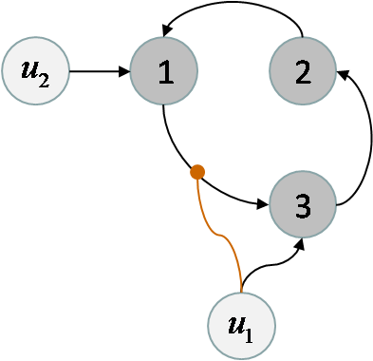
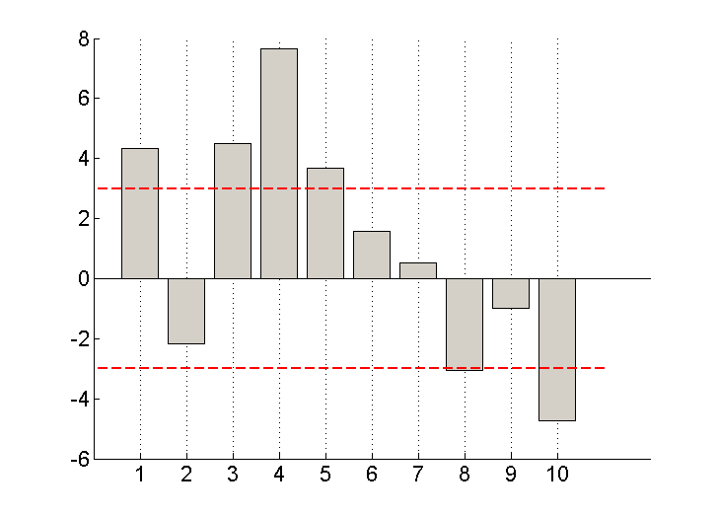
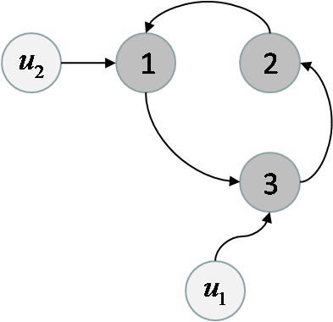
Bayesian inference
model comparison for group studies
m₁
differences in log- model evidences
m₂
subjects
fixed effect
assume all subjects correspond to the same model
random effect
assume different subjects might correspond to different models

Slide 30
Overview
1 DCM: introduction
2 Dynamical systems theory
4 Bayesian inference
5 Conclusion

Slide 31
Conclusion
summary
Functional integration
→ connections are recruited in a context-dependent fashion
→ which connections are modulated by experimental factors?
Dynamical system theory
→ DCM uses it to model feedback loops
→ linear systems have a unique impulse response function
Bayesian inference
→ parameter estimation and model comparison/selection
→ types, roles and impacts of priors

Slide 32
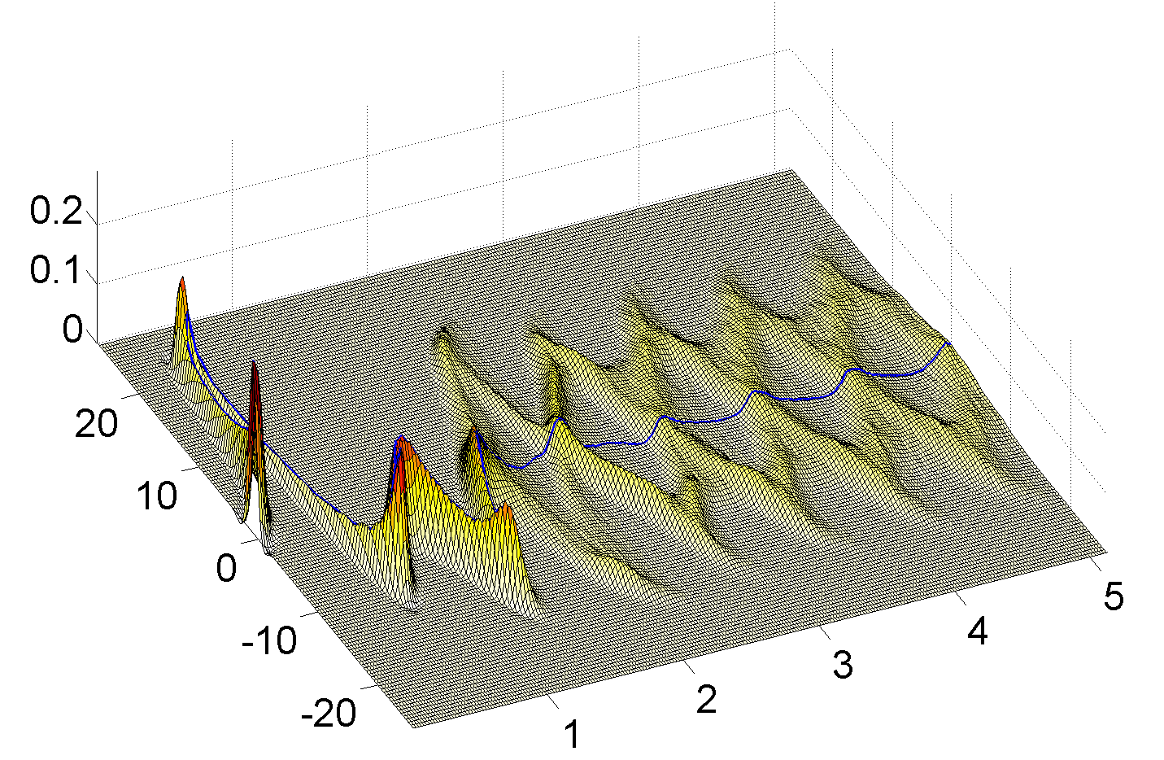
Conclusion
DCM for fMRI: variants
• two-states DCM
• stochastic DCM
x₁ (A.U.)
time (s)

Slide 33
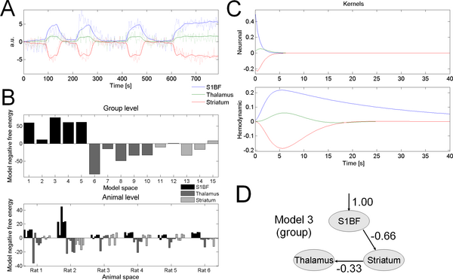
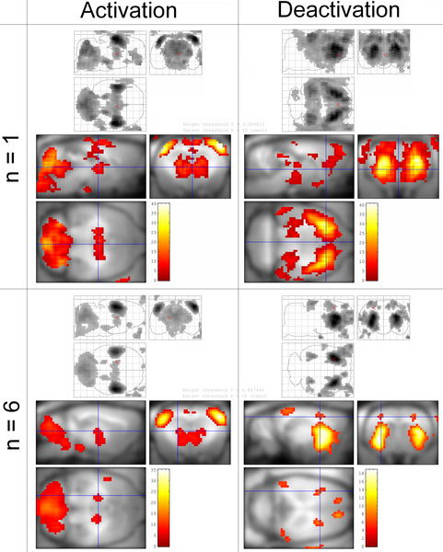
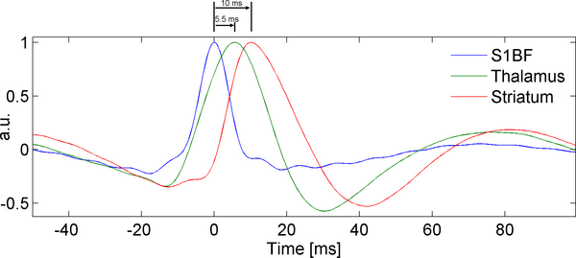
Conclusion
DCM for fMRI: validation
activation
deactivation
David et al., 2008
Notes:
What sort of studies are suitable to apply DCM to?

Slide 34
Conclusion
planning a compatible DCM study
Suitable experimental design:
  any design that is suitable for a GLM (including multifactorial designs)
  include rest periods (cf. build-up and decay dynamics)
  re-write the experimental manipulation in terms of:
    driving inputs (e.g., presence/absence of visual stimulation)
    modulatory inputs (e.g., presence/absence of motion in visual inputs)
Hypothesis and model:
  Identify specific a priori hypotheses (≠ functional segregation)
  which models are relevant to test this hypothesis?
  check existence of effect on data features of interest
  formal methods for optimizing the experimental design w.r.t. DCM
  [Daunizeau et al., PLoS Comp. Biol., 2011]
Notes:
What sort of studies are suitable to apply DCM to?

Slide 35
References
Daunizeau et al. 2012: Stochastic Dynamic Causal Modelling of fMRI data: should we care about neural noise? Neuroimage 62: 464-481.
Schmidt et al., 2012: Neural mechanisms underlying motivation of mental versus physical effort. PLoS Biol. 10(2): e1001266.
Daunizeau et al., 2011: Optimizing experimental design for comparing models of brain function. PLoS Comp. Biol. 7(11): e1002280
Daunizeau et al., 2011: Dynamic Causal Modelling: a critical review of the biophysical and statistical foundations. Neuroimage, 58: 312-322.
Den Ouden et al., 2010: Striatal prediction error modulates cortical coupling. J. Neurosci, 30: 3210-3219.
Stephan et al., 2009: Bayesian model selection for group studies. Neuroimage 46: 1004-1017.
David et al., 2008: Identifying Neural Drivers with Functional MRI: An Electrophysiological Validation. PloS Biol. 6: e315.
Stephan et al., 2008: Nonlinear dynamic causal models for fMRI. Neuroimage, 42: 649-662.
Friston et al., 2007: Variational Free Energy and the Laplace approximation. Neuroimage, 34: 220-234.
Sporns O., 2007: Brain connectivity. Scholarpedia 2(10): 1695.
David O., 2006: Dynamic causal modeling of evoked responses in EEG and MEG. Neuroimage, 30: 1255-1272.
Friston et al., 2003: Dynamic Causal Modelling. Neuroimage 19: 1273-1302.

Slide 36
Many thanks to:
Karl J. Friston (UCL, London, UK)
Will D. Penny (UCL, London, UK)
Klaas E. Stephan (UZH, Zurich, Switzerland)
Stefan Kiebel (MPI, Leipzig, Germany)

