Slide 1
Group Analysis
‘Ōiwi Parker Jones
SPM Course, London
May 2015

Slide 2
Overview
Variation may come from multiple sources
Some common to all data, e.g. measurement noise
Some common to subsets, e.g. subject variability
How do we model this?

Slide 3
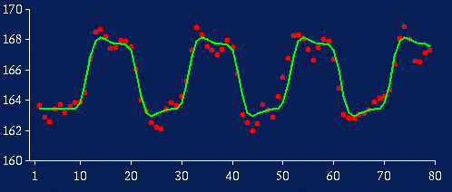
Subject 1
For voxel v in the brain
Effect size, c ~ 4

Slide 4
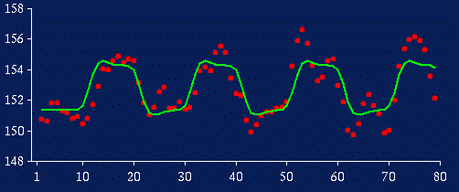
Subject 2
For voxel v in the brain
Effect size, c ~ 2

Slide 5
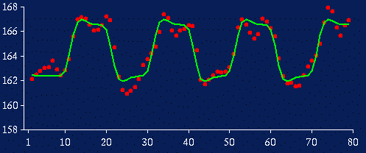
Subject 12
For voxel v in the brain
Effect size, c ~ 4

Slide 6
Random effect analysis (RFX)
>> c = [4, 2, 3, 1, 1, 2, 3, 3, 3, 2, 4, 4];
>> m = mean(c) % mean effect size
>> s_b = std(c) % between subject variability
>> n = length(c) % number of samples
>> sem = s_b / sqrt(n) % standard error of the mean
>> t = m / sem % t-stat
>> [~,p] = ttest(c,0) % p-value

Slide 7
Random effect analysis (RFX)
>> c = [4, 2, 3, 1, 1, 2, 3, 3, 3, 2, 4, 4];
>> m = mean(c) % 2.67
>> s_b = std(c) % 1.07
>> n = length(c) % 12
>> sem = s_b / sqrt(n) % 0.31
>> t = m / sem % 8.61
>> [~,p] = ttest(c,0) % 10⁻⁶

Slide 8
Subject 1
For voxel v in the brain
Effect size, c ~ 4
Within subject variability, s_{w}~0.9

Slide 9
Subject 2
For voxel v in the brain
Effect size, c ~ 2
Within subject variability, s_{w}~1.5

Slide 10
Subject 12
For voxel v in the brain
Effect size, c ~ 4
Within subject variability, s_{w}~1.1

Slide 11
Fixed effects analysis (FFX)
>> s_w = [0.9, 1.5, 1.2, 0.5, 0.4, 0.7, 0.8, 2.1, 1.8, 0.8, 0.7, 1.1]
>> m = mean(c) % mean effect size
>> s_w = mean(s_w) % mean s_w
>> n = length(c)*50 % number of samples
>> sem = s_w / sqrt(n) % standard error of the mean
>> t = m / sem % t-stat
>> [~,p] = ttest(c,0) % p-value
Notes:
n = 50 * 12

Slide 12
Fixed effects analysis (FFX)
>> s_w = [0.9, 1.5, 1.2, 0.5, 0.4, 0.7, 0.8, 2.1, 1.8, 0.8, 0.7, 1.1]
>> m = mean(c) % 2.67
>> s_w = mean(s_w) % 1.04
>> n = length(c) * 50 % 600 = 12 subj x 50 scans
>> sem = s_w / sqrt(n) % 0.04
>> t = m / sem % 62.7
>> [~,p] = ttest(c,0) % 10⁻⁵¹
“The fallacy of
classical inference”
Notes:
n = 50 * 12

Slide 13
n = 600
s_{w}
…

Slide 14
n = 12
Subj 1
Subj 2
Subj 12
s_{b}
…

Slide 15
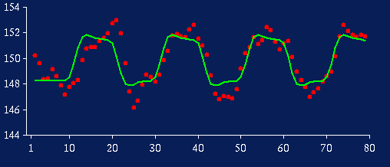
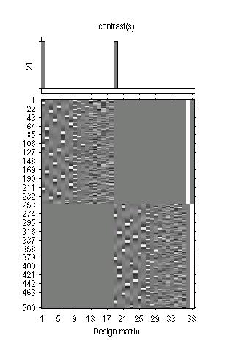
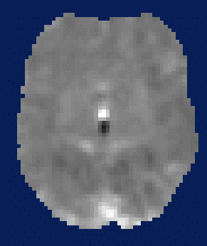
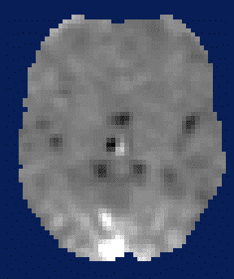

Summary stats
First level
Data Design Matrix Contrast Images

Slide 16
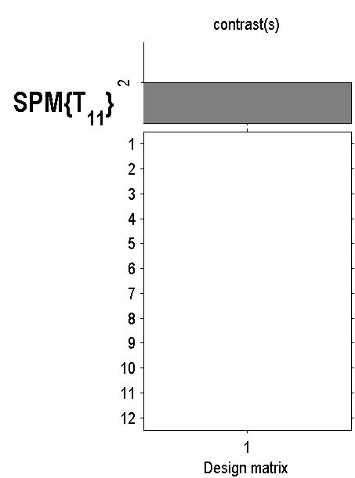
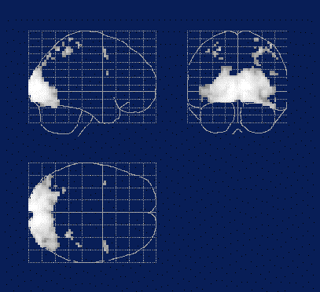
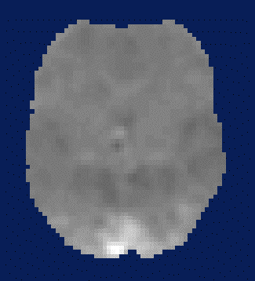
Summary stats
First level
Second level
Data Design Matrix Contrast Images
SPM(t)
One-sample
t-test @ 2nd level

Slide 17

Hierarchical model
(1) Within subject variance, s_{w}(i)
(2) Between subject variance,s_{b}
=
+
=
+
Second level
First level
Notes:
Multiple variance components at each level.
theta^{(1)} effect sizes
e^{(1)} is s_w
theta^{(2)} is constrained by s_b
E-step, estimate effect sizes
M-step, estimate variance components

Slide 18
Summary stats vs hierarchical models
Most people use summary stats (for RFX in neuroimaging)
  Quick to compute
  Equivalent to hierarchical models if
    within-subject variances are the same
    1st level designs are the same (e.g. equal number of trials)
Hierarchical models
  Guarantee optimal analysis for each dataset
  Can be very useful if
    assumptions 1, 2 above are violated (e.g. patient studies)
    you want to check your results

Slide 19
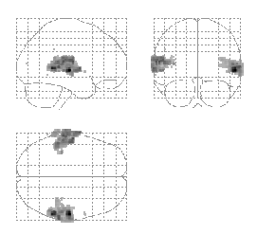

Auditory example
Summary
statistics
Hierarchical
Model
Friston et al. (2004) Mixed effects and fMRI studies, Neuroimage

Slide 20
Multiple conditions (part 1)
Condition 1 Condition 2 Condition 3
Sub1 Sub13 Sub25
Sub2 Sub14 Sub26
... ... ...
Sub12 Sub24 Sub36
ANOVA at 2nd level (e.g. drug).
Notes:
If you have two conditions this is a two-sample t-test.

Slide 21
Multiple conditions (part 2)
Condition 1 Condition 2 Condition3
Sub1 Sub1 Sub1
Sub2 Sub2 Sub2
... ... ...
Sub12 Sub12 Sub12
‘ANOVA within subjects’ at 2nd level.
(This is an ANOVA but with average subject effects removed.)
Notes:
If you have two conditions this is a paired t-test.

Slide 22
Summary
Group analysis can be used to model different sources of variation in data, either common (FFX) or not (RFX)
Group inference usually proceeds with RFX, not FFX. Group effects are compared between, rather than within, subject variability.
Hierarchical models provide a gold standard for RFX analysis but are computationally intensive (spm_mfx).
Summary statistics are a robust method for RFX group analysis (see SPM book; Mumford and Nichols, NI, 2009).
This approach is flexible: use ‘ANOVA’ or ‘ANOVA within subject’ at 2nd level for inferences about multiple experimental conditions.

Slide 23

Notes:
;)

