Slide 1
Dynamic Causal Modelling
Introduction
SPM Course (fMRI), October 2015
Peter Zeidman
Wellcome Trust Centre for Neuroimaging
University College London

Slide 2
Dynamic Causal Modelling
is a framework
for creating, estimating and comparing generative models
of neuroimaging timeseries
We use these models to investigate
effective connectivity of neuronal populations

Slide 3
Contents
Overview of DCM
  Effective connectivity, DCM framework, generative models
Model specification
  Neural model, haemodynamic model
Model estimation
  Model inversion, parameter inference
Example

Slide 4
Contents
Overview of DCM
  Effective connectivity, DCM framework, generative models
Model specification
  Neural model, haemodynamic model
Model estimation
  Model inversion, parameter inference
Example

Slide 5
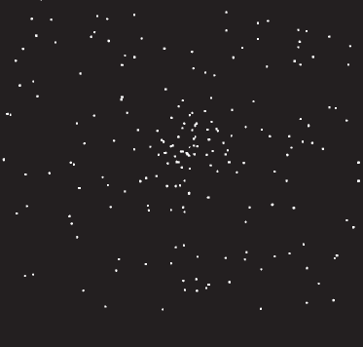
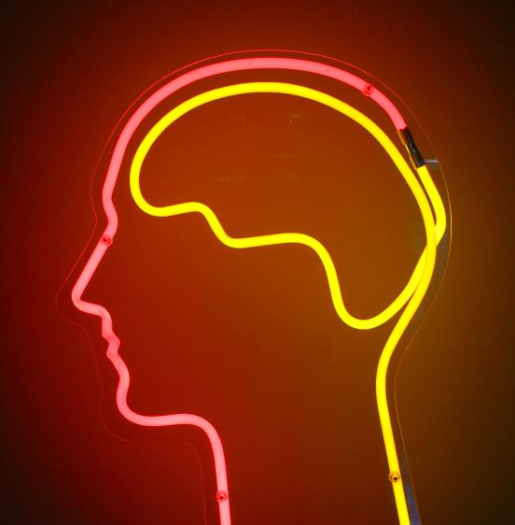
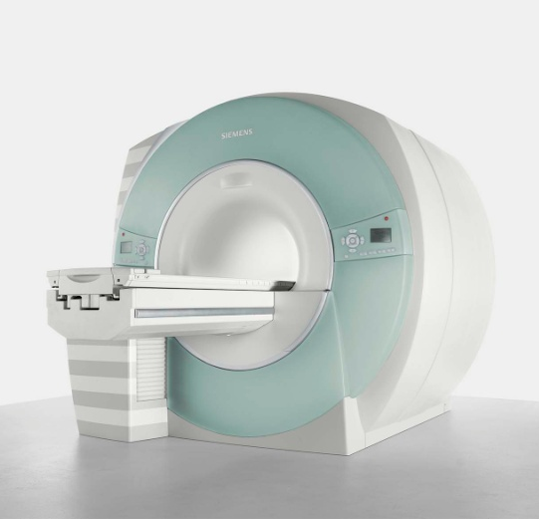
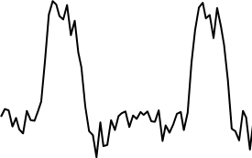
The system of interest
Experimental Stimulus
(Hidden) Neural Activity
Observations (BOLD)
Vector u
Vector y
on
?
BOLD
off
time
time
Stimulus from Buchel and Friston, 1997
Brain by Dierk Schaefer, Flickr, CC 2.0
Notes:
Experimental stimulation causes changes in neural activity. Neural activity in turn causes the BOLD response, which we observe via the scanner. We are interested in the hidden neural activity, which we cannot directly observe - so it must be inferred.

Slide 6
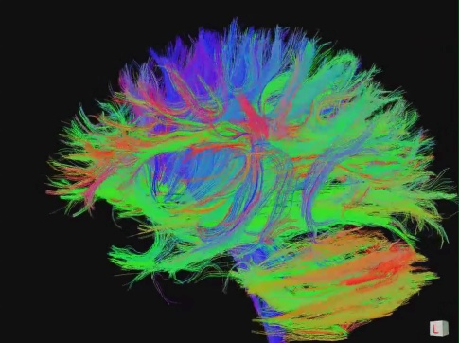
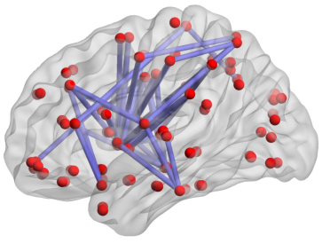
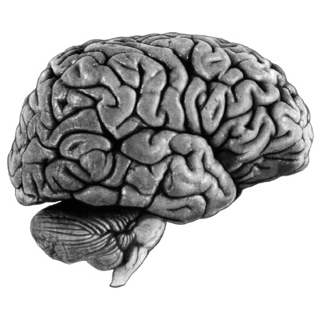
Connectivity
Structural Connectivity
Physical connections of the brain
Functional Connectivity
Dependencies between BOLD observations
Effectivity Connectivity
Causal relationships between brain regions
"Connectome" by jgmarcelino. CC 2.0 via Wikimedia Commons
Figure 1, Hong et al. 2013 PLOS ONE.
KE Stefan, SPM Course 2011
Notes:
Connectivity analysis is another way to look at neural activity. The most interesting is effective connectivity – interactions at the neural level.

Slide 7
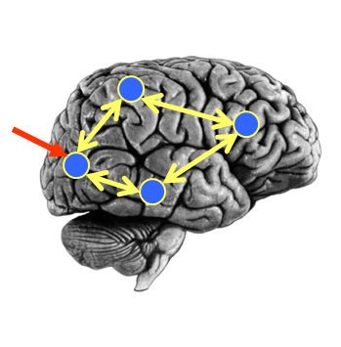
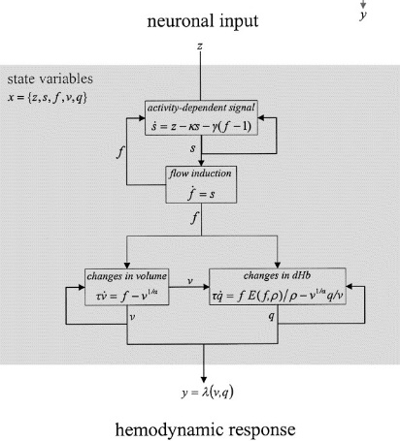

DCM Framework
Neural Model
Observation Model
Experimental Stimulus (u)
Observations (y)
How brain activity z changes over time
What we would see in the scanner, y, given the neural model?
.
z = f(z,u,θ^{n})
y = g(z, θ^{h})
Stimulus from Buchel and Friston, 1997
Figure 3 from Friston et al., Neuroimage, 2003
Brain by Dierk Schaefer, Flickr, CC 2.0

Slide 8
DCM Framework
Neural Model
Observation Model
Experimental Stimulus (u)
Observations (y)
Generative model
p(u,y)
Stimulus from Buchel and Friston, 1997
Figure 3 from Friston et al., Neuroimage, 2003
Brain by Dierk Schaefer, Flickr, CC 2.0

Slide 9
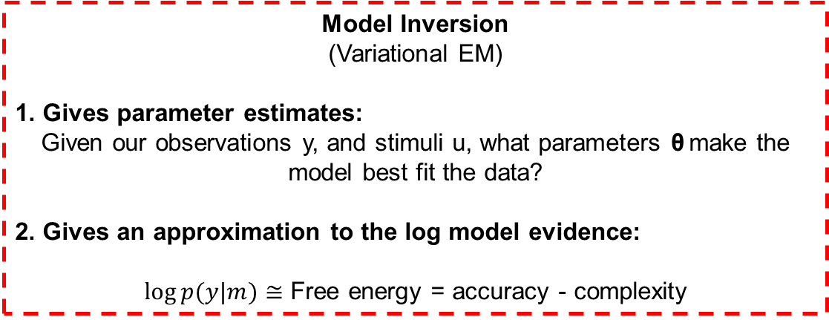
DCM Framework
Neural Model
Observation Model
Experimental Stimulus (u)
Observations (y)
Model Inversion
(Variational EM)
1. Gives parameter estimates:
Given our observations y, and stimuli u, what parameters θ make the model best fit the data?
2. Gives an approximation to the log model evidence:
$log⁡p(y|m)≅$ Free energy = accuracy - complexity

Slide 10



DCM Framework
Experimental Stimulus (u)
Neural Model
Observation Model
Observations (y)
Model 1:
Model comparison: Which model best explains my observed data?
Experimental Stimulus (u)
Neural Model
Observation Model
Observations (y)
Model 2:

Slide 11
DCM Framework
We embody each of our hypotheses in a generative model.
  The generative model separates neural activity from haemodynamics
We perform model estimation (inversion)
  This identifies parameters θ = {θ^{n},θ^{h}} which make the model best fit the data and the free energy (log model evidence)
We inspect the estimated parameters and / or we compare models to see which best explains the data.

Slide 12
Contents
Overview of DCM
  Effective connectivity, DCM framework, generative models
Model specification
  Neural model, haemodynamic model
Model estimation
  Model inversion, parameter inference
Example

Slide 13
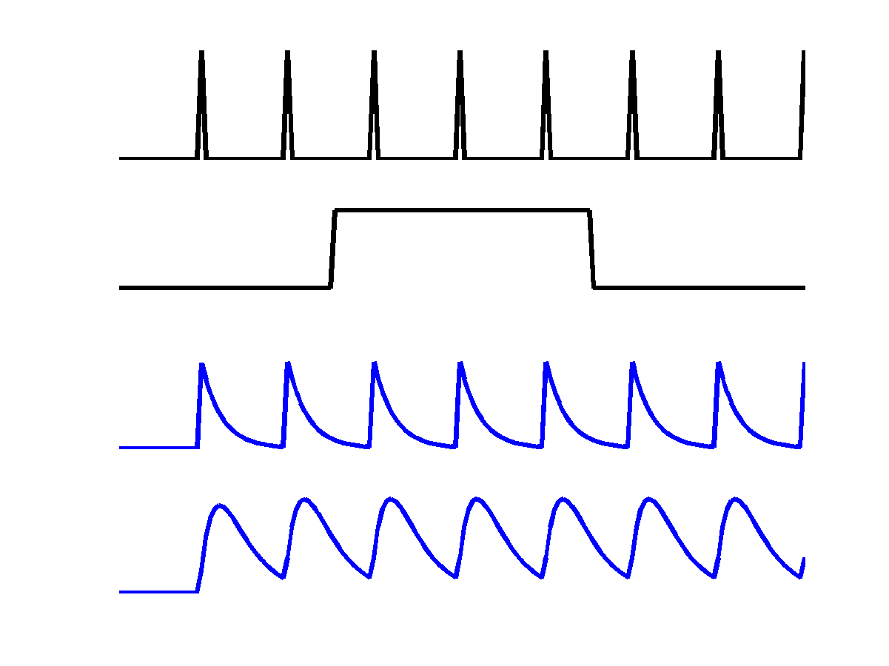
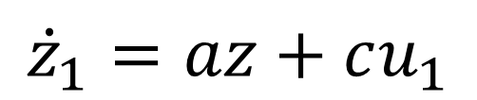
The Neural Model
“How does brain activity, z, change over time?”
V1
u₁
z₁
a
c
z₁
Driving input u₁
z₂
$${\dot{z}}_{1}=az+cu_{1}$$
Inhibitory self-connection (Hz).
Rate constant: controls rate of decay in region 1. More negative = faster decay.

Slide 14


The Neural Model
“How does brain activity, z, change over time?”
Change of activity in V1:
V5
a₂₂
z₂
$${\dot{z}}_{1}=a_{11}z_{1}+c_{11}u_{1}$$
a₂₁
Change of activity in V5:
V1
$${\dot{z}}_{2}=a_{22}z_{2}+a_{21}z_{1}$$
z₁
a₁₁
c₁₁
Self decay
V1 input
Driving input u₁

Slide 15
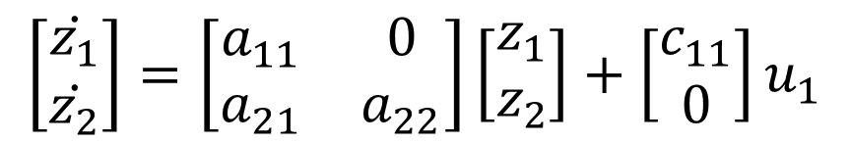

The Neural Model
“How does brain activity, z, change over time?”
$$\left[\begin{matrix}\dot{z_{1}} \\ \dot{z_{2}}\end{matrix}\right]=\left[\begin{matrix}a_{11} & 0 \\ a_{21} & a_{22}\end{matrix}\right]\left[\begin{matrix}z_{1} \\ z_{2}\end{matrix}\right]+\left[\begin{matrix}c_{11} \\ 0\end{matrix}\right]u_{1}$$
V5
a₂₂
z₂
a₂₁
Columns are outgoing connections
Rows are incoming connections
V1
z₁
a₁₁
$$\dot{z}=Az+Cu_{1}$$
c₁₁
Driving input u₁

Slide 16

The Neural Model
“How does brain activity, z, change over time?”
$$\dot{z}=Az+Cu_{1}$$
V5
a₂₂
z₂
u₁
a₂₁
V1
z₁
a₁₁
z₁
z₂
c₁₁
Driving input u₁

Slide 17
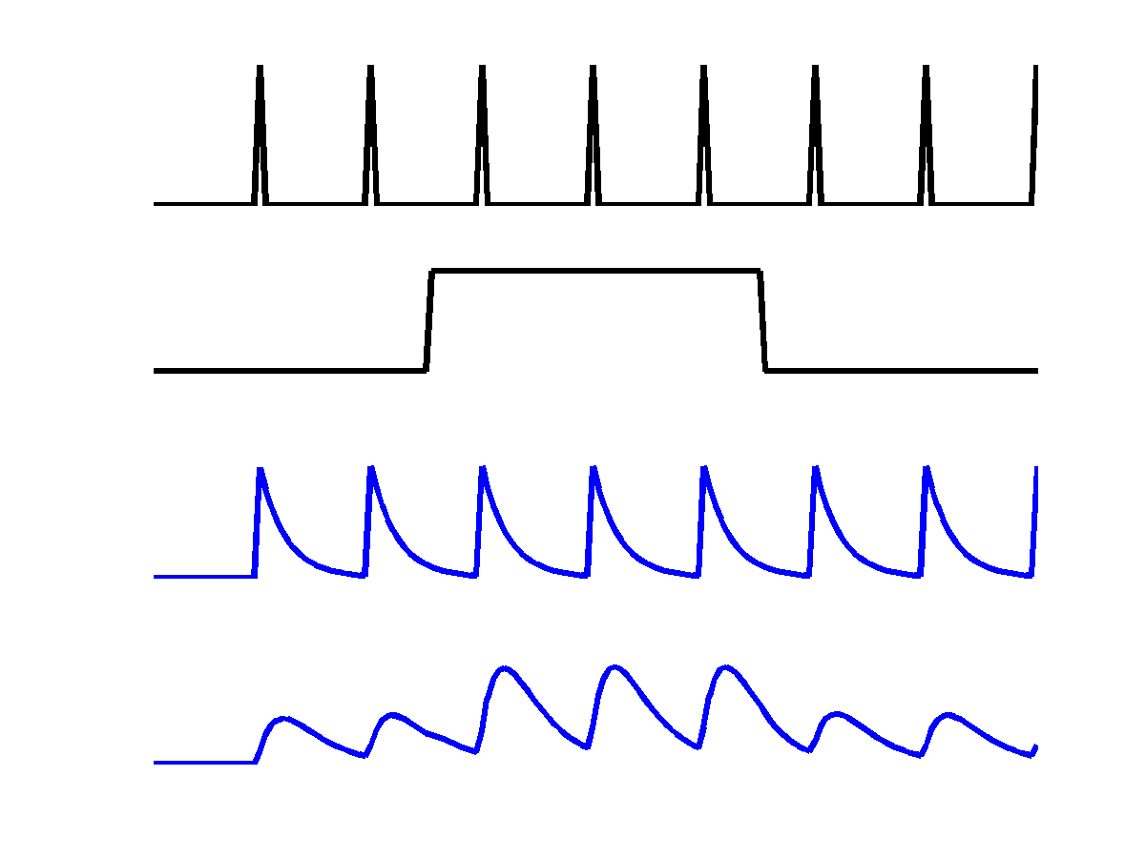
The Neural Model
“How does brain activity, z, change over time?”
V5
a₂₂
u₁
z₂
b₂₁
u₂
a₂₁
Attention u₂
V1
z₁
z₁
a₁₁
c₁₁
z₂
Driving input u₁
Could model be used to model a main effect and interaction

Slide 18


The Neural Model
“How does brain activity, z, change over time?”
Change of activity in V1:
V5
a₂₂
z₂
$$\dot{z_{1}}=a_{11}z_{1}+c_{11}u_{1}$$
b₂₁
a₂₁
Attention u₂
V1
Change of activity in V5:
z₁
a₁₁
$$\dot{z_{2}}=a_{22}z_{2}+a_{21}z_{1}+{(b}_{21}^{}u_{2}{)z}_{1}$$
c₁₁
Driving input u₁
Self decay
V1 input
Modulatory input

Slide 19

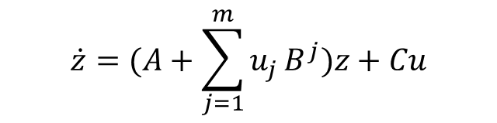
The Neural Model
V5
z₂
a₂₂
b₂₁
a₂₁
“How does brain activity, z, change over time?”
Attention u₂
V1
a₁₁
z₁
For m inputs:
c₁₁
$$\dot{z}=(A+\sum_{j=1}^{m}{u_{j}}B^{j})z+Cu$$
Driving input u₁
A: Structure
B: Modulatory
Input
C: Driving
Input
$$\left[\begin{matrix}{\dot{z}}_{1} \\ {\dot{z}}_{2}\end{matrix}\right]=\left(\left[\begin{matrix}a_{11} & 0 \\ a_{21} & a_{22}\end{matrix}\right]+u_{2}\left[\begin{matrix}0 & 0 \\ b_{21} & 0\end{matrix}\right]\right)\left[\begin{matrix}z_{1} \\ z_{2}\end{matrix}\right]+\left[\begin{matrix}c_{11} & 0 \\ 0 & 0\end{matrix}\right]\left[\begin{matrix}u_{1} \\ u_{2}\end{matrix}\right]$$
Change in
activity per
region
External input 2
(attention)
Current
activity
per region
All
external input

Slide 20
DCM Framework
Neural Model
Observation Model
Experimental Stimulus (u)
Observations (y)
How brain activity z changes over time
What we would see in the scanner, y, given the neural model?
.
z = f(z,u,θ^{n})
y = g(z, θ^{h})
Stimulus from Buchel and Friston, 1997
Figure 3 from Friston et al., Neuroimage, 2003
Brain by Dierk Schaefer, Flickr, CC 2.0

Slide 21
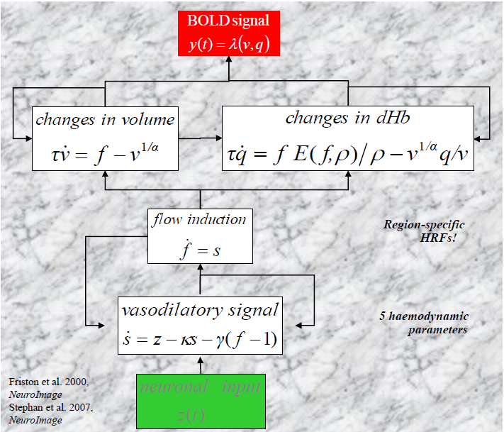
The Haemodynamic Model

Slide 22
Contents
Overview of DCM
  Effective connectivity, DCM framework, generative models
Model specification
  Neural model, haemodynamic model
Model estimation
  Model inversion, parameter inference
Example

Slide 23
DCM Framework
Neural Model
Observation Model
Experimental Stimulus (u)
Observations (y)
How brain activity z changes over time
What we would see in the scanner, y, given the neural model?
.
z = f(z,u,θ^{n})
y = g(z, θ^{h})
Stimulus from Buchel and Friston, 1997
Figure 3 from Friston et al., Neuroimage, 2003
Brain by Dierk Schaefer, Flickr, CC 2.0

Slide 24
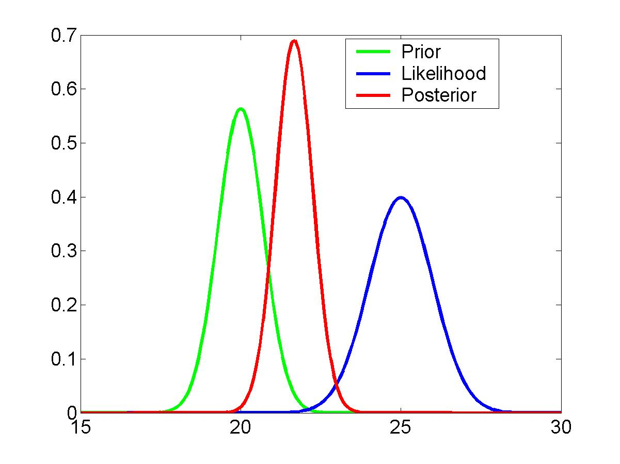
Bayesian Models
new data
prior knowledge
posterior ∝ likelihood ∙ prior
parameter estimates

Slide 25

Priors
All parameters have prior distributions, $p(θ)$
Between-regions neuronal coupling parameters have shrinkage priors.
Haemodynamic parameters have empirical priors.
Prior means stored in DCM.M.pE, covariance in DCM.M.pC
Prior on between-region coupling
N(0,1/64)
-1
-0.5
0
0.5
1
Connection strength (Hz)

Slide 26
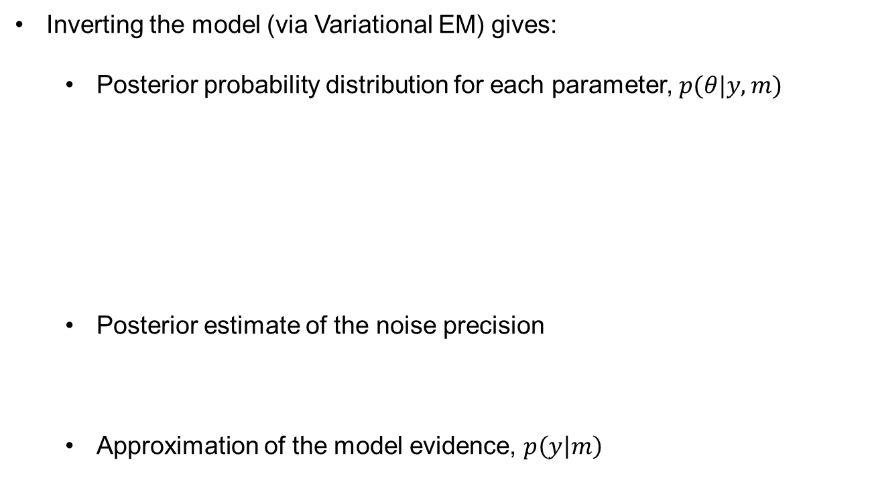
Model Estimation
Inverting the model (via Variational EM) gives:
  Posterior probability distribution for each parameter, $p(θ|y,m)$
  Posterior estimate of the noise precision
  Approximation of the model evidence, $p\left(y | m\right)$
Posterior mean stored in DCM.Ep
Posterior variance stored in DCM.Vp.
Noise precision stored in DCM.Ce
        Free energy stored in DCM.F

Slide 27
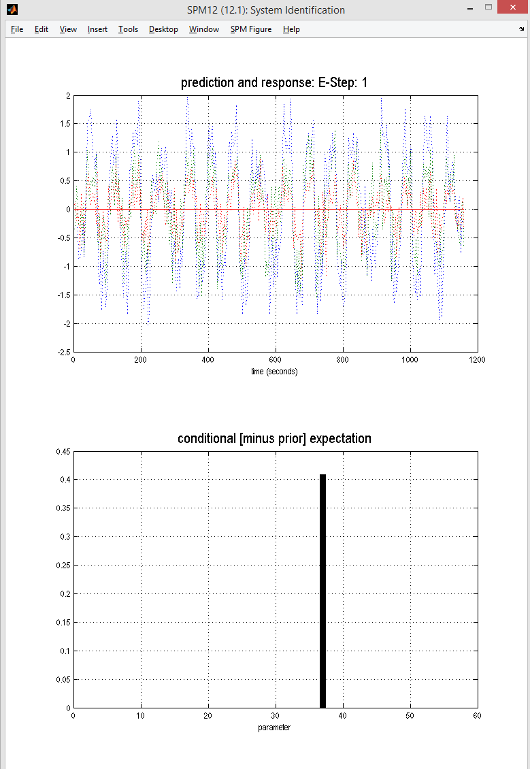

Slide 28
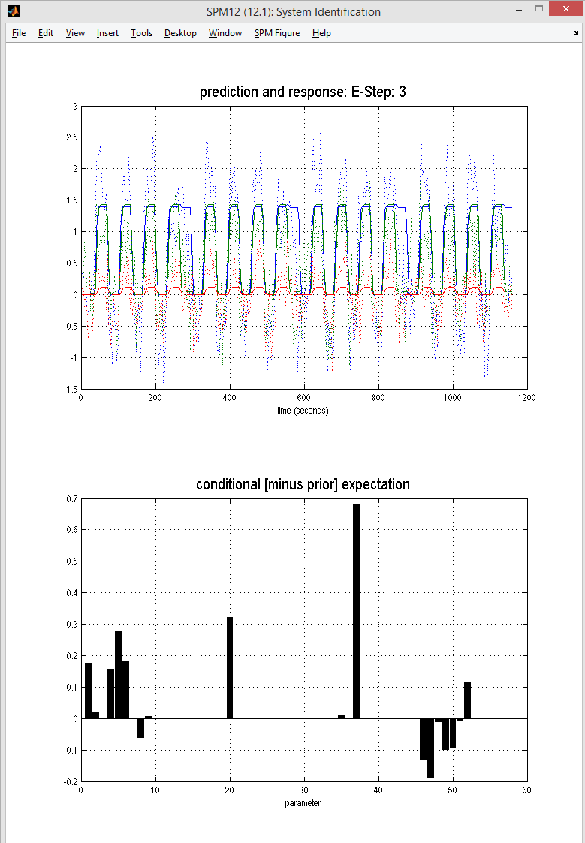

Slide 29
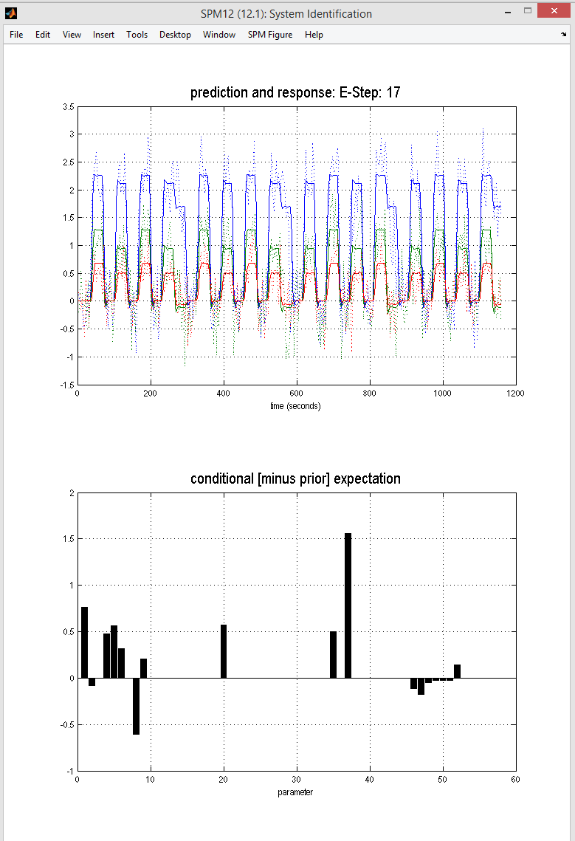

Slide 30
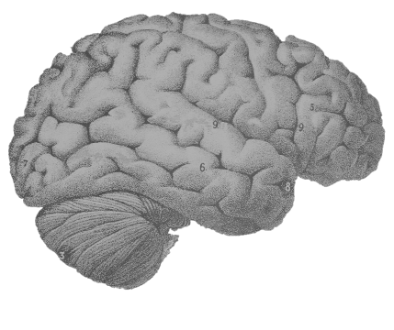
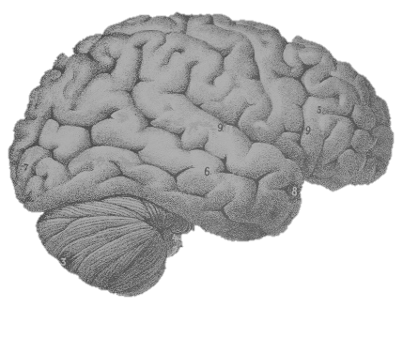
Bayesian Model Reduction
Model 1
Model 2
Model 3
Option 1:
Individually fit each model to the data (then inspect or compare)
Option 2:
Fit only the full model (model 1) then use ‘post-hoc model reduction’ (Bayesian Model Reduction) to estimate the others

Slide 31
Contents
Overview of DCM
  Effective connectivity, DCM framework, generative models
Model specification
  Neural model, haemodynamic model
Model estimation
  Model inversion, parameter inference
Example

Slide 32
Preparing data

Slide 33
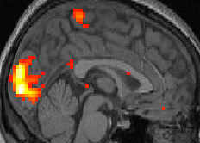
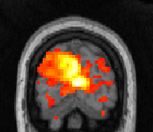
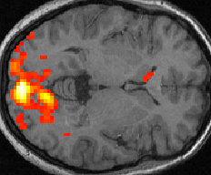

Choosing Regions of Interest
We generally start with SPM results
12
10
8
6
4
2
0

Slide 34

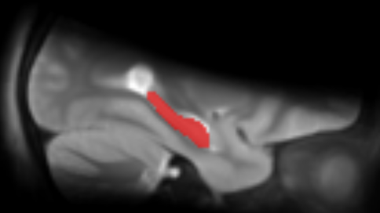
ROI Options
1. A sphere with given radius
2. An anatomical mask
Positioned at the group peak
or
Allowed to vary for each subject, within a radius of the group peak
+

Slide 35
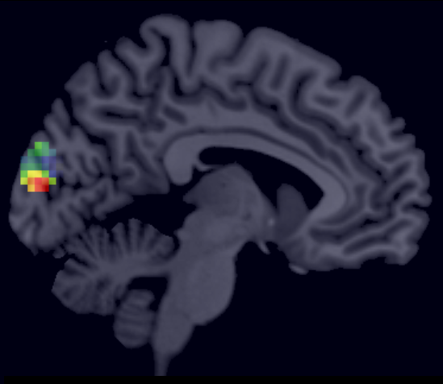
Pre-processing
Regress out nuisance effects (anything not specified in the ‘effects of interest f-contrast’)
Remove confounds such as low frequency drift
Summarise the ROI by performing PCA and retaining the first component
1st eigenvariate: test
3
New in SPM12: VOI_xx_eigen.nii
(When using the batch only)
2
1
0
-1
-2
-3
-4
200
400
600
800
1000
time \{seconds\}
230 voxels in VOI from mask VOI_test_mask.nii
Variance: 81.66%

Slide 36
example

Slide 38
Reading > fixation (29 controls)
Lesion (Patient AH)

Slide 39
1. Extracted regions of interest. Spheres placed at the peak SPM coordinates from two contrasts:
A. Reading in patient > controls
B. Reading in controls
2. Asked which region should receive the driving input

Slide 40
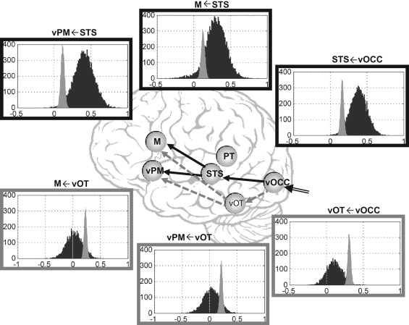
Bayesian Model Averaging
Key:
Controls
Patient
Seghier et al., Neuropsychologia, 2012

Slide 41
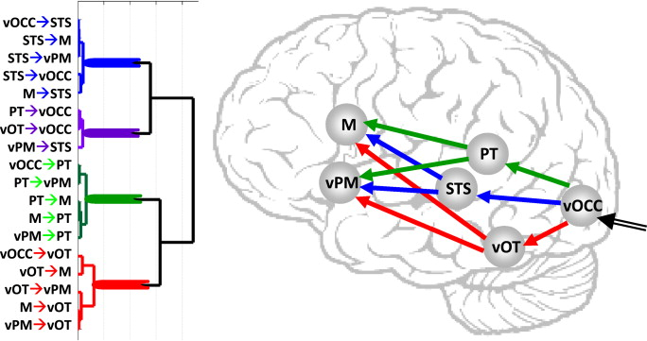
Seghier et al., Neuropsychologia, 2012

Slide 42
troubleshooting

Slide 43
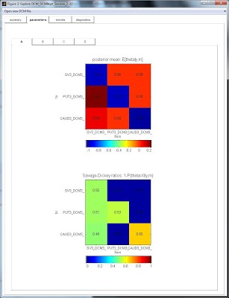
spm_dcm_fmri_check(DCM)
spm_dcm_explore (DCM)
From Jean Daunizeau’s website

Slide 44
Further Reading
The original DCM paper | Friston et al. 2003, NeuroImage
Descriptive / tutorial papers
Role of General Systems Theory | Stephan 2004, J Anatomy
DCM: Ten simple rules for the clinician | Kahan et al. 2013, NeuroImage
Ten Simple Rules for DCM | Stephan et al. 2010, NeuroImage
DCM Extensions
Two-state DCM | Marreiros et al. 2008, NeuroImage
Non-linear DCM | Stephan et al. 2008, NeuroImage
Stochastic DCM | Li et al. 2011, NeuroImage Friston et al. 2011, NeuroImage Daunizeau et al. 2012, Front Comput Neurosci
Post-hoc DCM | Friston and Penny, 2011, NeuroImage Rosa and Friston, 2012, J Neuro Methods
A DCM for Resting State fMRI | Friston et al., 2014, NeuroImage

Slide 45
extras

Slide 46


Variational Bayes
Approximates:
The log model evidence:
Posterior over parameters:
The log model evidence is decomposed:
The difference between the true and
approximate posterior
Free energy (Laplace approximation)
Accuracy
-
Complexity

Slide 47
The Free Energy
Accuracy
-
Complexity
Complexity
Distance between
prior and posterior
means
Occam’s factor
Volume of
prior parameters
posterior-prior
parameter means
Prior precisions
Volume of
posterior parameters
(Terms for hyperparameters not shown)

Slide 48
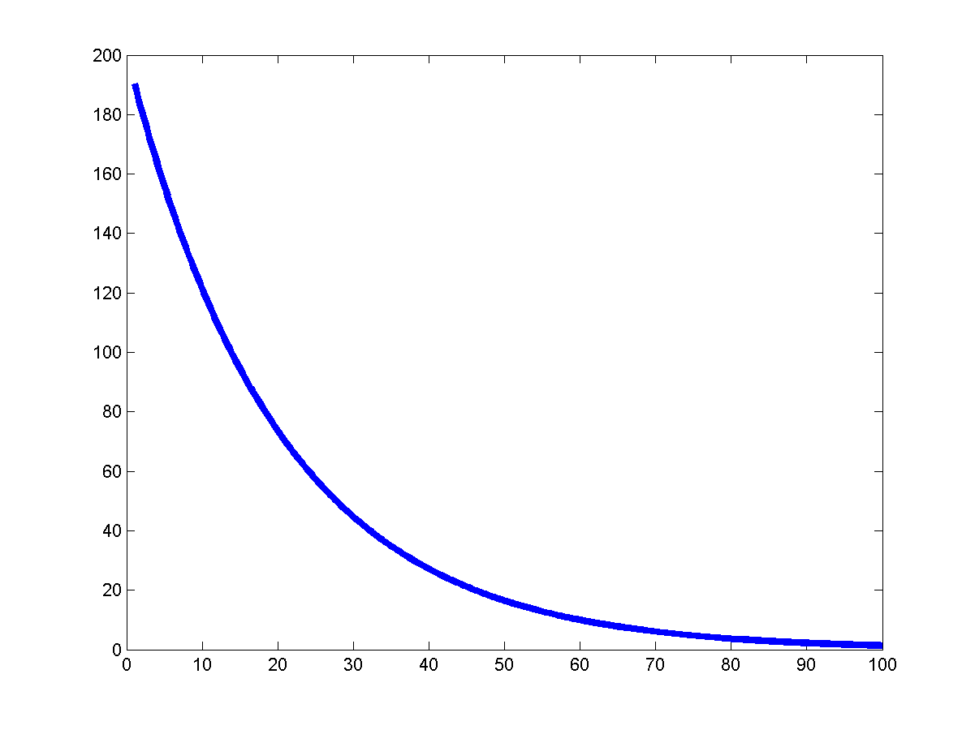
DCM parameters = rate constants
Integration of a first-order linear differential equation gives an
exponential function:
Coupling parameter a is inversely
proportional to the half life τ of x(t):
The coupling parameter ‘a’
thus describes the speed of
the exponential change in x(t)

Slide 49
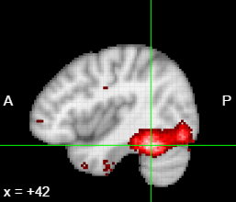
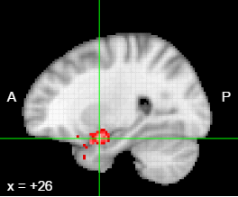
A factorial design translates easily to DCM
A (fictitious!) example of a 2x2 design:
Factor 1:
Stimulus (face or inverted face)
Factor 2:
Valence (neutral or angry)
Main effect of face: FFA
Interaction of
Stimulus x Valence:
Amygdala
Valence
From a factorial design:
Main effects → driving inputs
Interactions → modulatory inputs
Face
FFA
Amy

