Slide 1


DCM for fMRI – Advanced topics
Klaas Enno Stephan

Slide 2
Overview
DCM: basic concepts
Evolution of DCM for fMRI
Bayesian model selection (BMS)
Translational Neuromodeling

Slide 3
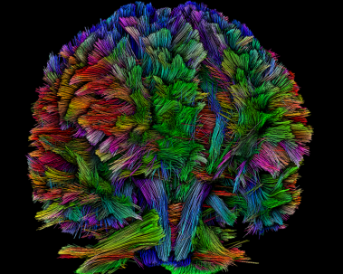
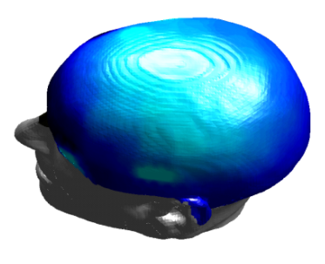
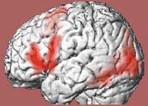
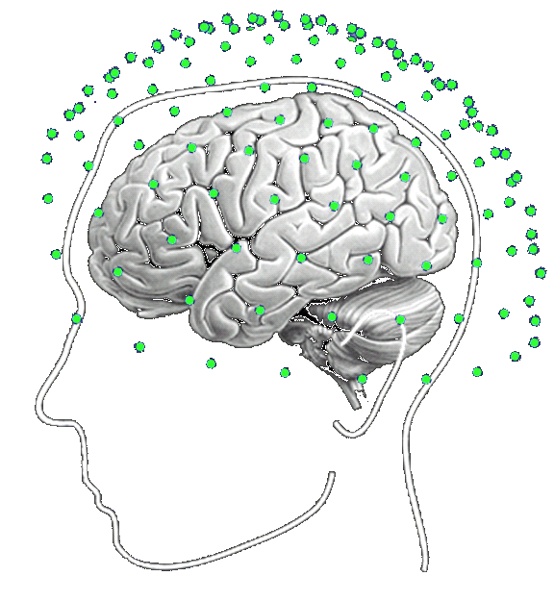
Dynamic causal modeling (DCM)
dwMRI
EEG, MEG
fMRI
structural priors
structural priors
Forward model:
Predicting measured activity
Model inversion:
Estimating neuronal mechanisms

Slide 4

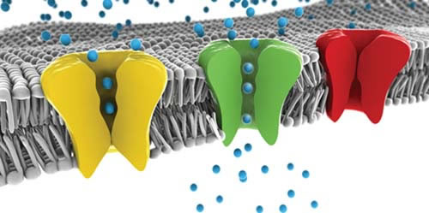
Generative model
enforces mechanistic thinking: how could the data have been caused?
generate synthetic data (observations) by sampling from the prior – can model explain certain phenomena at all?
inference about model structure: formal approach to disambiguating mechanisms → p(m|y)
inference about parameters → p(θ|y)

Slide 5
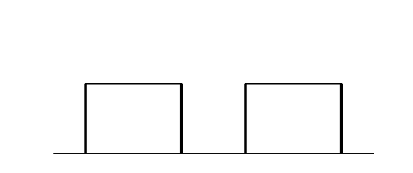
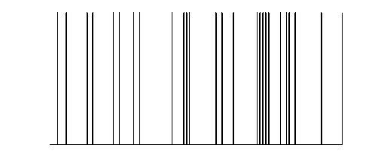
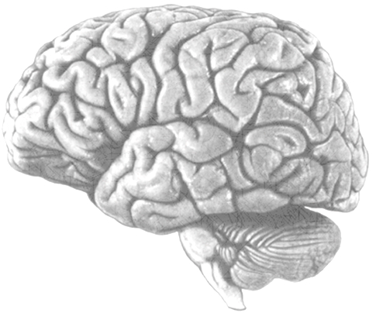
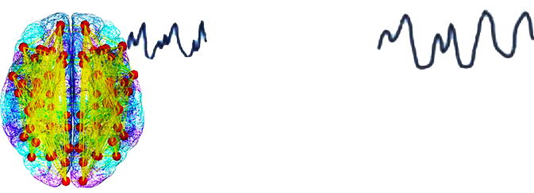
Modulatory input
Driving input
u₂(t)
Neuronal state equation
u₁(t)
t
t
$$\dot{x}=\left(A+\sum{u_{j}B^{\left(j\right)}}\right)x+Cu$$
$$x_{2}(t)$$
endogenous
connectivity
$$A=\frac{∂\dot{x}}{∂x}$$
$$x_{1}(t)$$
modulation of
connectivity
$$B^{(j)}=\frac{∂}{∂u_{j}}\frac{∂\dot{x}}{∂x}$$
$$x_{3}(t)$$
direct inputs
$$C=\frac{∂\dot{x}}{∂u}$$
Local hemodynamic
state equations
Neuronal states
$$x_{i}(t)$$
$$\dot{s}=x−κs−γ\left(f−1\right)$$
vasodilatory
signal and flow
induction (rCBF)
$$\dot{f}=s$$
Hemodynamic model
$$f$$
Balloon model
$$τ\dot{ν}=f−ν^{1/α}$$
$ν_{i}(t)$ and $q_{i}(t)$
$$τ\dot{q}=fE(f,E_{0})/E_{0}−ν^{1/α}q/ν$$
Changes in volume ($ν$)
and dHb ($q$)
BOLD signal change equation
BOLD signal
$$y=V_{0}\left[k_{1}\left(1−q\right)+k_{2}\left(1−\frac{q}{ν}\right)+k_{3}\left(1−ν\right)\right]+e$$
Stephan et al. 2015, Neuron
y(t)
with $k_{1}=4.3θ_{0}E_{0}TE$, $k_{2}=εr_{0}E_{0}TE$, $k_{3}=1−ε$

Slide 6
Bayesian system
identification
Design experimental inputs
Neural dynamics
Define likelihood model
Observer function
Specify priors
Inference on model structure
Invert model
Inference on parameters
Make inferences

Slide 7
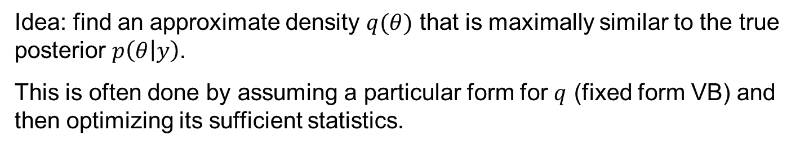
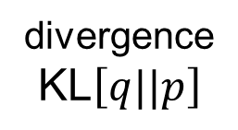
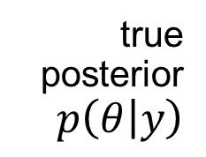
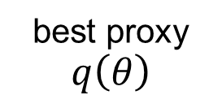
Variational Bayes (VB)
Idea: find an approximate density $q(θ)$ that is maximally similar to the true posterior $p\left(θ | y\right)$.
This is often done by assuming a particular form for $q$ (fixed form VB) and then optimizing its sufficient statistics.
true
posterior
$p\left(θ | y\right)$
hypothesis
class
divergence
$\text{KL}\left[q||p\right]$
best proxy
$$q\left(θ\right)$$

Slide 8



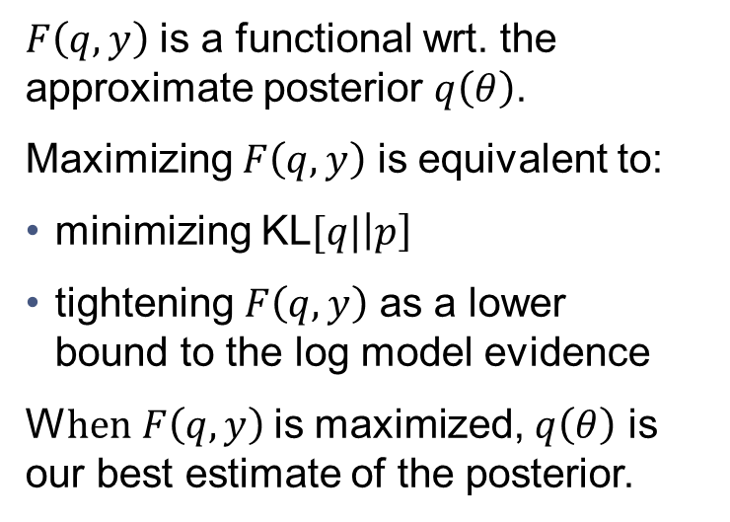


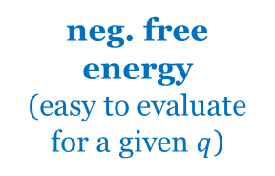



Variational Bayes
$${\ln{p\left(y\right)}}^{∗}$$
$$\ln{p\left(y\right)}$$
$\text{l}\text{n}{p(y)}=\text{KL}[q|\left|p\right] + F\left(q,y\right)$
$$\text{KL}[q|\left|p\right]$$
divergence $≥ 0$
(unknown)
neg. free energy
(easy to evaluate for a given $q$)
$$F\left(q,y\right)$$
$$\text{KL}[q|\left|p\right]$$
$F\left(q,y\right)$ is a functional wrt. the approximate posterior $q\left(θ\right)$.
Maximizing $F\left(q,y\right)$ is equivalent to:
minimizing $\text{KL}[q|\left|p\right]$
tightening $F\left(q,y\right)$ as a lower
bound to the log model evidence
W$hen F\left(q,y\right)$ is maximized, $q\left(θ\right)$ is our best estimate of the posterior.
$$F\left(q,y\right)$$
initialization …
… convergence

Slide 9
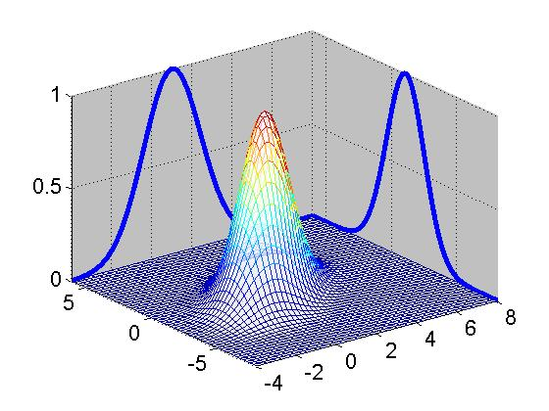

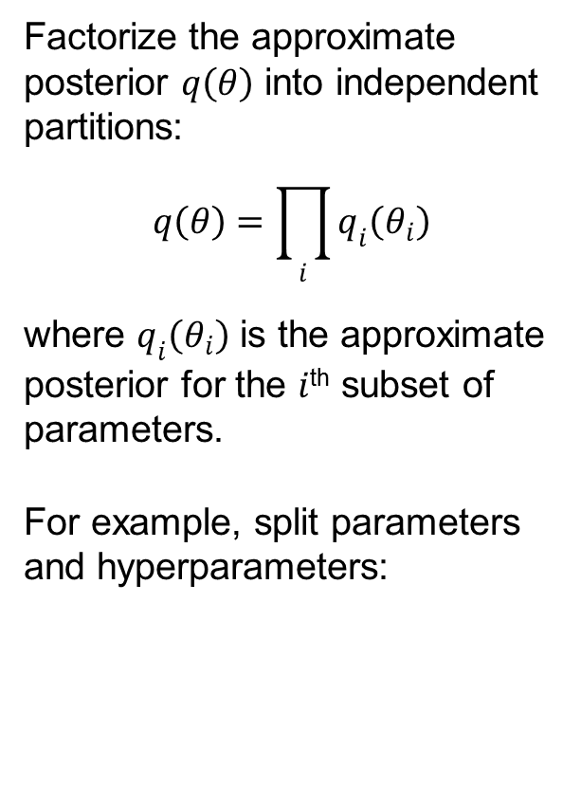



Mean field assumption
Factorize the approximate posterior $q\left(θ\right)$ into independent partitions:
$$q\left(θ\right)=\prod_{i}{q_{i}\left(θ_{i}\right)}$$
where $q_{i}\left(θ_{i}\right)$ is the approximate posterior for the $i$^{th} subset of parameters.
For example, split parameters and hyperparameters:
$$q\left(θ_{1}\right)$$
$$q\left(θ_{2}\right)$$
$$θ_{2}$$
$$θ_{1}$$
Jean Daunizeau, www.fil.ion.ucl.ac.uk/ ~jdaunize/presentations/Bayes2.pdf

Slide 10
VB in a nutshell (mean-field approximation)
❶ Neg. free-energy approx. to model evidence.
❷ Mean field approx.
❸ Maximise neg. free energy wrt. q = minimise divergence,
by maximising variational energies
❹ Iterative updating of sufficient statistics of approx. posteriors by gradient ascent.

Slide 11
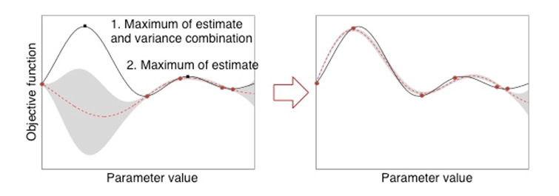
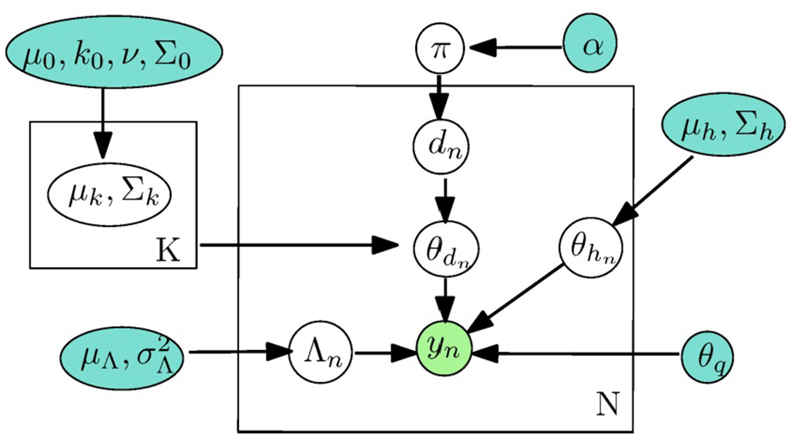
DCM: methodological developments
Local extrema → global optimisation
schemes for model inversion
  MCMC
  (Gupta et al. 2015, NeuroImage)
  Gaussian processes
  (Lomakina et al. 2015, NeuroImage)
Sampling-based estimates of model evidence
  Aponte et al. 2015, J. Neurosci. Meth.
  Raman et al., in preparation
Choice of priors → empirical Bayes
  Friston et al., submitted
  Raman et al., submitted

Slide 12
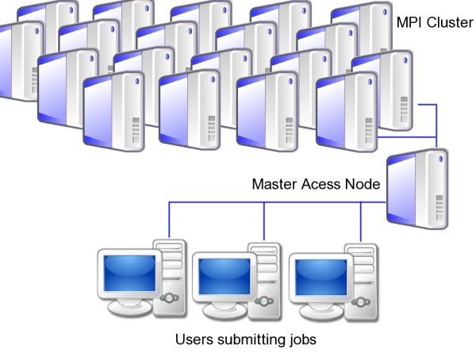
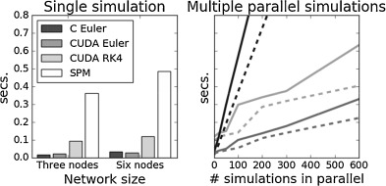
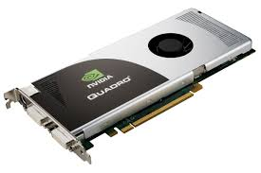
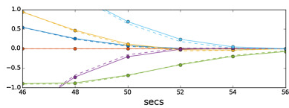
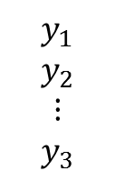
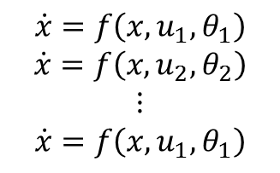
mpdcm: massively parallel DCM
$$\dot{x}=f\left(x, u_{1}, θ_{1}\right)$$
$$\dot{x}=f\left(x, u_{2},θ_{2}\right)$$
$$⋮$$
$$\dot{x}=f\left(x, u_{1}, θ_{1}\right)$$
$$y_{1}$$
$$y_{2}$$
$$⋮$$
$$y_{3}$$
mpdcm_integrate(dcms)
www.translationalneuromodeling.org/tapas
Aponte et al. 2015., J. Neurosci Meth.

Slide 13
Overview
DCM: basic concepts
Evolution of DCM for fMRI
Bayesian model selection (BMS)
Translational Neuromodeling

Slide 14
The evolution of DCM in SPM
DCM is not one specific model, but a framework for Bayesian inversion of dynamic system models
The implementation in SPM has been evolving over time, e.g.
  improvements of numerical routines (e.g., optimisation scheme)
  change in priors to cover new variants (e.g., stochastic DCMs)
  changes of hemodynamic model
To enable replication of your results, you should ideally state which SPM version (release number) you are using when publishing papers.

Slide 15
Factorial structure of model specification
Three dimensions of model specification:
  bilinear vs. nonlinear
  single-state vs. two-state (per region)
  deterministic vs. stochastic

Slide 16
y
y
y
BOLD
y
−
−
λ
−
hemodynamic
model
activity
x₂(t)
activity
x₃(t)
activity
x₁(t)
neuronal
states
x
modulatory
input u₂(t)
integration
driving
input u₁(t)
t
Neural state equation
endogenous connectivity
t
modulation of
connectivity
The classical DCM:
a deterministic, one-state, bilinear model
direct inputs

Slide 17
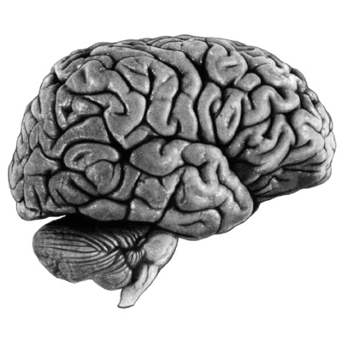
bilinear DCM
non-linear DCM
modulation
driving
input
driving
input
modulation
Two-dimensional Taylor series (around x₀=0, u₀=0):
Bilinear state equation:
Nonlinear state equation:

Slide 18
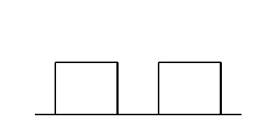
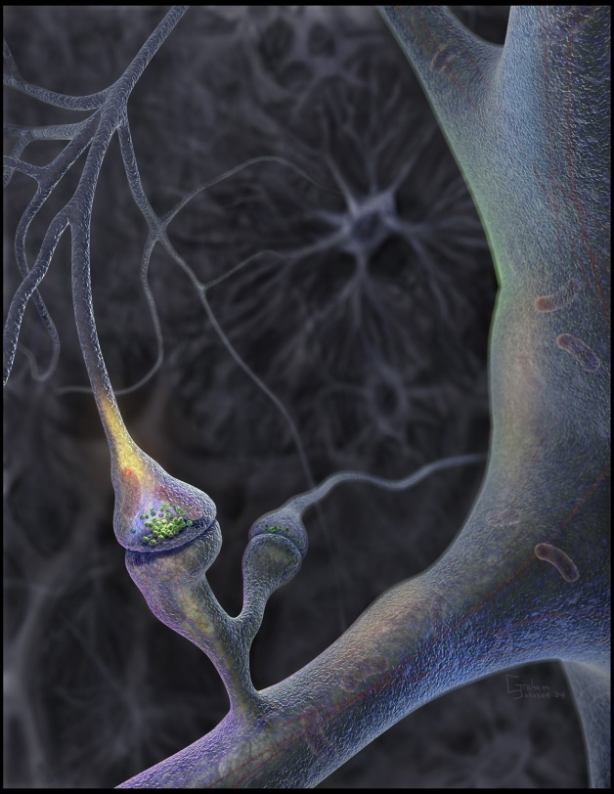
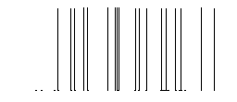
Neural population activity
u₂
u₁
x₃
fMRI signal change (%)
x₁
x₂
Nonlinear Dynamic Causal Model for fMRI
Stephan et al. 2008, NeuroImage

Slide 19
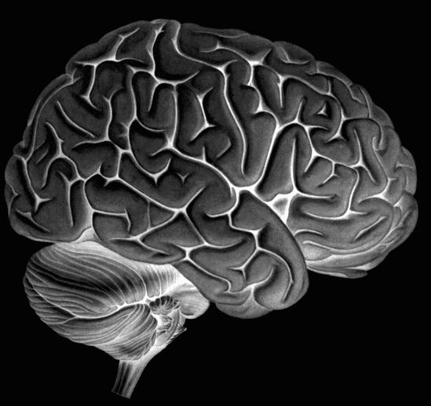
Two-state DCM
Single-state DCM
Two-state DCM
input
Extrinsic (between-region) coupling
Intrinsic (within-region) coupling
Marreiros et al. 2008, NeuroImage

Slide 20
Estimates of hidden causes and states
(Generalised filtering)
Stochastic DCM
all states are represented in generalised coordinates of motion
random state fluctuations w^{(x)} account for endogenous fluctuations,
have unknown precision and smoothness
→ two hyperparameters
fluctuations w^{(v)} induce uncertainty about how inputs influence neuronal activity
can be fitted to resting state data
Li et al. 2011, NeuroImage

Slide 21
Spectral DCM
deterministic model that generates predicted cross-spectra in a distributed neuronal network or graph
finds the effective connectivity among hidden neuronal states that best explains the observed functional connectivity among hemodynamic responses
advantage:
  replaces an optimisation problem wrt. stochastic differential equations with a deterministic approach from linear systems theory
  → computationally very efficient
disadvantages:
  assumes stationarity
Friston et al. 2014, NeuroImage

Slide 22

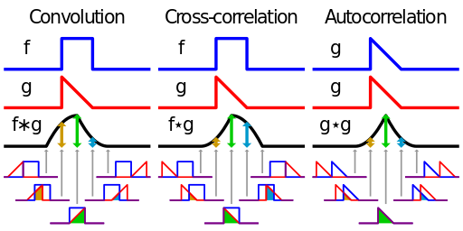
Cross-correlation & convolution
cross-correlation = measure of similarity of two waveforms as a function of the time-lag of one relative to the other
  slide two functions over each other and measure overlaps at all lags
related to the pdf of the difference beteween two random variables
→ a general measure of similarity between two time series
Source: Wikipedia

Slide 23
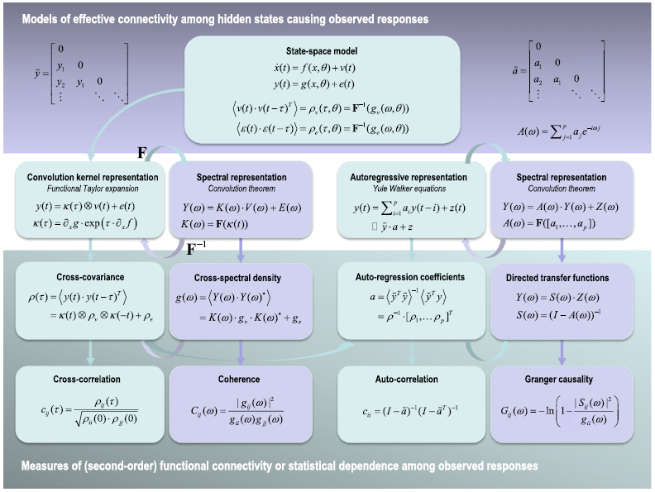
cross-spectra
= Fourier transform of cross-correlation
cross-correlation
= generalized form of correlation (at zero lag, this is the conventional measure of functional connectivity)
Friston et al. 2014, NeuroImage

Slide 24
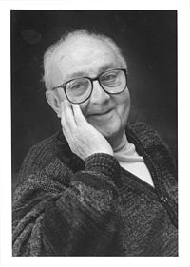
“All models are wrong,
but some are useful.”
George E.P. Box (1919-2013)

Slide 25
Hierarchical strategy for model validation
❶
numerical analysis & simulation studies
For DCM: >15 published validation studies
(incl. 6 animal studies):
infers site of seizure origin (David et al. 2008)
infers primary recipient of vagal nerve stimulation (Reyt et al. 2010)
infers synaptic changes as predicted by microdialysis (Moran et al. 2008)
infers fear conditioning induced plasticity in amygdala (Moran et al. 2009)
tracks anaesthesia levels (Moran et al. 2011)
predicts sensory stimulation (Brodersen et al. 2010)
in silico
❷
cognitive experiments
humans
❸
experimentally controlled system perturbations
animals &
humans
❹
clinical utility
patients

Slide 26
Overview
DCM: basic concepts
Evolution of DCM for fMRI
Bayesian model selection (BMS)
Translational Neuromodeling

Slide 27
Generative models & model selection
any DCM = a particular generative model of how the data (may) have been caused
generative modelling: comparing competing hypotheses about the mechanisms underlying observed data
  a priori definition of hypothesis set (model space) is crucial
  determine the most plausible hypothesis (model), given the data
model selection ≠ model validation!
  model validation requires external criteria (external to the measured data)

Slide 28
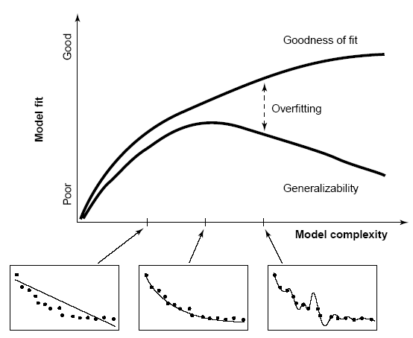
Model comparison and selection
Given competing hypotheses on structure & functional mechanisms of a system, which model is the best?
Which model represents the
best balance between model
fit and model complexity?
For which model m does p(y|m) become maximal?
Pitt & Miyung (2002) TICS

Slide 29
Bayesian model selection (BMS)
Model evidence:
Gharamani, 2004
p(y|m)
y
accounts for both accuracy and complexity of the model
all possible datasets
allows for inference about model structure
Various approximations, e.g.:
negative free energy, AIC, BIC
McKay 1992, Neural Comput.
Penny et al. 2004a, NeuroImage

Slide 30
Approximations to the model evidence in DCM
Logarithm is a monotonic function
Maximizing log model evidence
= Maximizing model evidence
Log model evidence = balance between fit and complexity
No. of
parameters
Akaike Information Criterion:
No. of
data points
Bayesian Information Criterion:
Penny et al. 2004a, NeuroImage

Slide 31



The (negative) free energy approximation F
Neg. free energy is a lower bound on log model evidence:
$$\ln{p\left(y|m\right)}$$
$$\text{KL}[q|\left|p\right]$$
$$F\left(q,y\right)$$
Like AIC/BIC, F is an accuracy/complexity tradeoff:

Slide 32
The complexity term in F
In contrast to AIC & BIC, the complexity term of the negative free energy F accounts for parameter interdependencies.
The complexity term of F is higher
  the more independent the prior parameters (↑ effective DFs)
  the more dependent the posterior parameters
  the more the posterior mean deviates from the prior mean

Slide 33
Bayes factors
To compare two models, we could just compare their log evidences.
But: the log evidence is just some number – not very intuitive!
A more intuitive interpretation of model comparisons is made possible by Bayes factors:
positive value, [0; ∞[
B₁₂ | p(m₁|y) | Evidence
1 to 3 | 50-75% | weak
3 to 20 | 75-95% | positive
20 to 150 | 95-99% | strong
≥ 150 | ≥ 99% | Very strong
Kass & Raftery classification:
Kass & Raftery 1995, J. Am. Stat. Assoc.

Slide 34
Fixed effects BMS at group level
Group Bayes factor (GBF) for 1...K subjects:
Average Bayes factor (ABF):
Problems:
blind with regard to group heterogeneity
sensitive to outliers

Slide 35
Random effects BMS for heterogeneous groups
Dirichlet parameters α
= “occurrences” of models in the population
Dirichlet distribution of model probabilities r
Multinomial distribution of model labels m
Model inversion by Variational Bayes (VB) or MCMC
Measured data y
Stephan et al. 2009a, NeuroImage
Penny et al. 2010, PLoS Comp. Biol.

Slide 36
Random effects BMS for heterogeneous groups
Dirichlet parameters α
= “occurrences” of models in the population
k = 1...K
r_{k}
Dirichlet distribution of model probabilities r
m_{nk}
Multinomial distribution of model labels m
Model inversion by Variational Bayes (VB) or MCMC
y_{n}
n = 1...N
Measured data y
Stephan et al. 2009a, NeuroImage
Penny et al. 2010, PLoS Comp. Biol.

Slide 37
m₂
LD
LD|LVF
m₁
MOG
FG
FG
MOG
MOG
FG
FG
MOG
LD|RVF
LD|LVF
LD
LD
LG
LG
LG
LG
RVF
stim.
LD
LVF
stim.
RVF
stim.
LD|RVF
LVF
stim.
m₂
m₁
Data: Stephan et al. 2003, Science
Models: Stephan et al. 2007, J. Neurosci.

Slide 38
m₂
m₁
Stephan et al. 2009a, NeuroImage

Slide 39
How can we report the results of random effects BMS?
1. Dirichlet parameter estimates
2. expected posterior probability of obtaining the k-th model for any randomly selected subject
3. exceedance probability that a particular model k is more likely than any other model (of the K models tested), given the group data
4. protected exceedance probability:
see below

Slide 40
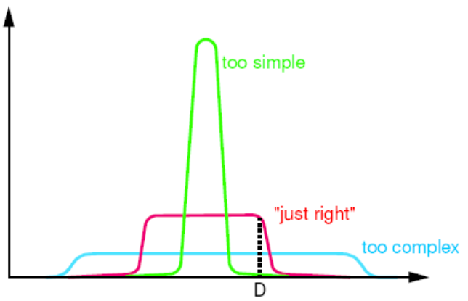
Overfitting at the level of models
↑ #models ⇒ ↑ risk of overfitting
solutions:
  regularisation: definition of model space = choosing priors p(m)
  family-level BMS
  Bayesian model averaging (BMA)
posterior model probability:
BMA:

Slide 41
Model space partitioning:
comparing model families
m₂
m₁
m₁
m₂
Stephan et al. 2009, NeuroImage

Slide 42
Bayesian Model Averaging (BMA)
abandons dependence of parameter inference on a single model and takes into account model uncertainty
represents a particularly useful alternative
  when none of the models (or model subspaces) considered clearly outperforms all others
  when comparing groups for which the optimal model differs
single-subject BMA:
group-level BMA:
NB: p(m|y_{1..N}) can be obtained by either FFX or RFX BMS
Penny et al. 2010, PLoS Comput. Biol.

Slide 43
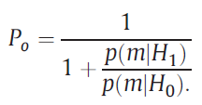
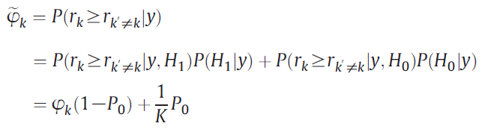
Protected exceedance probability:
Using BMA to protect against chance findings
EPs express our confidence that the posterior probabilities of models are different – under the hypothesis H₁ that models differ in probability: r_{k}≠1/K
does not account for possibility "null hypothesis" H₀: r_{k}=1/K
Bayesian omnibus risk (BOR) of wrongly accepting H₁ over H₀:
protected EP: Bayesian model averaging over H₀ and H₁:
Rigoux et al. 2014, NeuroImage

Slide 44
definition of model space
inference on model structure or inference on model parameters?
inference on
individual models or model space partition?
inference on
parameters of an optimal model or parameters of all models?
optimal model structure assumed to be identical across subjects?
comparison of model families using
FFX or RFX BMS
optimal model structure assumed to be identical across subjects?
BMA
yes
no
yes
no
FFX BMS
RFX BMS
FFX BMS
RFX BMS
FFX analysis of parameter estimates
(e.g. BPA)
RFX analysis of parameter estimates
(e.g. t-test, ANOVA)
Stephan et al. 2010, NeuroImage

Slide 45
Two empirical example applications
Breakspear et al. 2015,
Brain
Schmidt et al. 2013,
JAMA Psychiatry

Slide 46
Go/No-Go task to emotional faces
(bipolar patients, at-risk individuals, controls)
Hypoactivation of left IFG in the at-risk group during fearful distractor trials
DCM used to explain interaction of motor inhibition and fear perception
That is: what is the most likely circuit mechanism explaining the fear x inhibition interaction in IFG?
Breakspear et al. 2015, Brain

Slide 47
Model space
models of
serial (1-3), parallel (4) and hierarchical (5-8) processes
Breakspear et al. 2015, Brain

Slide 48
Family-level BMS
family-level comparison:
nonlinear models more likely than bilinear ones in both healthy controls and bipolar patients
at-risk group: bilinear models more likely
significant group difference in ACC modulation of DLPFC→IFG interaction
Breakspear et al. 2015, Brain

Slide 49
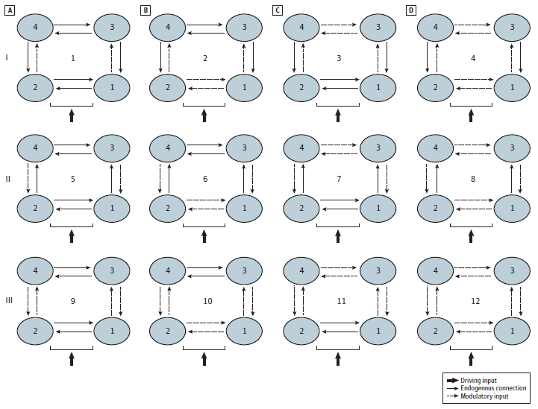
Prefrontal-parietal connectivity during working memory in schizophrenia
17 at-risk mental state (ARMS) individuals
21 first-episode patients
(13 non-treated)
20 controls
Schmidt et al. 2013, JAMA Psychiatry

Slide 50
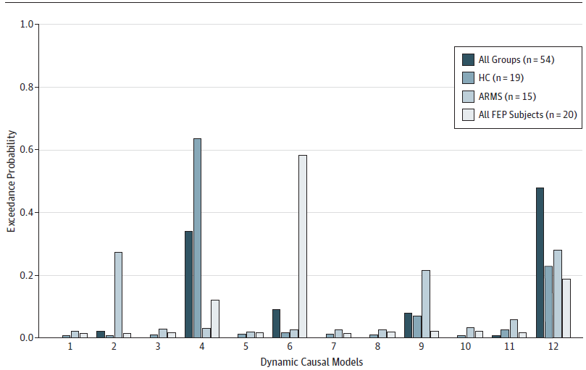
BMS results for all groups
Schmidt et al. 2013, JAMA Psychiatry

Slide 51
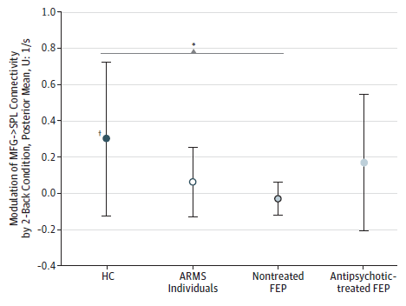
BMA results: PFC → PPC connectivity
17 ARMS, 21 first-episode (13 non-treated), 20 controls
Schmidt et al. 2013, JAMA Psychiatry
Notes:
we cannot be absolutely sure that in this case the B parameters encode synaptic plasticity
clinical scores did not differ between treated and non-treated FEPs: Brief Psychiatric Rating Scale (BPRS)³⁷, the Scale for the Assessment of Negative Symptoms (SANS)³⁸ and the Global Assessment of Functioning (GAF)

Slide 52
Overview
DCM: basic concepts
Evolution of DCM for fMRI
Bayesian model selection (BMS)
Translational Neuromodeling

Slide 53
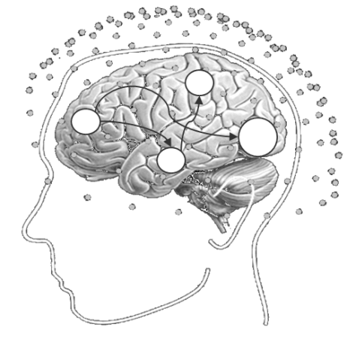





❶
Computational assays:
Models of disease mechanisms
Translational Neuromodeling
❹
Individual treatment prediction
❸
Detecting physiological subgroups
(based on inferred mechanisms)
❷
Application to brain activity and behaviour of individual patients
• disease mechanism A
• disease mechanism B
• disease mechanism C
Stephan et al. 2015, Neuron

Slide 54
Model-based predictions for single patients
model structure
DA
BMS
parameter estimates
model-based decoding
(generative embedding)
Notes:
Overall, Bayesian model selection is a generic and powerful procedure that has found widespread application in machine learning and neuroimaging. However, as every method, it has limitations and there are cases when it cannot be used at all. For these cases, we have been developing a new approach which we colloquially refer to as “model-based decoding”. This approach rests on using a model for theory-guided dimensionality reduction and selecting those data features which are used subsequently for classification. Here, different models can be compared, by cross-validation, in terms of how well their parameters preserve information about the relevant class labels.

Slide 55
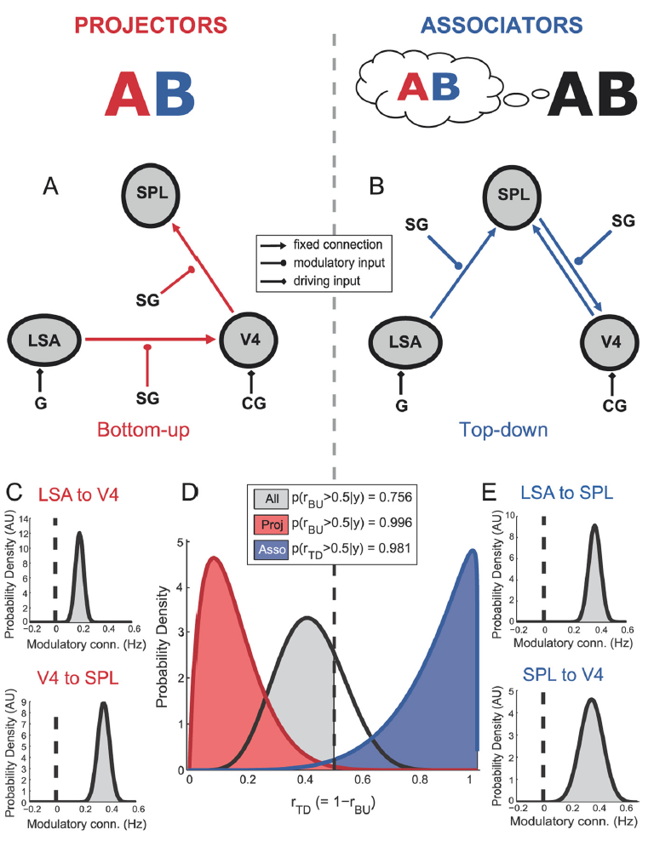
Synaesthesia
“projectors” experience color externally colocalized with a presented grapheme
“associators” report an internally evoked association
across all subjects: no evidence for either model
but BMS results map precisely onto projectors (bottom-up mechanisms) and associators (top-down)
van Leeuwen et al. 2011, J. Neurosci.

Slide 56
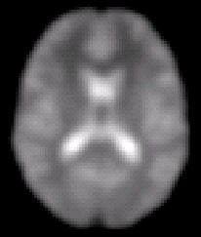





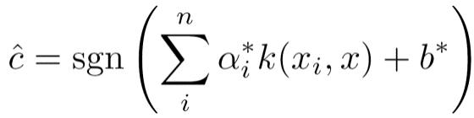
Generative embedding (supervised): classification
step 1 —
model inversion
A
step 2 —
kernel construction
A → B
A → C
B → B
B → C
B
C
measurements from an individual subject
subject-specific
inverted generative model
subject representation in the generative score space
A
step 4 —
interpretation
step 3 —
support vector classification
B
C
jointly discriminative
model parameters
separating hyperplane fitted to discriminate between groups
Brodersen et al. 2011, PLoS Comput. Biol.

Slide 57
Discovering remote or “hidden” brain lesions

Slide 58
Discovering remote or “hidden” brain lesions

Slide 59
Connectional fingerprints : aphasic patients (N=11) vs. controls (N=26)
6-region DCM of auditory areas during passive speech listening
Brodersen et al. 2011, PLoS Comput. Biol.

Slide 60
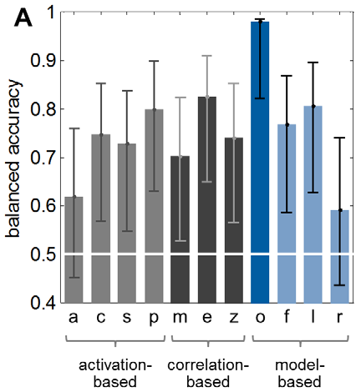
Can we predict presence/absence of the "hidden" lesion?
Classification accuracy
PT
PT
HG
(A1)
HG
(A1)
MGB
MGB
auditory stimuli
Brodersen et al. 2011, PLoS Comput. Biol.

Slide 61
Voxel-based activity space
Model-based parameter space
Voxel 3
Parameter 3
patients
controls
Voxel 2
Parameter 2
Voxel 1
Parameter 1
classification accuracy
75%
classification accuracy
98%
Brodersen et al. 2011, PLoS Comput. Biol.

Slide 62
×
×
×
Brodersen et al. 2011, PLoS Comput. Biol.

Slide 63
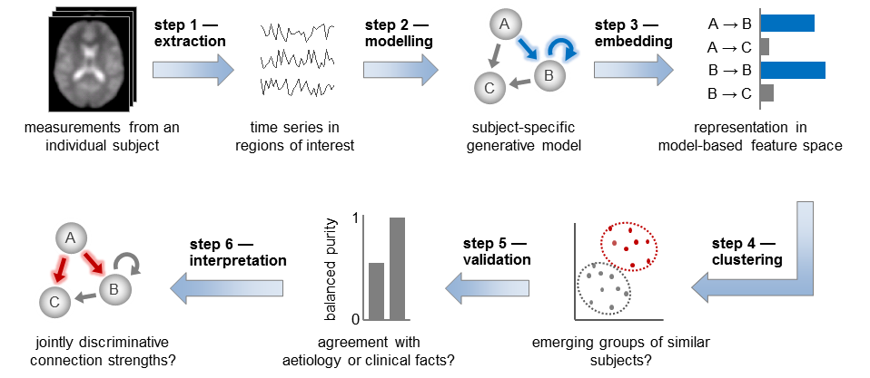
Generative embedding (unsupervised): detecting patient subgroups
Brodersen et al. 2014, NeuroImage: Clinical

Slide 64
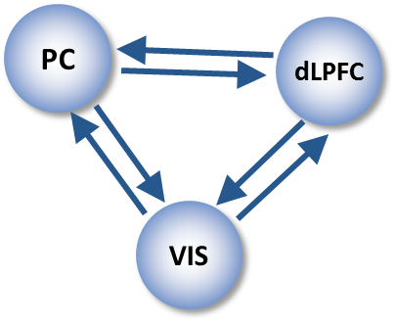
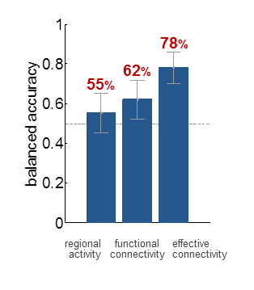

Generative embedding of variational Gaussian Mixture Models
Supervised:
SVM classification
Unsupervised:
GMM clustering
71%
number of clusters
number of clusters
42 controls vs. 41 schizophrenic patients
fMRI data from working memory task (Deserno et al. 2012, J. Neurosci)
Brodersen et al. (2014) NeuroImage: Clinical

Slide 65



Detecting subgroups of patients in schizophrenia
Optimal cluster solution
three distinct subgroups (total N=41)
subgroups differ (p < 0.05) wrt. negative symptoms on the positive and negative symptom scale (PANSS)
Brodersen et al. (2014) NeuroImage: Clinical

Slide 66
Dissecting spectrum disorders
Differential diagnosis
model validation
(longitudinal patient studies)
BMS
Generative
embedding
(unsupervised)
Computational assays
Generative models of behaviour & brain activity
BMS
Generative
embedding
(supervised)
optimized experimental paradigms
(simple, robust, patient-friendly)
initial model validation
(basic science studies)
Stephan & Mathys 2014, Curr. Opin. Neurobiol.

Slide 67
Further reading: DCM for fMRI and BMS – part 1
Aponte EA, Raman S, Sengupta B, Penny WD, Stephan KE, Heinzle J (2015) mpdcm: A Toolbox for Massively Parallel Dynamic Causal Modeling. Journal of Neuroscience Methods, in press
Breakspear M, Roberts G, Green MJ, Nguyen VT, Frankland A, Levy F, Lenroot R, Mitchell PB (2015) Network dysfunction of emotional and cognitive processes in those at genetic risk of bipolar disorder. Brain, in press.
Brodersen KH, Schofield TM, Leff AP, Ong CS, Lomakina EI, Buhmann JM, Stephan KE (2011) Generative embedding for model-based classification of fMRI data. PLoS Computational Biology 7: e1002079.
Brodersen KH, Deserno L, Schlagenhauf F, Lin Z, Penny WD, Buhmann JM, Stephan KE (2014) Dissecting psychiatric spectrum disorders by generative embedding. NeuroImage: Clinical 4: 98-111
Daunizeau J, David, O, Stephan KE (2011) Dynamic Causal Modelling: A critical review of the biophysical and statistical foundations. NeuroImage 58: 312-322.
Daunizeau J, Stephan KE, Friston KJ (2012) Stochastic Dynamic Causal Modelling of fMRI data: Should we care about neural noise? NeuroImage 62: 464-481.
Friston KJ, Harrison L, Penny W (2003) Dynamic causal modelling. NeuroImage 19:1273-1302.
Friston K, Stephan KE, Li B, Daunizeau J (2010) Generalised filtering. Mathematical Problems in Engineering 2010: 621670.
Friston KJ, Li B, Daunizeau J, Stephan KE (2011) Network discovery with DCM. NeuroImage 56: 1202–1221.
Friston K, Penny W (2011) Post hoc Bayesian model selection. Neuroimage 56: 2089-2099.
Kiebel SJ, Kloppel S, Weiskopf N, Friston KJ (2007) Dynamic causal modeling: a generative model of slice timing in fMRI. NeuroImage 34:1487-1496.
Li B, Daunizeau J, Stephan KE, Penny WD, Friston KJ (2011) Stochastic DCM and generalised filtering. NeuroImage 58: 442-457
Lomakina EI, Paliwal S, Diaconescu AO, Brodersen KH, Aponte EA, Buhmann JM, Stephan KE (2015) Inversion of Hierarchical Bayesian models using Gaussian processes. NeuroImage 118: 133-145.
Marreiros AC, Kiebel SJ, Friston KJ (2008) Dynamic causal modelling for fMRI: a two-state model. NeuroImage 39:269-278.
Penny WD, Stephan KE, Mechelli A, Friston KJ (2004a) Comparing dynamic causal models. NeuroImage 22:1157-1172.
Penny WD, Stephan KE, Mechelli A, Friston KJ (2004b) Modelling functional integration: a comparison of structural equation and dynamic causal models. NeuroImage 23 Suppl 1:S264-274.

Slide 68
Further reading: DCM for fMRI and BMS – part 2
Penny WD, Stephan KE, Daunizeau J, Joao M, Friston K, Schofield T, Leff AP (2010) Comparing Families of Dynamic Causal Models. PLoS Computational Biology 6: e1000709.
Penny WD (2012) Comparing dynamic causal models using AIC, BIC and free energy. Neuroimage 59: 319-330.
Rigoux L, Stephan KE, Friston KJ, Daunizeau J (2014) Bayesian model selection for group studies – revisited. NeuroImage 84: 971-985.
Stephan KE, Harrison LM, Penny WD, Friston KJ (2004) Biophysical models of fMRI responses. Curr Opin Neurobiol 14:629-635.
Stephan KE, Weiskopf N, Drysdale PM, Robinson PA, Friston KJ (2007) Comparing hemodynamic models with DCM. NeuroImage 38:387-401.
Stephan KE, Harrison LM, Kiebel SJ, David O, Penny WD, Friston KJ (2007) Dynamic causal models of neural system dynamics: current state and future extensions. J Biosci 32:129-144.
Stephan KE, Weiskopf N, Drysdale PM, Robinson PA, Friston KJ (2007) Comparing hemodynamic models with DCM. NeuroImage 38:387-401.
Stephan KE, Kasper L, Harrison LM, Daunizeau J, den Ouden HE, Breakspear M, Friston KJ (2008) Nonlinear dynamic causal models for fMRI. NeuroImage 42:649-662.
Stephan KE, Penny WD, Daunizeau J, Moran RJ, Friston KJ (2009a) Bayesian model selection for group studies. NeuroImage 46:1004-1017.
Stephan KE, Tittgemeyer M, Knösche TR, Moran RJ, Friston KJ (2009b) Tractography-based priors for dynamic causal models. NeuroImage 47: 1628-1638.
Stephan KE, Penny WD, Moran RJ, den Ouden HEM, Daunizeau J, Friston KJ (2010) Ten simple rules for Dynamic Causal Modelling. NeuroImage 49: 3099-3109.
Stephan KE, Iglesias S, Heinzle J, Diaconescu AO (2015) Translational Perspectives for Computational Neuroimaging. Neuron 87: 716-732.

Slide 69
































Thank you – TNU
E. Aponte
T. Baumgartner
I. Berwian
D. Cole
A. Diaconescu
S. Grässli
H. Haker
J. Heinzle
Q. Huys
S. Iglesias
L. Kasper
N. Knezevic
E. Lomakina
S. Marquardt
S. Paliwal
F. Petzschner
S. Princz
S. Raman
D. Renz
M. Schnebeli
I. Schnürer
D. Schöbi
G. Stefanics
M. Stecy
K.E. Stephan
S. Tomiello
L. Weber
A. Ziogas

Slide 70







Thank you – friends and colleagues
Wellcome Trust Centre for Neuroimaging
  Karl Friston
  Ray Dolan
  Will Penny
  Rosalyn Moran
  Jean Daunizeau
  Marta Garrido
  Lee Harrison
  Alex Leff
MPI Cologne, Brisbane, Berlin
  Michael Breakspear
  Marc Tittgemeyer
  Florian Schlagenhauf
  Lorenz Deserno

Slide 71


Thank you – UZH & ETH partnership
Medical Faculty
Faculty of Science
Dept. of Information Technology
& Electrical Engineering

Slide 72
Thank you

