Slide 1

Principles of Dynamic Causal Modelling (DCM)
SPM course for MEG & EEG 2016
Bernadette van Wijk
Charité-University Medicine Berlin

Slide 2
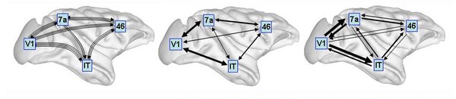
Structural connectivity
Functional connectivity
Effective connectivity
O. Sporns 2007, Scholarpedia
Structural connectivity
= presence of axonal connections
Functional connectivity
= statistical dependencies between regional time series
Effective connectivity
= causal (directed) influences between neuronal populations
! connections are recruited in a context-dependent fashion

Slide 3
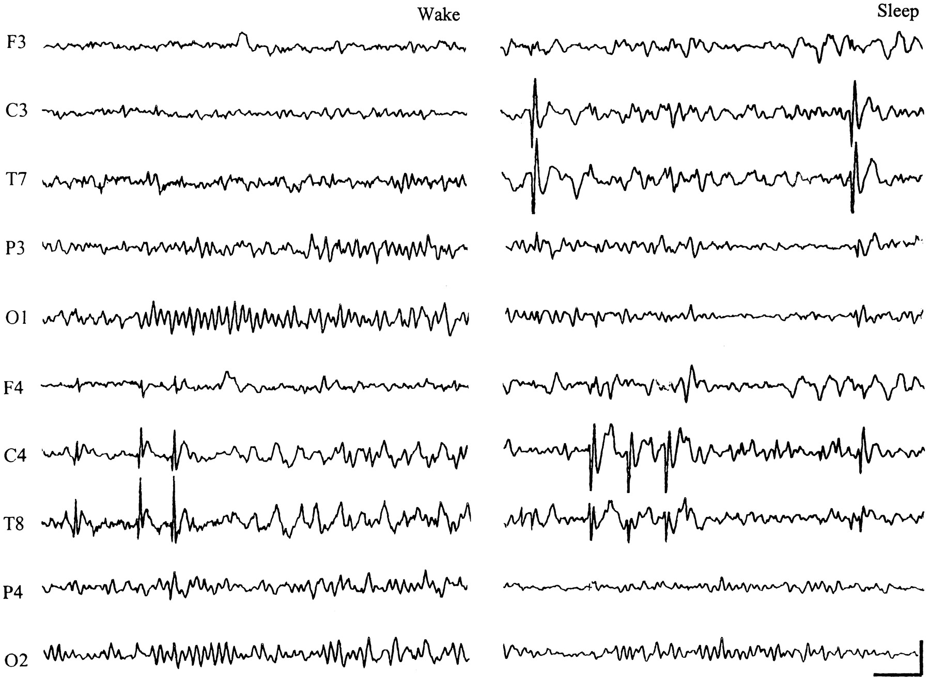
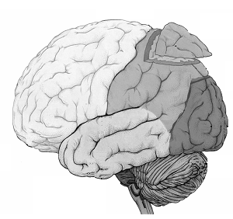
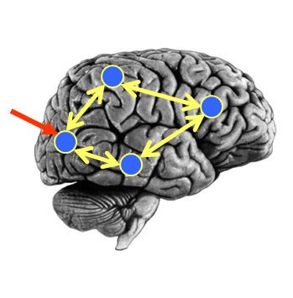
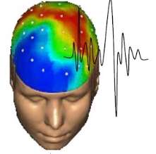
Causal Mechanisms
Observations / Data Features
y
Generative model
stimuli
u
Neural Model
Observation Model
θ
+
Forward model
Model Inversion
Given our observations y, and stimuli u,
what parameters θ make the model best fit the data?

Slide 4
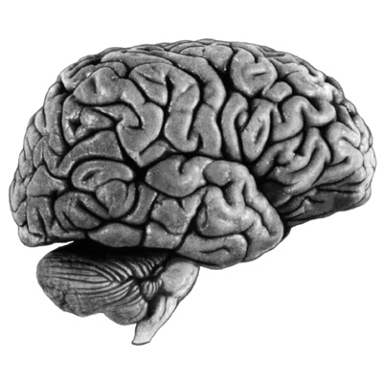
What can we do with DCM?
Model A
Model B
driving
input
driving
input
modulation
modulation
Model comparisons Test hypotheses
Does model A explain the data better than model B?
Parameter inference What are the connection strengths?
How do they change between conditions?
Simulations What happens to neural activity if…

Slide 5
DCM is a computational modelling technique
to estimate bio-physiological information
from functional neuroimaging data
Generative model contains differential equations of neural activity
Generative models range from simple to more detailed equations
Principles are always the same
Explain observed data (sensor or source) by source interactions
Bayesian inference (priors, posteriors, model evidence)

Slide 6
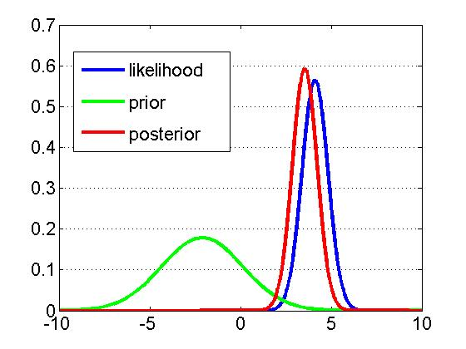





Bayesian Inference
DCM: model structure
Priors on all parameters
Neural state equations
Observation function
→ Likelihood
DCM: Bayesian inference
Posterior parameter estimates
Model evidence
“Accuracy - Complexity”

Slide 7
Model inversion
Specify generative forward model
(with prior distributions of parameters)
Data feature (e.g. evoked responses)
Expectation-Maximization algorithm
Iterative procedure:
Compute model response using
current set of parameters
Compare model response with data
Improve parameters, if possible
Posterior distributions of parameters
Model evidence

Slide 8

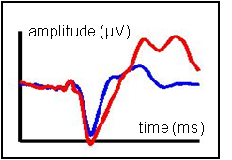
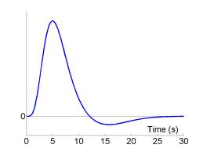
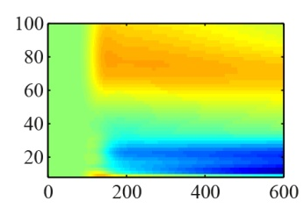
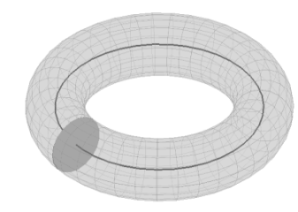
Physiological
Event-related potentials (ERP)
Cross-spectral densities (CSD)
Phenomenological
Phase coupling (PHA)
Dynamic Causal Modelling
fMRI
Induced responses (IND)
inhibitory interneurons
spiny stellate cells
pyramidal
cells
30
25
20
Frequency (Hz)
15
10
Frequency (Hz)
5
0
5
10
15
20
25
30
Time (s)

Slide 9
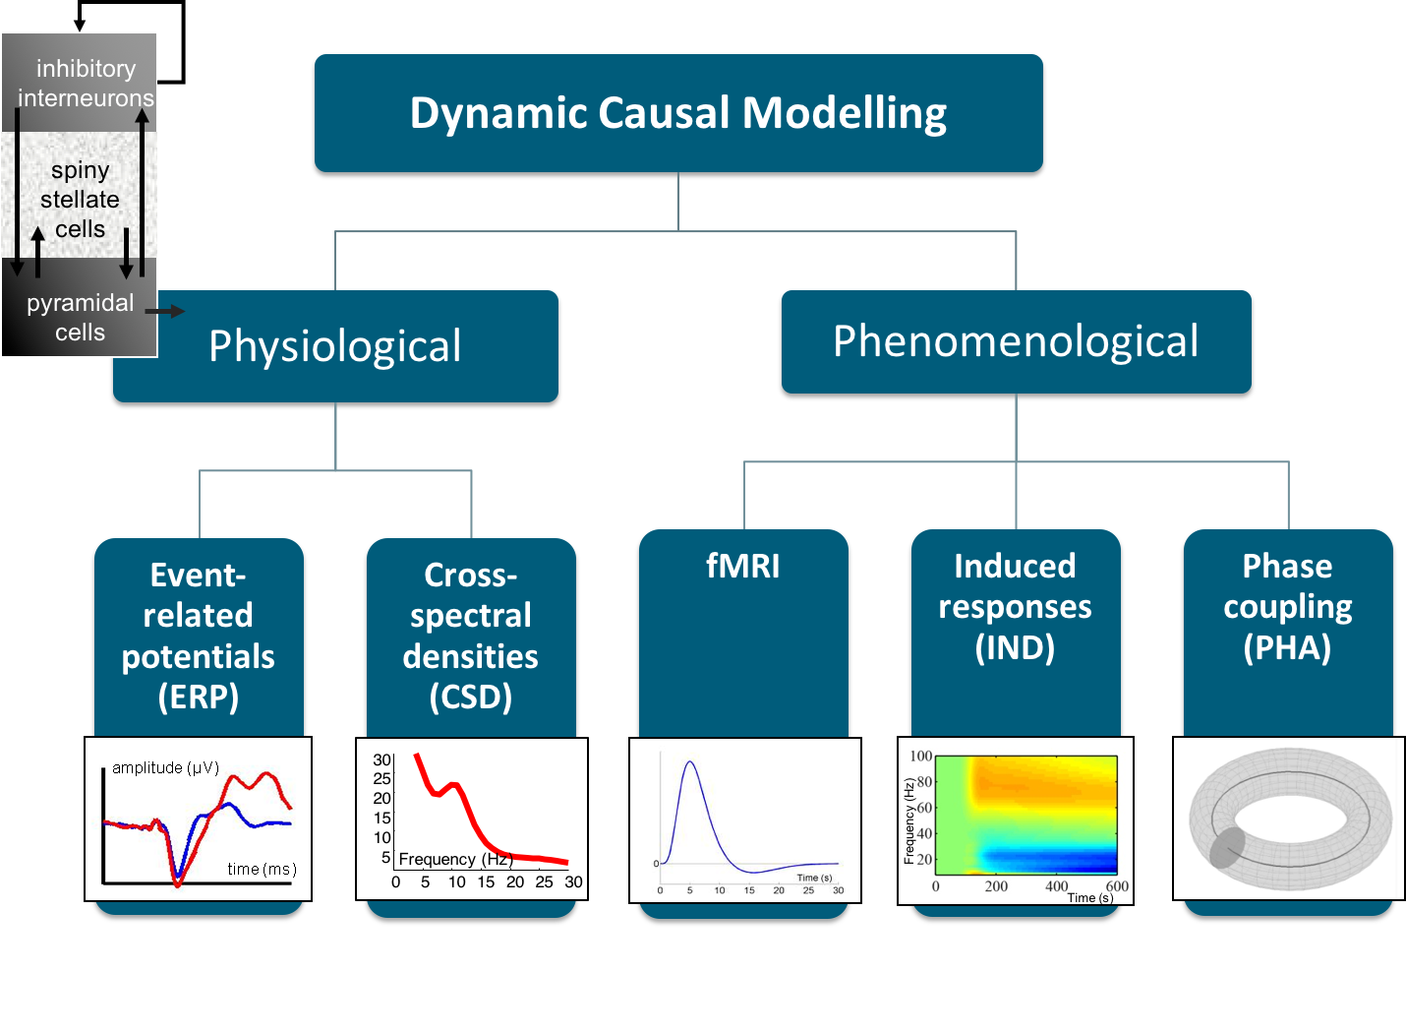

Slide 10

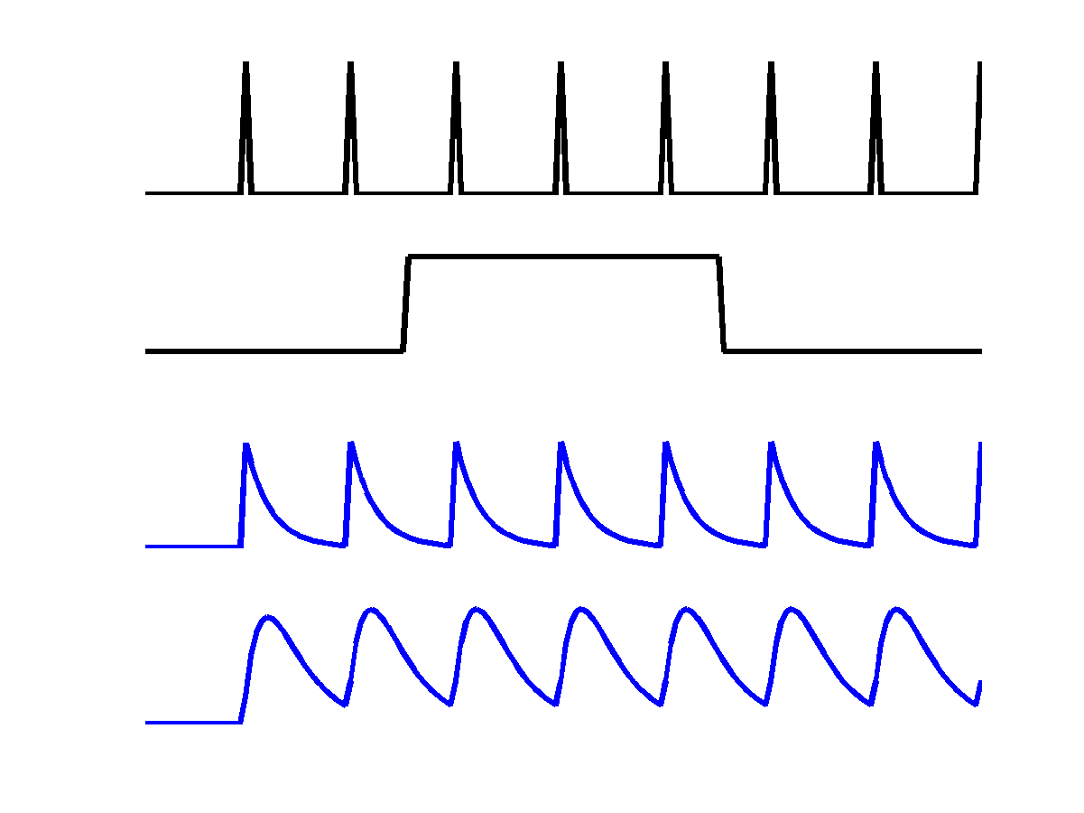
Single region
cf. Neural state equations in DCM for fMRI
u₁
c
u₁
a₁₁
z₁
u₂
z₁
z₂

Slide 11
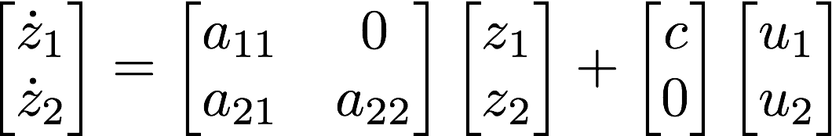
cf. DCM for fMRI
Multiple regions
u₁
c
u₁
a₁₁
z₁
u₂
z₁
a₂₁
z₂
z₂
a₂₂

Slide 12
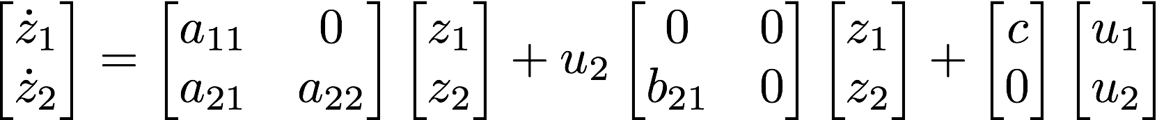
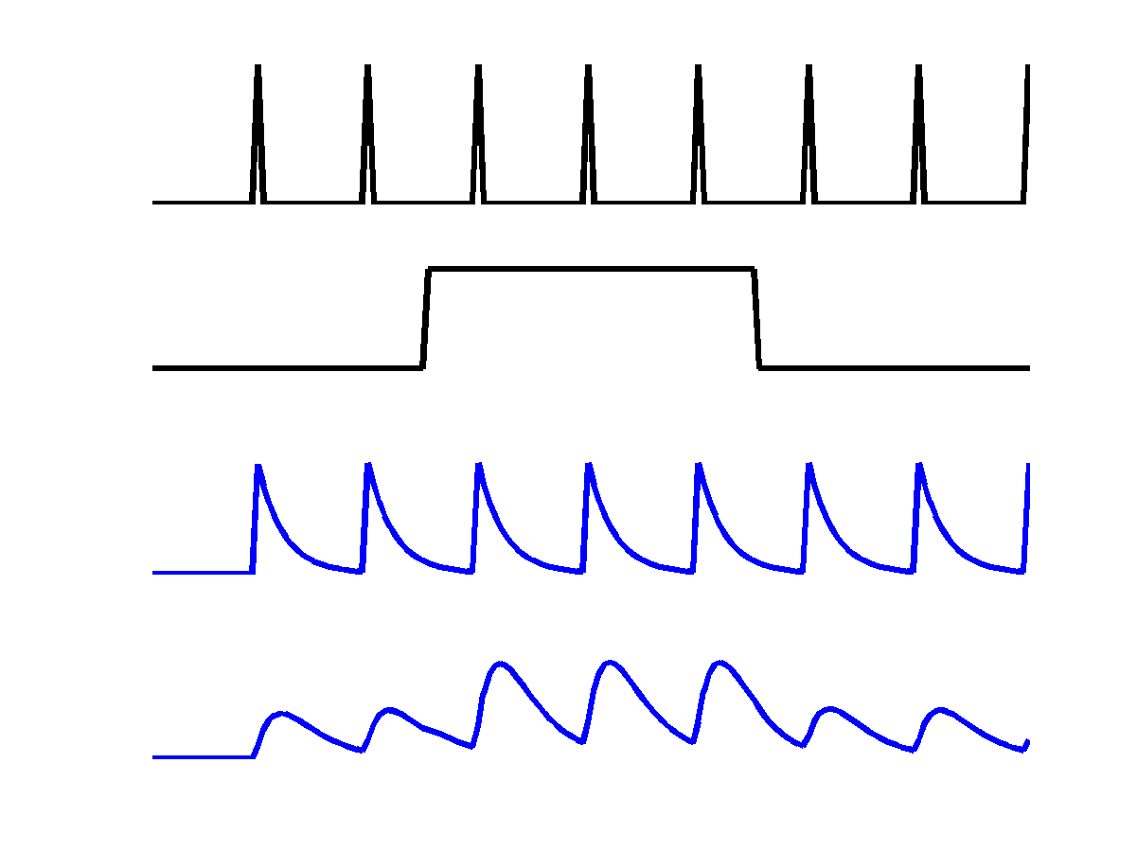
cf. DCM for fMRI
Modulatory inputs
u₁
u₂
c
u₁
a₁₁
z₁
u₂
b₂₁
z₁
a₂₁
z₂
z₂
a₂₂

Slide 13
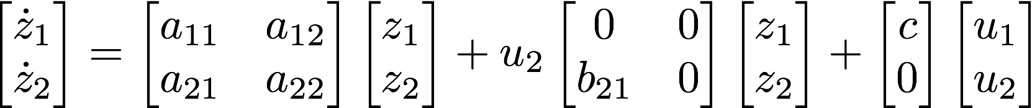
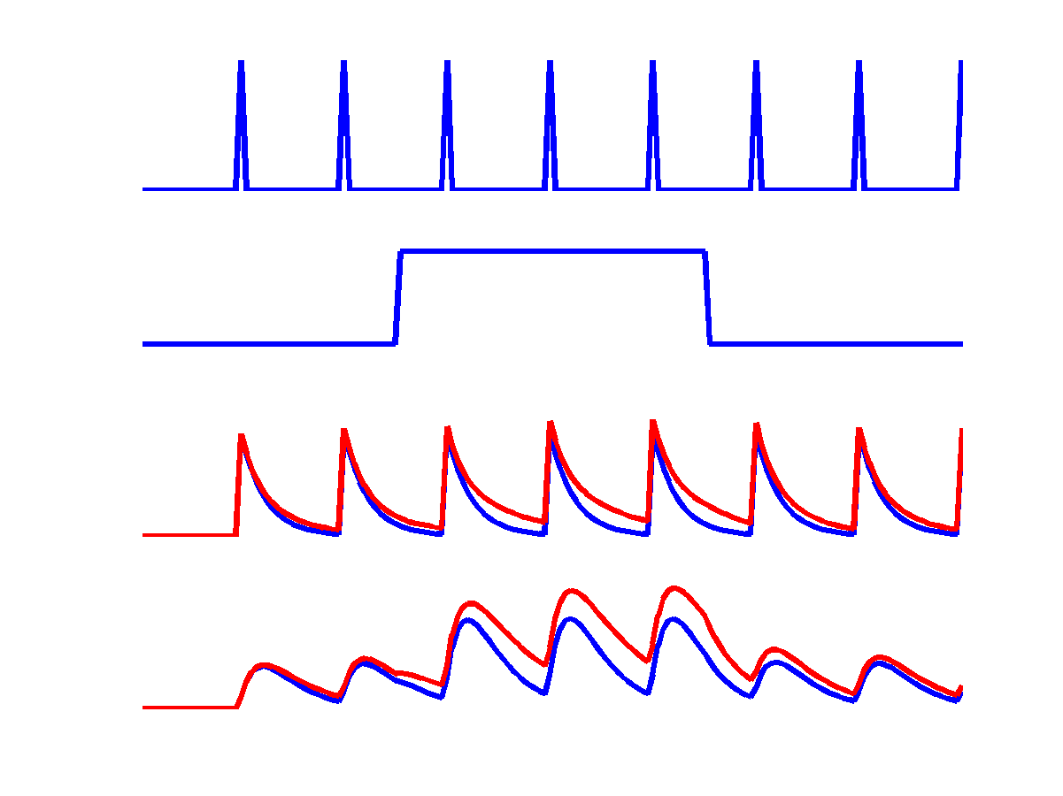
cf. DCM for fMRI
Reciprocal connections
u₁
u₂
c
u₁
a₁₁
z₁
u₂
a₁₂
b₂₁
z₁
a₂₁
z₂
z₂
a₂₂

Slide 15
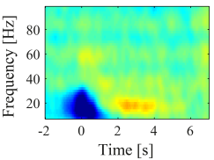

DCM for induced responses
Region 1
Region 2
?
?
Changes in power caused by external input and/or coupling with other regions
e.g., beta activity in region 1 leads to a gamma increase in region 2
Model comparisons Which regions are connected? E.g. Forward/backward connections
(Cross-)frequency coupling Does slow activity in one region affect fast activity in another?

Slide 16
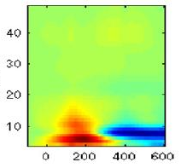
Time-Frequency Responses
Frequency
Time
Where g(t) is a K x 1 vector of spectral responses
A is a K x K matrix of frequency coupling parameters
Also allow A to be changed by experimental condition

Slide 17
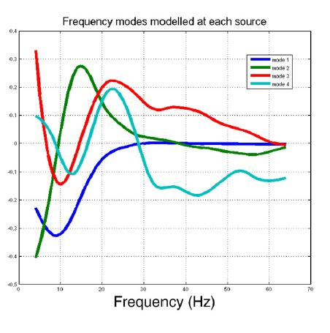
Use of Frequency Modes
G=USV’
Frequency
Time
Where G is a K x T spectrogram
U is K x K’ matrix with K frequency modes
V is K x T and contains spectral mode responses over time
Hence A is only K’ x K’, not K x K

Slide 18
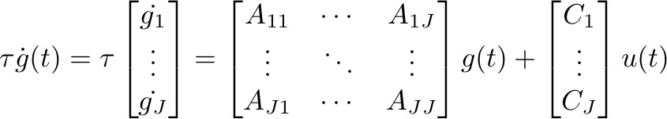
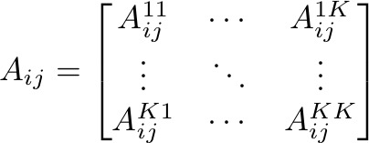
Generative model
Intrinsic (within-source) coupling
Extrinsic (between-source) coupling
Linear (within-frequency) coupling
How frequency K in
region j affects
frequency 1 in region i
Nonlinear (between-frequency) coupling

Slide 19
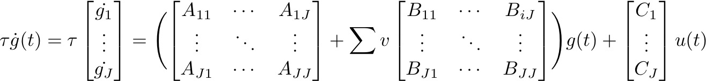
Modulatory connections
A matrix
B matrix
→ B matrix is used to compare parameter values between conditions

Slide 20
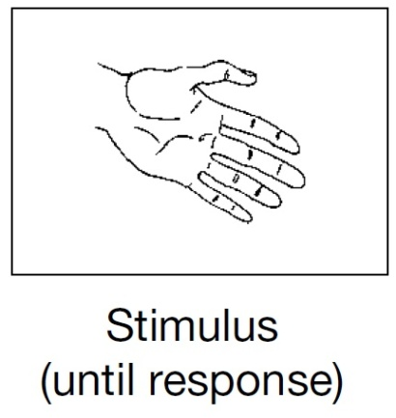
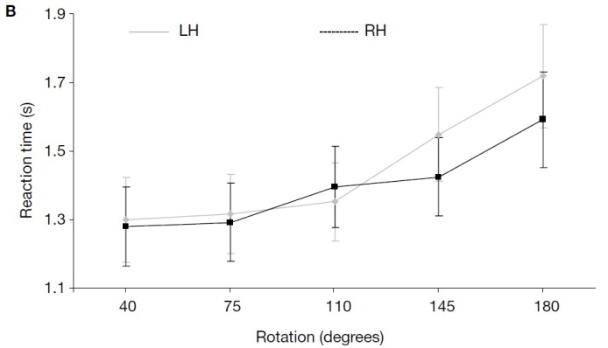
Example with MEG data
Motor imagery through mental hand rotation
De Lange et al. 2008

Slide 21
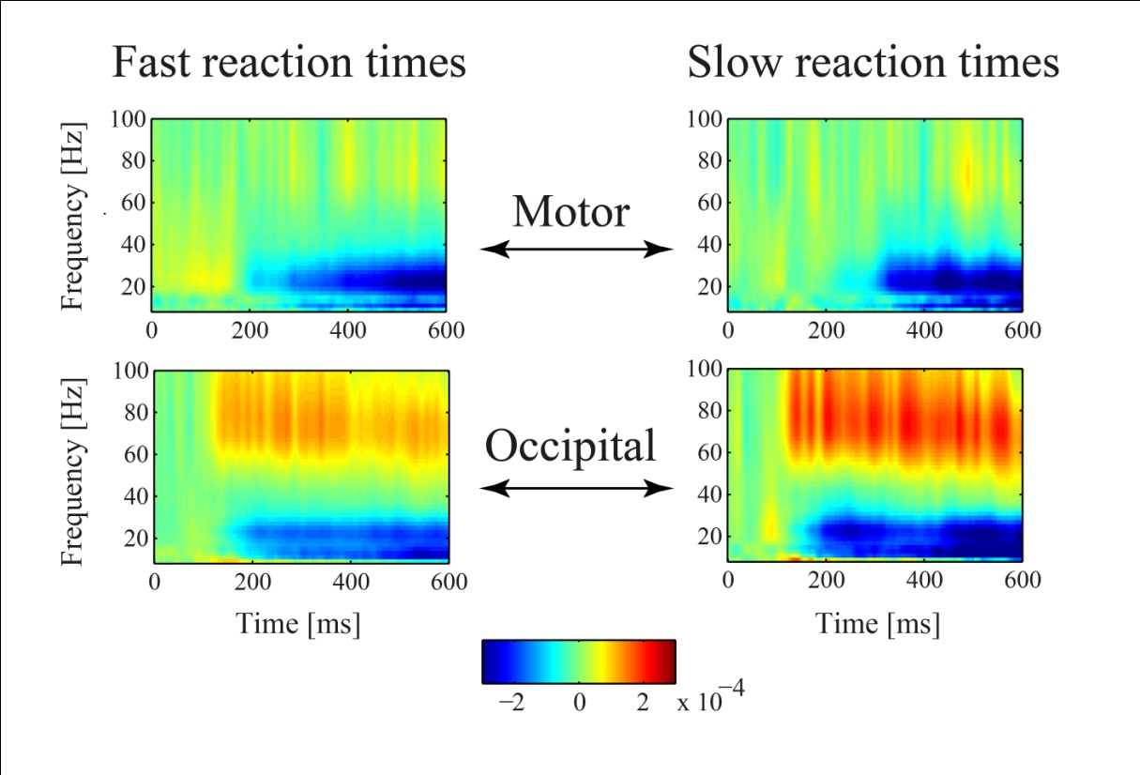
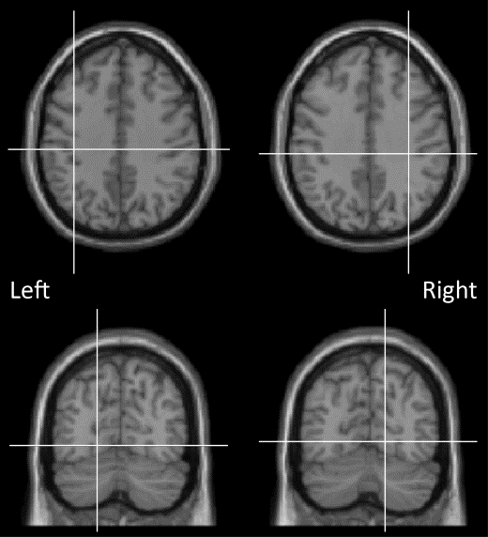
Induced responses in Motor and Occipital areas
M
O
MNI coordinates
[34 -28 37] [-37 -25 39]
[14 -69 -2] [-18 -71 -5]
Slow reaction times: → Stronger increase in gamma power in O
→ Stronger decrease in beta power in O

Slide 22
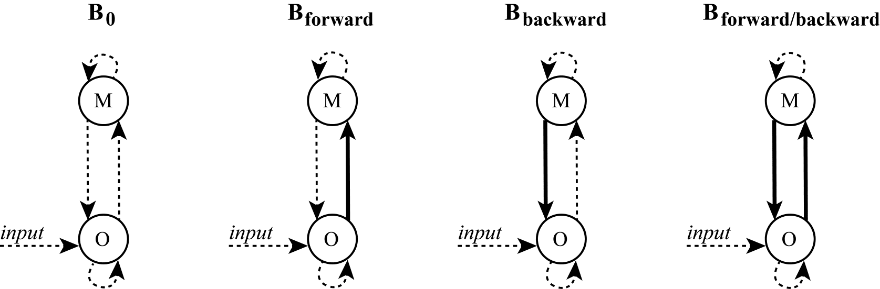
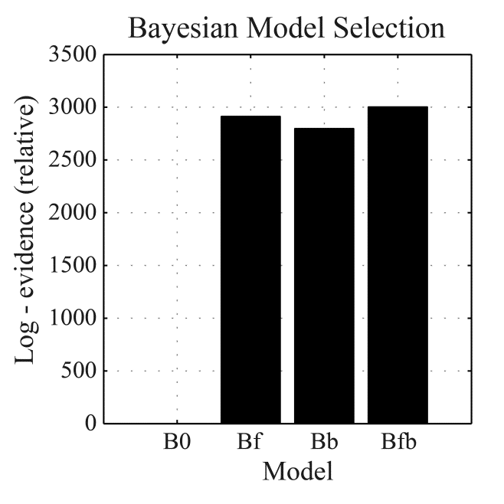
Model comparisons
Do slow/fast reaction times differ in forward and/or backward processing?
A matrix = fast responses
B matrix = slow responses

Slide 23
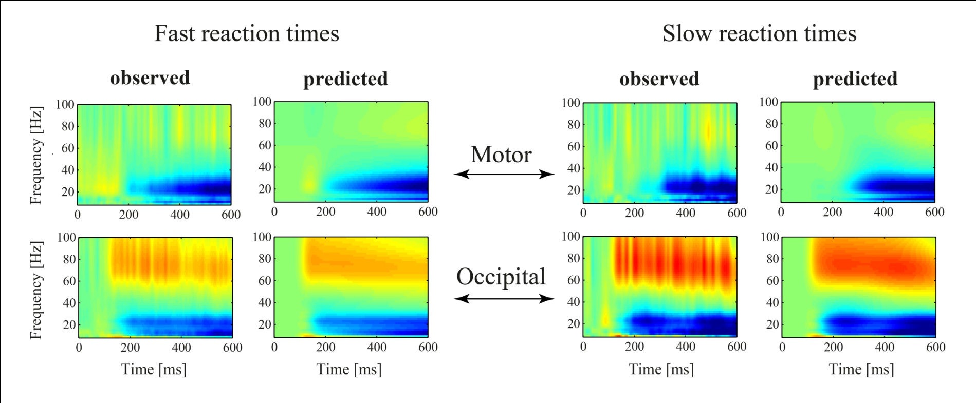
Results for Model B_{forward/backward}
Good correspondence between observed and predicted spectra

Slide 24
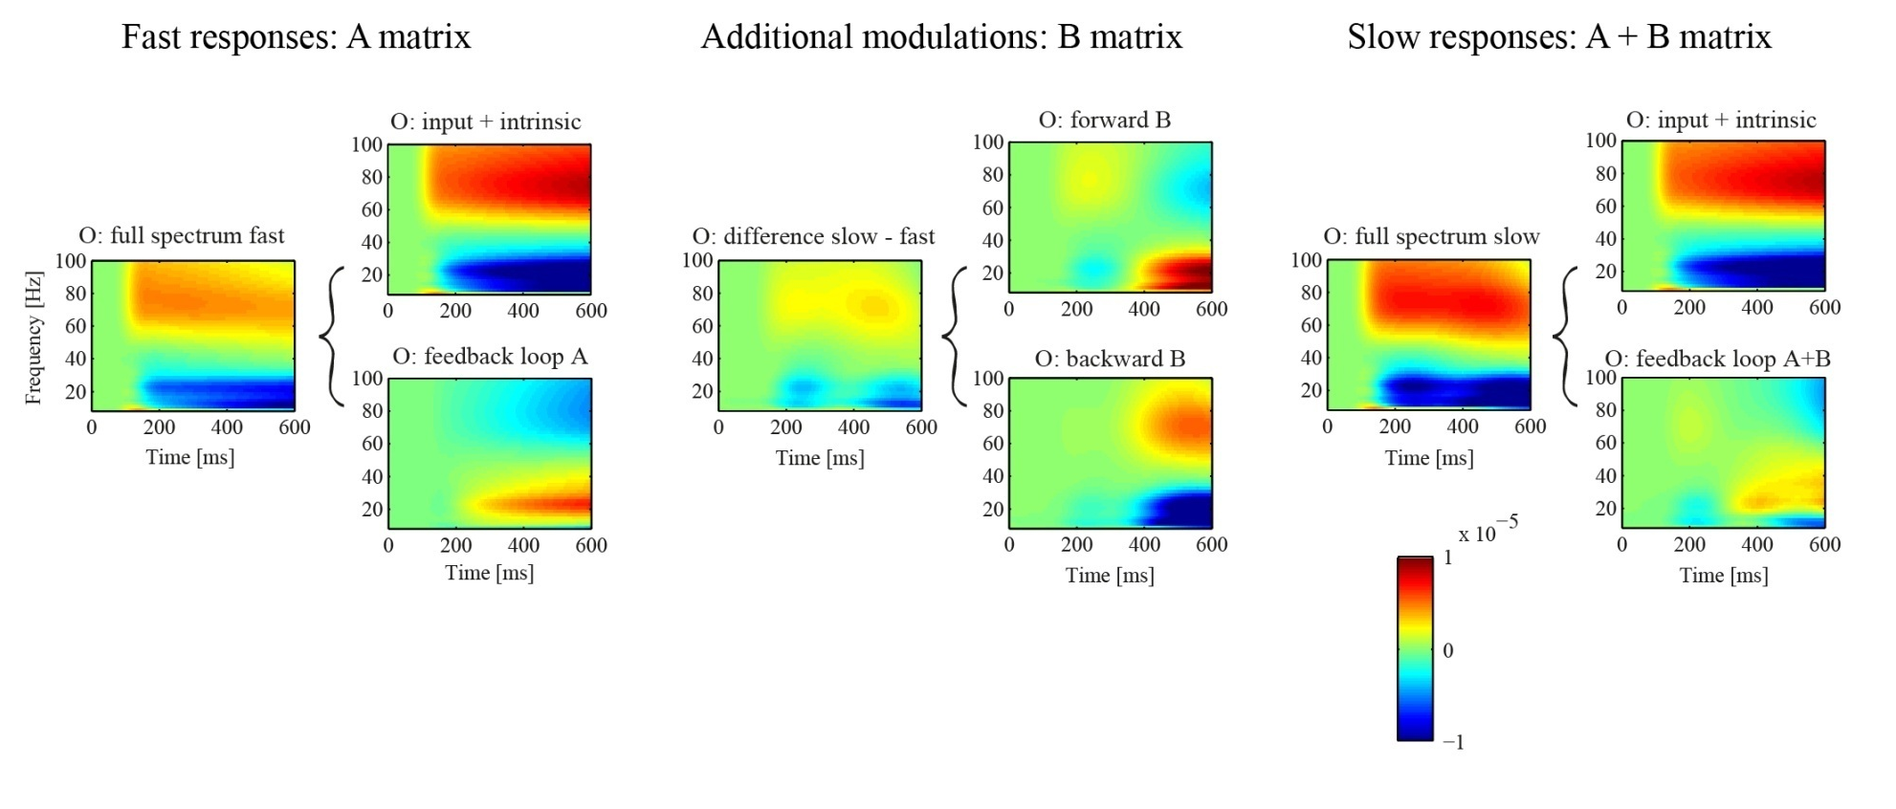
Simulations with estimated model parameters
→ Feedback loop with M acts to attenuate modulations in O
→ Attenuation is weaker for slow reaction times

Slide 25
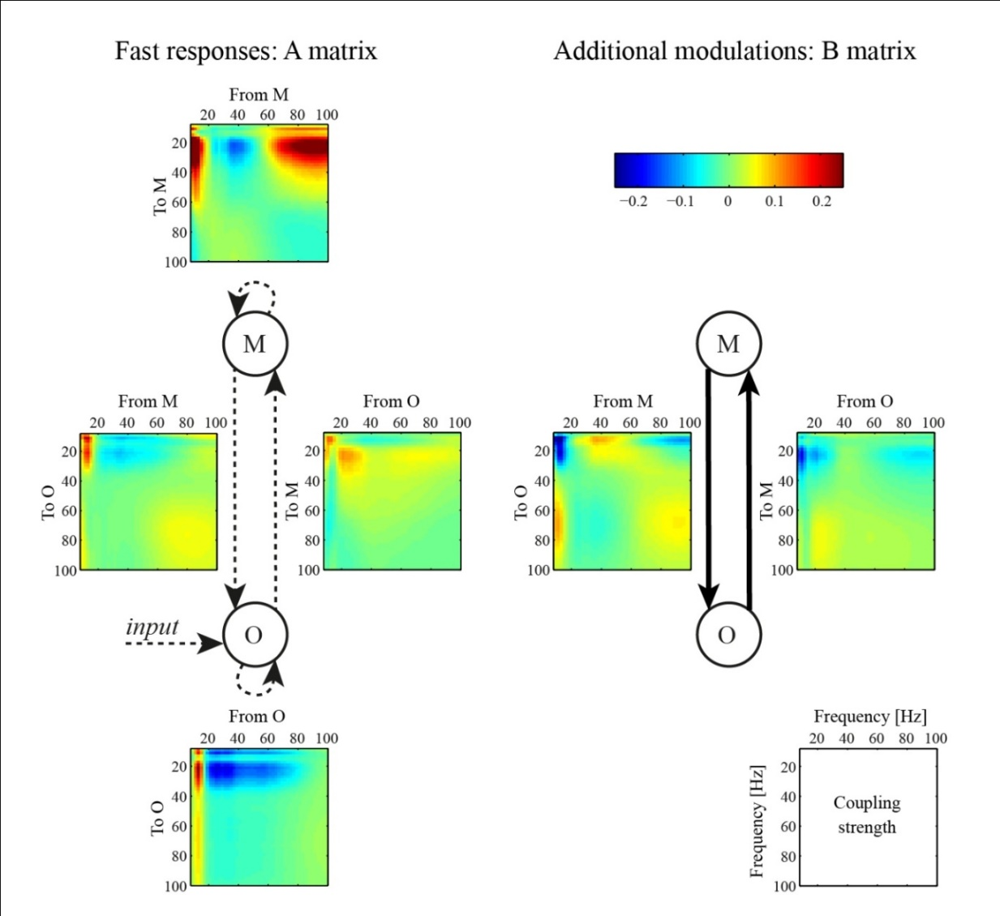

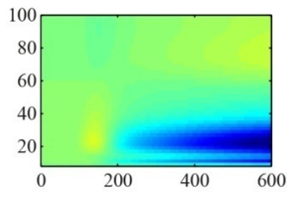
Parameter Inference
How do (cross-)frequency couplings lead to the observed time-frequency responses?
O
M
3
4
2
→ Interactions are mainly
within frequency bands
5
1

Slide 26
Parameter Inference
How do (cross-)frequency couplings lead to the observed time-frequency responses?
O
M
3
4
2
→ Interactions are mainly
within frequency bands
→ Slow reaction times
accompanied by a
negative beta to gamma coupling from M to O
5
1

Slide 28

DCM for Phase Coupling
Synchronization achieved by phase coupling between regions
Region 1
Region 2
x~(t)
?
x~(t)
Phase
φ
?
x(t)
x(t)
Phase
φ
Model comparisons: Which regions are connected?
E.g. ‘master-slave’/mutual connections
Parameter inference: (frequency-dependent) coupling values

Slide 30
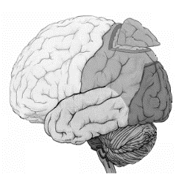
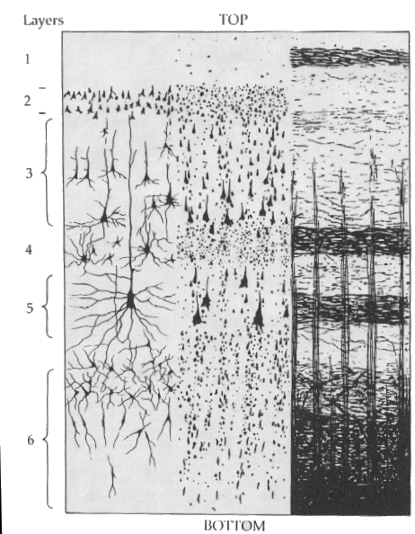
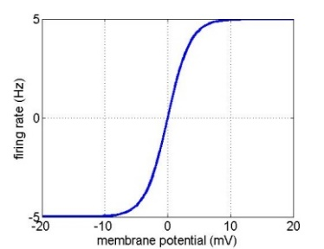
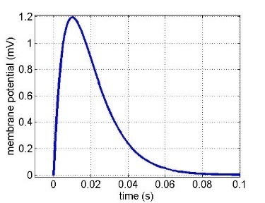
Physiological neural model
Inhibitory cells in extragranular layers
Extrinsic input
Inhibitory interneurons
γ
γ
Exogeneous input
4
3
Spiny stellate cells
Excitatory spiny cells in granular layers
Extrinsic connections
Forward
Backward
Lateral
Extrinsic output
γ
Pyramidal cells
1
γ
Measured response
2
Excitatory pyramidal cells in extragranular layers
Sigmoid function
Synaptic kernel
H
Maximum
Post Synaptic Potential
Firing rate
Membrane potential
Inverse Time Constant
Membrane potential
Time (s)

Slide 31


Convolution models
Conductance models
Sigmoid function
Synaptic kernel
Current
Conductance
Reversal Pot – Potential Diff
H
Firing Variance
Firing rate
Membrane potential
Unit noise
Membrane potential
Time (s)
Time Constant
Afferent Firing
No. open channels
ERP original model - based on Jansen & Rit (1995)
SEP ERP with faster dynamics for evoked potentials
CMC Canonical Microcircuit Model (Bastos et al. 2012)
separate superficial & deep pyramidal cells
LFP ERP with self-connection for inhibitory neurons (Moran et al. 2007)
NFM ERP as a neural field model
(Pinotsis et al. 2012)
NMM based on Morris & Lecar (1981)
MFM includes second order statistics
(population density) (Marreiros et al. 2009)
CMM canonical neural mass / mean field model
four populations
NMDA includes (ligand gated) NMDA receptors
(Moran et al. 2011)
See: Moran et al. (2013) Frontiers in Computational Neuroscience
“Neural masses and fields in dynamic causal modeling”

Slide 32
Which DCM should I use?
Select data feature of interest
  Event-related design: event-related potentials, induced responses
  Steady state activity: cross-spectral densities, phase coupling
Select type of generative model
  Physiological: convolution or conductance, several options
  Phenomenological: fixed choice
Specify networks - what do you want to test? (A matrix)
  What is the hypothesis?
  Which regions?
  Which connections?
Think about condition-specific effects (B matrix)
  Do you have more than 1 experimental condition?
  Which connections may show a difference between conditions?

Slide 33
Some technical differences between DCM types
Physiological DCMs
Phenomenological DCMs
Model sensor level data
Test for how many sources
Inverse problem included
Optimize source locations
Model source level data
Cannot compare nr of sources
Take specified source locations
Event-related DCMs
Steady-state DCMs
External stimulus modelled with Gaussian impulse
Require baseline interval
Perturbation with white/pink noise to generate cross-spectra

Slide 34
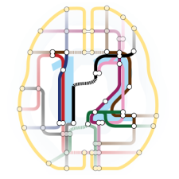
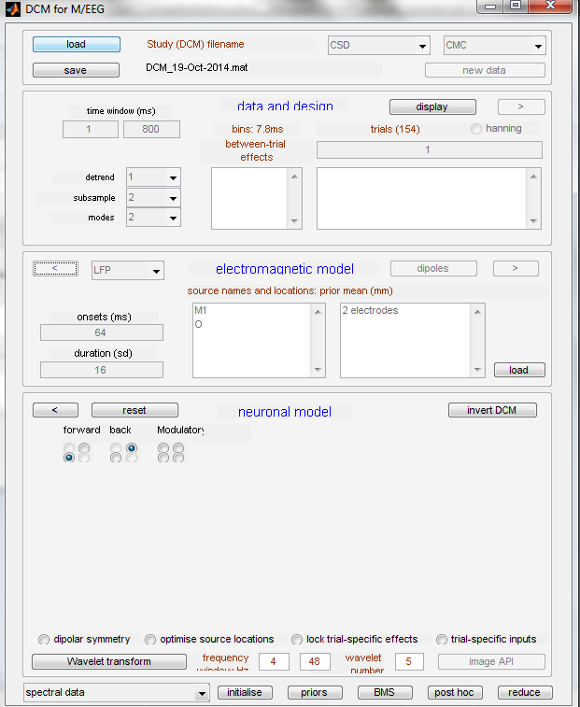
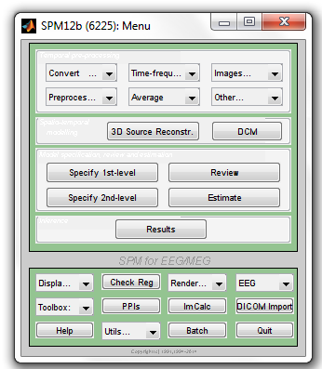
In SPM
SPM manual
Online videos
http://www.fil.ion.ucl.ac.uk/spm/course/

Slide 35
Further reading
The original DCM paper | Friston et al. 2003, NeuroImage
Guide to MEG/EEG analysis in SPM | Litvak et al. (2011) Comput Intell & Neurosci
Descriptive / tutorial papers
Ten Simple Rules for DCM | Stephan et al. 2010, NeuroImage
Overview of generative models | Moran et al. 2013, Front Comput Neurosci
Model selection for group studies | Stephan et al. 2009, Neuroimage
Comparing families of DCMs | Penny et al. 2010, PLoS One
DCM Applications
Event-related potentials | David et al. 2006, Neuroimage Garrido et al. 2007, PNAS Boly et al. 2011, Science
Cross-spectral densities | Moran et al. 2009, Neuroimage Moran et al. 2011, PLoS One Friston et al. 2012, Neuroimage
Induced responses | Chen et al. 2008, 2009, Neuroimage Van Wijk et al. 2012, Neuroimage
Phase coupling | Penny et al. 2009, J Neurosci Methods

Slide 36
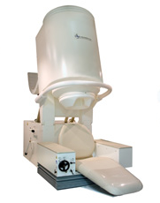
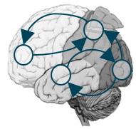
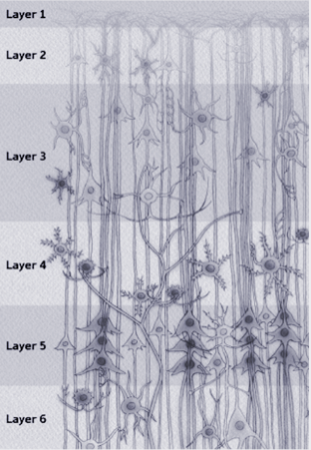
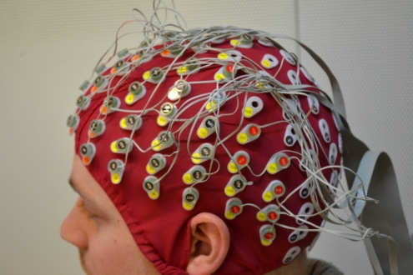
Summary
Observations (y)
Effective connectivity
Neurophysiology
Generative model
DCM uses computational modelling to explain experimental data
Generative models based on physiological knowledge
Link non-invasive brain responses to neurophysiology
Bayesian framework facilitates model comparisons and more...

